Slide 1
STEAM
Hiking Trails

Slide 2
Fact:
Sandstone is a sedimentary rock made chiefly or quartz and feldspar grains that is found throughout the western United States. The longest known sandstone arch in the world is the Landscape Arch found in Arches National Park near Moab, Utah. This arch extends for 306 feet. Hiking trails in the park help people view these majestic natural formations. The hiking trail associated with the Landscape Arch is 2 miles long round trip. The National Park Service suggest a hiking time of 30 to 60 minutes. A person could plan on taking an average of 45 minutes to complete the trail.

Slide 3
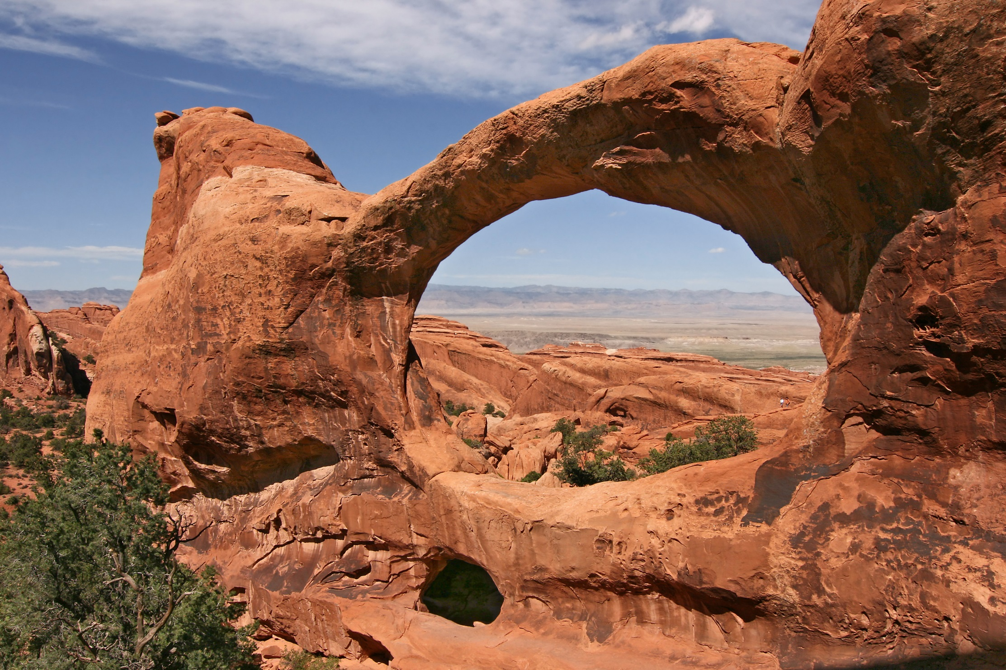
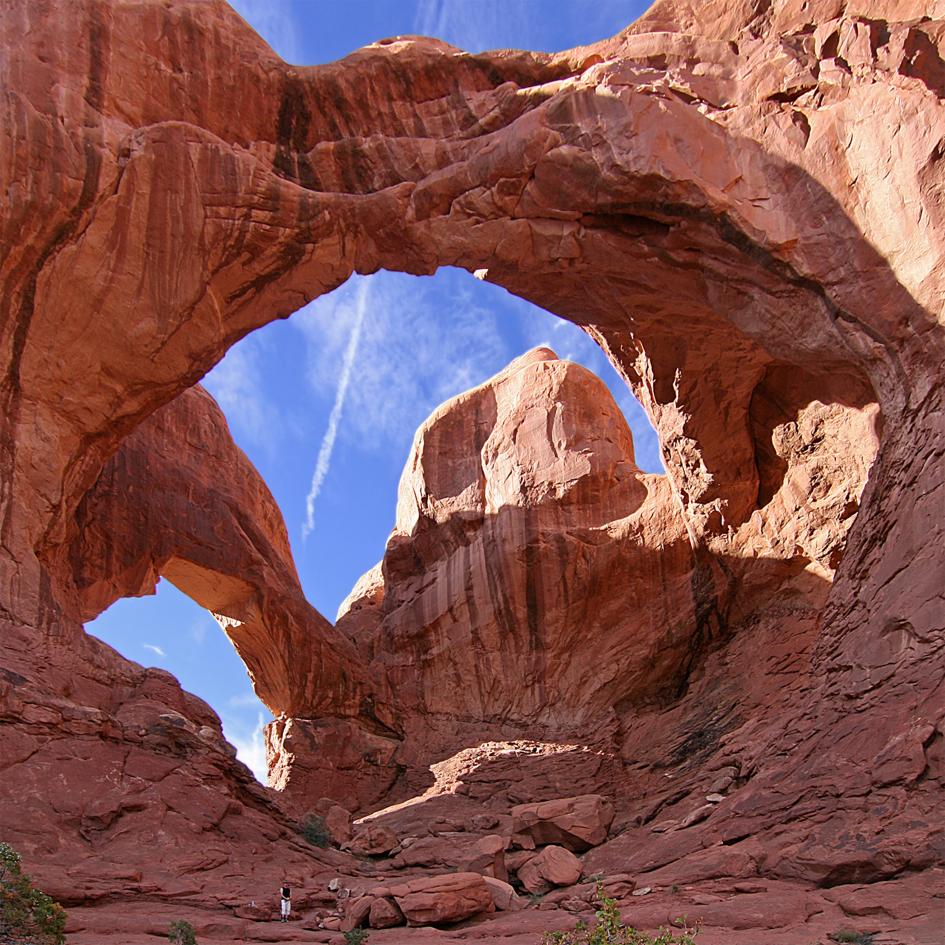
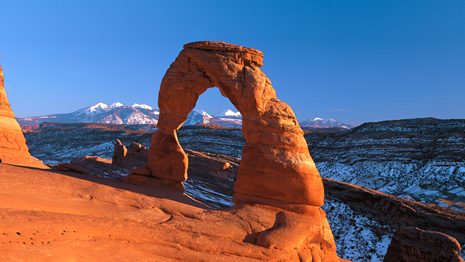

Slide 4
Directions:
Students are to:
-Research three other hiking trails in Arches National Park that people use to view the sandstone arches.
-Find the round-trip length of the trails and the time to hike the trail suggested by the National Park Service.
-Determine the average time a person would take to complete a round trip.
-Find one scientific fact about each arch

Slide 5
Chart:
Trail | Length of Trail (round trip) | Suggested Hiking Time | Average time to complete round trip
The Windows Arch | 1 mile | 30 to 60 minutes | About 45 minutes

Slide 6
STEAM
S Looking up scientific facts about each arch
T Using technology to look up pictures and
facts
E Engineering a poster about arches and
hiking trails
A Drawing pictures of arches for the poster
M Finding the average time to complete the
round trip

