Slide 1
STEAM planets

Slide 2
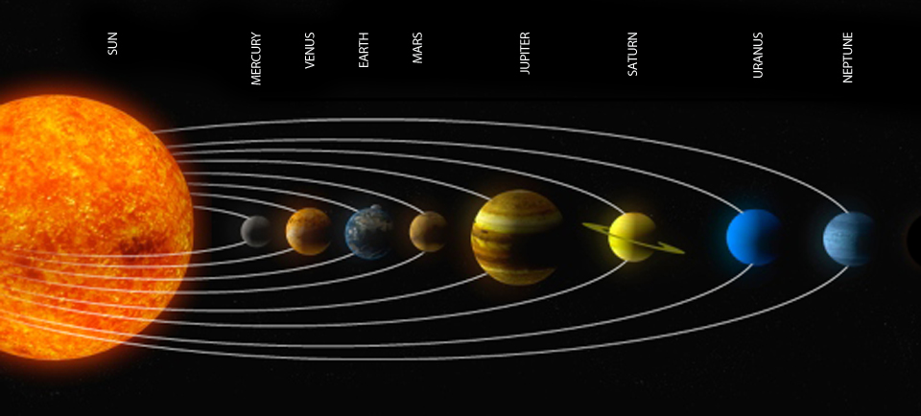
FACT:
Objects weigh more on Earth than they would weigh on Mars. Weight is a measure of the force of gravity and gravity is the attraction between two objects with mass. Because the Earth has more mass than Mars, the force of gravity is larger and objects weigh more.

Slide 3
Directions:
Fill out the first chart- known a good fraction or mixed number could be used to estimate change from Earth weight to Mars, the moon, Jupiter, or Saturn weight.
 | Weight in Pounds | Fraction of Earth Weight
Earth | 100
Mars | 35
Moon | 16
Jupiter | 235
Saturn | 90

Slide 4
A person’s weight on Mars is a fraction of his or her weight on Earth. You can think of the fraction as 35 out of 100 and it as 35/100. The fraction could be simplified to 7/20.
After completing the first chart, find the weights in the second chart.
  Example: If a man weighed 180 pounds on Earth, he would weigh about 7/20 x 180 = 63 pounds on Mars

Slide 5
 | Earth | Mars | Moon | Jupiter | Saturn
Mountain Bike | 40
Woman | 120
Car | 3,000
Elephant | 11,000

Slide 6
Don’t forget the STEAM
S
T
E
A
M

