Slide 1
STEAM
Roller Coasters

Slide 2
Fact!
Roller coasters are among the biggest attractions at amusement parks throughout the nation. In the 1920s, often known as the “golden age of roller coasters,” there were over 1,500 roller coasters in operation throughout the country.

Slide 3
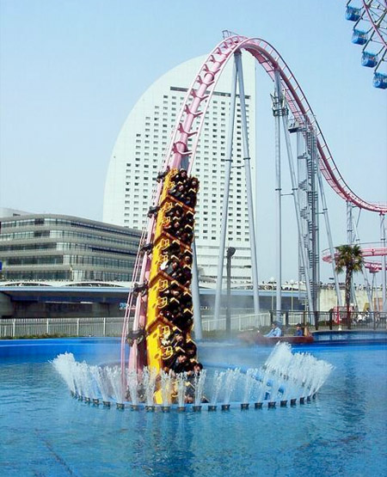
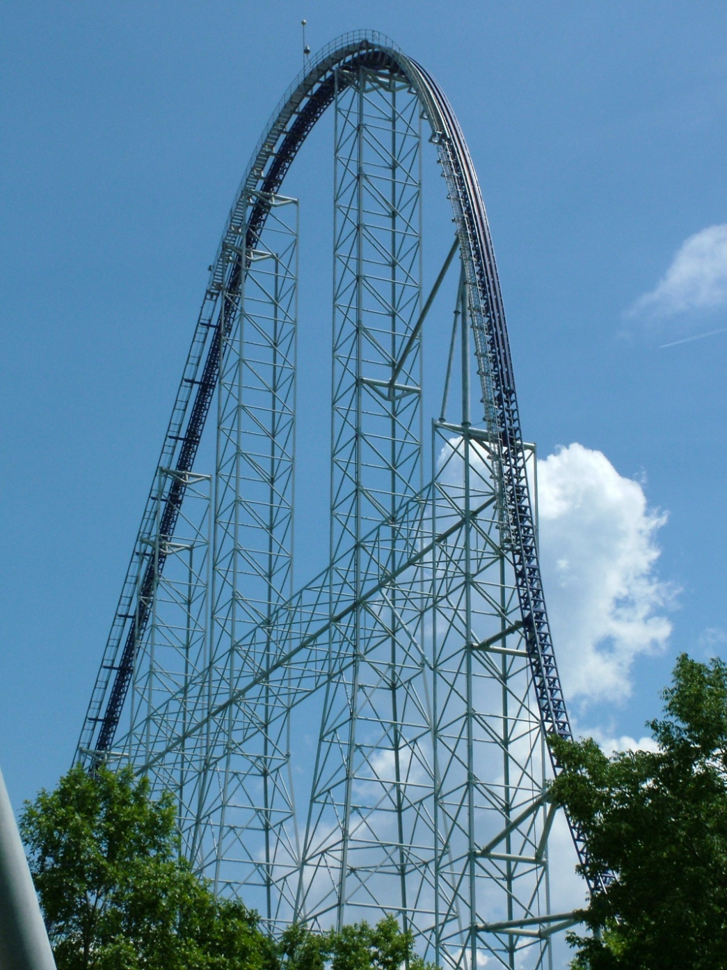
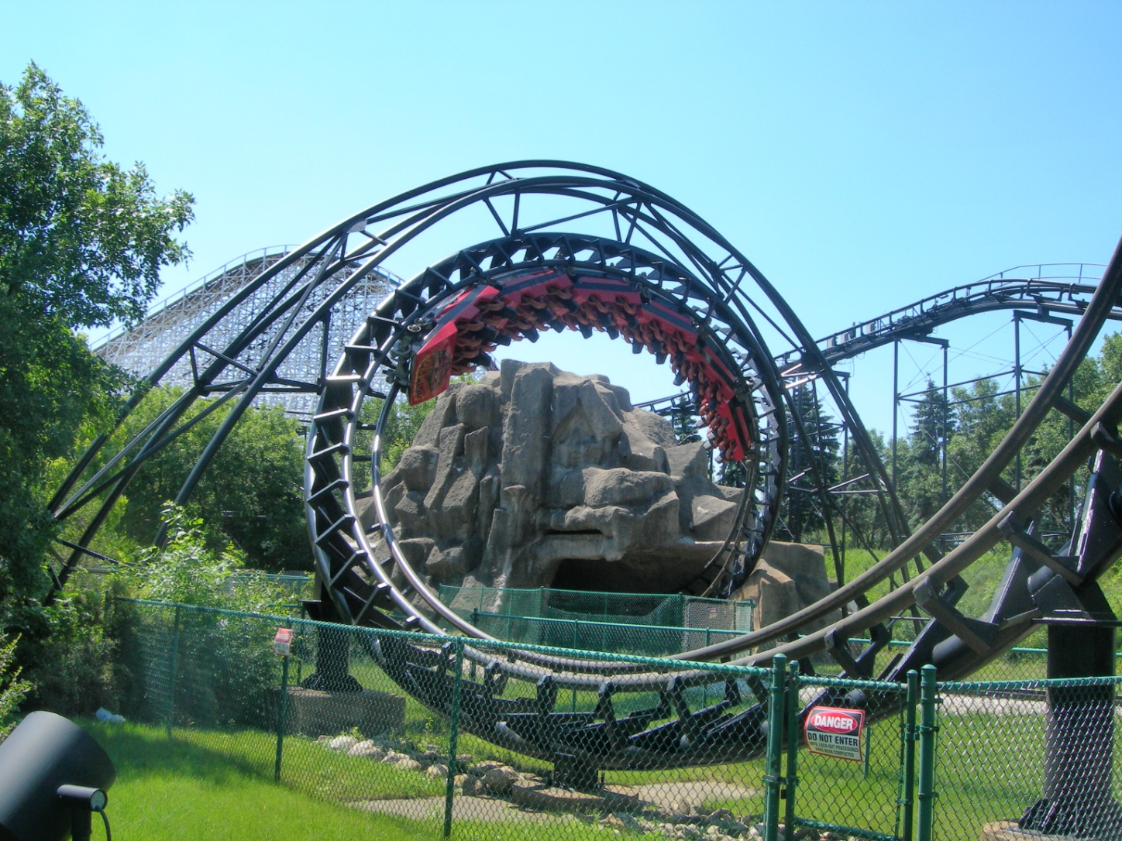
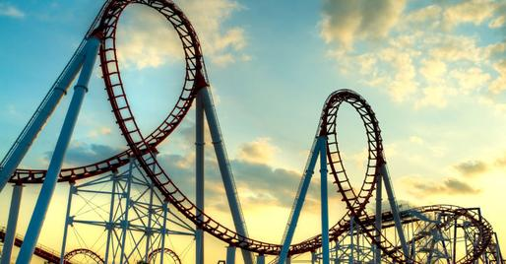

Slide 4
Directions:
Research roller coasters in the United States. Find the lengths and heights of 5 roller coasters. Then, find the average length and height of the five coasters you chose (do this by adding the all the lengths together and dividing it by 5…and do the same for the heights).
Also choose one of your five roller coasters and write me three facts about it.

Slide 5
Create a chart with your findings
Roller Coaster name and location | Length (feet) | Height (feet)
Kiddy Coaster Rye Playland | 300 | 16
#2
#3
#4
#5
Average:
Remember, to find the average you add all the lengths together and divide that answer by 5. Then do the same for the heights).

Slide 6
STEAM
S looking up facts about a roller coaster
T using technology to look up facts and pictures of roller coasters
E engineering a chart about roller coasters and their lengths and heights
A creating an artistic poster
M finding their average of their lengths and heights

