Slide 1
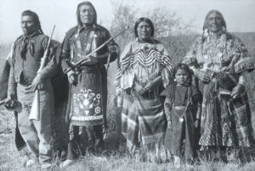
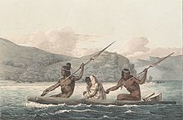
The Maidu
By Janel Nieto
This Photo by Unknown author is licensed under CC BY-SA.
This Photo by Unknown author is licensed under CC BY-SA.

Slide 2
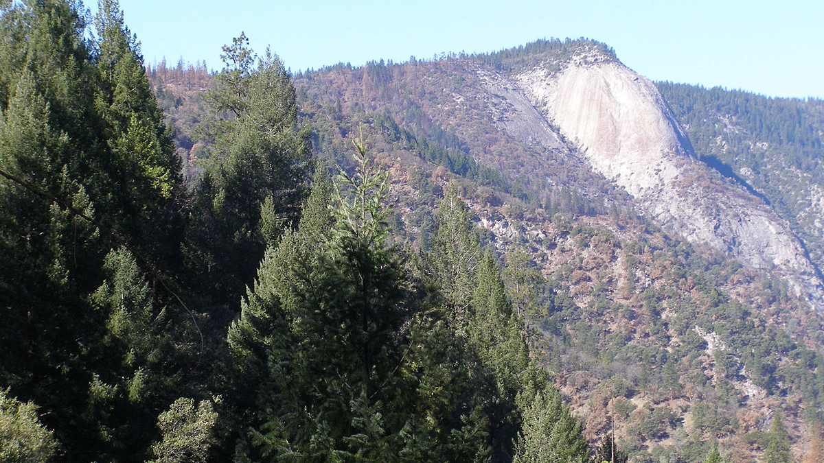
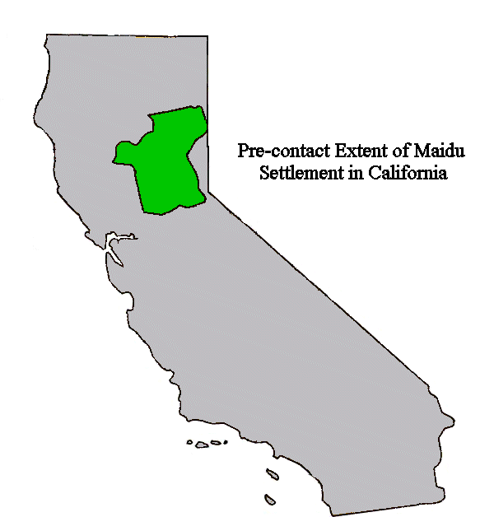
Location
The Maidu lived in a mountain valley in north California.
The Maidu lived in villages of five to ten.
They lived on the edges of the valley.
This Photo by Unknown author is licensed under CC BY-SA.
This Photo by Unknown author is licensed under CC BY-SA.

Slide 3
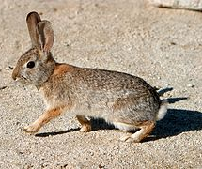
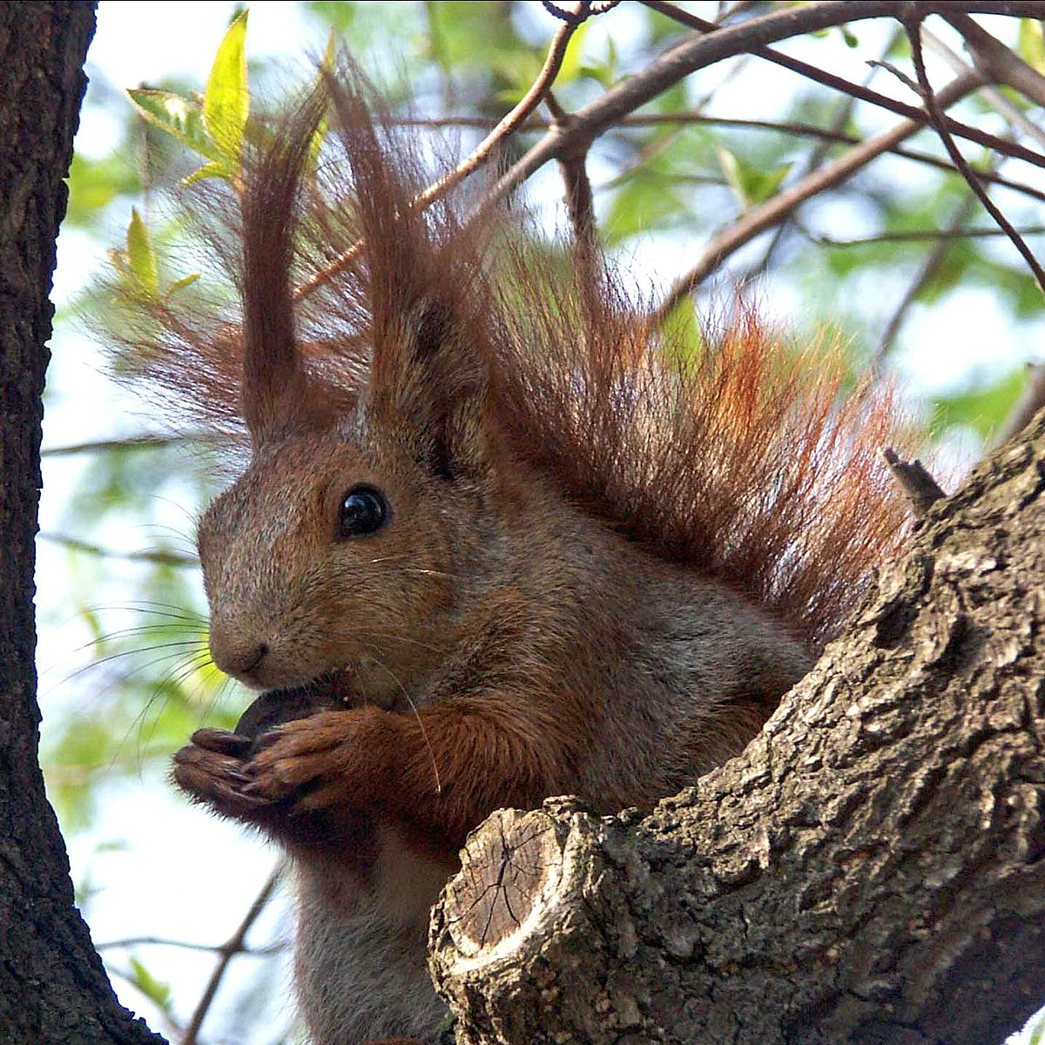
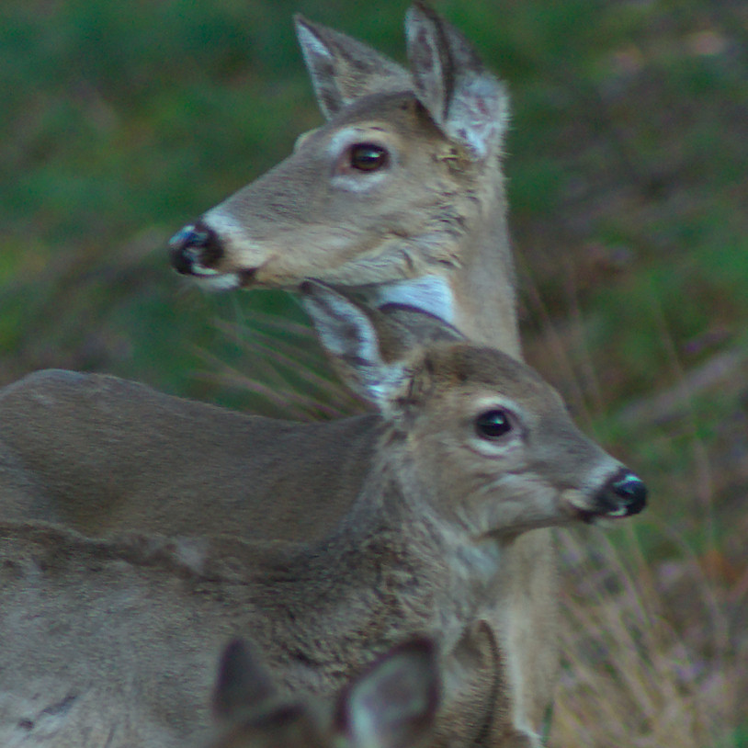
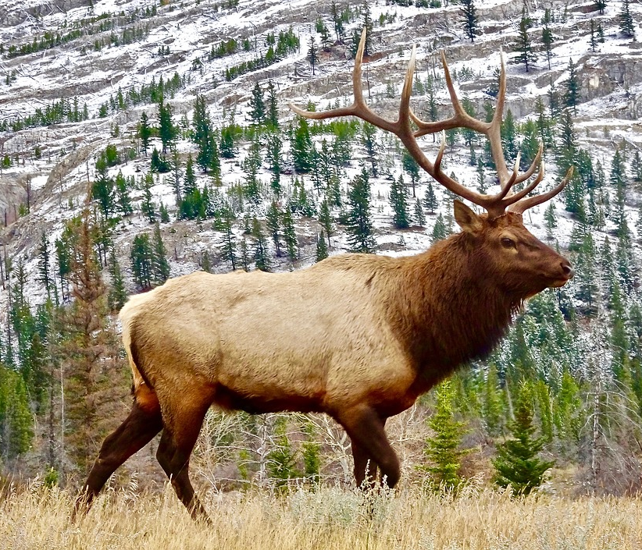
Food
The Maidu hunted deer, elk, squirrel, rabbits, geese, duck, quail, grasshoppers, crickets and bears.
The Maidu gathered acorns, nuts, seeds, roots and berries.
They also fished for eels, salmon and trout.
This Photo by Unknown author is licensed under CC BY-SA.
This Photo by Unknown author is licensed under CC BY-SA.
This Photo by Unknown author is licensed under CC BY-SA.

Slide 4
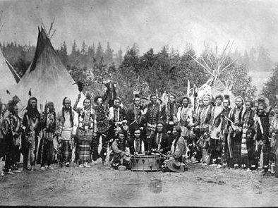
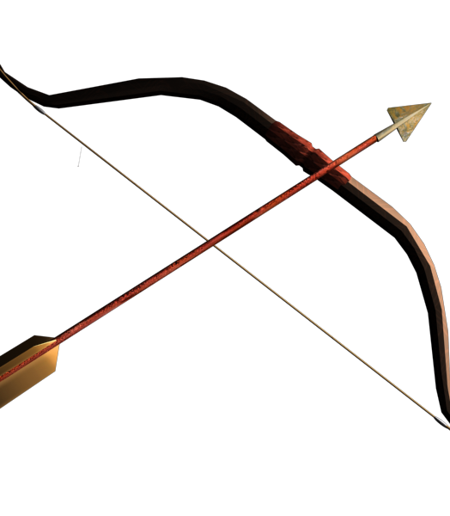
Culture
The Maidu men hunted with bows and arrows.
The Maidu woman gathered food to cook, store and eat
The Maidu people panted their bodies for ceremonies.
This Photo by Unknown author is licensed under CC BY-SA.
This Photo by Unknown author is licensed under CC BY-NC.

Slide 5
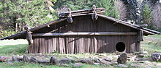
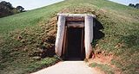
Shelter
The Maidu's shelter are eathen homes are covered with brush. In the winter their shelters are partly underground so that they keep warm.
This Photo by Unknown author is licensed under CC BY-SA.
This Photo by Unknown author is licensed under CC BY-SA.

Slide 6
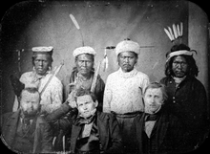
Maidu Tribe
This Photo by Unknown author is licensed under CC BY-SA.

