Slide 1
Chapter 4
Part 2

Slide 2
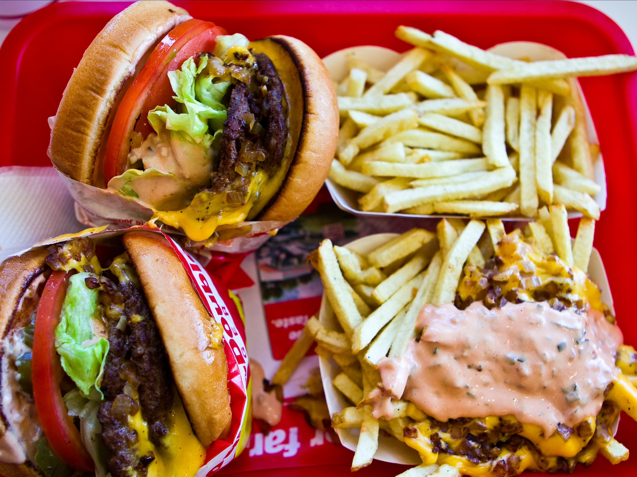
I. Perceptual Set
Our mental tendencies and assumptions affect our top-down processing of sensory information.
Context affects our interpretation of neutral information. We don’t like slow drivers in front of us, but rarely worry about the drivers we are slowing down behind us.
Motivation also changes our perception. When you grocery shop while hungry, everything looks more appealing.
Notes:
http://static3.businessinsider.com/image/55fc68f7bd86ef11008bb735/in-n-out-president-explains-why-the-burger-chain-probably-wont-expand-to-the-east-coast.jpg

Slide 3
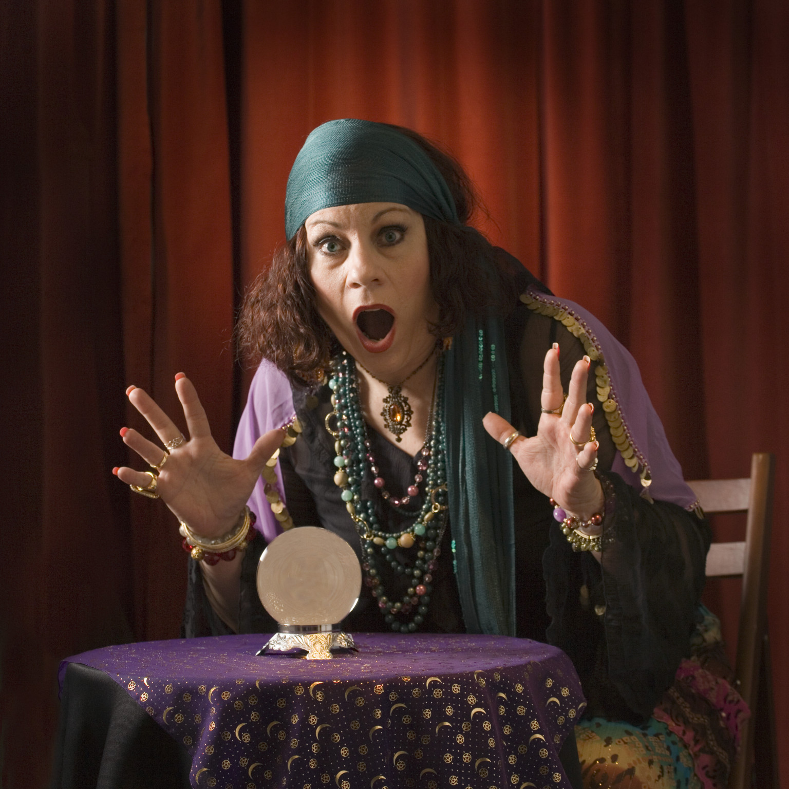
I. Perceptual Set
Emotions have a dramatic affect on our perceptions. When we are sad, we interpret everything in a more sad or depressing way.
Emotions affect our social interactions as well. When relationships are more secure then difficult situations are easier to get through.
The way we view the world and the things that occur in it dictate what our reality is. We put meaning into what happens to us and around us.
ESP and psychic abilities have yet to be proven to exist.
Notes:
http://i.huffpost.com/gen/1216238/images/o-SHOCKED-PSYCHIC-facebook.jpg

Slide 4
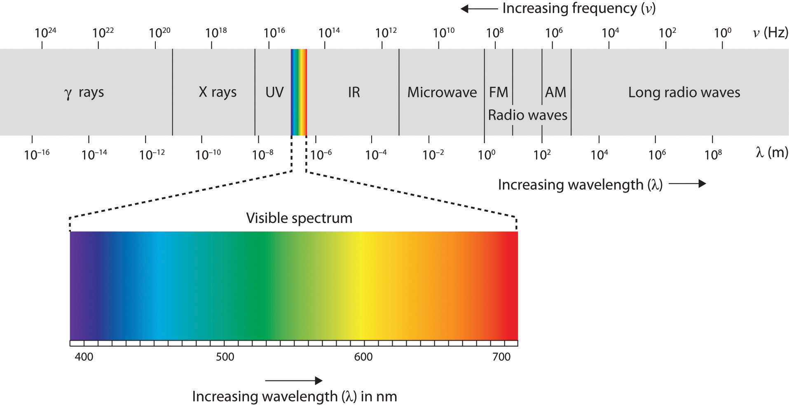
II. Light Energy and Eye Structures
Our eyes receive light energy and transduce it into neural messages. We perceive a very small band of energy in the electromagnetic spectrum.
The colors that we see are reflected off the objects they hit. Each color is a particular wavelength of visible light. Short wavelengths are blue, longer are red, and everything else is between those two shades.
The amplitude, or height, of the wave determines the brightness of the color.
Notes:
https://globalfreedommovement.org/wp-content/uploads/2015/10/visible-spectrum.jpg

Slide 5
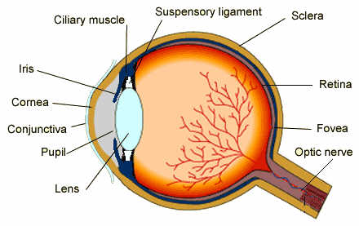
II. Light Energy and Eye Structures
The iris not only reacts to the amount of light coming into the eye, it also reacts to your cognitive and emotional states.
The image that passes through the cornea and pupil and then is focused by the lens onto the retina is upside-down. The receptors convert the light into neural impulses and send those to the brain.
The brain then reassembles those impulses into an upright image that is then processed by the brain to react to what is going on around you.
Notes:
https://www.scientificpsychic.com/workbook/eye.jpg

Slide 6
III. Information Processing in the Eye and Brain
The retina has rods and cones that detect the light coming in, and that triggers the bipolar cells that then trigger the ganglion cells, sending the signal down their axons that form the optic nerve.
Where the axons come together from all one million ganglion cells there is a blind spot in your vision that has no receptor cells. However, the brain fills in that spot in your vision.
Notes:
http://top-10-list.org/wp-content/uploads/2014/03/We-all-have-a-blind-spot.jpg

Slide 7
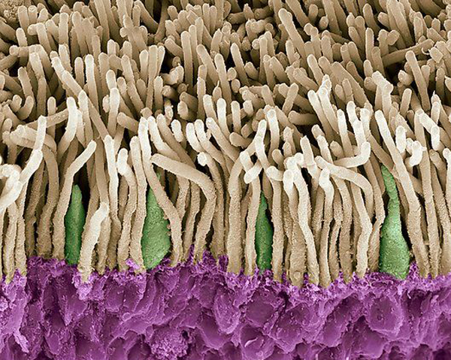
III. Information Processing in the Eye and Brain
The rods and cones are the photoreceptors but they have different responsibilities. Cones are located in the fovea, the retina’s central area of focus. They transmit the color and detail of what is seen to the brain. But they do not work in dim light.
Rods are located in the outer regions and work in low light, but they do not transmit much color or detail. Individual cones work with individual bipolar and ganglion cells. Groups of rods work with individual bipolar and ganglion cells.
Notes:
http://www.anatomybox.com/wp-content/uploads/2011/06/F0010041-Retina_rods_and_cones_SEM-SPL.jpg

Slide 8
III. Information Processing in the Eye and Brain
Rods provide peripheral vision, that gives little detail but allows us to see something there.
The retina has three types of color receptors, for red, blue, and green. This proved the Young-Helmholtz trichromatic theory that stated since all colors can be made from the three primary colors, the eye must detect those three colors.
Notes:
https://upload.wikimedia.org/wikipedia/commons/thumb/0/0e/Red-green-blue_flag.svg/1280px-Red-green-blue_flag.svg.png

Slide 9
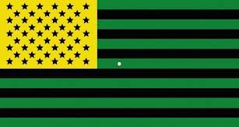
III. Information Processing in the Eye and Brain
Color blind people lack functioning red or green sensitive cones, or sometimes both. So they won’t see shades of green or shades of red but can detect other colors.
Another aspect of color vision is the opponent-process theory. This states that colors that are opposite each other; red-green, blue-yellow, black-white, turn each other off and do not mix.
We can see mixtures of red and blue or green and blue, but not red and green.
Notes:
https://i.pinimg.com/736x/97/46/e0/9746e0783cd2fdf537801fe66c103133.jpg

Slide 10
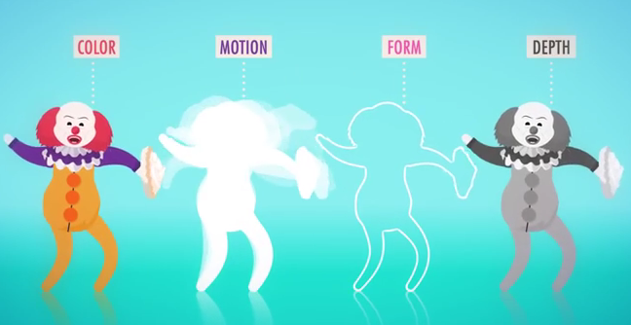
III. Information Processing in the Eye and Brain
Feature detectors are the areas in the brain that process images and respond to specific features of the stimulus. Different areas of the brain recognize different objects.
Our brain is able to do all of these things at once because of parallel processing. All of this processing is happening at the same time in different areas of the brain, and then the brain integrates it all together.
Notes:
http://3.bp.blogspot.com/-W9TfL1nUAuw/Uyy3q1BMRYI/AAAAAAAAADY/wQIbAeQbQdk/s1600/Untitled.png

Slide 11
In your notebooks
Write a half-page summary of the lecture today.

