Slide 1
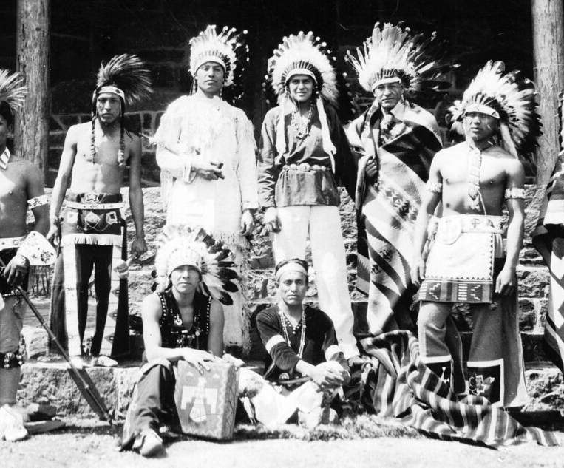
Pomo
By: Lucero, Rodrigo, and
Bella

Slide 2
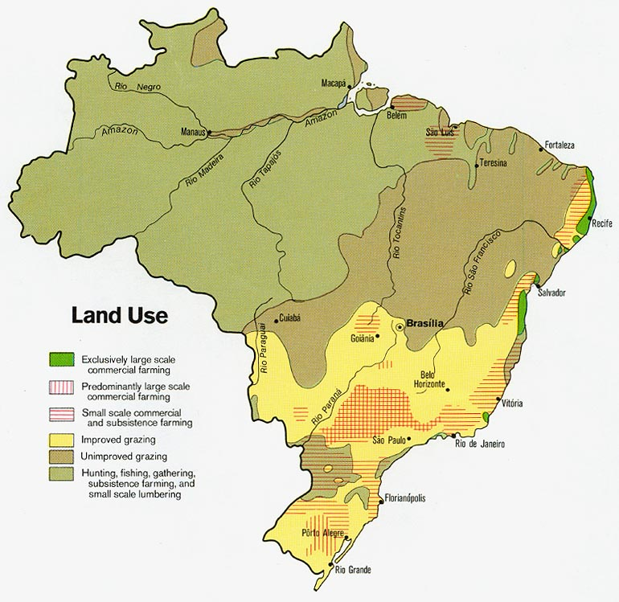
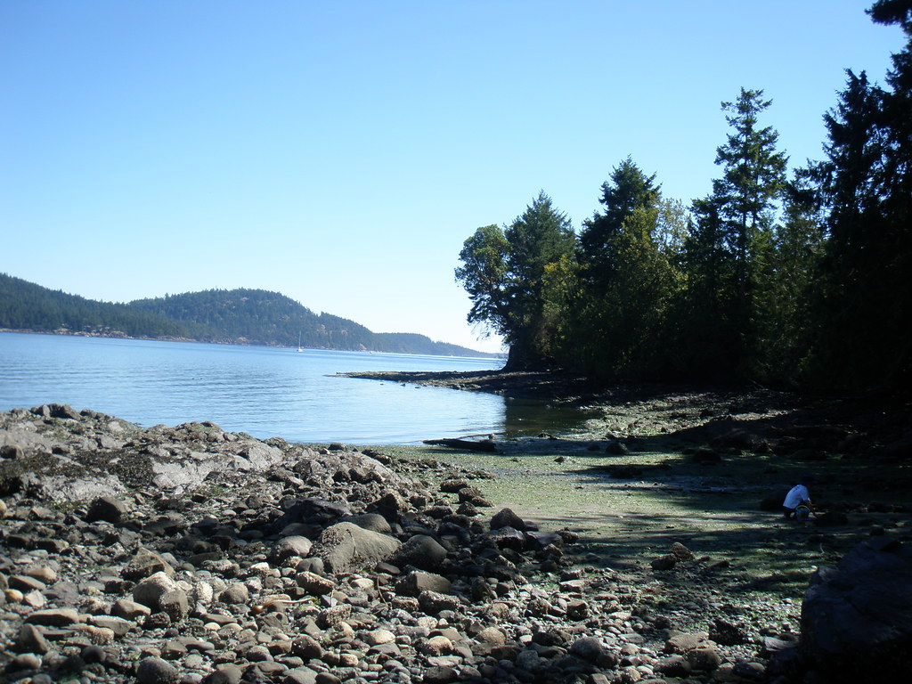
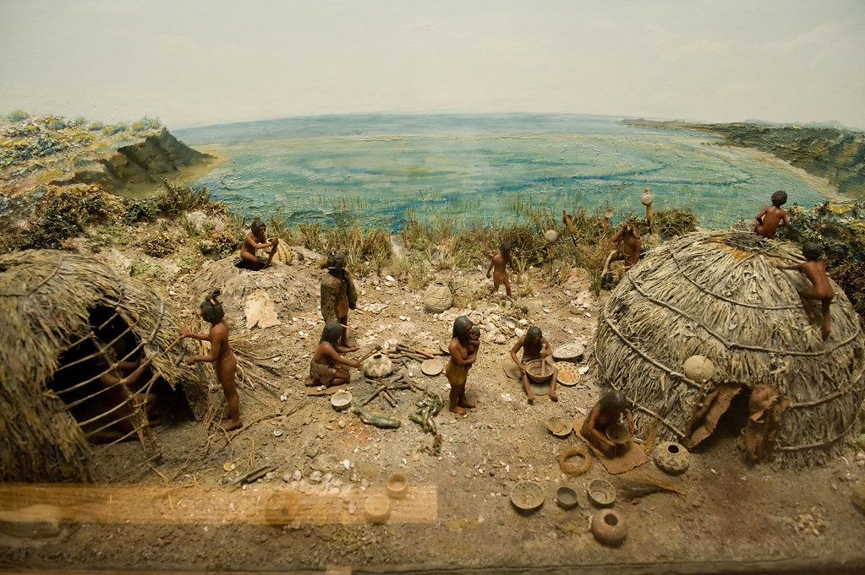
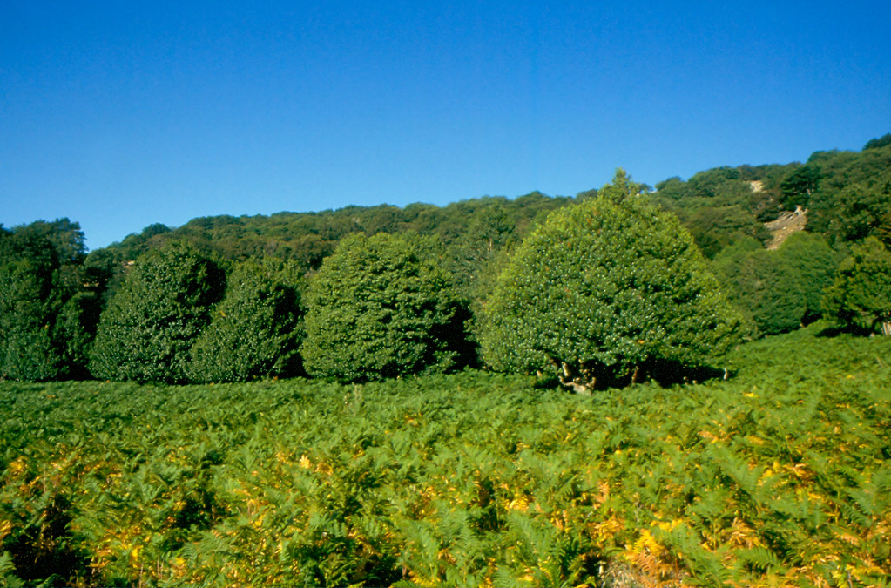
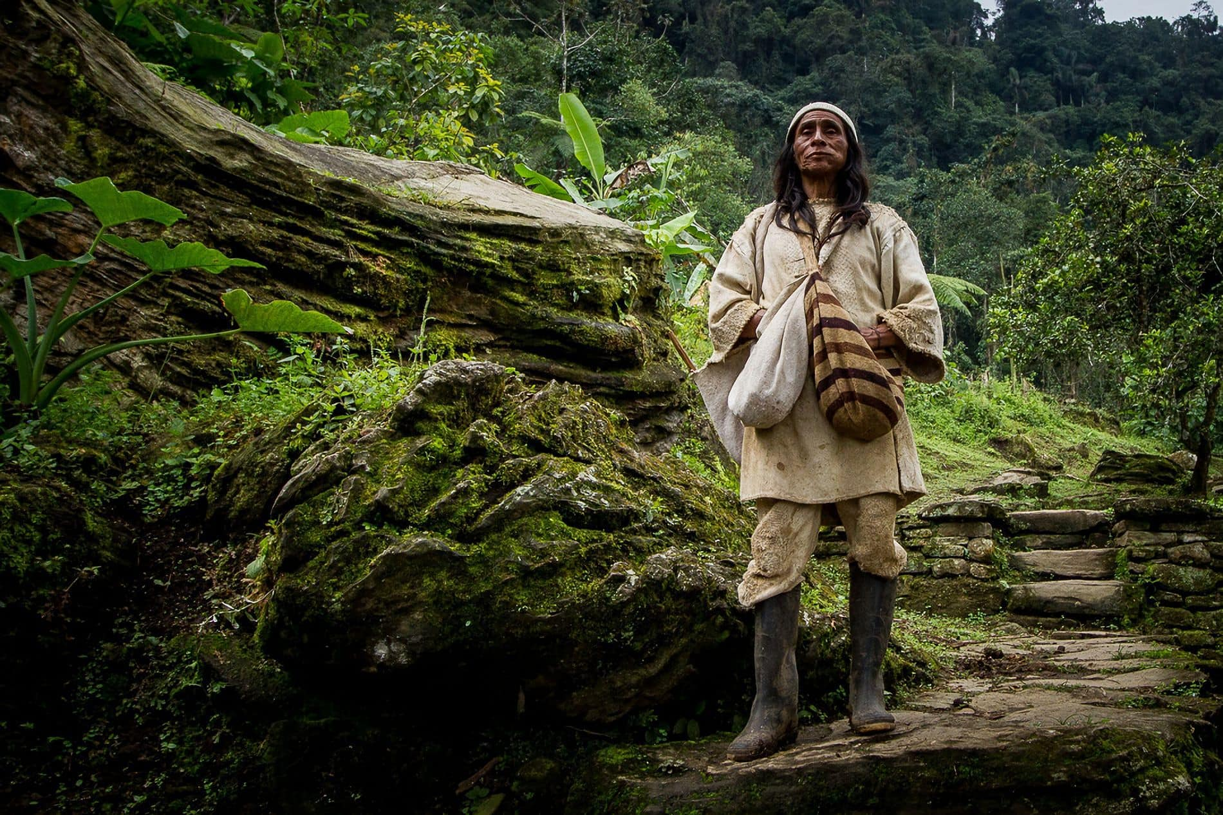
Location
ThePhoto by PhotoAuthor is licensed under CCYYSA.
.
The Pomo lived in the northern part of California. They lived near lakes, oceans, and rivers. The land had rolling hills and good soil.
is l
ThePhoto by PhotoAuthor is licensed under CCYYSA.

Slide 3
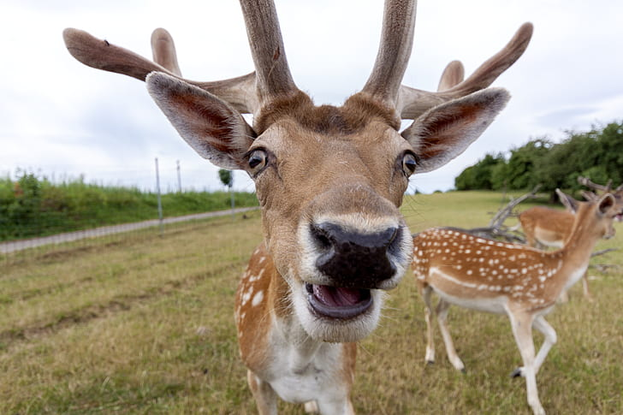
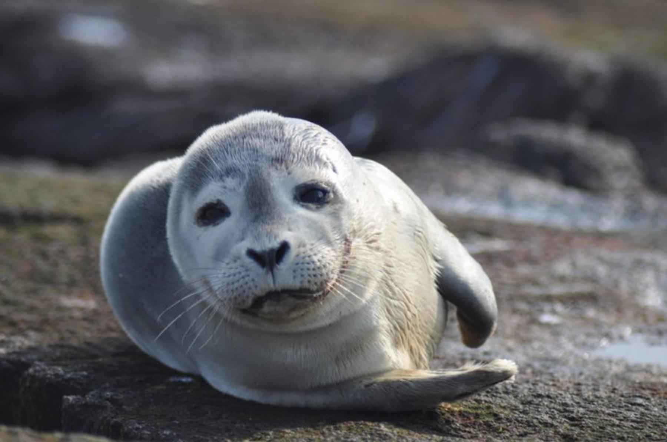
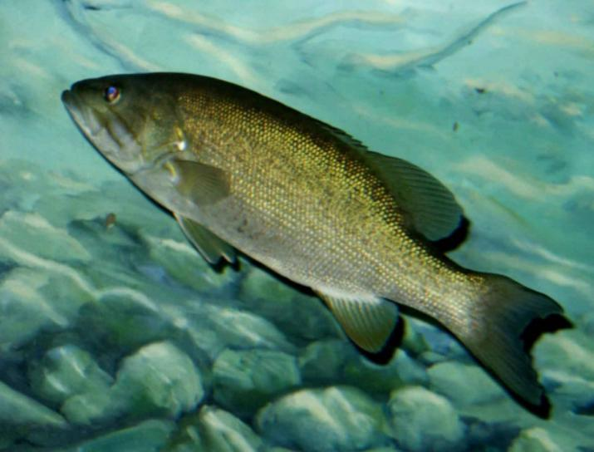
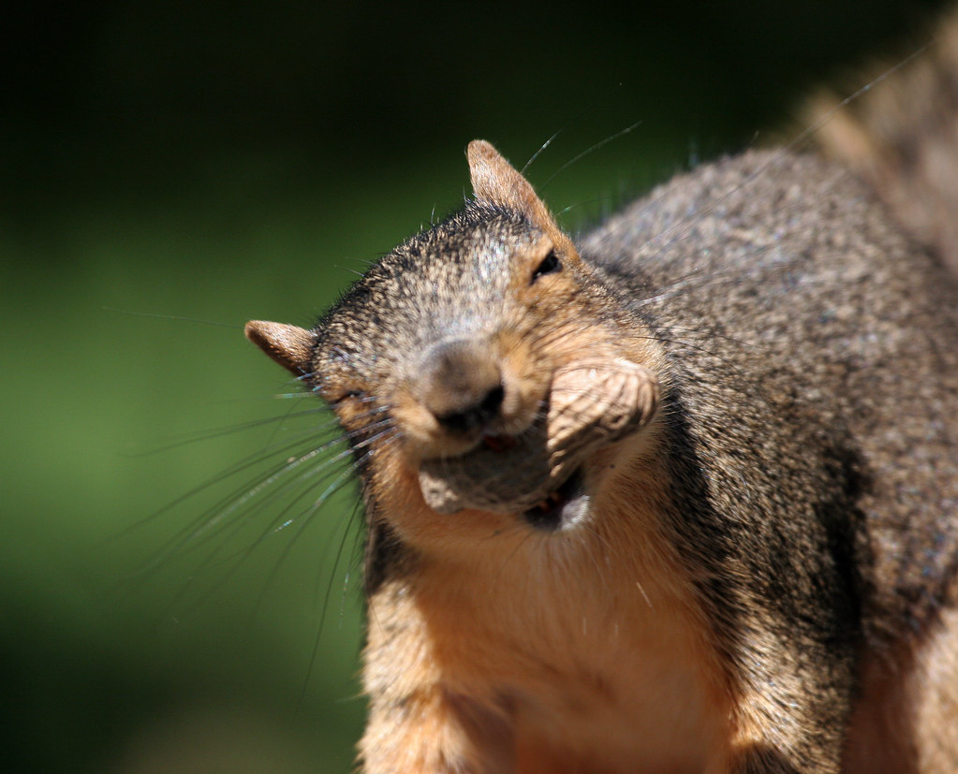
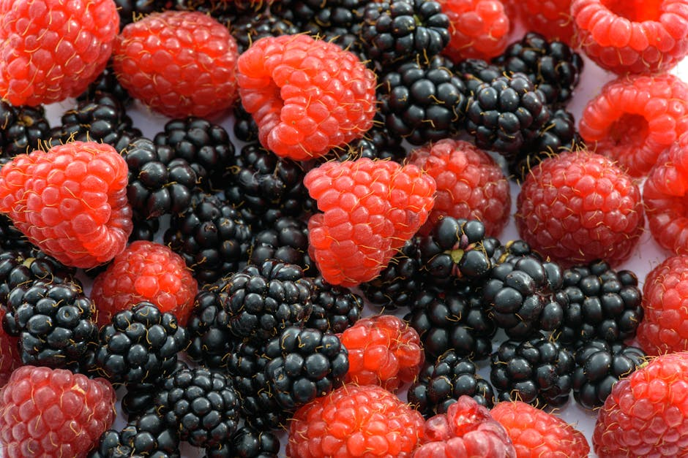
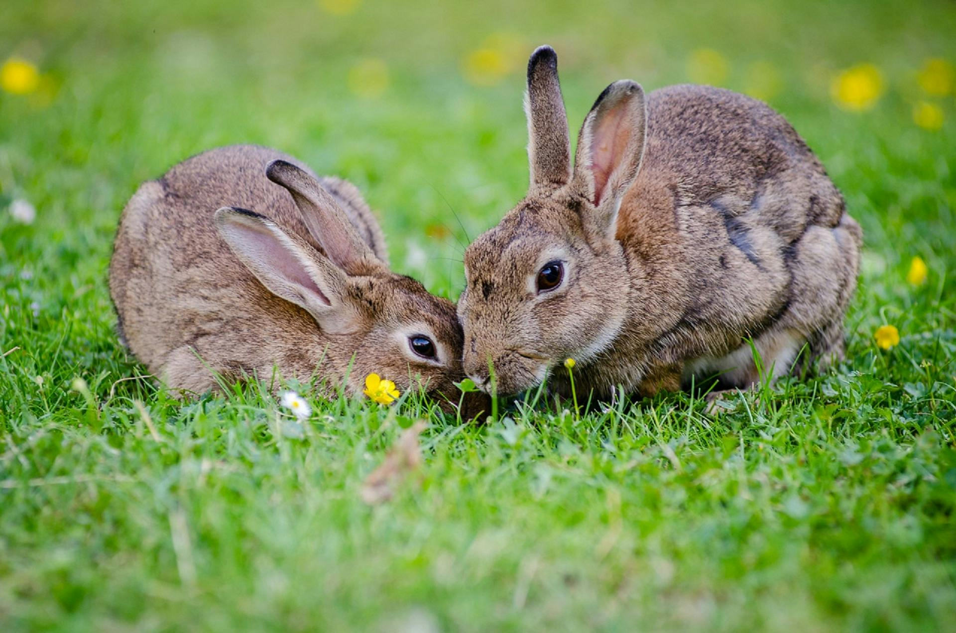
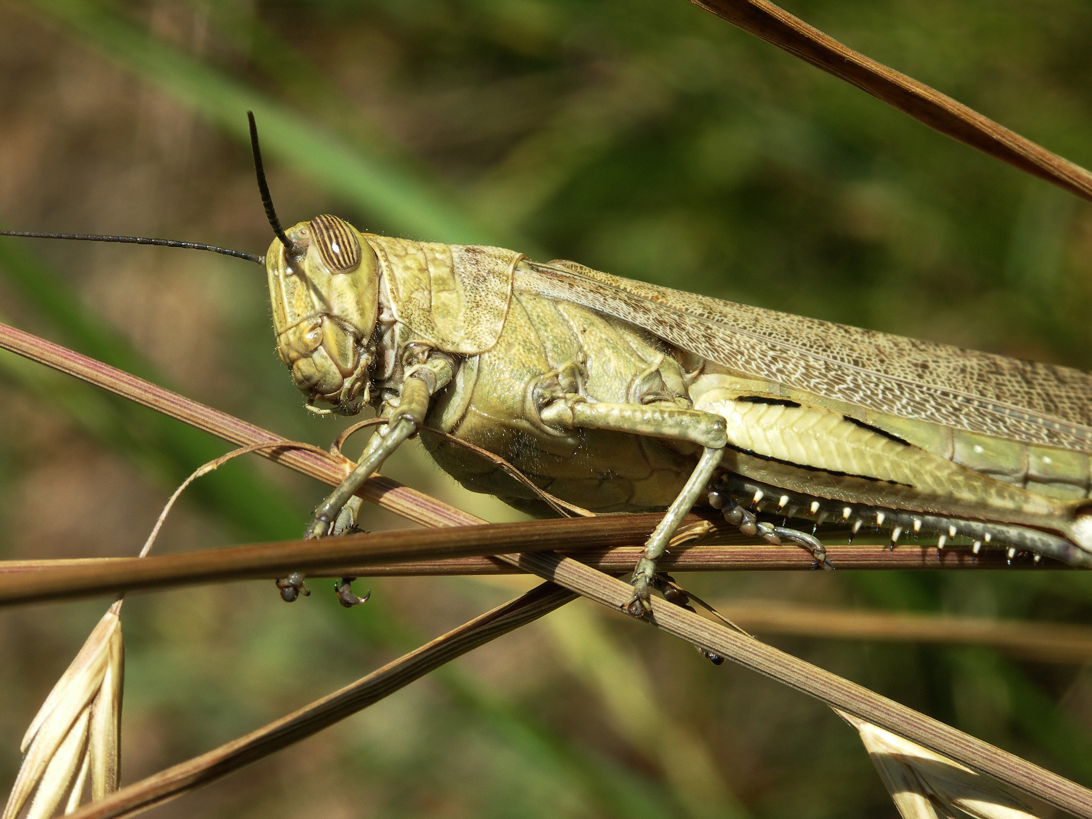
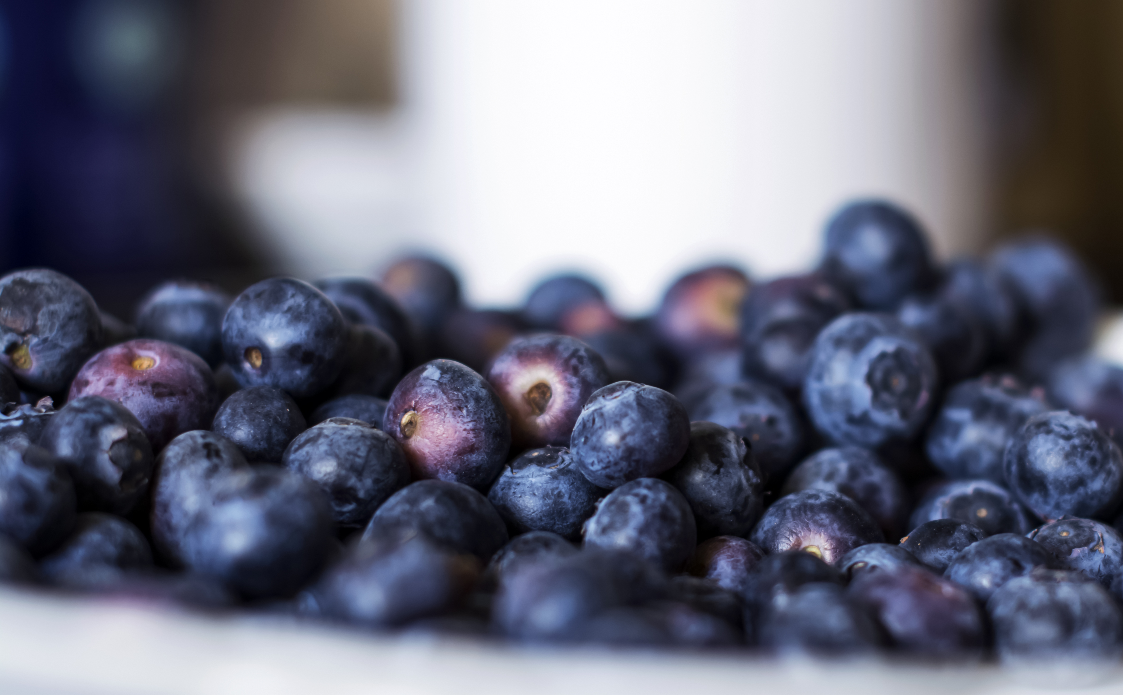
Food
They gathered acorns, grasshoppers, buckeye nuts, berries, and seeds.
They fished for shellfish, seaweed, and sealions.
They hunted deer, bears, rabbits, elk, squirrels, and birds.

Slide 4
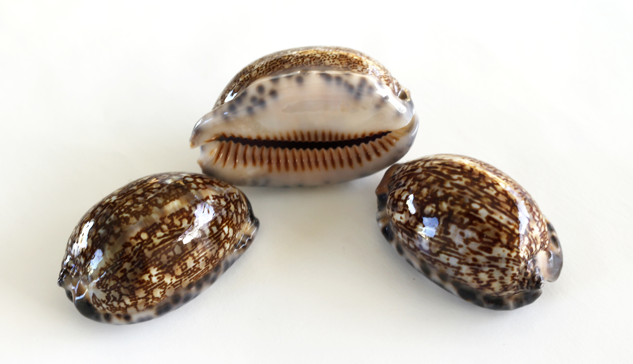
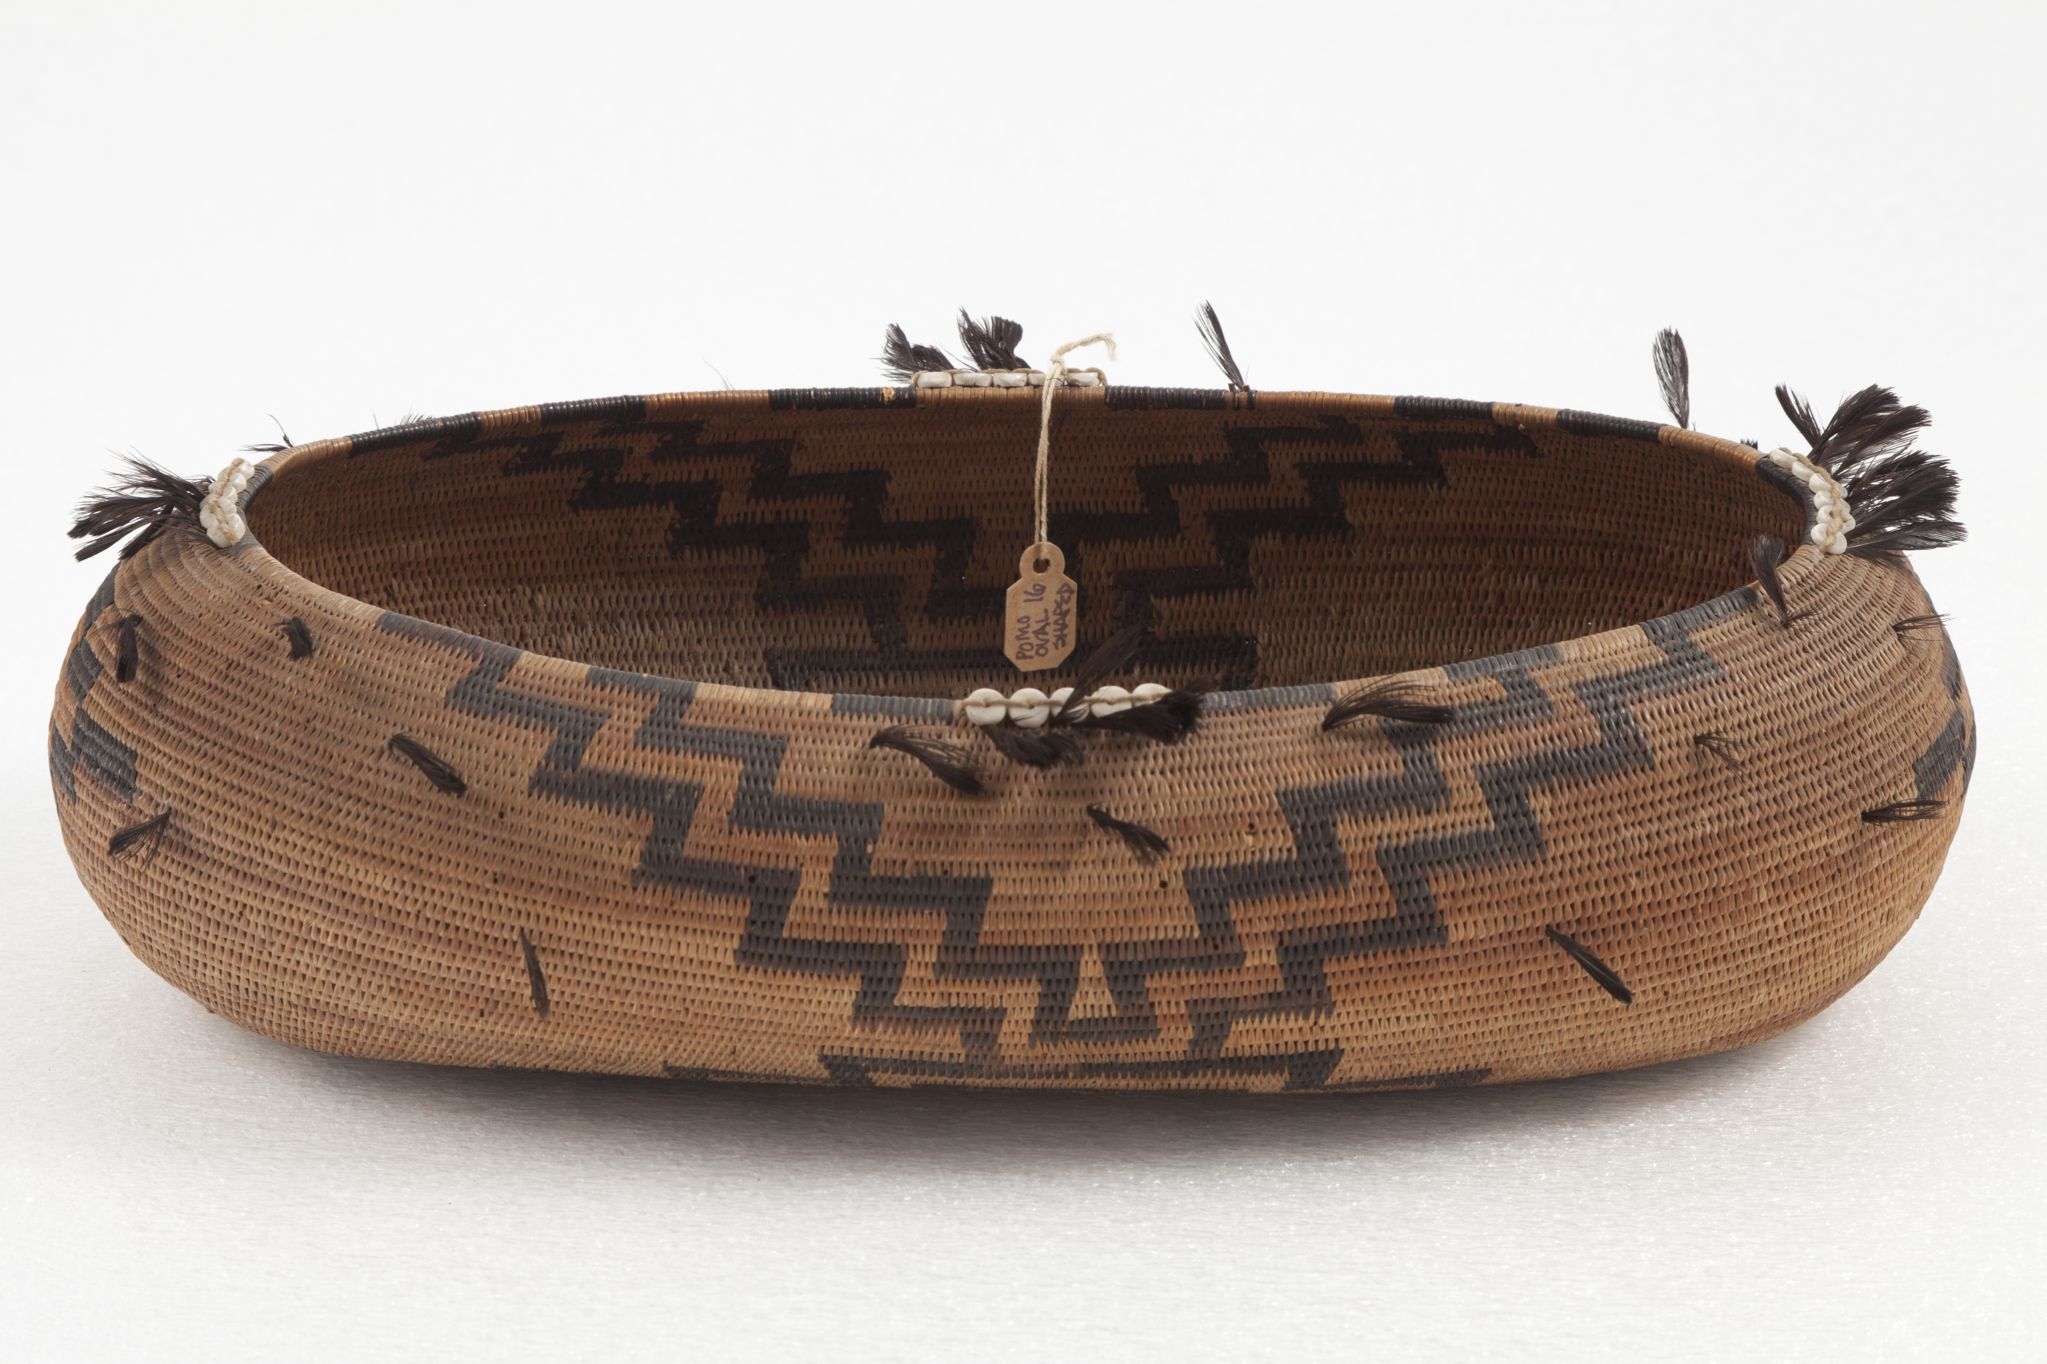
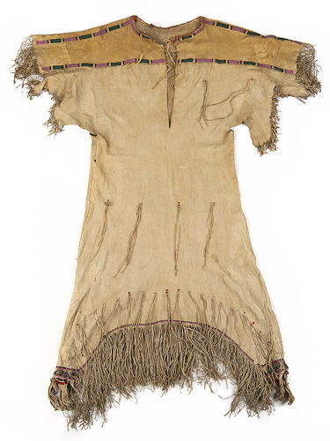
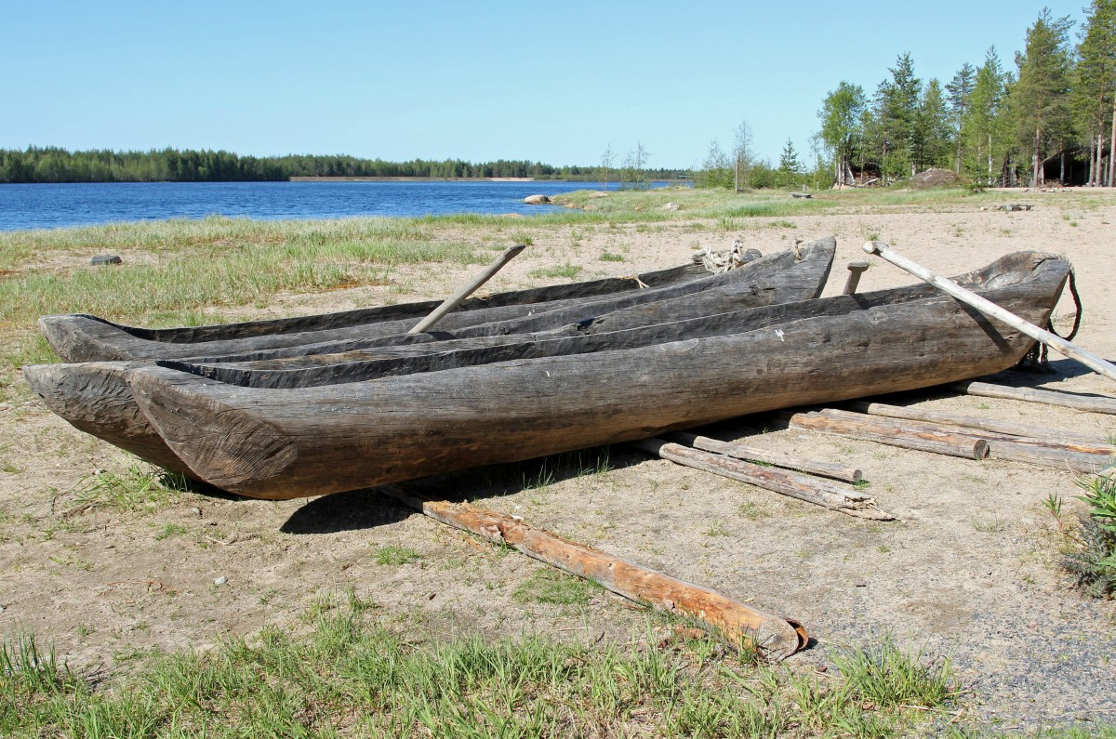
Culture
They built canoes. The clamshell beads were used as money and used to trade with other tribes. They used animal skins for clothes.
under CCYYSA.

Slide 5
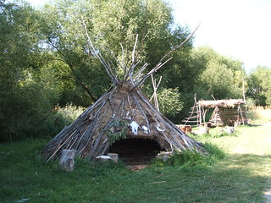
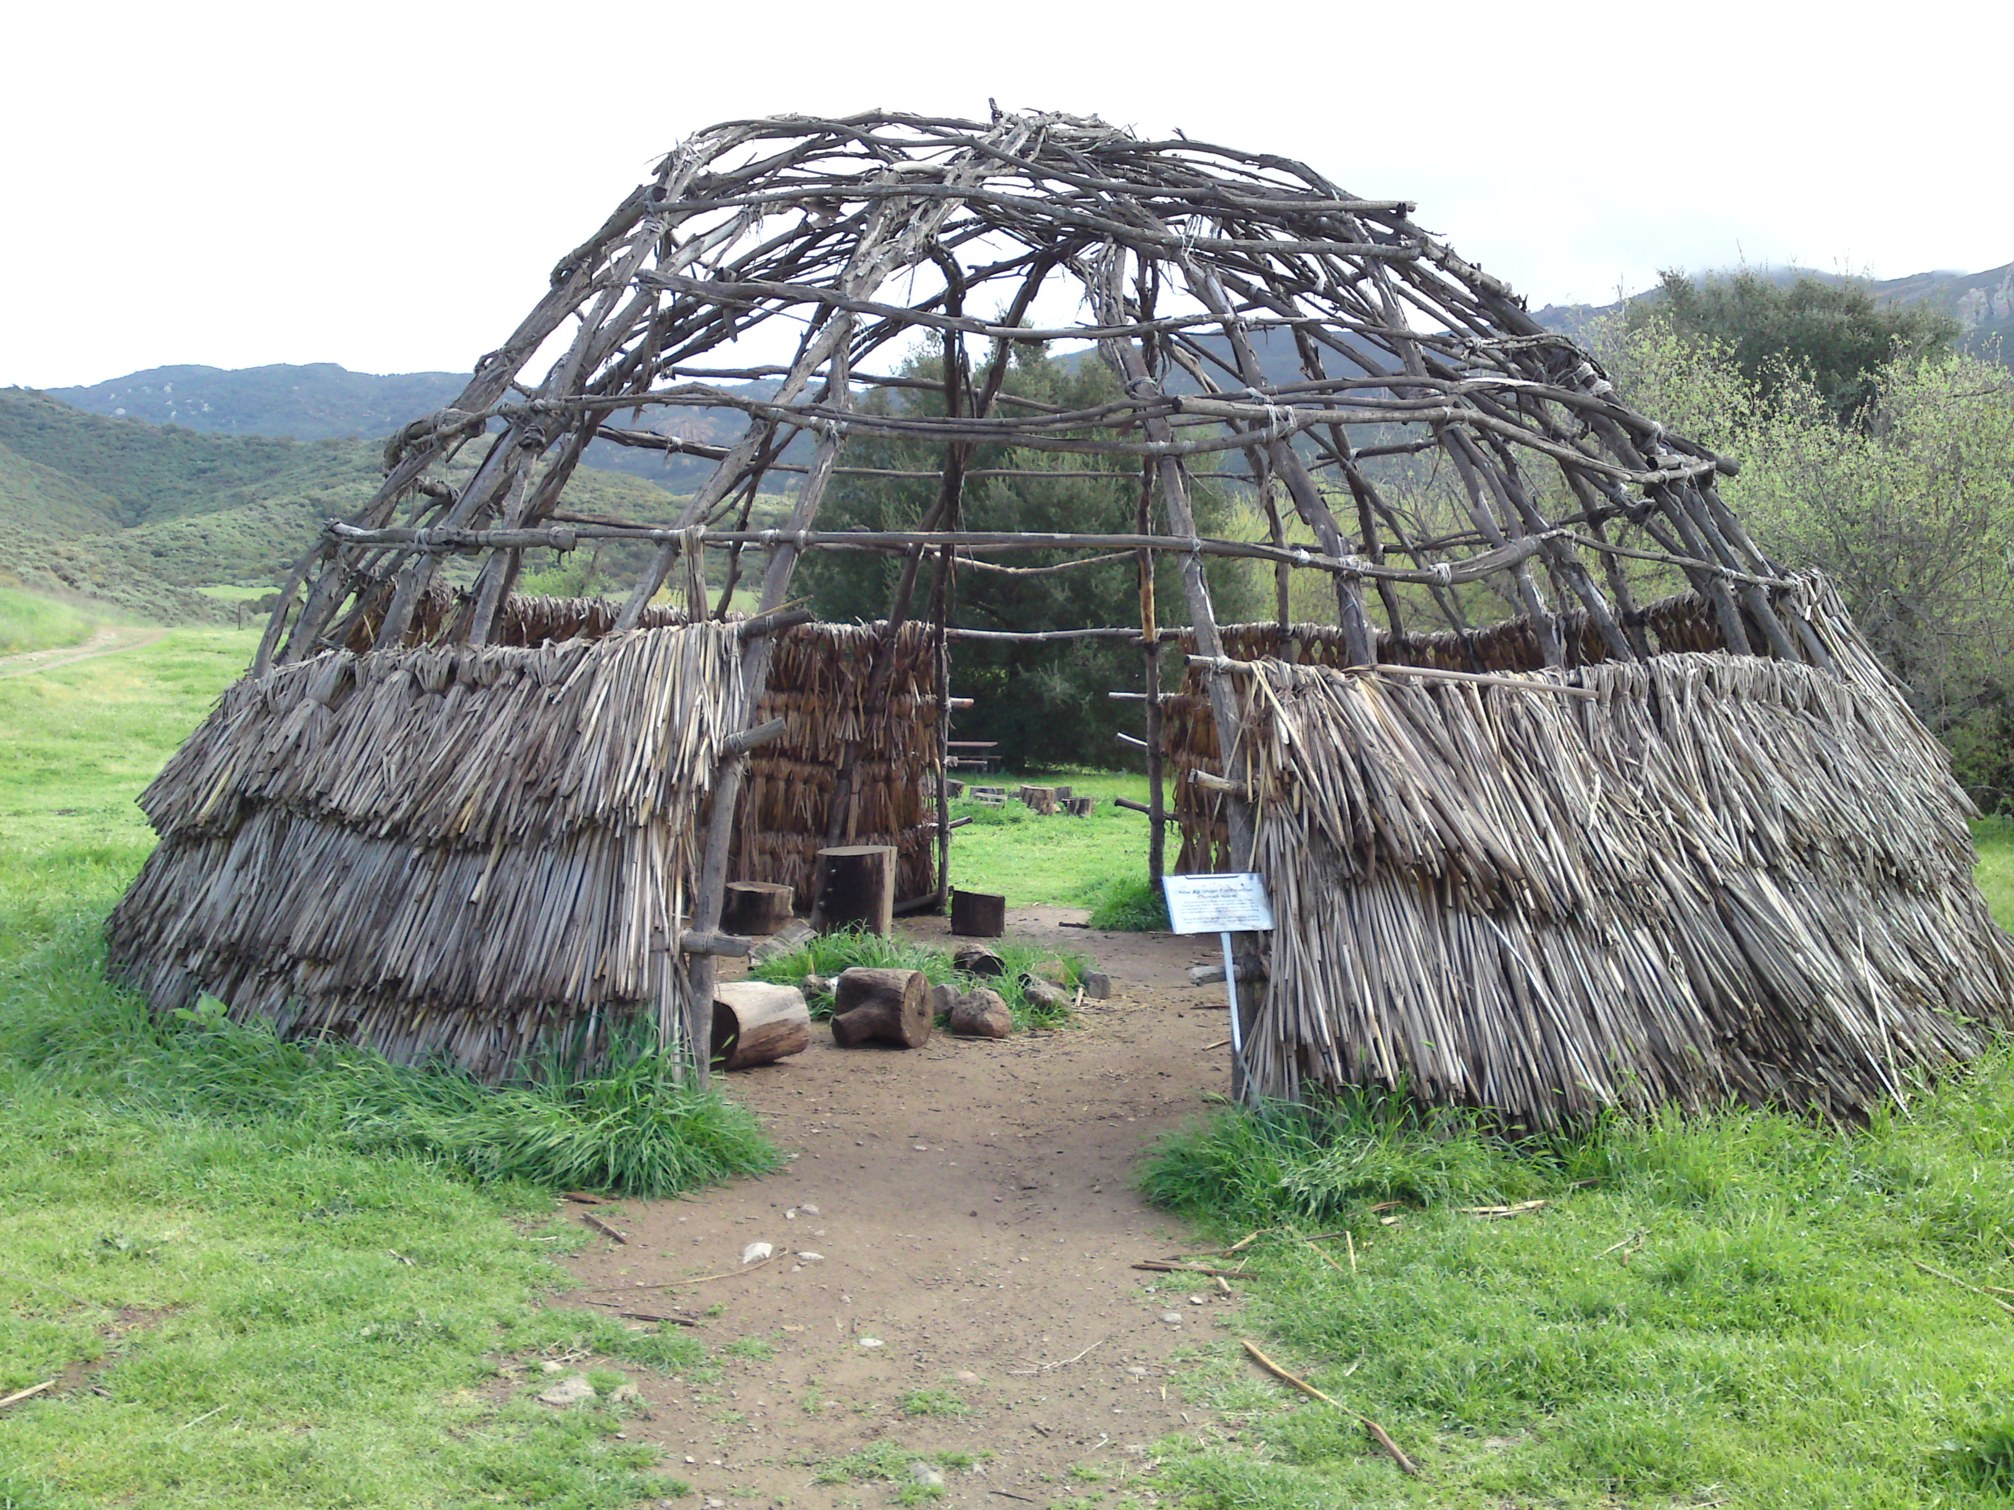
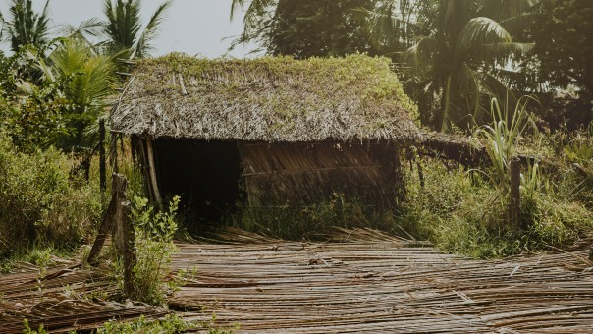
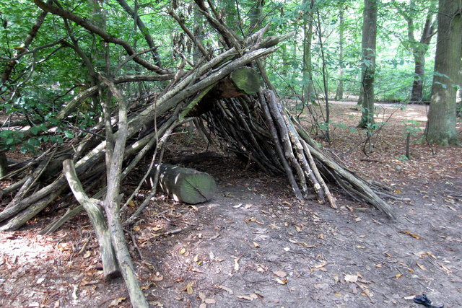
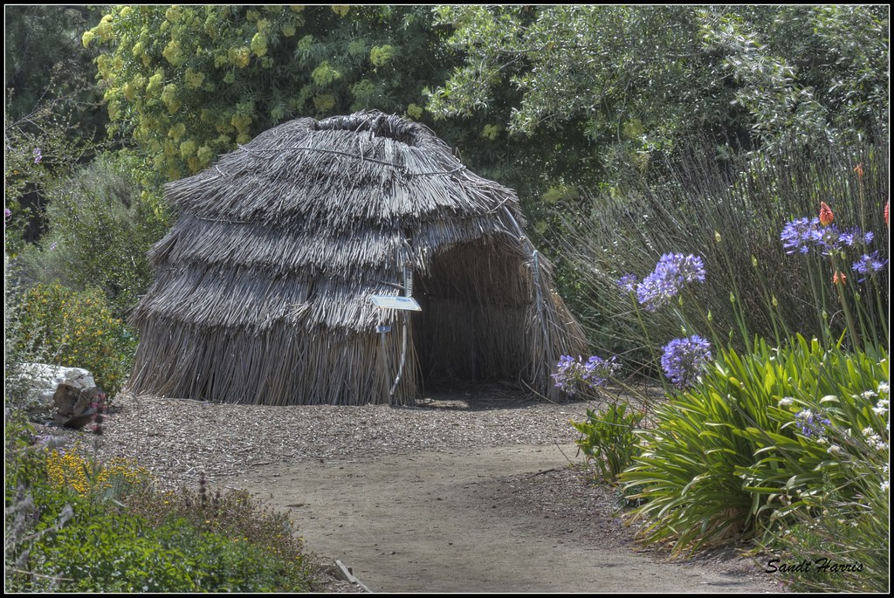
Shelter
The shelter of the Pomo was sturdy and round.
Some used grass on top of the tule.
Their homes were made of cone – shaped pieces of redwood bark.

Slide 6
ThePhoto by PhotoAuthor is licensed under CCYYSA.
ThePhoto by PhotoAuthor is licensed under CCYYSA.

