Slide 1
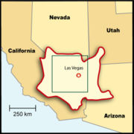
Mojave tribe
By Logan and Ruben
ThePhoto by PhotoAuthor is licensed under CCYYSA.

Slide 2
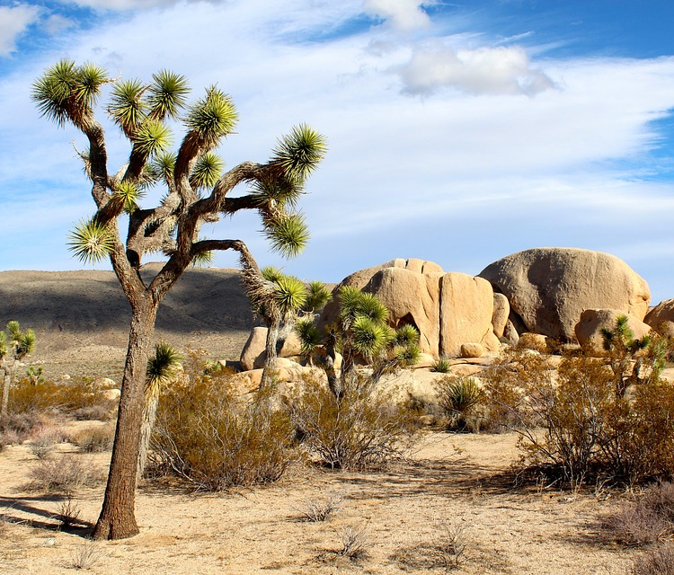
Location
The Mojave lived in the southeastern part of California. They lived near mountains, valleys, rivers, and lakes .
They lived in the Mojave desert. It was hot in the day and cold in the night.

Slide 3
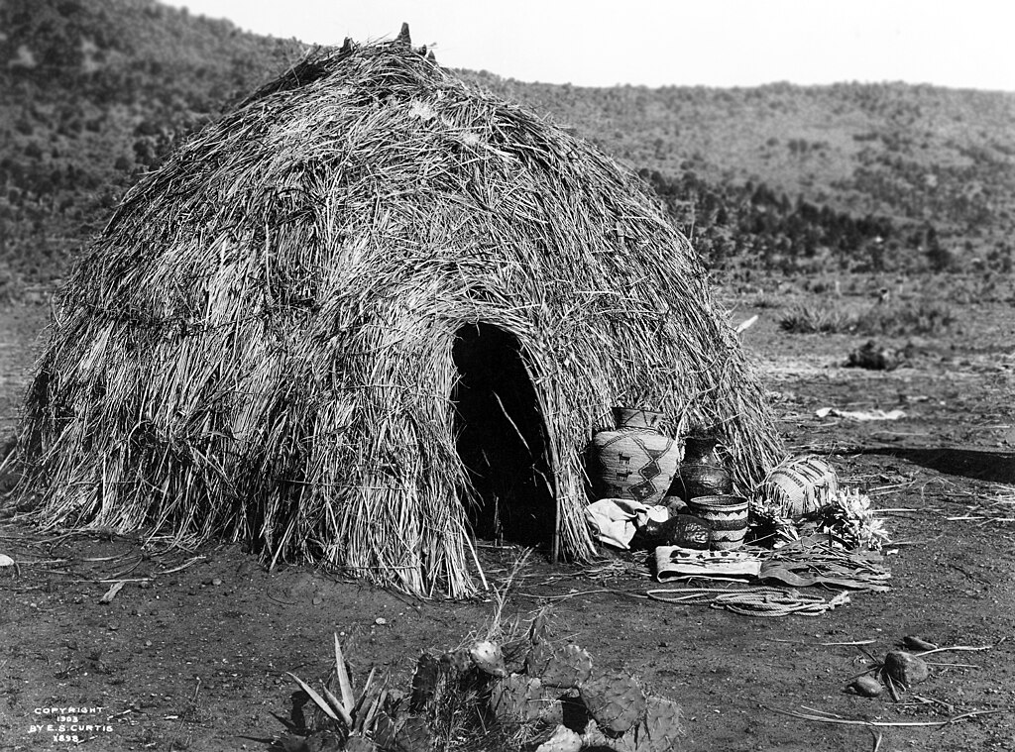
Shelter
ThePhoto by PhotoAuthor is licensed under CCYYSA.
The shelter of the Mojave tribe protected them from the environment. They used redwood logs or cottonwood poles to build their home.
Their shelters are open and made out of redwood. They used tree trunks to make their homes stand.

Slide 4
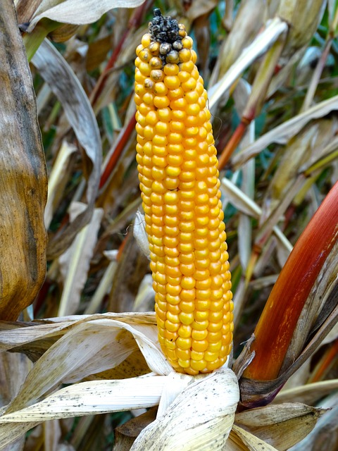
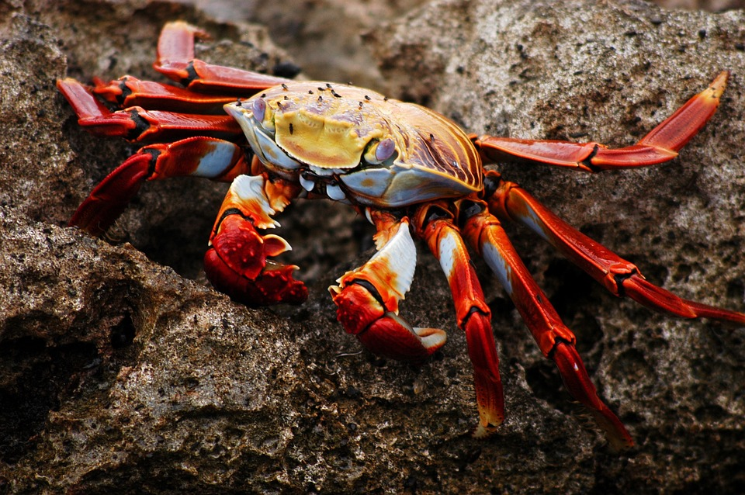
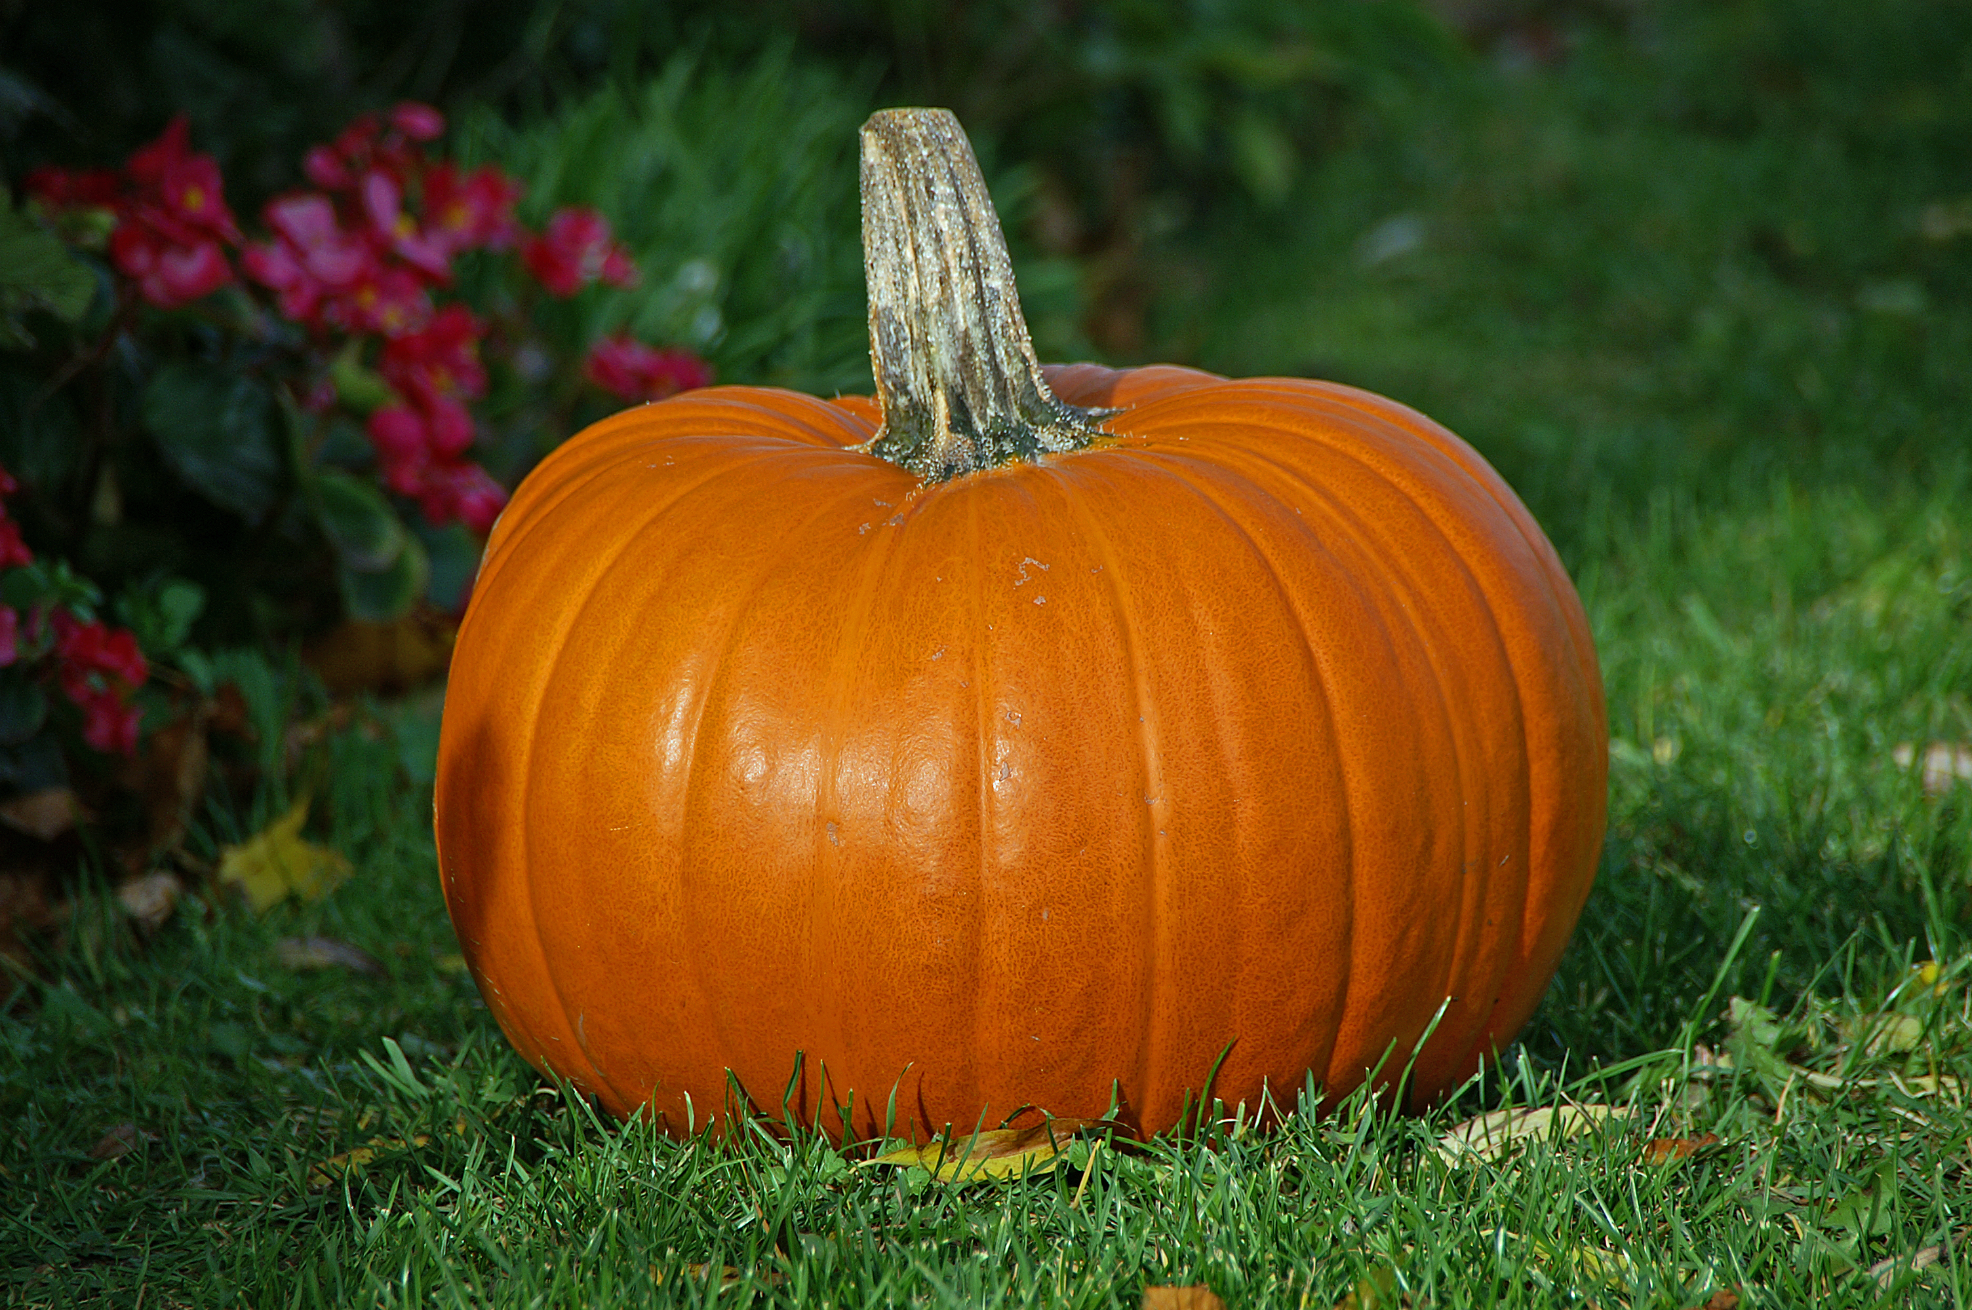
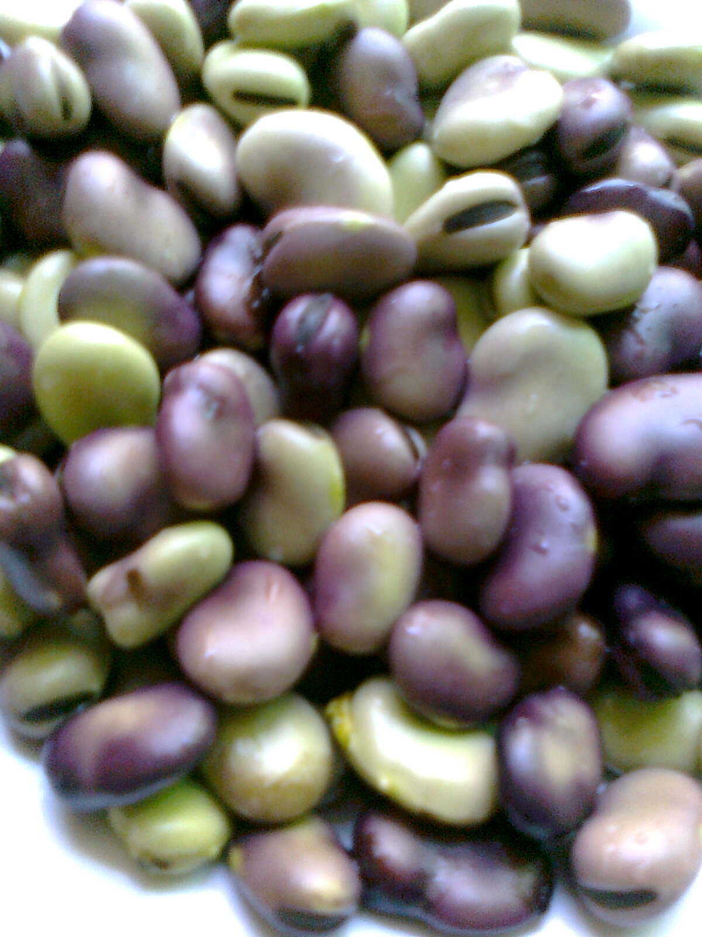
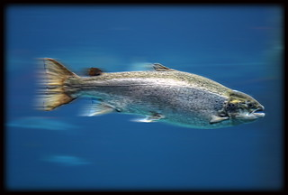
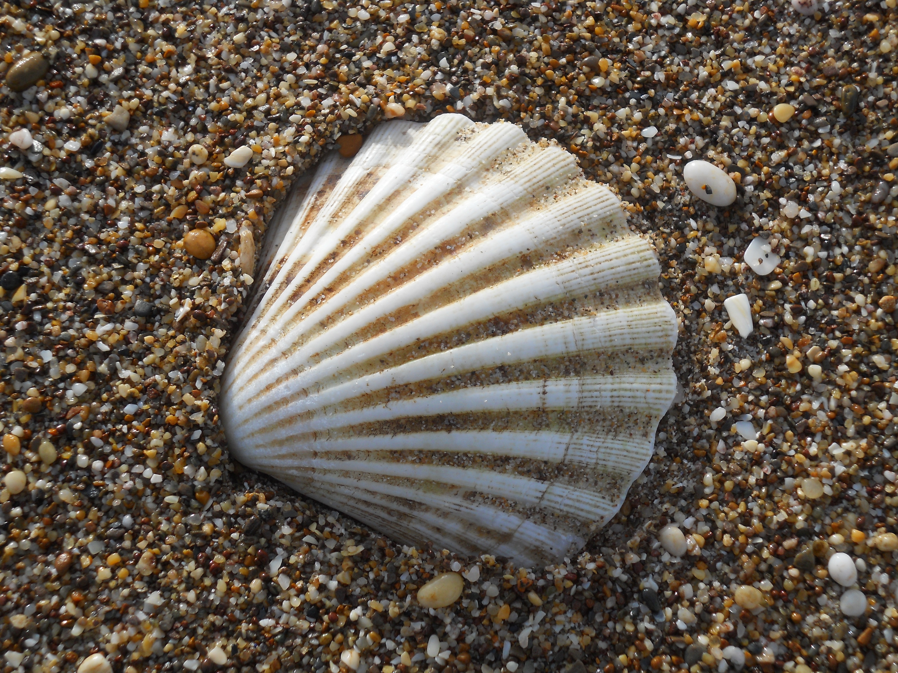
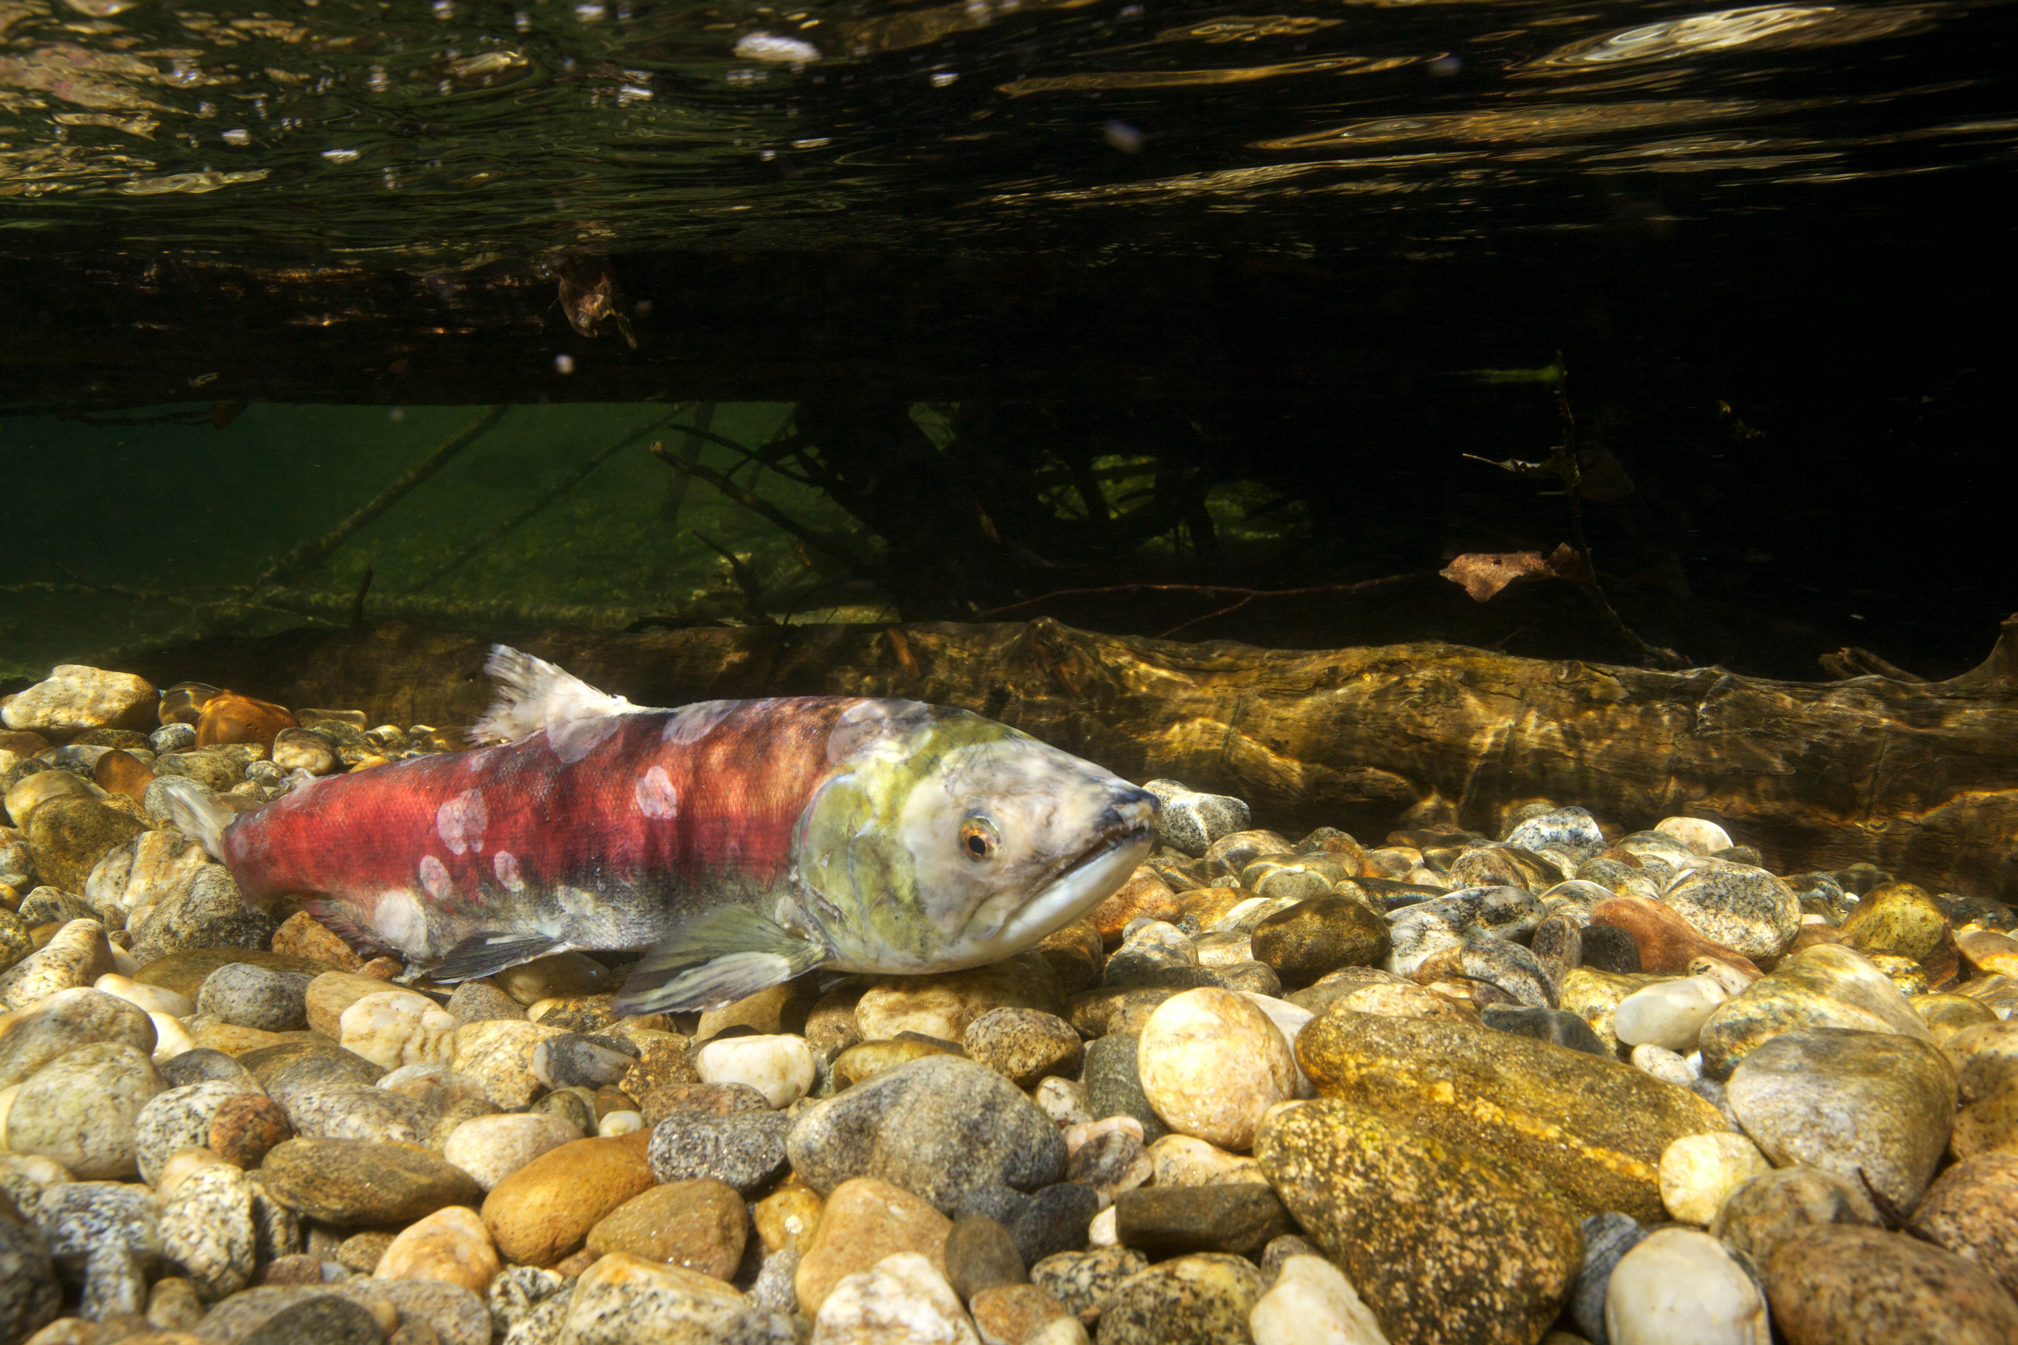
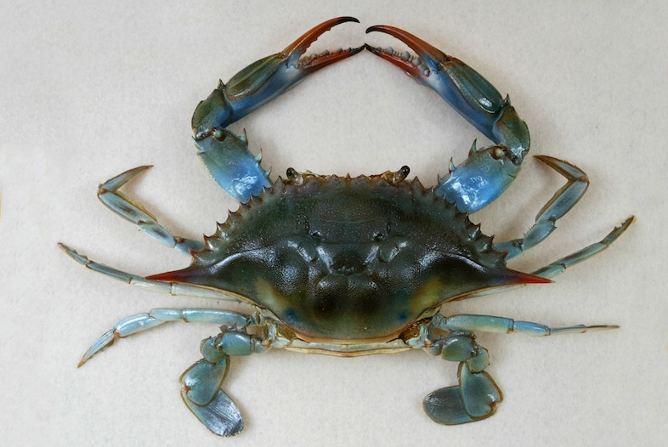
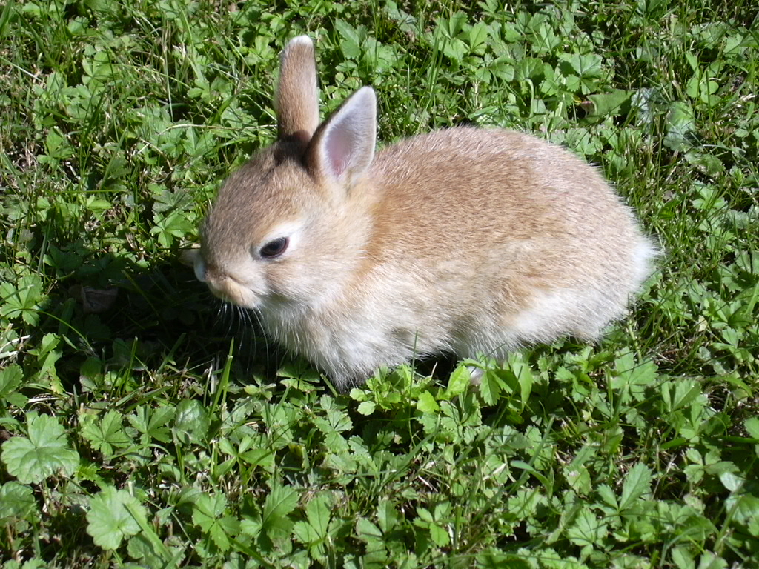
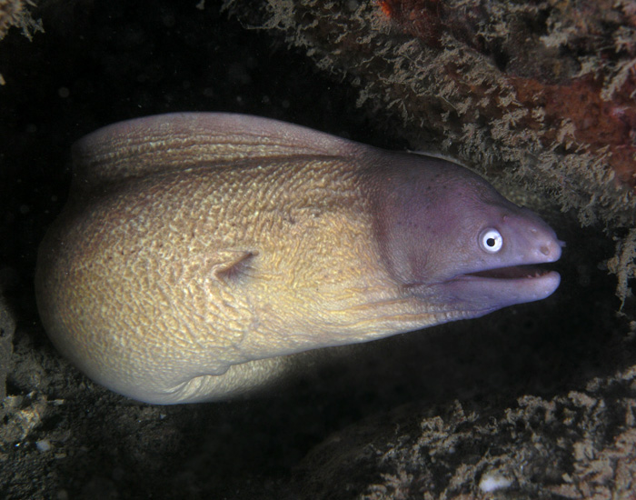
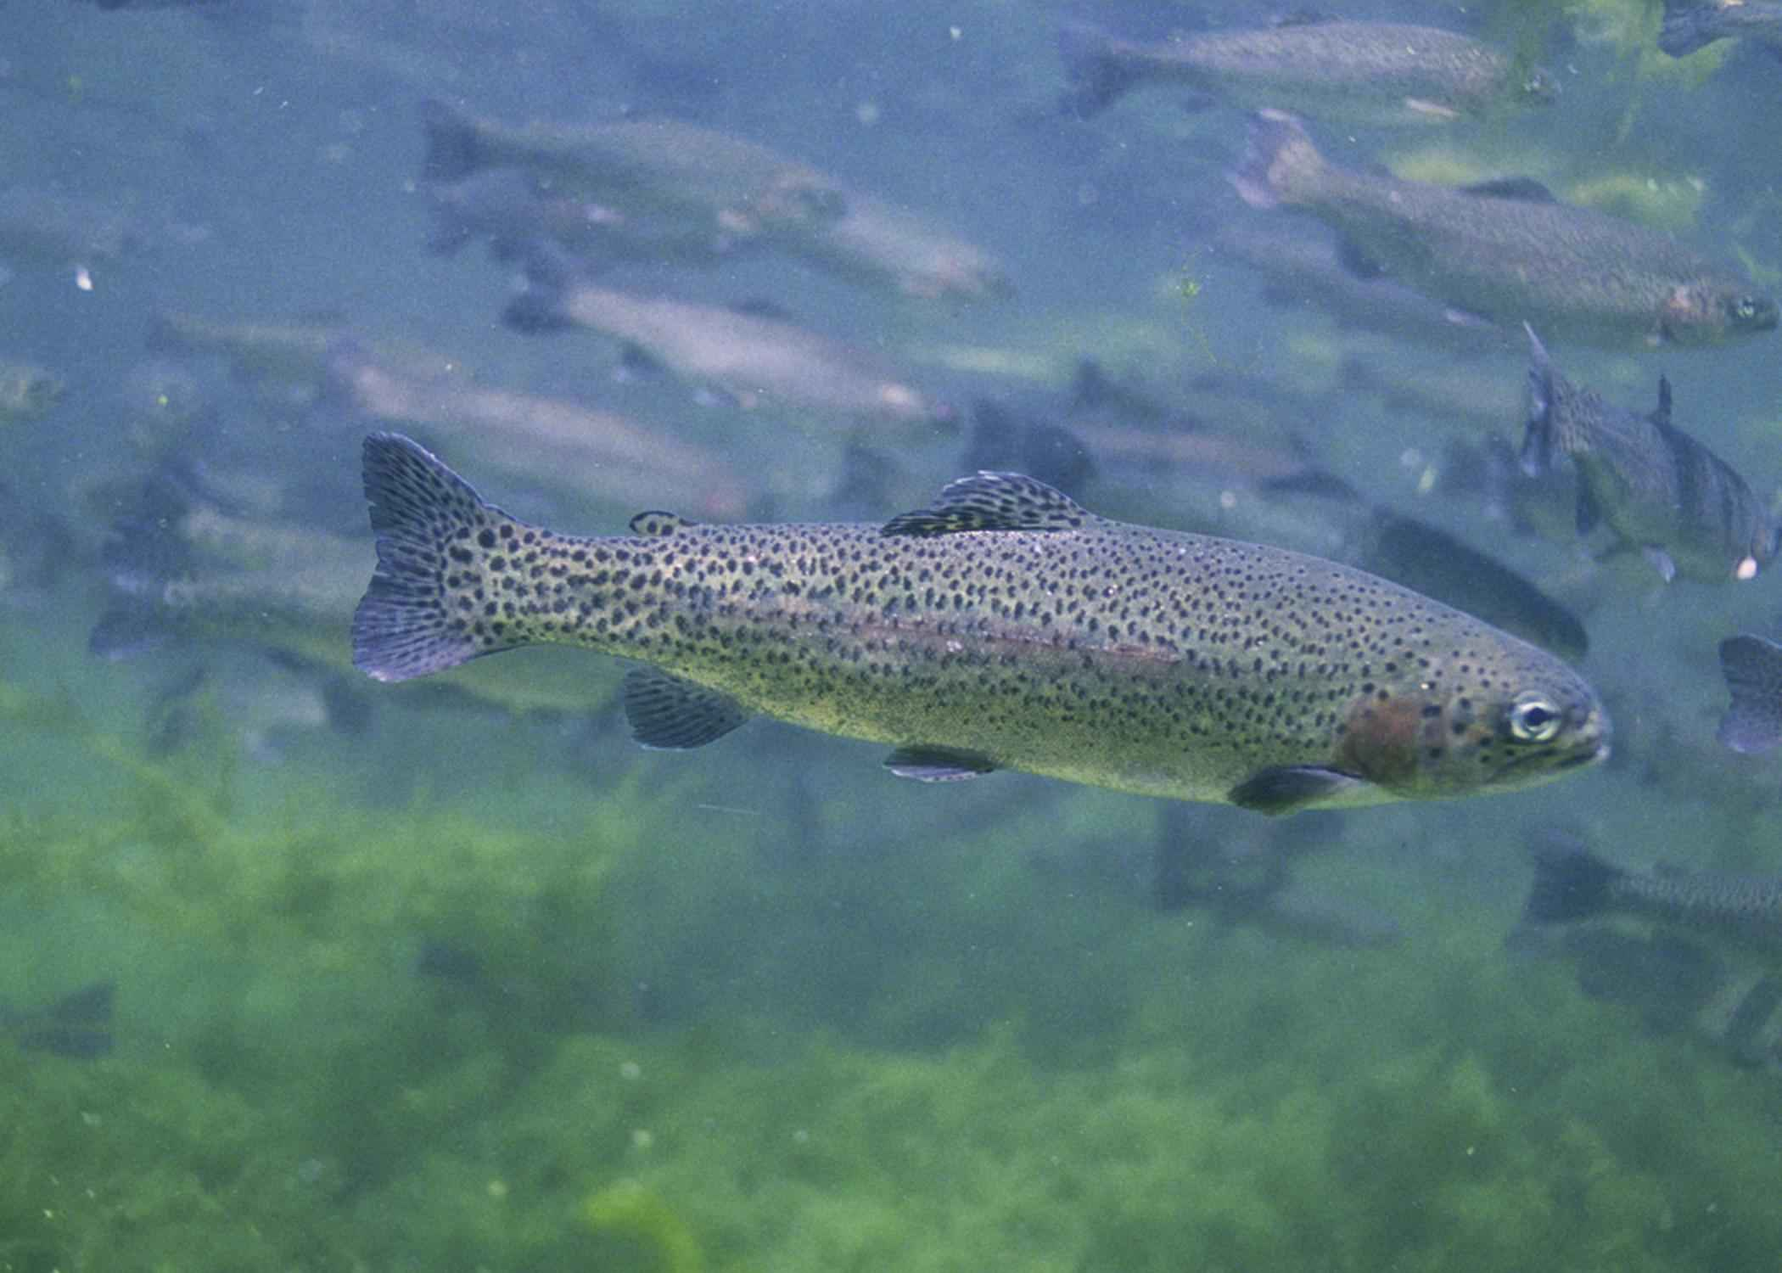
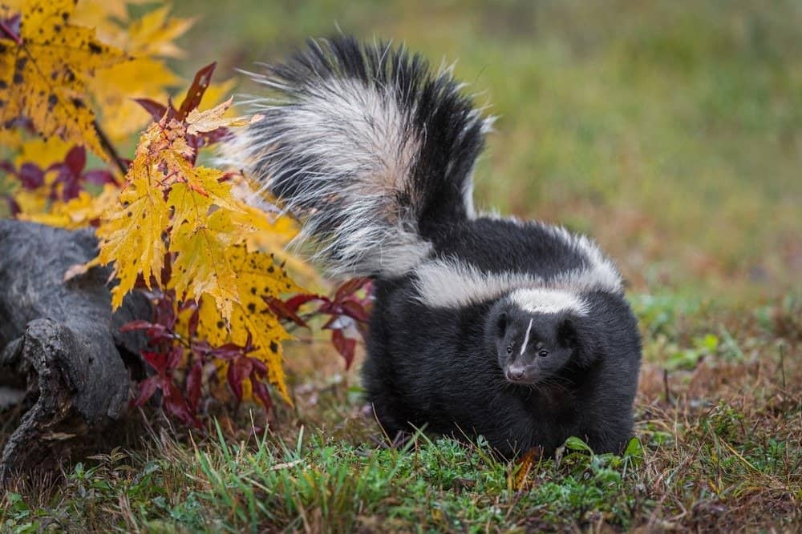
Food
ThePhoto by PhotoAuthor is licensed under CCYYSA.
The Mojave gathered corn, beans, and pumpkins.
They fished salmon, trout, eels, clams, and crabs.
They hunted rabbits, skunk, and beavers.
ThePhoto by PhotoAuthor is licensed under CCYYSA.
ThePhoto by PhotoAuthor is licensed under CCYYSA.
ThePhoto by PhotoAuthor is licensed under CCYYSA.
ThePhoto by PhotoAuthor is licensed under CCYYSA.

Slide 5
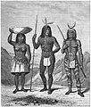
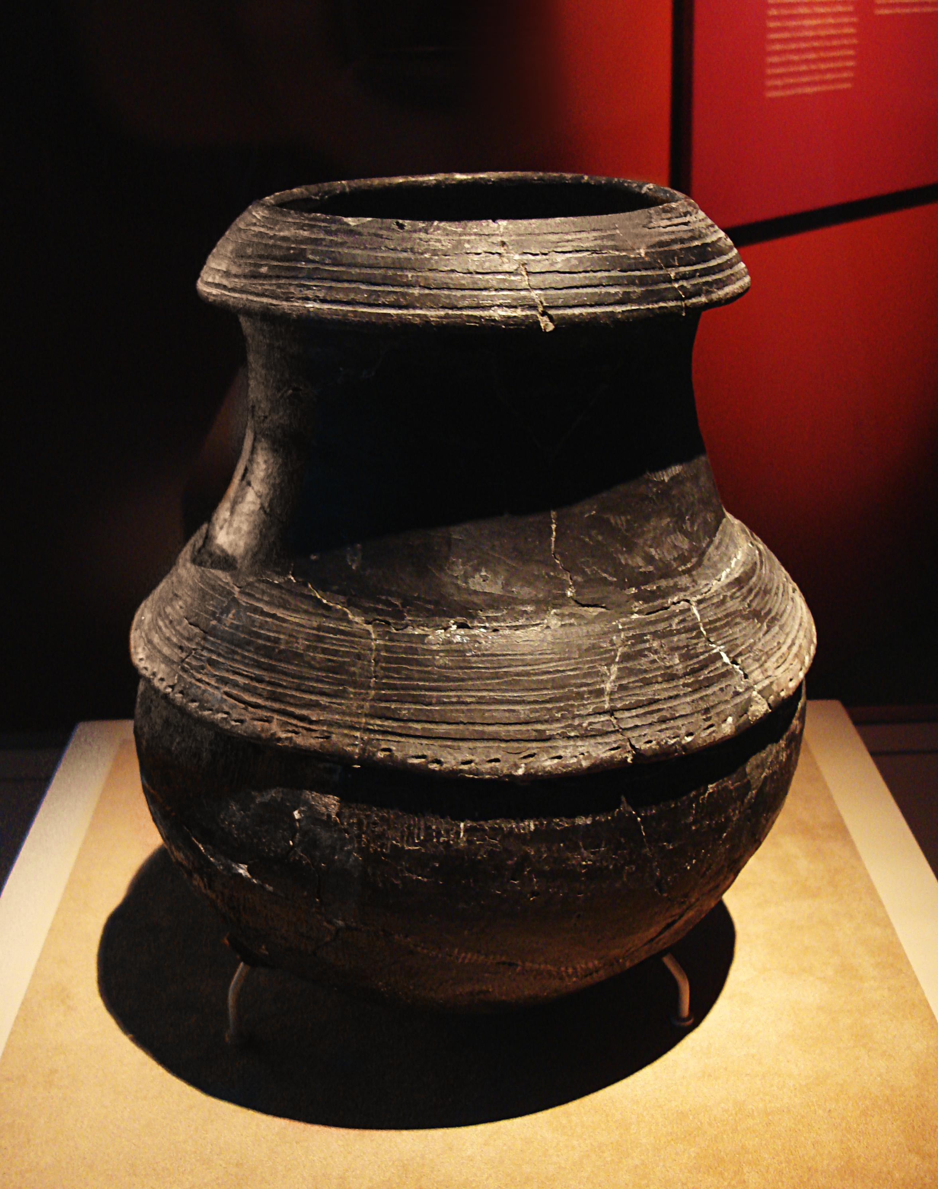
Culture
ThePhoto by PhotoAuthor is licensed under CCYYSA.
They carried pottery on their heads. They used clay to make pots to store food.
Village chiefs were chosen in ceremonies based on their vision.
ThePhoto by PhotoAuthor is licensed under CCYYSA.

Slide 6
Thanks for watching

