Slide 1
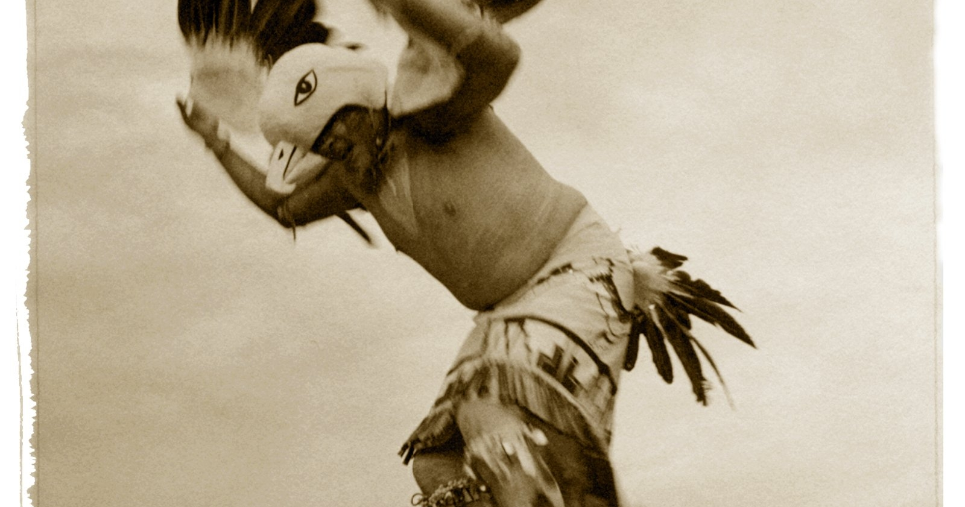
MAIDU
By jayden wheeler & zander sorensen

Slide 2
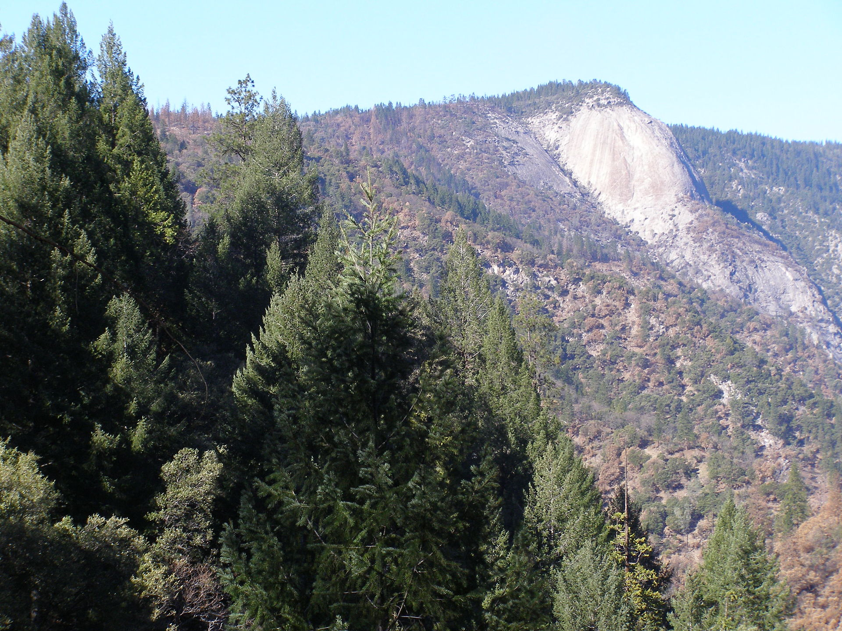
Location
The Maidu tribe lived in the Nothern part of California.
The Indians traveled from valleys during hot summer months to the cooler regions of the foothills.
The Indians lived in villages. Each village was known to the people by the name of valley.

Slide 3
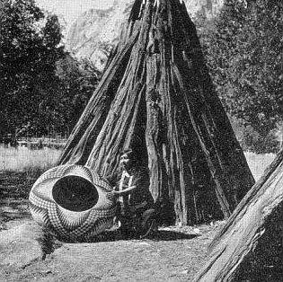
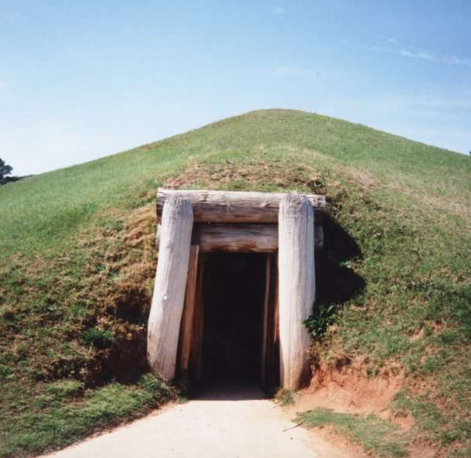
Shelter
In the winter the Indians have underground homes
The houses were made of wood and they were coned shaped and covered with hay
The houses had a hole in the top to get into the houses

Slide 4
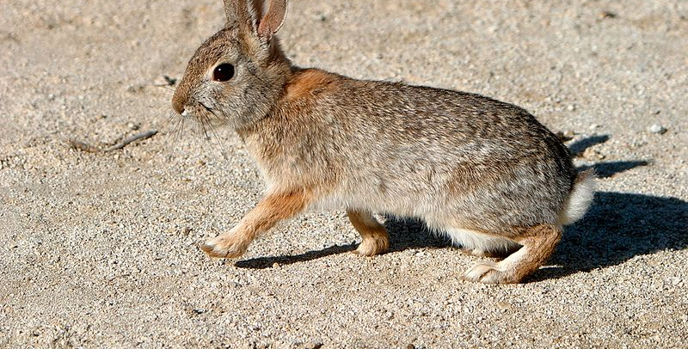
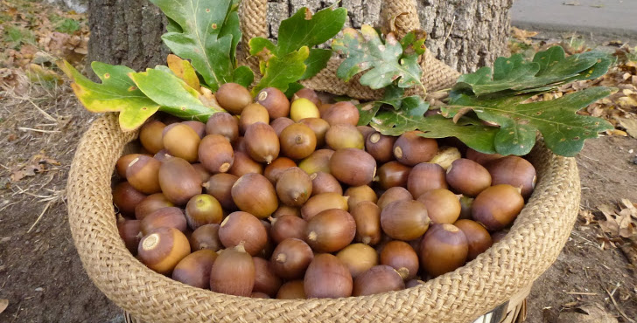
Food
They prepare acorns to eat by chopping them up and then putting water in them to make a paste
They eat seeds, nuts ,berries. Berries were crushed and mixed with water to make dough
The rivers are filled with fish so the Indians can eat a lot of fish

Slide 5
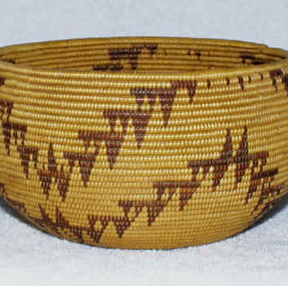
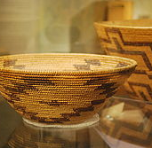
Culture
They make feast baskets to carry food in .
They wear moccasins filled with grass to keep them warm
They wear deer skin around their legs to keep them warm

Slide 6
