Slide 1
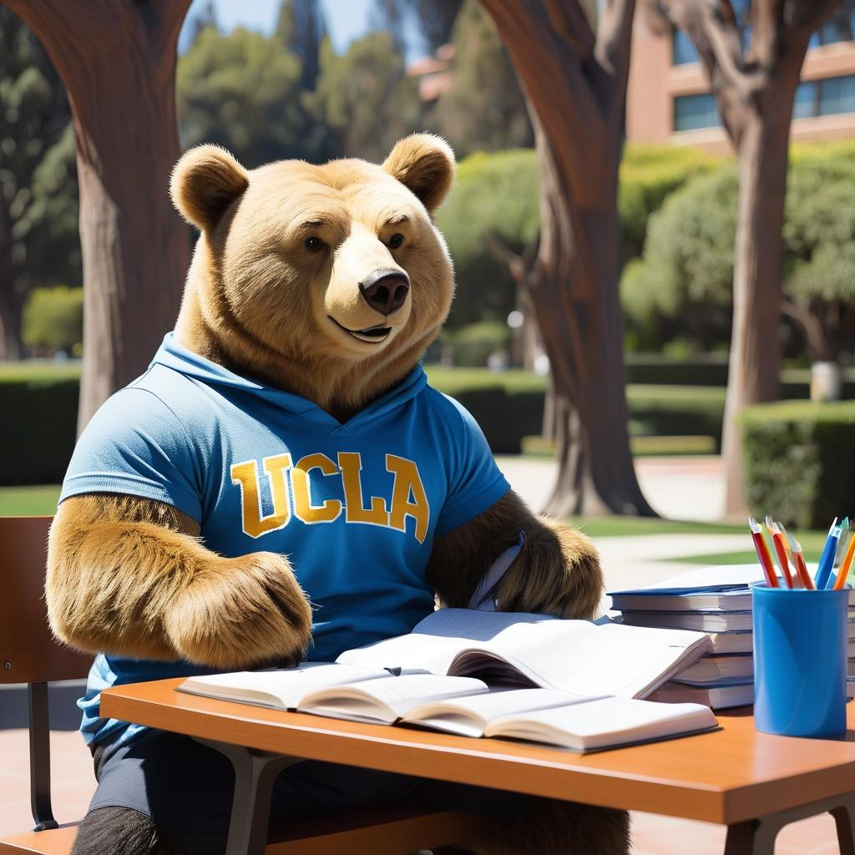
Welcome to the Bruin Zone
Back to School Night
August 22, 2024
Ms. Jimenez
Room 140

Slide 2
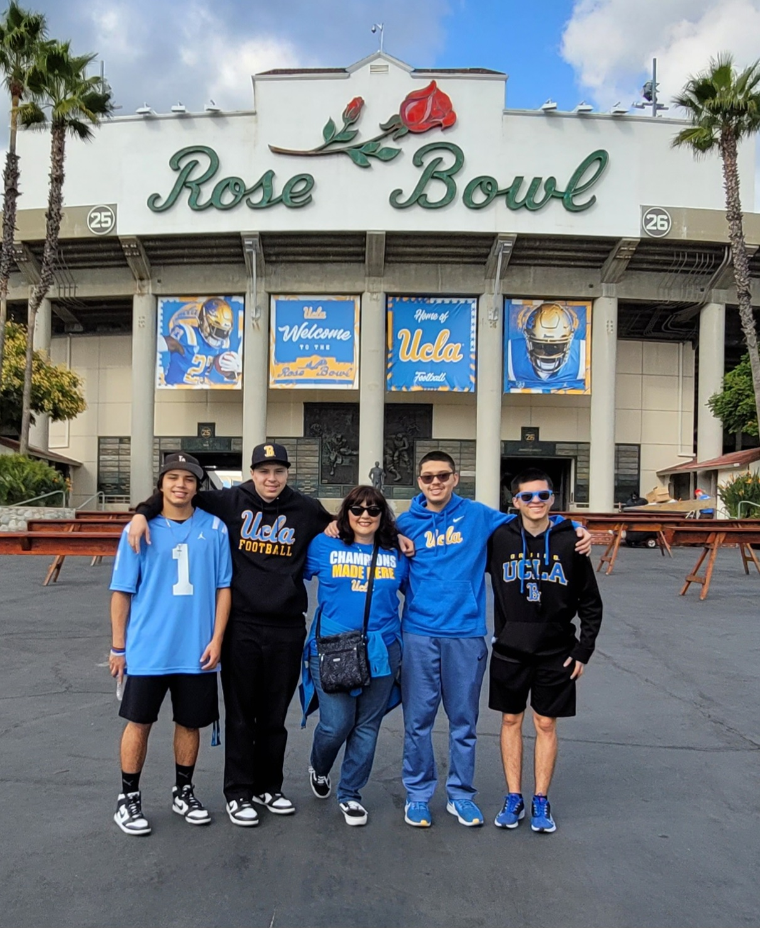
Welcome parents!
Welcome to our Class!
A little about Me:
26th year teaching
Taught 3rd, 4th, 5th, 6th, and 2nd
Credential and degree from CSUSB
Masters of Education & Curriculum from CSUSB
Single mom of 4 boys and our dog, Lola
Love all things Disney and Dodgers
Grateful for my life’s opportunities

Slide 3
Classroom Policies
Bathroom
1 boy and one girl allowed at a time in the restroom per Dr. Custodio.
Bathroom emergencies are the exceptions, but student must inform teacher and sign out before leaving.
Water
Students may have a water bottle at their desk with them that they can drink from without asking. Students are responsible for refilling bottles during appropriate times.
Students without a bottle may access our fountain with permission during lessons or when needed during independent work time.

Slide 4
Classroom Policies (continued)
Homework
Students will have nightly homework.
Students will earn a Golden Eagle Ticket for a signature in the agenda and on reading log and completed worksheet.
I will not take away recess if the work is not done. I will communicate the missing work in the agenda, and they will not earn a Golden Eagle Ticket.
Tardy
Students are marked tardy if they enter the room after the class has already entered.
Snack
Students may eat a healthy snack at first recess on the benches on the playground.
Students may not have candy or cookies during this time. Suggestions are carrots, goldfish crackers, graham crackers, breakfast bar, or fruit.

Slide 5
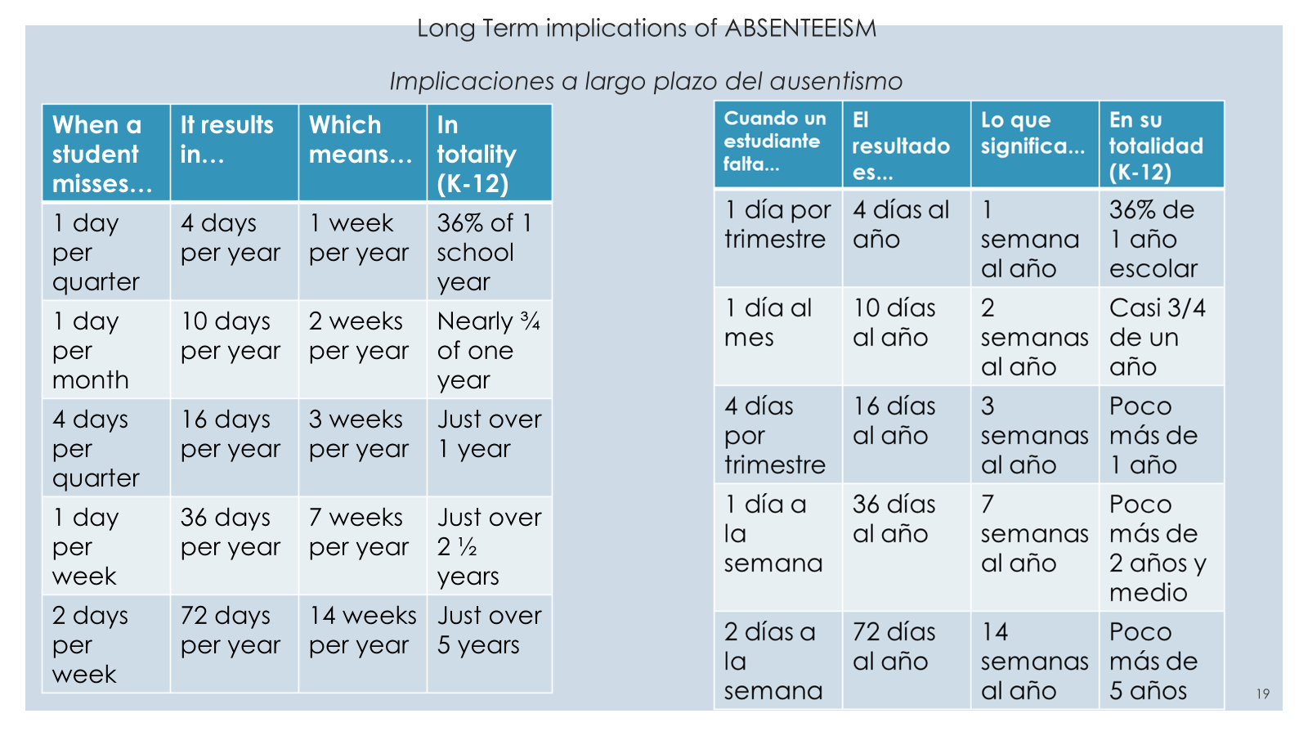

Slide 6
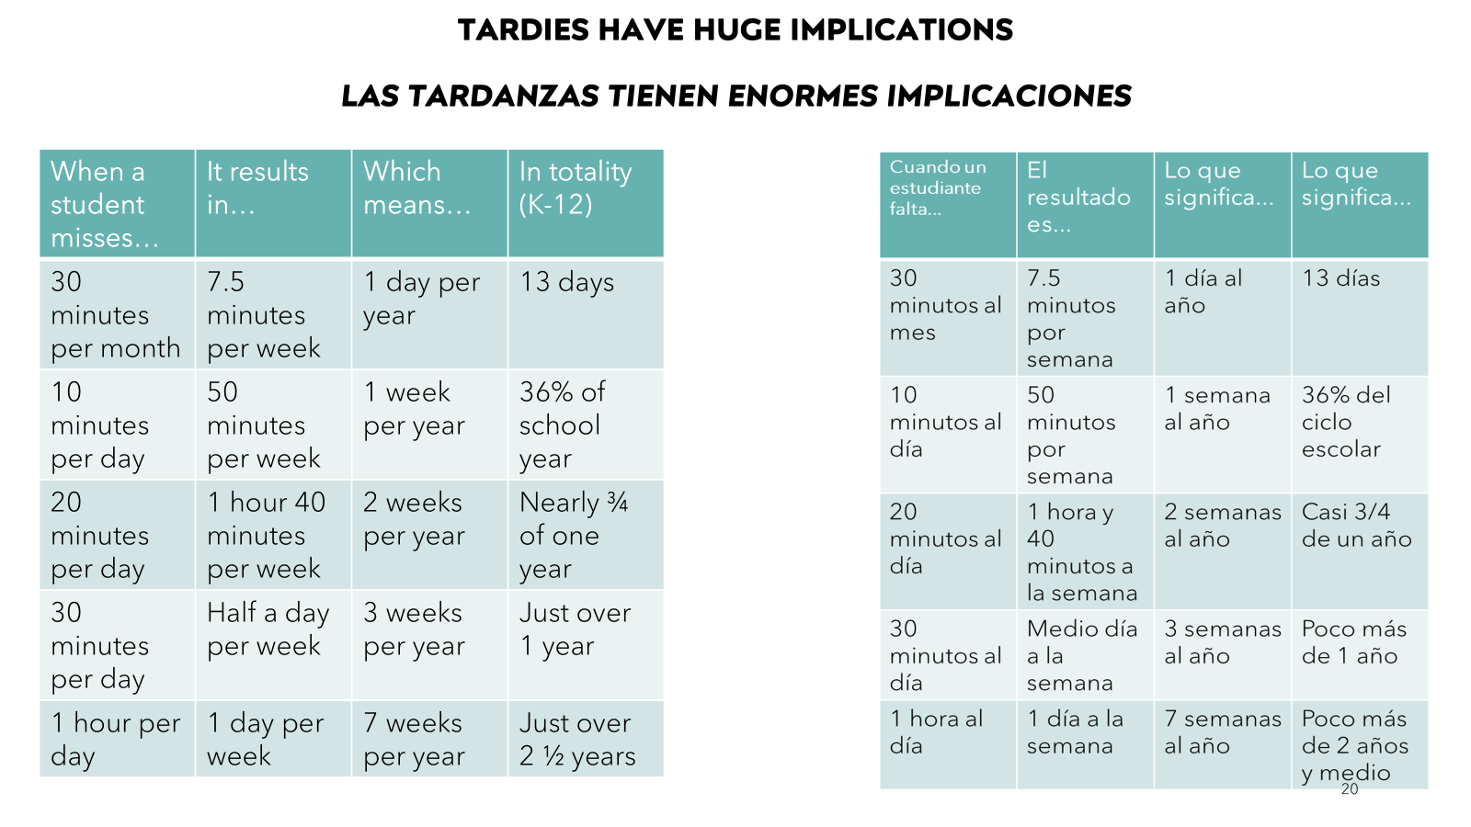

Slide 7
Nightly Homework
Parent Signature
Any person you trust to check the homework, notes, reminders, and “keep at home” section of the binder may sign the agenda.
By signing you are acknowledging your child’s behavior (it is green unless colored differently), their homework is complete (not necessarily correct), and you have seen any notes or announcements in the “keep at home” section of the binder that should be emptied nightly.
2. Worksheet
Spelling Practice: Students will have a weekly spelling list they will be responsible for learning. They will have one practice sheet a day as homework, but it is advised you spend another 5 minutes studying nightly.
Math Skills Practice: Students will get nightly practice on a skill we are currently learning or one we are revisiting.

Slide 8
Nightly Homework (continued)
Reading Log
Read a minimum of 10 minutes a night (more is always recommended). Students do not need to complete a book each night. They may read chapter books or read a book over multiple nights.
Write the title of the book with the correct capitalization and spelling.
Write two good sentences with correct capitalization and punctuation. A good sentence is something more than “The cat had a hat.” For example, “The cat got into a lot of trouble. The cat had many funny friends.”
I have a library with many shelves of books for students to check-out. Students may use their own books for reading log homework or use their weekly library book that we check out each Wednesday.

Slide 10
Class Information
Classroom Incentives
Individual Incentives: Golden Eagle Tickets, WOW Board, Clip Chart
Team Incentives: Weekly Table Tally Points
Class Incentives: Marble Jar
Curriculum and Programs
Wonders (ELA/ELD/Social Studies), Savvas (Math), Twig (Science), ELEVO (PE), Second Step (SEL)
Google Classroom (daily independent classwork), Lexia (ELA supplement), DreamBox (Math intervention), 99Math (Math fluency)

Slide 11
Helpful Information
Contact Information:
Email: Lisa_Jimenez@chino.k12.ca.us
Parent Portal (Aeries)
Parent Square Communication (sign-ups coming for Parent Conferences)
School agendas and website have many useful pages of information including the calendar, school rules, policies, and much more. If you have a general question look there first.
You can access all programs through your child’s ClassLink page.

Slide 12
Suggestions for Success
Have a routine and try to stick to it. At this age students who go to bed between 8-8:30pm, wake-up with enough time to get ready in the morning, and eat breakfast and are ready to tackle the day.
Ask specific questions about their day. “What was one new word you learned today?” “Were you a good friend today?” “What was your favorite part about math?” You may not get much from the general “How was your day?” question.
Communicate with me directly. If you have a question, concern, or need to let me know about something going on, please contact me directly for the most accurate information and immediate action.
Teach your child to tie their shoes, begin to talk about time and money. Get an analog clock if you do not have one and help them practice. Have students count money they have saved in a piggy bank.
Less screen time and more board games, reading, coloring, drawing, playing outside, helping in the kitchen, helping with the care of pets, and other household tasks.

Slide 13
Questions?

