Slide 1
Weather and Climate by Danielle and Trevor
This Photo by Unknown author is licensed under CC BY-SA.
This Photo by Unknown author is licensed under CC BY-NC-ND.
This Photo by Unknown author is licensed under CC BY-SA.

Slide 2
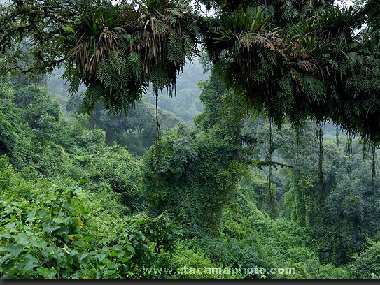
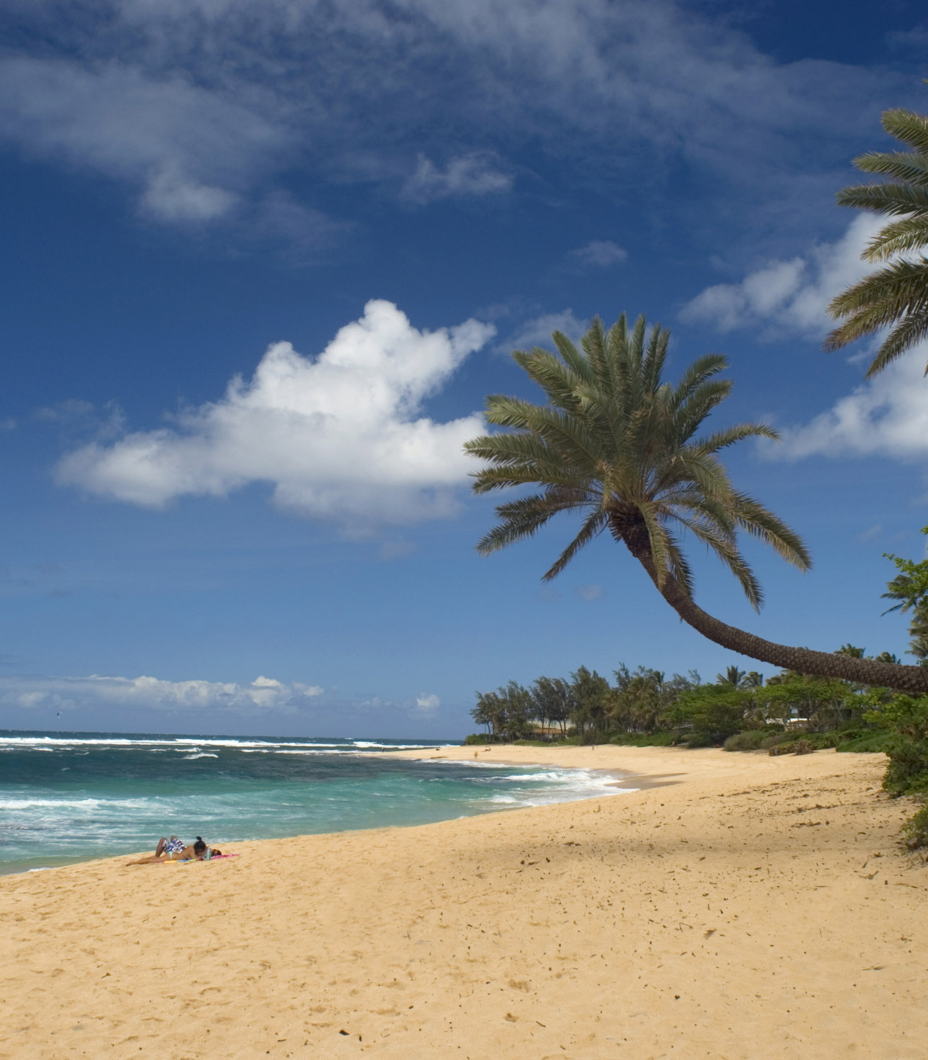
Tropical climate zone
Close to the equator
80 - 90 degrees all year long
Low latitude climate
This Photo by Unknown author is licensed under CC BY-NC.
This Photo by Unknown author is licensed under CC BY.

Slide 3
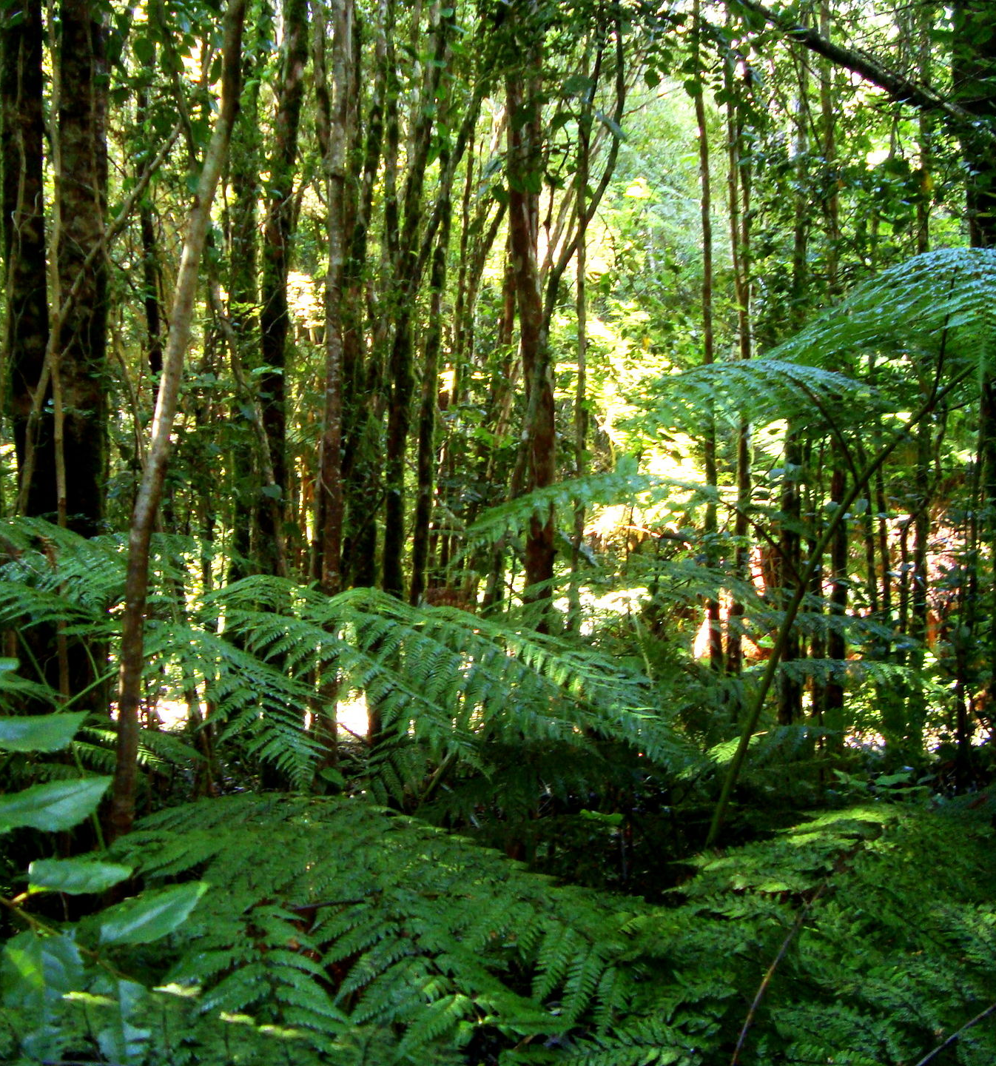
Temperate climate zone
It's warm there in the summer and cool in winters.
It's not too hot or cold .
These are mild climates.
This Photo by Unknown author is licensed under CC BY.
This Photo by Unknown author is licensed under CC BY.
This Photo by Unknown author is licensed under CC BY-SA.
This Photo by Unknown author is licensed under CC BY-SA.

Slide 4
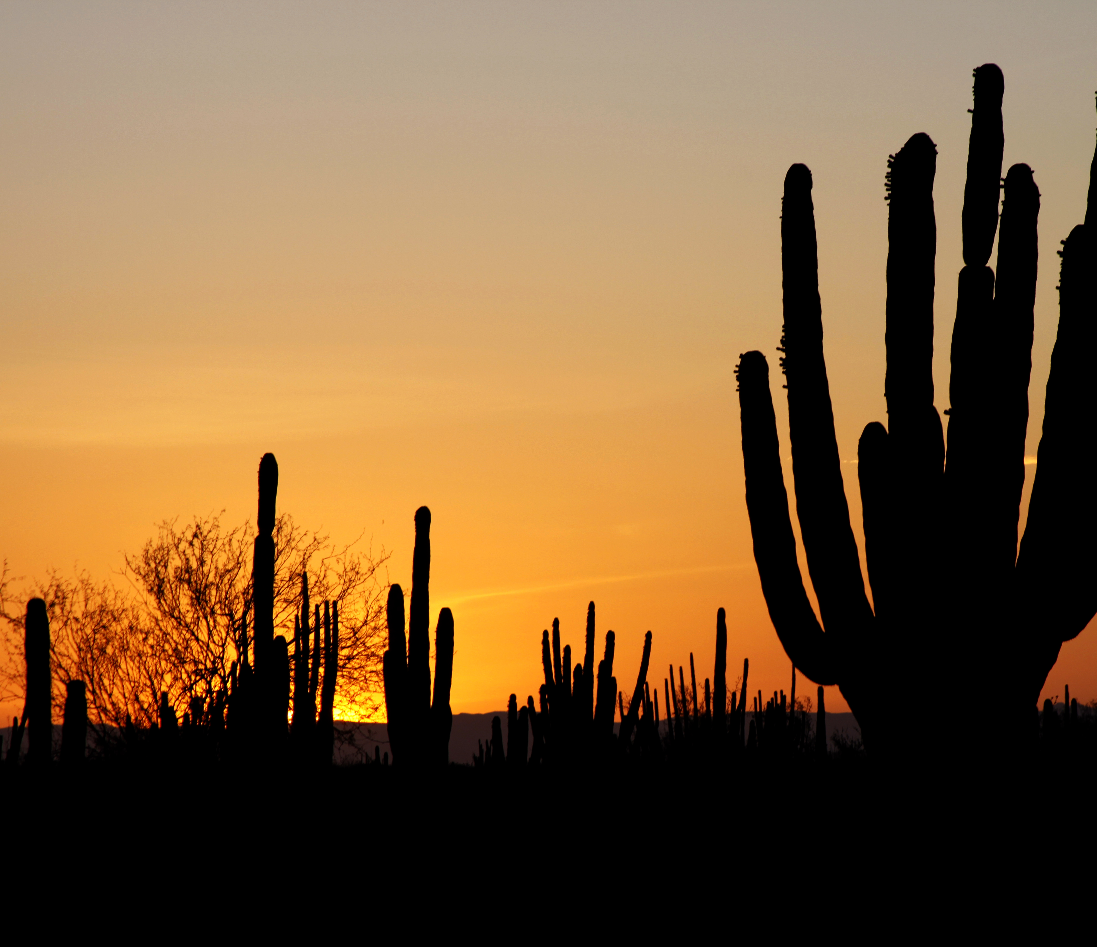
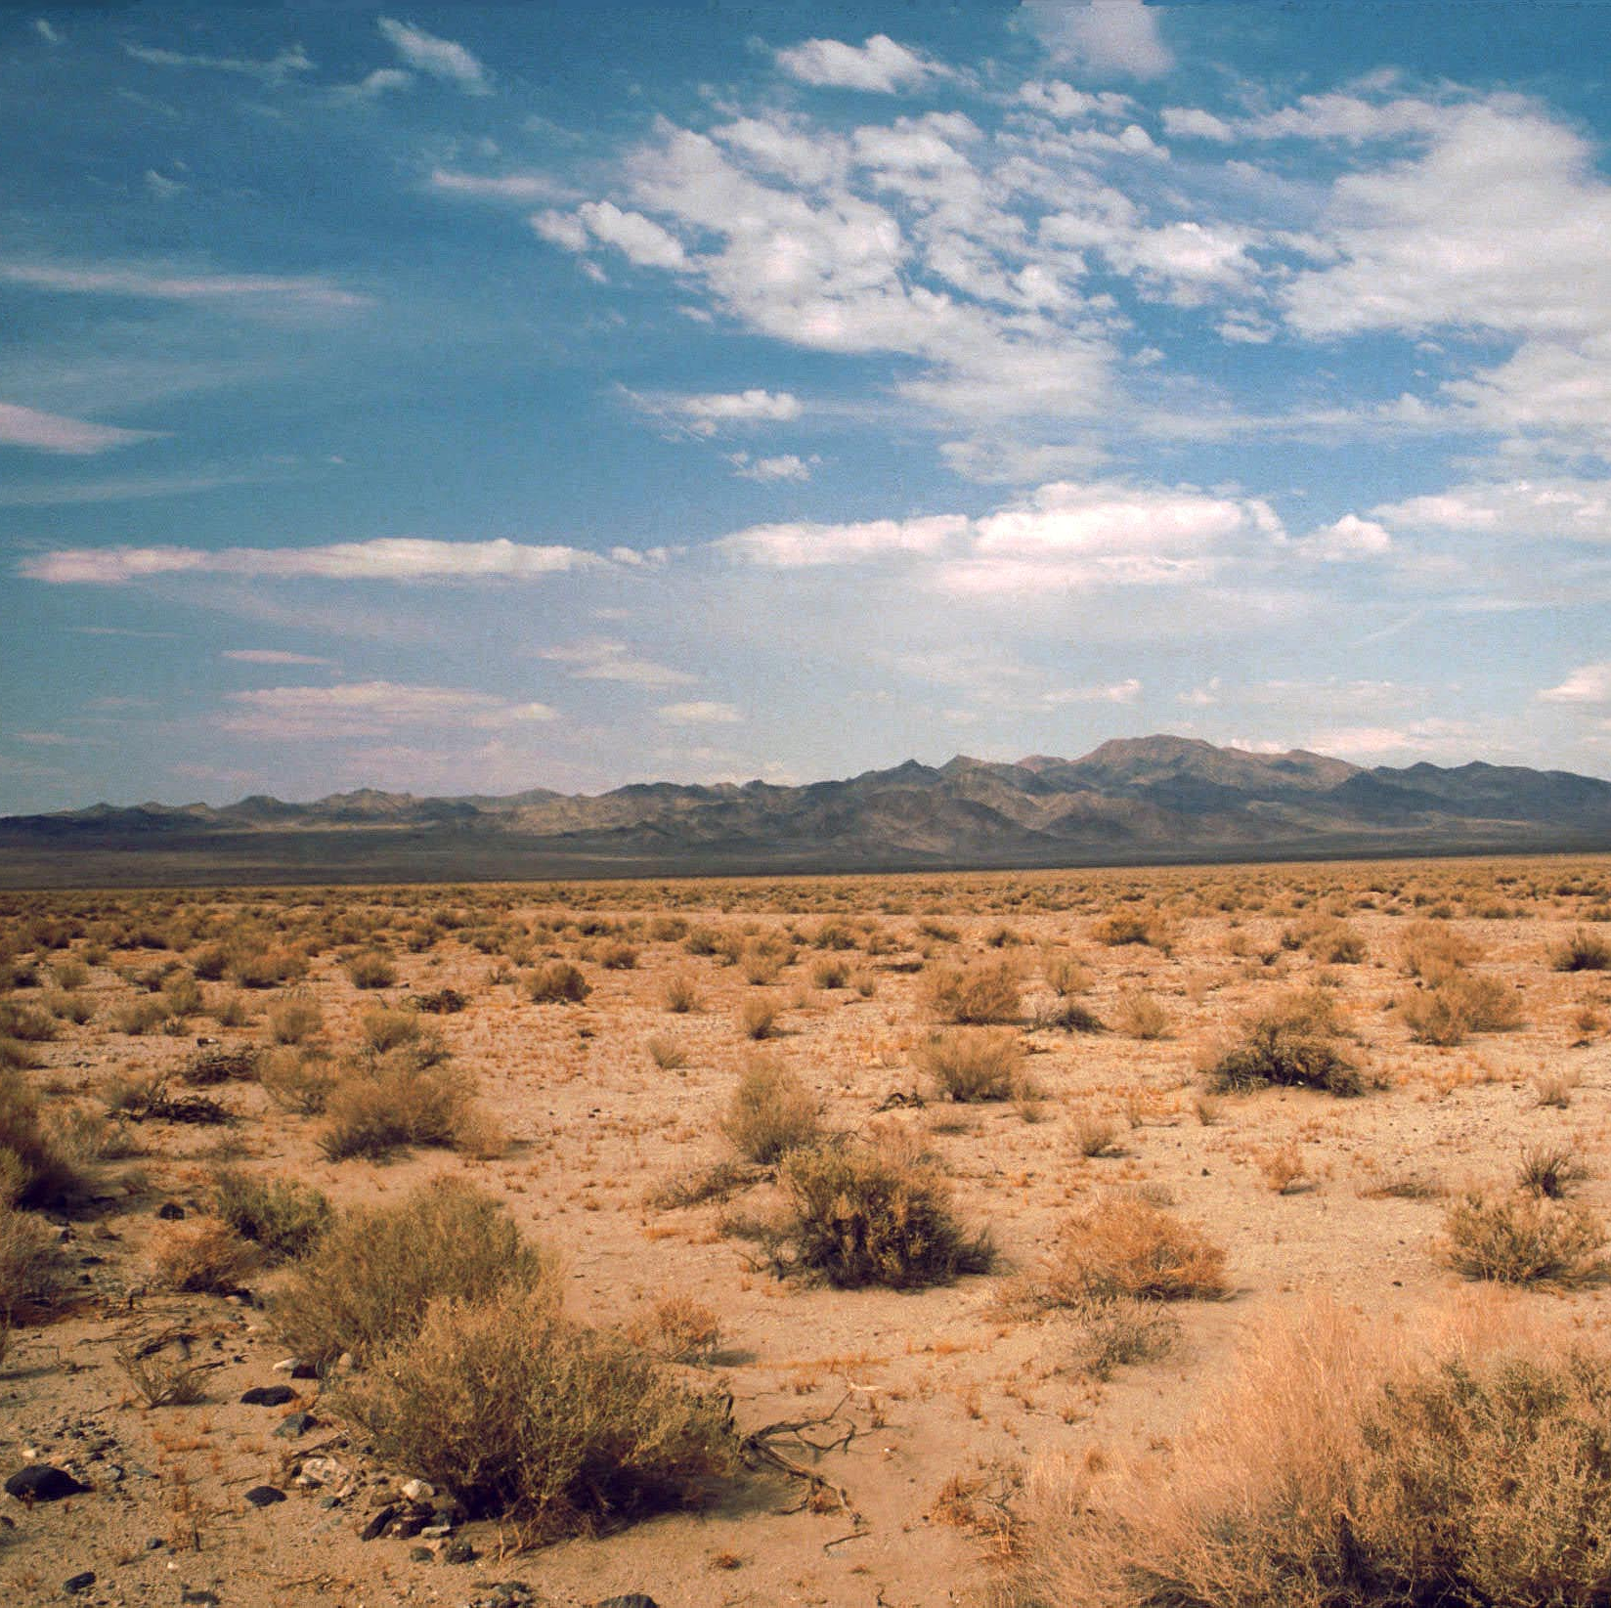
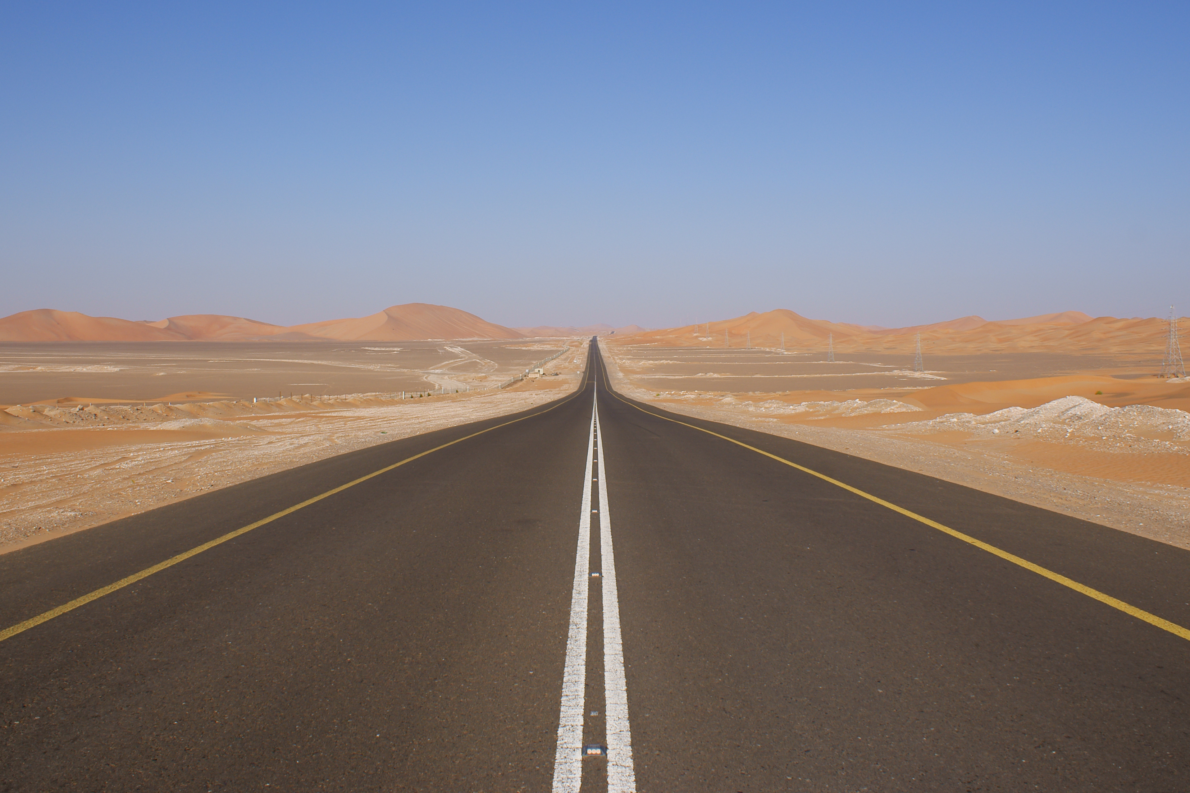
Desert Climate Zone
Most of the time deserts are hot.
Plants barely grow over there.
Plants don’t grow their because there is barely any rain.
At night it gets very cold.
This Photo by Unknown author is licensed under CC BY-SA.
This Photo by Unknown author is licensed under CC BY-SA.
This Photo by Unknown author is licensed under CC BY-SA.
This Photo by Unknown author is licensed under CC BY-SA.

Slide 5
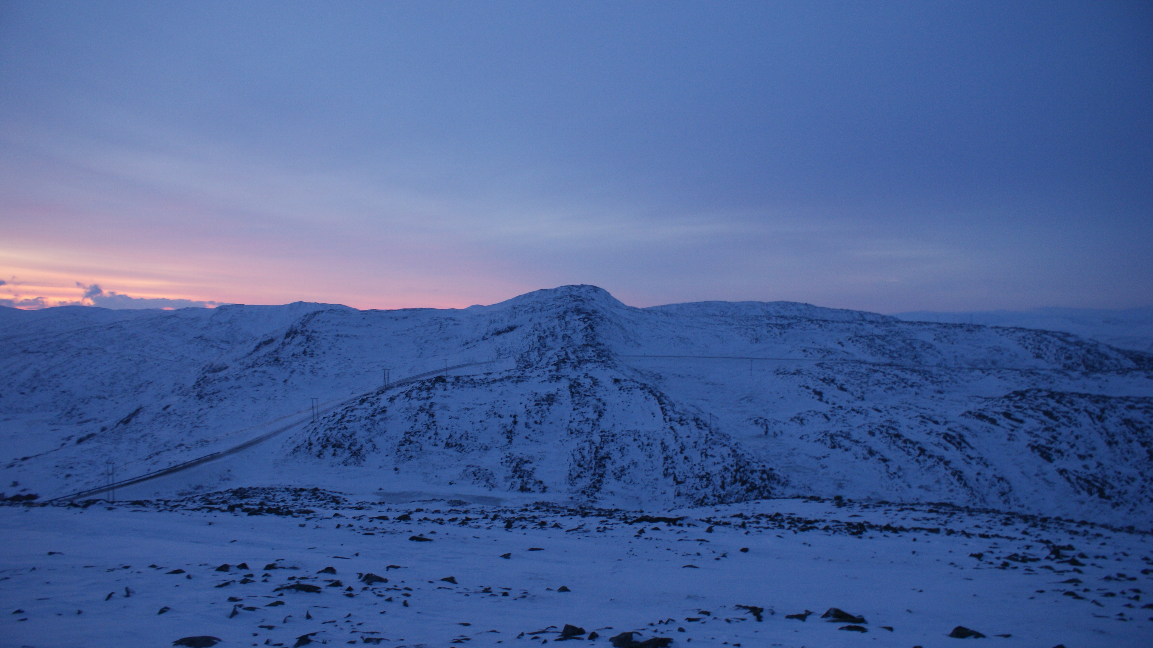
Polar Climate Zone
The climate is cold.
And it can be dangerous.
It is very cold for people, but not for polar bears .
This Photo by Unknown author is licensed under CC BY-NC-ND.

Slide 6
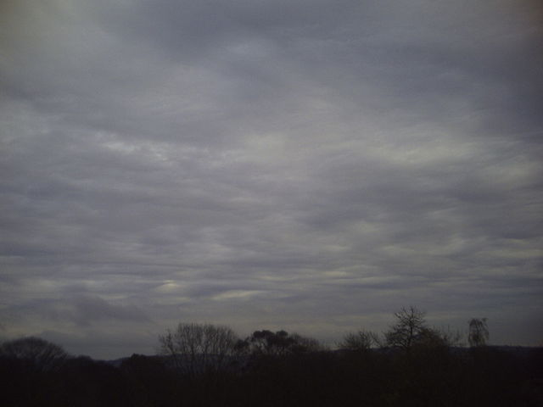
Stratonimbus Clouds
The stratonimbus clouds have a lot of rain.
It can last all day.
This Photo by Unknown author is licensed under CC BY-SA.
This Photo by Unknown author is licensed under CC BY-SA.
This Photo by Unknown author is licensed under CC BY-SA.

Slide 7
Cumulus Clouds
They are very puffy and tall .
They are not storm clouds
This Photo by Unknown author is licensed under CC BY-SA.
This Photo by Unknown author is licensed under CC BY-SA-NC.
This Photo by Unknown author is licensed under CC BY-SA.

Slide 8
Cumulonimbus clouds are storm clouds.
Can rise to 20 km into the sky –that's over 12 miles!
A single cloud can weigh up to one million tons.
This Photo by Unknown author is licensed under CC BY-SA.
This Photo by Unknown author is licensed under CC BY-SA.

Slide 9
Stratus Clouds
Thick low sheet like clouds that cover the sky . It a dense shapeless blanket of clouds.
This Photo by Unknown author is licensed under CC BY-SA.

Slide 10
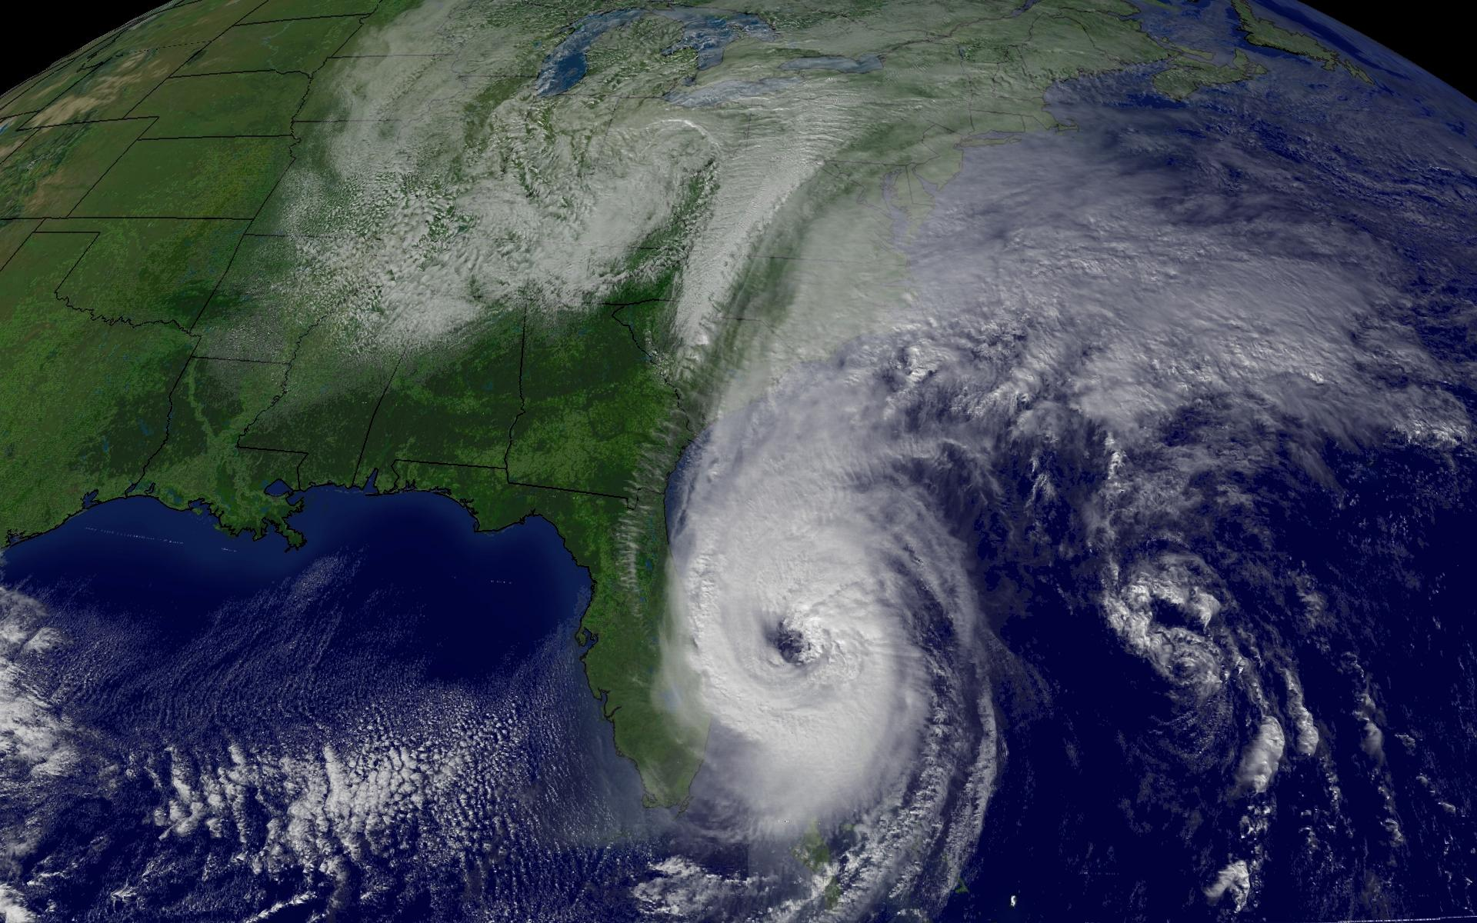
Extreme Weather - Hurricanes
A hurricane begins as a tropical storm, but it begins to pick up water.
When hurricanes are out at sea ,they cause little damage.
They are very destructive as they bring heavy rain, storms and wind.
This Photo by Unknown author is licensed under CC BY-SA.

Slide 11
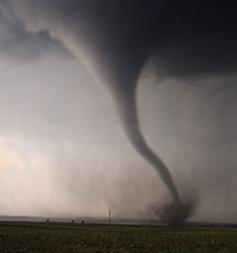
Extreme Weather Tornado
Tornadoes form over flat land when warm wind meets with cool.
Rip apart homes
The EF5 hit Toplin, Missouri with had wind speed of 322
They are sometime called twisters.
They are one of the most violent storms of nature.
This Photo by Unknown author is licensed under CC BY-SA.

Slide 12
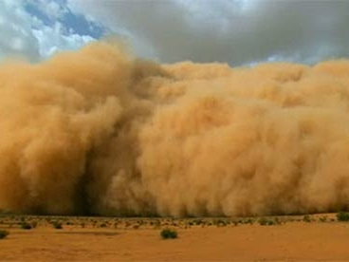
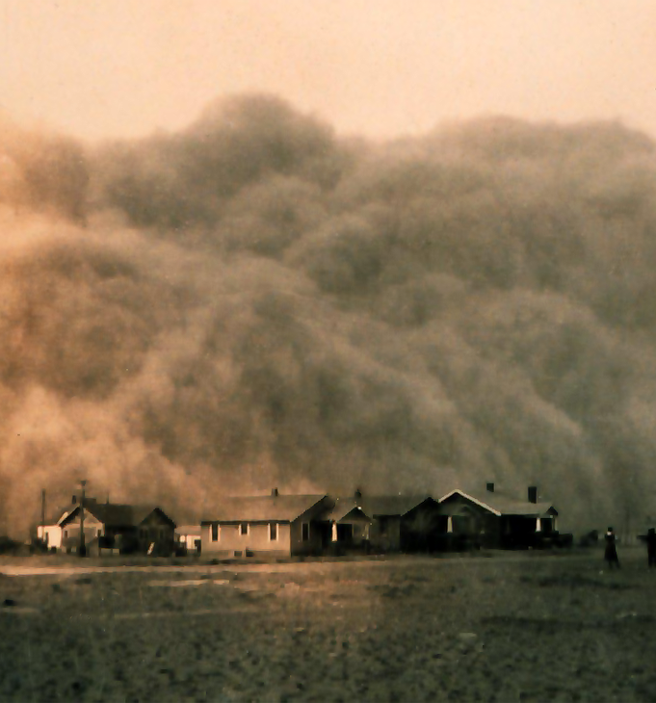
Dust Storms
A dust storm is a meteorological phenomenon common in arid and semi-arid regions.
Can hurt or kill people .
Cannot breathe in the middle of a dust storms.

