Slide 1
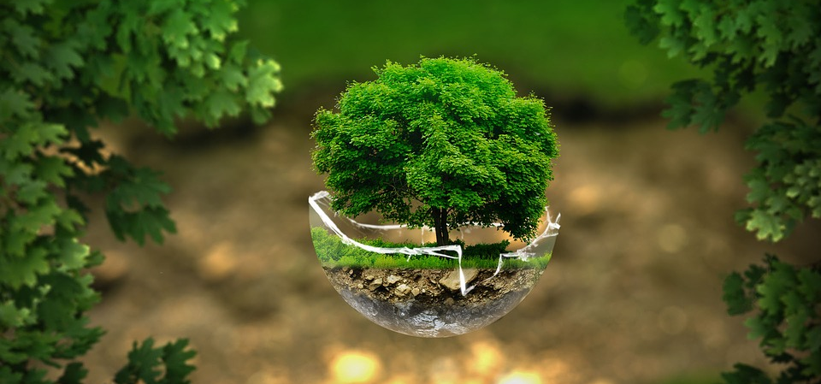
Ecology Notes Pages 1-7
By Janie Period 3

Slide 2
-Science- page 1
True
Helpful
Inspiring
Necessary
Kind
/20 not graded
18/20 your grade
0/20 not turned in
To: f_last@stu.chino.k12.ca.us
CC:
Subject- Class Expectations
Dear Student
Please log on early, be visible, engage and respond, THINK, and ask for help.
Thank you
Student
period
School email
Short subject
Message here,
Not in subject
Complete name
And period
This Photo by Unknown author is licensed under CC BY-SA.

Slide 3
Cell Theory page 2
All living things are composed of cells.
Cells are the basic units of structure and function in living things.
All cells are produced from other cells.
This Photo by Unknown author is licensed under CC BY-SA.

Slide 4
Cells page 3
nucleus
Cell wall
nucleus
Cell membrane
Cell membrane
vacuoles
mitochondria
chloroplast
cytoplasm
mitochondria
vacuole
cytoplasm

Slide 5
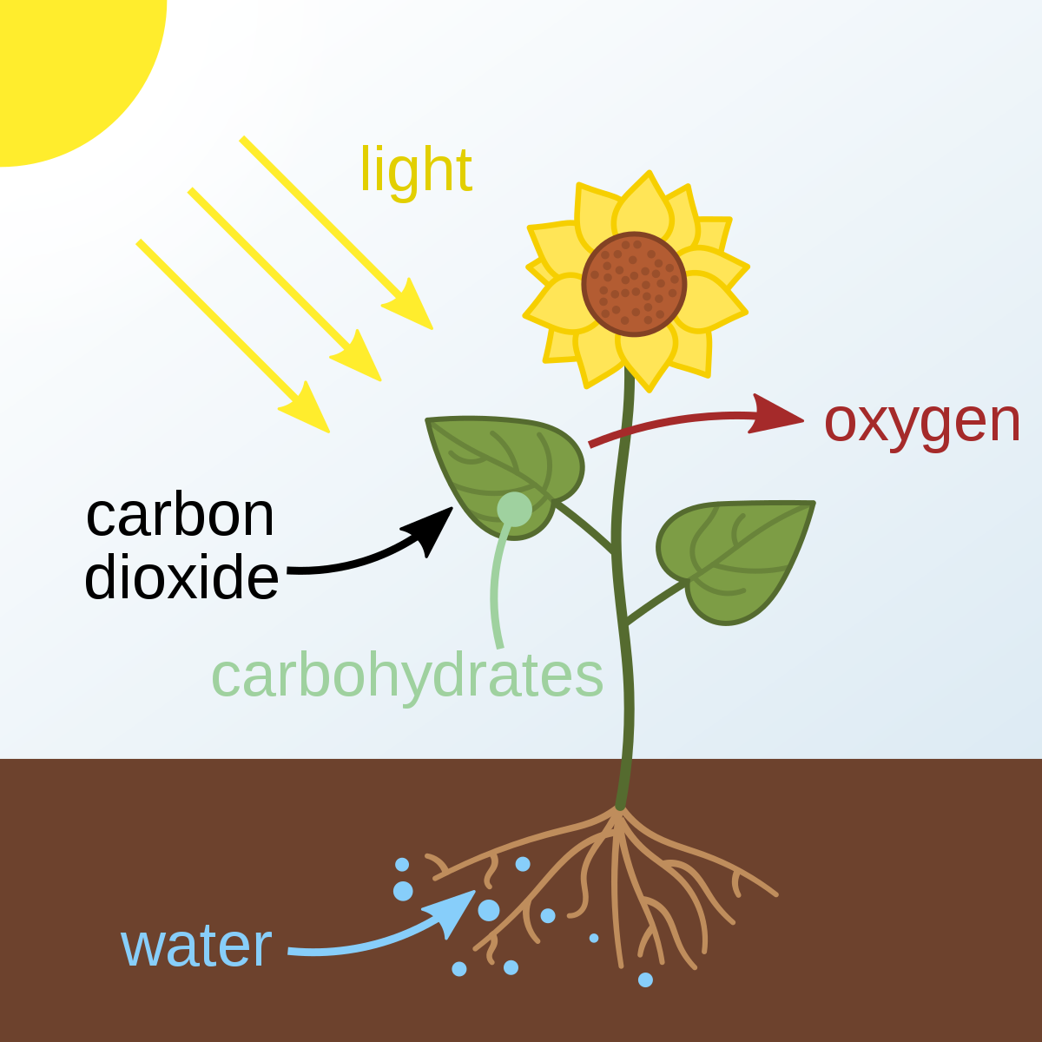
Photosynthesis page 4 part 1
6 CO2 + 6 H2O C6H12O6 + 6 O2
carbon dioxide plus water with sunlight yields glucose plus oxygen
+
CO2
CO2
H2O
CO2
H2O
O2
+
O2
CO2
H2O
+
CO2
O2
CO2
H2O
O2
CO2
C6H12O6
O2
O2
H2O
H2O

Slide 6
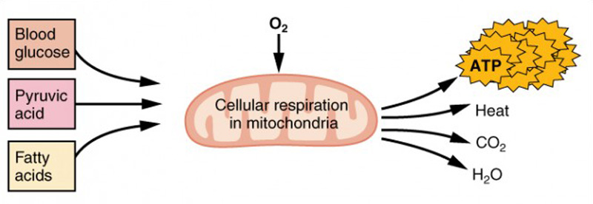
Cellular Respiration page 4 part 2
C6H12O6 + 6 O2 6 CO2 + 6 H2O (ATP)
Glucose plus oxygen yields carbon dioxide plus water with energy
CO2
H2O
H2O
O2
CO2
O2
CO2
H2O
H2O
+
+
O2
O2
CO2
C6H12O6​
CO2
CO2
O2
CO2
H2O
O2
H2O

Slide 7
Photosynthesis Cellular Respiration Cycle page 6
sunlight
oxygen
sugar
glucose
water
carbon dioxide

Slide 8
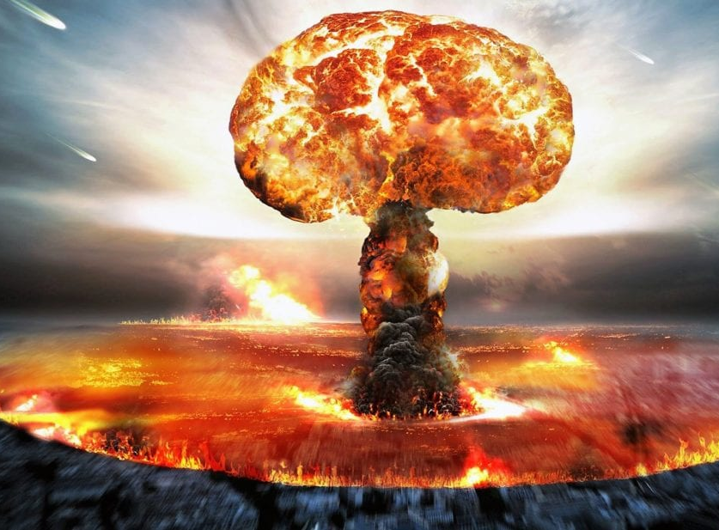
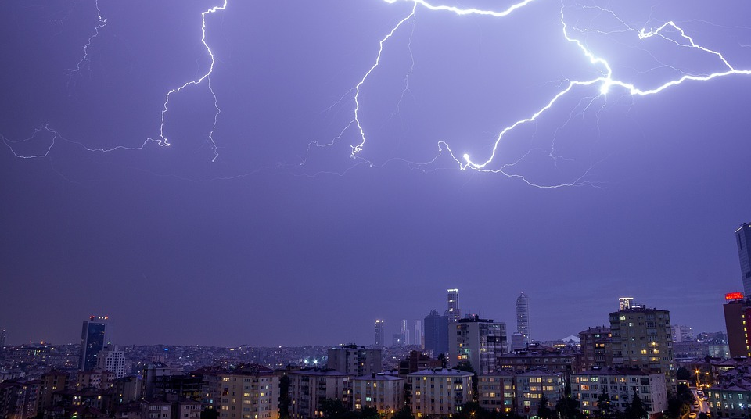
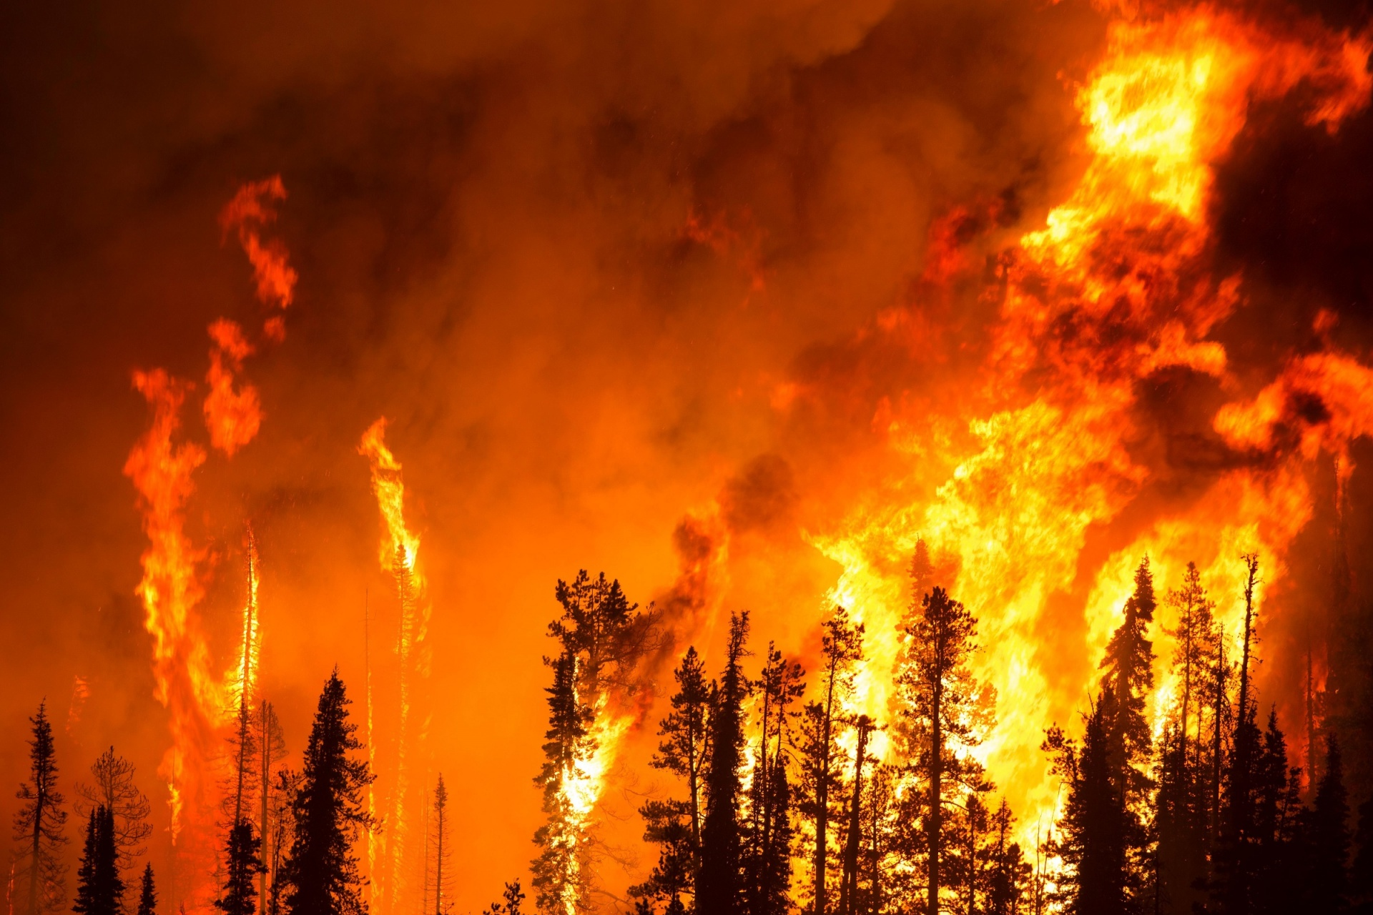
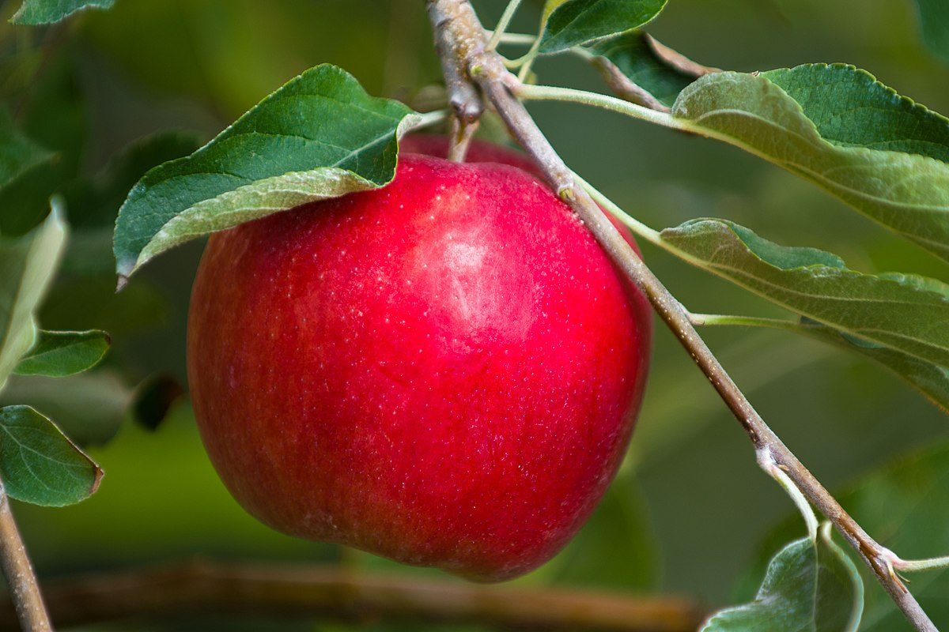
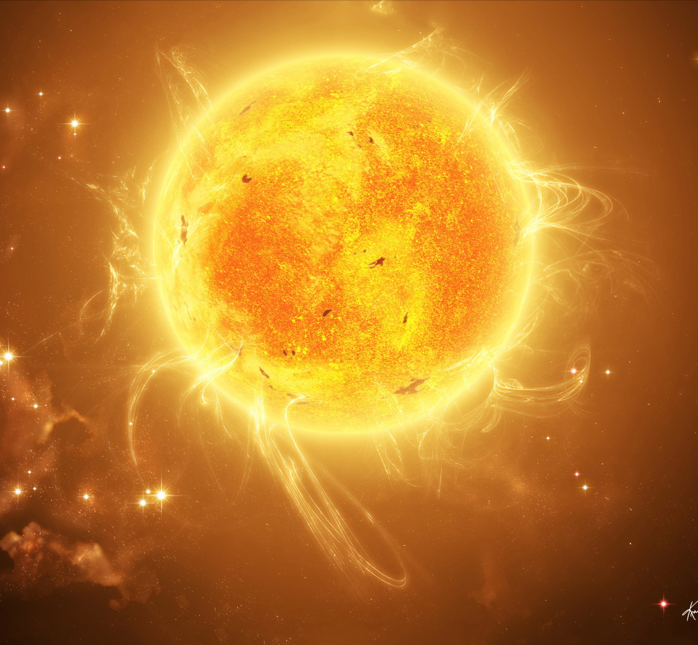
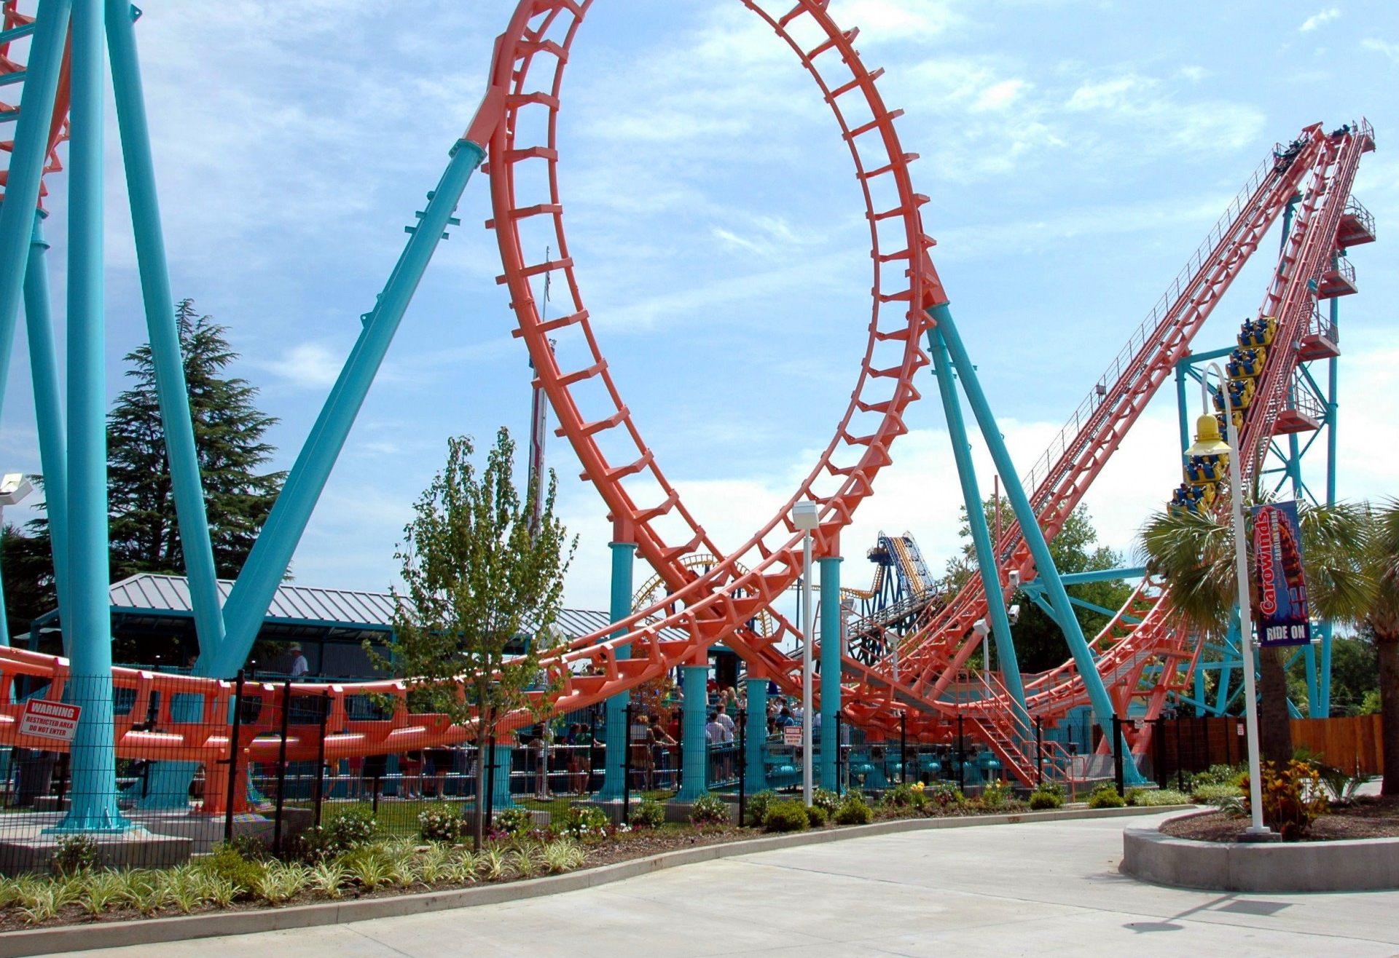
Energy... Page 7
is the ability to do work, transfer heat or cause change.
Mechanical
motion and position
Electrical
flow of electrons
Radiant
forms of light energy
Chemical
stored in bonds
Nuclear
splitting atoms
Thermal
heat

Slide 9
This must be the last page in the PowerPoint
Instructions
Turn your notes into a complete, detailed PowerPoint presentation. You must do more than just insert photos of your notes, but you may include the pictures you drew as part of your presentation. You may use internet pictures as well and you can be creative with the fonts and colors.

