Slide 1
Pomo Tribe
By Antonio and Kris

Slide 2
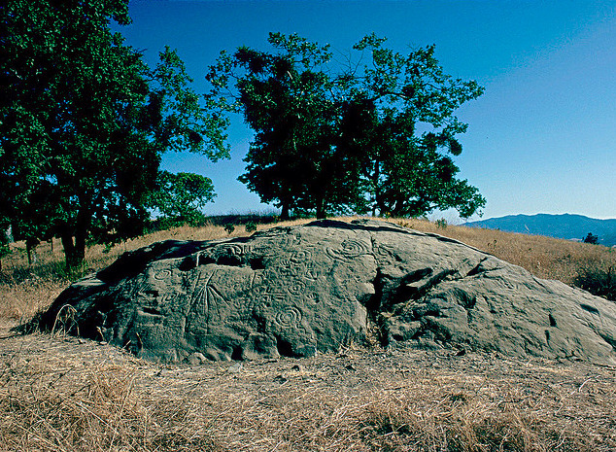
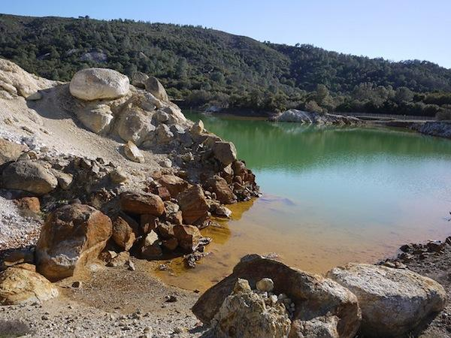
The Pomo's location
The Pomo's location was cool and wet.
The Pomo have up to seven villages.
The Pomo lived in central California from the Pacific Ocean to the Clear Lake.

Slide 3
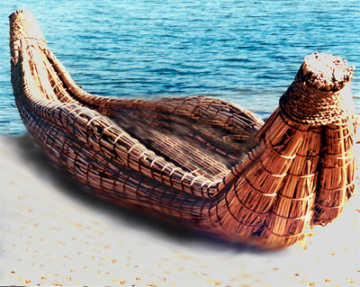
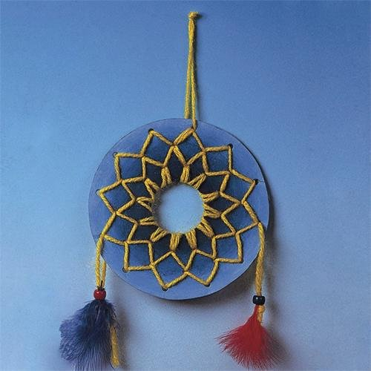
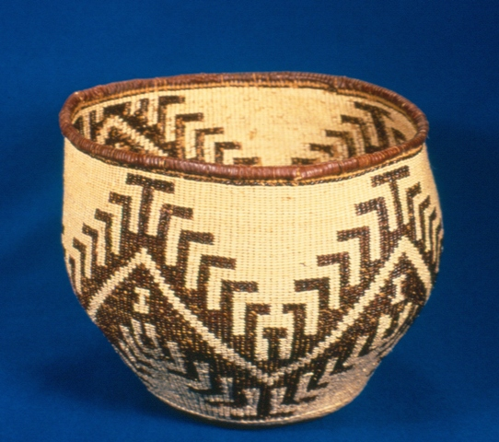
Their culture
They made feather baskets and beautiful jewelry.
After feast they dance and one dance they act like the dead.
They made banana shaped boats out of long grass.
They had dream catchers.

Slide 4
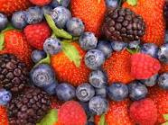
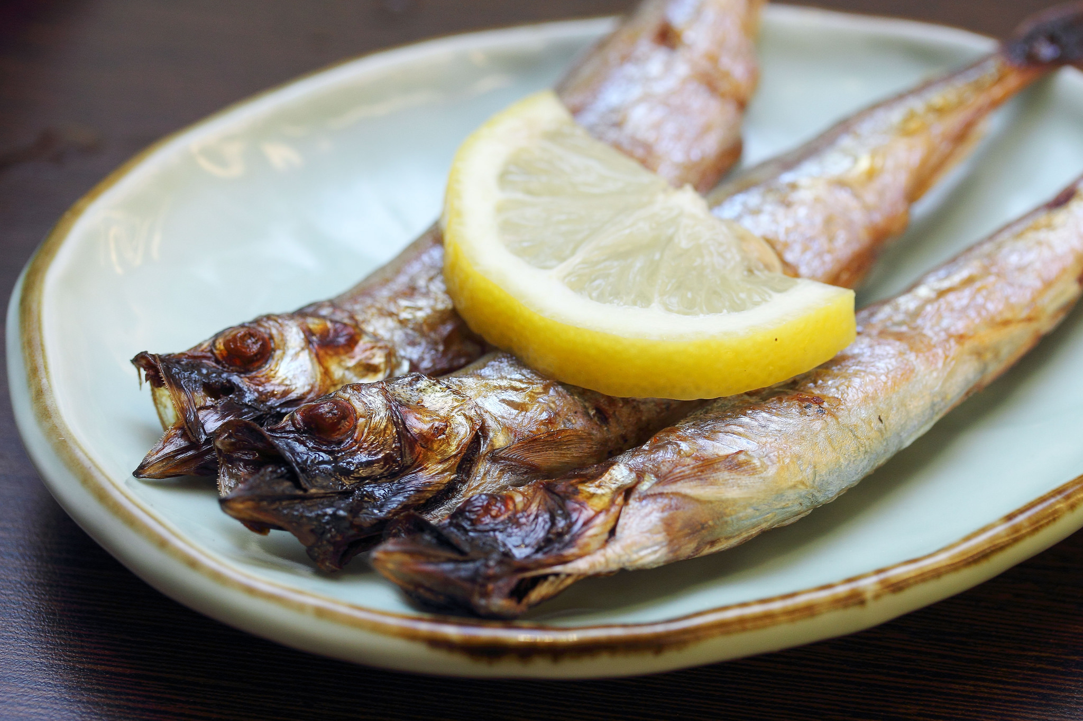
Pomo food
The Pomo ate dry seaweed, bass, and pike. The Pomo near the sea ate sea lion, shellfish, and seal.
The Pomo men hunted deer, elk, antelope, grass hoppers, caterpillars, and fresh water fish.
Notes:
re

Slide 5
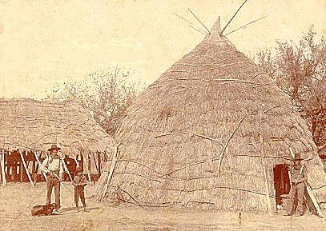
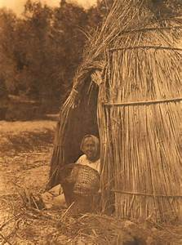
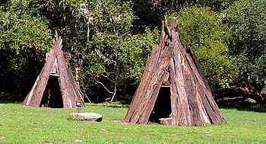
Shelter
Some used grass to cover a home and there home was
built over a hole.
The tules were tied into bundles then tied to poles that made circular shapes.
The ones near the sea had cone homes.
Notes:
omes

Slide 6
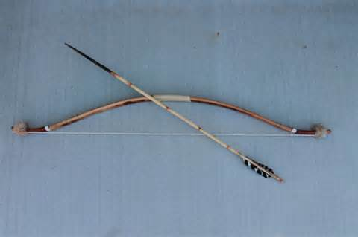
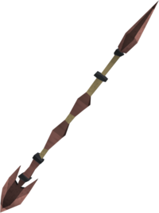
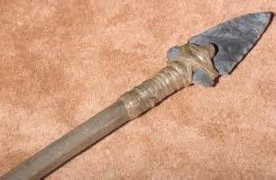
Tools and weapons
The weapons were made out of stone, sticks, and string.
The weapons were spears, bows, and knives.

