Slide 1
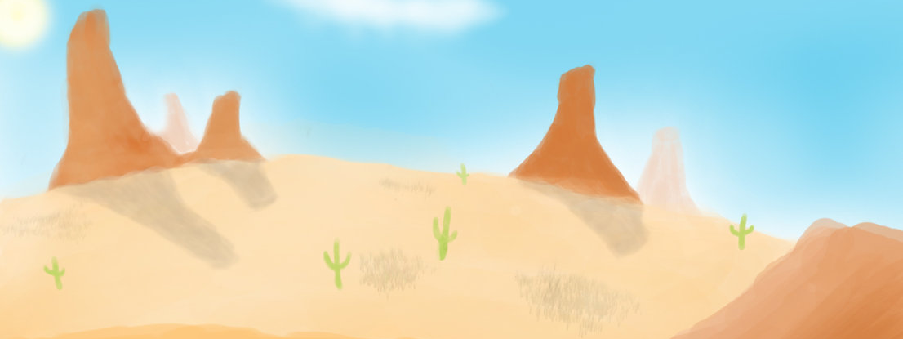
Mojave of the Southern Desert
By .Isaiah and Ezekiel

Slide 2
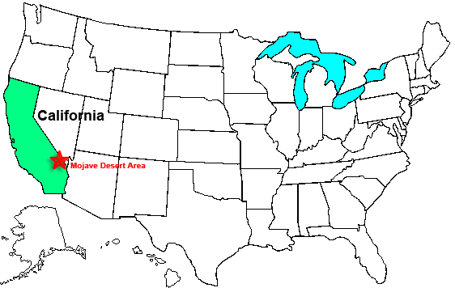
Location
Live in the Southern part of California
Along the Colorado River
They lived in Arizona and California
They had hot summers and mild winters

Slide 3
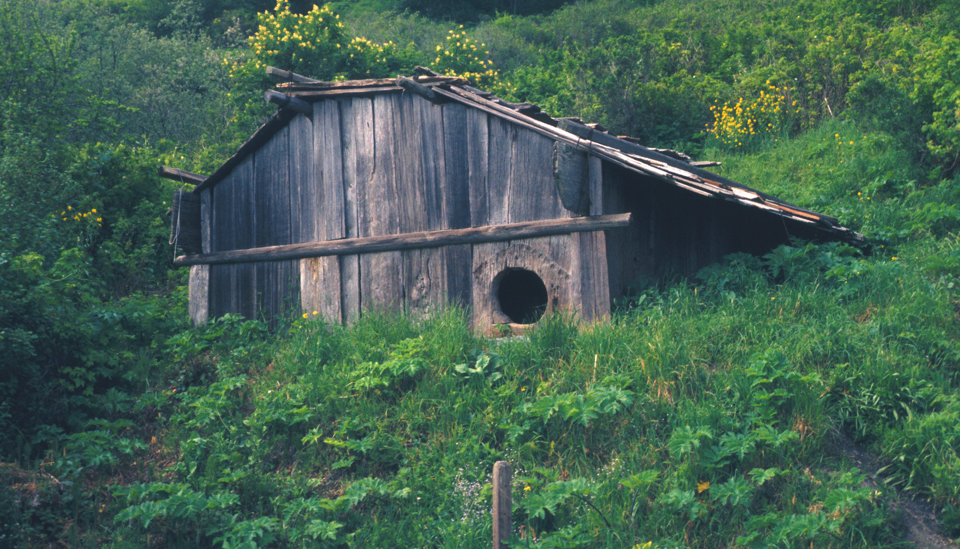
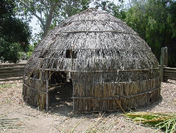
Shelter
When it got cold families got together in one house
They had houses from bundles of grass and mud
They usually just have shade roofs called ramadas

Slide 4
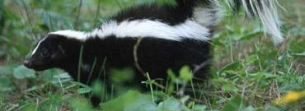
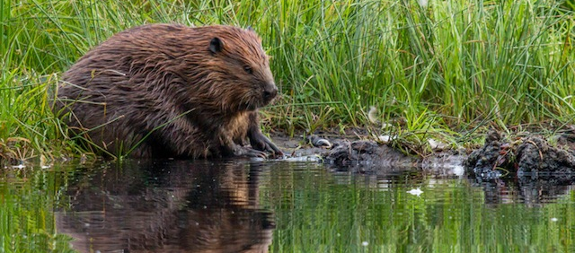
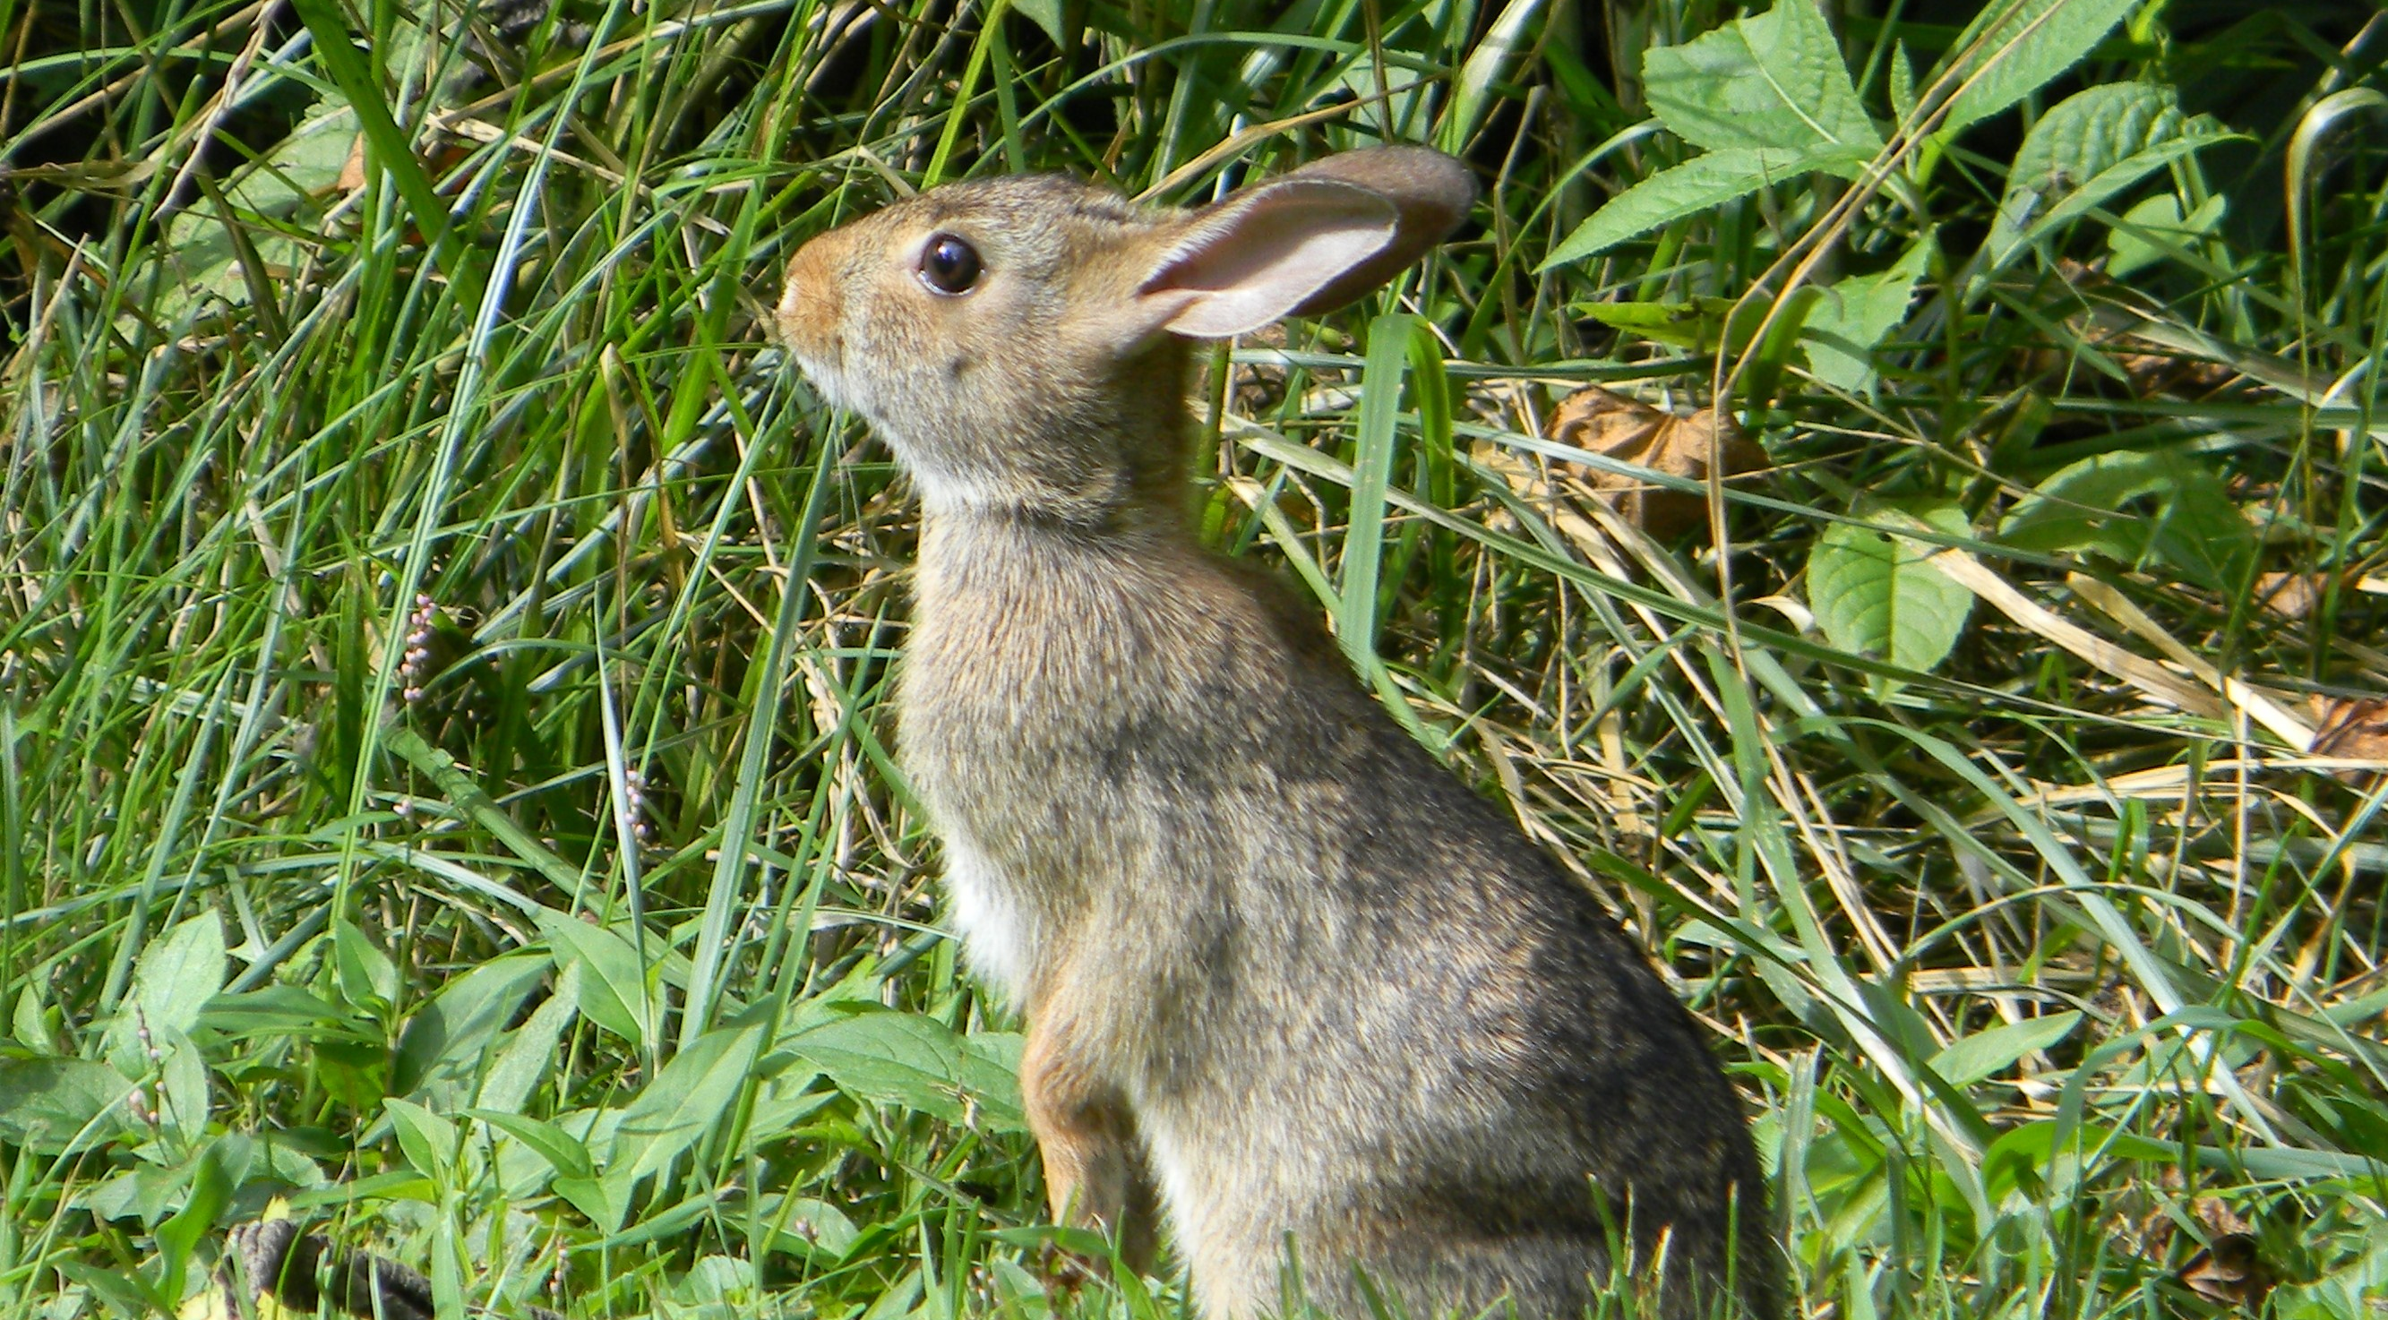
Food
They hunt rabbits, skunks, and beavers.
They gathered bean,corn, and pumpkins.
They use baskets to catch fish.

Slide 5
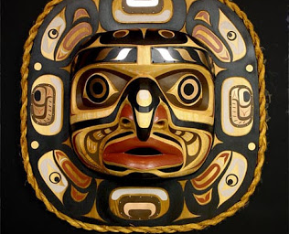
Culture
They make their tools out of wood.
They make their tattoos out of blue
cactus plant
They have a ceromnies every Fall

Slide 6
