Slide 1
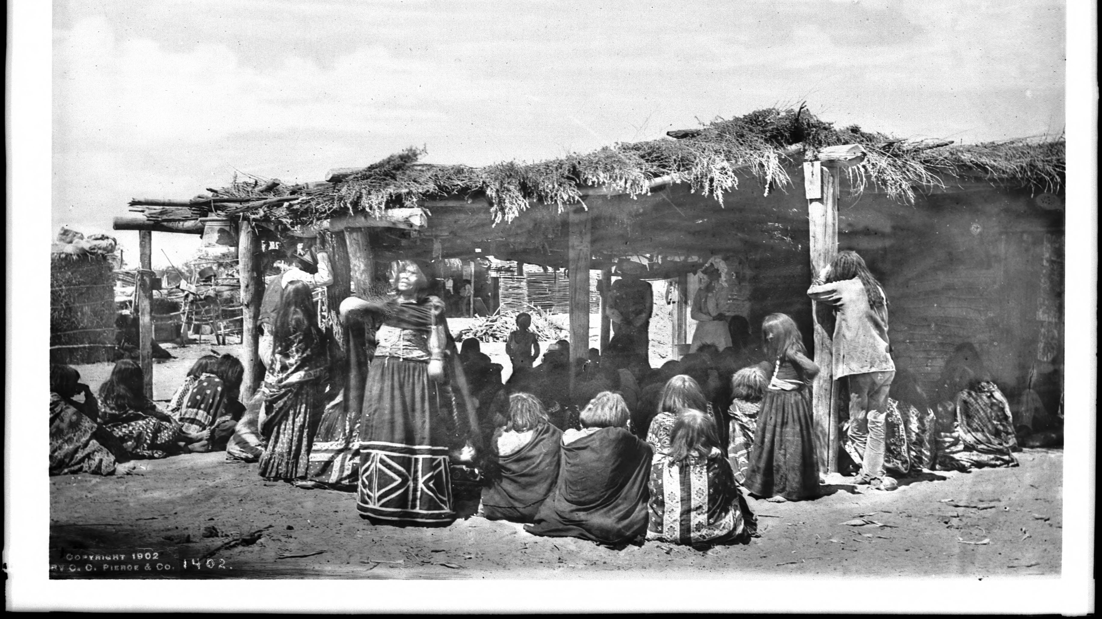
Mojave tribe
By
Maritza and
Armando

Slide 2
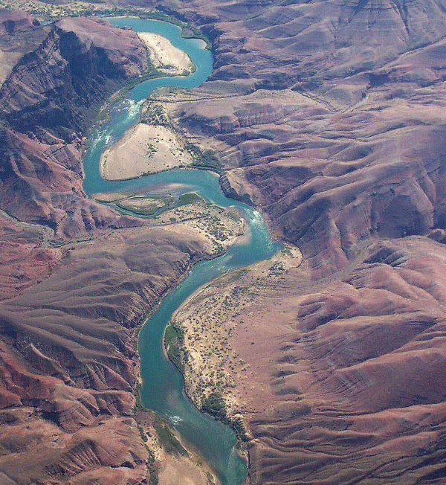
Location
They lived near the bank of Colorado River
They also lived in Southeastern California , San Bernarndino , and Eastern Imperial county
Southwestern Arizona , Mojave desert, and the east of Colorado River

Slide 3
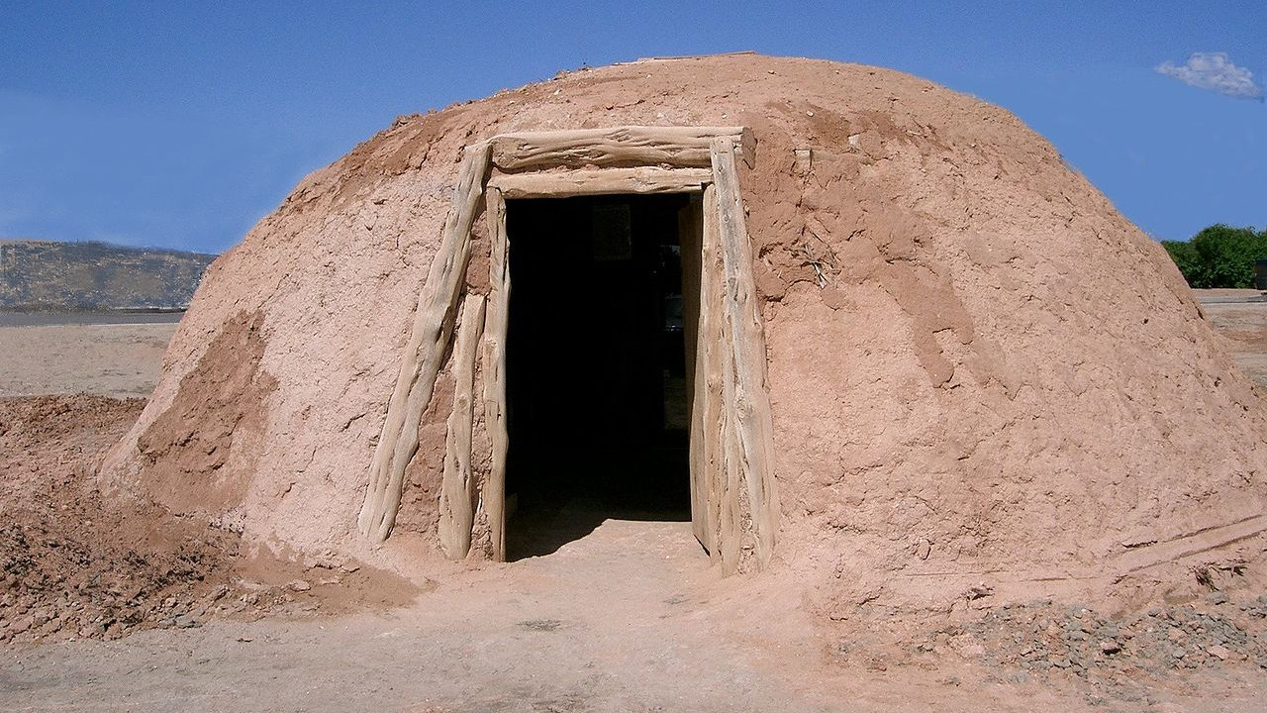
Shelter
Their houses were open on the sides with slanted roofs
Six poles supporting a flat roof covered with bundles of reeds or grasses , called a ramada
The houses had side walls made from poles slanting from the ground.
Made houses from red wood planks or cotton wood planks

Slide 4
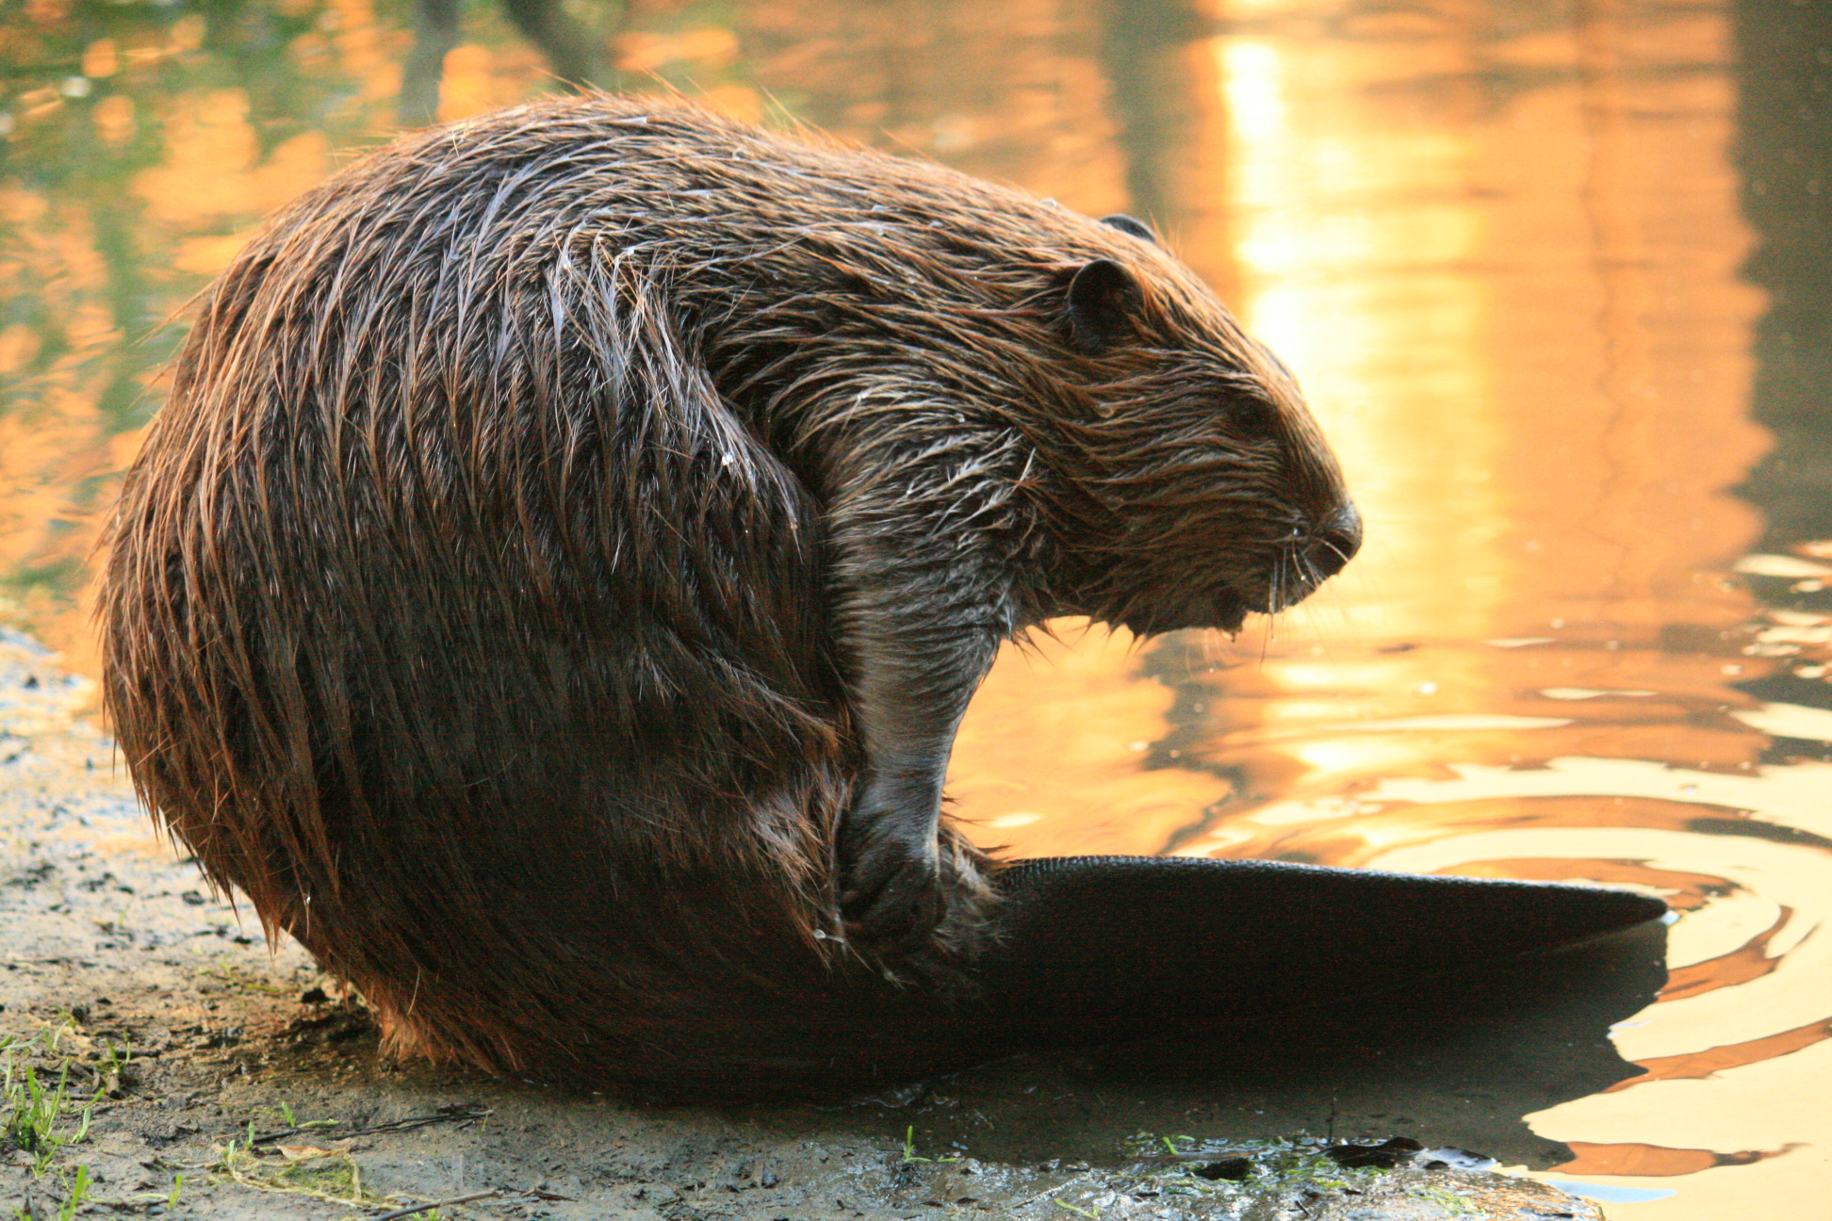
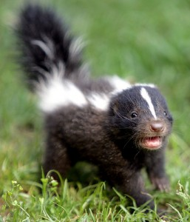
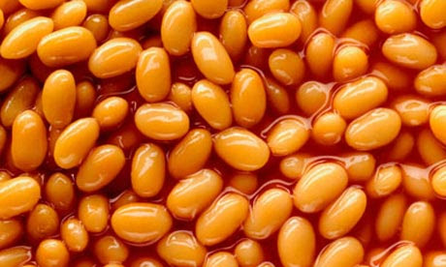
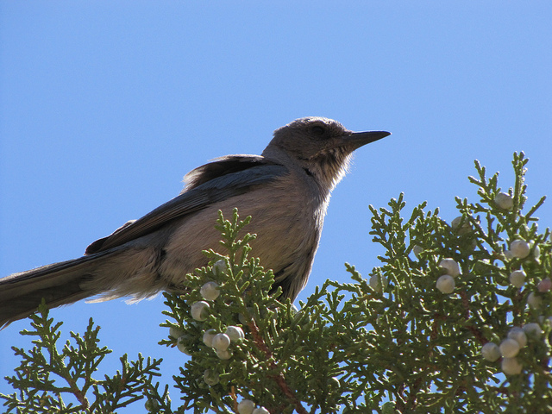
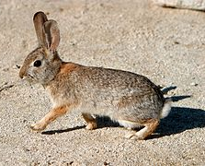
Food
The Mojave indians planted beans, corn , and pumpkins . They are farmers
They fished in the Colorado river with traps and nets
They trapped small animals such as rabbits , skunks , and beavers to eat

Slide 5
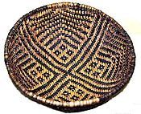
Culture
The Mojave tribe makes baskets out of grasses
Each indian has a job such as a fisher , hunter , and farmer
The people moved closer to the river in the late spring and summer
Women carried logs on their backs in nets bags attached to rough
Wooden frames supported by a band across the forehead

