Slide 1
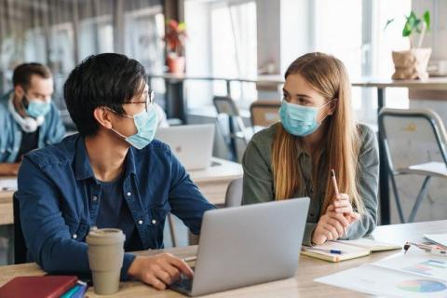
COVID-19 Back to School Basics for Secondary Students
Created by: Sherry Ma, MHA, BSN,RN,PHN
School Nurse

Slide 2
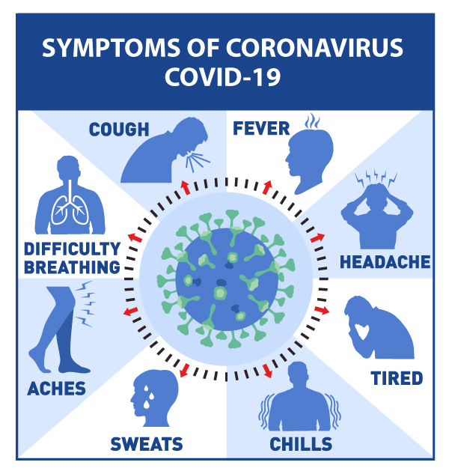
What is COVID-19?
A disease caused by a new coronavirus
It is mainly spread from person-to-person
Notes:
Most people have mild to no symptoms
A minority of people have severe symptoms that require hospitalization
Mainly Spreads person to person
Between two people who are in close contact
Respiratory droplets from a cough, sneeze, singing or talking.
Symptoms include:
• Fever (100.0 or greater) • Nausea
• Stomachache • Diarrhea
• Headache • Fatigue
• Runny nose • Congestion
•Sore throat • Loss of taste or smell
• Muscle/body aches • New and persistent/
•Shortness of breath and/or uncontrolled cough
difficulty breathing

Slide 3
What is Being Done About COVID-19?
Scientists and doctors are working every day to learn about COVID-19
They are working hard to keep us safe
Notes:
You hear a lot about COVID-19 because it is a new illness.....

Slide 4
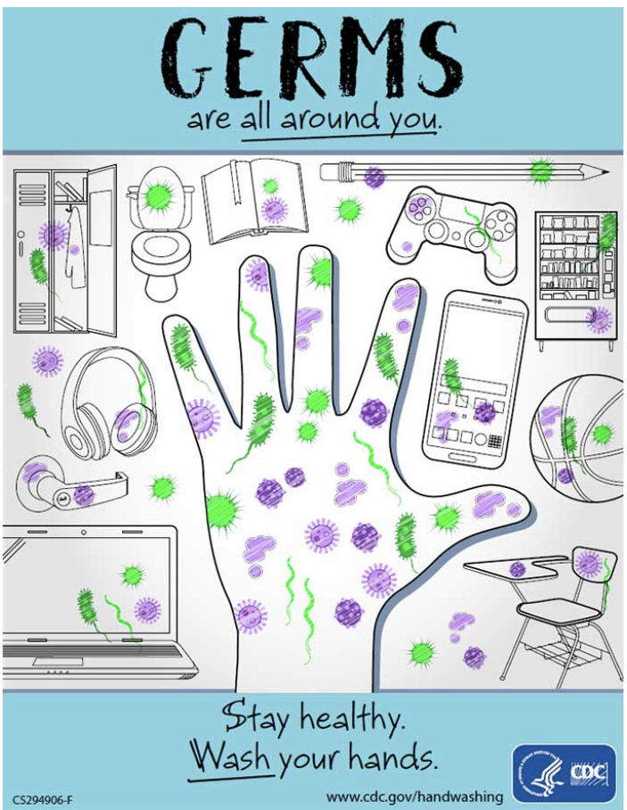
It Starts with Good Hand Hygiene
Hand washing is the first line of defense
Wash hands with soap and water for at least 20 seconds or use hand sanitizer that is at least 60-70% ethyl-alcohol based
Notes:
When you should wash your hands?
After physical contact with people who are ill
Before, during, and after food prep
Before eating food
After touching garbage/trash
Before touching your eyes, mouth, or nose
After using the toilet, assisting in the bathroom, or changing a diaper
After touching any high contact surfaces in public (i.e. gas pumps, credit card machines, doorknobs)
Before and after wearing gloves
Before putting on and after taking off a face mask

Slide 5
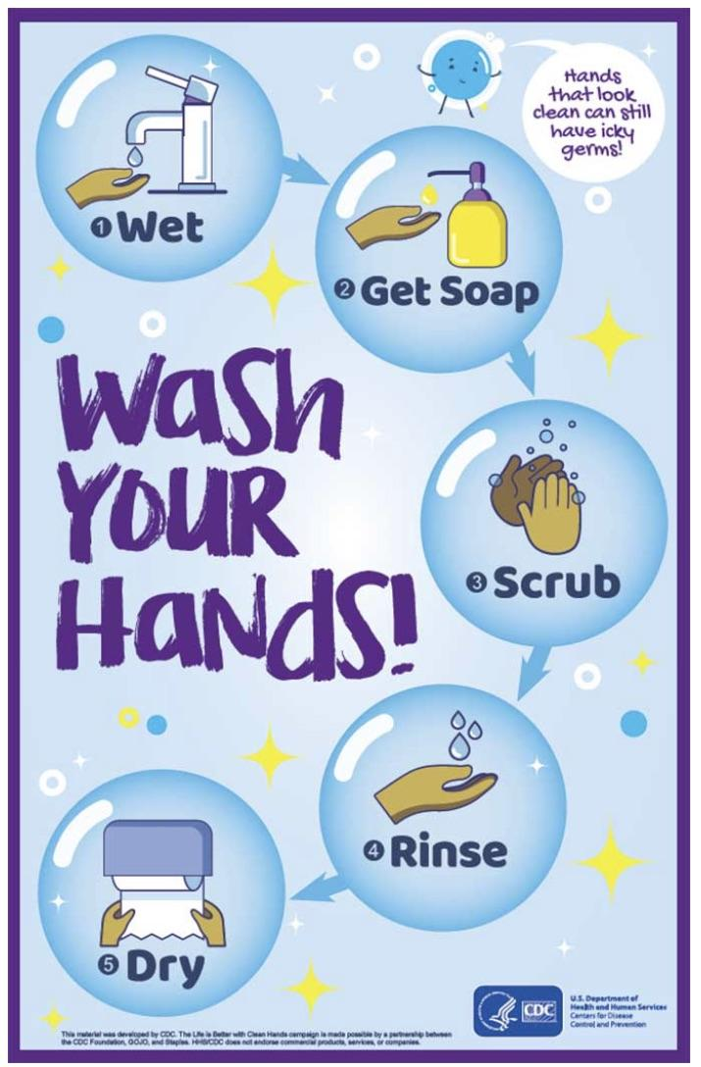
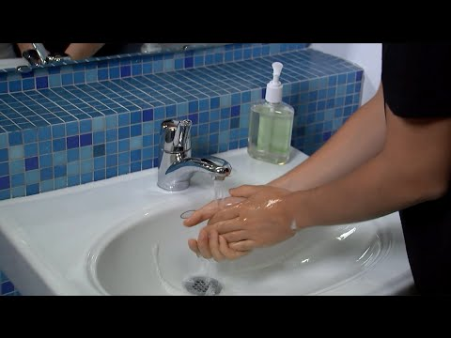
Washing Hands Saves Lives!
Video: https://youtu.be/eZw4Ga3jg3E

Slide 6
Social Distancing
Keep a safe distance to slow the spread
of the virus
Practice social distancing by putting
space between yourself and others
Stay about 2 arms’ length from other people
who are not from your household in both
indoor and outdoor spaces
Notes:
-Stay distanced while playing
-Keep Distance at gatherings with people
-Choose Safe Social Activities

Slide 7
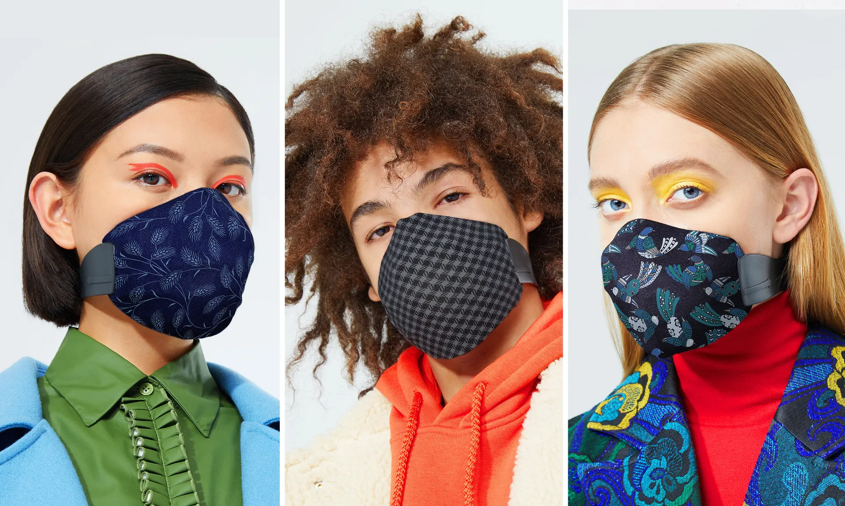
Mask Wearing, The New Fashion
Masks can help protect others from any germs that you might be carrying, even if you do not feel sick
Notes:
Do not use: Reference only https://www.theguardian.com/fashion/2020/jan/13/fashionable-face-masks-trying-to-make-something-horrific-seem-appealing#img-1

Slide 8
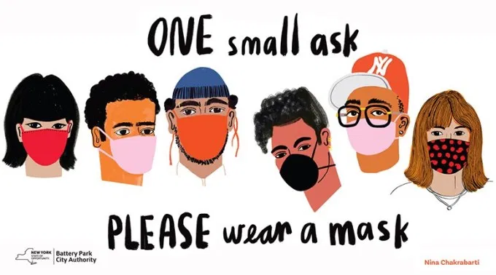
Mask Wearing 101
Wash your hands before putting on a mask
Masks with windows may be appropriate for
some people
Inspect the mask for tears or holes before
putting it on
Do not reuse masks that are damp or soiled
Notes:
Wash your hands if you accidently touch the mask while wearing it, and after taking off your mask
Mask with window may be appropriate for some people who communicate with sign language or who have facial expressions that signify oncoming seizure

Slide 9
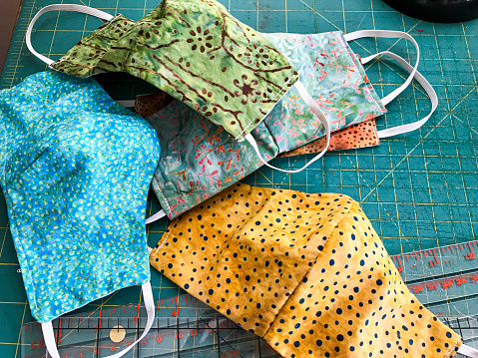
Wearing a Mask
Prevents spread of germs
Must be worn in school and classroom
settings
Worn in the absence of signs or symptoms
of illness
Should be at least two layers of cloth
Notes:
Prevents spread of germs from people who may be sick or do not have symptoms
Should be at least two layer
-Should cover your nose and mouth without large gaps around the side
-A metal piece bent over the bridge of the nose will help people with glasses prevent fogging
-Wash masks daily and when visibly soiled or wet
Do not use: Reference Only https://www.cnn.com/videos/us/2020/04/01/college-student-face-masks-deaf-hard-hearing-pkg-vpx.wlex

Slide 10
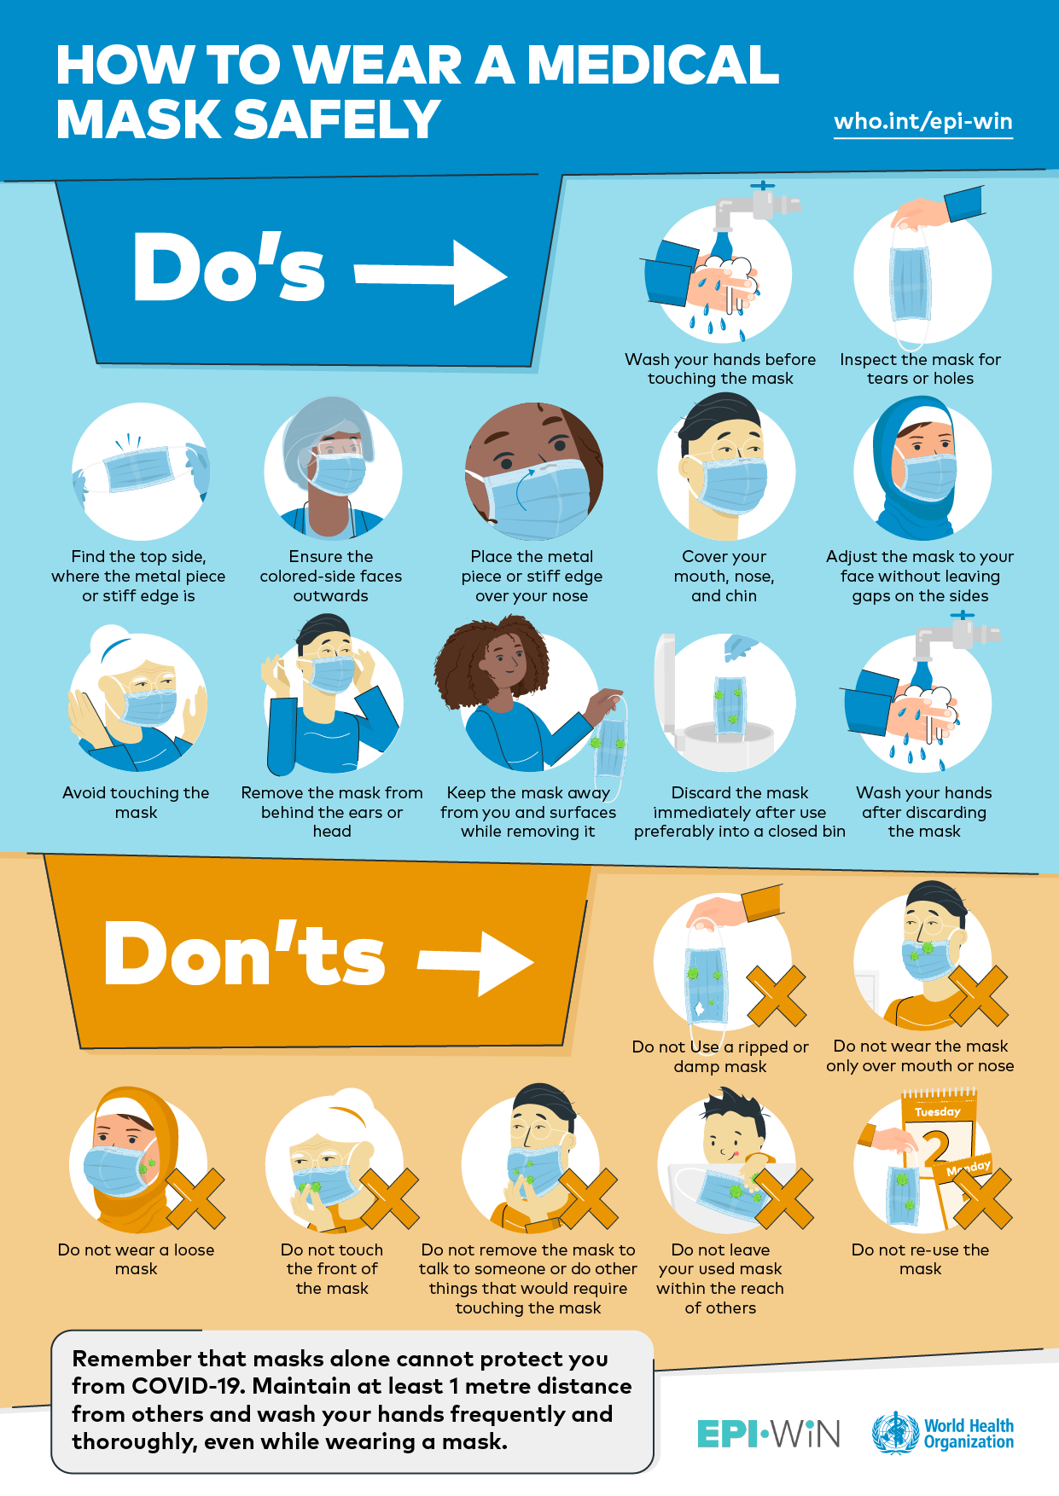
Masks and Keeping Yourself Safe
Do not touch your mask while wearing it
Follow these steps to remove your mask
Wash or dispose of your masks when visibly wet or soiled and daily
Notes:
Do not contaminate yourself while wearing your mask
-Don’t put the mask around your neck or up on your forehead
-Avoid touching the mask and wash your hands if you do
Do not contaminate yourself while removing your mask
-Grasp just the ties or the elastics at the ears or the back of the head
-Fold the mask with the outside corners together
-Be careful not to touch your eyes, nose or mouth and wash your hands
-Wash or dispose of masks when they become visibly wet or soiled and daily

Slide 11
What do I do if I become sick at school?
Report any symptoms to an adult on campus
Teacher
Coach
Administrator
School Health Office
They will direct you on what to do next

Slide 12
Resources
https://www.cdc.gov/handwashing/when-how-handwashing.html
https://newsnetwork.mayoclinic.org/discussion/how-to-take-your-temperature/
https://my.clevelandclinic.org/health/articles/9959-thermometers-how-to-take-your-temperature
https://www.fda.gov/medical-devices/general-hospital-devices-and-supplies/non-contact-infrared-thermometers
https://www.thenationalcouncil.org/covid-19-guidance-for-behavioral-health-residential-facilities/
https://youtu.be/M4olt47pr_o
https://www.medscape.com/viewarticle/931249?fbclid=IwAR072eaDCNowWkeX5ea2TDkS1341vF50kY-SvxwC9VzoKediJHgaG0aUEWQ
https://www.hopkinsmedicine.org/health/conditions-and-diseases/coronavirus/coronavirus-face-masks-what-you-need-to-know
https://www.cdc.gov/coronavirus/2019-ncov/community/schools-childcare/guidance-for-schools.html

