Slide 1
Committee Membership
Ch 5 sec 4

Slide 2
I. Purposes of Committees
Committees ease Congressional workload by dividing work among smaller groups, allowing members to specialize on key issues.
Committees allow members to discuss and select the most important bills Congress will consider.
Notes:
http://www.ashdown-eyes.co.uk/28dec4-j.JPG

Slide 3
I. Purposes of Committees
Committees hold investigative public hearings on key problems and issues to inform the public.
Committees allow Congress to examine and alter many more bills than they could if everything was done with the entire House or Senate debating each bill.
Notes:
http://www.edu.pe.ca/southernkings/Pictures/mt3.jpg

Slide 4
II. Kinds of Committees
Standing committees deal with certain issues continuing from one Congress to the next.
The majority party in each house controls standing committees and bases their membership on each party’s strength.
Notes:
http://www.wmonline.com/attract/lakes/woodland.jpg

Slide 5
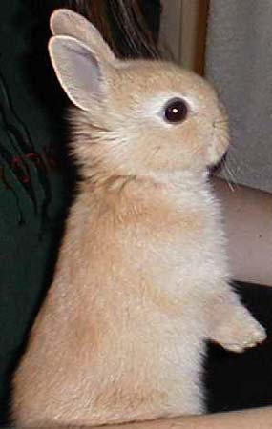
II. Kinds of Committees
Subcommittees handle special subcategories of standing committees’ work, and continue from one Congress to the next.
Select committees are special committees created in both houses of Congress, usually for one term only, to study a specific issue and report their findings.
Notes:
http://images.google.com/imgres?imgurl=http://www.4hccsprojects.com/rabbit/rabbit%25204.jpg&imgrefurl=http://www.4hccsprojects.com/rabbit/&h=281&w=400&sz=26&hl=en&start=20&tbnid=XT9-2wGn-JTZ1M:&tbnh=87&tbnw=124&prev=/images%3Fq%3Drabbit%26svnum%3D10%26hl%3Den%26lr%3D%26safe%3Dactive

Slide 6
II. Kinds of Committees
Joint committees are made up of members of both houses to act as study groups.
Conference committees are temporary committees set up to resolve the differences in the House and Senate versions of a bill by working out a compromise bill that each house then can accept or reject.
Notes:
http://www.chocolate-fondue-fountain.co.uk/images/SephraFount-MC%20brush%20edge%20web.jpg

Slide 7
III. Choosing Committee Members
Assigning members to various committees is a key decision in the organization of Congress.
Membership on certain committees:
Helps members build reputations and increase their chances for reelection.
Gives members a chance to influence important national legislation
Enables members to influence other members since those committees deal with issues that are important to all members

Slide 8
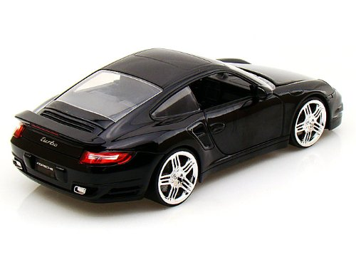
III. Choosing Committee Members
In both houses, both parties assign members to the standing committees.
The party leaders and chairpersons of the standing committees are the most important members of Congress.
Notes:
http://ecx.images-amazon.com/images/I/4175ZEJR3eL.jpg

Slide 9
III. Choosing Committee Members
Standing committee chairpersons make key decisions about the work of their committees, though their power has been reduced since 1970.
Seniority traditionally guided the election of chairpersons until the 1970s.
Notes:
http://newsimg.bbc.co.uk/media/images/40582000/jpg/_40582907_christmastree203.jpg

Slide 10
III. Choosing Committee Members
The most important standing committees in the House are the Rules committee, Ways and Means committee, and the Appropriations committee.
The most important standing committees in the Senate are the Foreign Relations committee, Finance committee, and Appropriations committee.
Notes:
http://brusimm.com/the-look-of-captain-americas-avenger-costume/

Slide 11
In your notebooks
Create a full page poster illustrating the kinds of committees, using pictures and descriptions to explain the different types.

