Slide 1
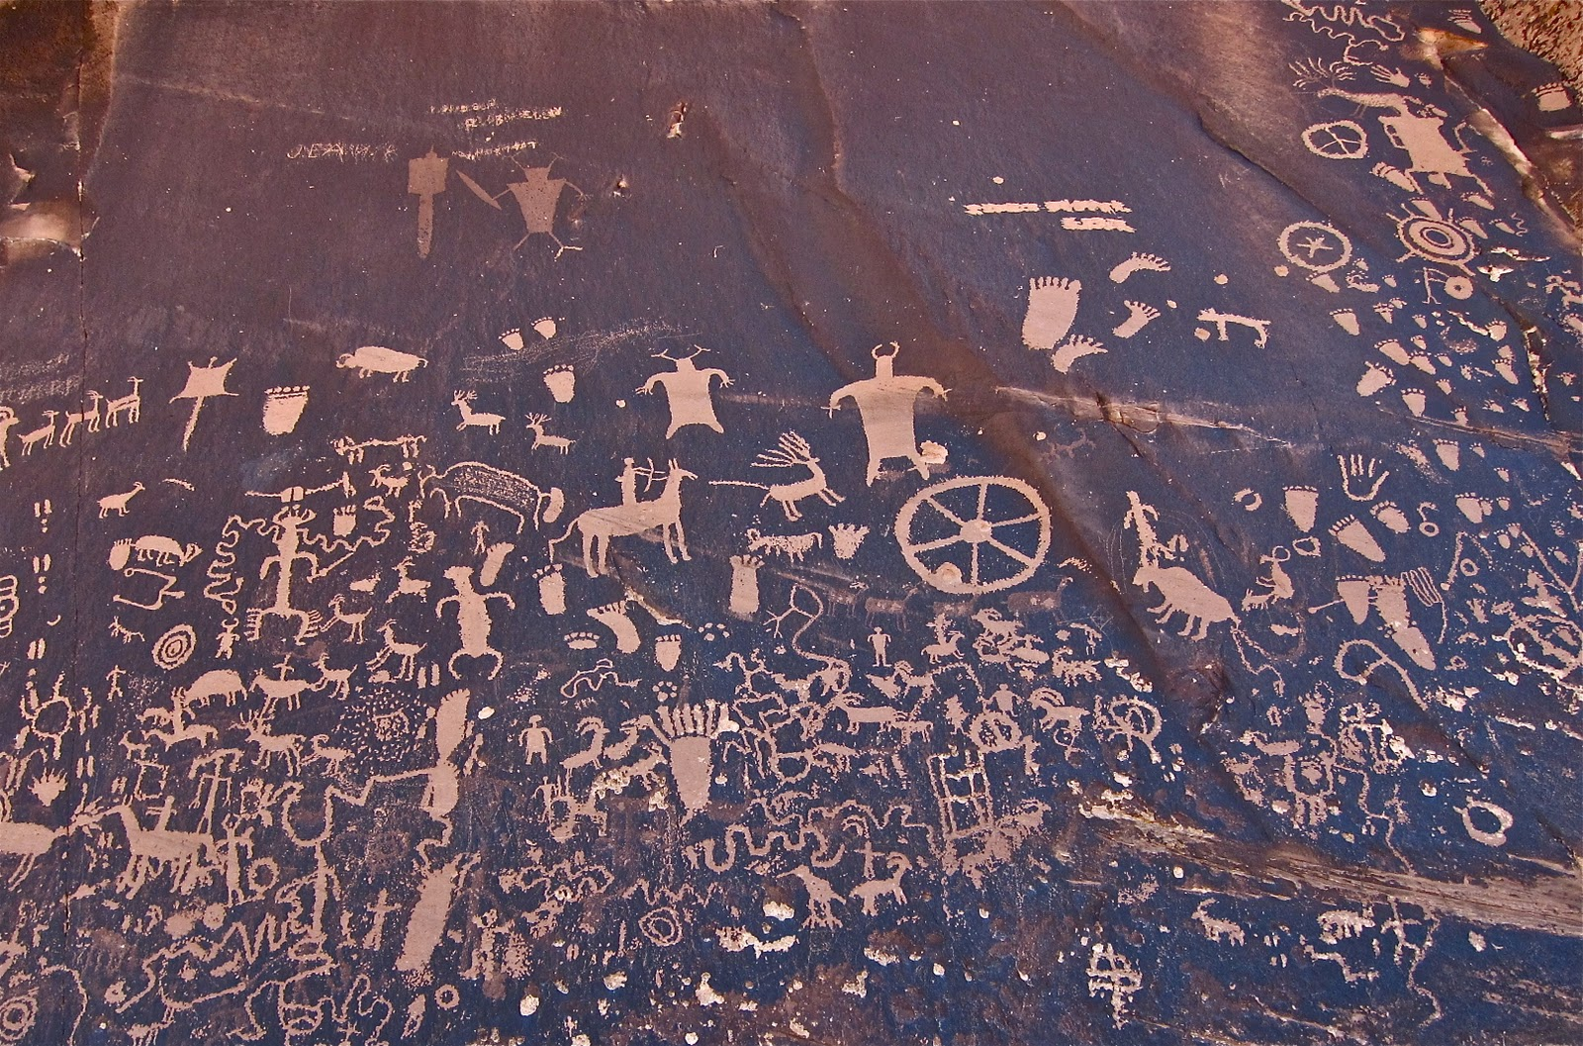
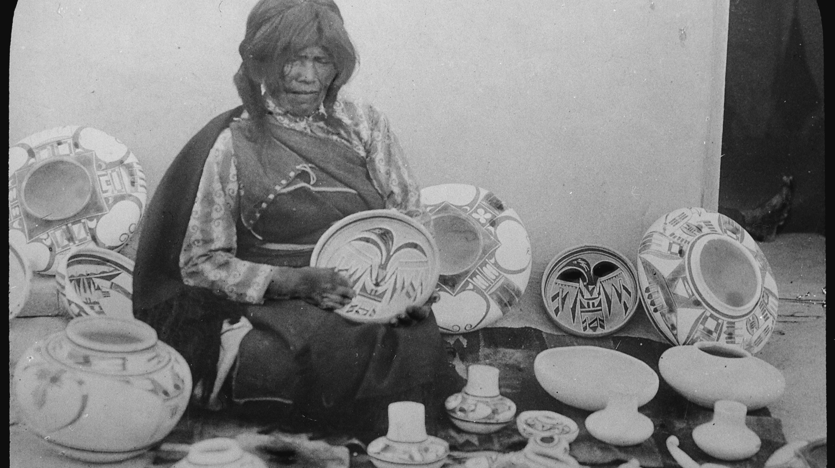
The Hopi tribe
By Isaiah Leos and Greyson Cuevas

Slide 2
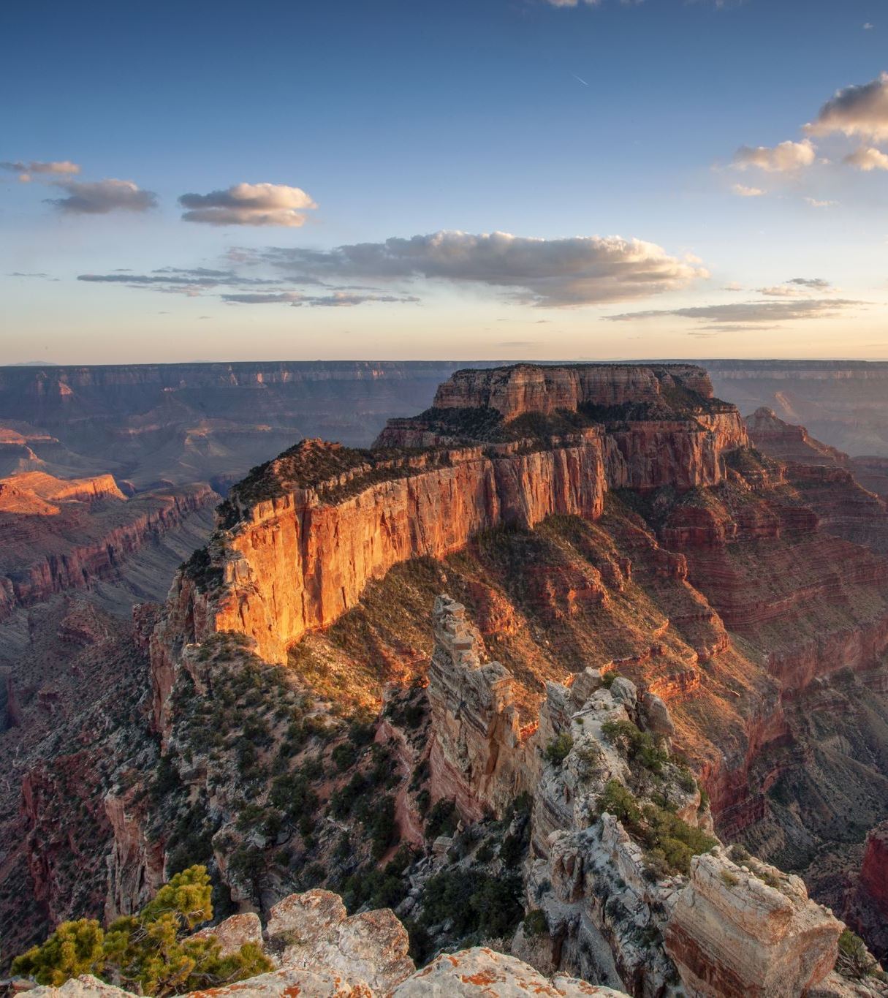
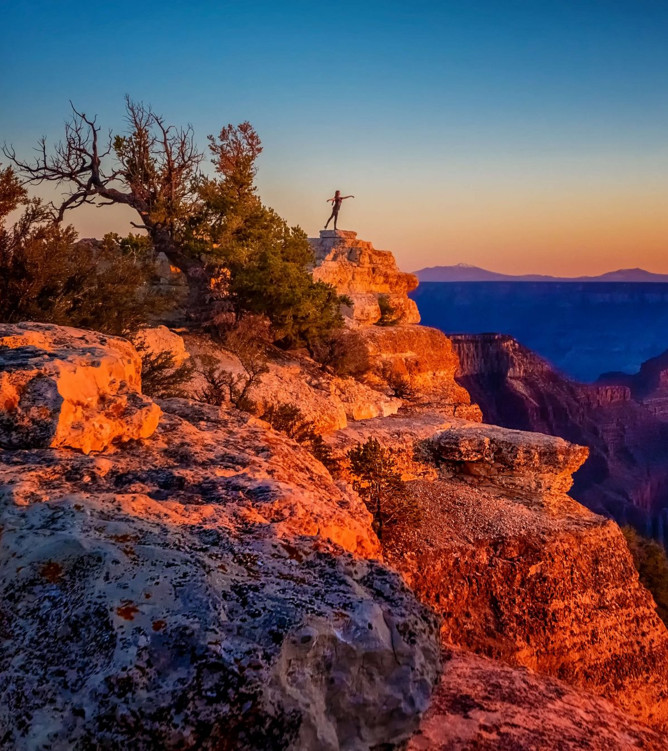
Location
They live near the Grand Canyon.
They live in the desert on top of the mesa.
The climate is usually hot most of the year.
This Photo by Unknown author is licensed under CC BY-NC-ND.

Slide 3
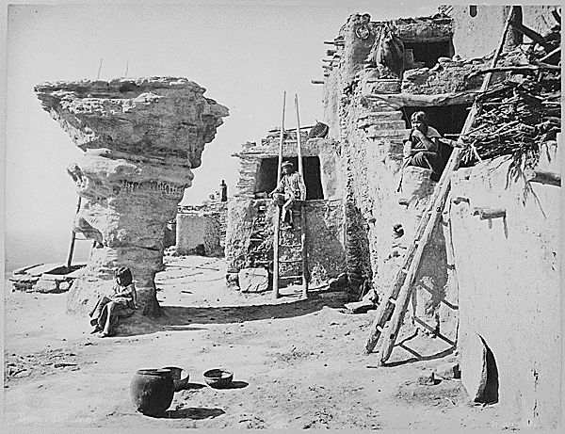
Shelter
The Hopi shelter protected the tribe from the environment.
They were made of dry clay and stone.
They have a flat roof​s and ​​multiple levels accessible by ladder.
The bottom level was under ground(called a kiva) and was used for religious ceremonies.
They lived in teepees.
The outside was wrapped in buffalo hide.
In the summer the covering would be raised to let air in.

Slide 4
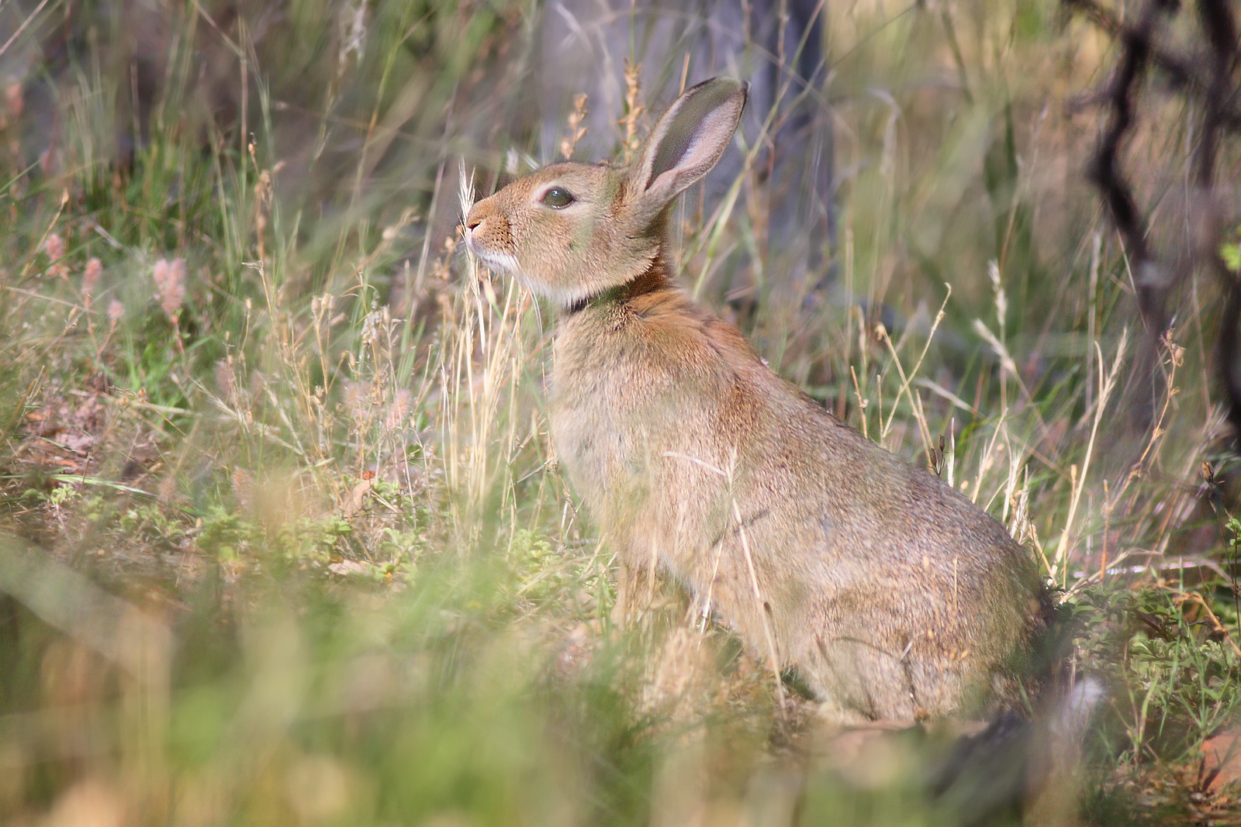
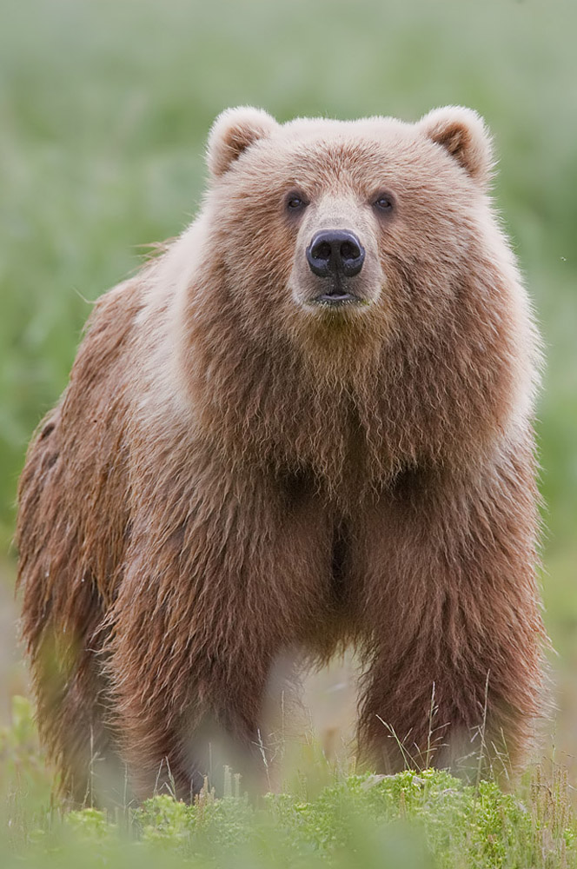
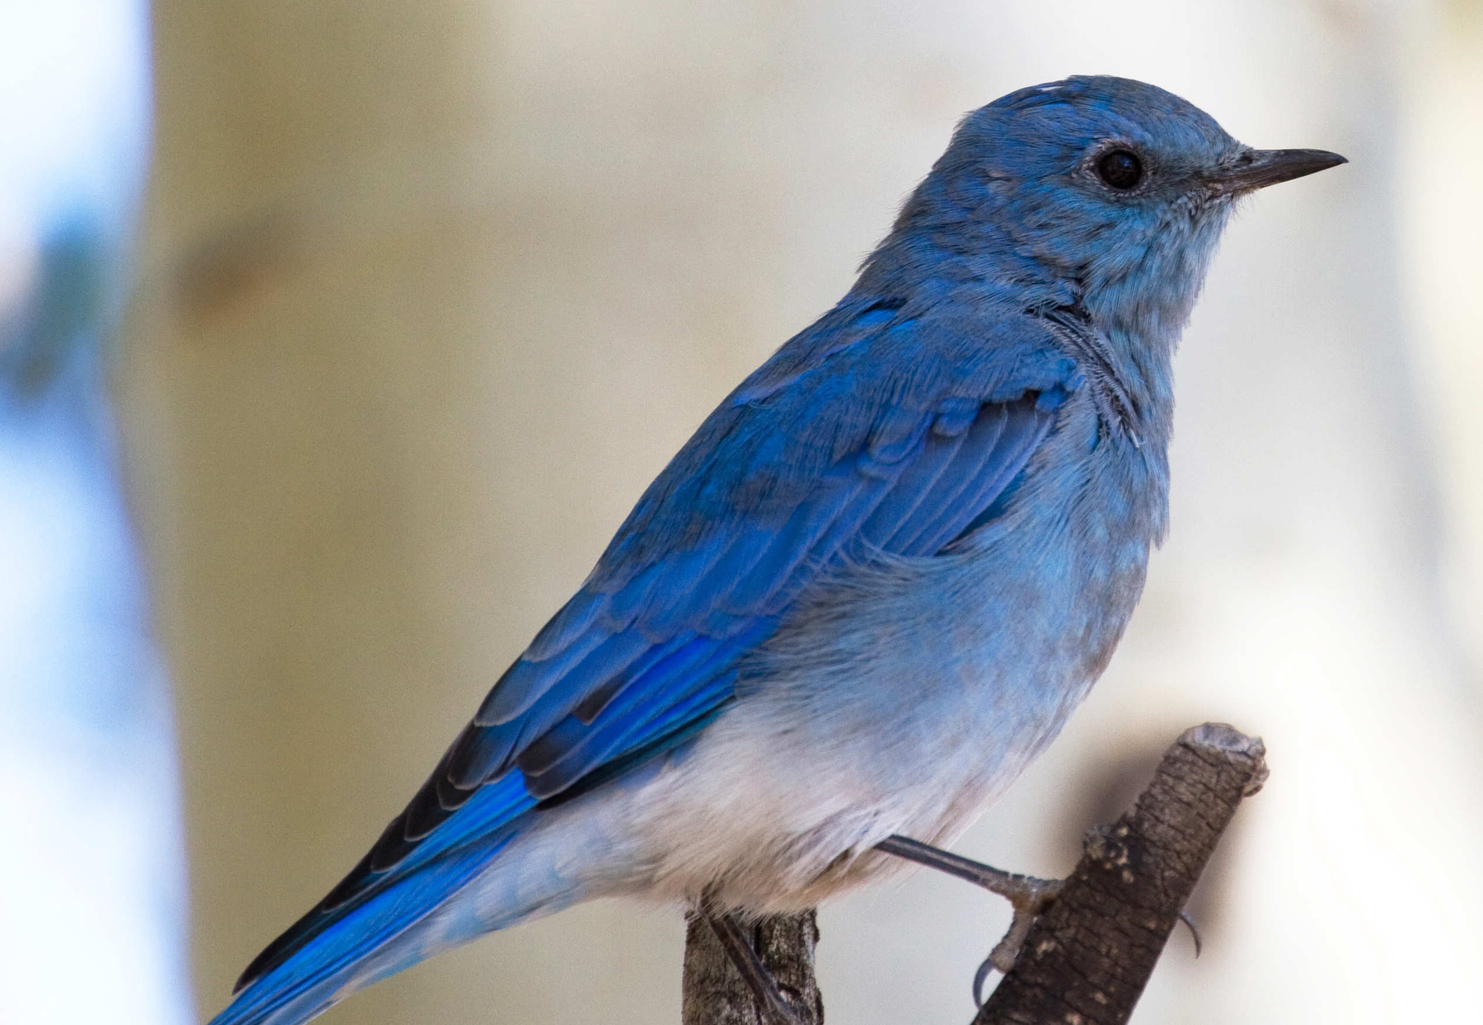
Food
They hunted rabbit, bear, and birds
They ate corn, beans, gourds and pumpkin
They also eat peaches, apricots and melons
They would also eat piki bread
This Photo by Unknown author is licensed under CC BY-SA.
This Photo by Unknown author is licensed under CC BY-SA.
This Photo by Unknown author is licensed under CC BY-SA.

Slide 5
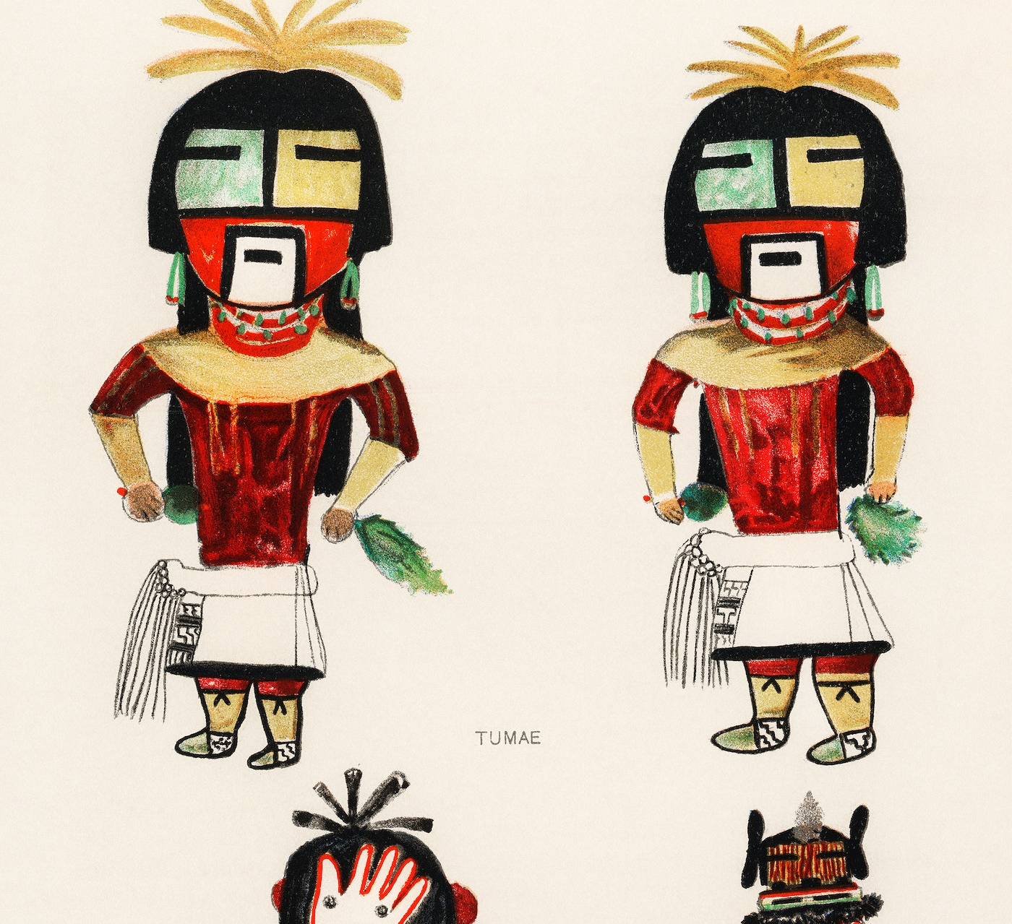
Culture
They made silver jewelry in the shape of birds and of other animals.
Their language is distinct with a Uto-Aztecan flavor.
They believe they must live in peace.
The culture of the Hopi tribe was unique

Slide 6
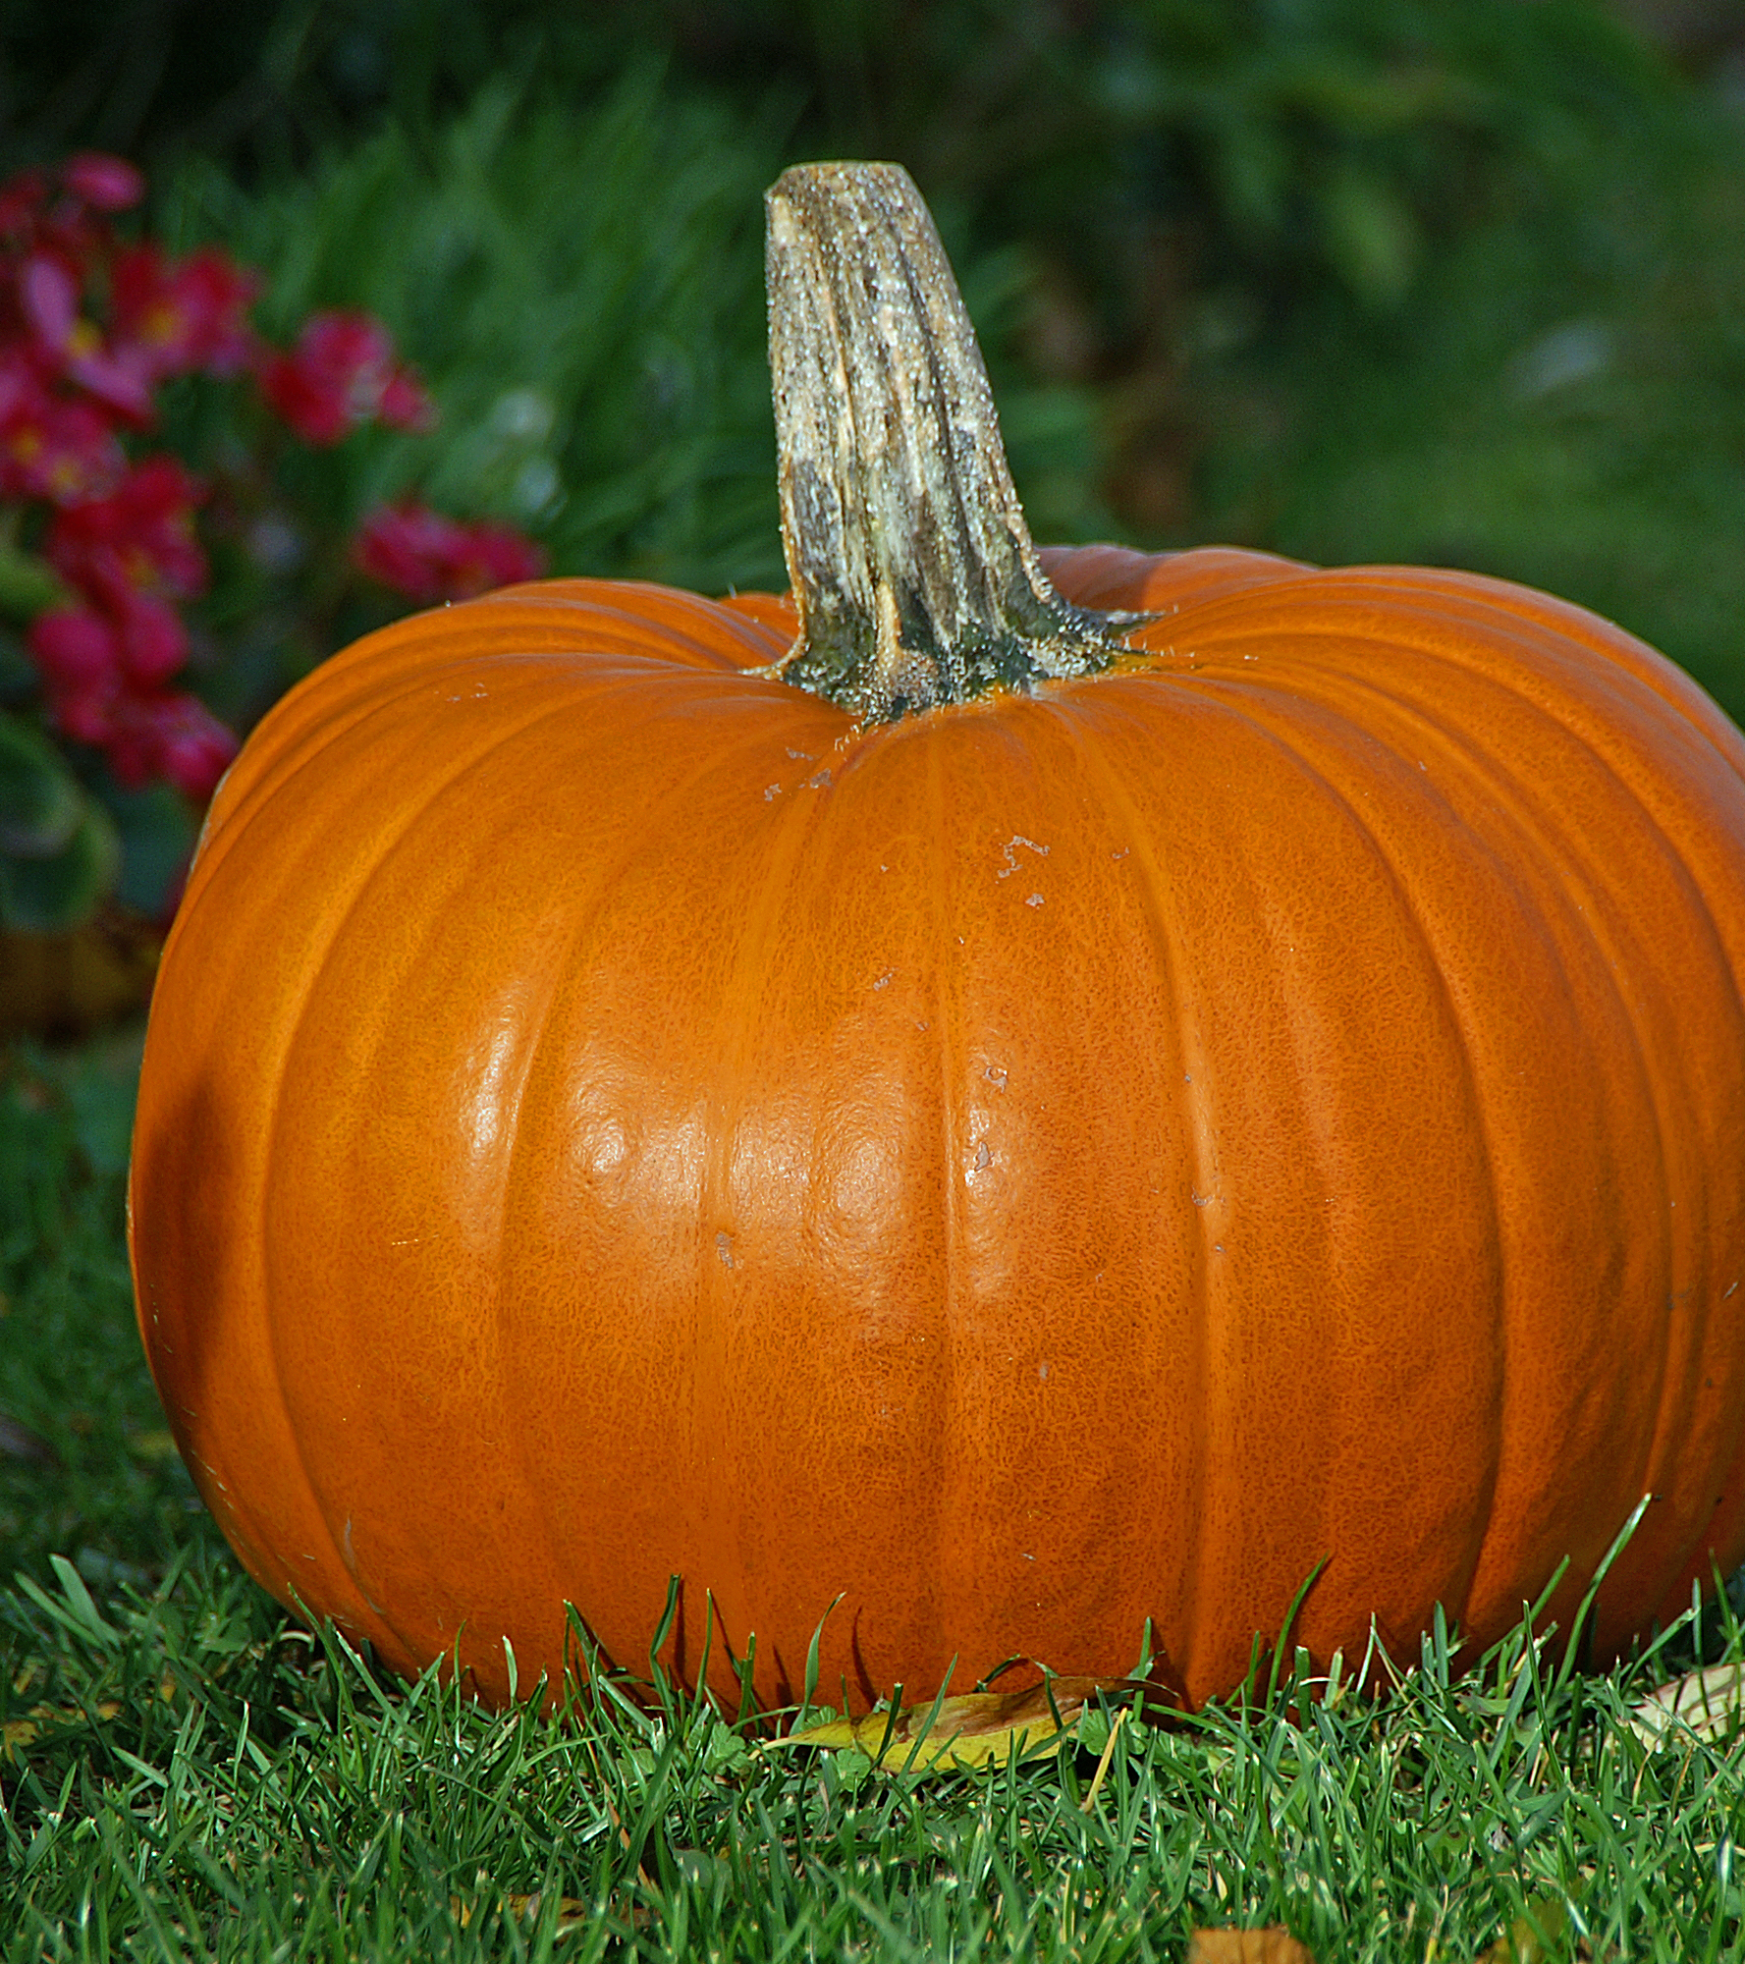
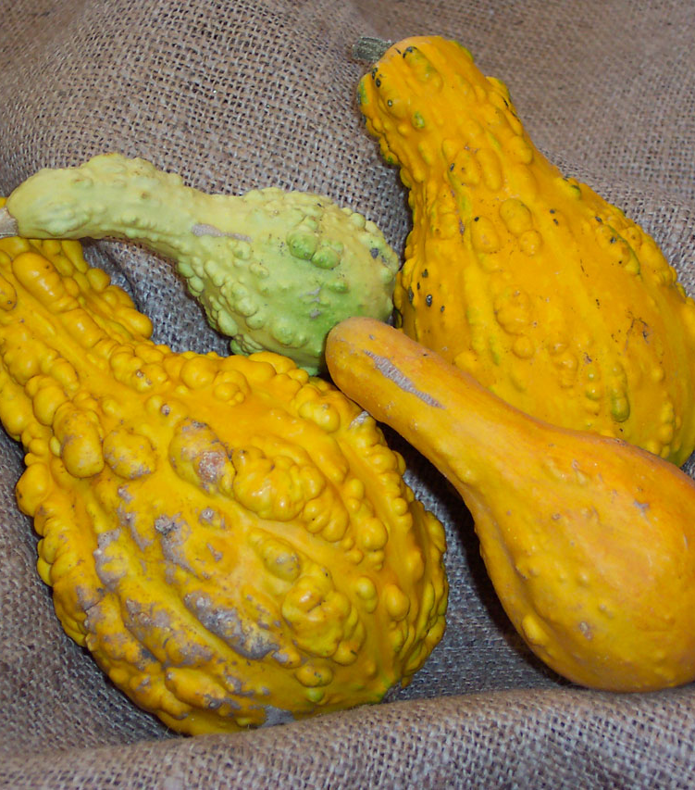
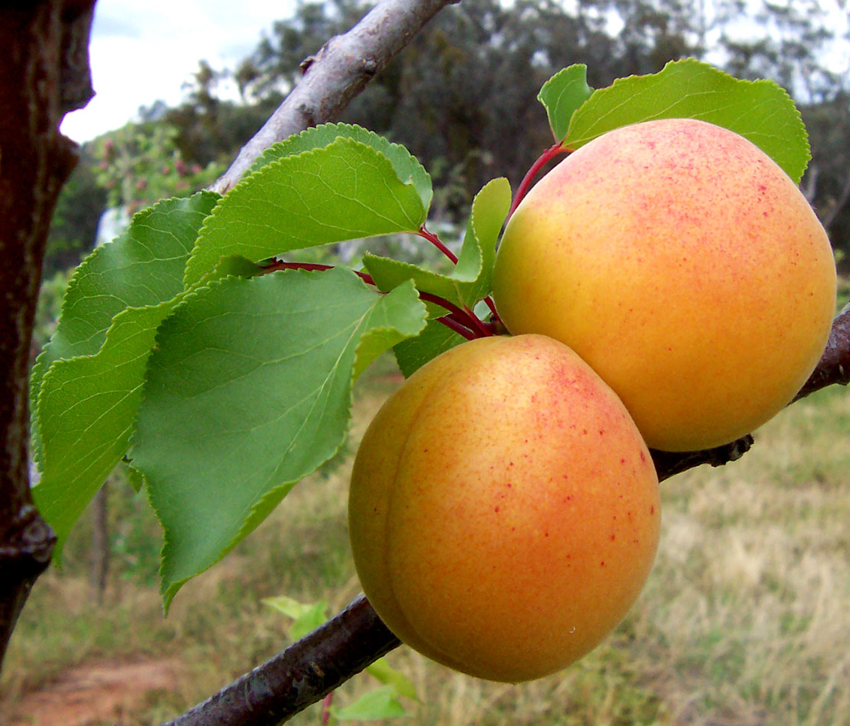
The other food They ate
This Photo by Unknown author is licensed under CC BY-SA.
This Photo by Unknown author is licensed under CC BY-SA.

Slide 7
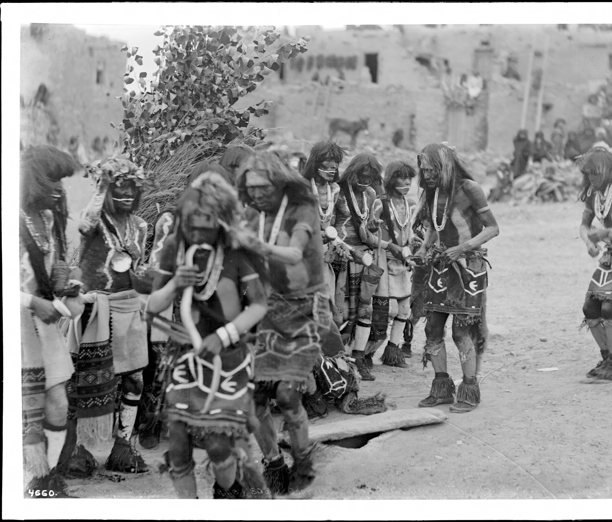
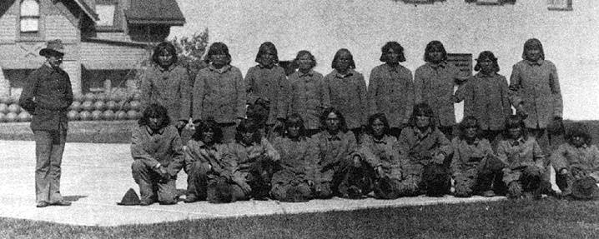
The Hopi Tribe The end
This Photo by Unknown author is licensed under CC BY-SA-NC.
This Photo by Unknown author is licensed under CC BY-SA.
This Photo by Unknown author is licensed under CC BY-SA.

