Slide 1
Maidu
By Antonio, Yoliet, and Jayln

Slide 2
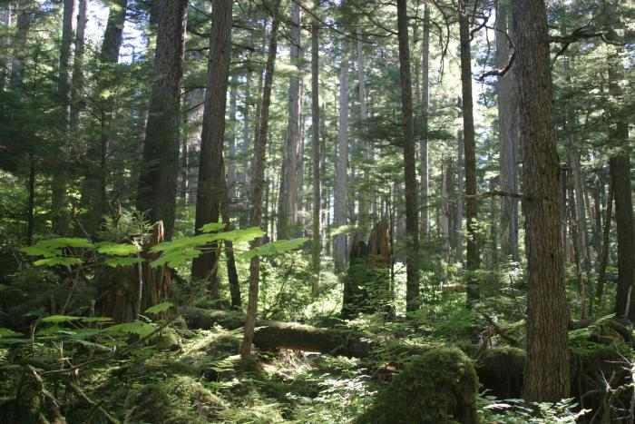
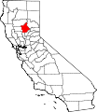
Location
This Photo by Unknown author is licensed under CC BY-SA.
The Maidu tribe lived in northeastern California. There are mountain valleys in this area. The summers were not too hot, and the winter were cold and freezing.

Slide 3
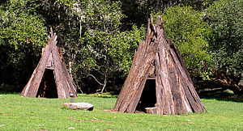
Shelter
z
Some Maidu homes were round and covered with bark that covered poles underneath. The Maidu tribe made their houses partly underground so they could stay warm in the winter. In the house there were up to 4 families.
This Photo by Unknown author is licensed under CC BY-SA.

Slide 4
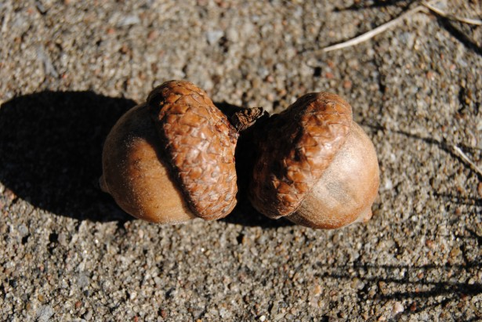
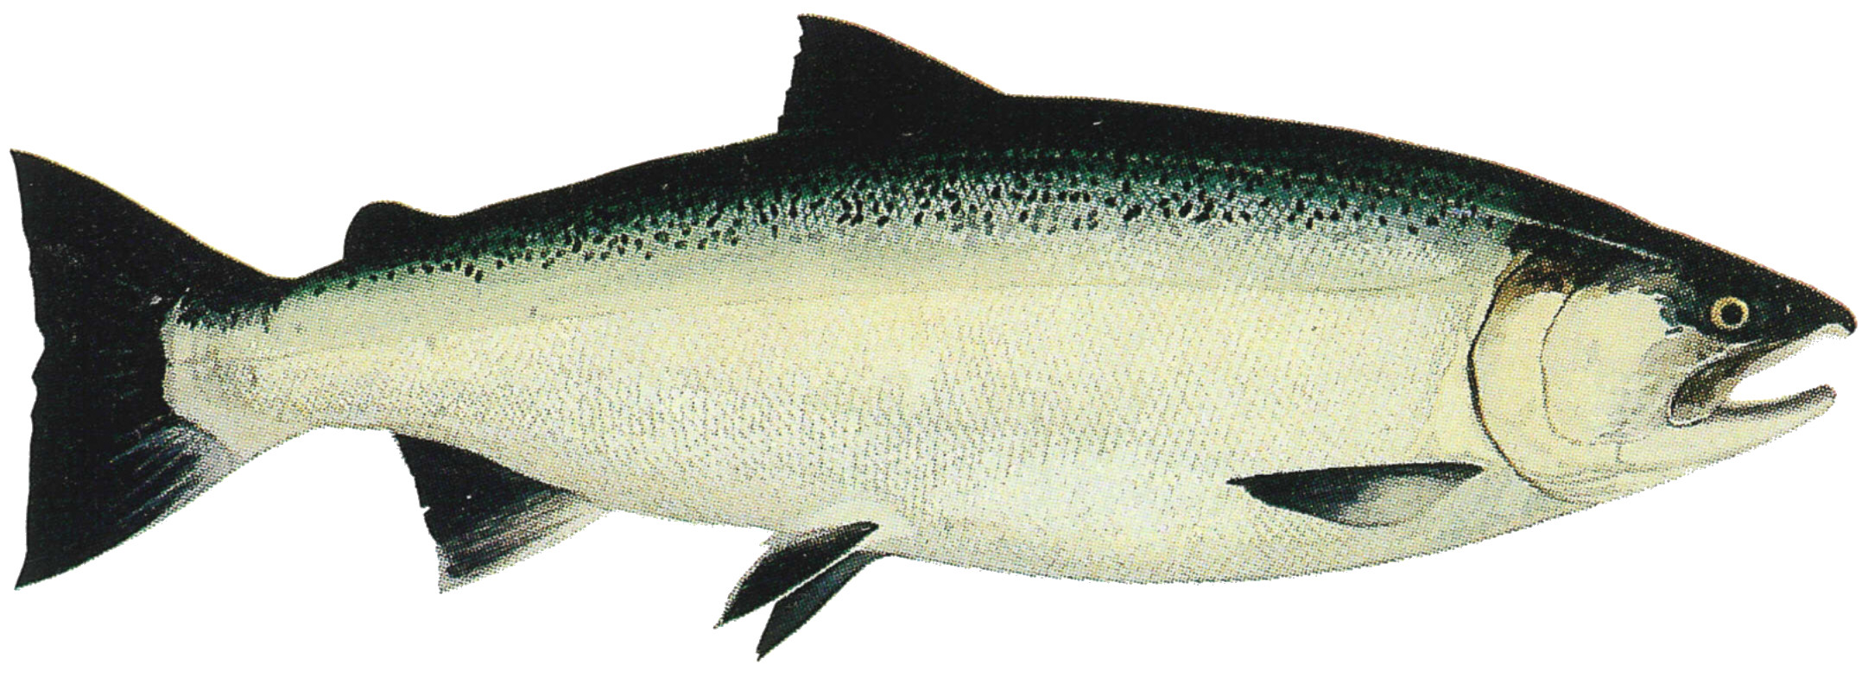
Food
Food
The Maidu tribe ate nuts, berries, acorns, corn, beans, fish, and wheat. In the winter they hunted deer and elk. They used dogs to help them hunt.
This Photo by Unknown author is licensed under CC BY-SA.
This Photo by Unknown author is licensed under CC BY-SA.

Slide 5
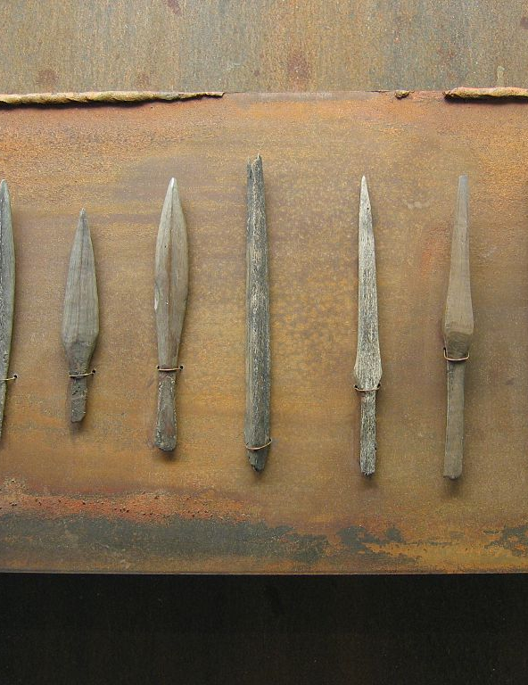
Weapons
The Maidu weapons were interesting. They
were mostly made of stone and wood. They killed deer ,elk ,fish and bear. They had spears, knives, and bows.
This Photo by Unknown author is licensed under CC BY-SA.

Slide 6
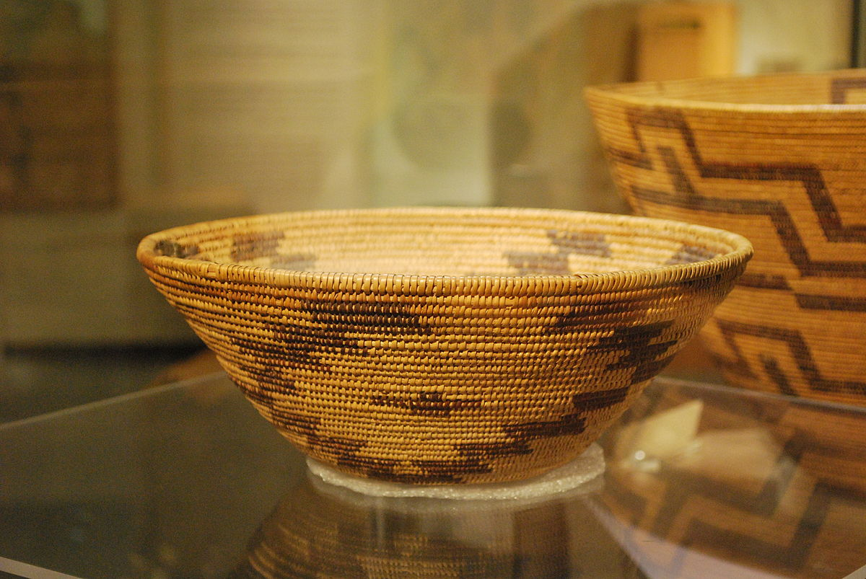
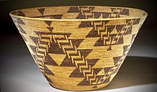
Culture
The headman's job was to give people advice and to speak to other groups. He was able to speak to other groups because he spoke other languages. They used deerskins as blankets and as clothing. They stuffed in their moccasins to keep their feet warm.
This Photo by Unknown author is licensed under CC BY-SA.
This Photo by Unknown author is licensed under CC BY-SA.

Slide 7
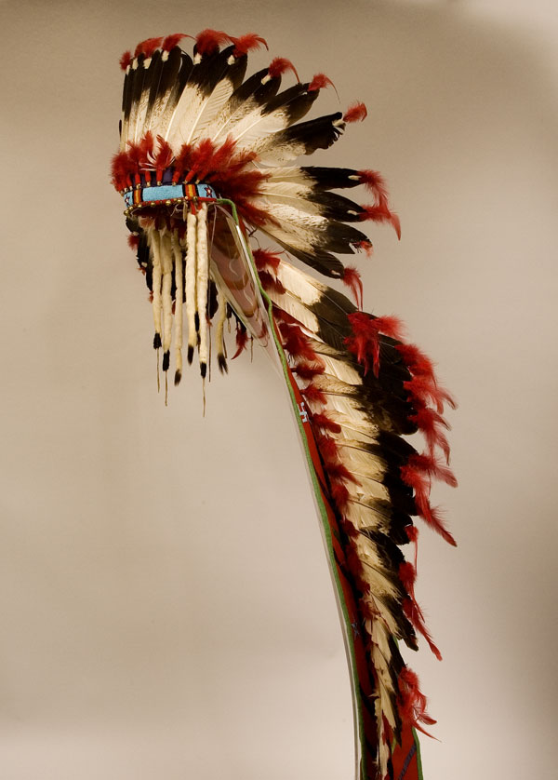
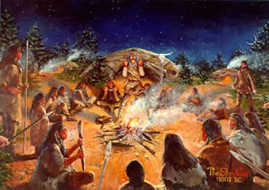
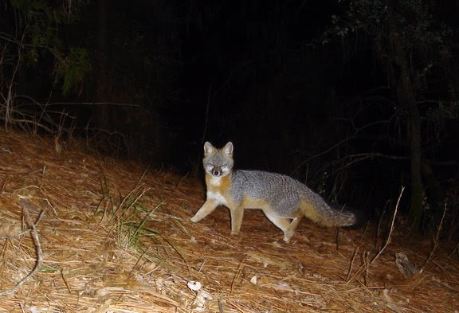
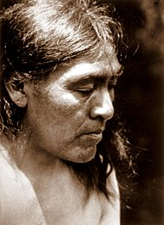
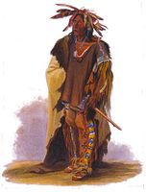
This Photo by Unknown author is licensed under CC BY-SA.
.
This Photo by Unknown author is licensed under CC BY.
This Photo by Unknown author is licensed under CC BY-SA.

