Slide 1
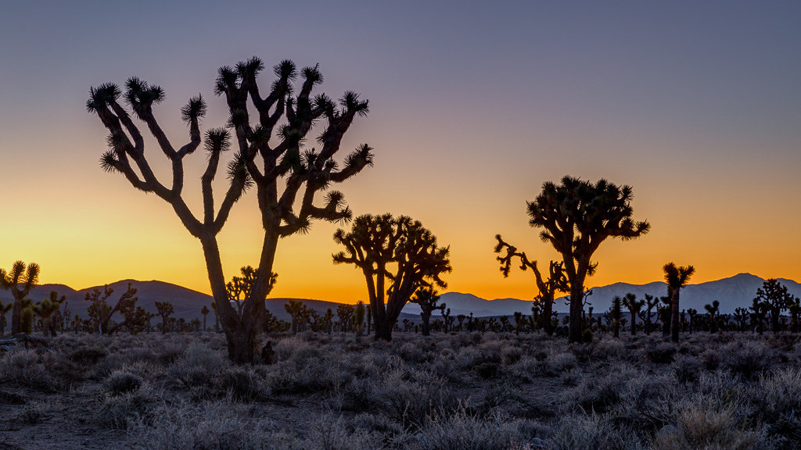
Mojave Tribe
By Wyatt and Sebastian

Slide 2
Location The Mojave tribe lived in the southeastern part of California. They live next to the Colorado river. They are located on high ground.
.

Slide 3
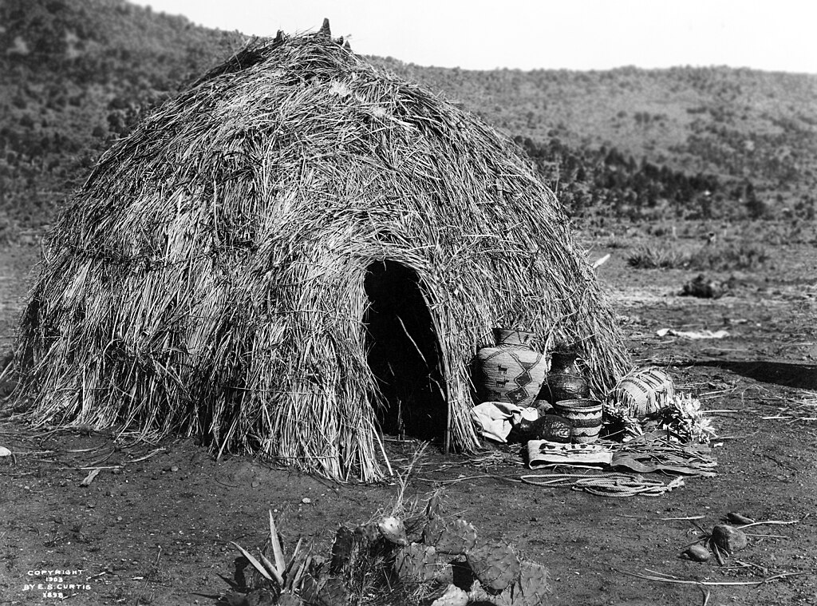
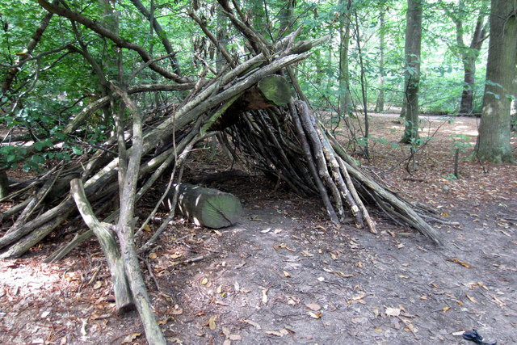
Shelter
The Mojave tribe is protected by the environment. There are 4 simple poles and a thatch roof. The houses are made out of redwood planks.
.

Slide 4
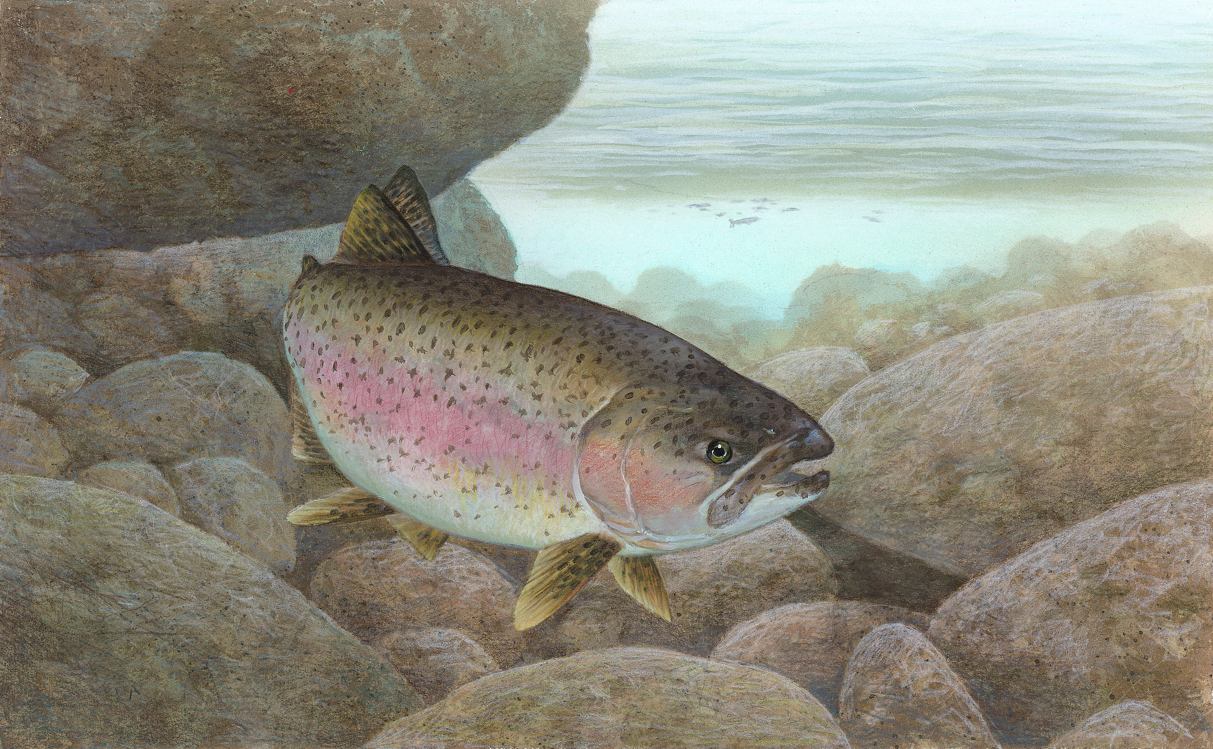
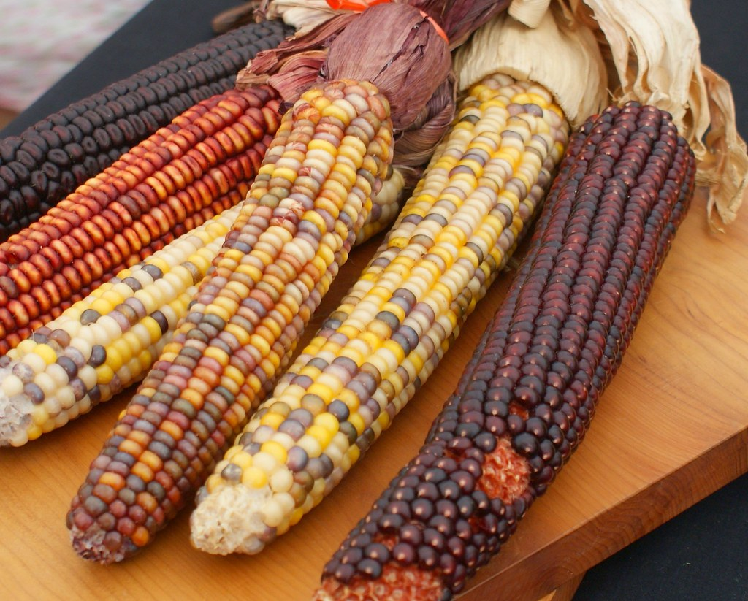
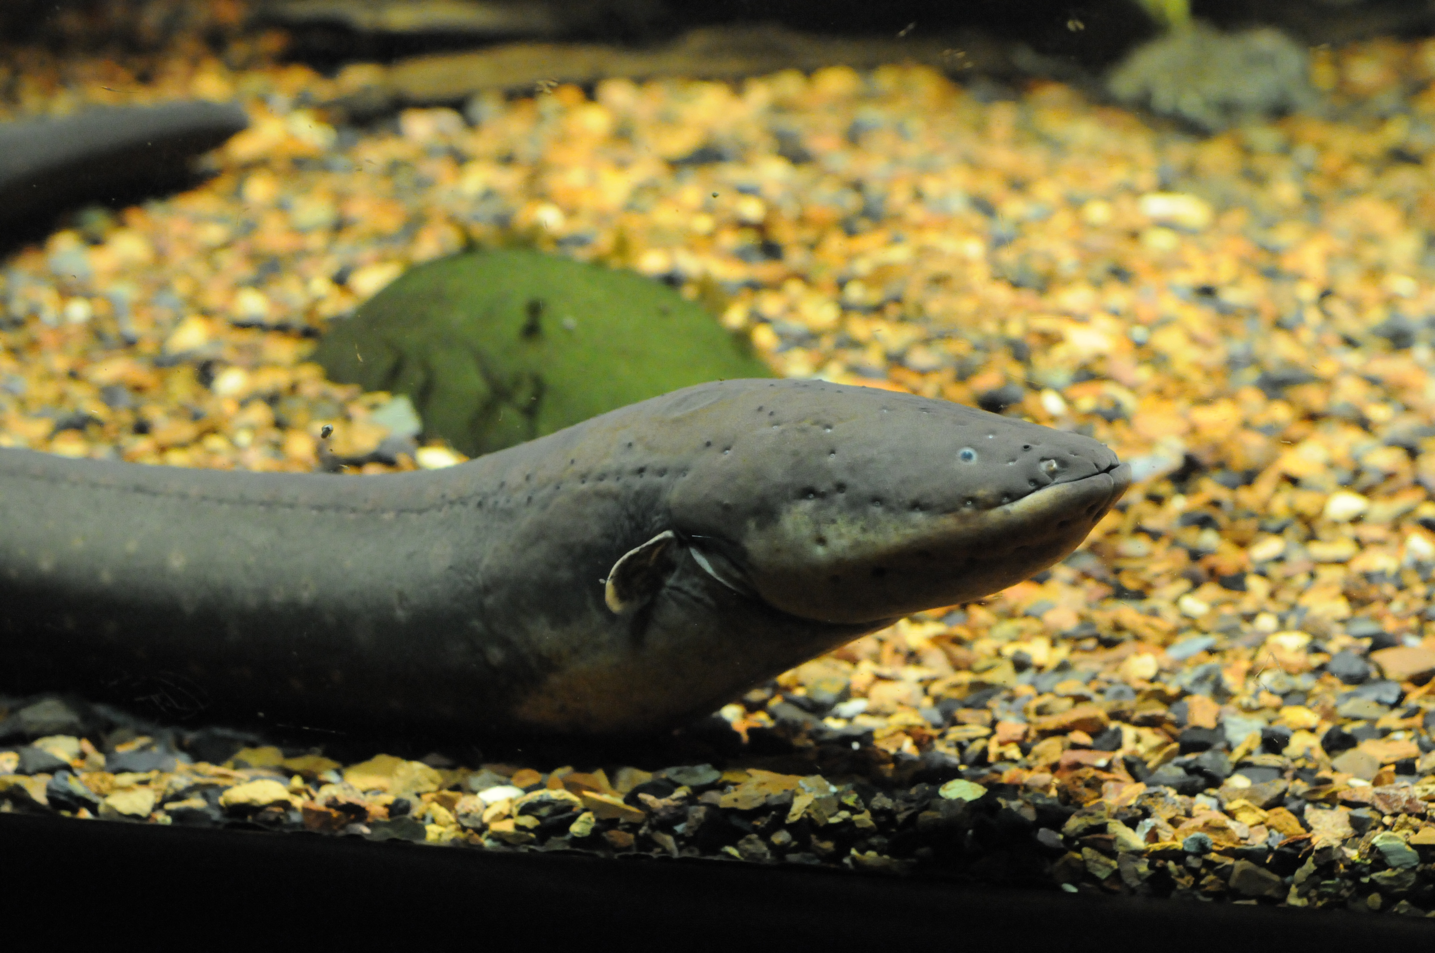
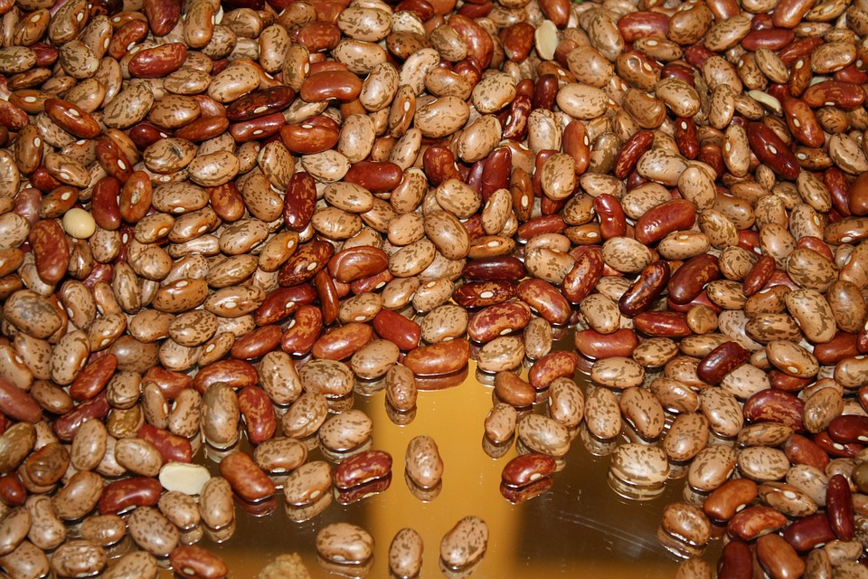
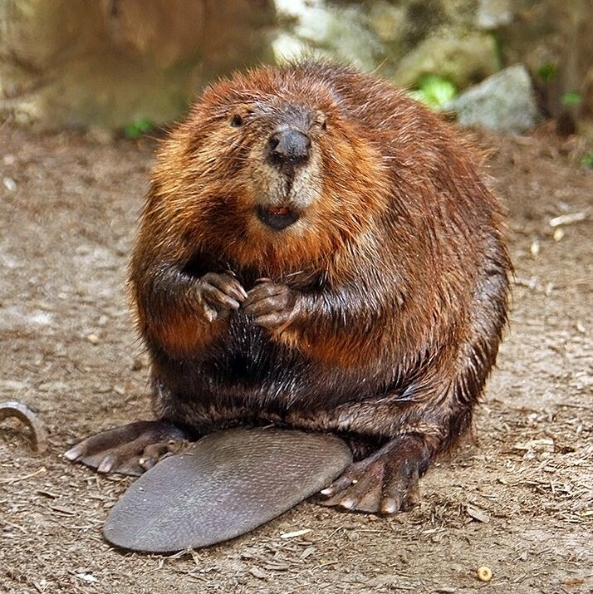
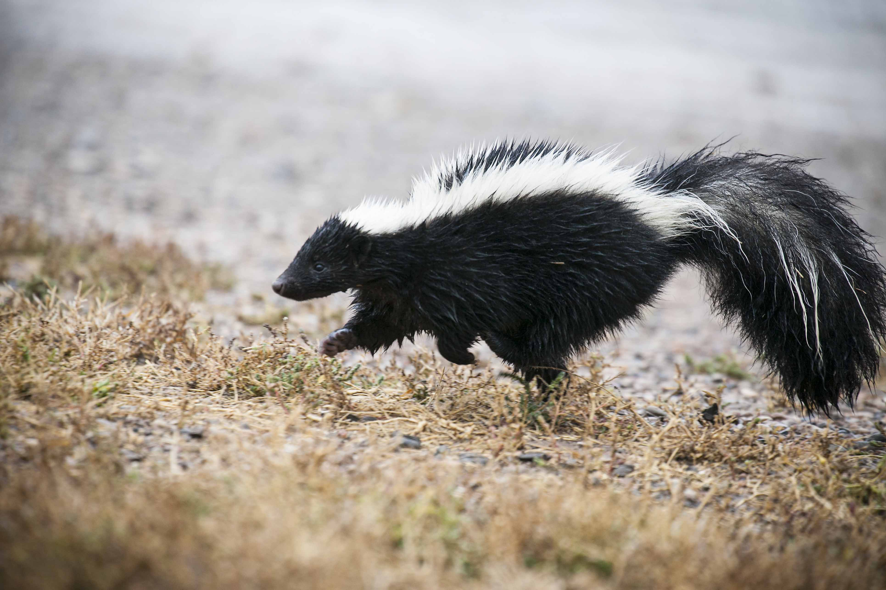
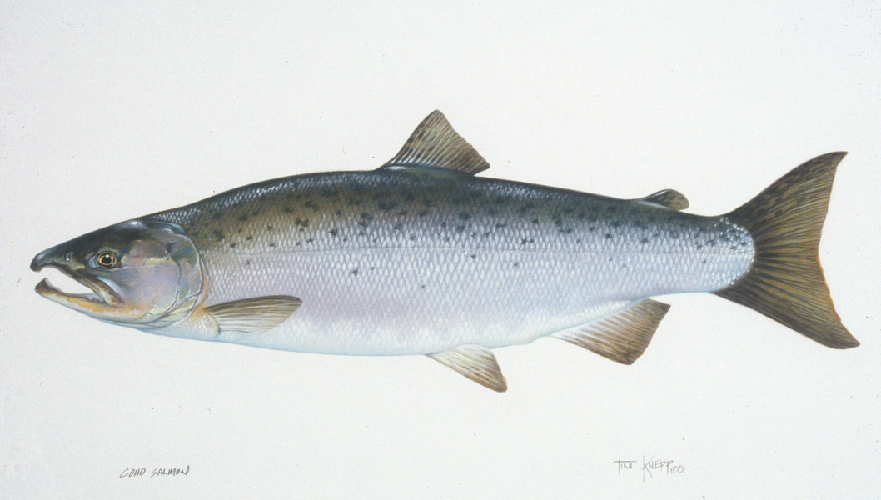
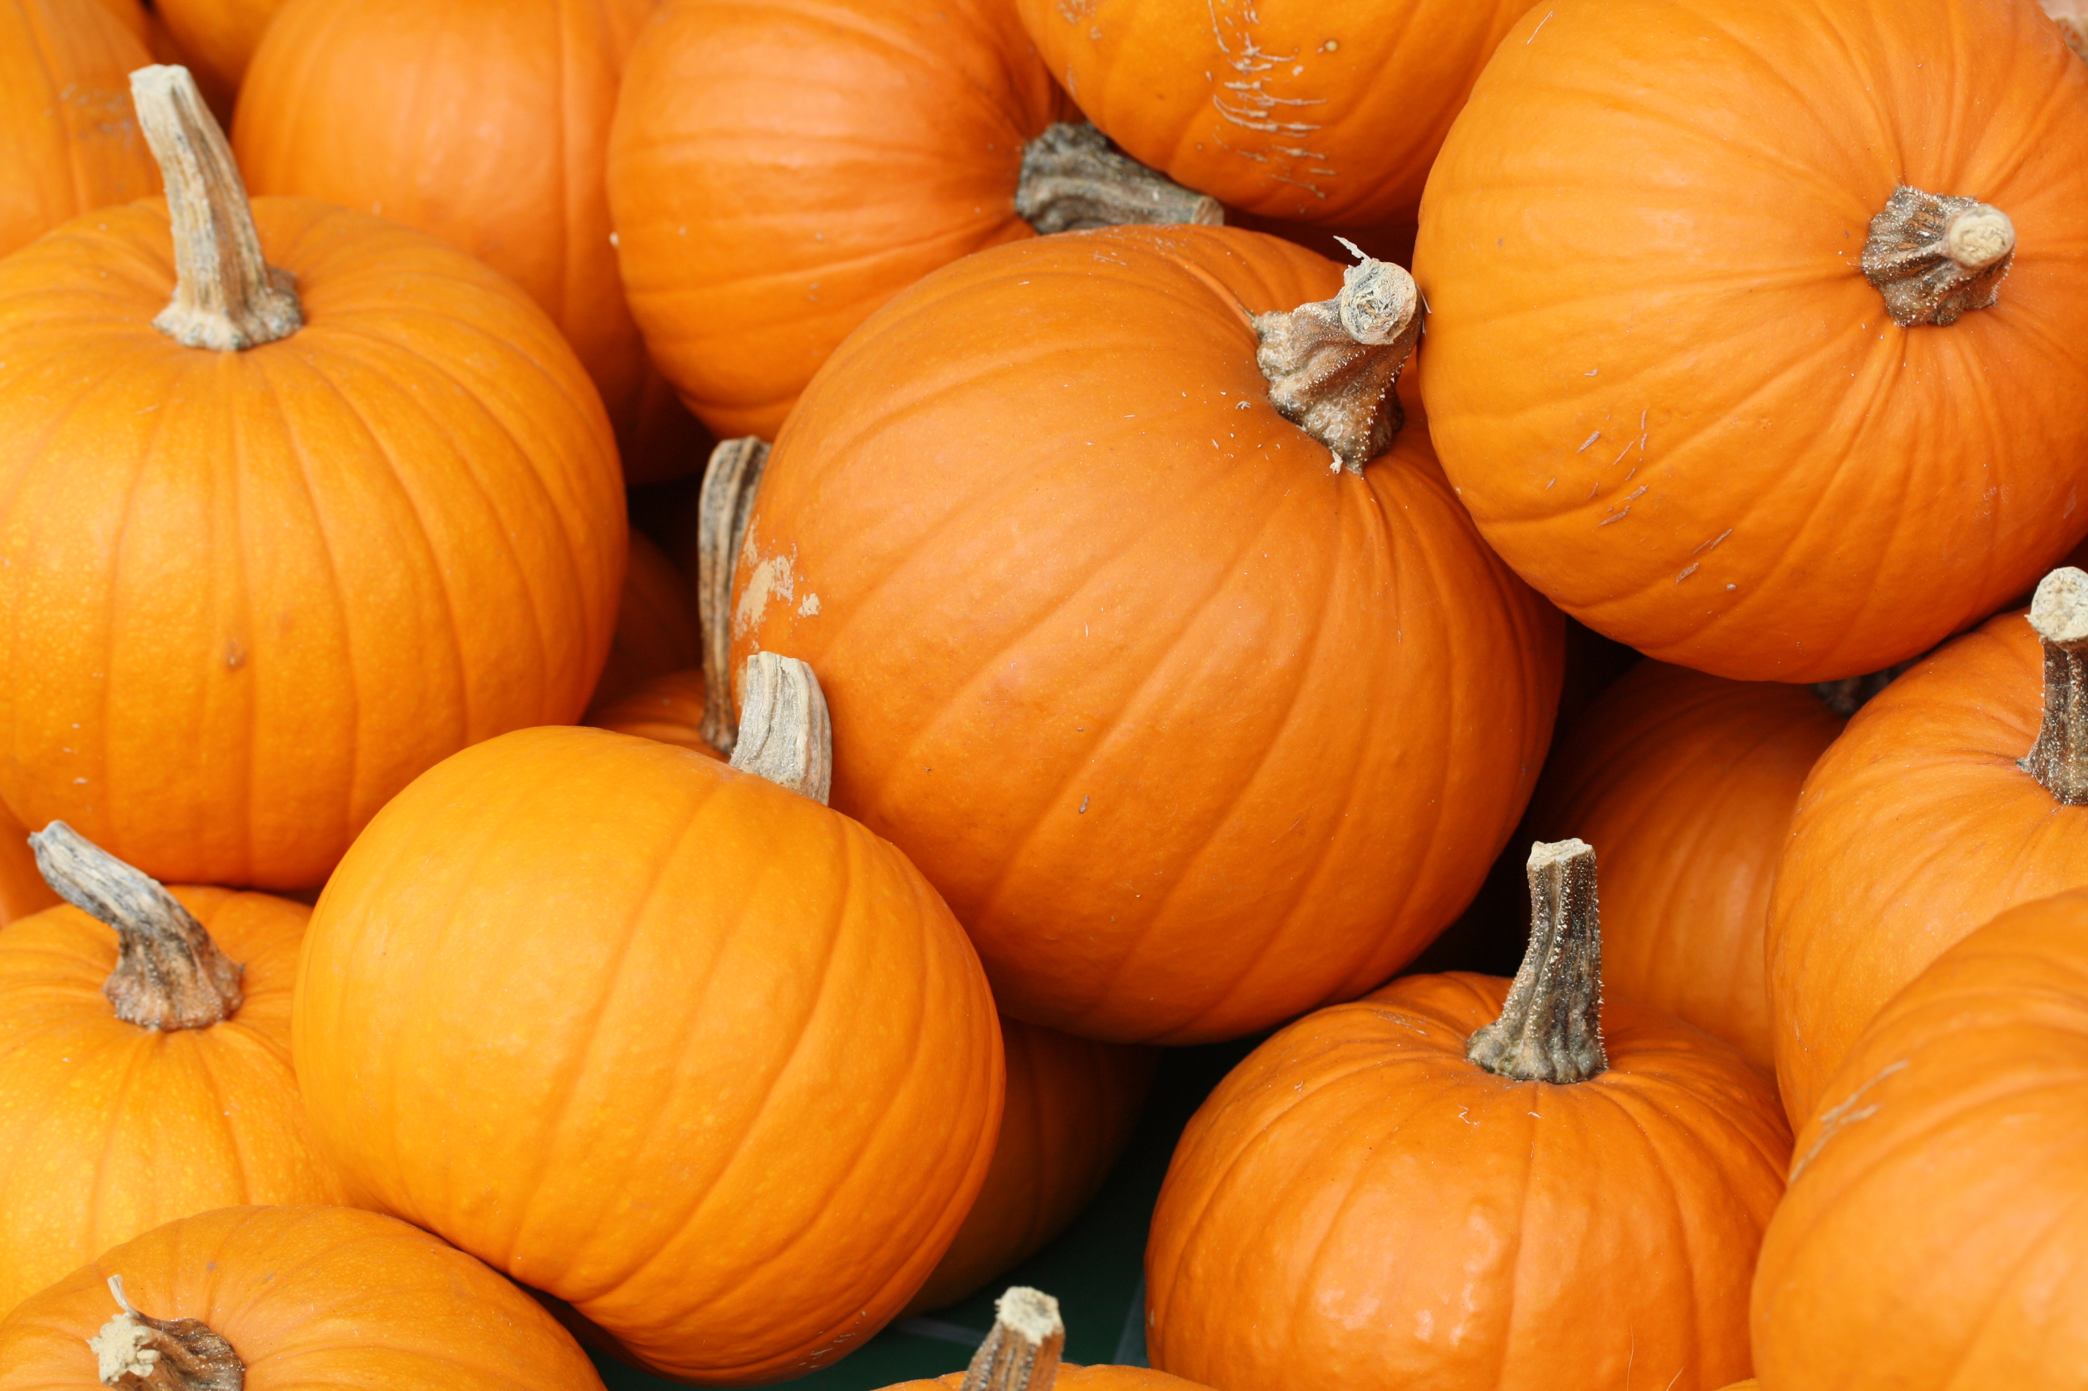
Food
The Mojave tribe used their land to find food in order to survive. They gathered beans, corn, pumpkins, plants, seeds and roots. They hunted rabbits, skunks and beavers. They fished salmon,trout and eels.
ThePhoto by PhotoAuthor is licensed under CCYYSA.
ThePhoto by PhotoAuthor is licensed under CCYYSA.
ThePhoto by PhotoAuthor is licensed under CCYYSA.
ThePhoto by PhotoAuthor is licensed under CCYYSA.

Slide 5
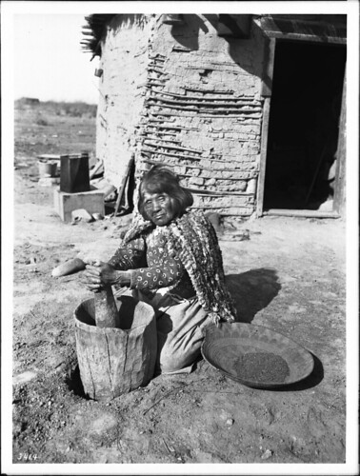
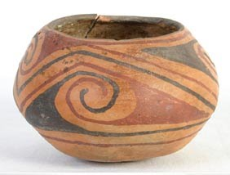
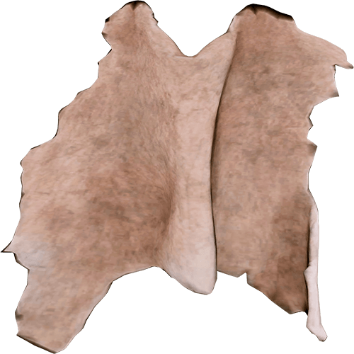
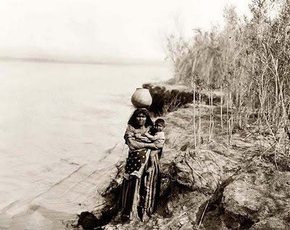
Culture
The Mojave tribe carried pottery on their heads. They have simple clothes. They were farmers. They wore shirts made of beaver and rabbit skins.
.
.
.
.

Slide 6
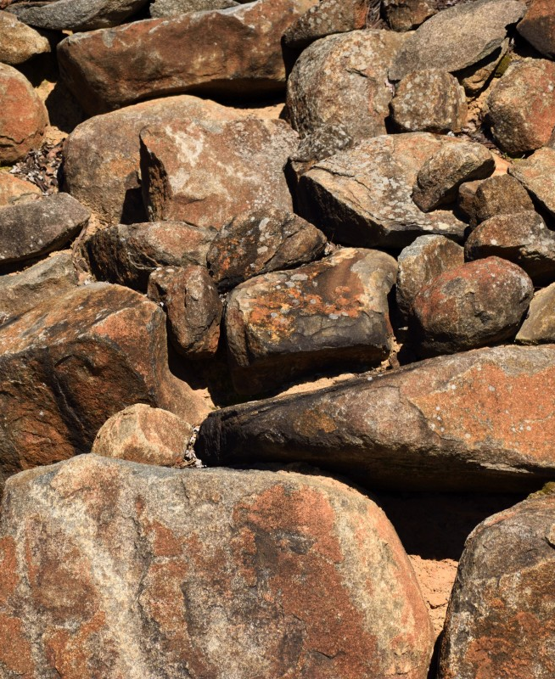
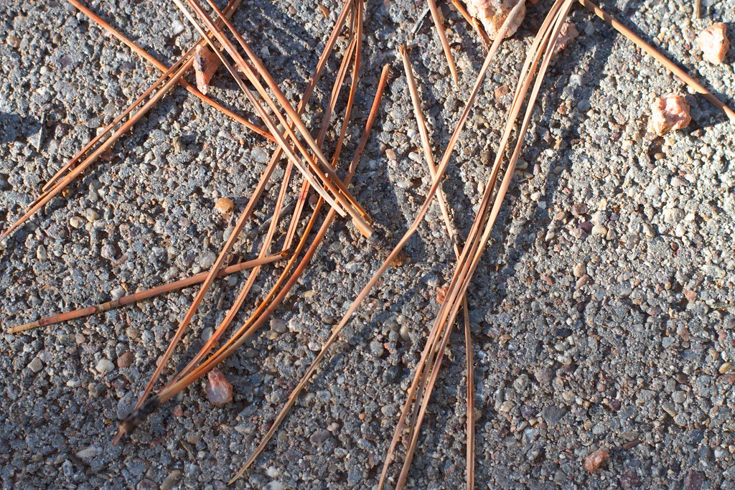
What the kids played with.
They played with rocks and sand. They fished to have fun. They played with sticks. They dressed up in their parents' clothes.

Slide 7
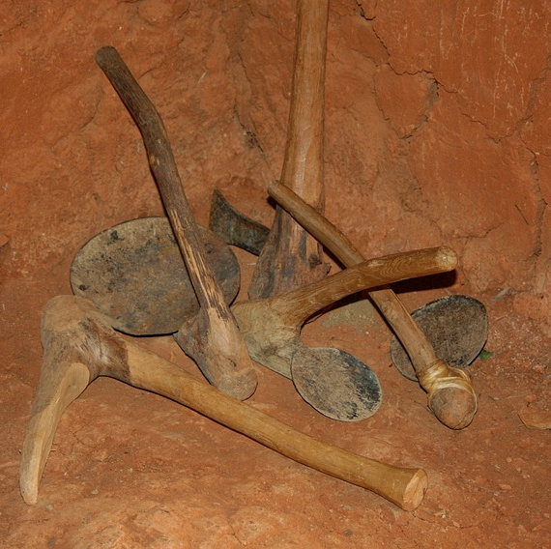
Tools
The Mojave carved sticks for tools. They made spears out of rocks and sticks. They use bow and arrows for tools.

Slide 8
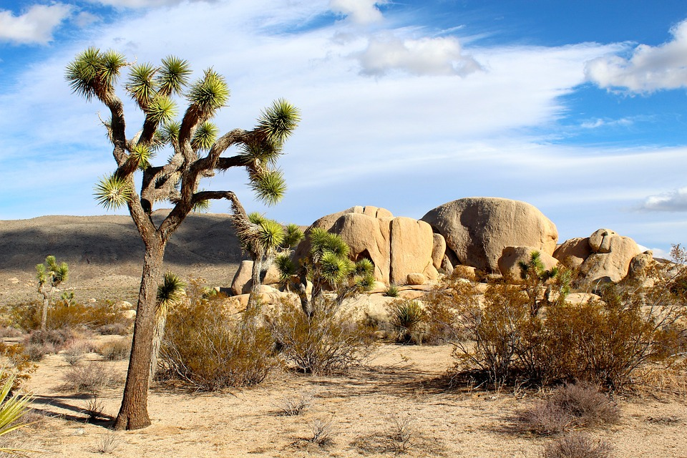
Thank you for listening!

