Slide 1
Influencing Court Decisions
Ch 12 sec 3

Slide 2
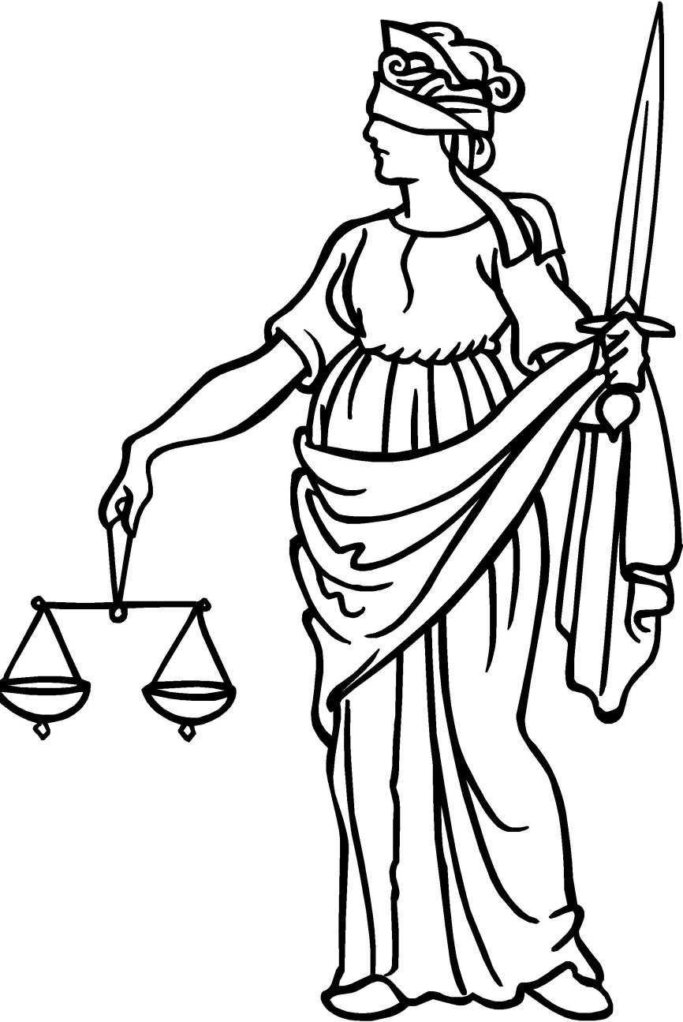
I. Basing Decisions on the Law
Justices must base their opinion on the law, not on personal opinions.
The Court must interpret laws and relate their interpretations to the Constitution itself, relevant statutes, and legal precedents.
Notes:
http://www.gleesonlaw.com/images/scales%20of%20justice.jpg

Slide 3
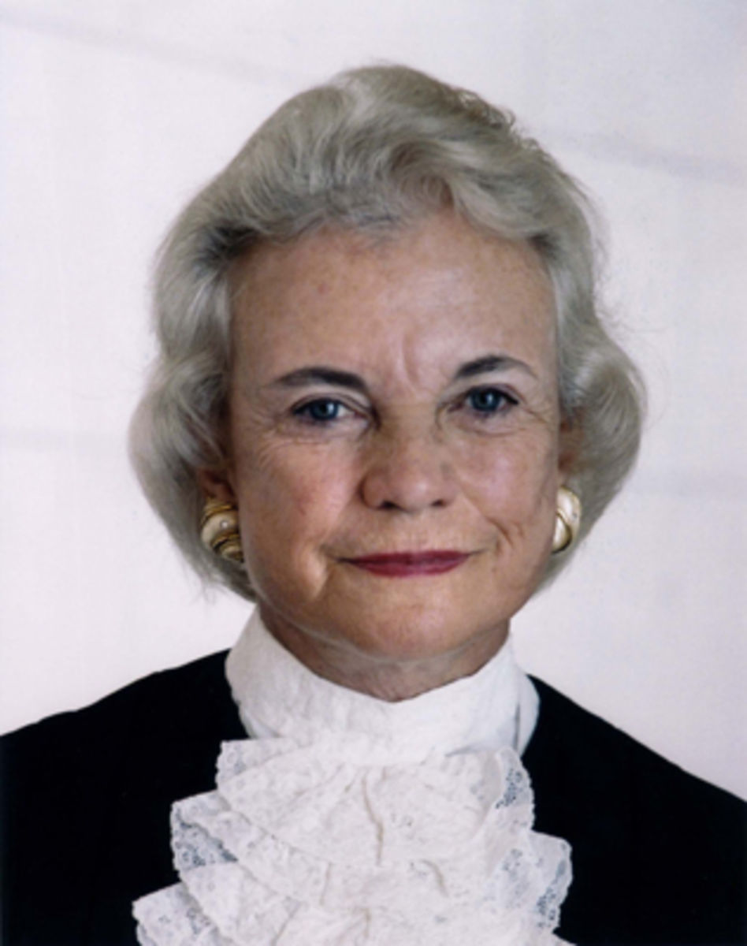
II. Views of the Justices
Justices monitor important issues; some become identified with them.
As justices retire, the majority voting blocs on certain issues may change.
Notes:
http://a4.files.biography.com/image/upload/c_fit,cs_srgb,dpr_1.0,h_1200,q_80,w_1200/MTI5MjkxNDc4ODk0NjUyMDM1.jpg

Slide 4
III. Relations Among Justices
Modern justices meet for discussion, but most communicate in writing.
Personal relations among justices may influence the Court’s decisions.
The chief justice’s skillful leadership can help promote harmony.
Notes:
http://outreach.uwyo.edu/correspondence/images/mail.jpg
http://images.inmagine.com/168nwm/dynamicgraphics/vc007/vc007059.jpg

Slide 5
IV. The Court and Society
Although insulated from public opinion and political pressures, the Court needs public support; its authority depends in part on public acceptance.
Justices are influenced by the values and beliefs of society; their decisions usually reflect important societal changes.
Notes:
http://secure.northlandmarine.com/images/ColBoysIceCaveRev06.jpg

Slide 6
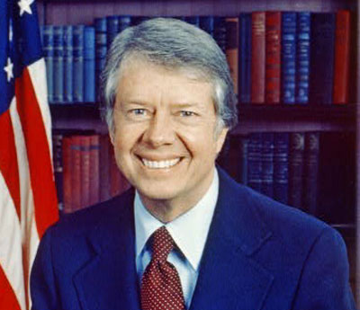
V. Balancing the Court’s Power
The power of presidents to fill vacancies on the Court, as has every full-term president except Carter, gives them influence over the Court.
As head of the executive branch, the president is responsible for enforcing the Court’s decisions but may do so vigorously or with little enthusiasm.
Notes:
http://www.visitingdc.com/images/jimmy-carter-picture.jpg

Slide 7
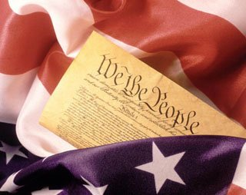
V. Balancing the Court’s Power
Congress has the power to limit the Court’s ability to hear certain cases; may propose a constitutional amendment to overturn a decision; may set, but not reduce, the justice’s salaries; uses its confirmation power to shape the Court’s position on social issues.
Notes:
http://www.theodoresworld.net/pcfreezone/wethepeople8.jpg

Slide 8
In your notebooks
321+1
Write 3 things you learned
Write 2 things you want to learn more about
Write 1 thing you did not understand
Write 1 thing someone else learned that you did not write down

