Slide 1
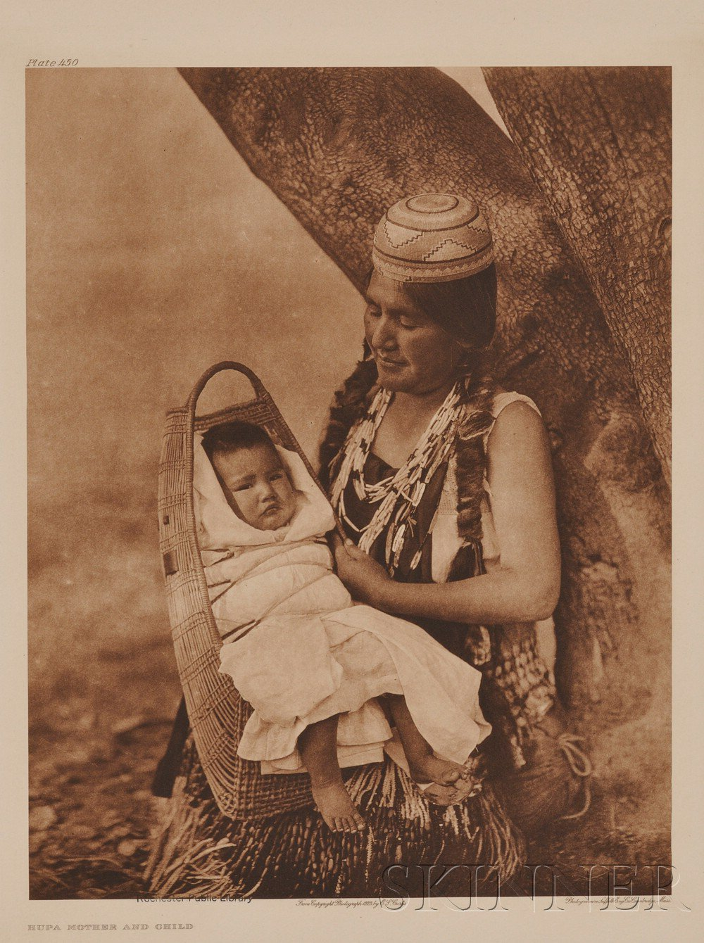
Maidu
Ariana
and
Rheeya

Slide 2
Shelter
The shelter was dug under ground, round , and covered with bark. The materials they used are sticks, grass, and dirt. Their shelter looked like a big round mound.

Slide 3
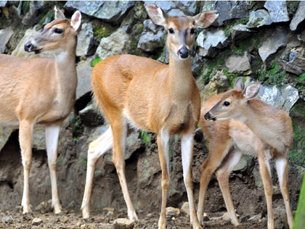
Food
The hunted for deer, elk, rabbits, birds, and bear. They gathered seeds, roots, and insects. They fished for trout, salmon, and eels.

Slide 4
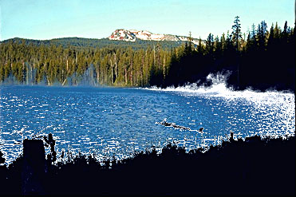
LOCATION
The Maidu lived around the northern part of California. They lived on top a hill. Their climate was warm in the summer, and their winters are cool.

Slide 5
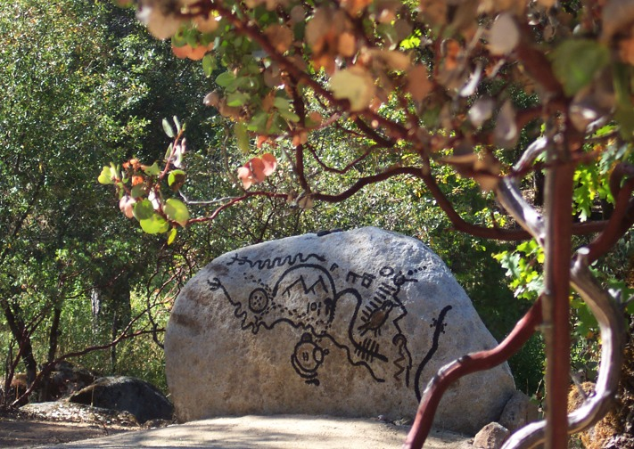
Culture
The Maidu made baskets so they could hold their food. The women wove baskets. The Maidu are known for their weaving skills.

Slide 6
