Slide 1
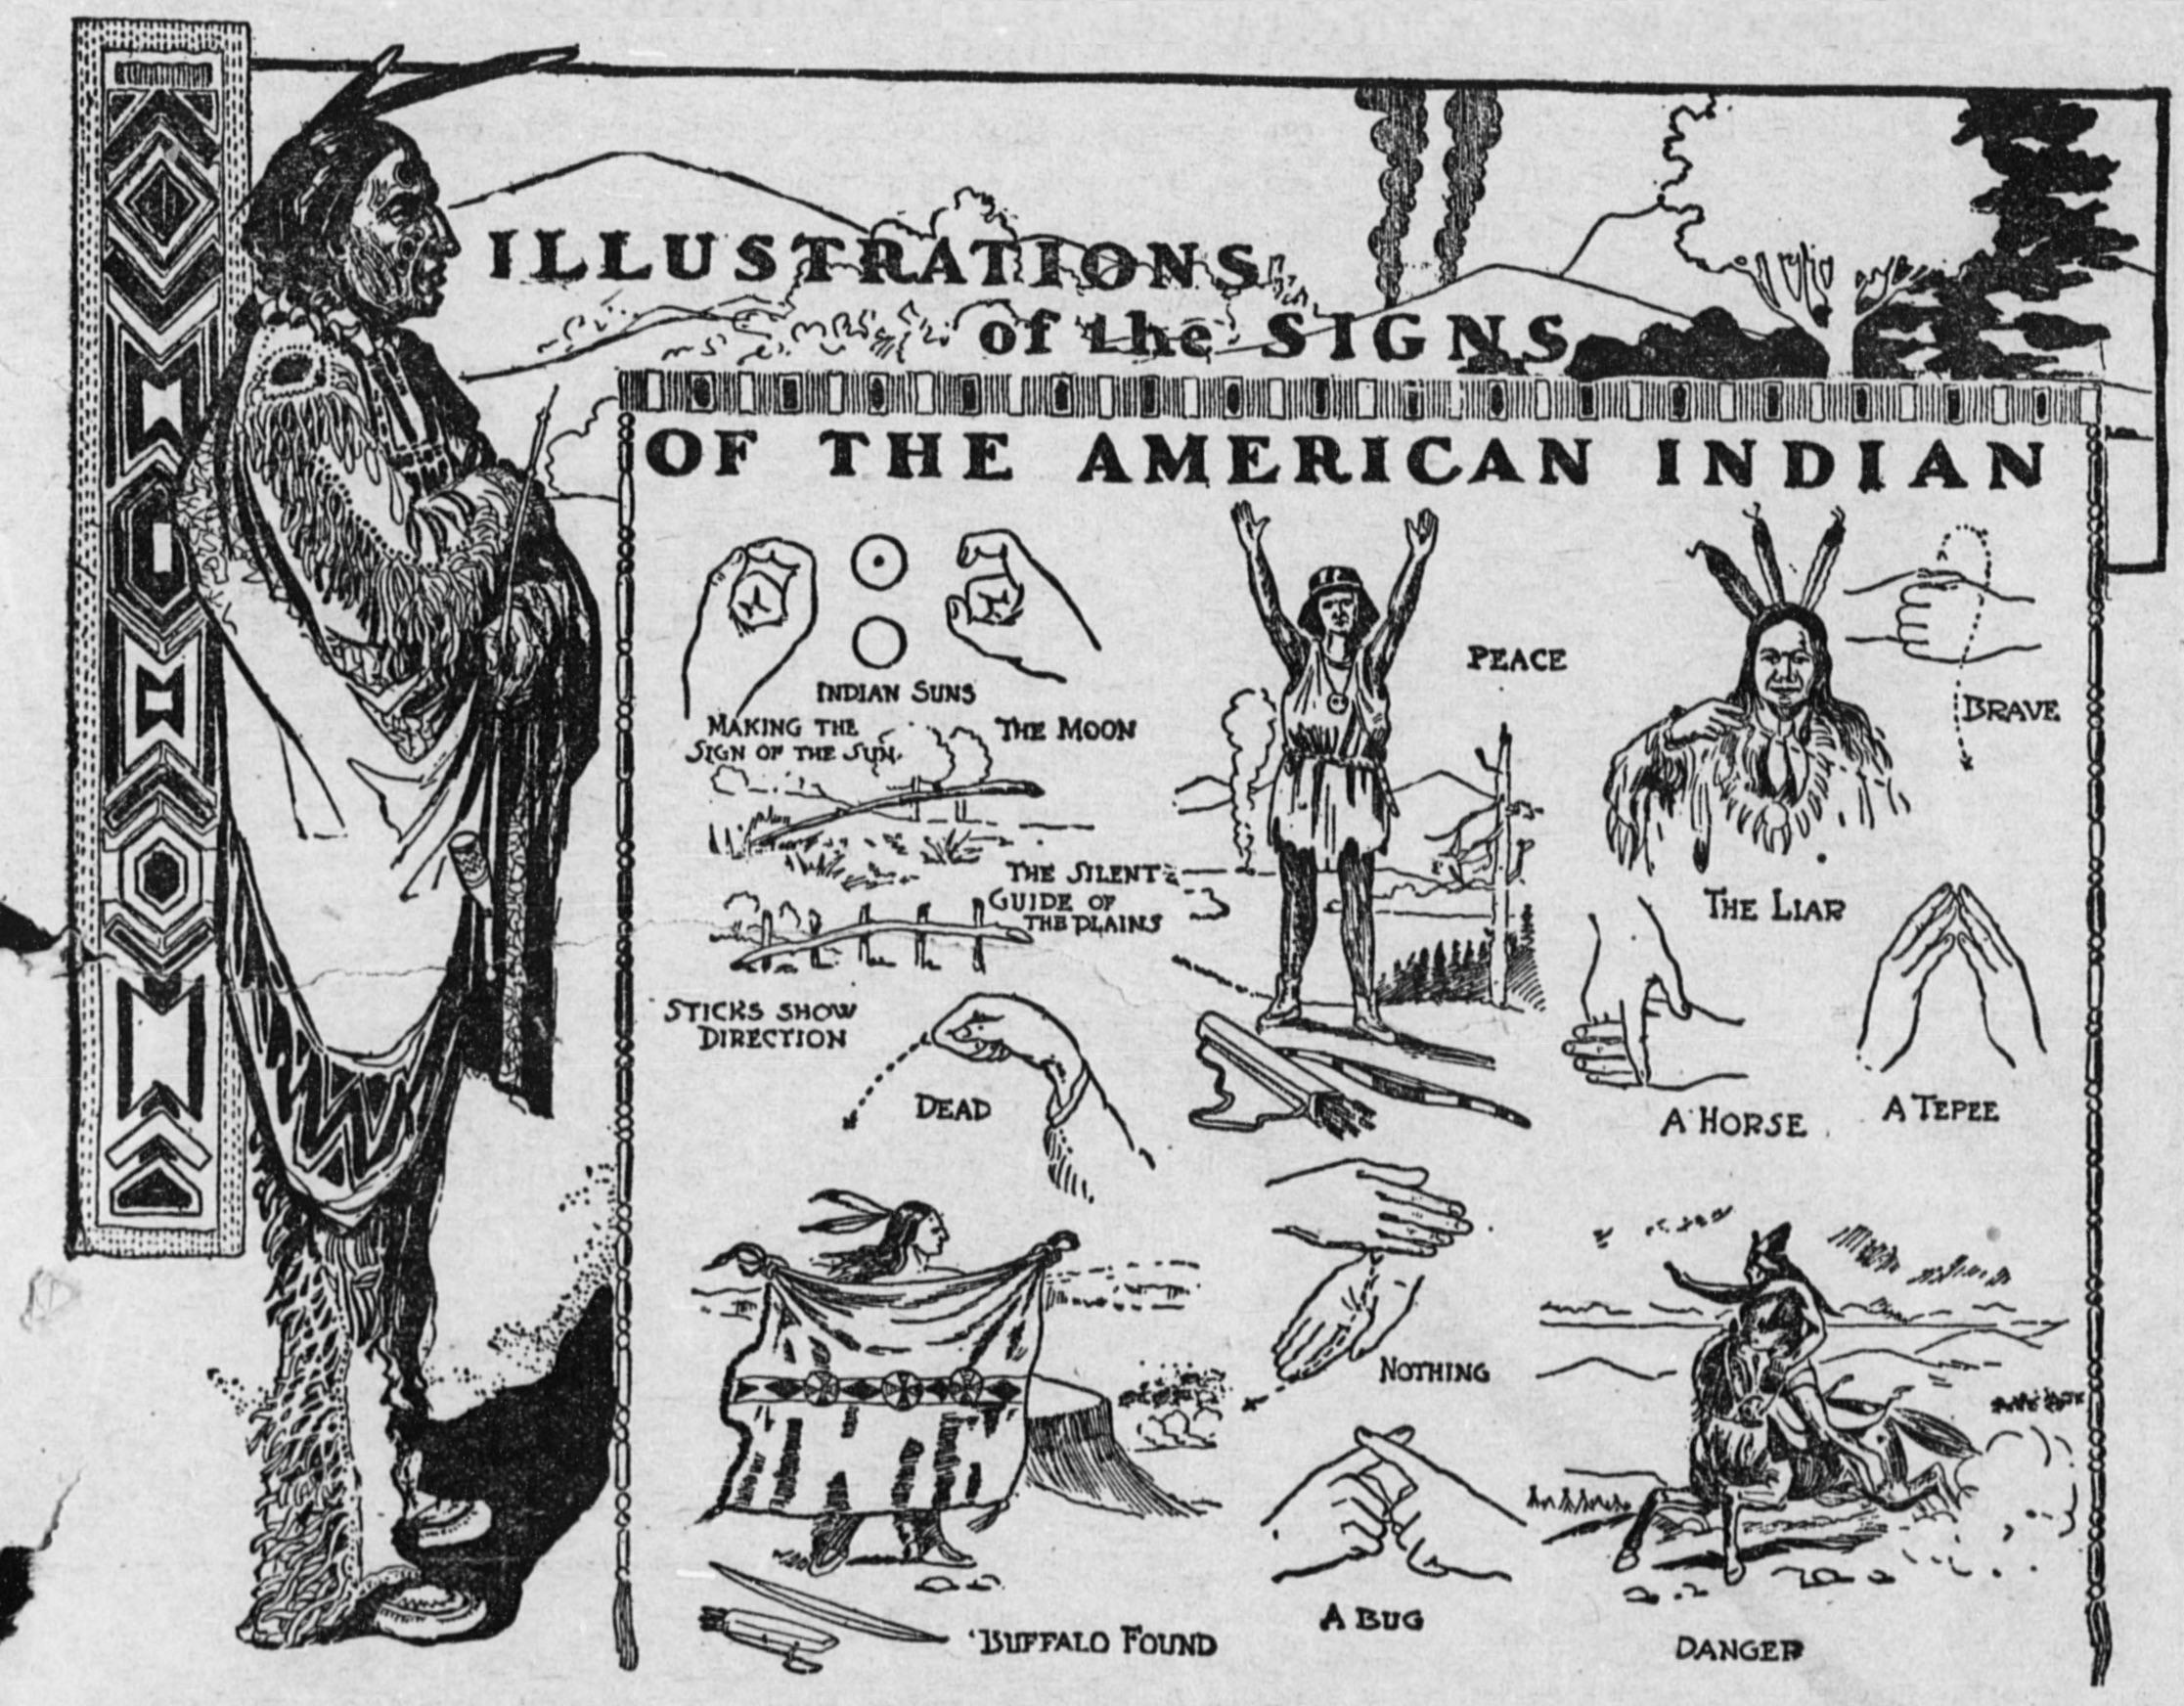
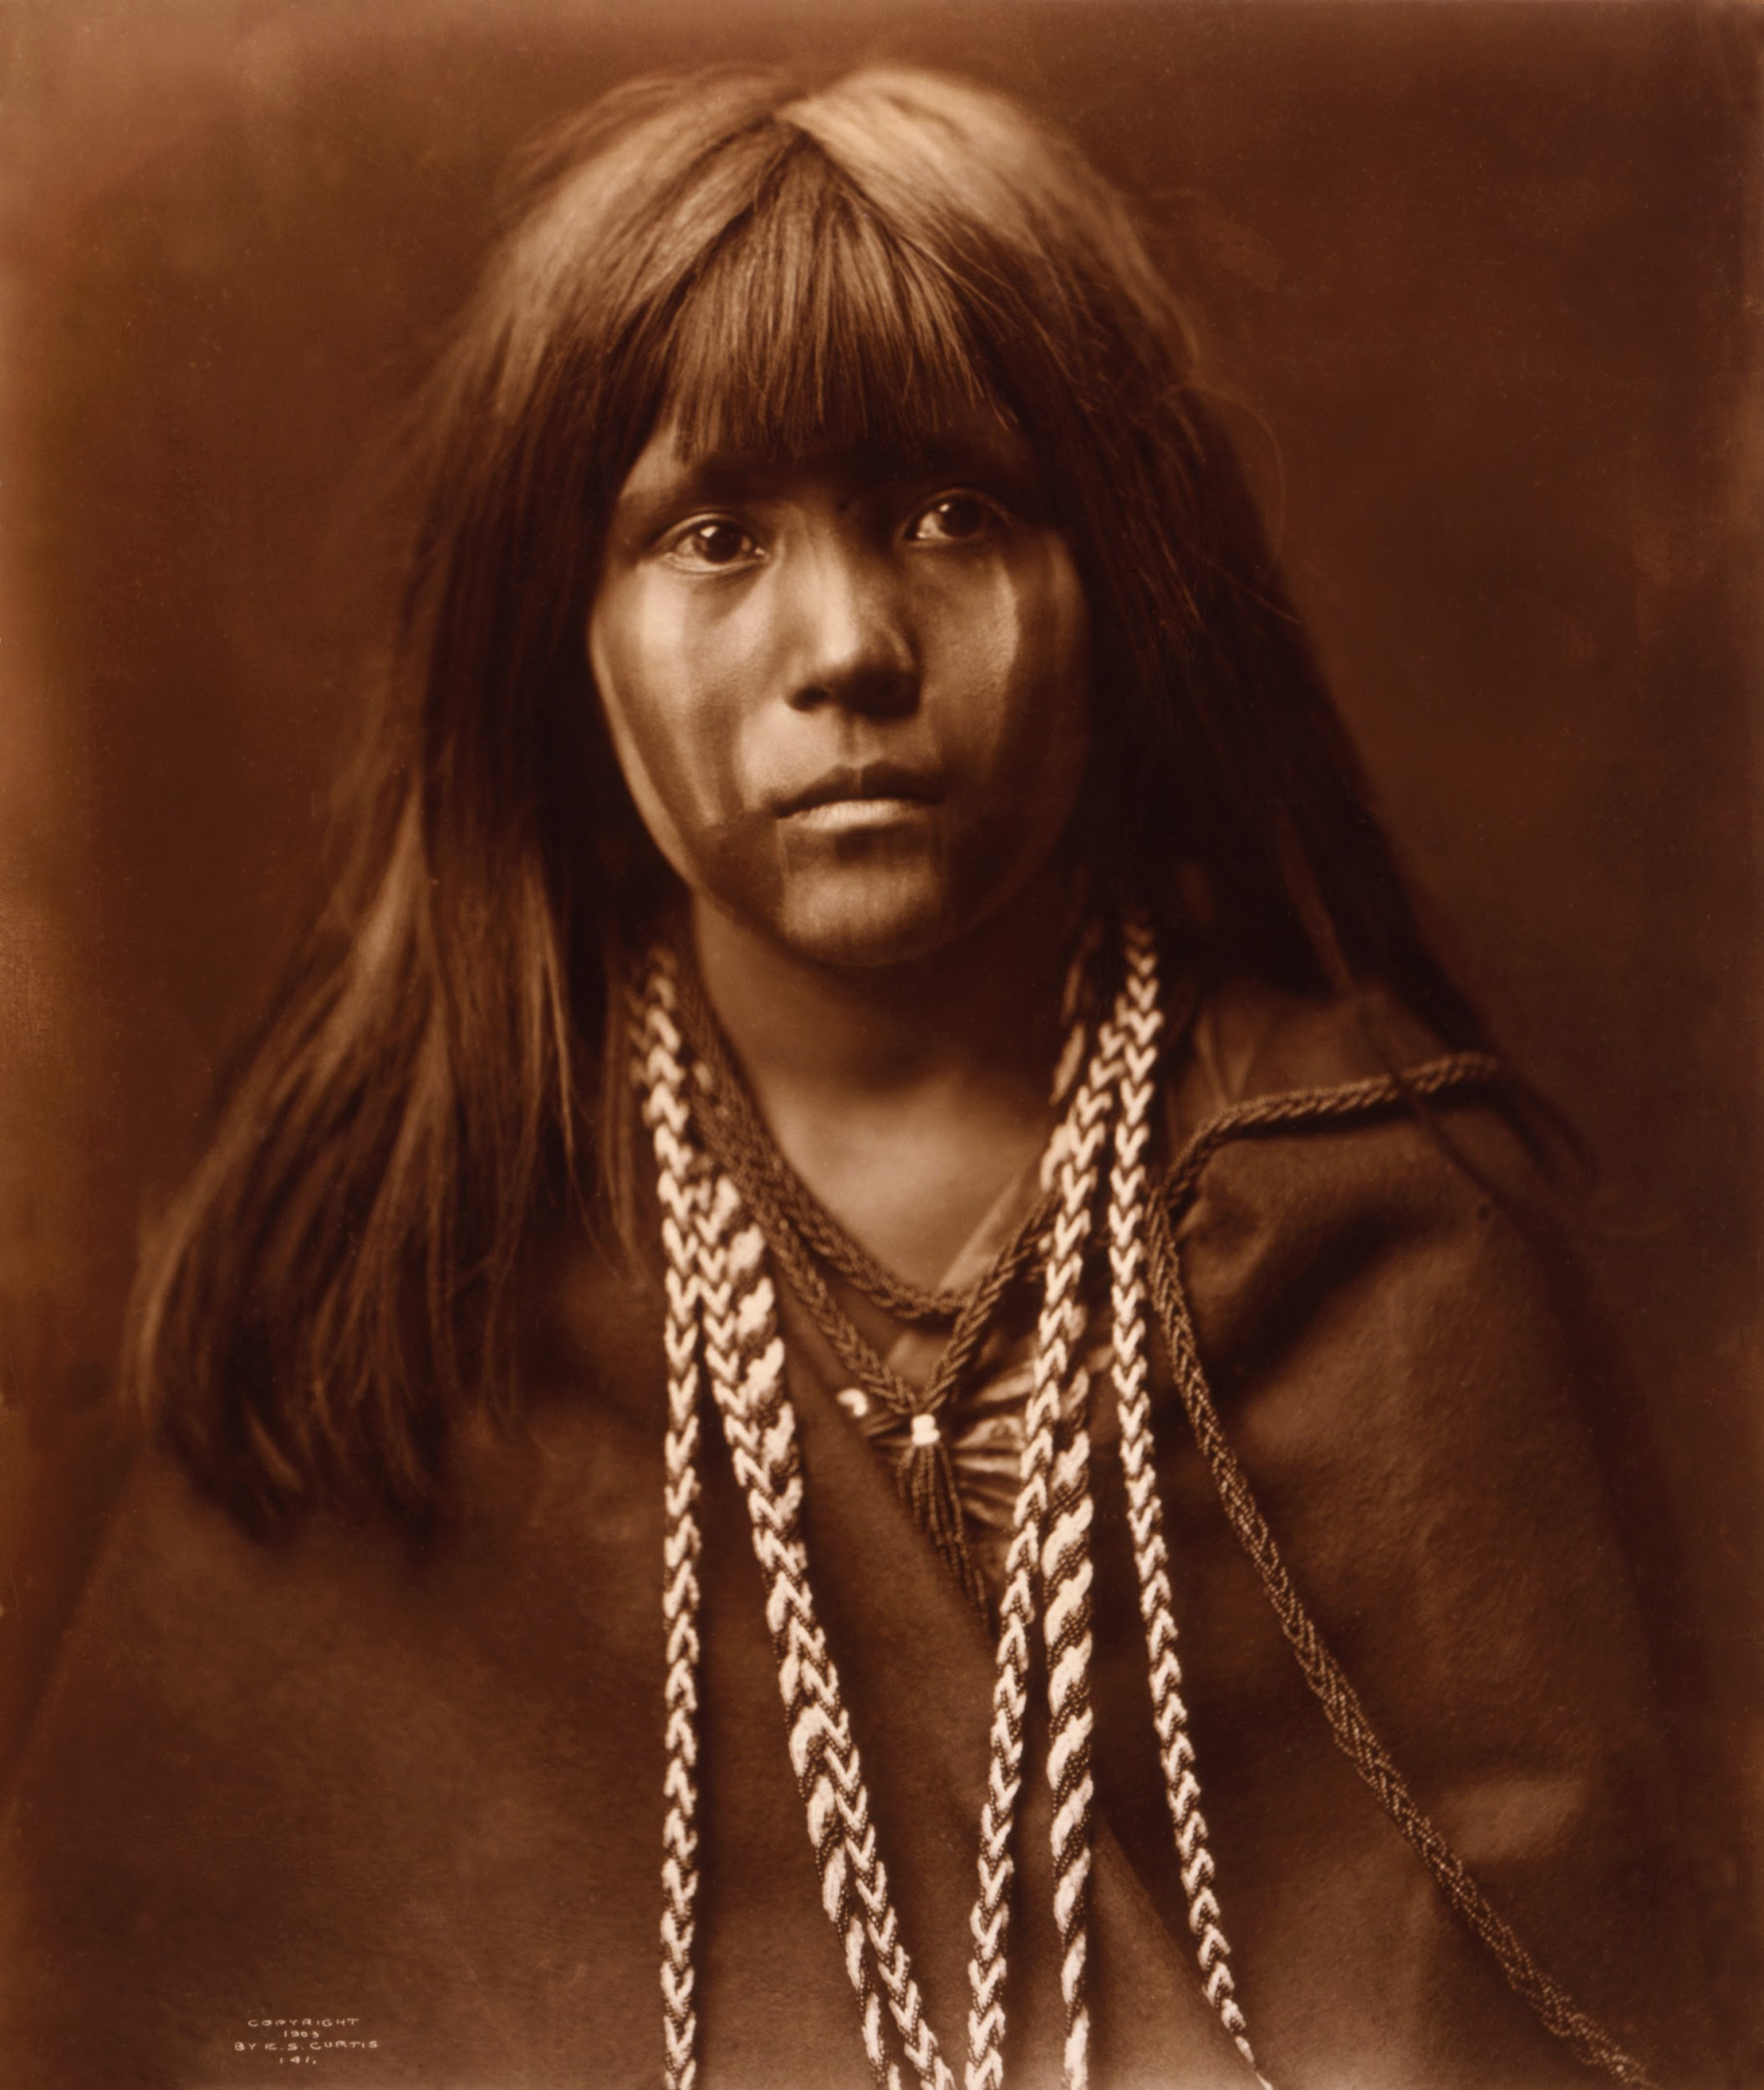
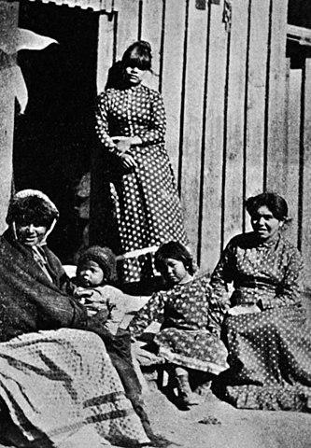
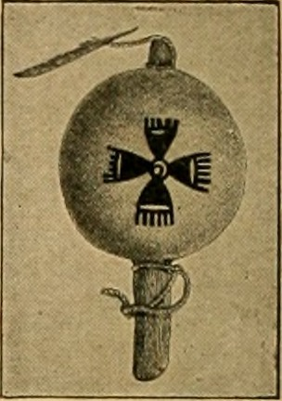
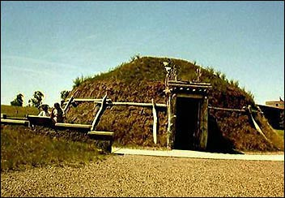
Maidu Tribe
By: Isaac, Kai, and Ryan

Slide 2
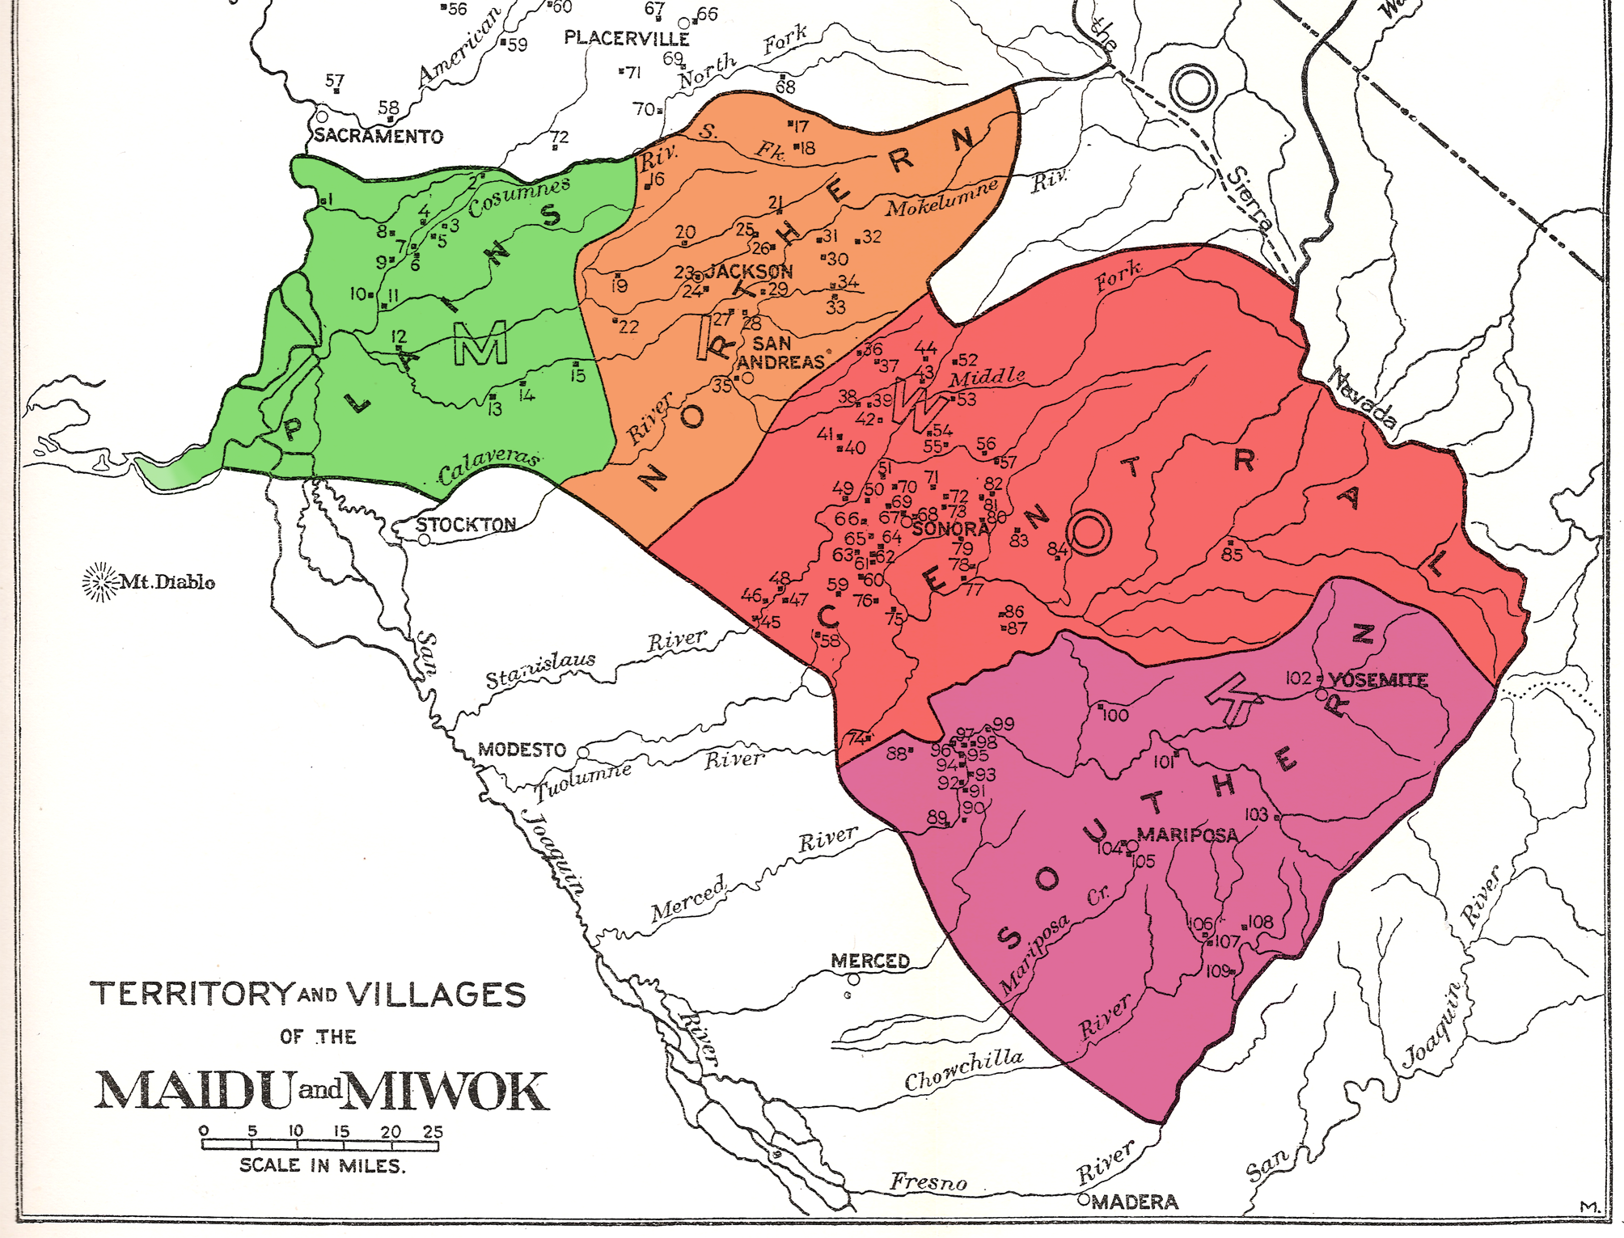
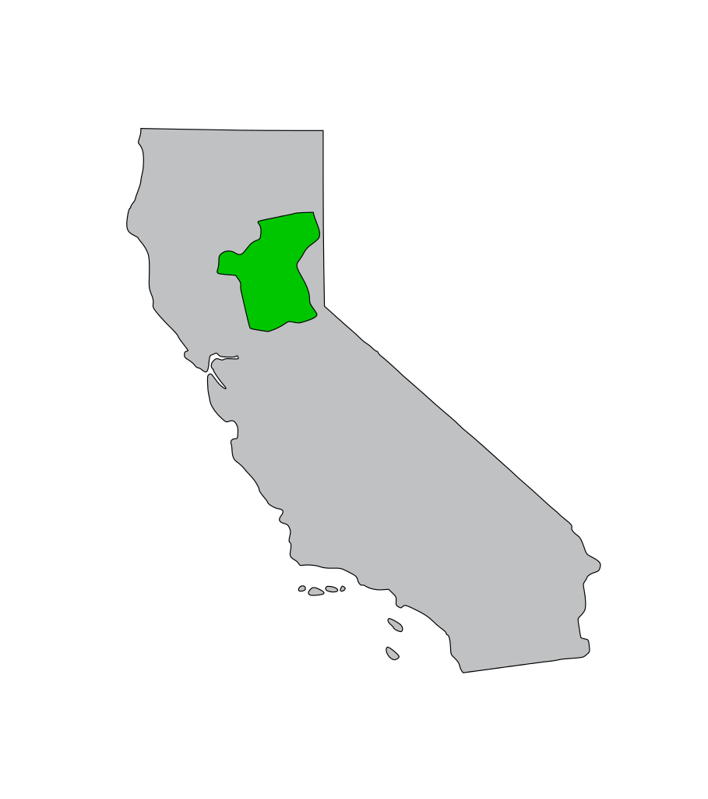
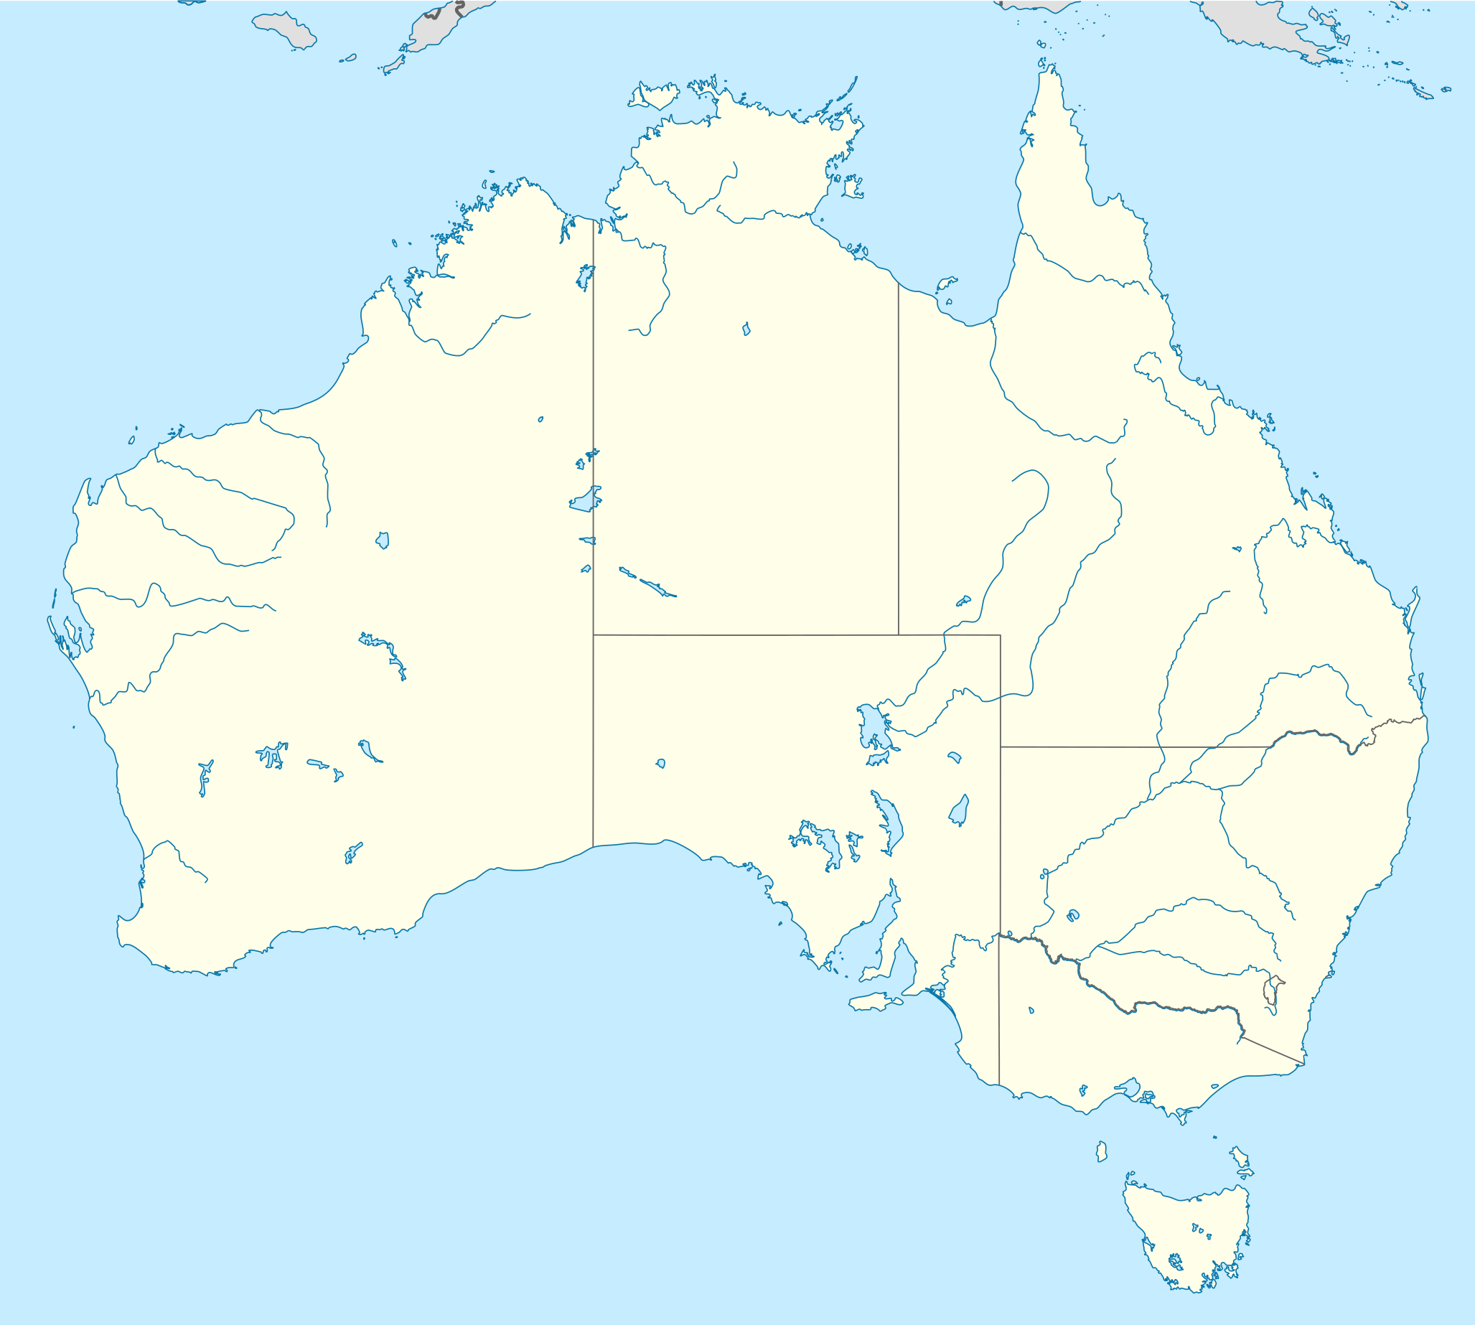
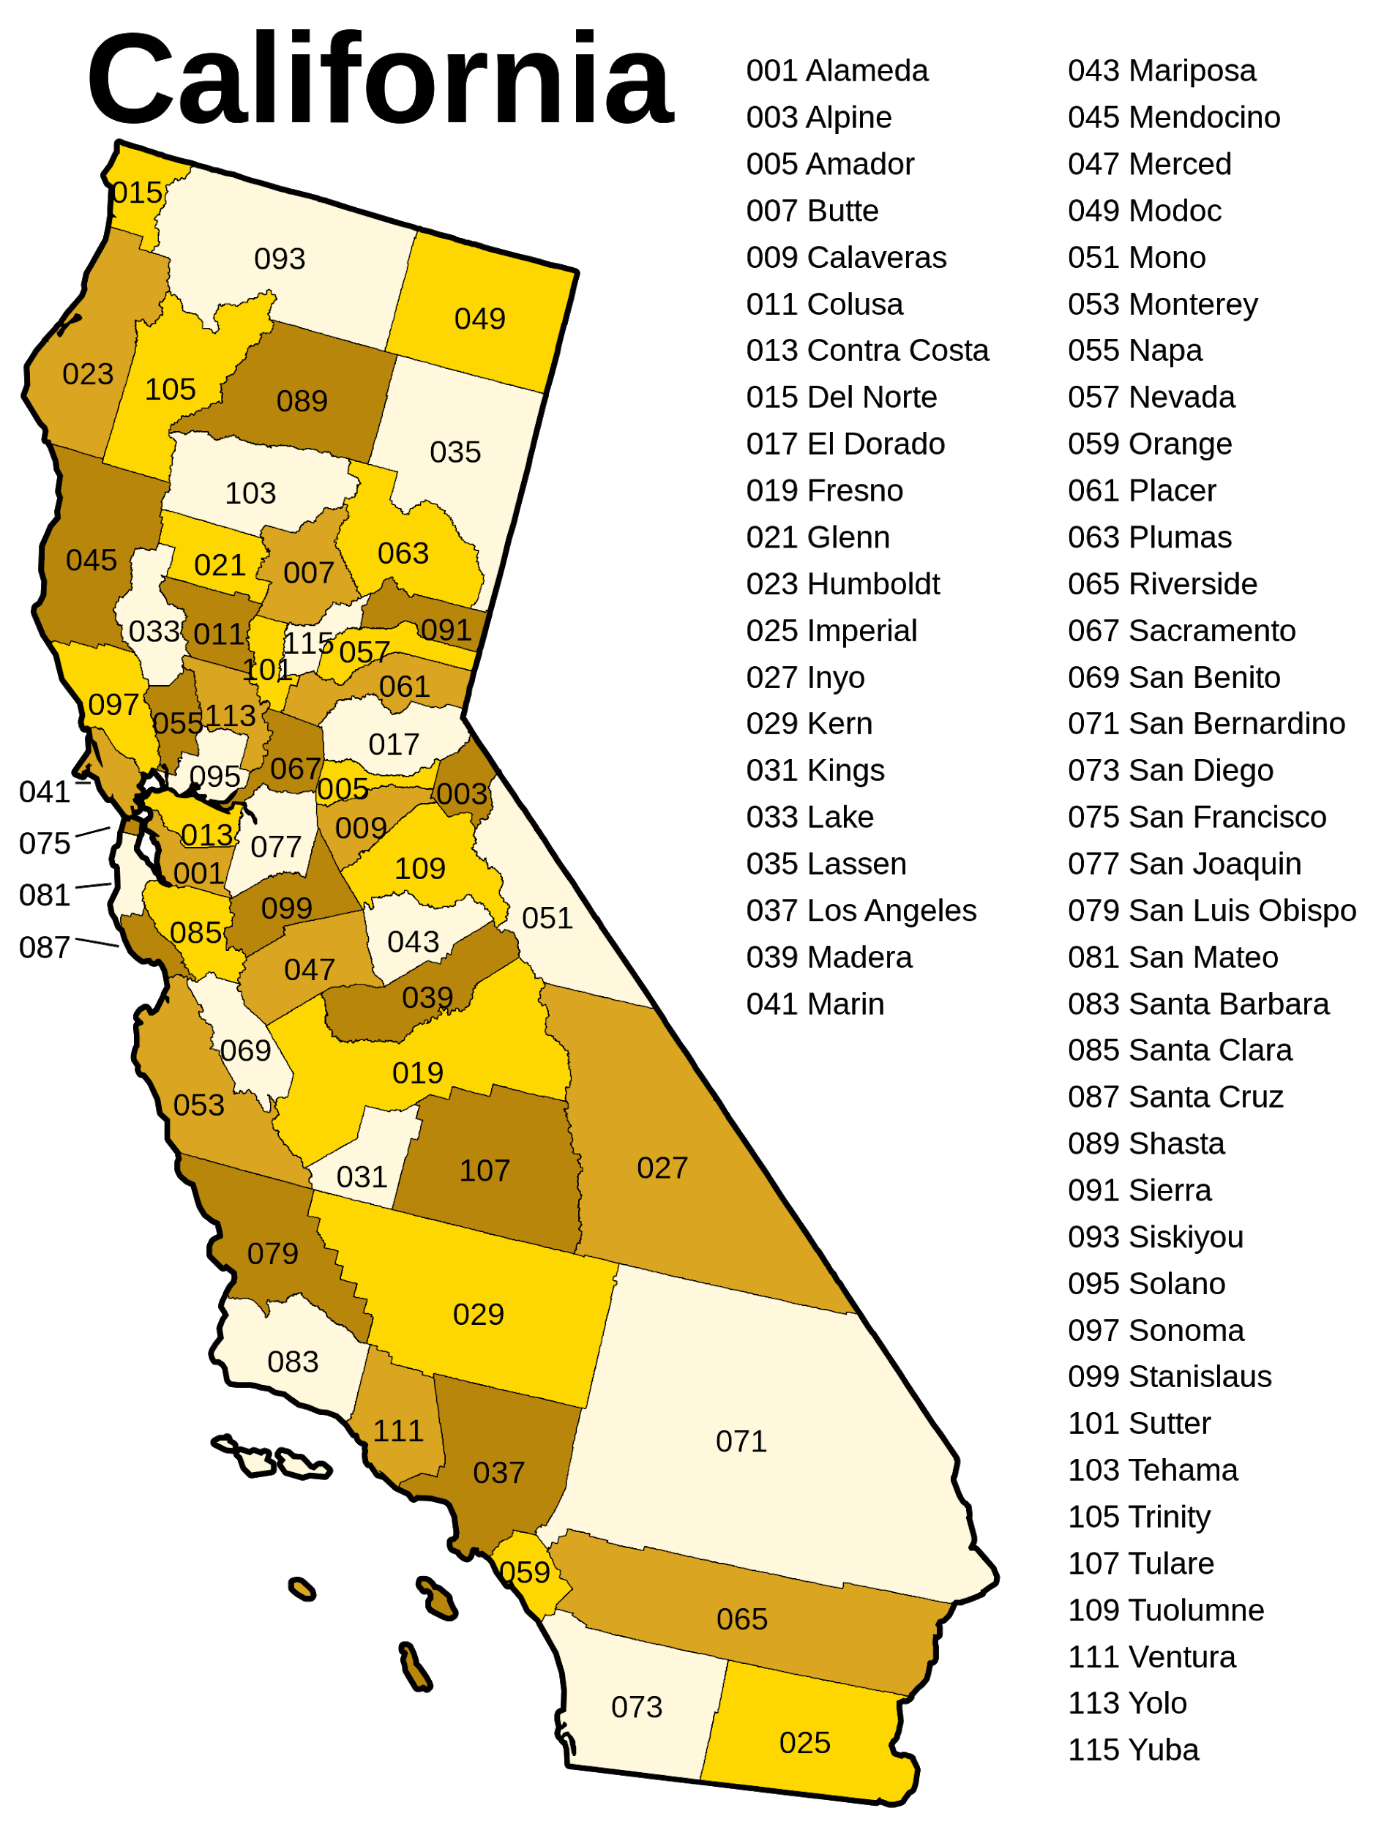
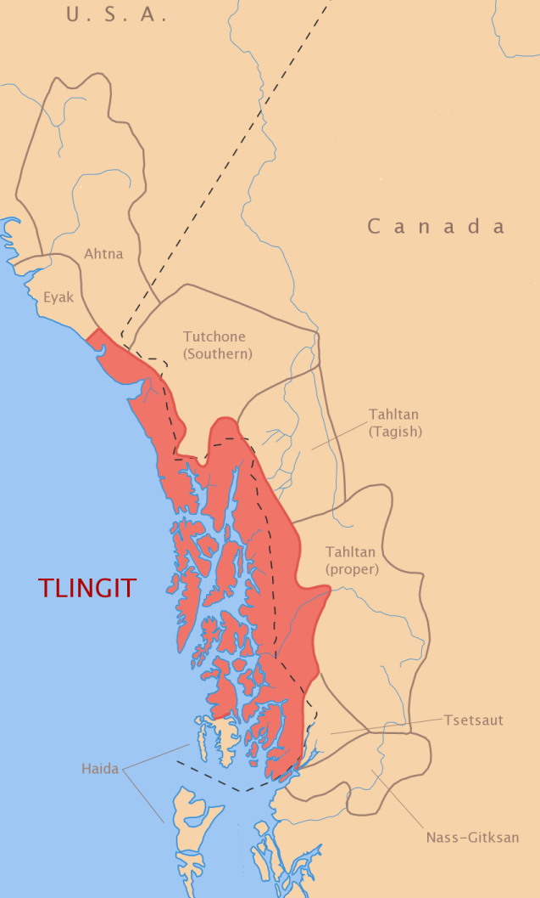
Location
The Maidu tribe lived in northeastern part of California. They lived near rivers and mountains. They had clothes suited for medium kind of climate. The Maidu often built their villages on high ground so that they could see strangers coming.

Slide 3
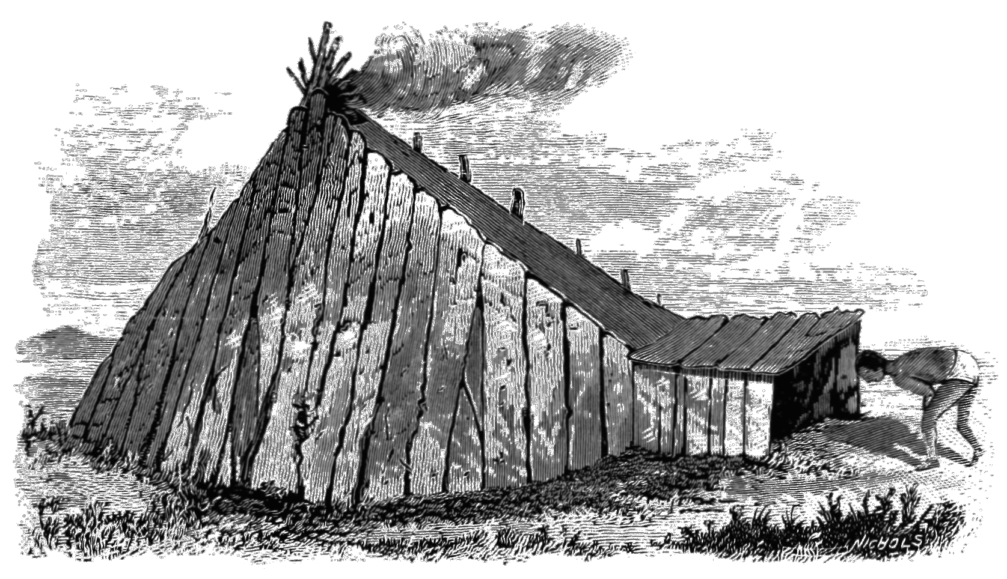
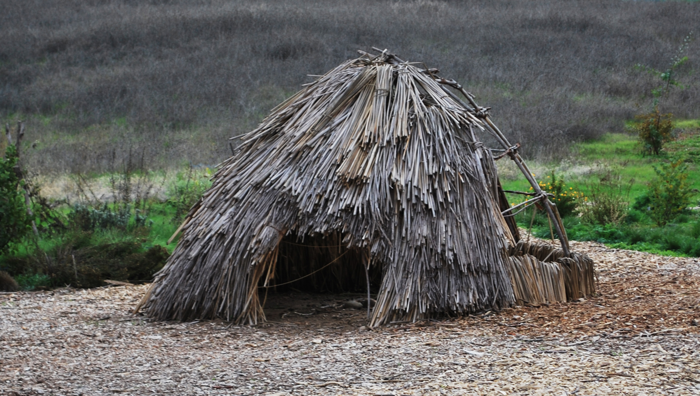
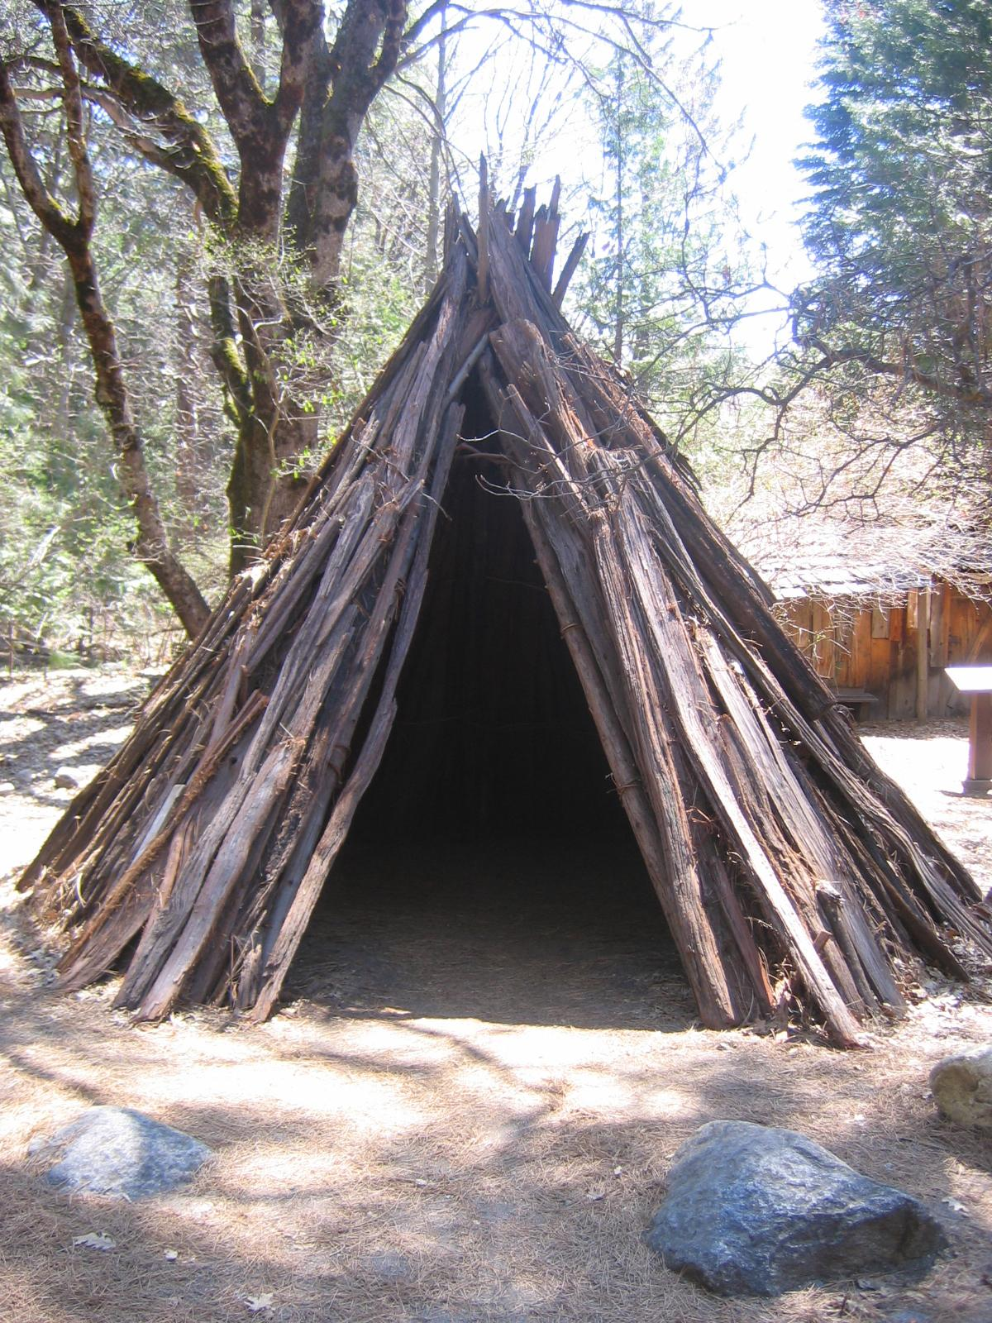
Shelter
The Maidu Tribe lived in homes made out of thatch and a hardly known material called buckeye. It looked like a big, rounded mound of earth with a hole in the top. The hole on the roof was the doorway. They covered their homes with brush they built them partly underground so they would keep warm in the winter. Several families might had shared one lodge.

Slide 4
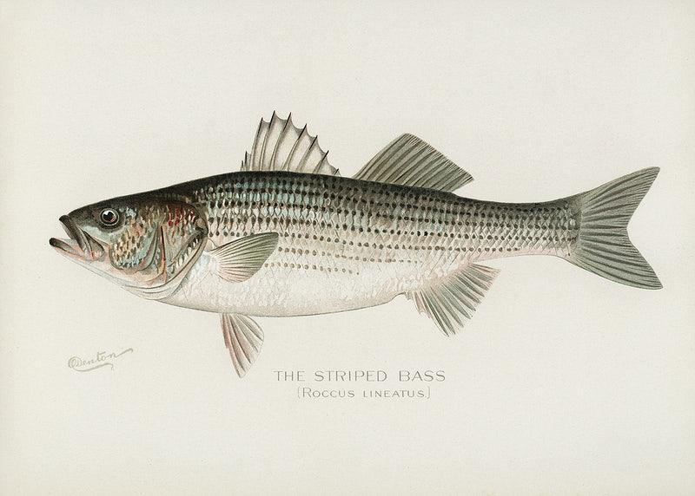
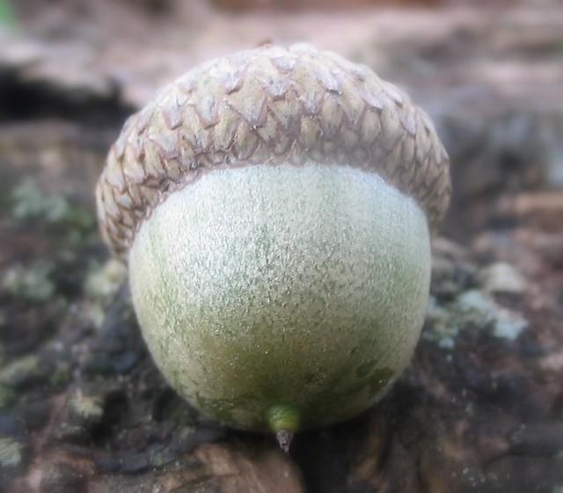
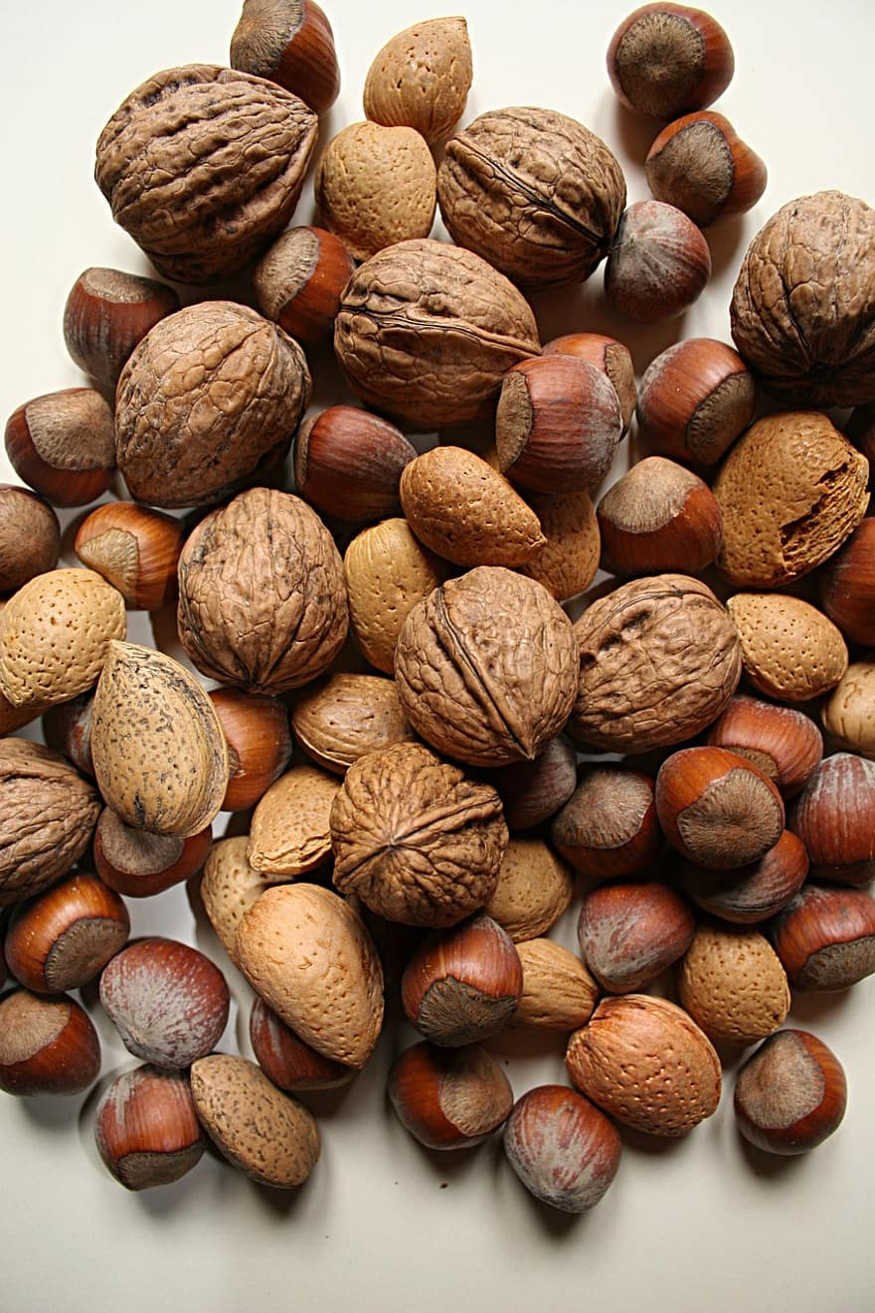
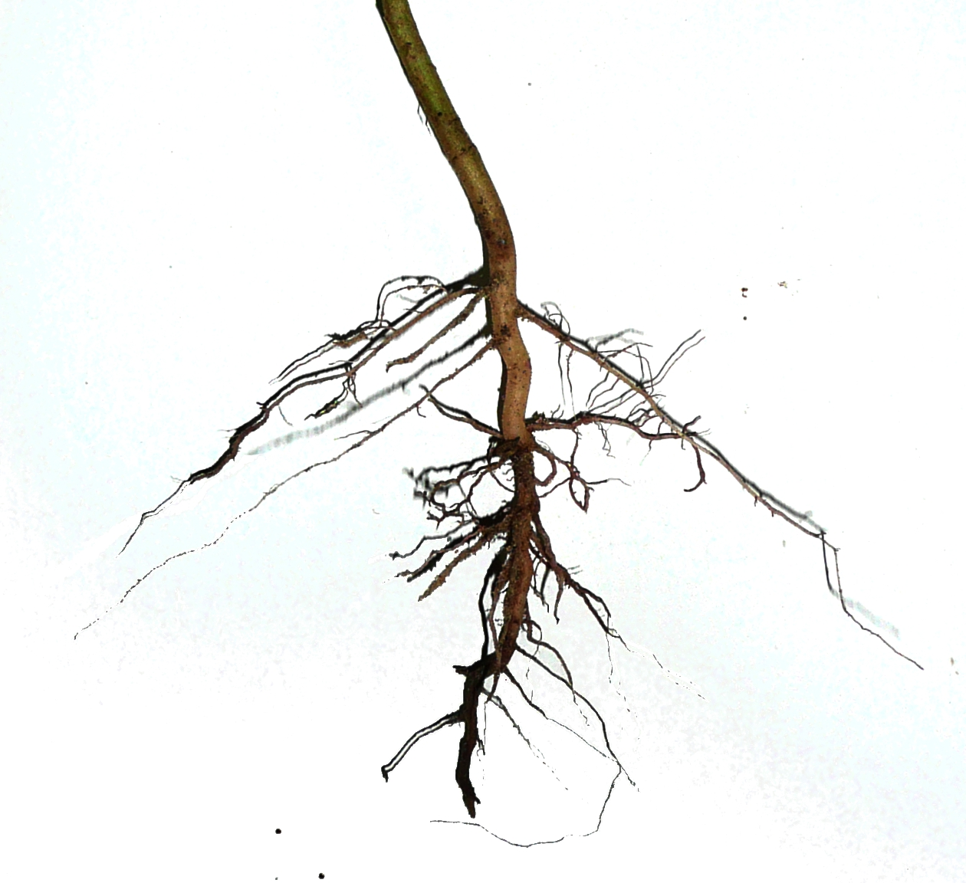
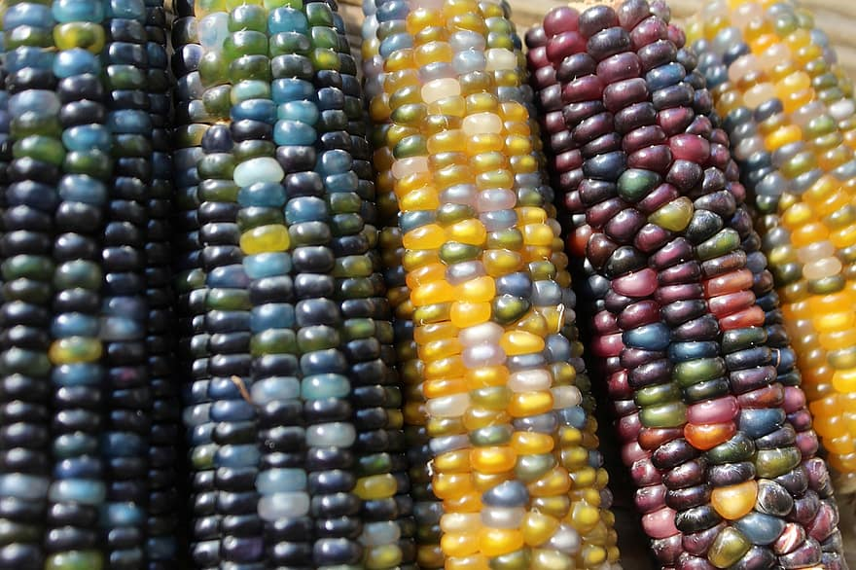
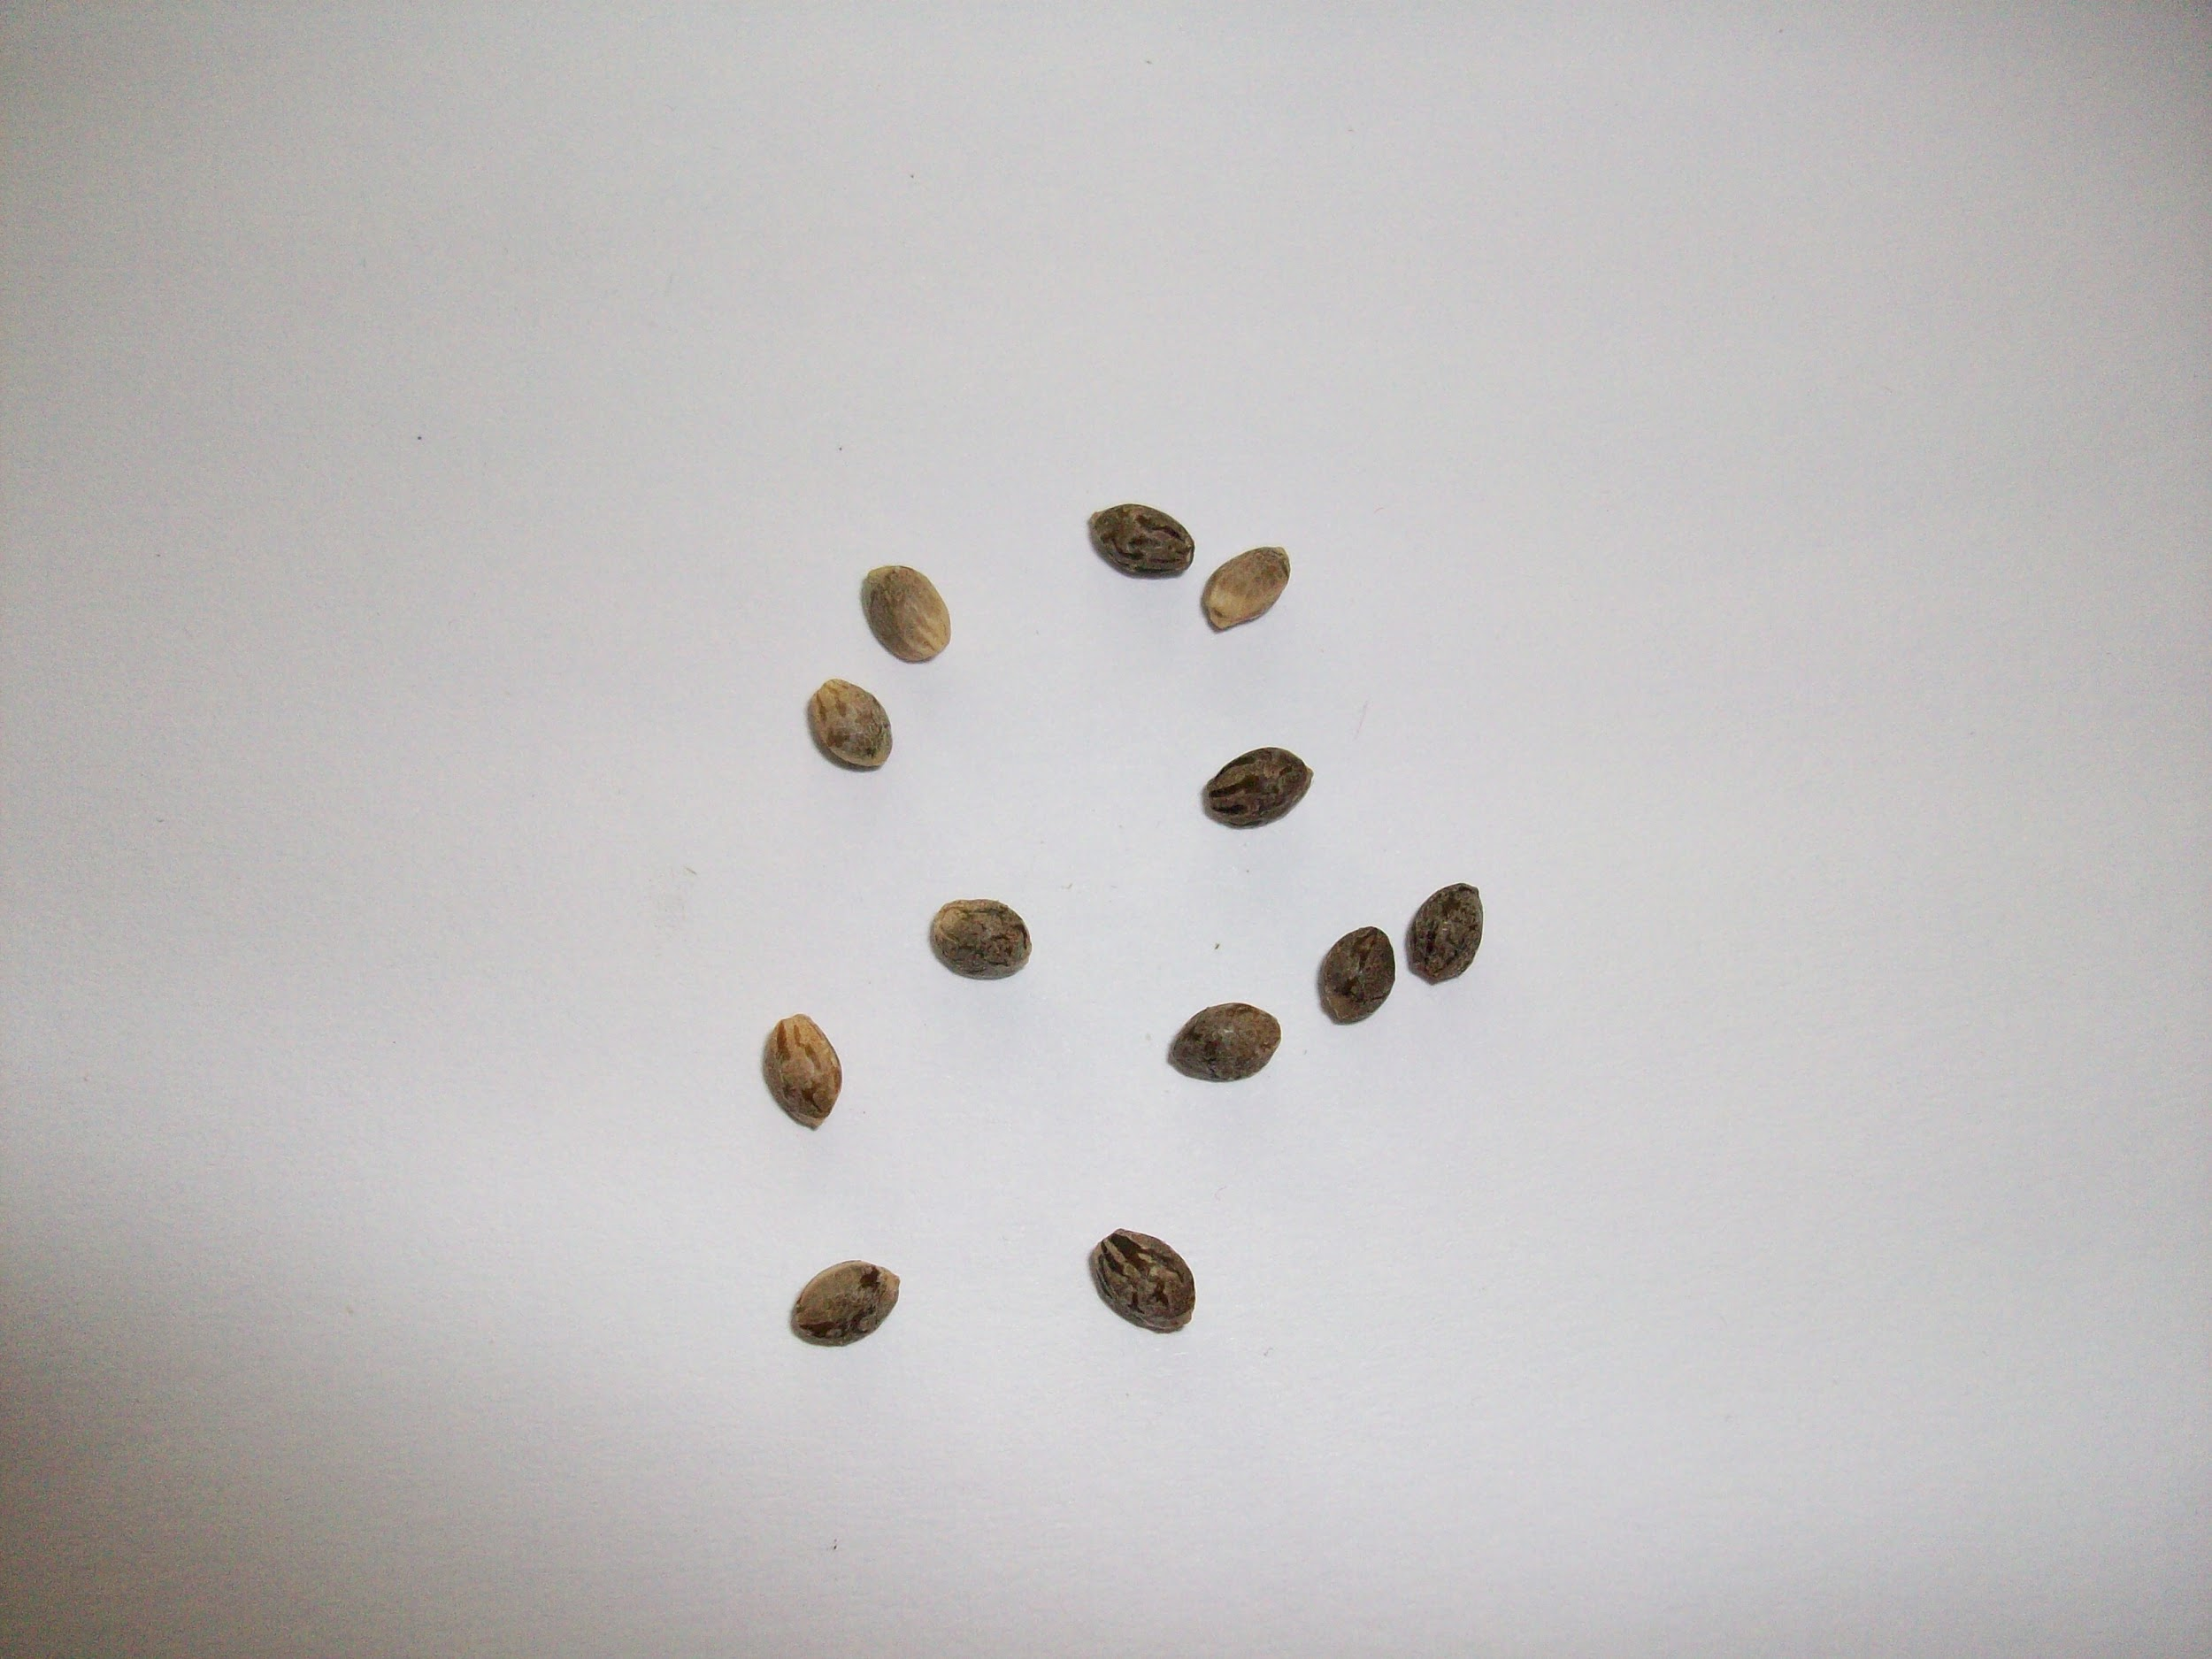
Food
The Maidu Indians got their food from nature. A staple food of Maidu were the acorns from the oak tree provided an abundance of these nuts. The acorns were then roasted and eaten whole ground into acorn meal which was used to make bread. Their protein diet was supplements by eating fruits, seeds, nuts, bulbs and roots. They also gathered wild plants, seeds, roots, insects, and berries. They hunted deer, elk, rabbits, birds, and sometimes even bears! They fished for salmon, trout, and eels in nearby rivers and streams.
Notes:
Write about the food the tribe ate, crops they grew, hunting & gathering skills, and ways to prepare meals.

Slide 5
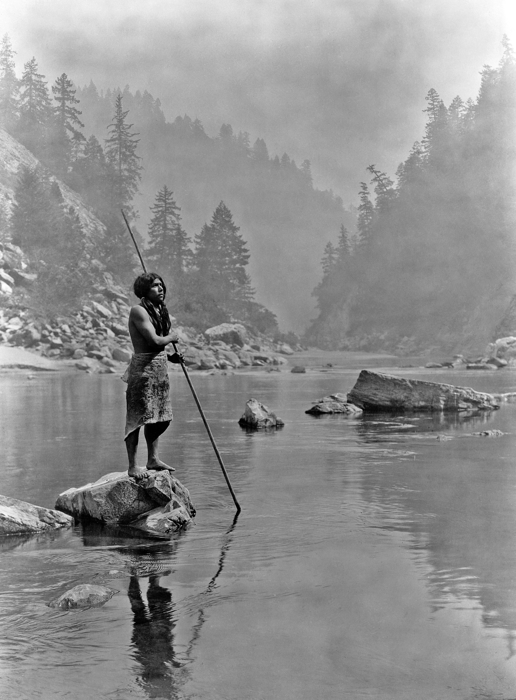
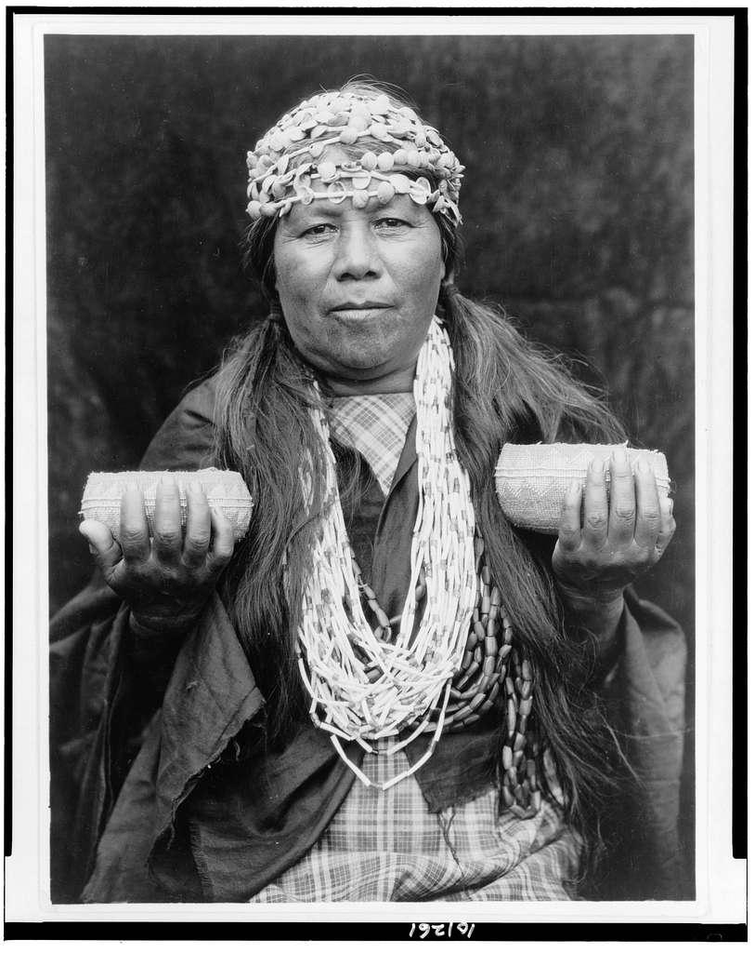
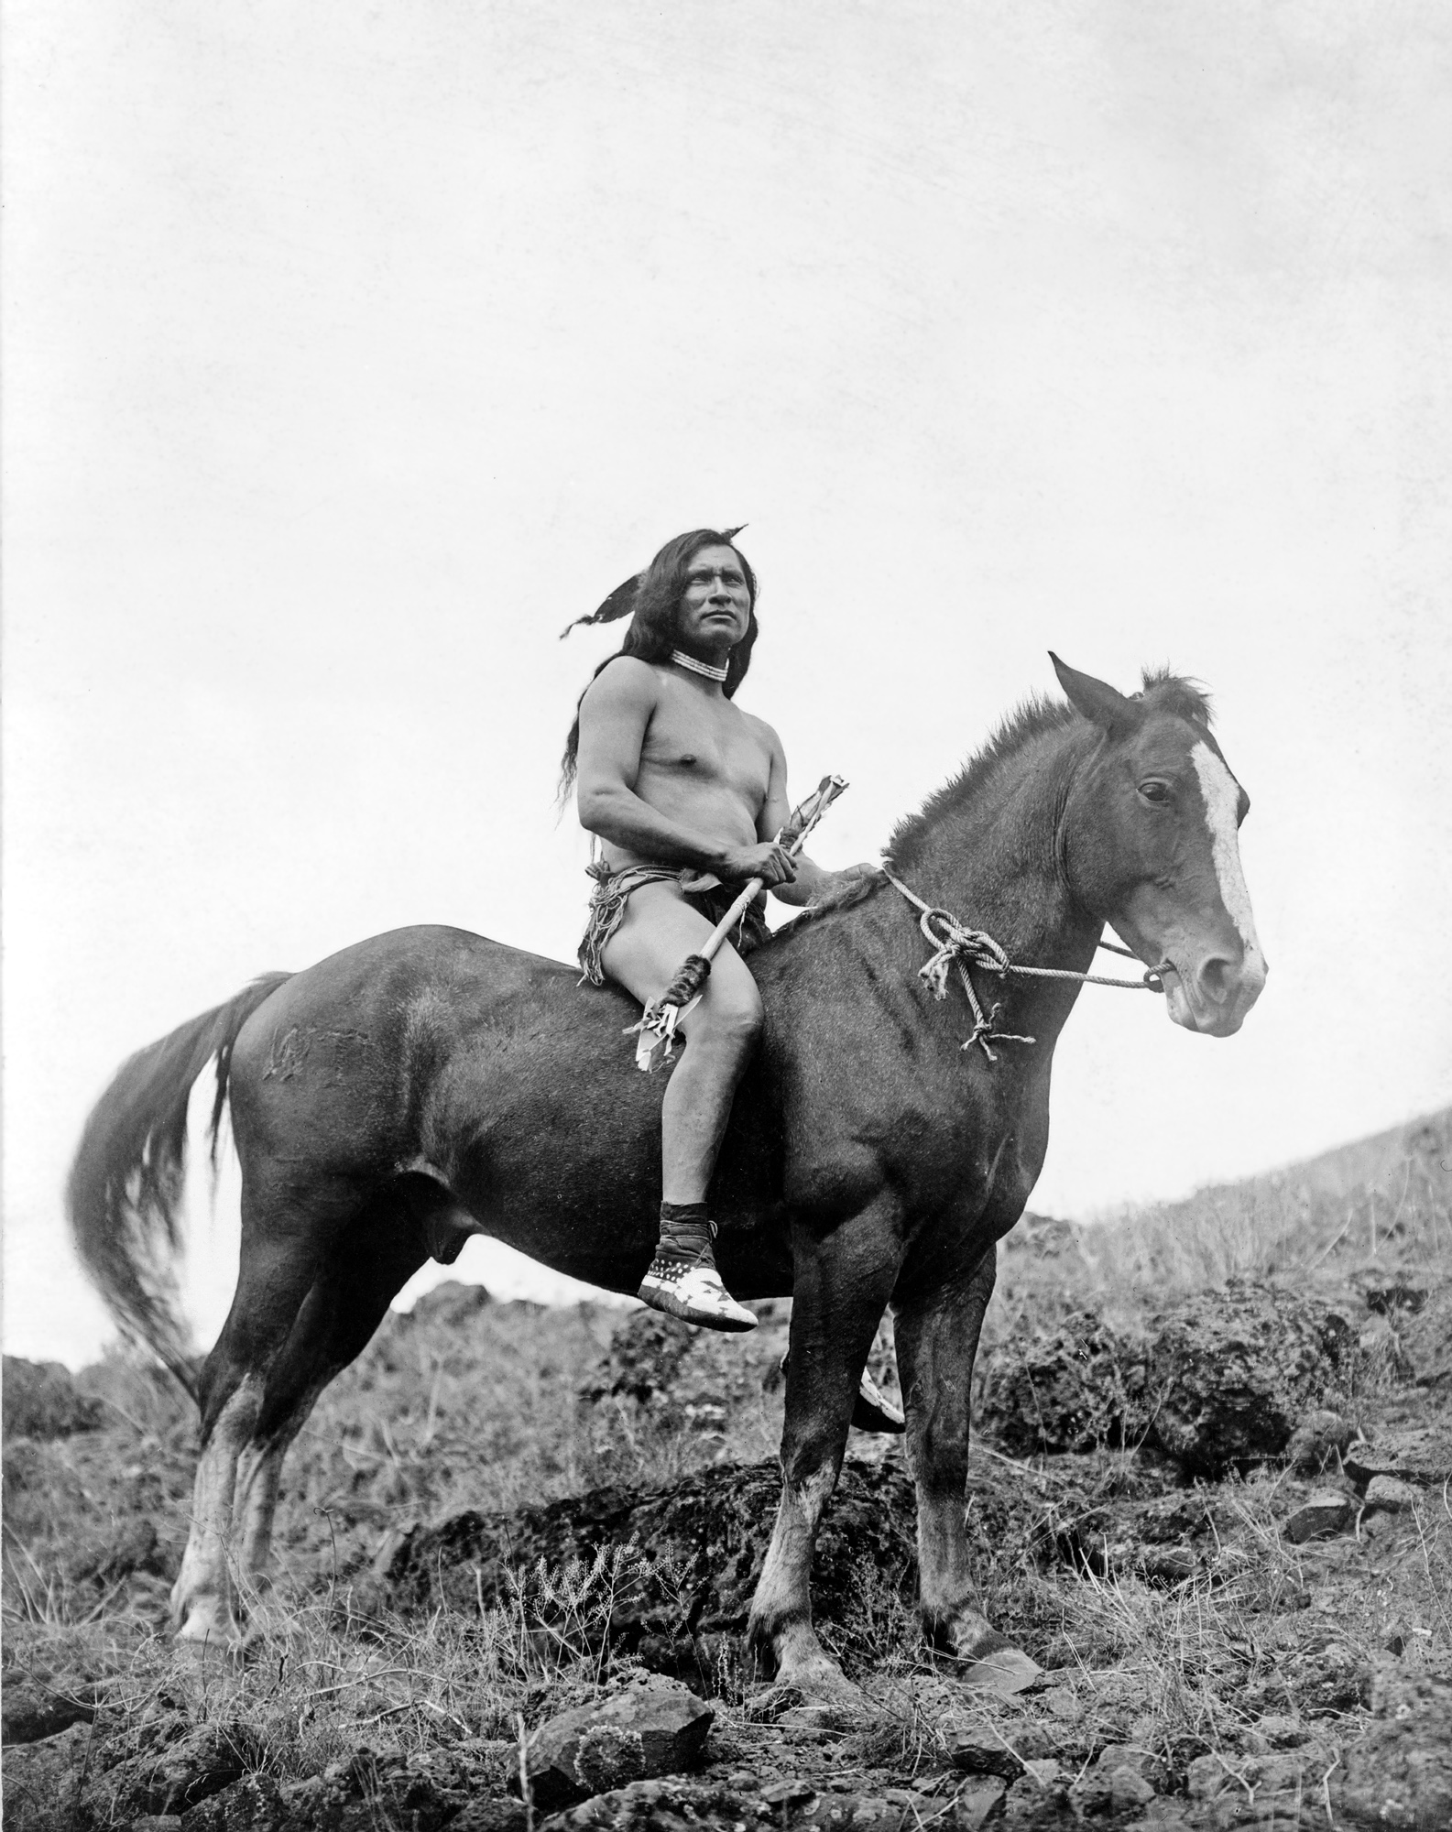
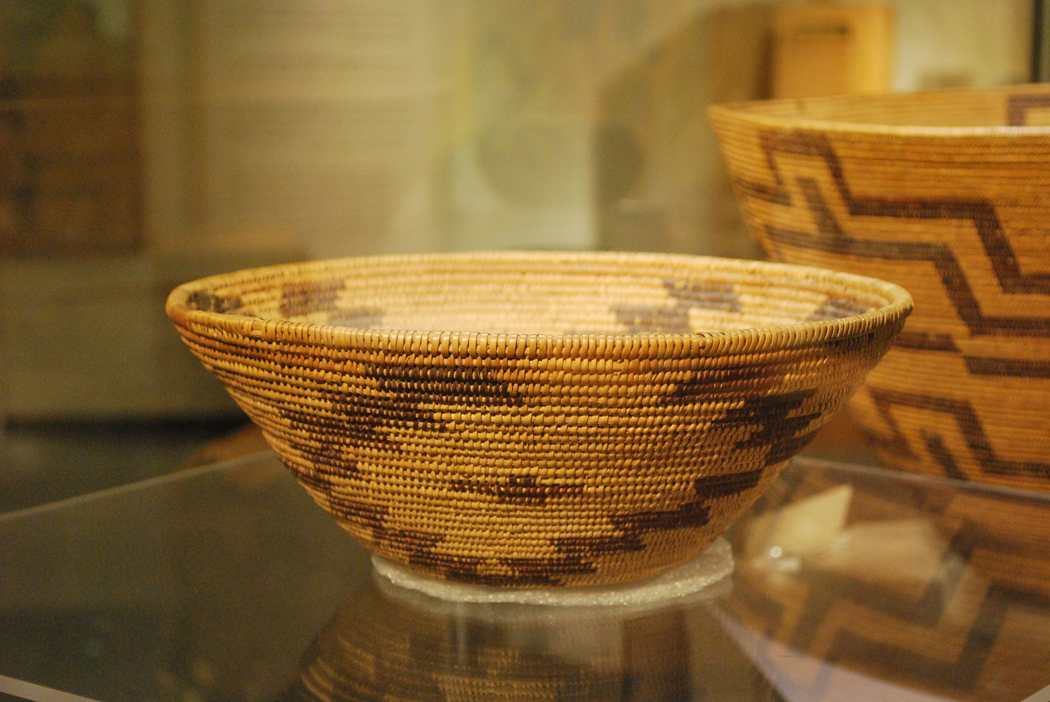
Culture
The Maidu tribe had an interesting culture. Maidu men made knives and arrowheads from flint. They hunted fish with spears. Maidu women prepared the food and made baskets. The Maidu carried, stored, and cooked food in baskets woven from reeds and grasses. Children also helped hunt, gather food, cook, and weave baskets. They sometimes wore tall moccasins stuffed with grass to protect their feet from the snow. They tied animal skins around their legs. Blankets of deerskin or rabbit fur also provided warmth.
Notes:
Write about the art, customs, ceremonies, and responsibilities of the men, women and children.

Slide 6
They had horses to get around the land and get stone and other materials. Their language was part of the Penutian Family. Tattooing was done by the Maidu. Men had vertical lines on the chin and women had tattoos on the chest, arms, and abdomen. The Maidu had many dances, both for special ceremonies and for fun. They used rattles, flutes, and whistles to make music for their dancing.

Slide 7
In the past, Indian kids had more chores and less time to play. They did have toys and games.
The Maidu Tribe favorite games were stick/pass and ball race, with different versions developed for both males and females. These games didn’t necessary involve a round ball like we are familiar with today. The hoop game was where players tried to throw long darts through a moving hoop. Teens and adults played gambling games. Young girls played with dolls they made with their moms. Women and girls played dice games. They also played a game where players held marked sticks behind their backs, and guessed their location for men and boys.
They thought it was fun back then when they didn't have electronics to play with.
Written by Isaac

Slide 8
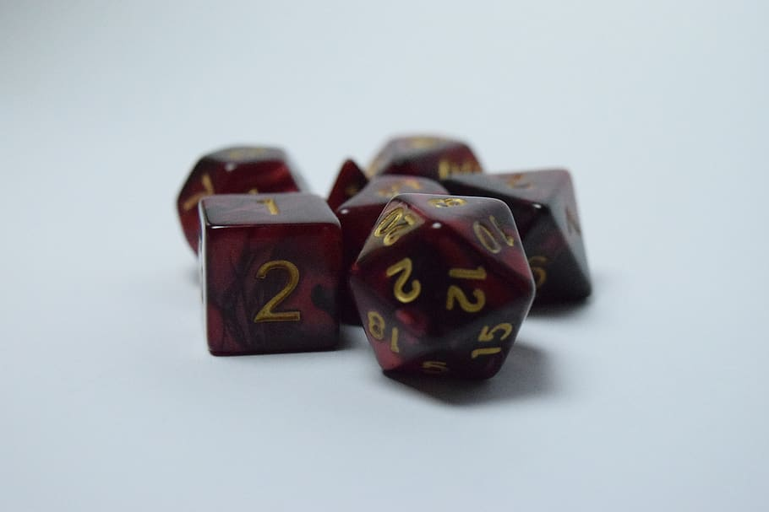
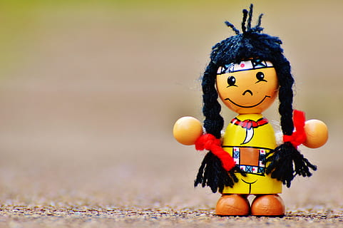
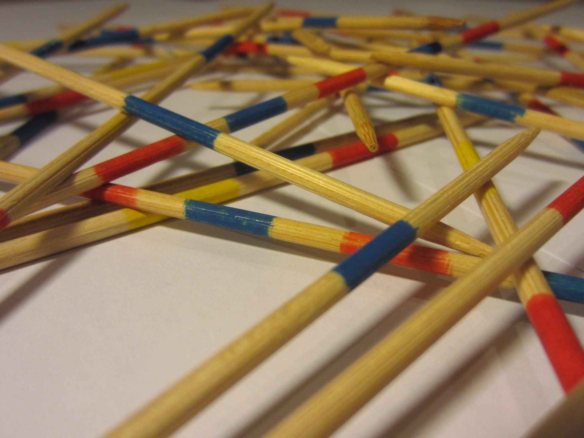
Game pictures
Isaac

Slide 9
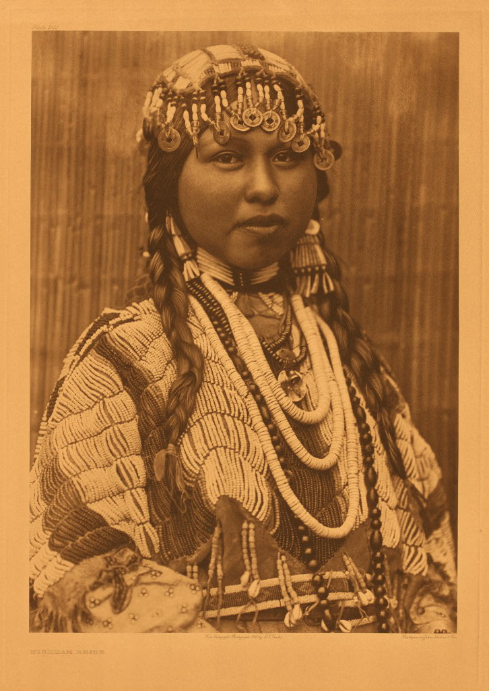
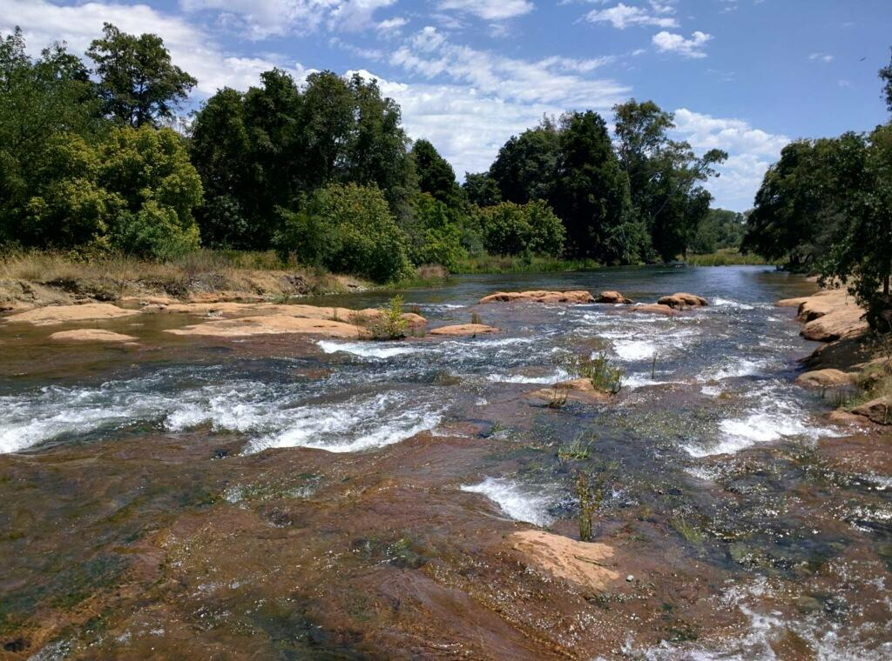
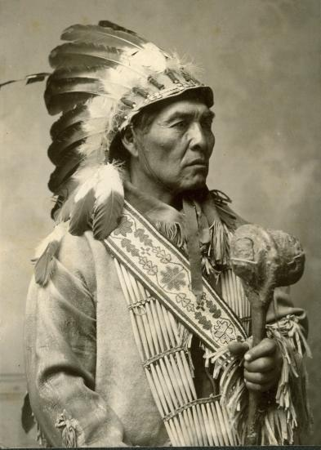
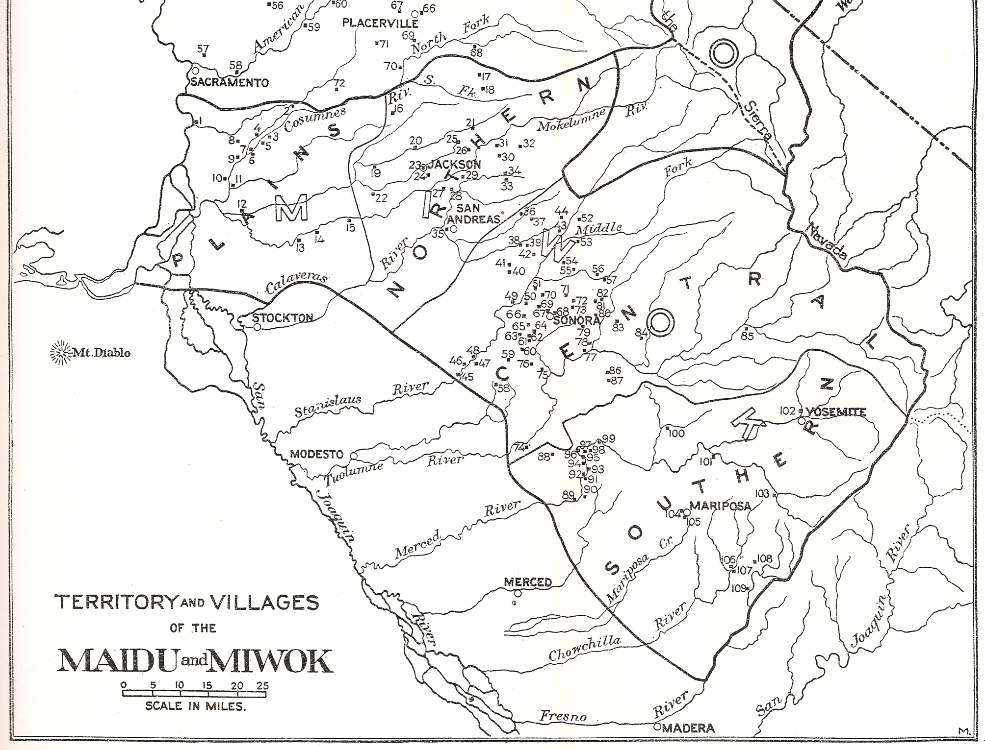
The end
Notes:
This slide is the last slide. You can add a picture or several pictures as an ending to your presentation.

