Slide 2
Teacher’s Name: Brittany viney
Email: Brittany_viney@chino.k12.ca.us
(weekdays-during school hours)
*Email & Parent square are the best ways to contact me
Phone: 909-606-8531

Slide 3
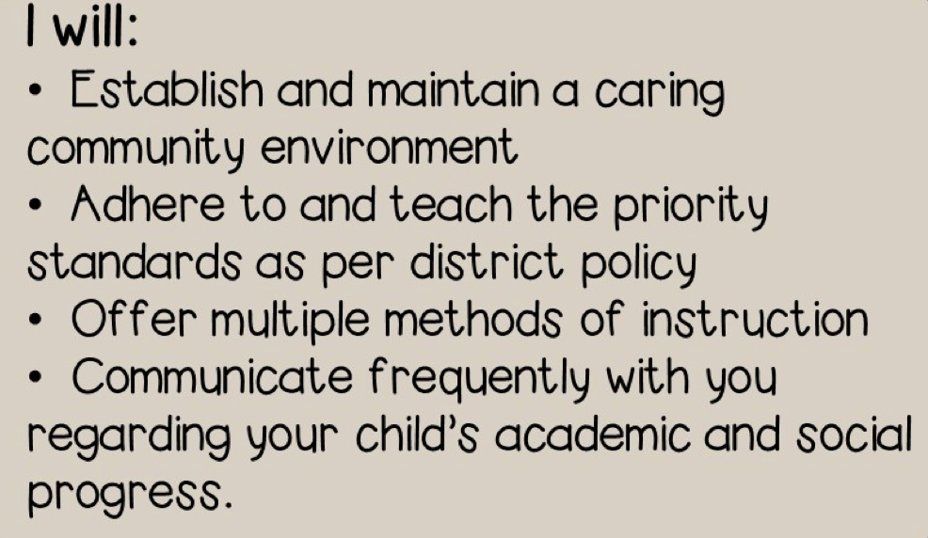
FAIR, FIRM, & CONSISTENT.

Slide 4
School Wide Expectations
BE RESPECTFUL
BE RESPONSIBLE
BE SAFE

Slide 5
Follow directions quickly
Raise your hand for permission to speak
Raise your hand for permission to leave your seat
Make smart choices
Keep your dear teacher happy ☺

Slide 6
RESTROOM POLICY
Students have before school, first recess, PE, lunch, 3rd recess and after school to use the restroom.
Bathroom use during class for emergencies is ALWAYS allowed. *Entire school uses a bathroom log*
Bathroom tickets are given as incentive to prevent unnecessary bathroom breaks where students miss important instruction.

Slide 7
Students receive Aim Highs, positive notes, earn rewards and/or extra privileges for positive, on-task behavior.
If poor choices are made, students have a chance to think about it and redirect themselves. Depending on the severity of the issue, students may bring home a Choice Slip Notice or an Incident Log for your review and signature.

Slide 8
Verbal Warning
Student(s) receive a Choice Slip or an Incident Log to be signed and returned the next day
Student(s) will be removed from the situation (change of seat/classroom)
Loss of recess/playtime
Parent phone call/email
Conference

Slide 9
Language Arts – Wonders by McGraw Hill
Math – Envision by SaVvas
Social Studies – Reflections by Harcourt
Science – NGSS standards & Twig Science

Slide 10
Science – NGSS standards & Twig Science
This year we will be going on a Field Trip to the Discovery Science Cube on October 11^{th , 2023.}
Field Trips do require signed permission slips
Parent Volunteers will be decided closer to the date

Slide 11
ELA Goals and Focus
I can . . .
Read with fluency and understanding
Identify the moral of the story
Understand how characters affect a story
Ask and answer questions about a text
Identify the main idea
Compare and contrast two nonfiction texts

Slide 12
Writing Goals and Focus
I can . . .
Write an opinion piece
Write a detailed narrative
Write an informative/explanatory text
Conduct a research project about a topic

Slide 13
Math Goals and Focus
I can . . .
Use multiplication and division within 100 to solve word problems
Find the unknown number in multiplication or division problems
Fluently multiply and divide
Use place value to round numbers to the nearest 10 and 100
Fluently add and subtract within 1,000
Tell time to the minute
Measure liquid volumes and masses of objects
Represent data in a graph and analyze the data
Measure area by counting unit squares
Solve perimeter problems
Label numbers on a number line
Explain equivalent fractions
Categorize shapes based on attributes
Divide shapes into equal parts and express it as a fractions

Slide 14
Physical Education:
Mon., Tues., Wed., Thurs., & Fri.
9:00-9:25
Music: Half an hour weekly
Library: Biweekly

Slide 15
Students are required to complete 100 minutes/week of physical education per California Education Code/Law.
3rd grade will participate in PE every Monday – Friday from 9:00-9:25.
Please have them wear appropriate shoes on
these days.

Slide 16
The class will have access to chrome books during class time. While using the chrome books students will be expected to:
log on without assistance
Use Google Classroom to complete work
Xtra Math
Access a variety of apps (prodigy, 99math, renaissance, etc)
Complete Typing lessons
Type writing assignments
Create a power point/sway presentation

Slide 17
Informal Assessment:
Observational data collected during projects, activities discussions, group times and centers
Formal Assessment:
- Daily assignments, quizzes and tests where a grade is given
- District assessments: Reading, Math, and Writing (some will be taken online).

Slide 18
4 - Excelling: Students at the Excelling level of performance are consistently performing at grade level, can demonstrate independence, and can extend the grade level standards, when applicable and expected at this point of the school year.
3 - Achieving: Students at the achieving level of performance demonstrate an adequate understanding of and ability to apply skills needed to meet grade level standards at this point of the school year.
2 - Progressing: Students at the progressing level of performance are partially meeting the grade level standards expected at this point of the school year.
1 - Beginning/Standard Not Met: Students at the Beginning/Standard Not Met level are not yet meeting grade level standards expected at this point of the school year.

Slide 19
-All homework is due the next day unless otherwise stated.
-Homework will be written daily in the student agenda. It is their responsibility. ☺ Agendas are $5.
-Students who don’t complete homework will receive a missing homework slip to be signed and returned along with the missing assignment the following day.
-All Classwork is due on time during class. If not turned in, it will either be completed at recess or taken home for homework.

Slide 20
Absent Work
-Absent students will have make-up work in the absent bin when they return to class. It is their responsibility to complete this absent work in a timely manner in order to learn the curriculum taught in class during class/instruction.
-If you know that you will be absent, with a minimum of 2 Days notice, I can gather work for your student to be picked up or send it home with your student.

Slide 21
Weekly Folders
Weekly Folders will be sent home every Thursday.
Inside the Folder is student work from the previous week for your review.
Students with a rubric score of 1 on a test/quiz will have work stapled to the right side for a signature.
Please look over the behavior rubric score and sign.
Students will return the folder on Friday.

Slide 22
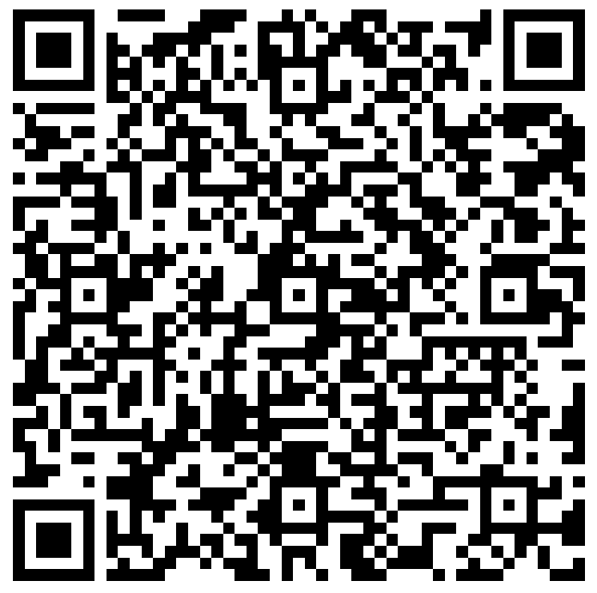
Parent Teacher Conferences
September: 11th, 12th, 13th
(minimum days-dismissal at 11:30am)
Sign up now:

Slide 23
Accelerated READER “AR”
From recognizing students’ achievements to students discovering new interests, Accelerated Reader helps create a culture of reading through choice.
Students who read more perform better in all their academic coursework. Help all your teachers by helping students learn to love reading.
Students will receive a ZPD level to help choose books at their appropriate level. A flyer will be sent home with this information ASAP.

Slide 24
Outside Food/Treats
Birthdays: Due to school policy and caution of allergies, the classroom teacher will recognize student in his/her own way (i.e. song, dance, acknowledgement)
Goodie bags with sealed store-bought treats and fun items are allowed.
No treats (cupcakes, donuts, etc.) allowed on campus. Do NOT drop off in the office.
Class Parties: In regards to food/treats for our class parties, myself and the room parent will coordinate this.

Slide 25
Here are some ways you can support our classroom.
(Please donate when you can.)
White Copy Paper Colored Copy Paper
Tissue Boxes Hand Sanitizer
Pencils Dry Erase Markers
Band Aids
Lysol/Disinfectant Spray
White cardstock paper
Clorox/Disinfectant Wipes
Clear Sheet Protectors

Slide 26
Parent Volunteer(s)
WE NEED YOU!
3 Classroom Parties
(Holiday, Friendship, End-of-Year)
Meet the Masters assistance

Slide 27
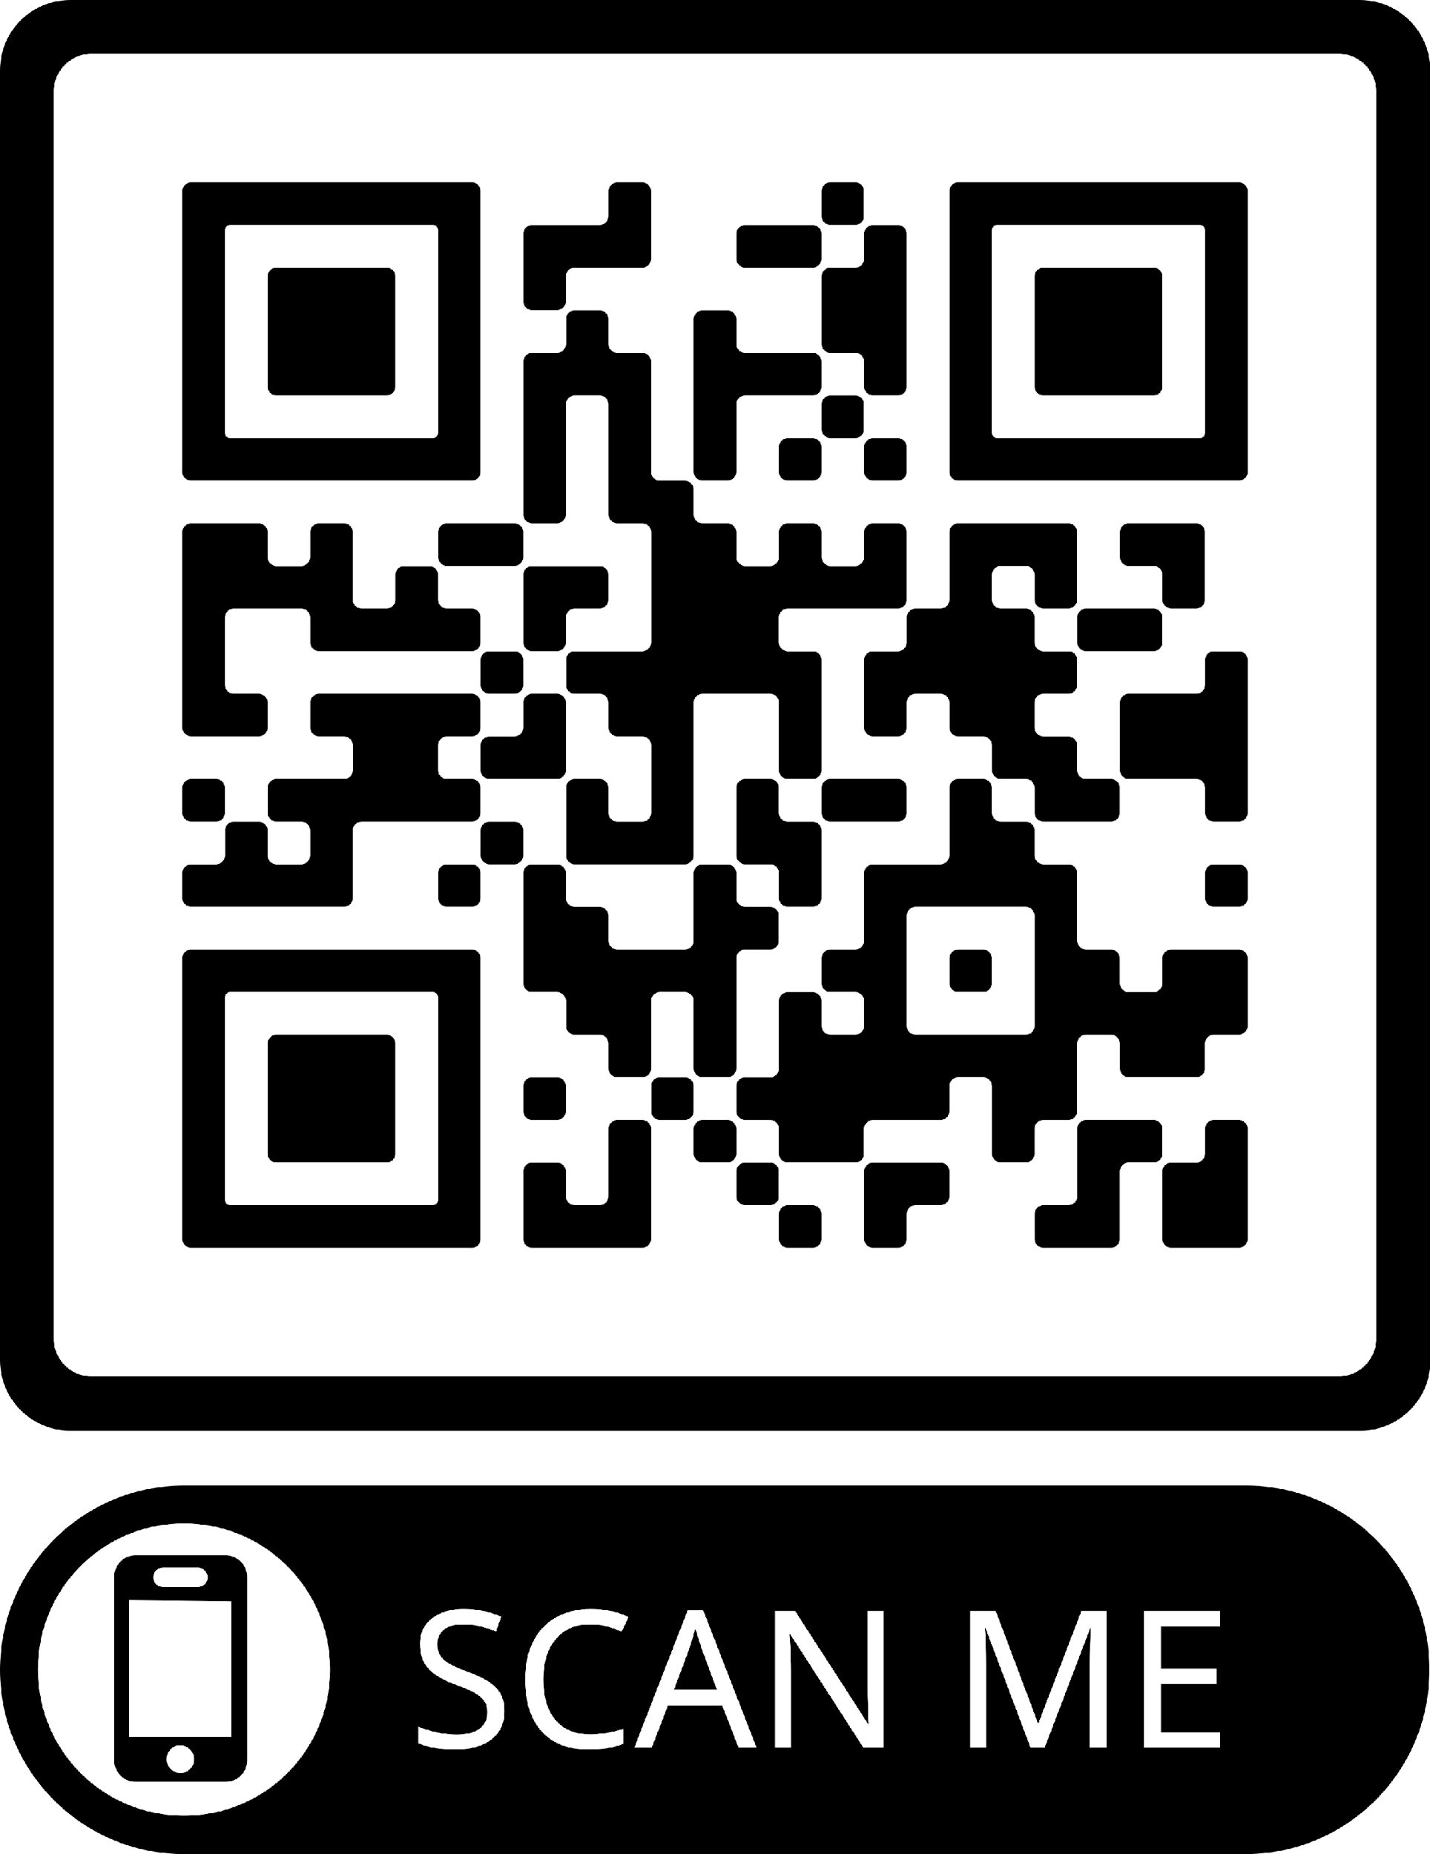
PTO
Parent Teacher Organization
Sign up for a membership! It doesn’t require participation and is a great way to donate and help our school funds! If our class has the most memberships the fastest, we earn a reward!
All classes with 80% membership,
get a party!
Spirit Days are on Fridays!
Purchase Spirit Wear here🡪

Slide 28
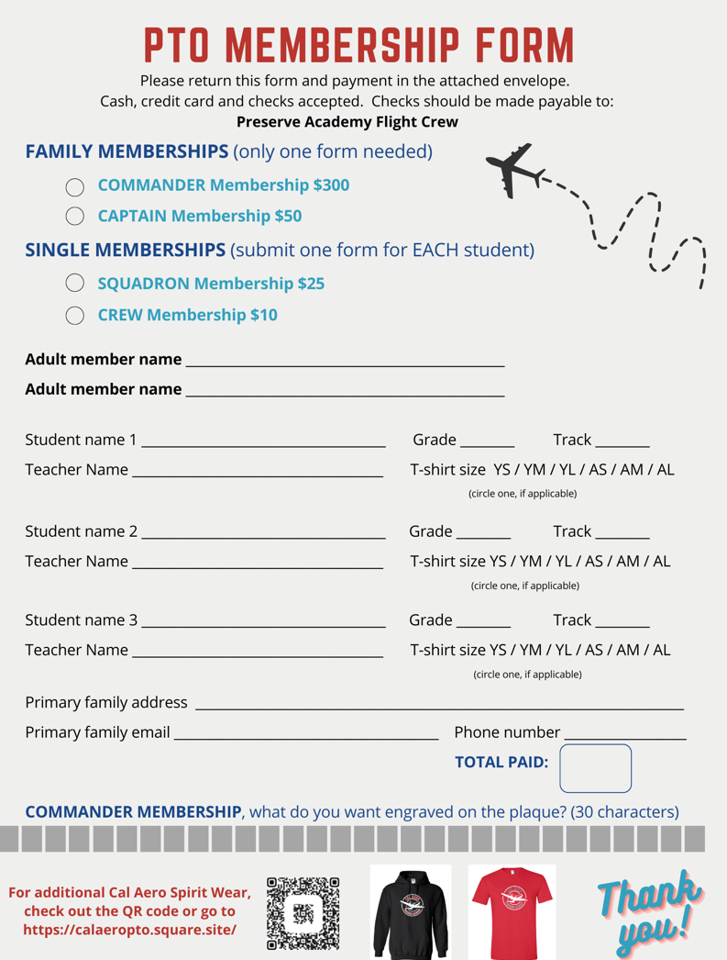

Slide 29
Cal Aero Chapter
What is all pro dads in school?
A monthly gathering at school where dads and kids engage in meaningful conversations and activities centered around a character-based curriculum.
Being a father isn't easy, but it is one of the most important and fulfilling jobs on the planet. Our Cal Aero Chapter of All Pro Dad program will be on a mission to help you love and lead your family.
**If you are interested in finding out more about this opportunity, please leave you name and number on the sheet provided.

