Slide 1
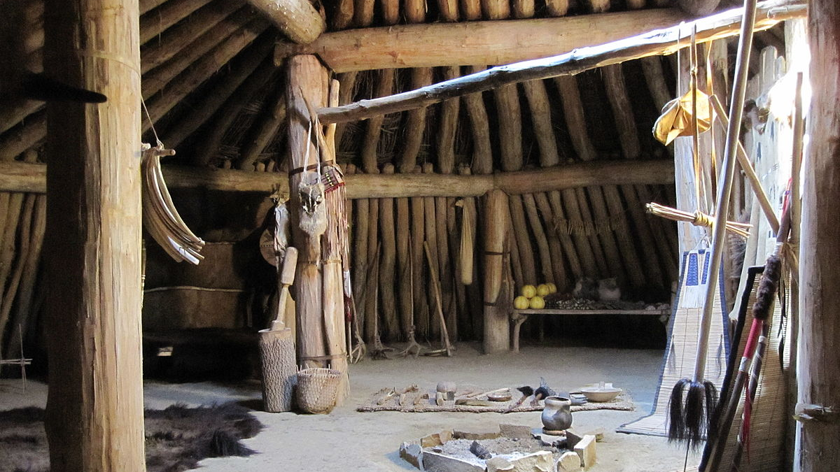
Maidu tribe
By Stephen and Joshua
This Photo by Unknown author is licensed under CC BY-SA.

Slide 2
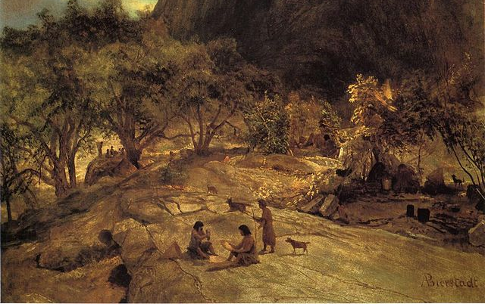
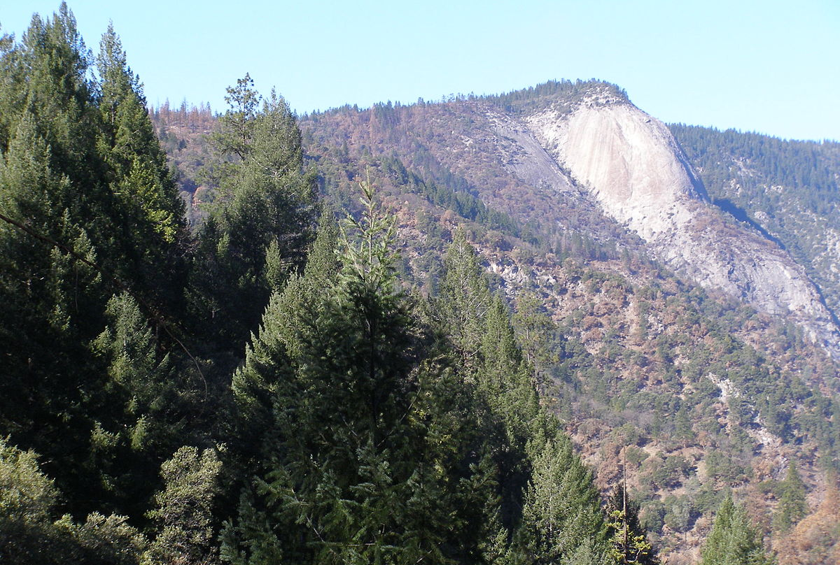
Location
The Maidu tribe lived in the central valley and northern mountain part of California. They lived up by mountains, valleys, rivers, and lakes.
This Photo by Unknown author is licensed under CC BY-SA.
This Photo by Unknown author is licensed under CC BY-SA.

Slide 3
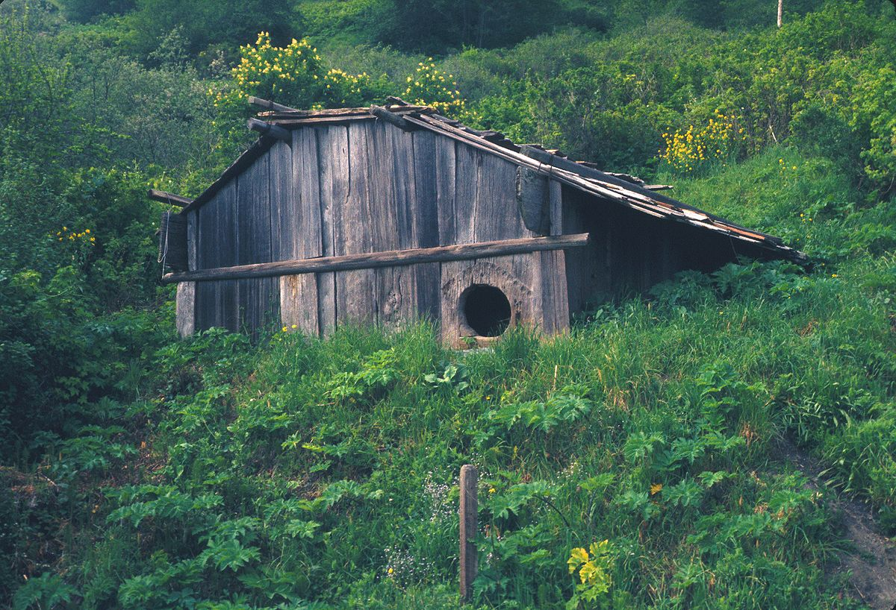
Shelter
The homes of the Maidu kept them safe and warm. There were poles that formed the homes. They covered the pole with bark and mud. The homes were partly underground in winter.
This Photo by Unknown author is licensed under CC BY-SA.
This Photo by Unknown author is licensed under CC BY-SA.

Slide 4
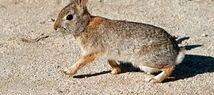
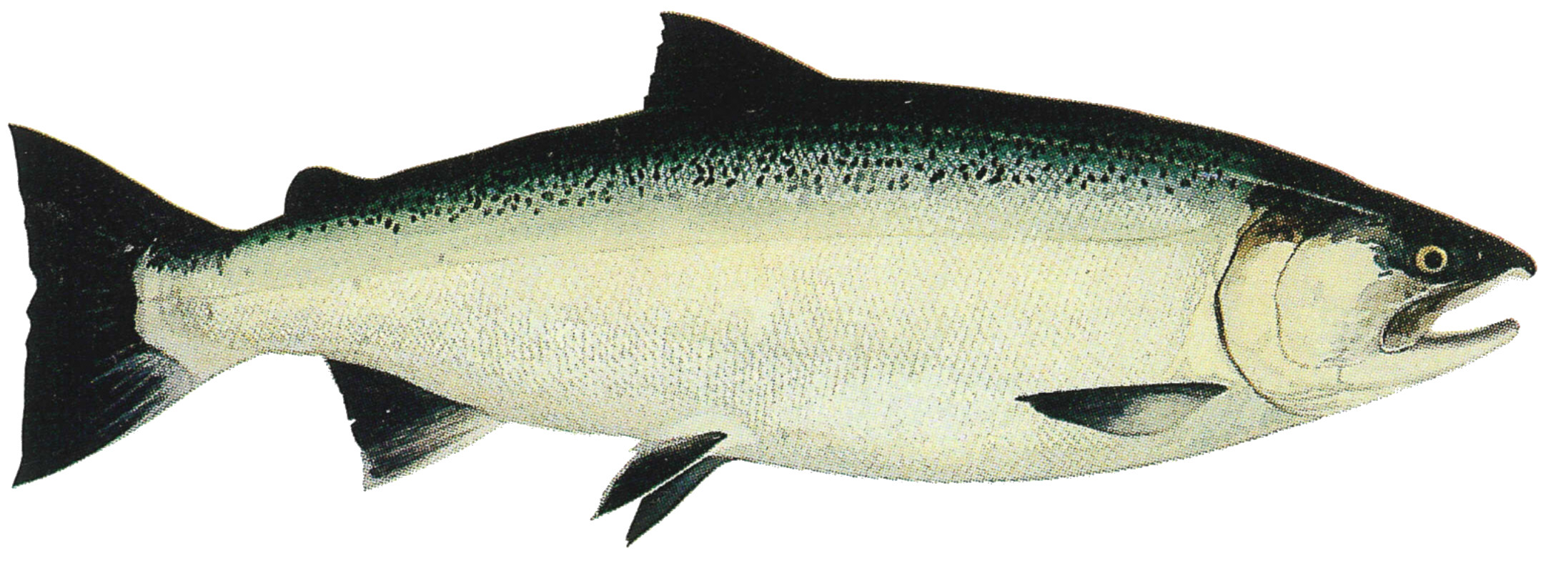
Food
They hunted deer, elk, rabbits, birds, and bears. They ate acorns and insects. The Maidu tribe also ate wild plants, seeds, berries, and roots. They also ate living bugs like crickets, grasshoppers, caterpillars and dried locusts.
This Photo by Unknown author is licensed under CC BY-SA.
This Photo by Unknown author is licensed under CC BY-SA.

Slide 5
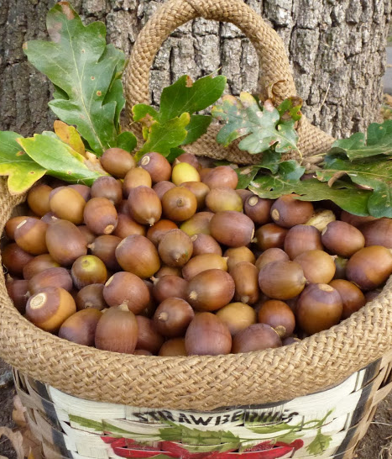
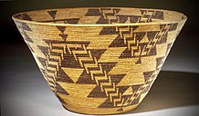
Culture
They believed animals, plants, trees, rivers, mountains, and rocks have spirits. Men made rafts and dugout canoes to travel. They spoke in the Penutian language.
This Photo by Unknown author is licensed under CC BY-NC-ND.
This Photo by Unknown author is licensed under CC BY-SA.
This Photo by Unknown author is licensed under CC BY-SA.

Slide 6
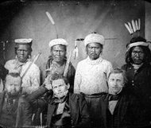
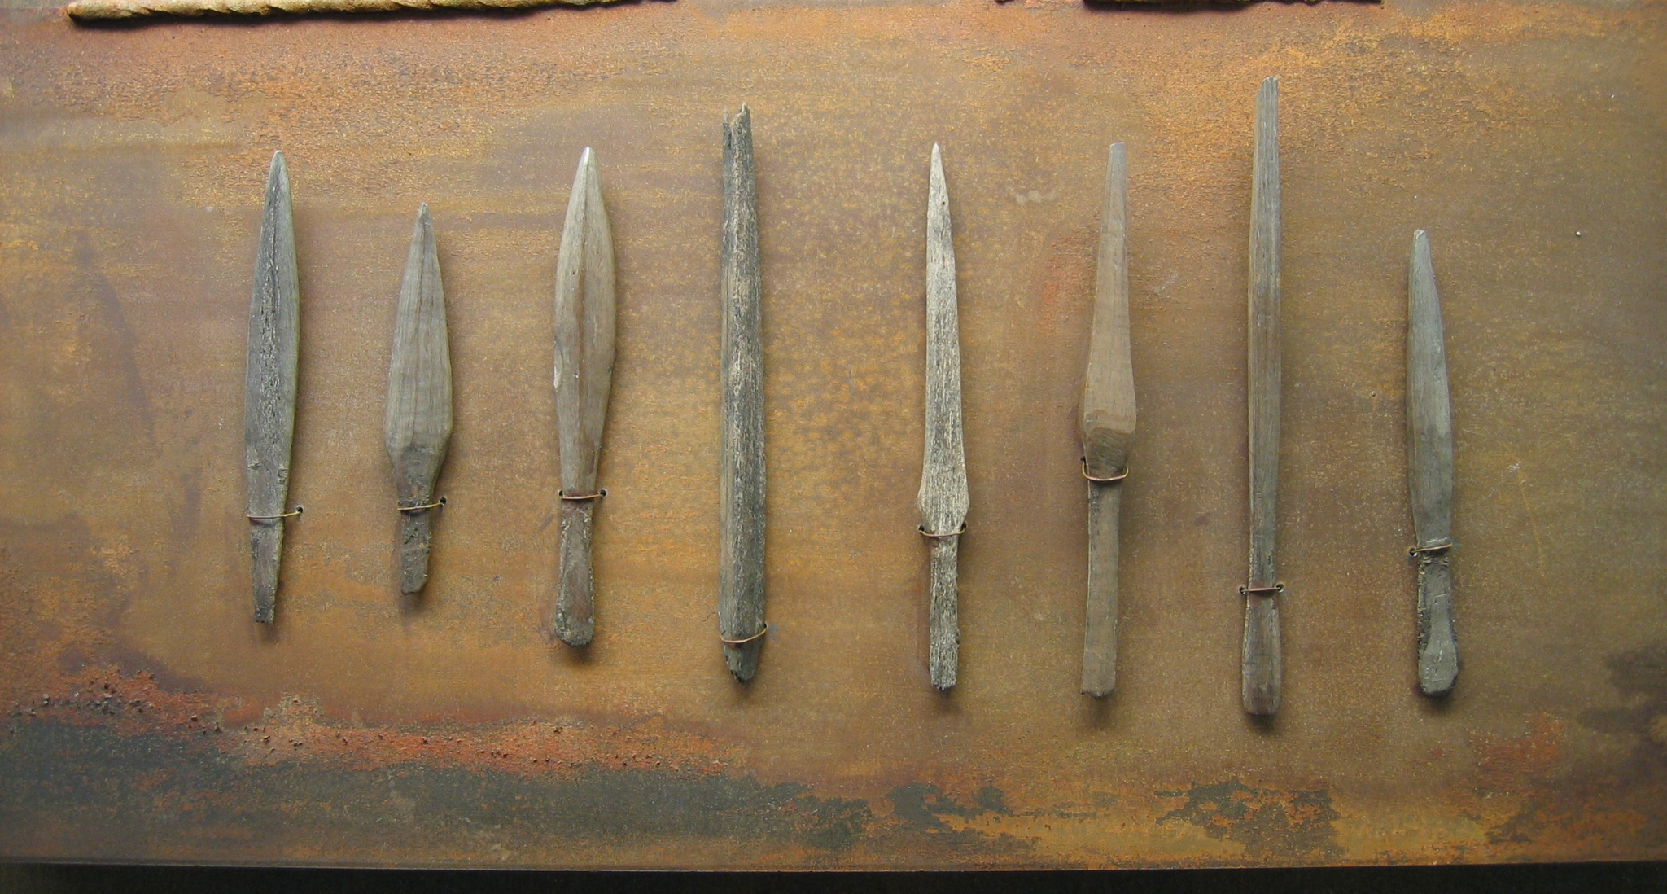
This Photo by Unknown author is licensed under CC BY-SA.
This Photo by Unknown author is licensed under CC BY-SA.
This Photo by Unknown author is licensed under CC BY-SA.

