Slide 1
Ecology Notes Pages 1-7
By Tammy Huynh - Period 4

Slide 2
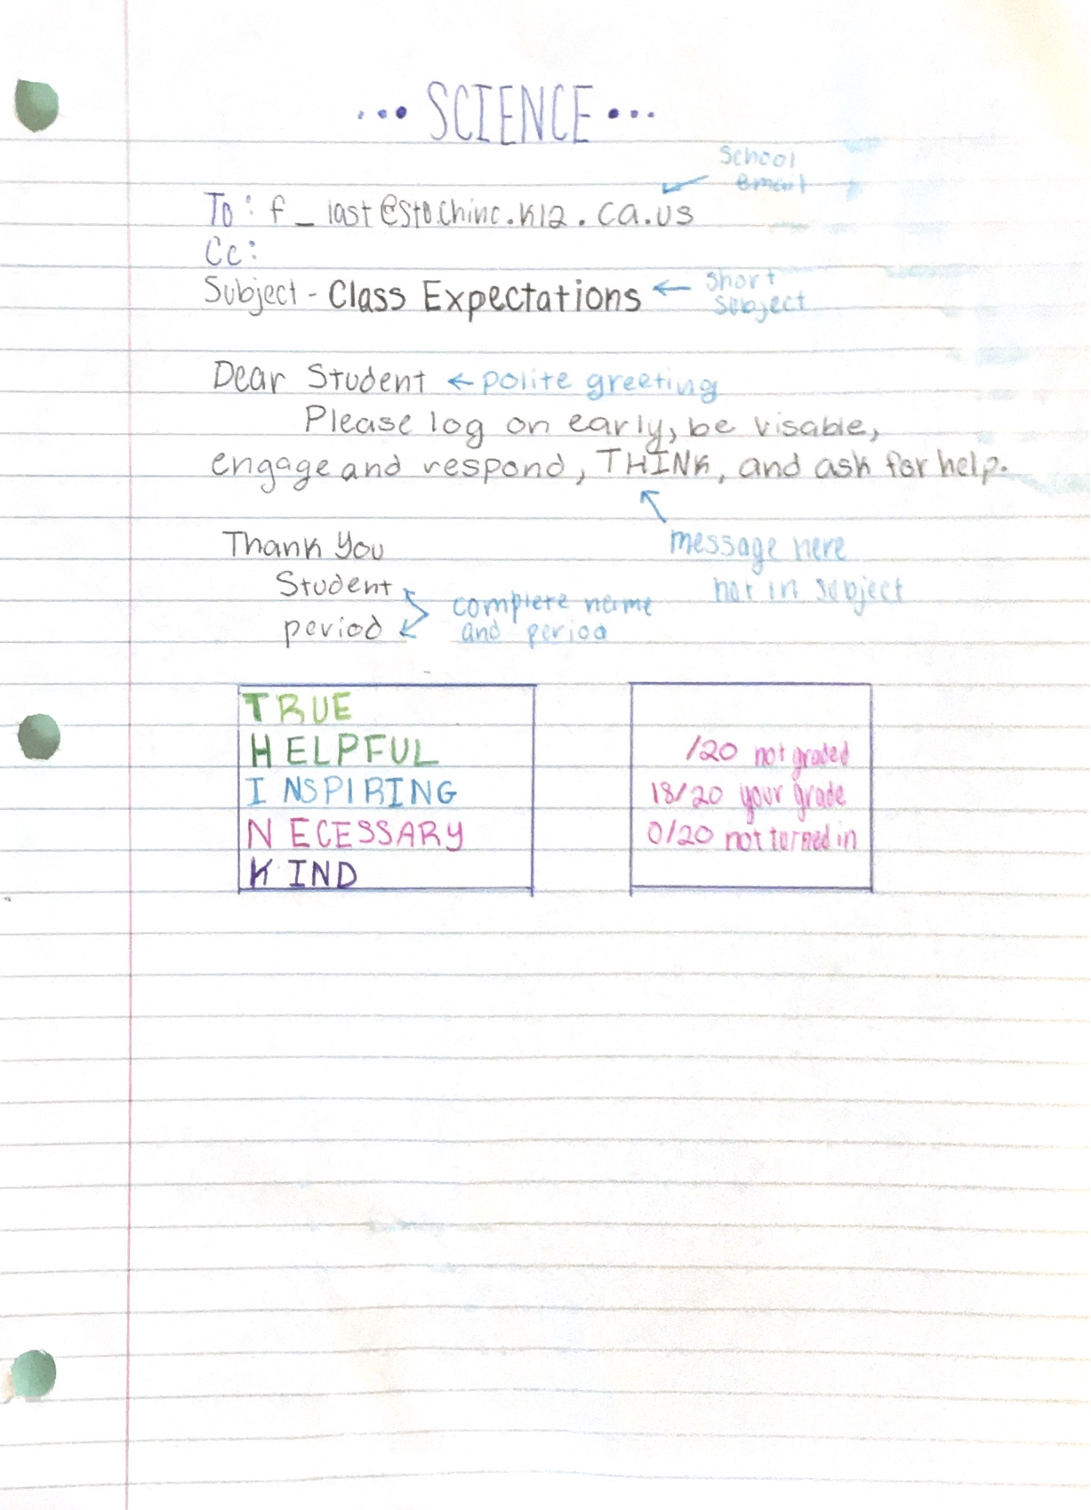
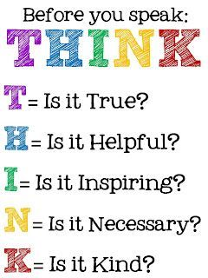
Class Expectations
To begin writing an email, type in the person's email. Next, write a subject explaining wha the email will be about. Then write the teachers name politely. Write a brief, respectful email. Lastly, finish it off with a sincerely, or thank you.

Slide 3
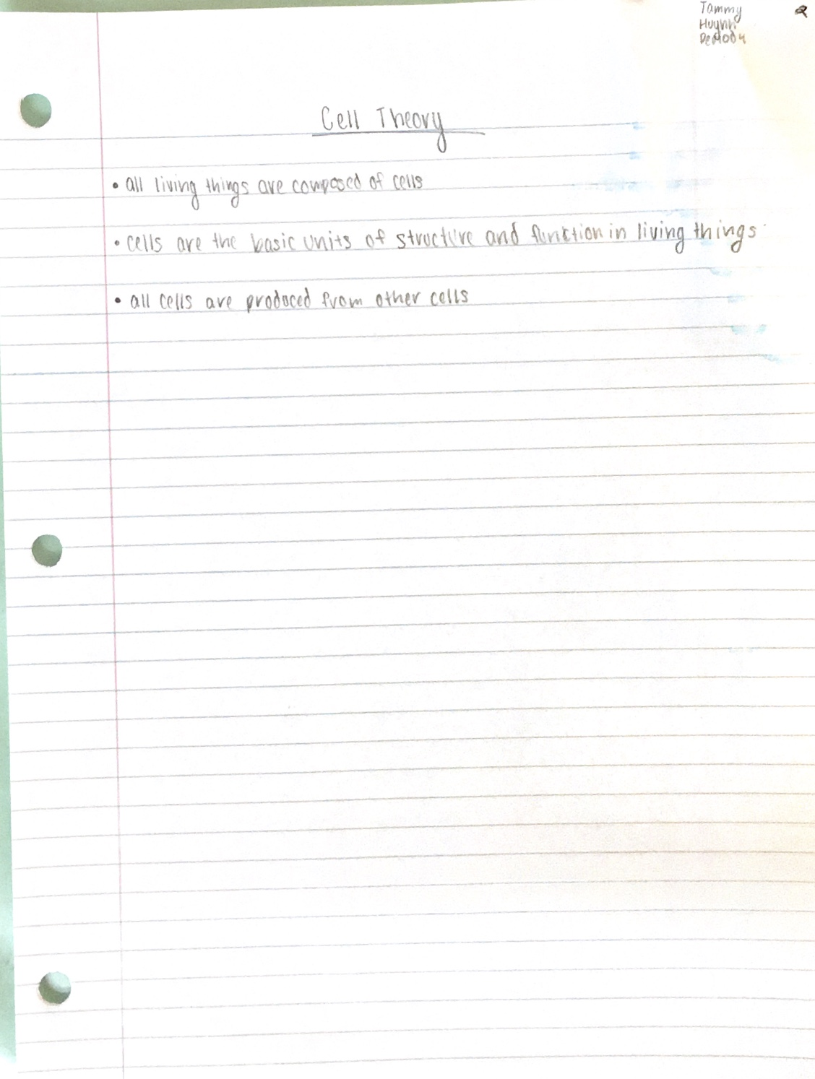
Cells Theory
Matthias Schleiden, Theodor Schwann, and Rudolf Virchow were the first scientists to come up with a theory about cells. Here is what they concluded:
1. All living things are made up of cells.
2. Cells are the basic units of structure and function in living things.
3. All cells are produced from other cells.

Slide 4
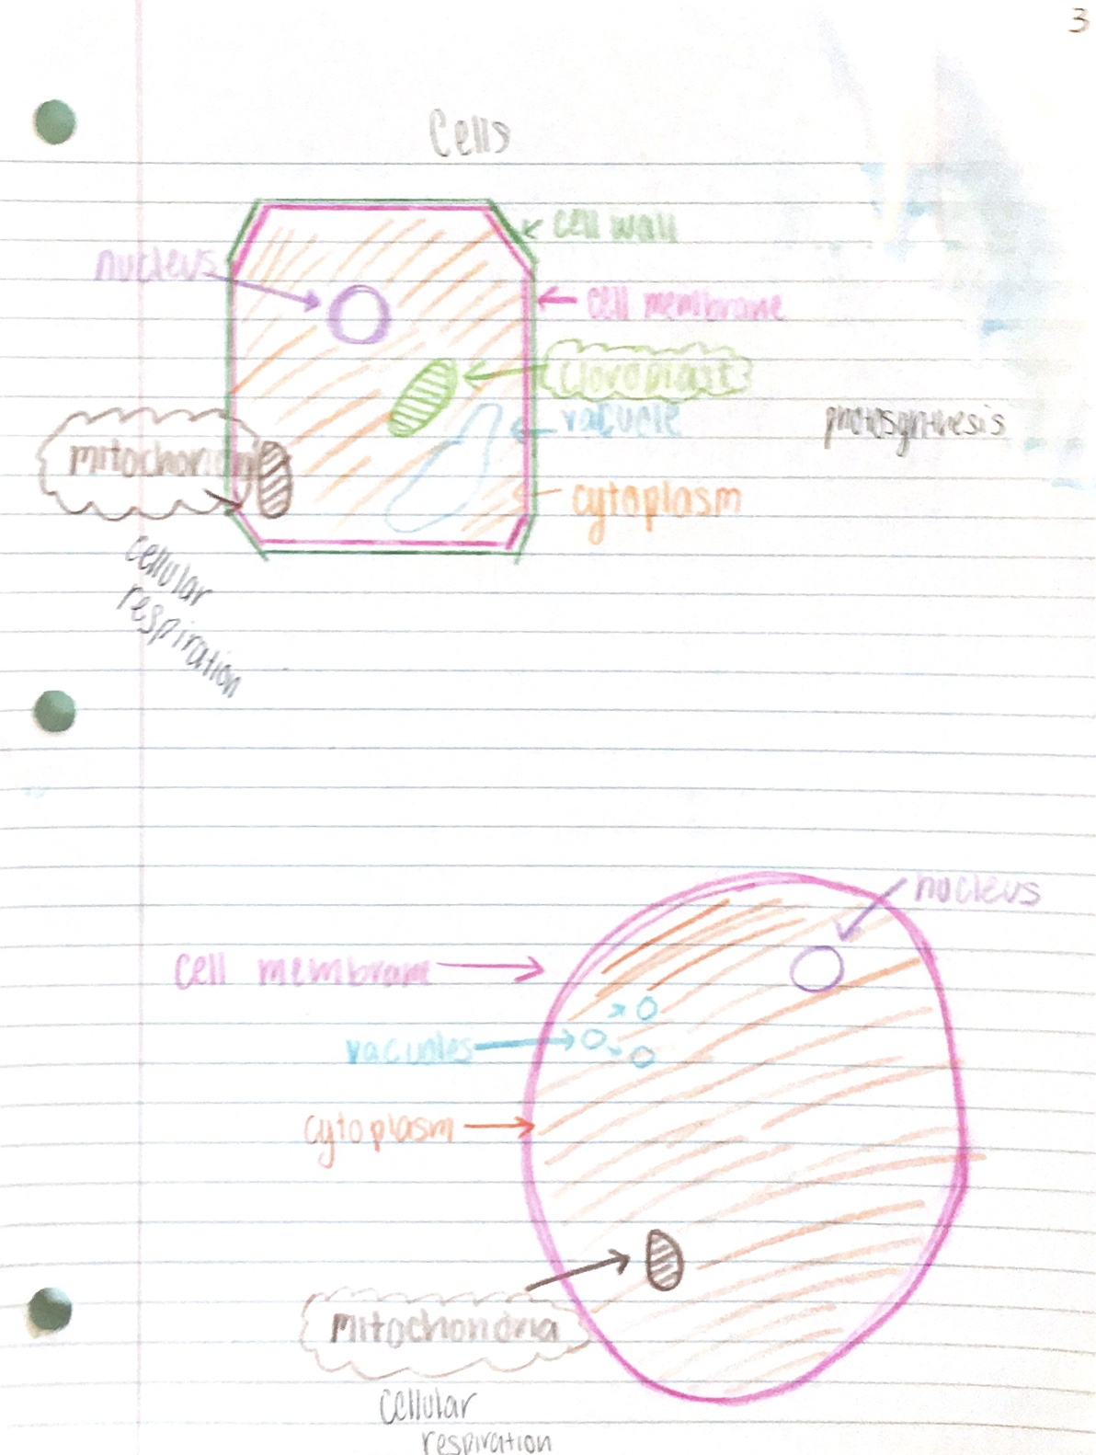
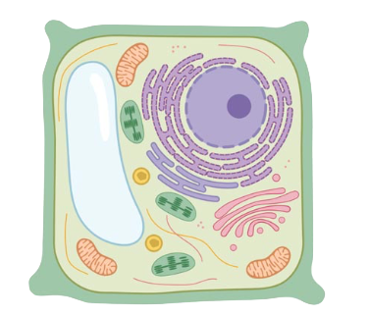
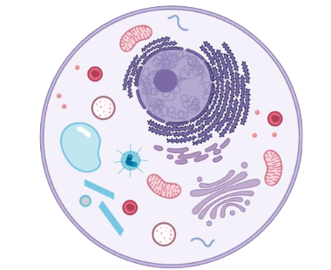
Cells
There are two main type of cells, animal and plant. A plant has a nucleus, cytoplasm, ribosome, mitochondrion, cell membrane, vacuole, and cell wall. An animal nucleus, cell membrane, vacuoles, cytoplasm, and mitochondria. While plants has a large vacuole, an animal has more smaller ones. A plant also has a cell wall while an animal does not.

Slide 5
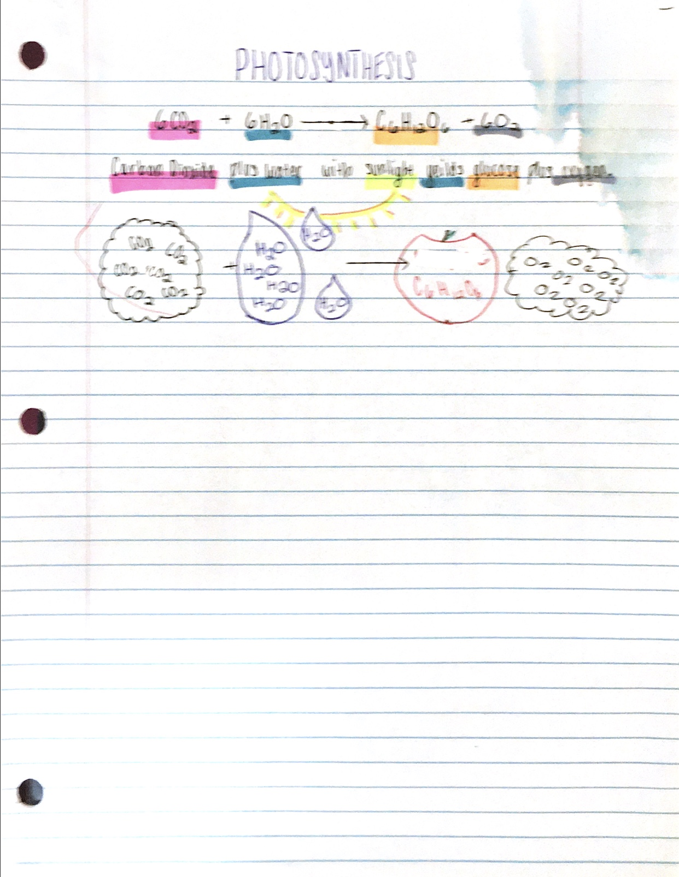
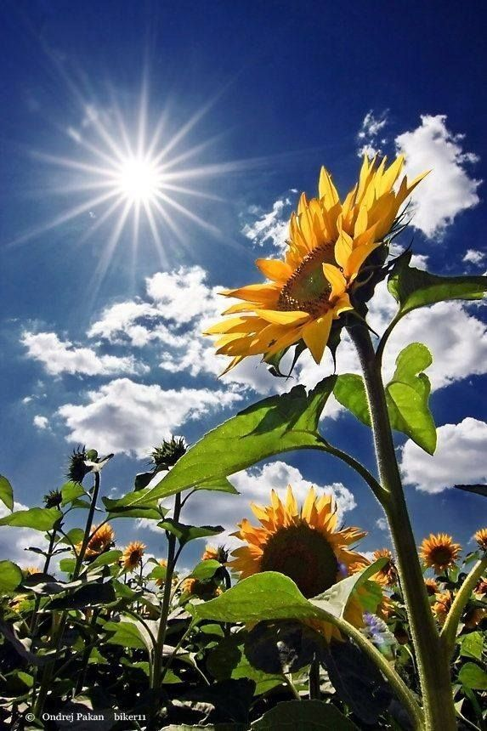
Photosynthesis
The process of photosynthesis starts off with carbon dioxide and water transforming into glucose(done by the sun). The plant then releases oxygen. Once, the plant makes its food, it stores it and uses it to repair and grow.

Slide 6
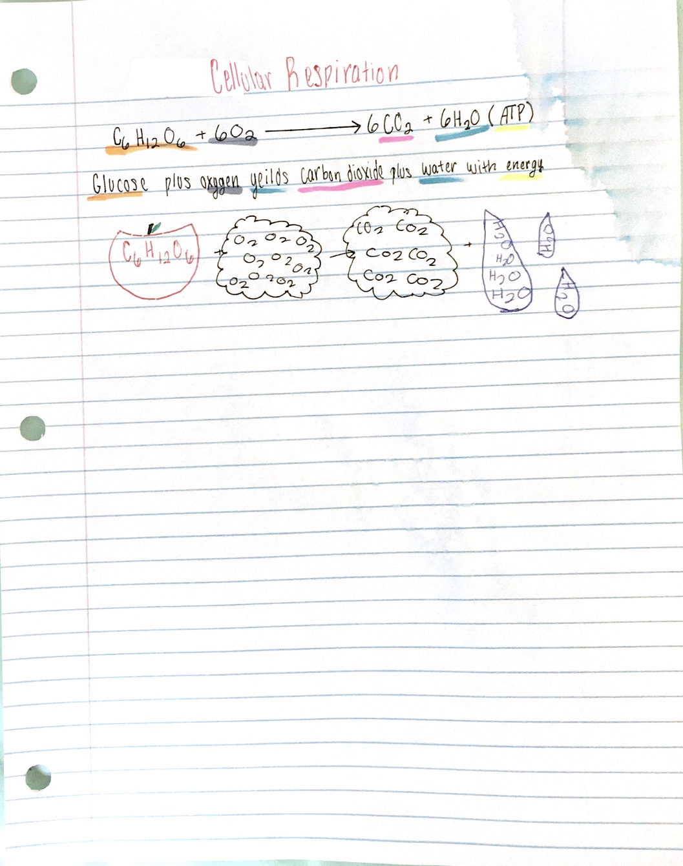
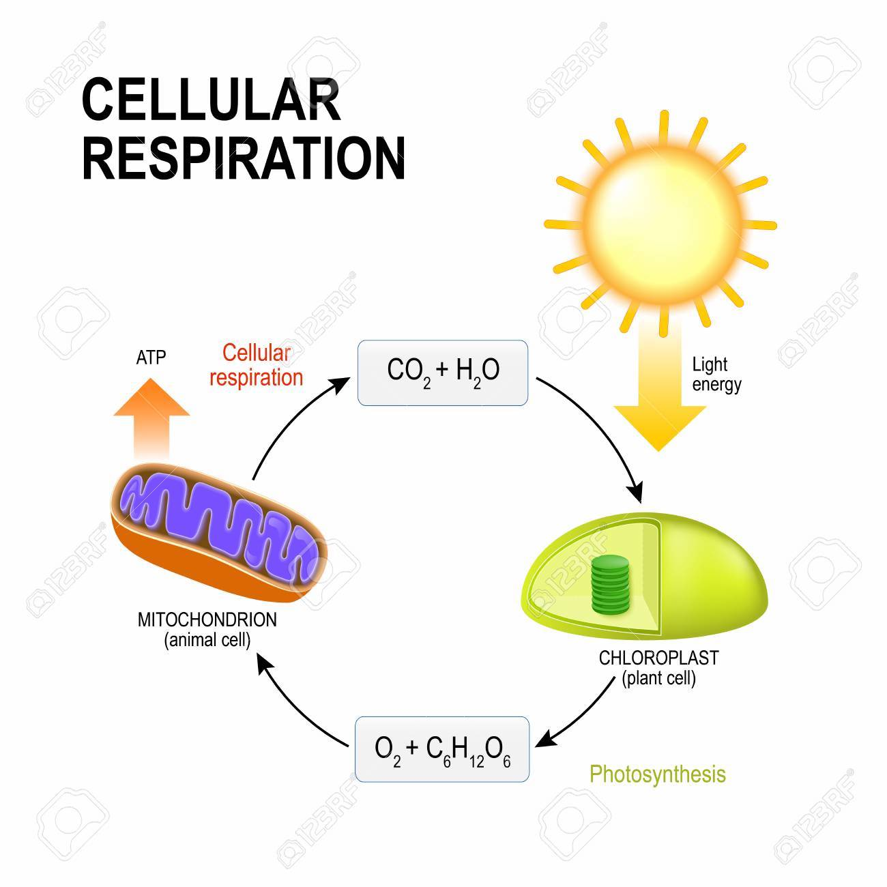
Cellular Respiration
The process of cellular respiration is the reverse process of photosynthesis. The process is glucose and oxygen transforming into water and energy.

Slide 7
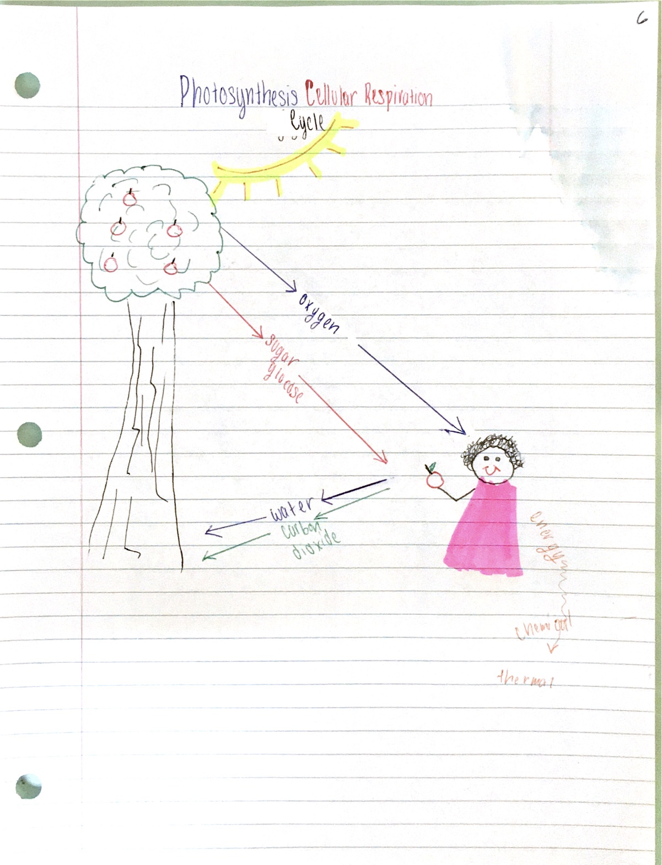
Photosynthesis and Cellular Respiration Cycle
The cycle starts off with a tree using photosynthesis to giving sugar glucose and oxygen. The oxygen then transforms to air and humans then give carbon dioxide and water. The sugar glucose will also give humans energy.

Slide 8
This must be the last page in the PowerPoint
Instructions
Turn your notes into a complete, detailed PowerPoint presentation. You must do more than just insert photos of your notes, but you may include the pictures you drew as part of your presentation. You may use internet pictures as well and you can be creative with the fonts and colors.

