Slide 1
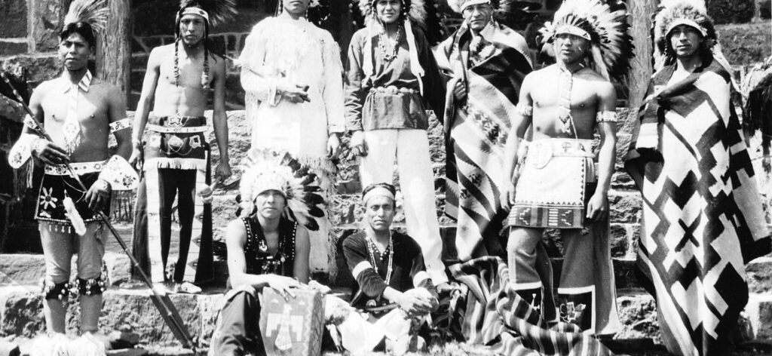
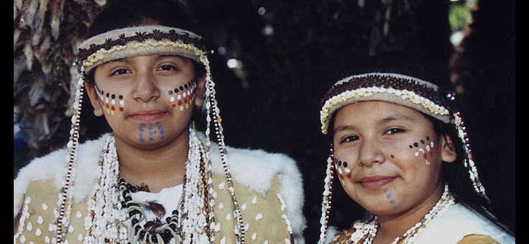
Gabrielino
Lily Foster
Zoe Liang

Slide 2
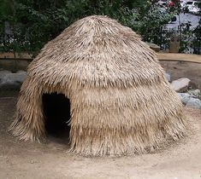
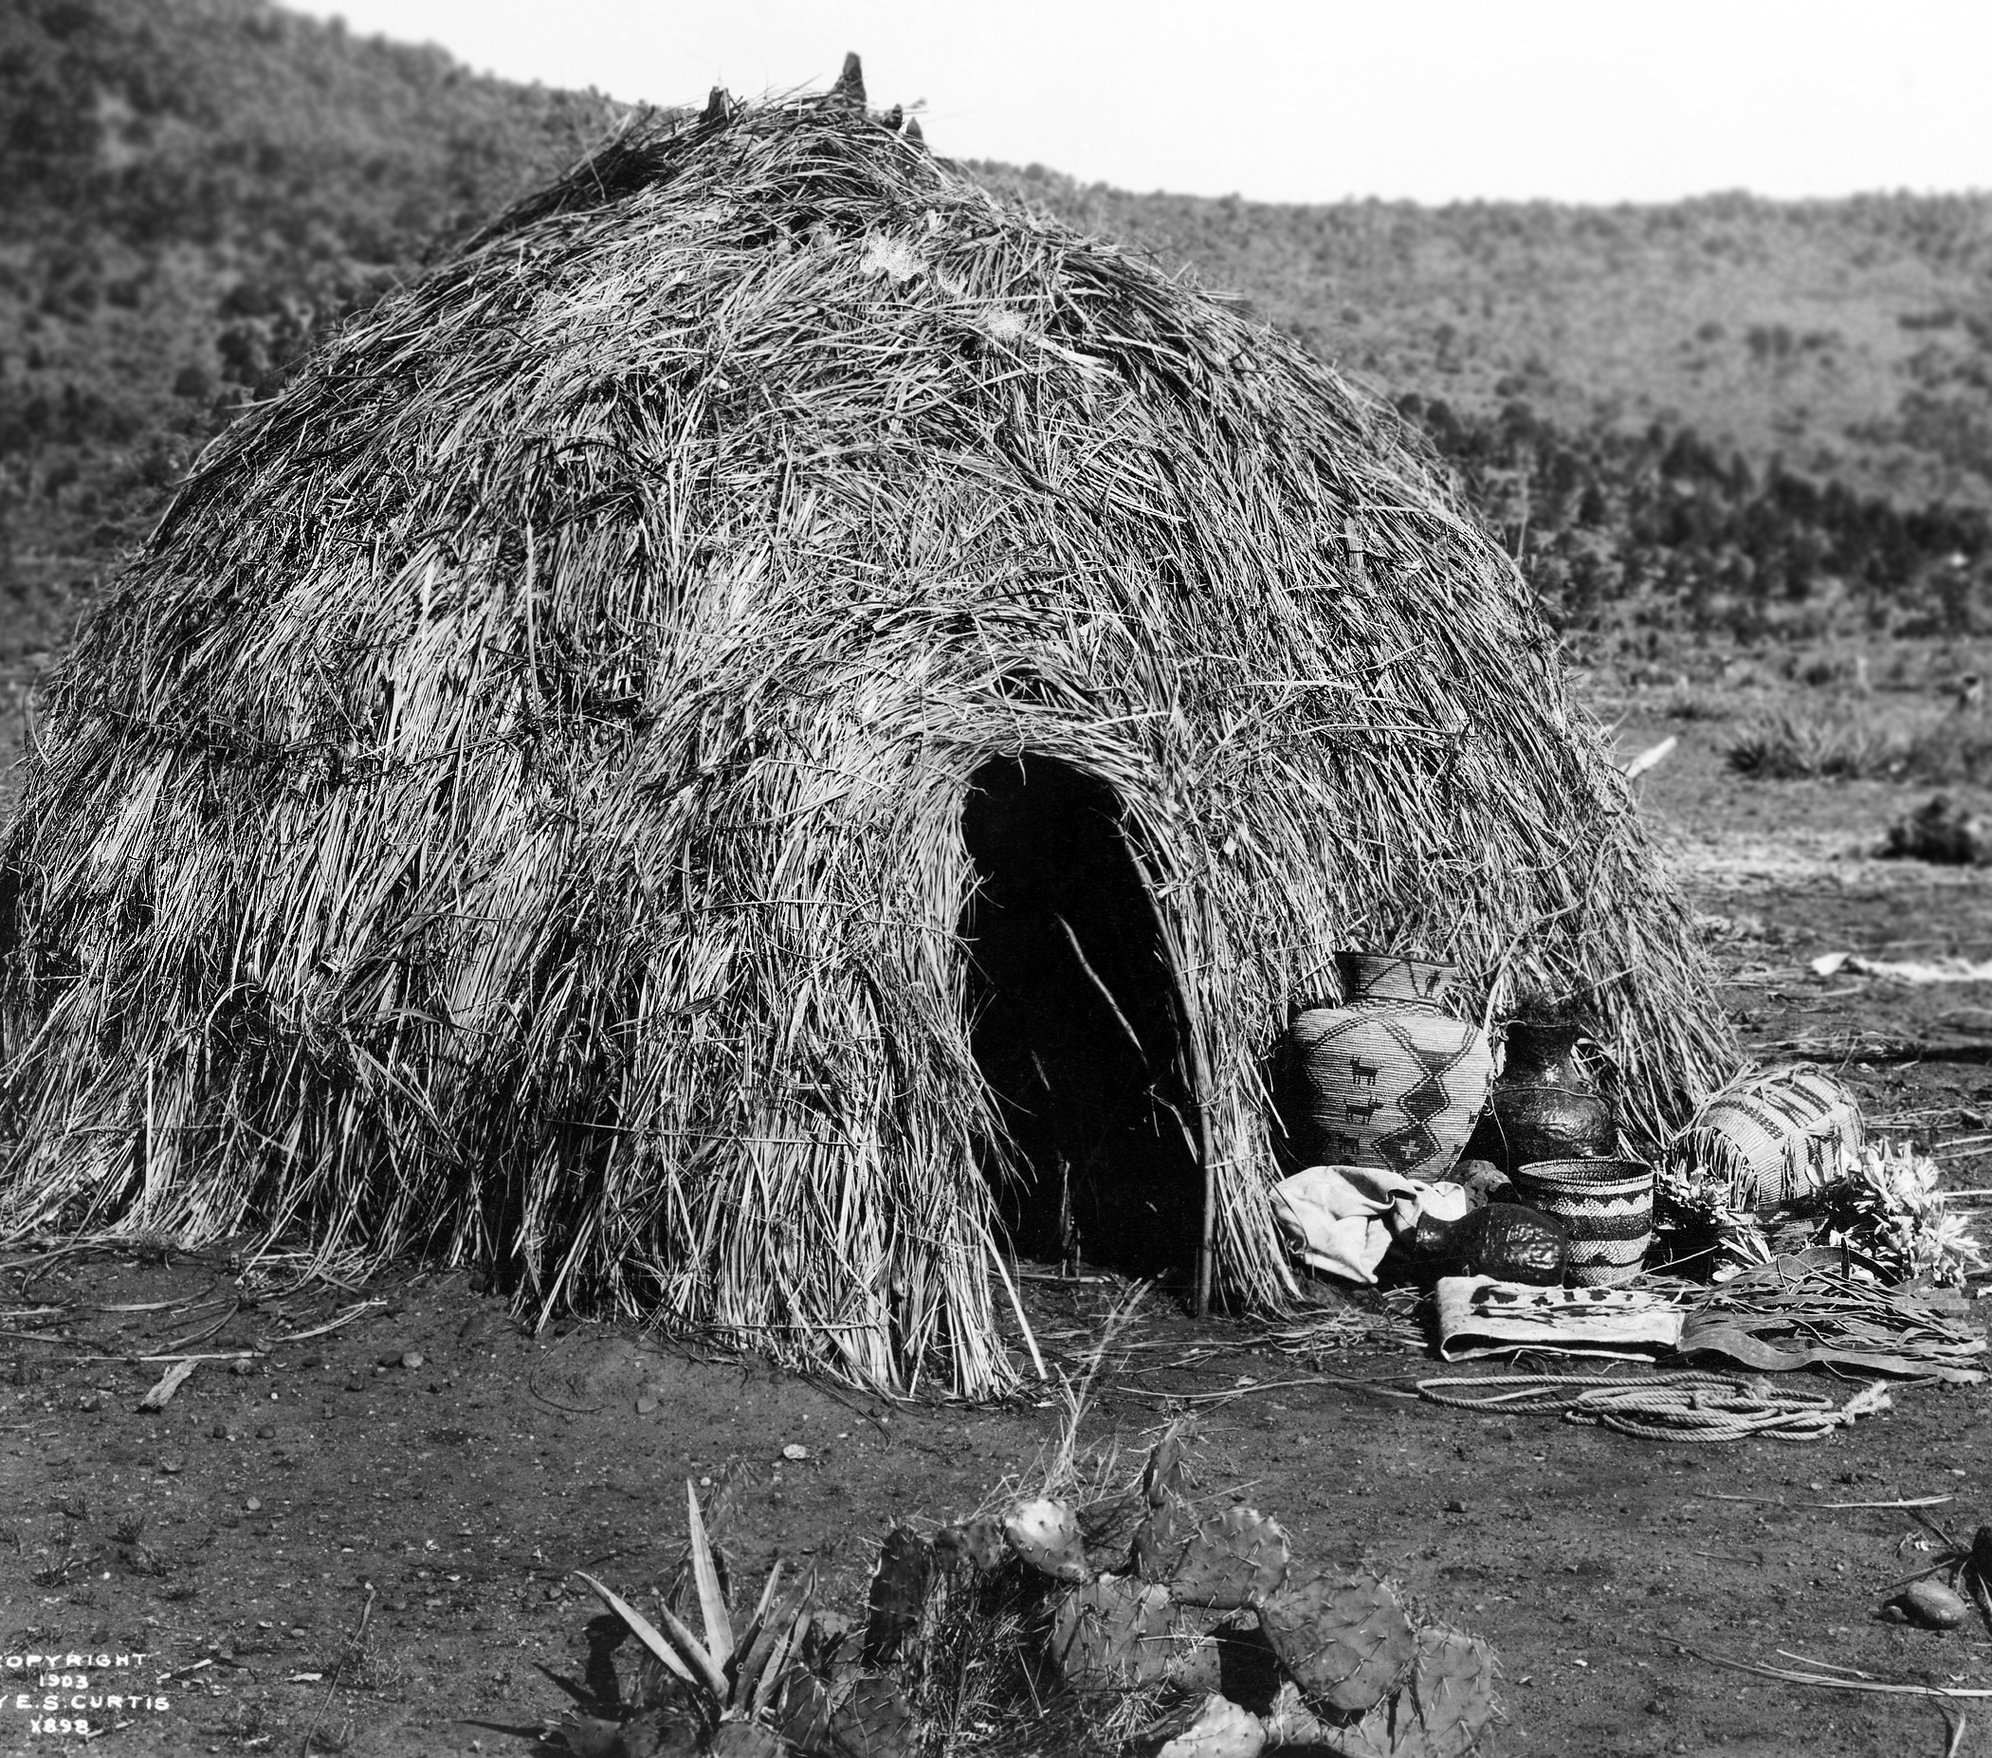
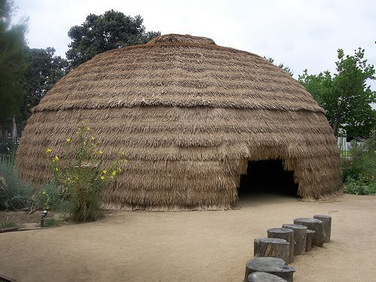
Shelter
The Gabrielino tribe had a unique shelter that protected them.
Their houses were dome-shaped wooden huts packed with clay and tule reeds
The walls kept the house cool in the day and warm at night
The houses were called earth homes

Slide 3
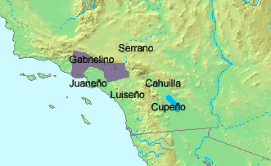
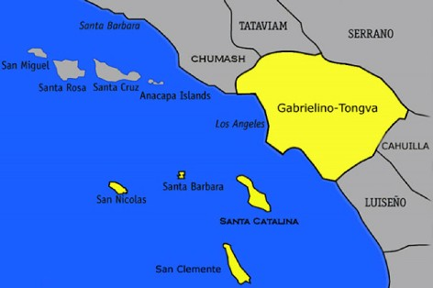
Location
The Gabrielino tribe had unique location.
They lived near present-day Los Angeles and the Southern Coast
They also lived near Orange County and San Bernardino County
The Gabrielino lived on the islands Santa Catalina, San Nicolas, and San Clemente

Slide 4
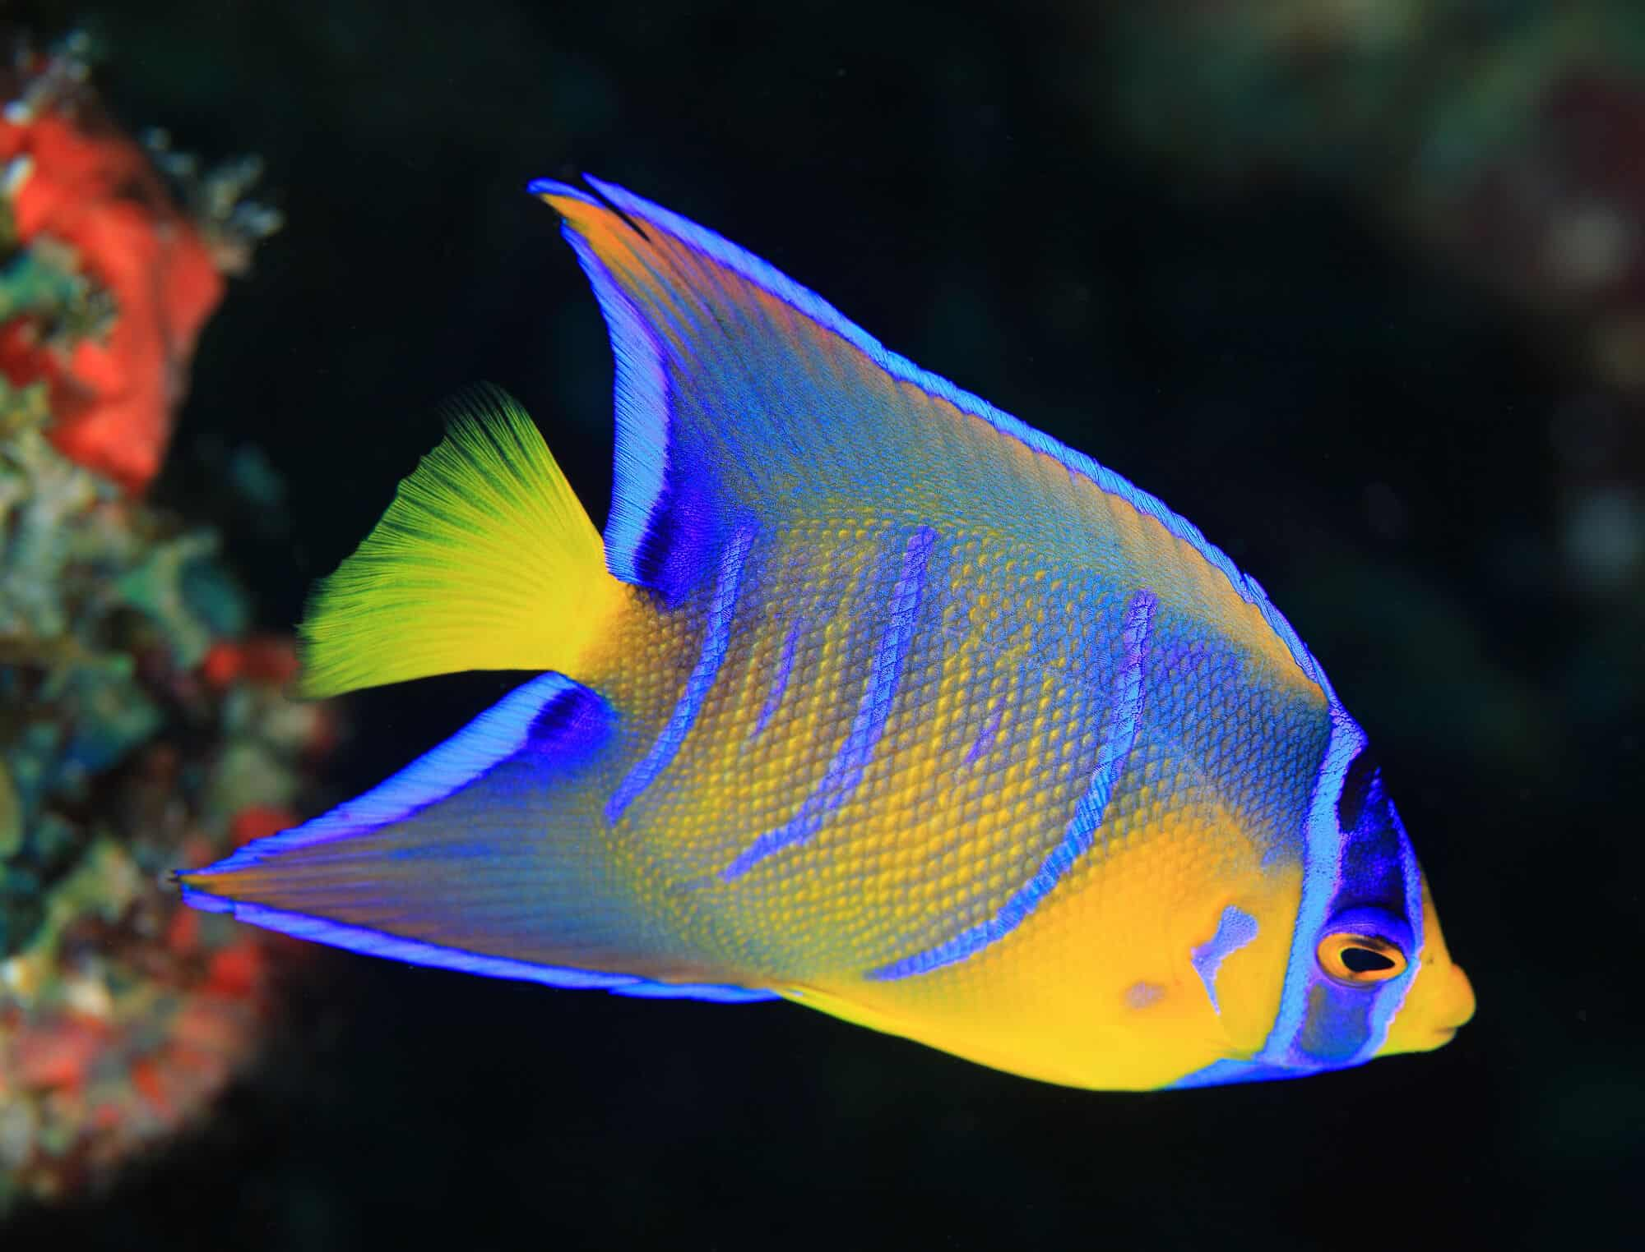
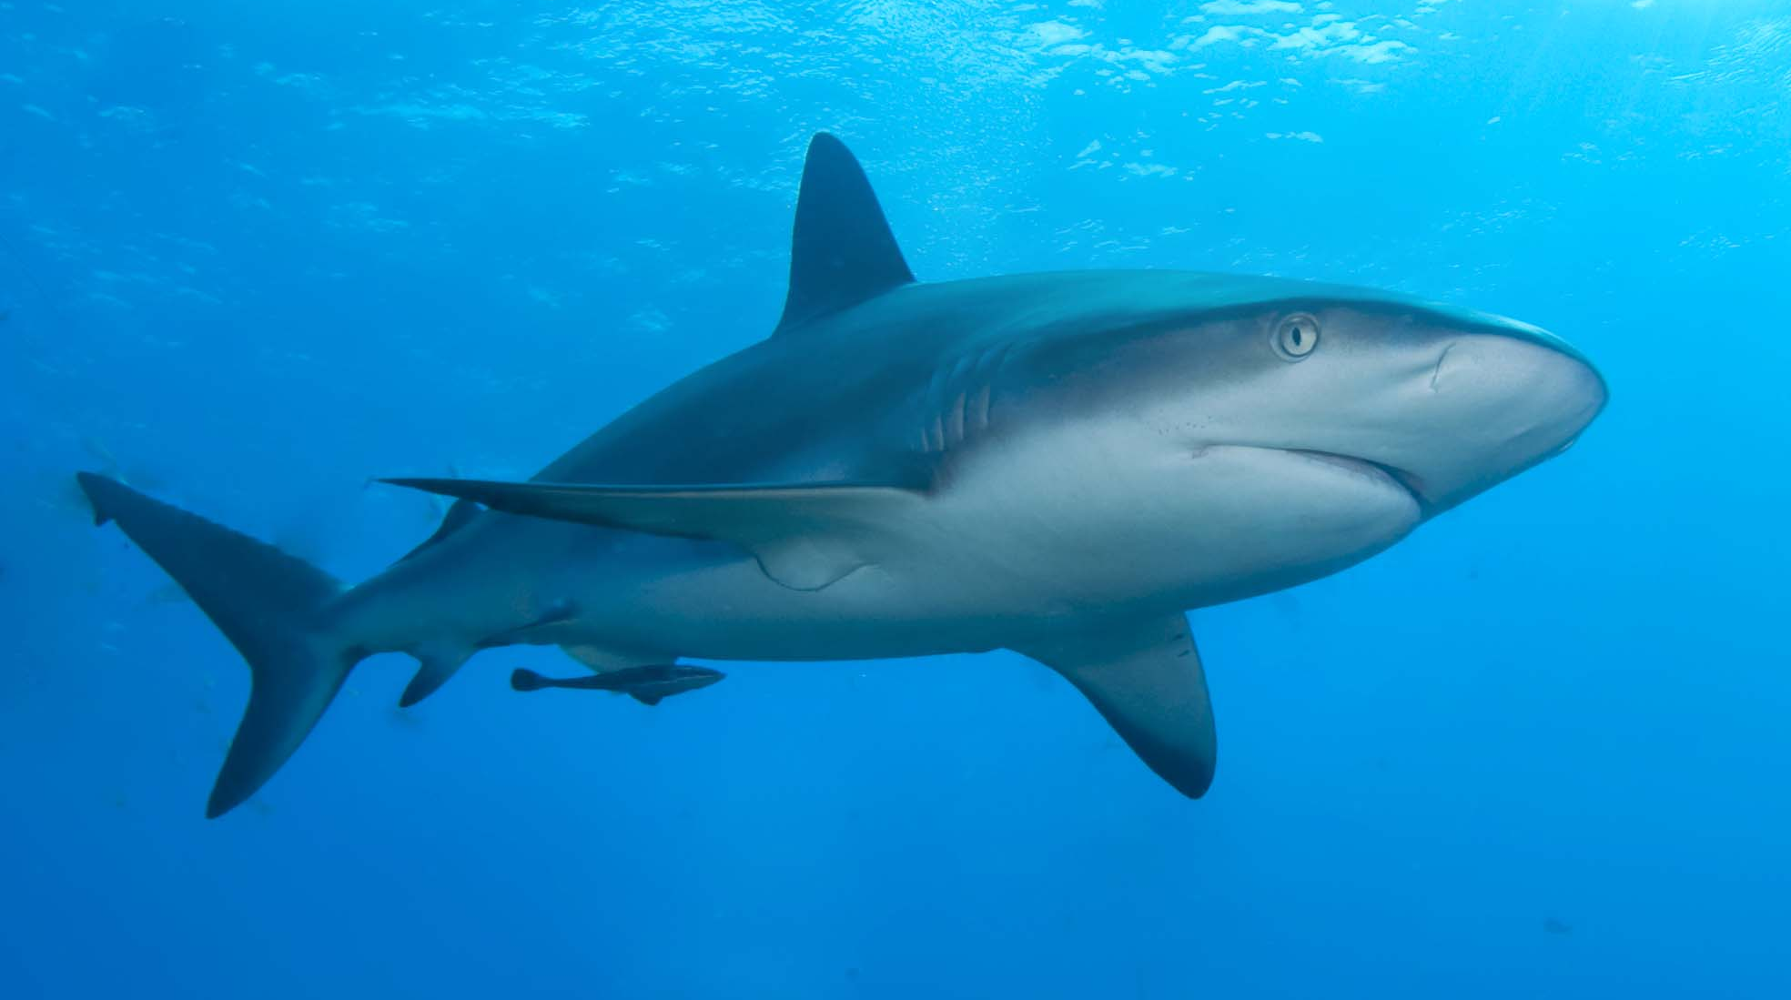
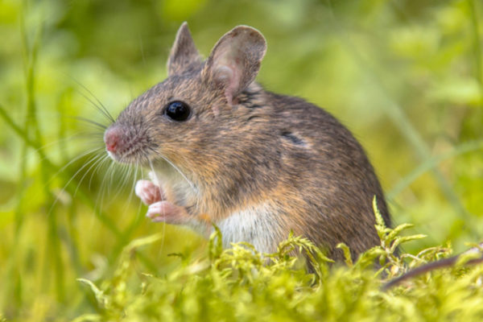
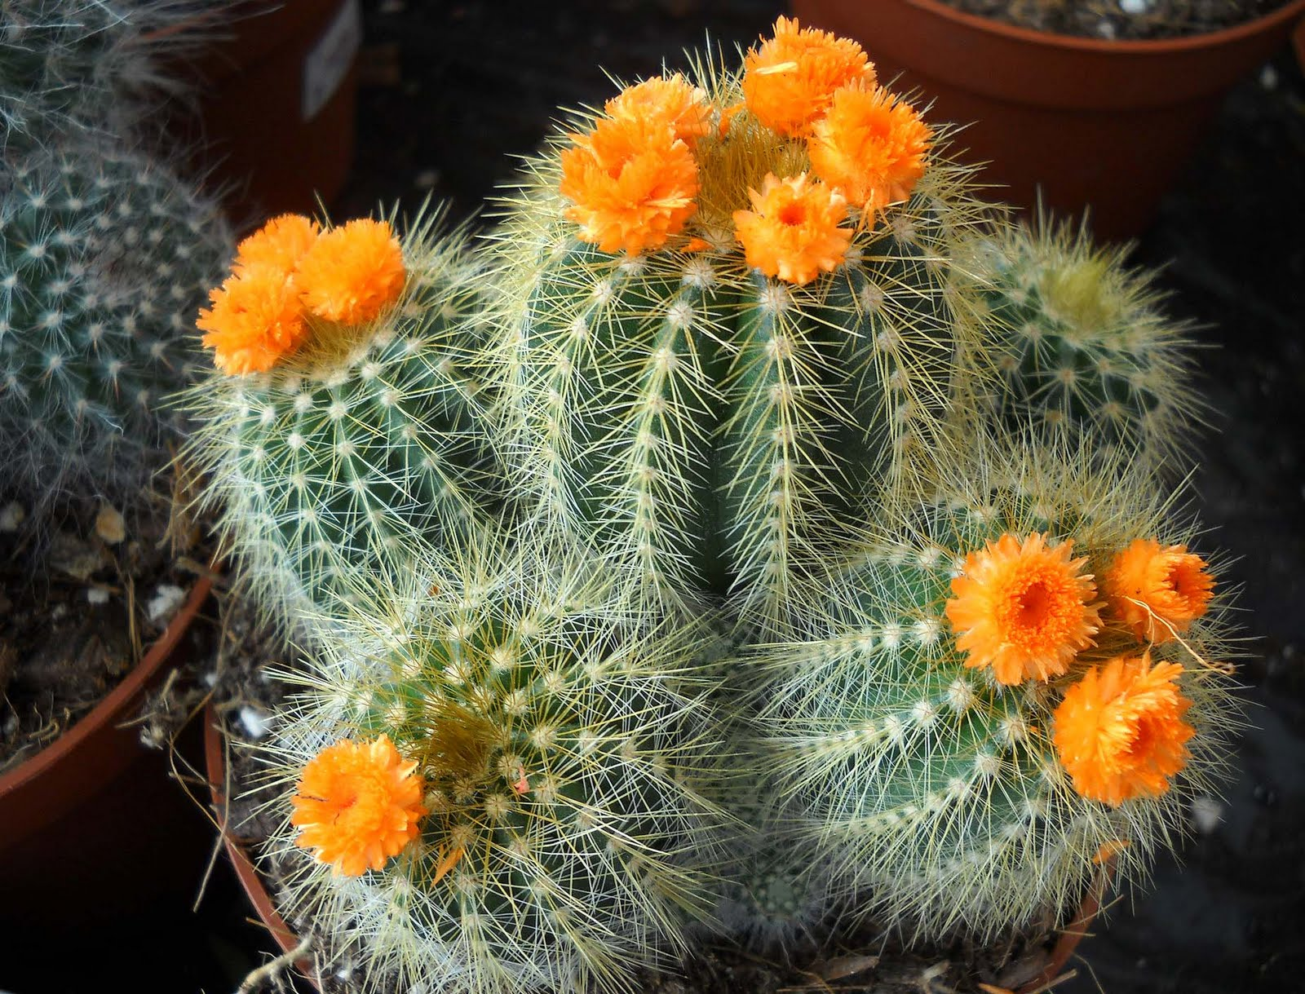
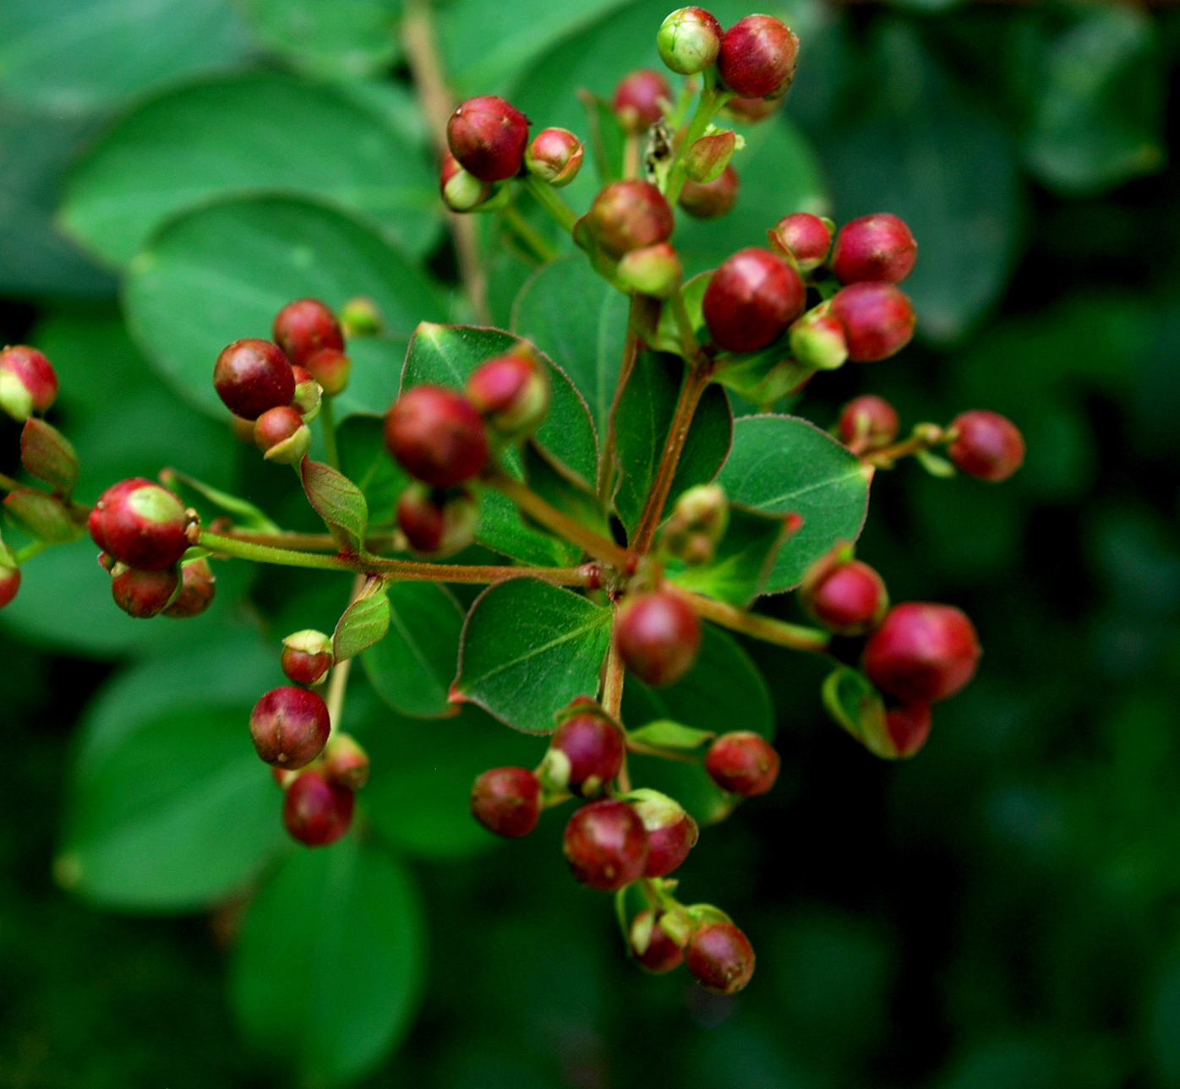
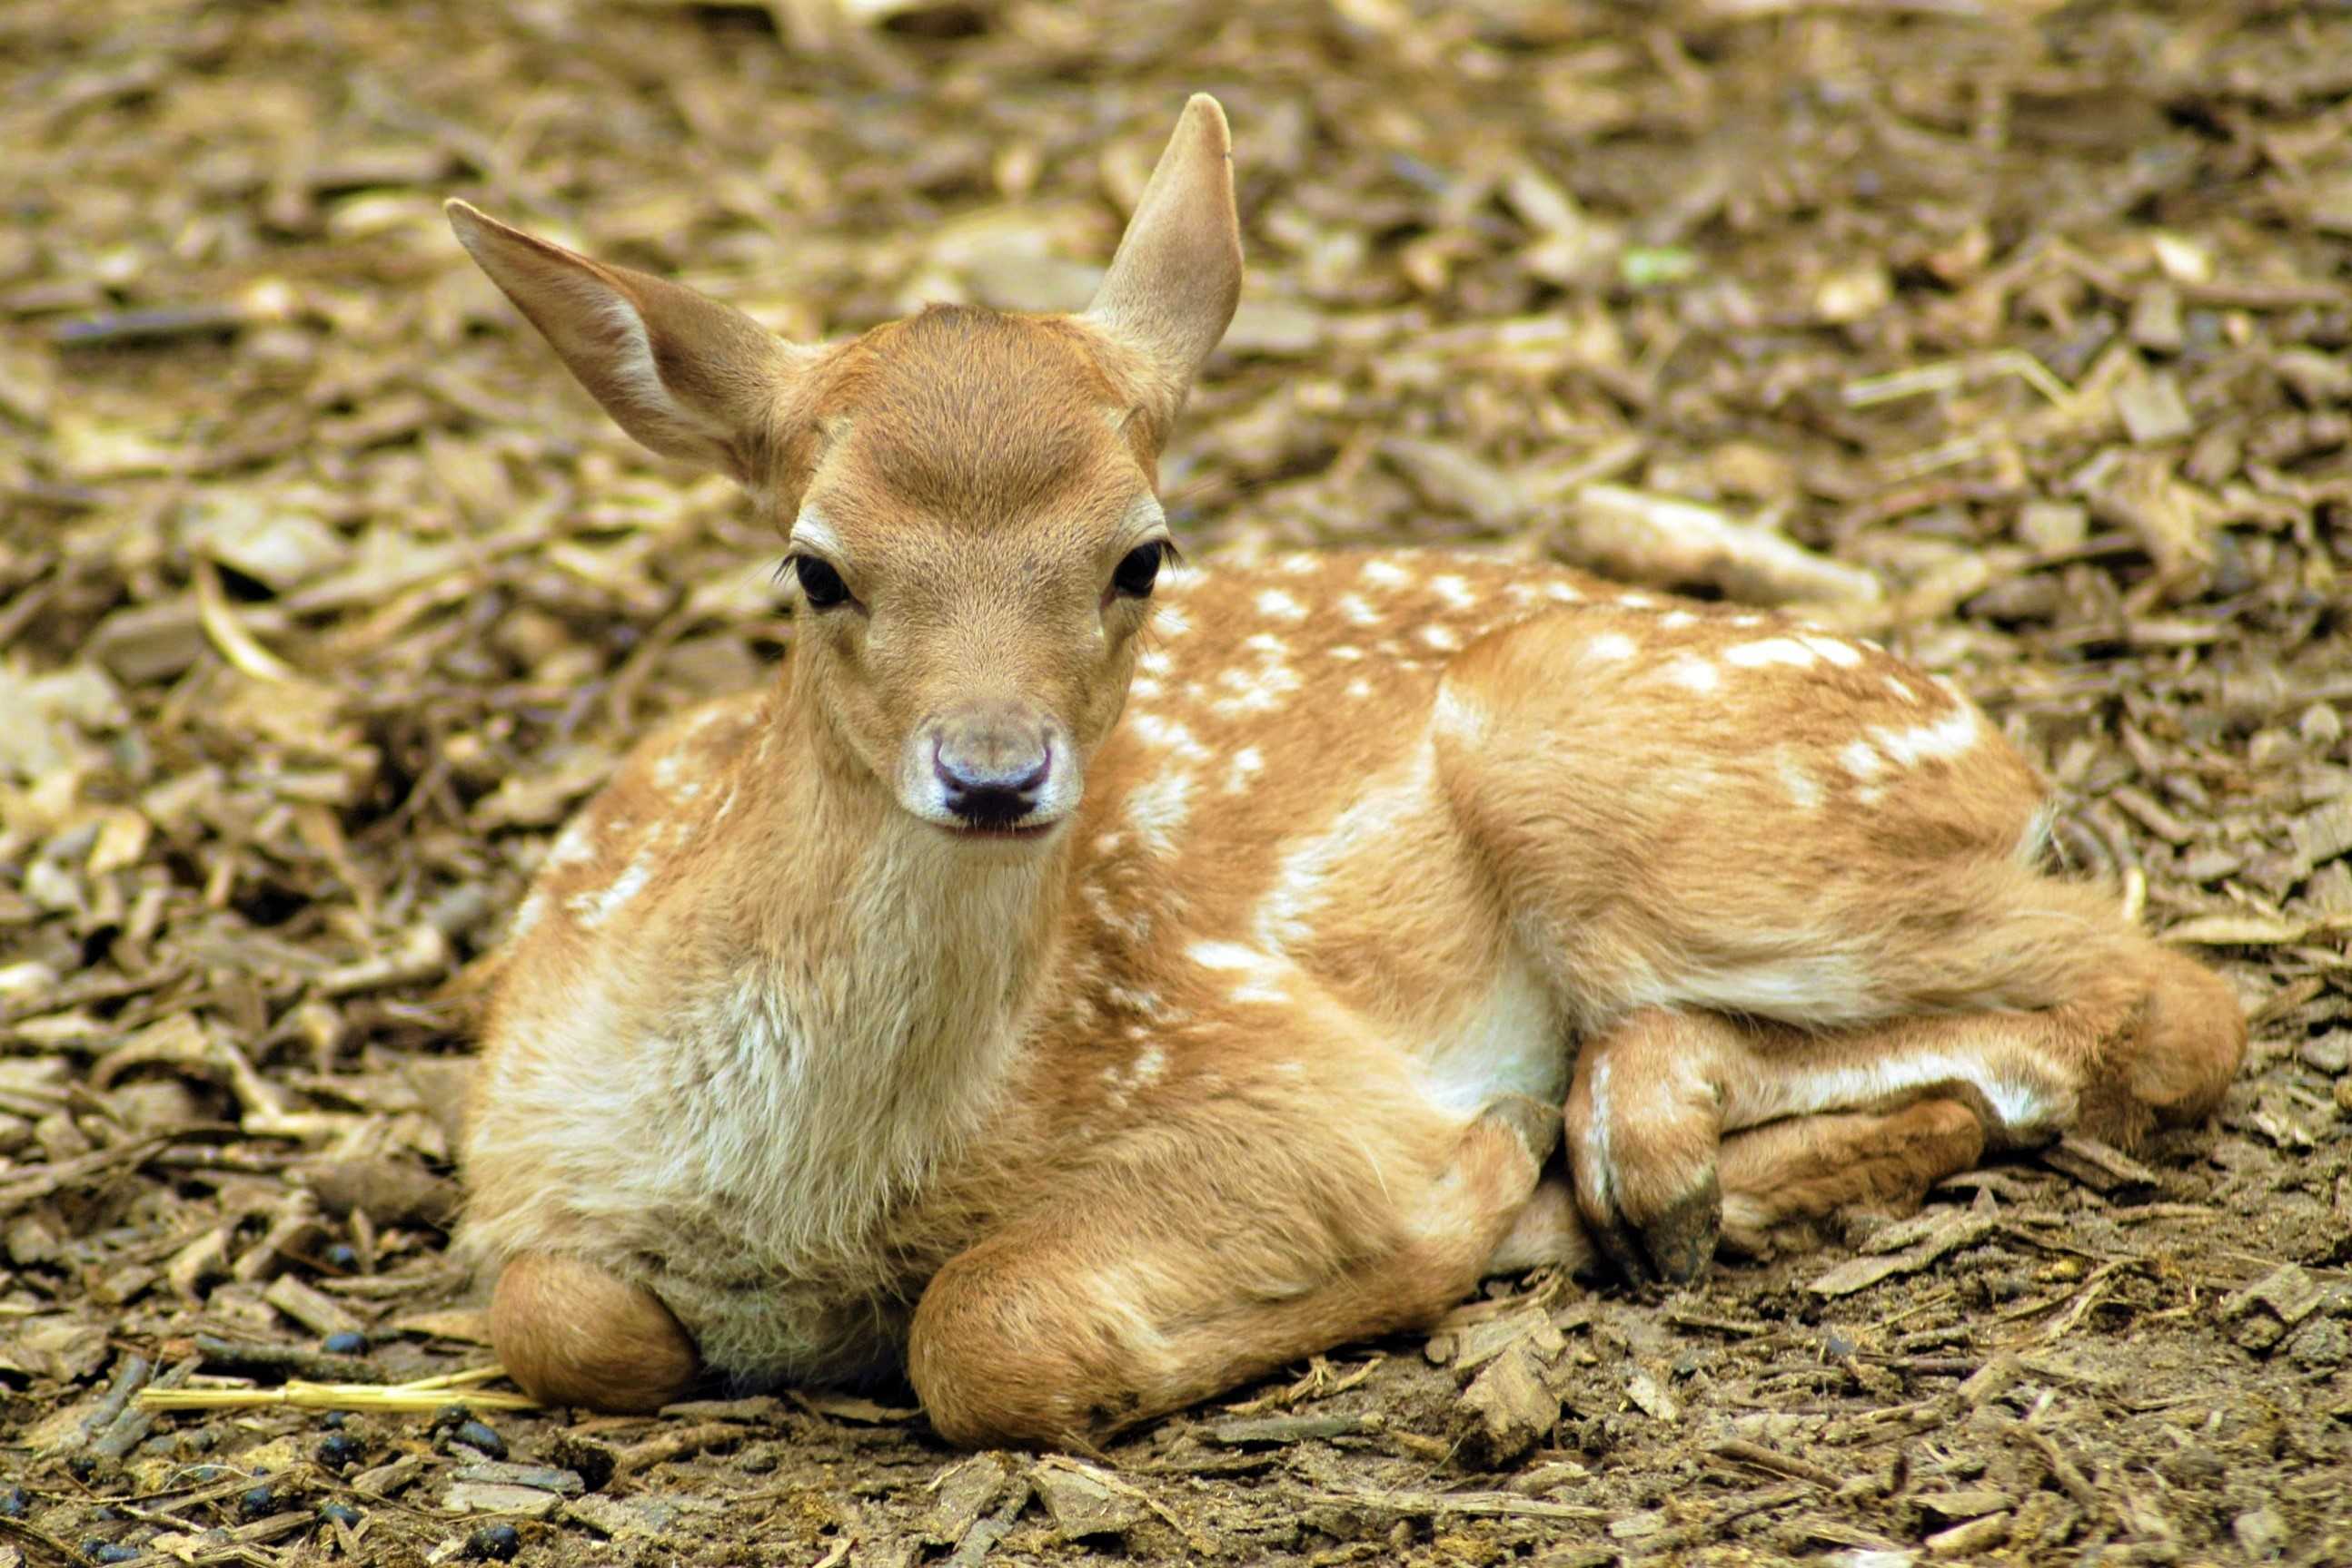
Food
The Gabrielino tribe got their food from nature.
They ate sharks, fish, shellfish, kelp, seals, sea lions, swordfish, tuna, elephant seals, scallops, mussels, limpets, and urchins
They also hunted squirrels, rabbits, deer, birds, snakes, and rodents
The Gabrielino gathered acorns, cattail plants, chia plants, seeds, nuts, fruits, berries, honey, pine nut, and cacti

Slide 5
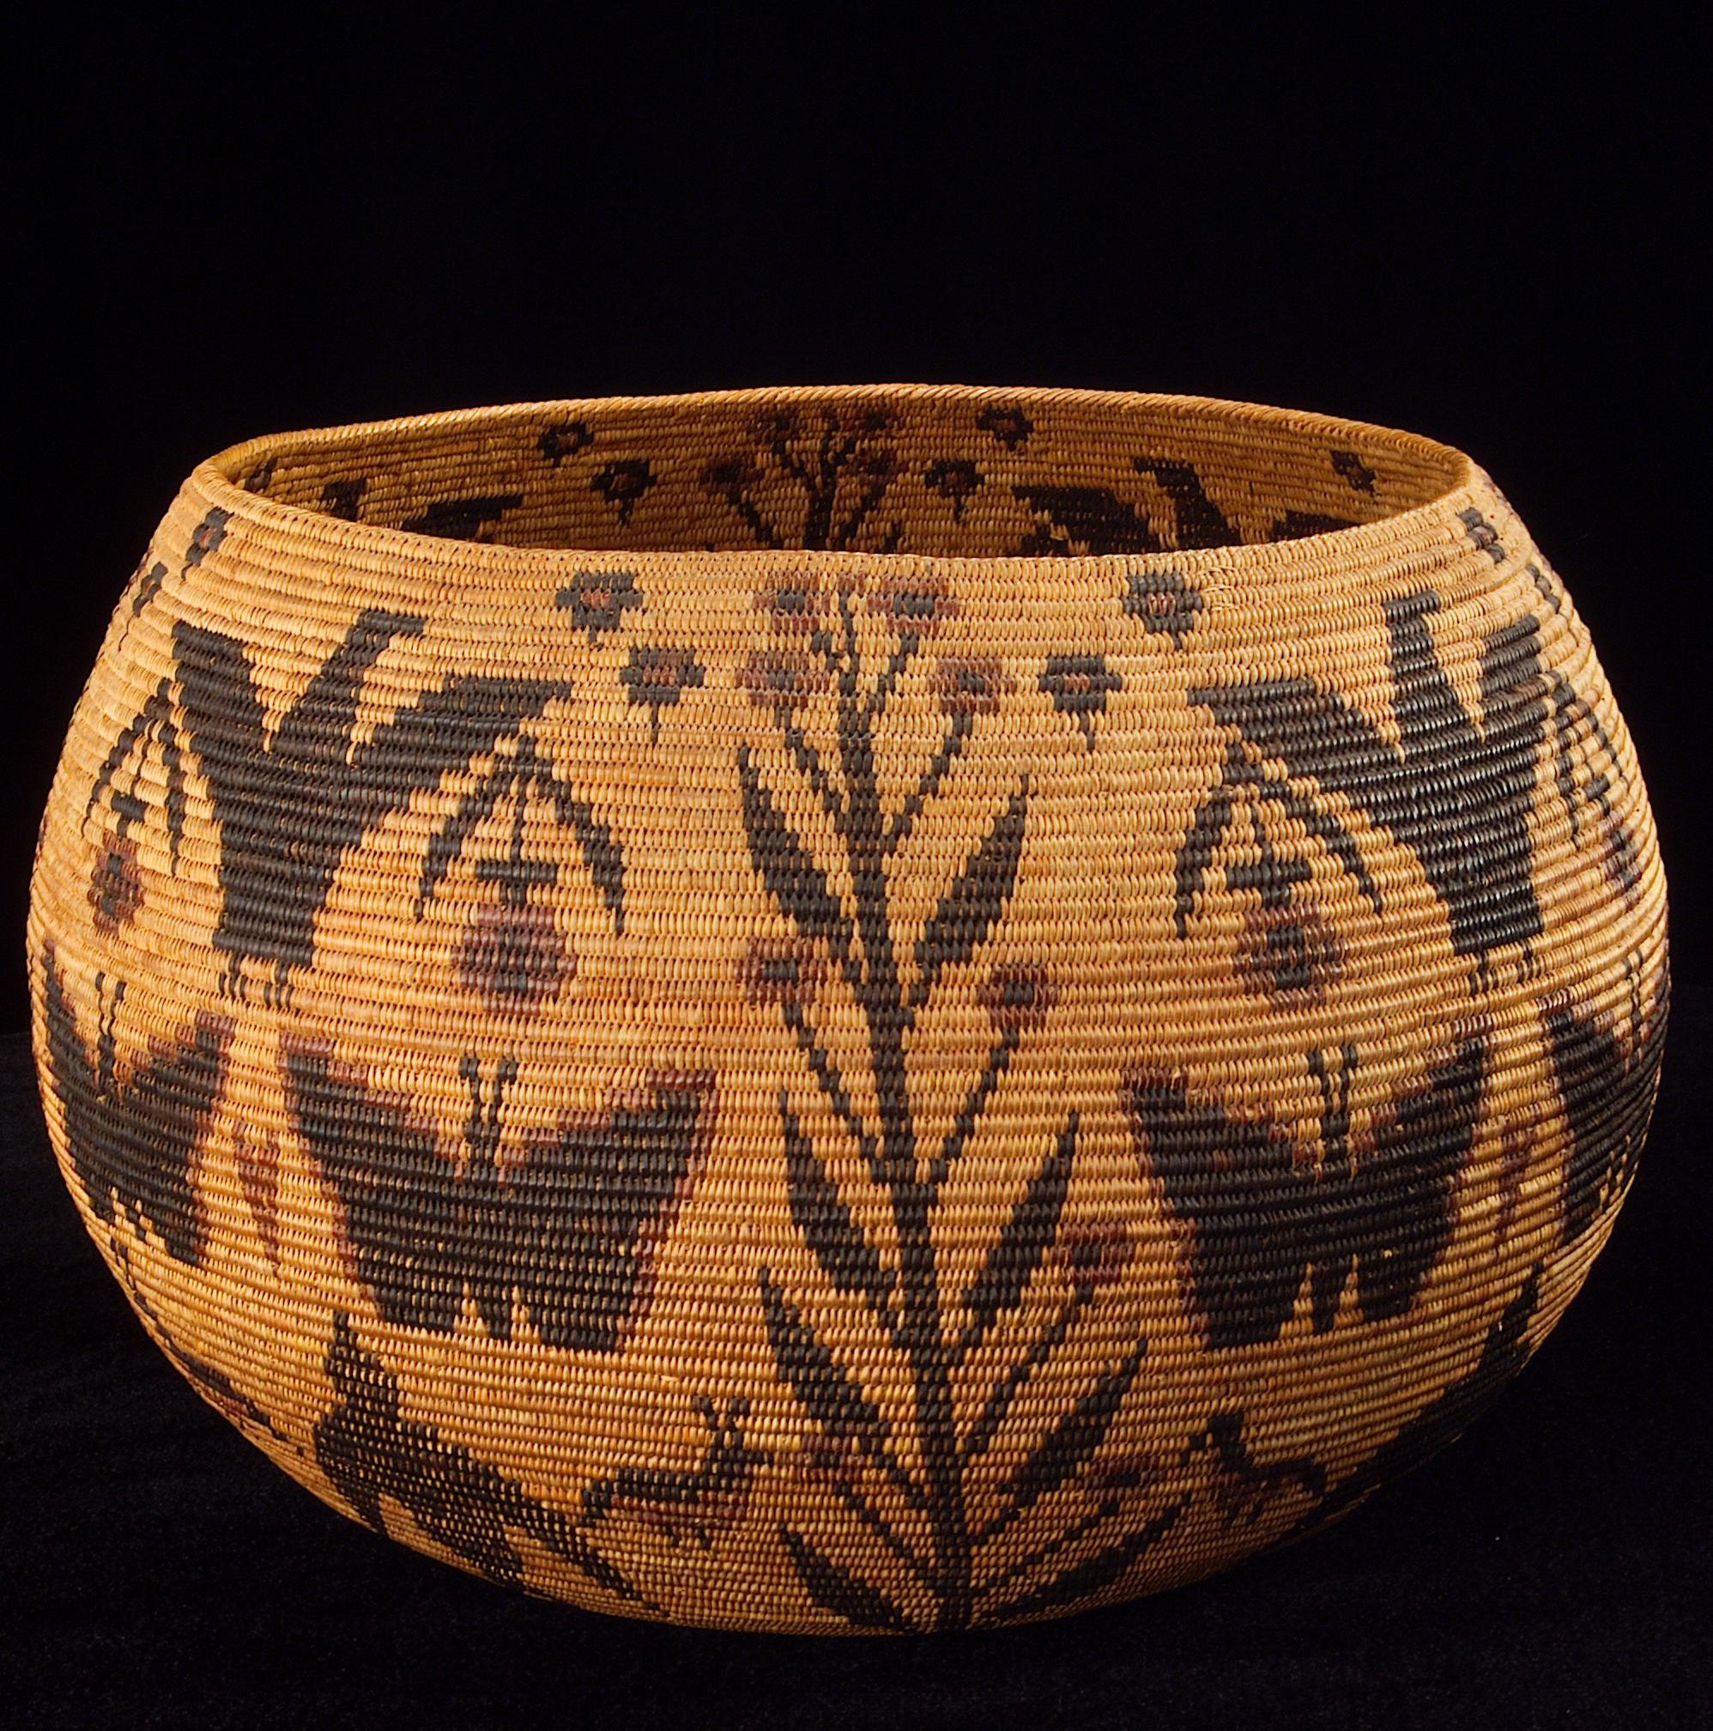
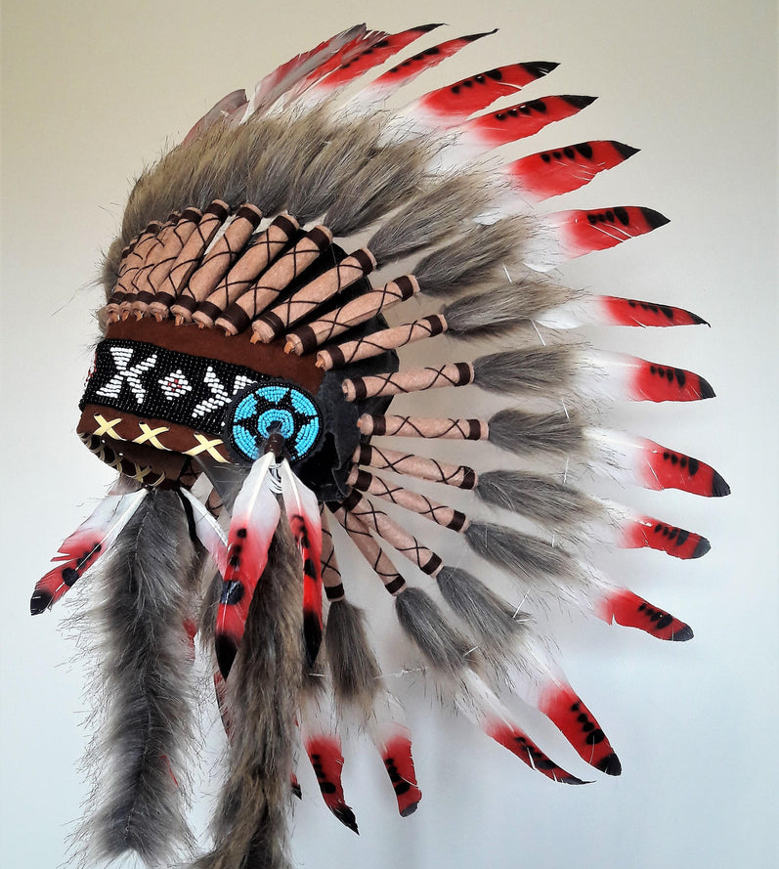
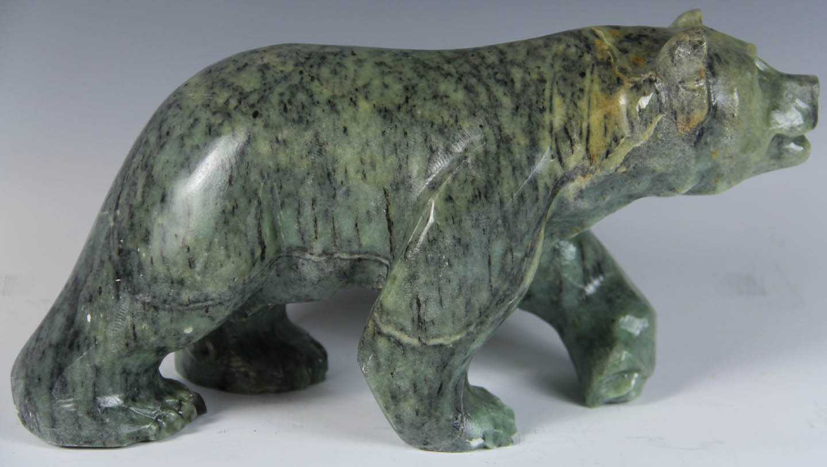
Culture
The culture of the Gabrielino was special.
The Gabrielino culture included lots of stories, legends and music
It also included rituals and dances
The Gabrielino tribe also wove baskets and carved soapstone

Slide 6
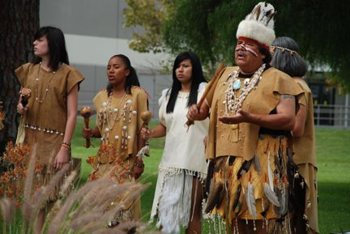
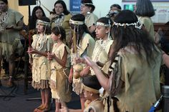
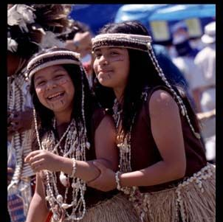
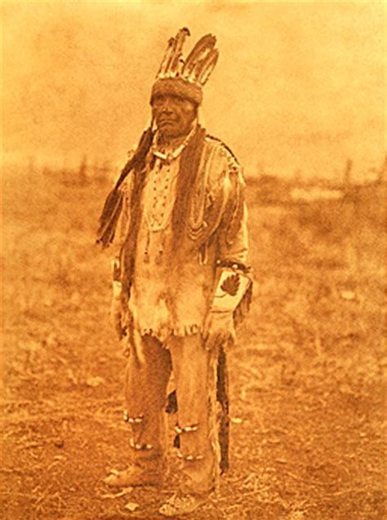
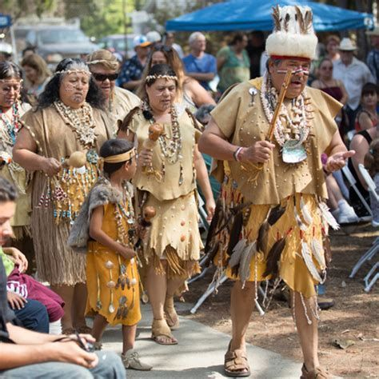
Clothing
The Gabrielino wore deerskin garments
They also wore capes from deerskin
The women wore aprons made from bark, willow, or cotton

Slide 7
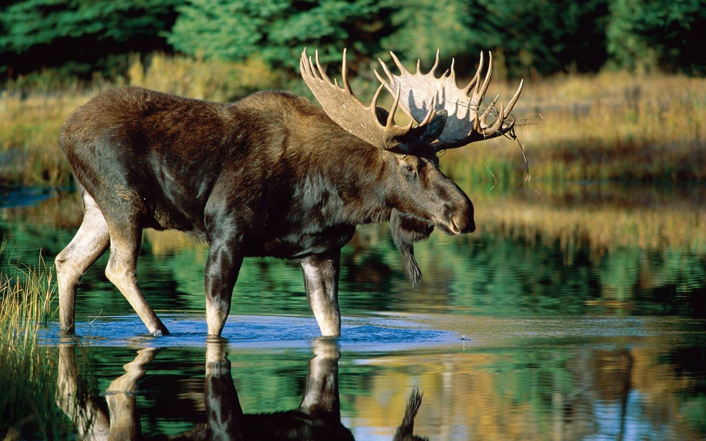
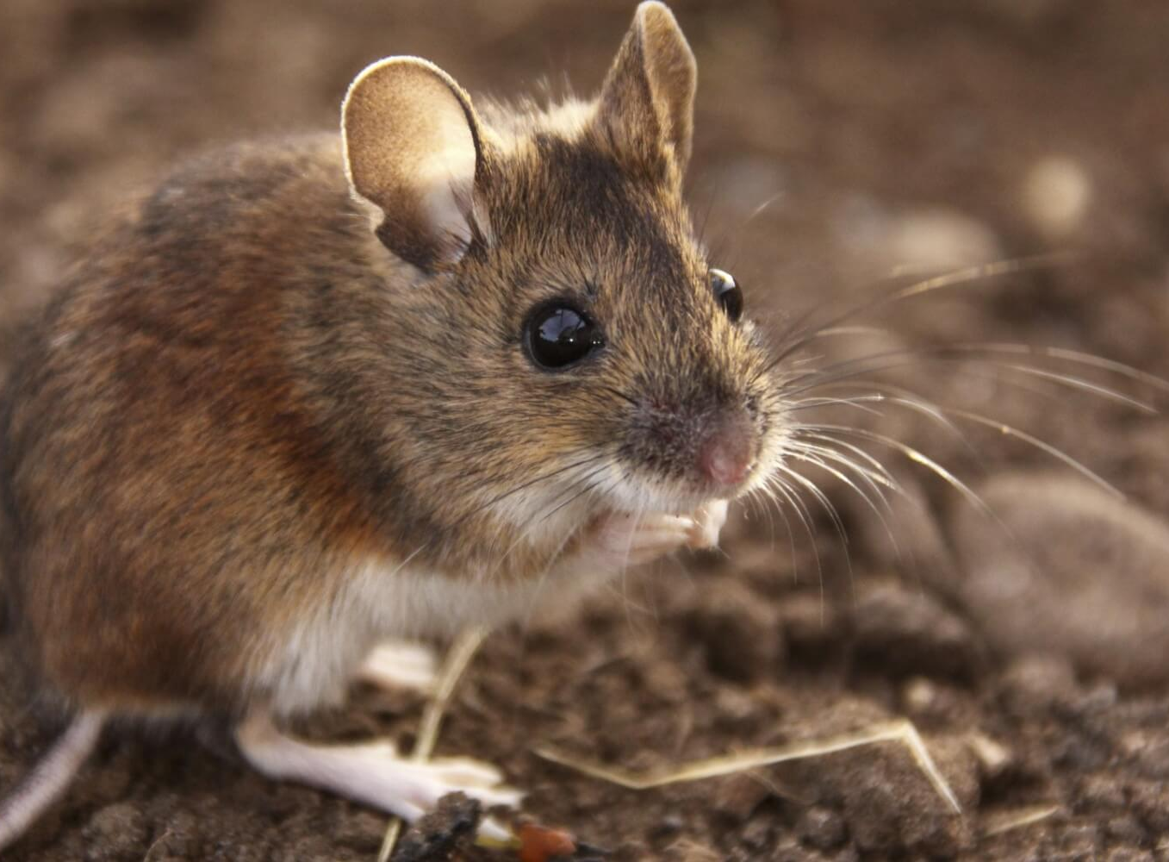
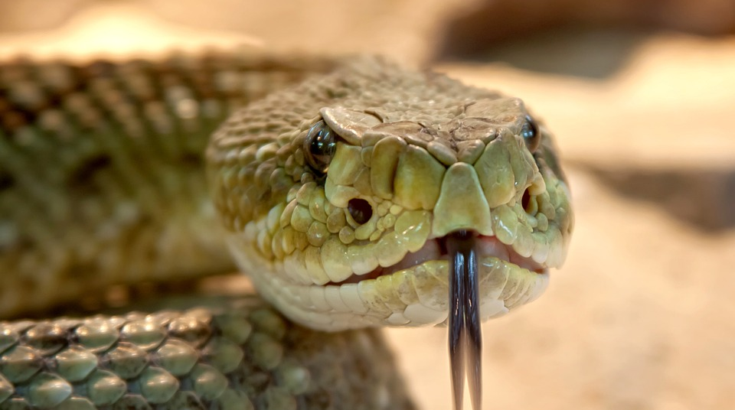
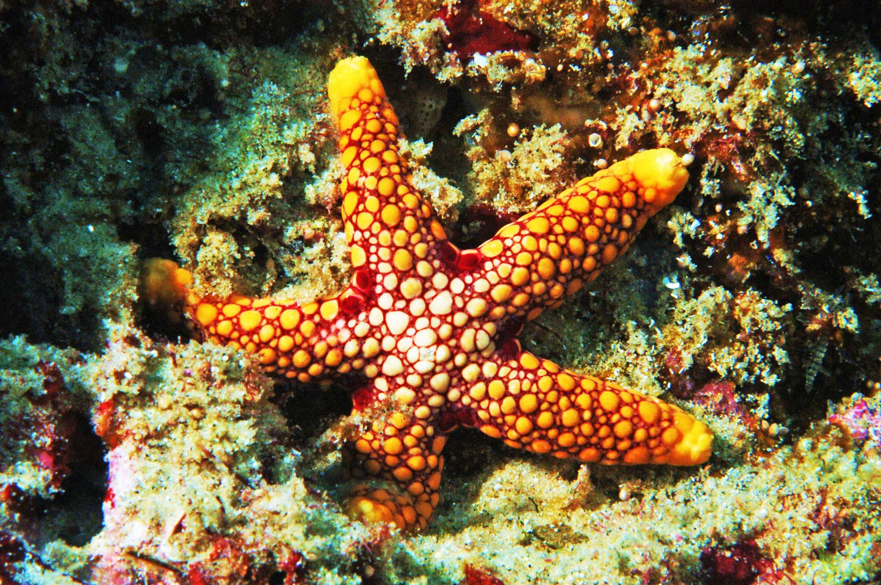
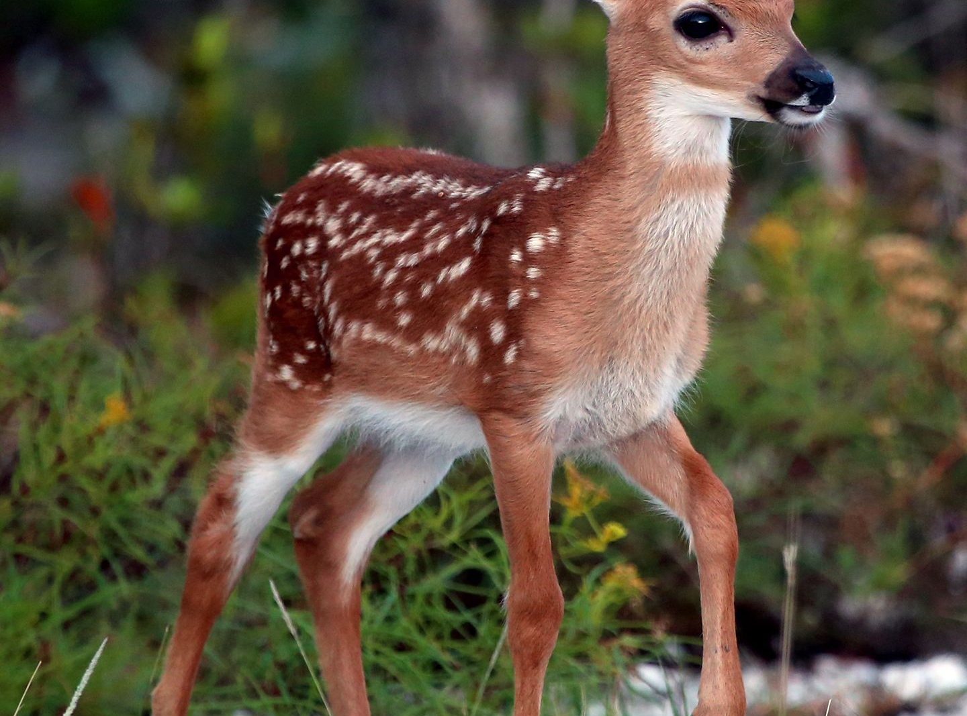
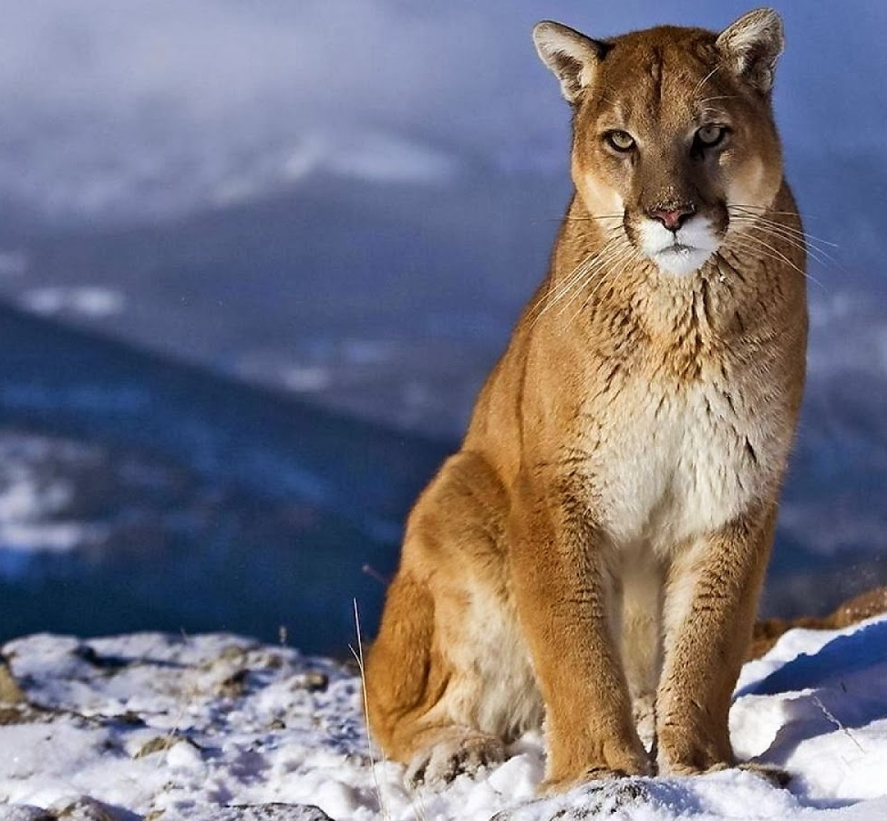
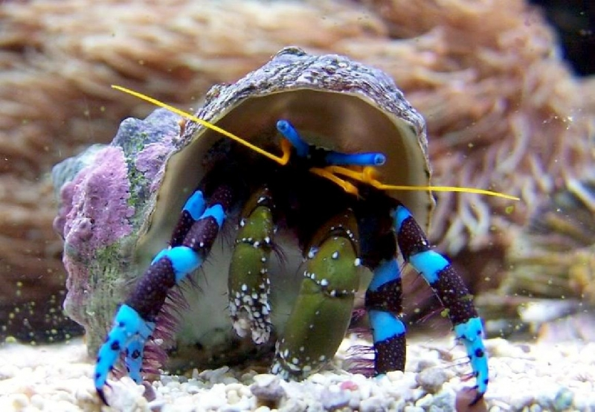
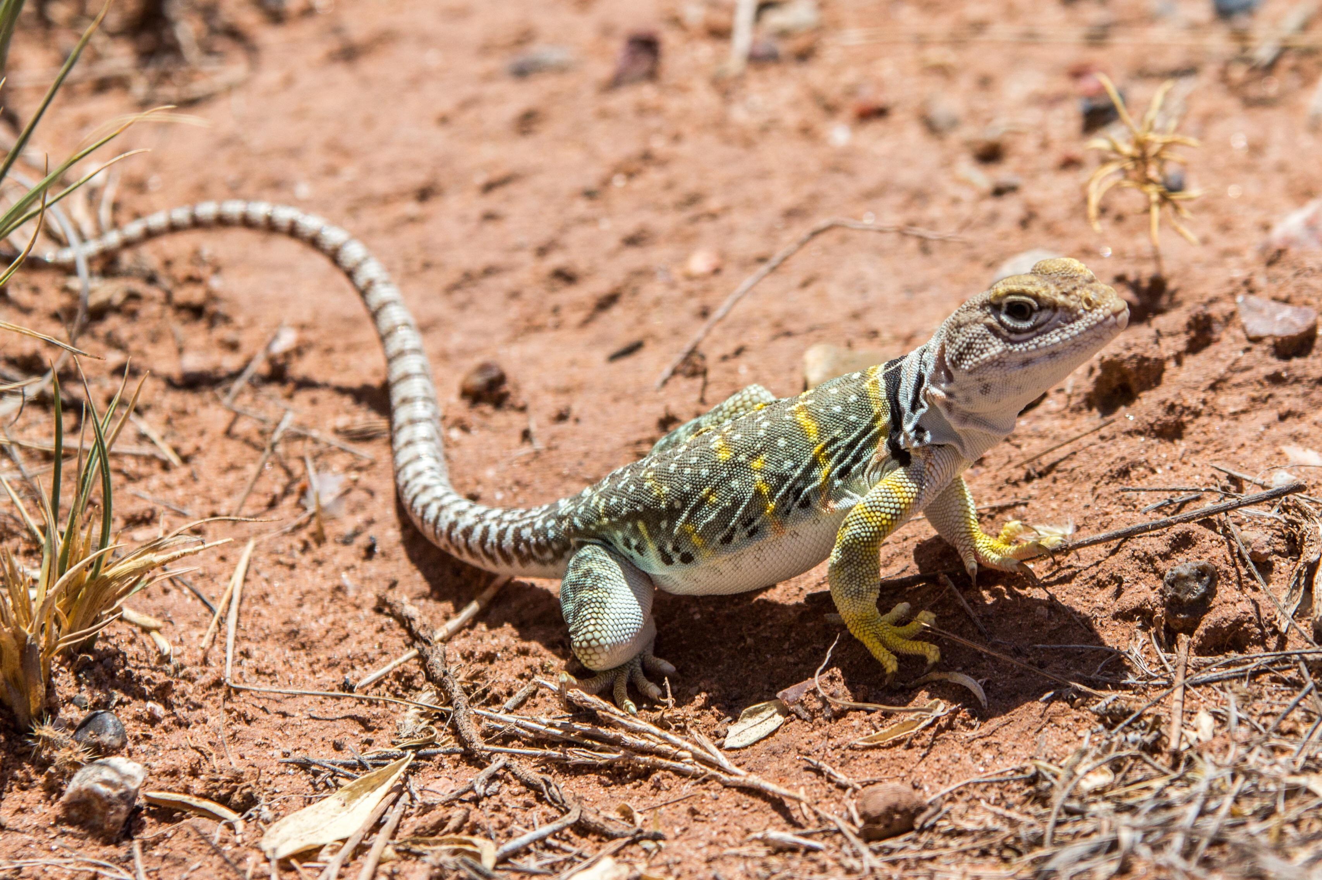
Animals
Animals that lived near the Gabrielino included reptiles such as snakes and lizards
They also lived near cougars, mountain lions, rabbits, deer, moose, mice, and rats
The ocean animals included sharks, fish, starfish, clams, shellfish, and hermit crabs

Slide 8
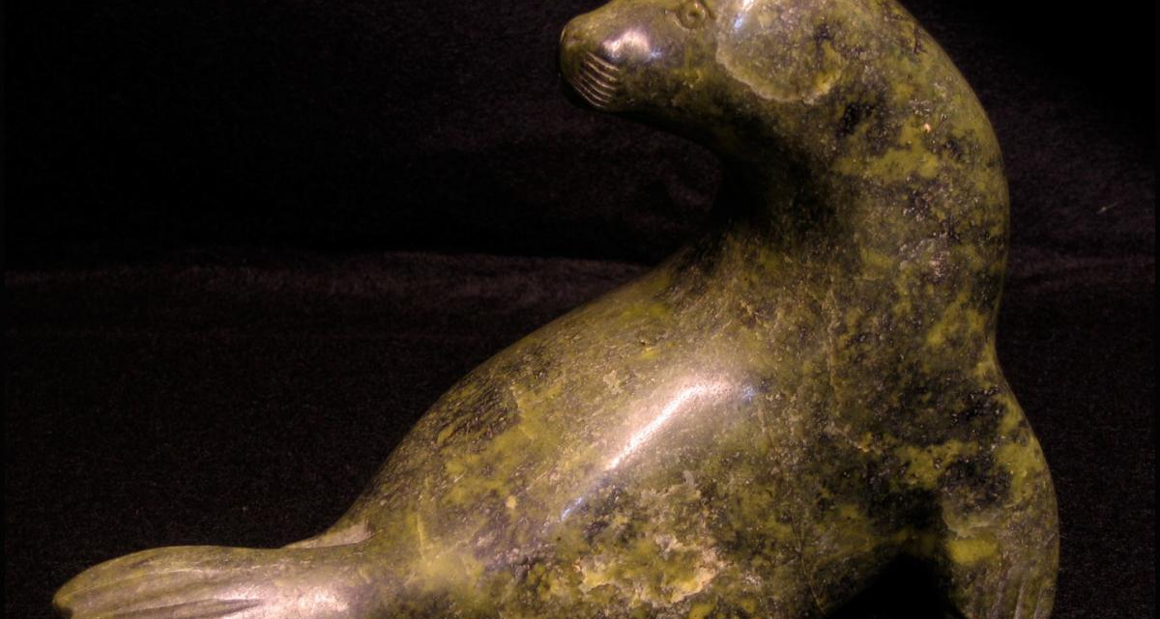
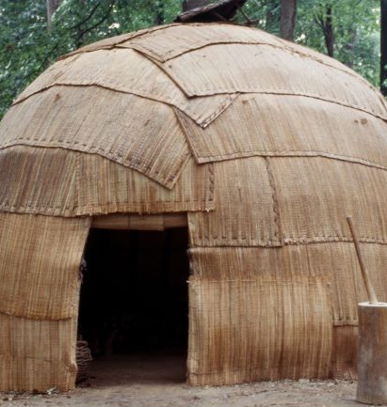
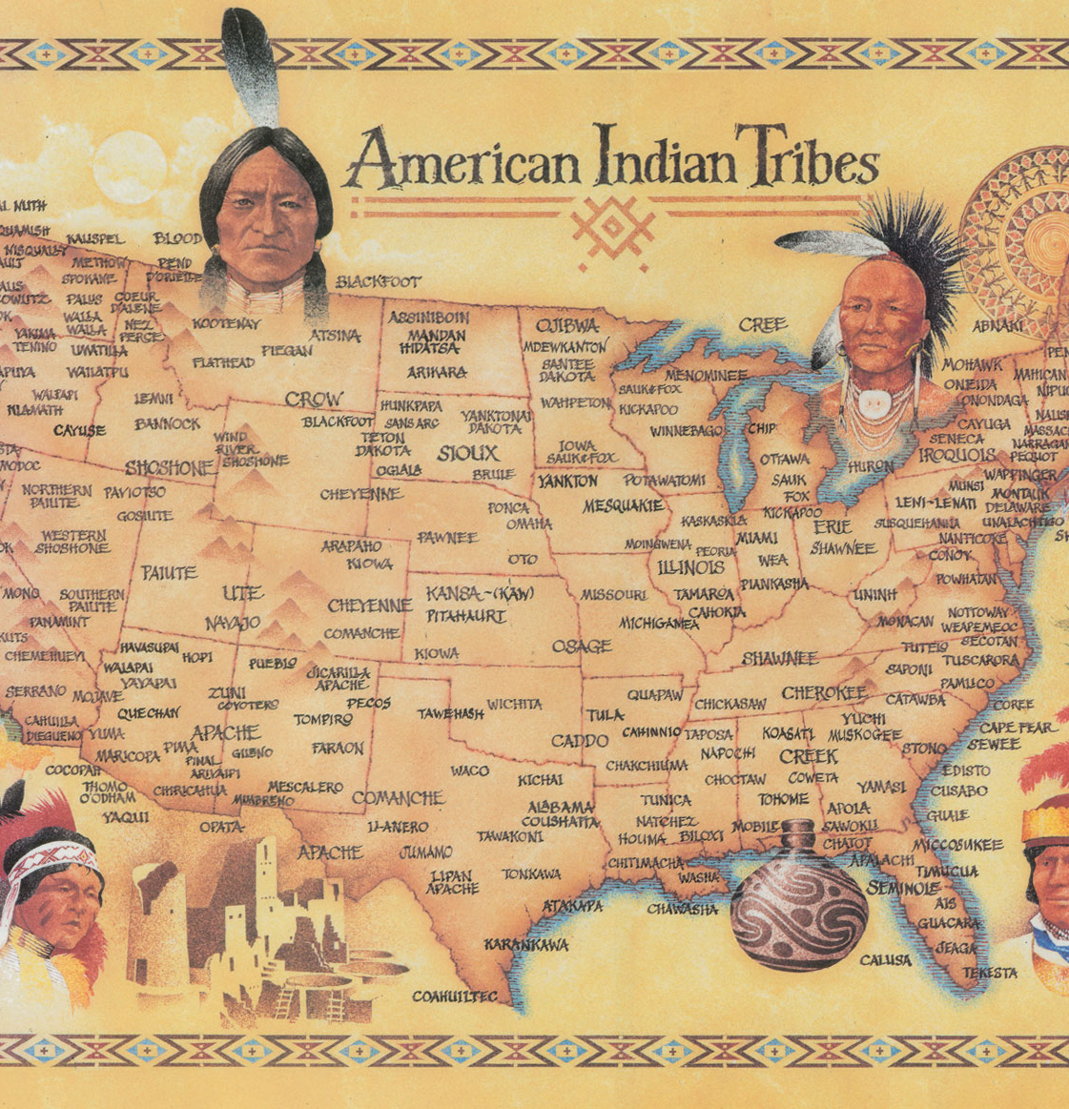
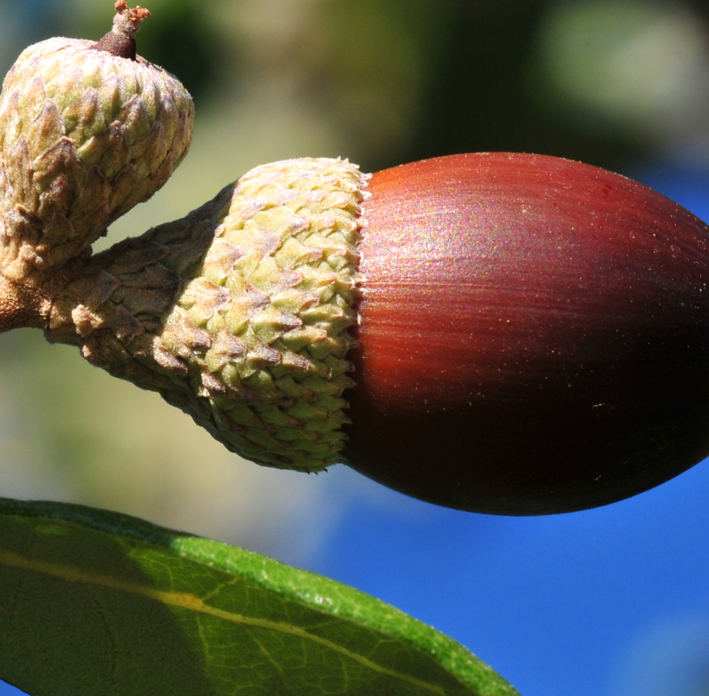
Thank You!
This Photo by Unknown author is licensed under CC BY-NC-ND.

