Slide 1
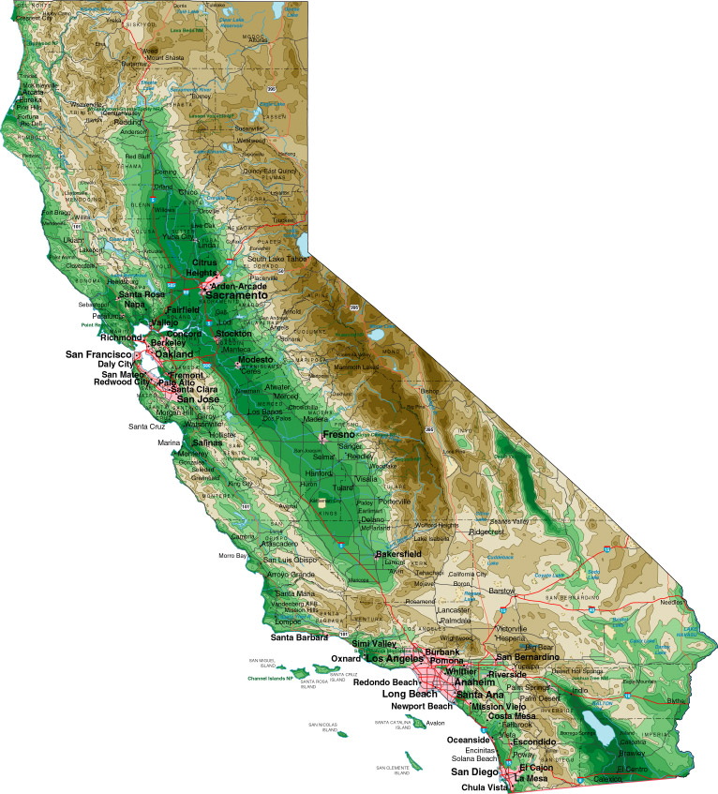
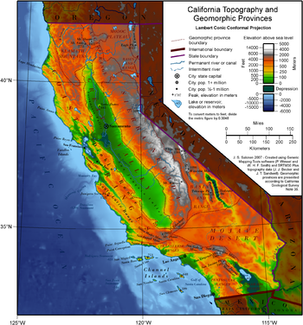
California’s Amazing 4 regions
Coast, Desert, Central Valley, Mountains

Slide 2
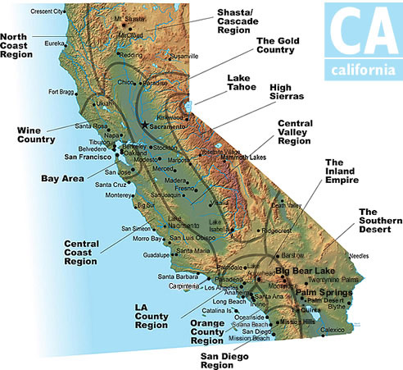

Slide 3
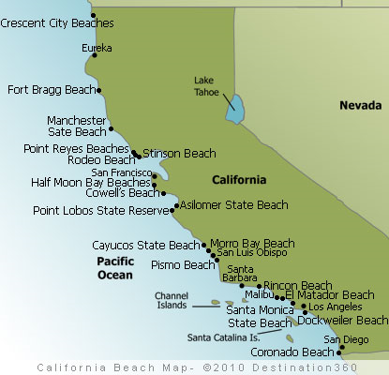
California Coastal Beaches

Slide 4
California Coast
800 miles along the west coast of the United States and the Pacific Ocean.
Northern Coast has mountains and steep rocky cliffs at its shoreline
Southern Coast has plains with sandy beaches.
Natural Harbors, San Francisco Bay, Monterey Bay, & San Diego Bay.
Valleys in coastal mountains have rich soils great for farming. North of San Francisco are the Napa & Sonoma Valleys, known for wines. South of San Francisco are the Santa Clara & Salinas Valleys known for food crops.
Island chains; North: Farallon Islands, South: Channel Islands.

Slide 5
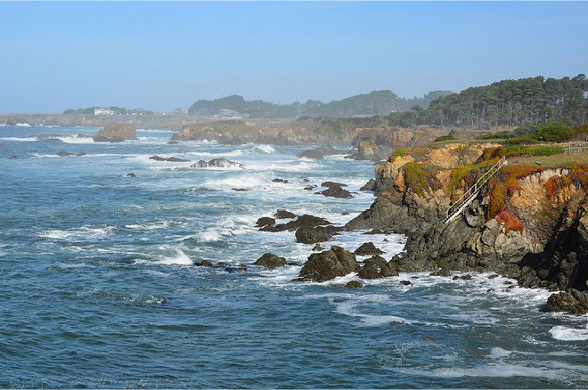
Northern California Coast Mendocino shoreline
Steep rocky cliffs and beaches in the northern coast region.
Humboldt Coastline

Slide 6
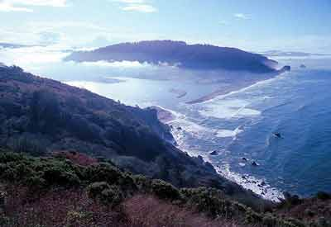
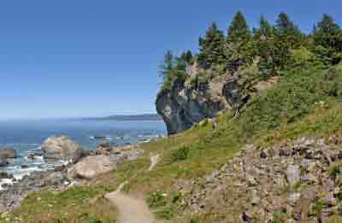
Klamath River Coastal overlook
Patrick’s point
north of Eureka

Slide 7
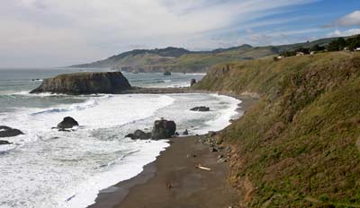
Goat Rock Beach, Sonoma County

Slide 8
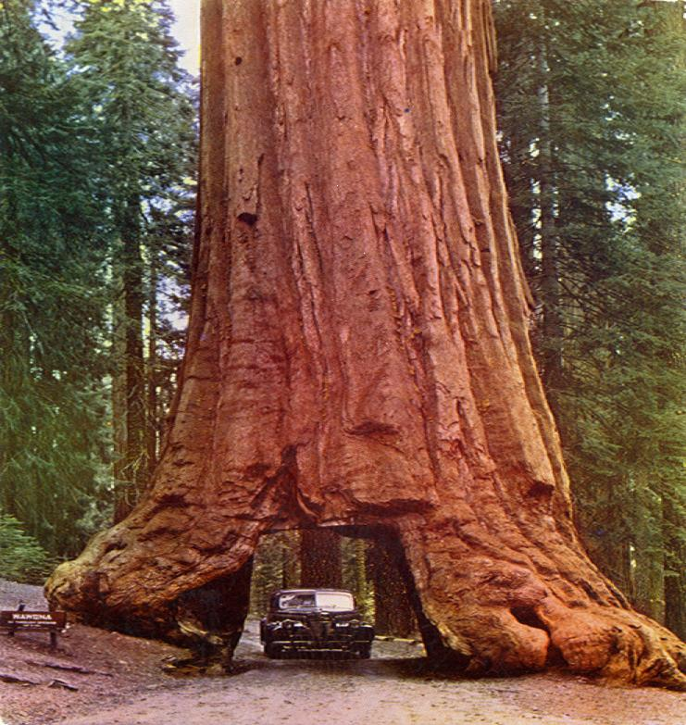
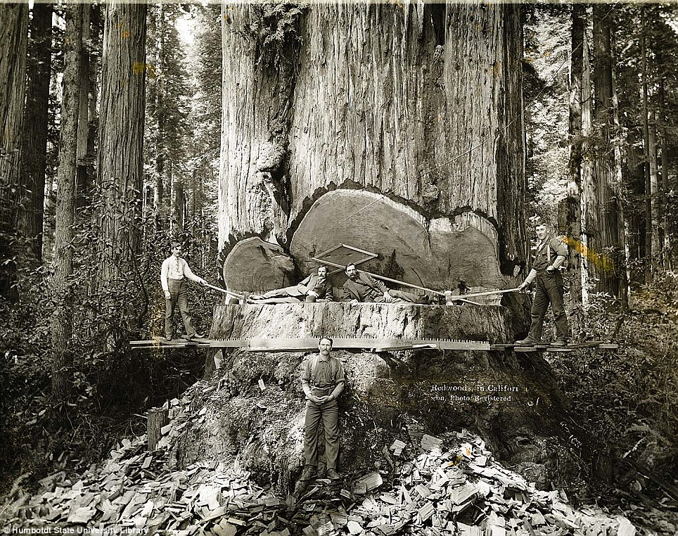
Redwoods

Slide 9
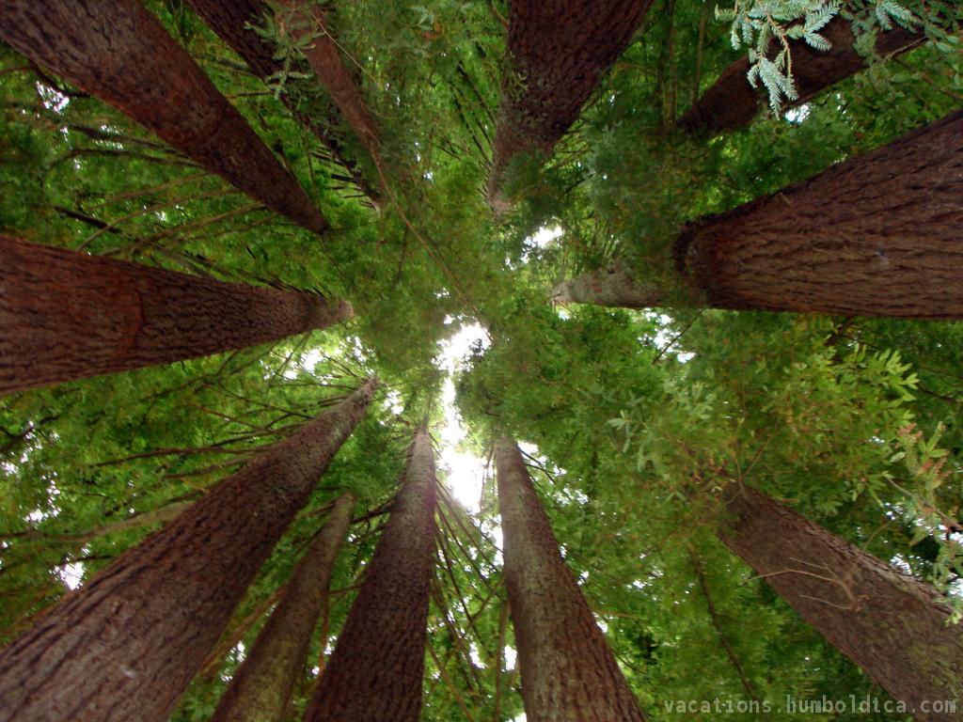
California Coastal Redwoods
These giants only grow in a small
Range along the California coast.
From Monterey Bay to Oregon border
and within 40 miles of the ocean.
The can live 1200-1800 years. They
Can reach 379 feet tall and 26 feet
Diameter. We have cut down as much
As 95% of the old growth redwood
Trees to use in construction.

Slide 10
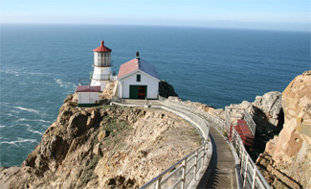
Pt. Reyes North of San Francisco
Pt. Reyes Lighthouse

Slide 11
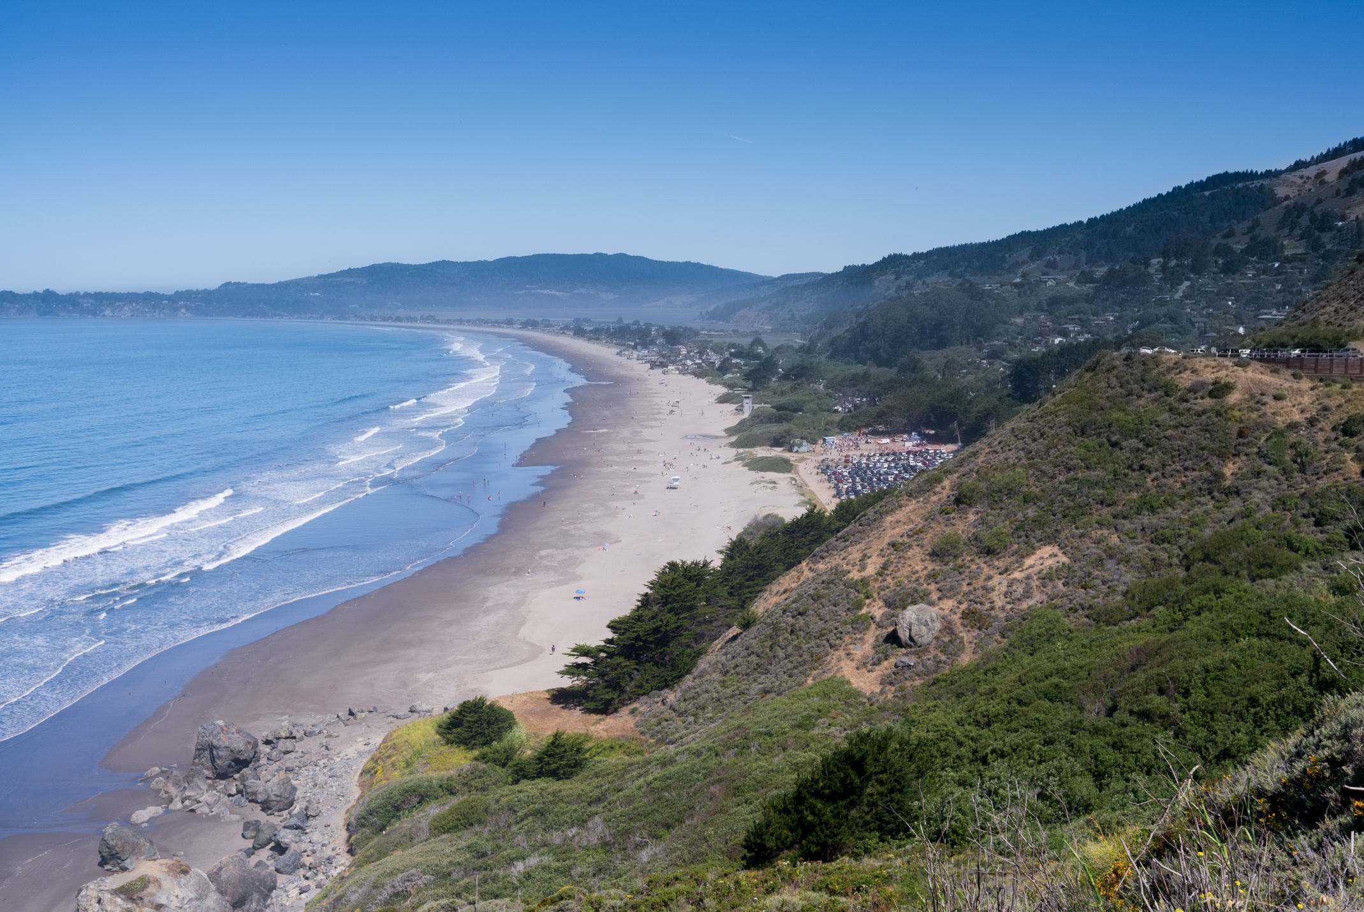
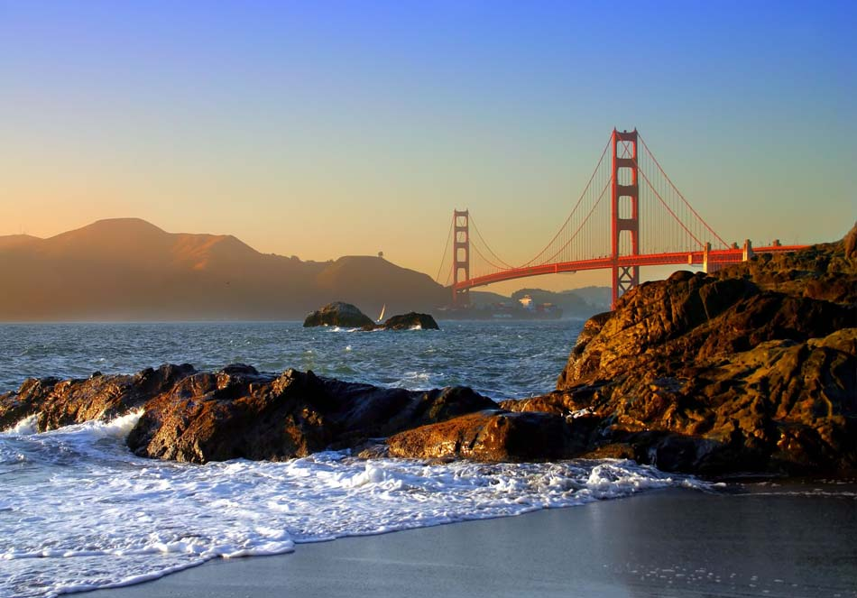
Stinson Beach north of San Francisco
Golden Gate Bridge

Slide 12
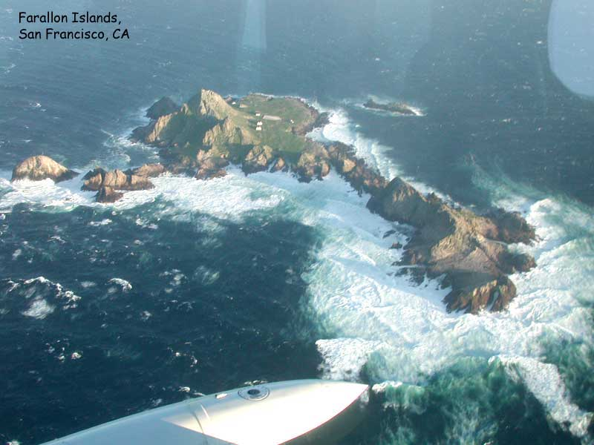

Slide 13
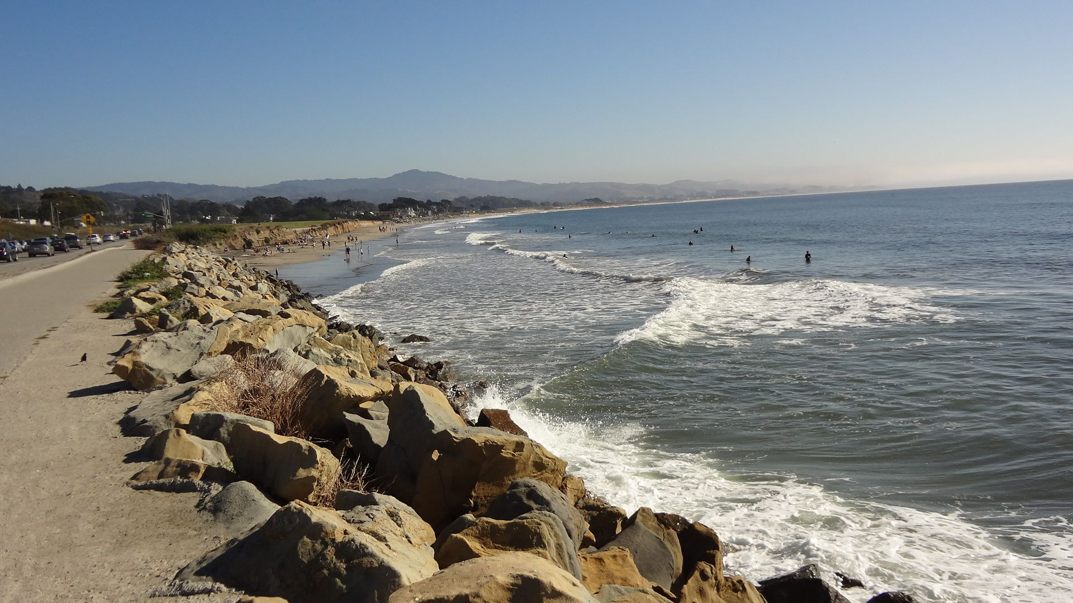
Montara Beach Central California Coast
Half Moon Bay
Central California Coast

Slide 14
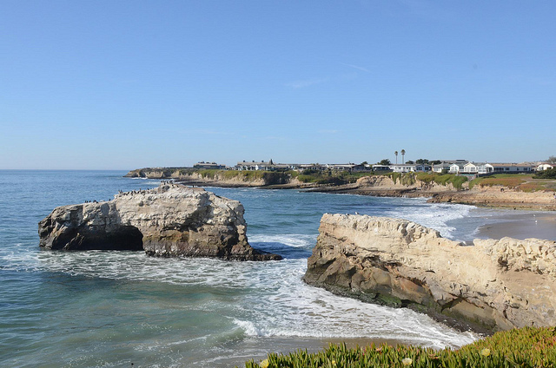
Natural Bridges Beach, Santa Cruz

Slide 15
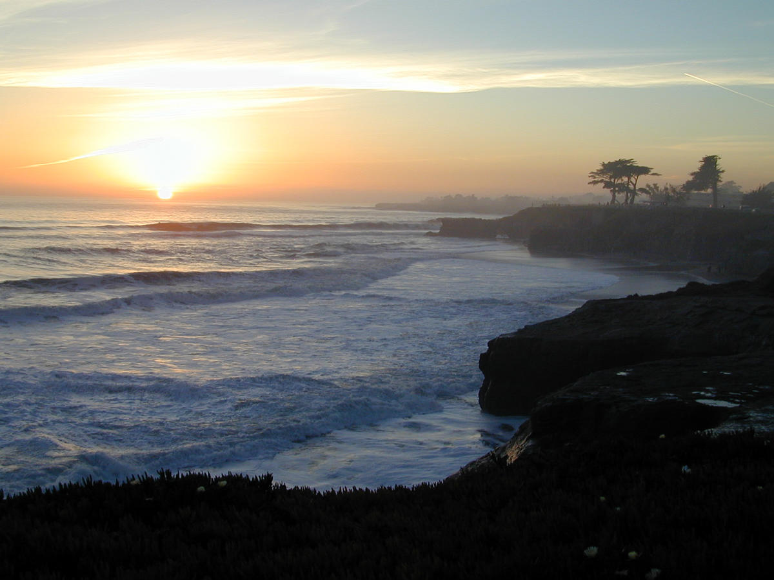
Santa Cruz

Slide 16
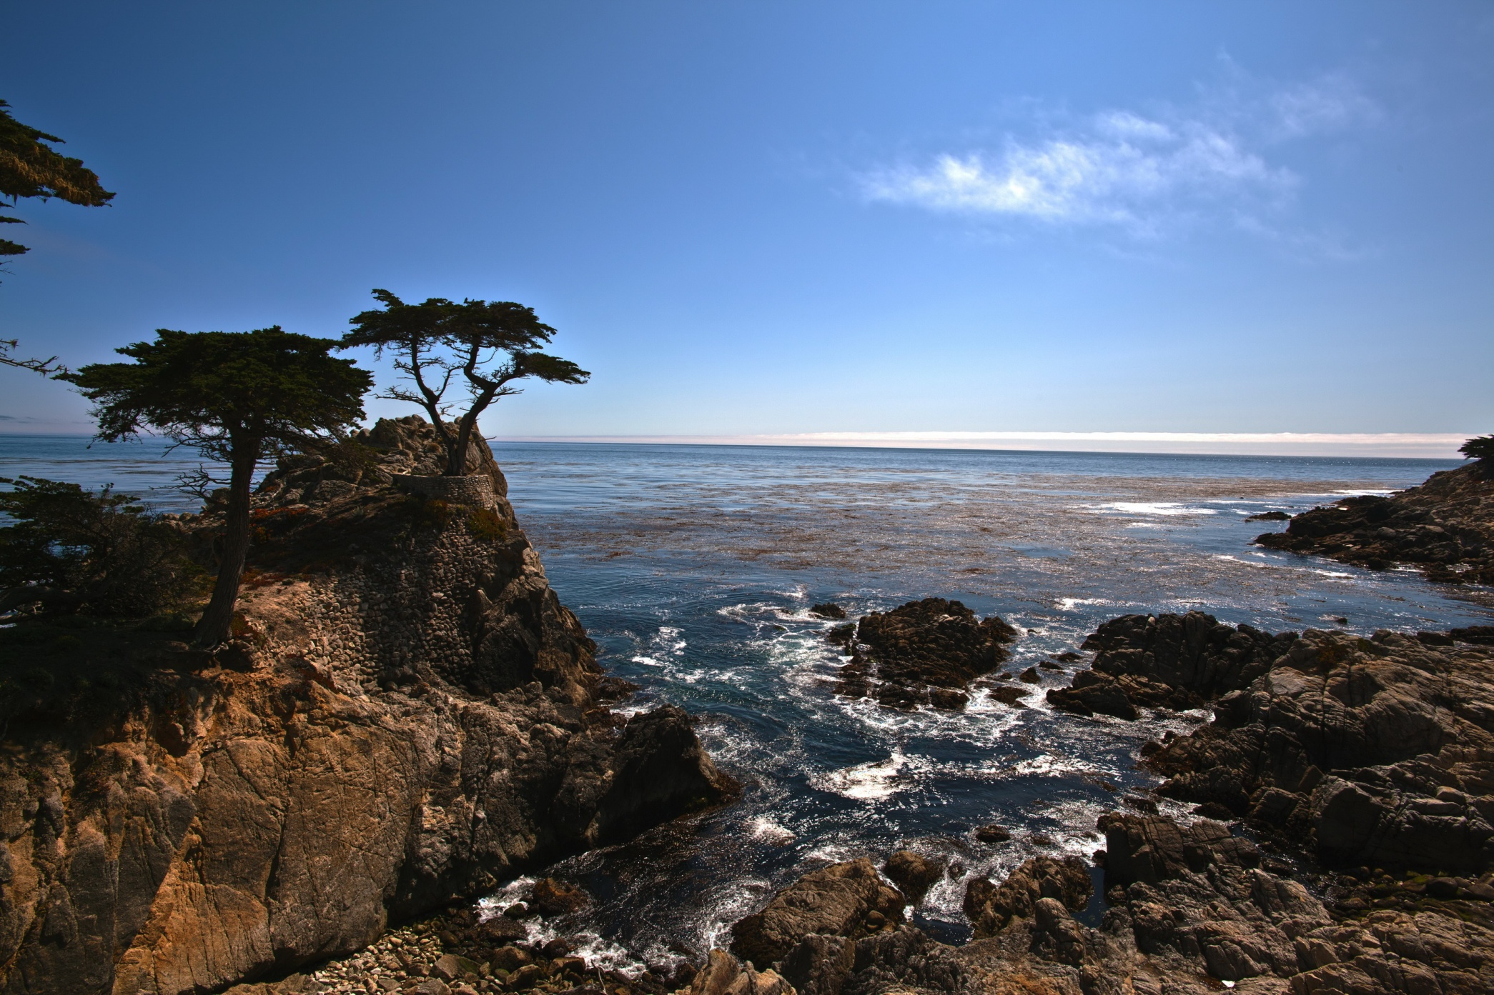
Lone Cypress, Monterey Bay

Slide 17
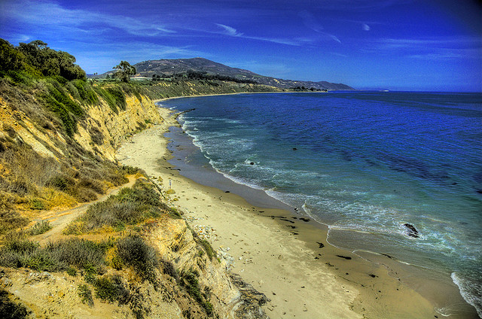
Carpinteria Beach, Santa Barbara

Slide 18
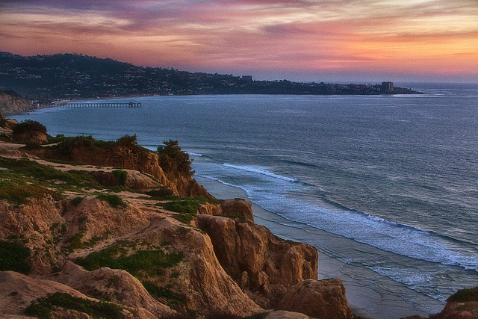
La Jolla Beach, Southern California

Slide 19
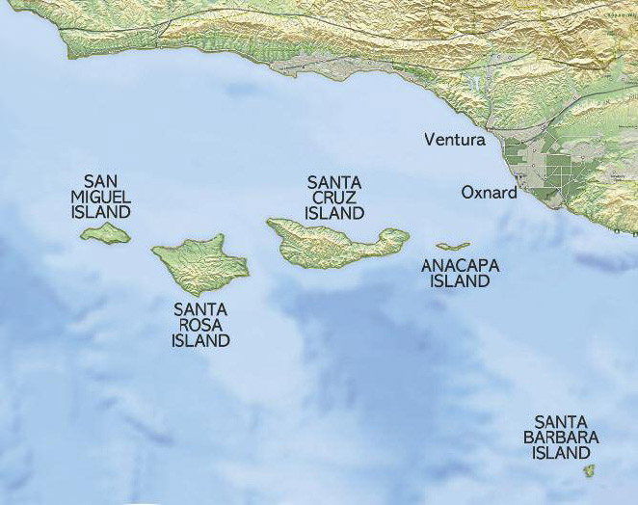
Channel Islands
off coast of Southern California

Slide 20
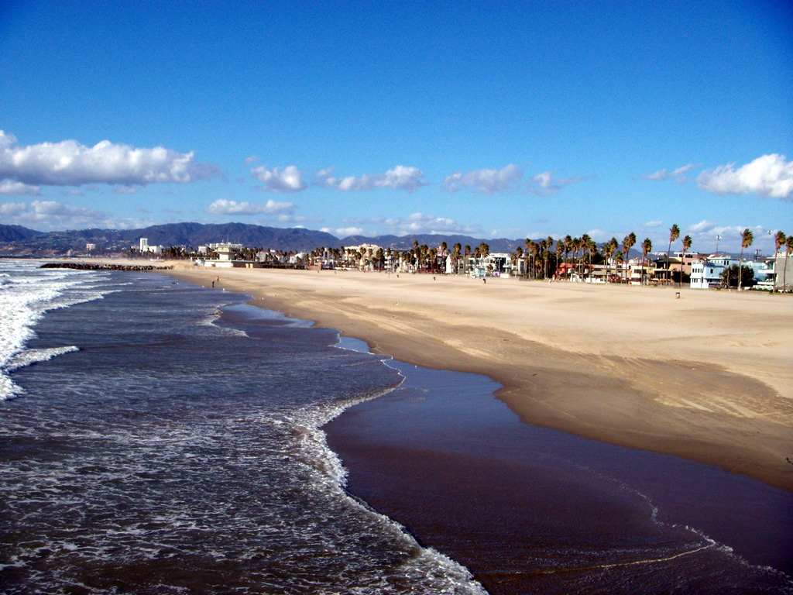
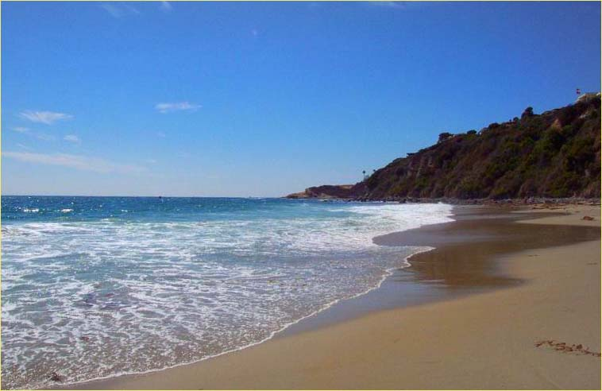
Venice Beach, Southern California
Dana Point, Southern Orange County

Slide 21
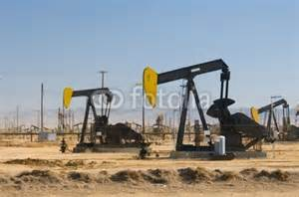
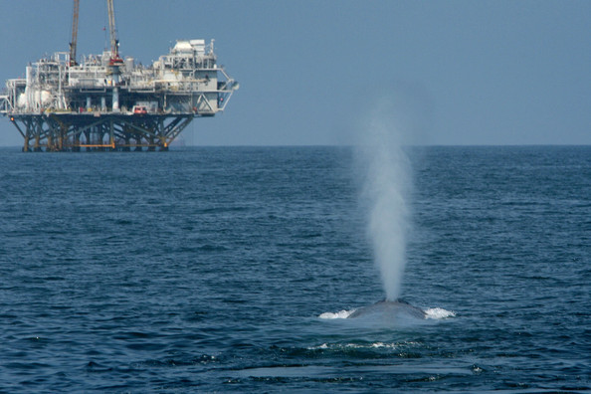
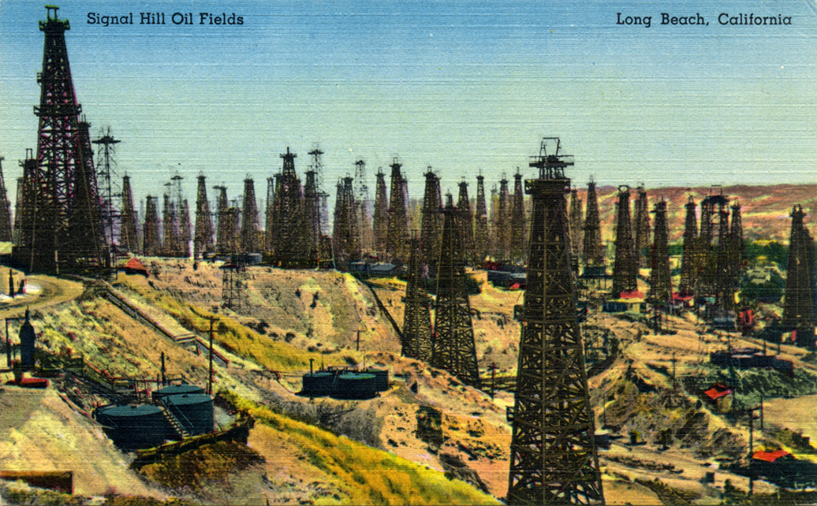
Oil drilling in Southern California coastal region. Oil, a natural resource, we use to provide gas and electricity is needed. However,conservationists are fighting to stop drilling and pumping of oil because of the damage it causes to the environment.

Slide 22
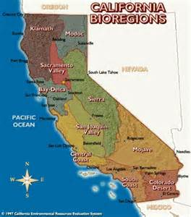
California Desert Region covers the southeastern part of California.
It includes the Mojave Desert, known as the high desert with elevations to 11.918 feet and the lowest point in the western hemisphere, Death Valley, 282 feet below sea level.
Even though it is extremely dry in the Colorado desert region, there is farming in the Imperial and Coachella Valley because they use irrigation to bring in water

Slide 23
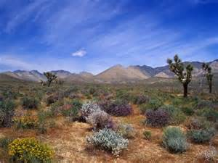
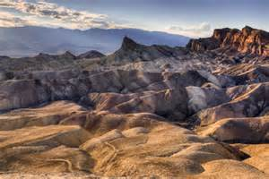

Slide 24
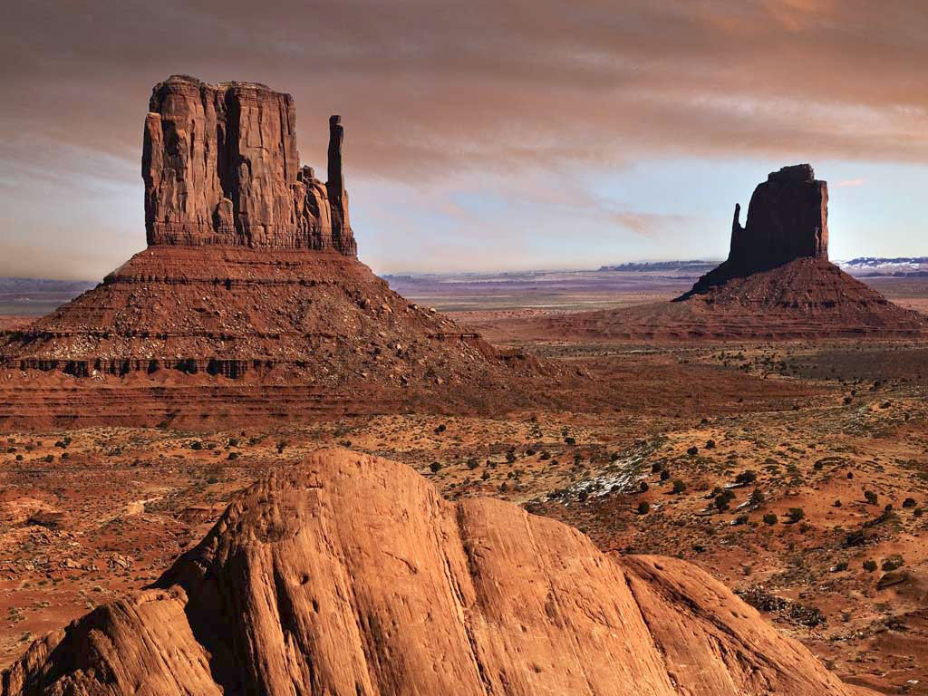

Slide 25
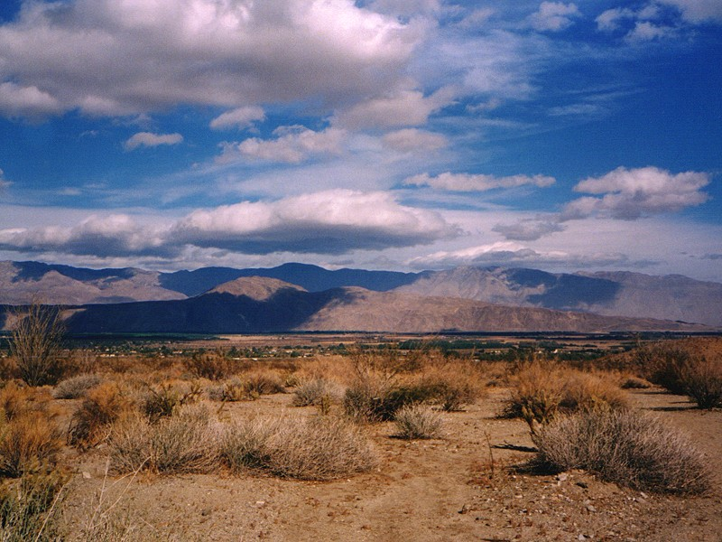
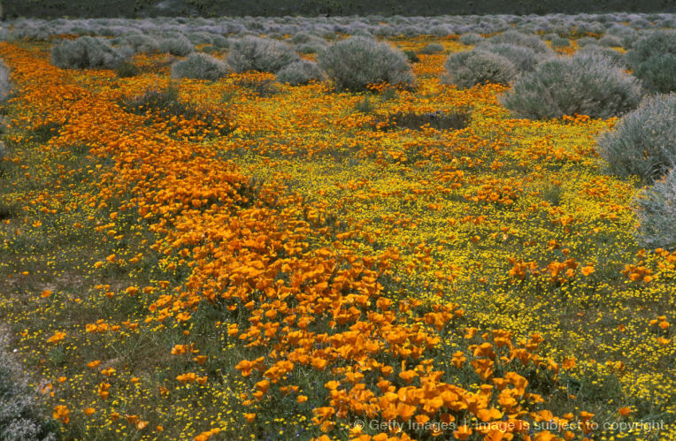
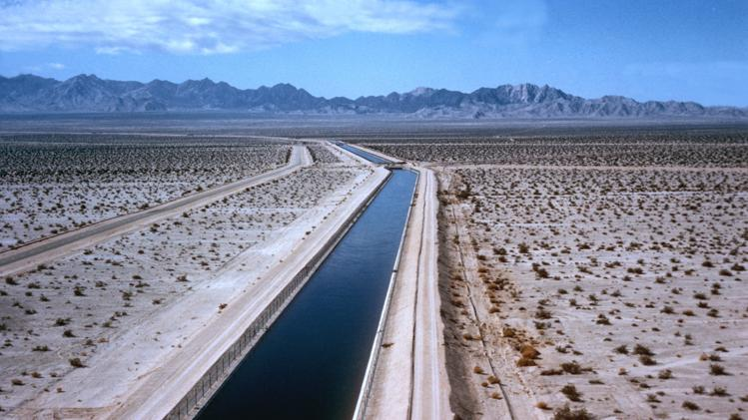
Poppy Field

Slide 26
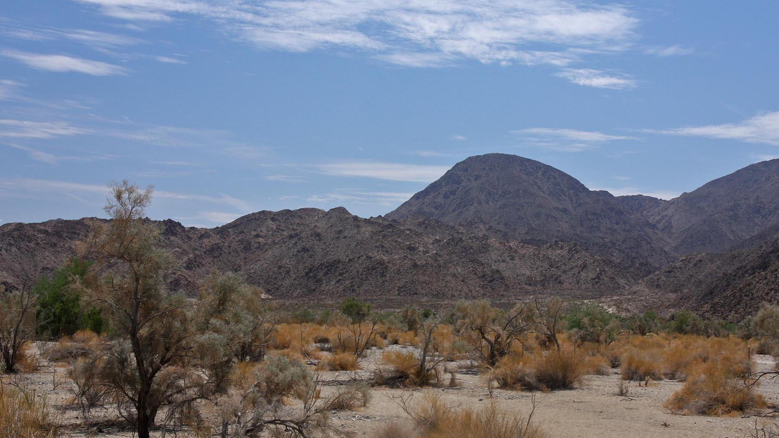
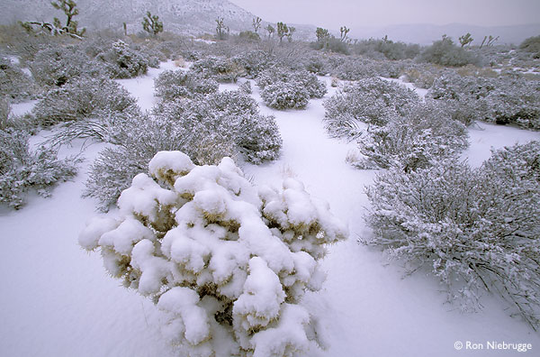
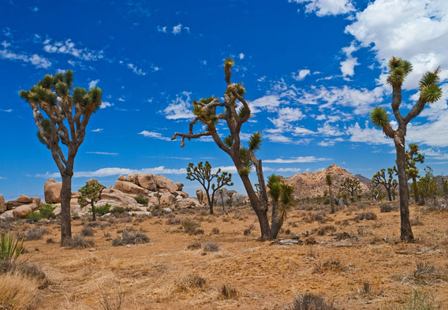
Mojave Desert

Slide 27
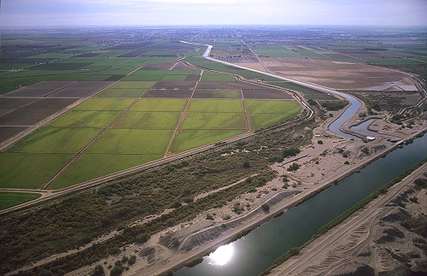
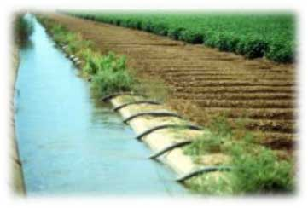
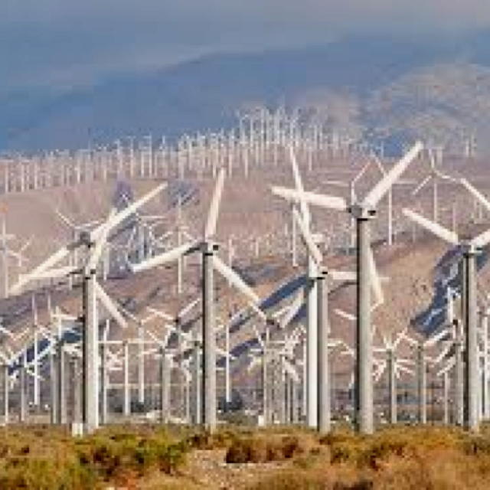
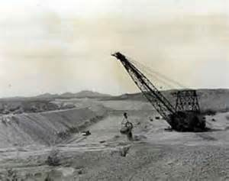
Irrigation allows the desert to bloom
Wind farm in Coachella valley
Digging aqua ducts to bring water
from Colorado river

Slide 28
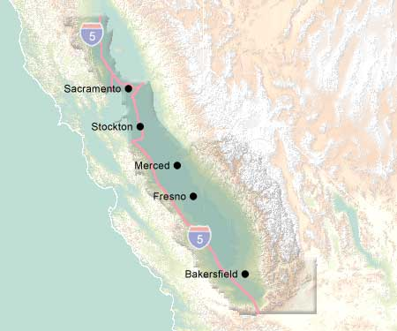
Central Valley
Located between Sierra Nevada and Coastal
Mountains. Northern valley is the Sacramento river valley
Southern valley is the San Joaquin river valley.
One of the most productive agricultural
(farming) regions in the world!!
It has fertile soil that has washed down
From the Sierra Nevada.

Slide 29
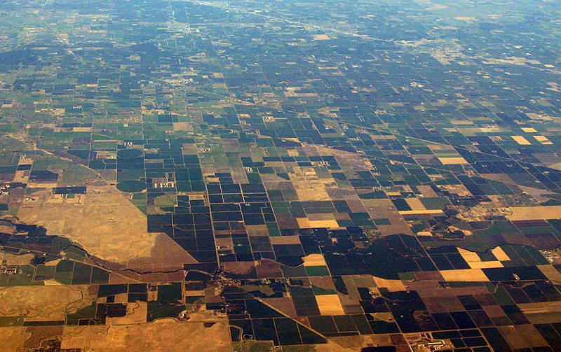
Central Valley Farmland

Slide 30
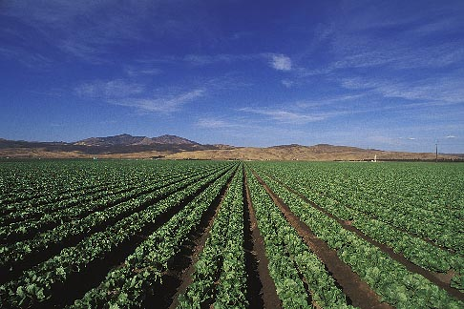
Lettuce Fields Central Valley

Slide 31
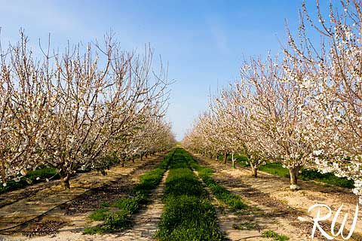
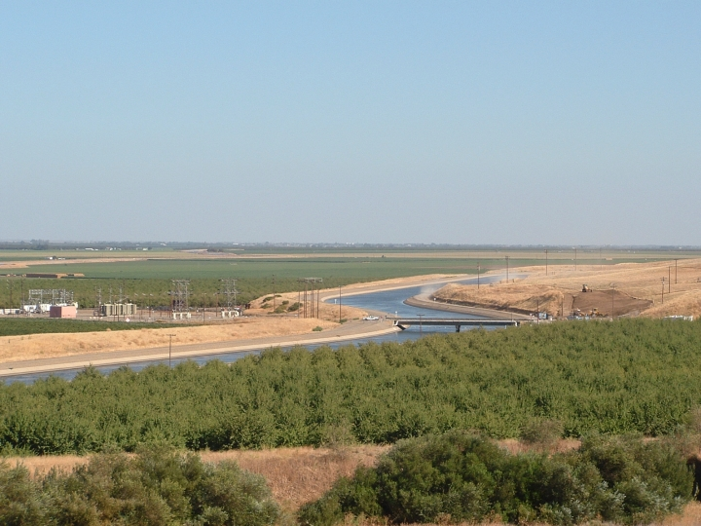
Almond Orchards
California Aquaduct used to move water to irrigate central valley farmland.

Slide 32
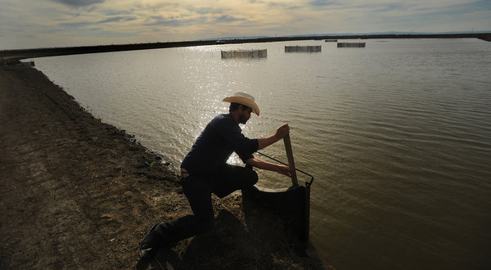
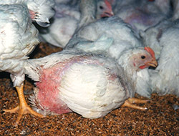
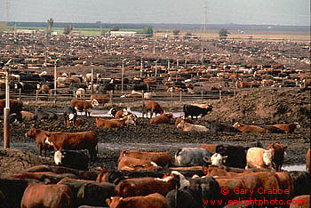
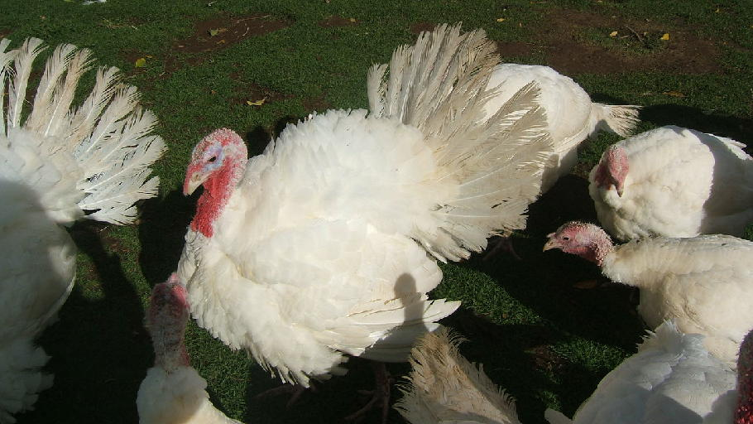
Livestock raised in Central Valley

Slide 33
Oranges from
southern Central valley
Grapes
Wheat

Slide 34
California Delta is where
Sacramento River
and San Joaquin River
join and flow into the
San Francisco Bay

Slide 35
Mountain Region runs North to South on the
Eastern edge of the st5 ate. Covers ½ the state.
They are higher than the coastal mountain
range.
Sierra Nevada range is the largest in the state.
At the southern end of the Sierra Nevada is
Mt. Whitney, 14,495 feet, is the tallest in the state. You will find deep valley between the peaks. Most famous is Yosemite Valley, one of the first National parks. Lake Tahoe is also found between the majestic peaks
The Cascade range Starts in north of the Sierra
Nevada and extends into Oregon and Washington. It includes the volcanoes, Mt. Shasta and Mt. Lassen

Slide 36
Lake Tahoe
Mammoth Moutain

Slide 37
McGee Creek

Slide 38
Mt. Shasta
Mt. Lassen

Slide 39
Mt. Whitney
Elevation 14.495 feet above sea level

Slide 41
Yosemite Valley

Slide 42
Half Dome
Yosemite National Park
Yosemite Falls
2,425 feet

Slide 44
California’s 4 Regions
Coast
Desert
Central Valley
Mountains

