Slide 1
A Safety & Health Curriculum for Young Workers
California Edition
DEPARTMENT OF HEALTH AND HUMAN SERVICES
Centers for Disease Control and Prevention
National Institute for Occupational Safety and Health

Slide 2
Young Worker Injuries
Lesson 1

Slide 3
Lets Play a game
http://Kahoot.it

Slide 4
You will learn about
Ways young workers can get hurt on the job
Common health and safety hazards on the job
Ways to reduce or control workplace hazards
Emergencies in the workplace and how to respond
What to do if you see something at work that could hurt you or make you sick
What legal rights and responsibilities young people have at work

Slide 5
Why are Young Workers More Likely to be Hurt on the Job?
Video and Discussion
https://youtu.be/jy9YDD1LTiI

Slide 6
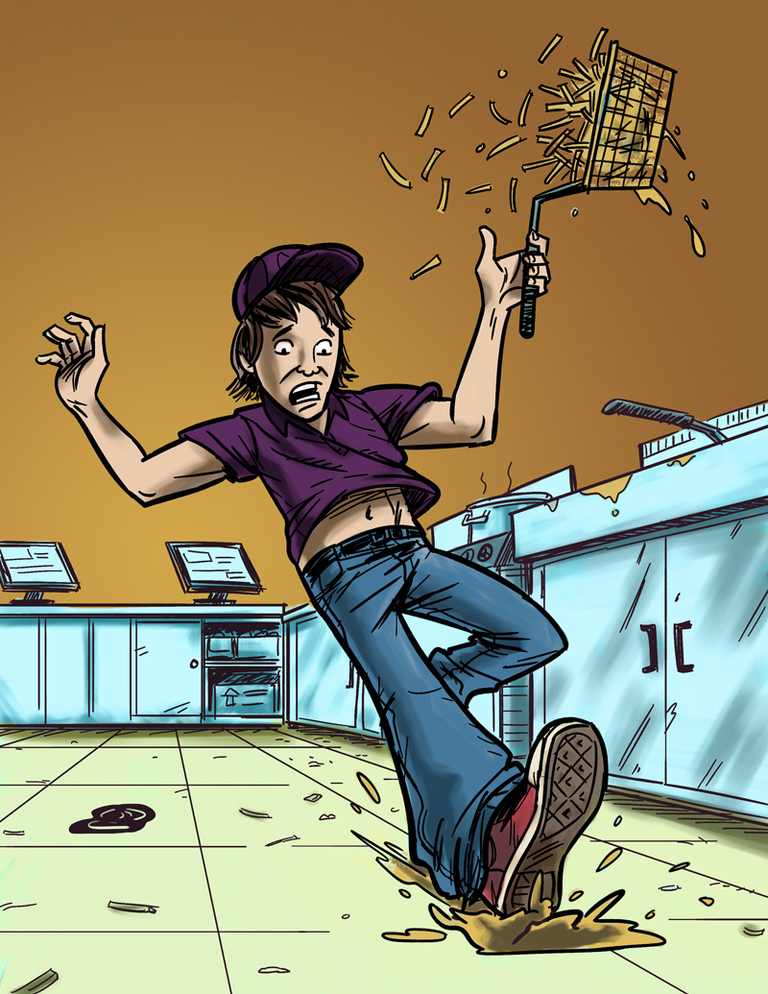
Examples of Teen Work Injuries
Jack’s Story
Job: Fast food worker
Hazard: Greasy, slippery floors
Injury: Injured tailbone
The Impact of Work Injuries
Why do you think this happened?
What could have prevented Jack from getting hurt?
How might this injury impact Jack’s daily life?

Slide 7
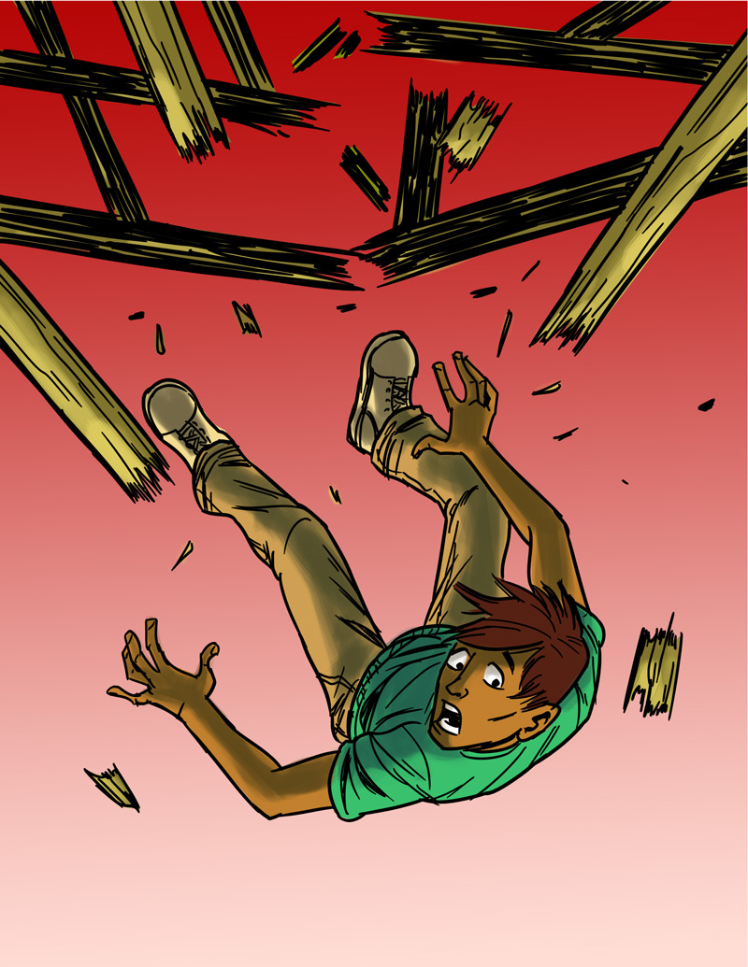
Teen Work Injuries
Antonio’s Story
Job: Construction helper
Hazard: Unguarded chimney hole (on an unfinished roof)
Injury: Broken back
The Impact of Work Injuries
Why do you think this happened?
What could have prevented Antonio from being injured?
How might this injury impact Antonio’s daily life?

Slide 8
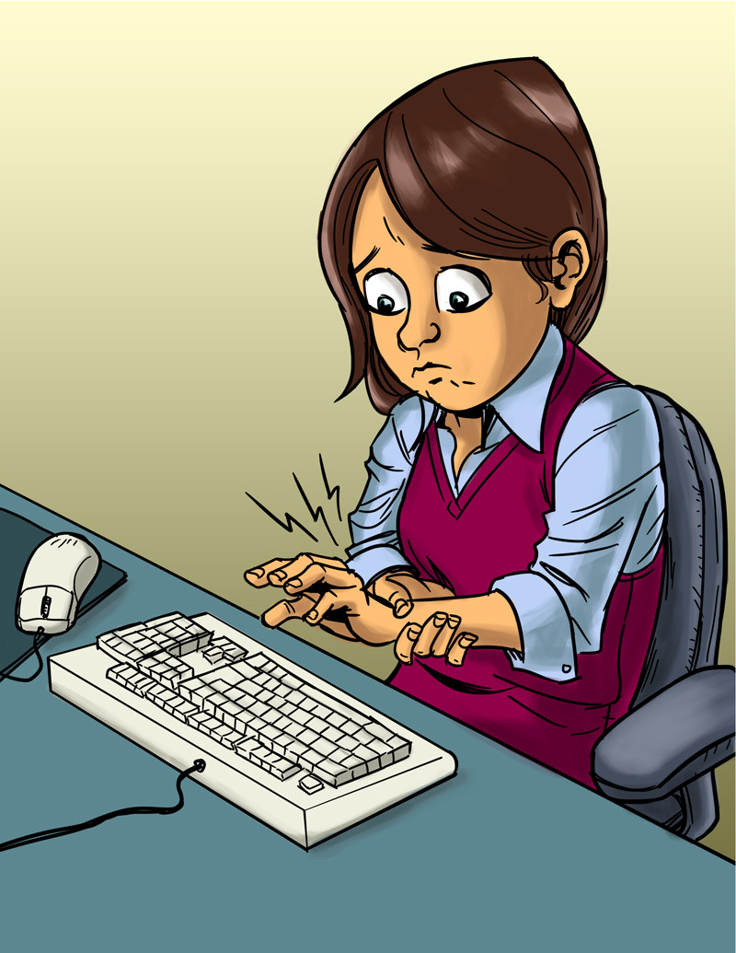
Teen Work Injuries
Angela’s Story
Job: Office worker
Hazard: Excessive typing in an awkward position
Injury: Repetitive stress injury
The Impact of Work Injuries
Why do you think this happened?
What could have prevented Angela from being injured?
How might this injury impact Angela’s daily life?

Slide 9
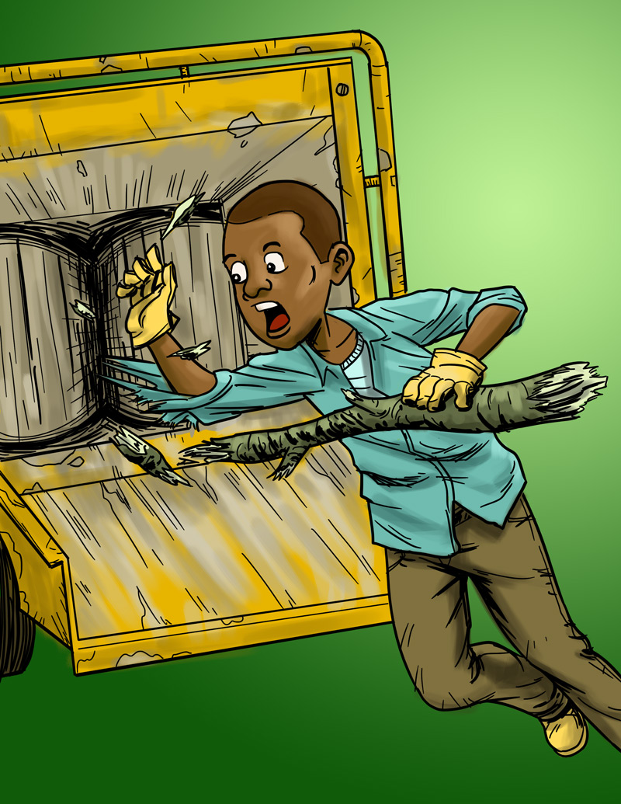
Teen Work Injuries
Terrell’s Story
Job: Landscape worker
Hazard: Wood chipper
Injury: Death
The Impact of Work Injuries
Why do you think this happened?
What could have prevented Terrell from being killed?

Slide 10
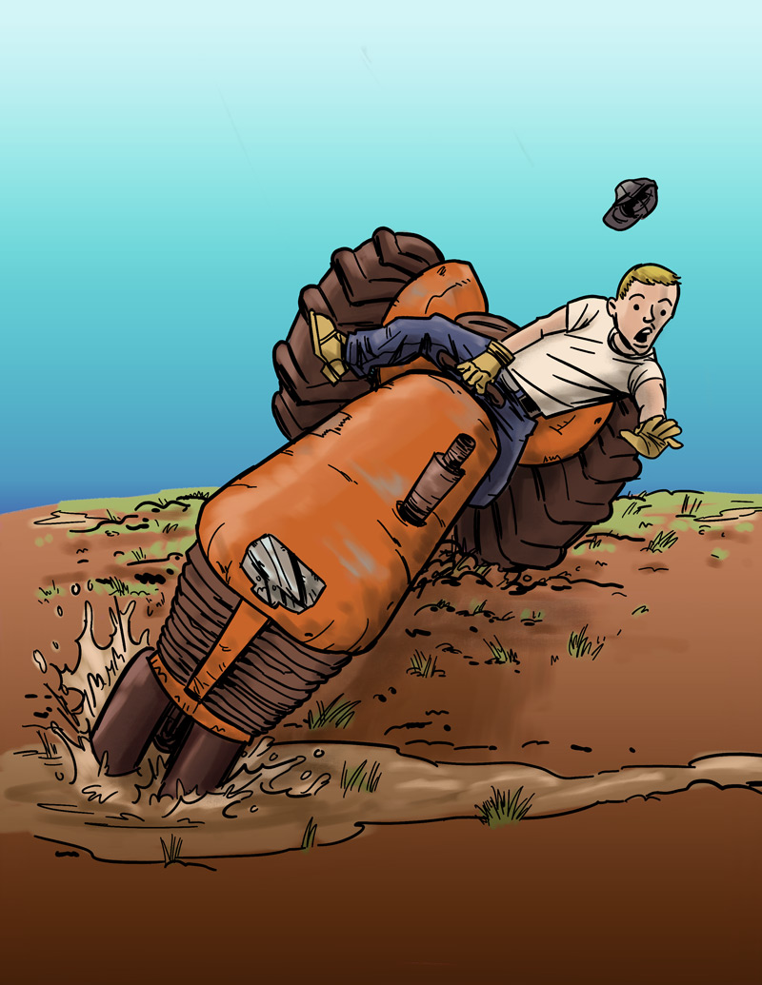
Teen Work Injuries
Cody’s Story
Job: Farm worker
Hazard: Tractor without roll bar
Injury: Legs crushed under tractor
The Impact of Work Injuries
Why do you think this happened?
What could have prevented Cody from getting hurt?
How might this injury impact Cody’s daily life?

Slide 11
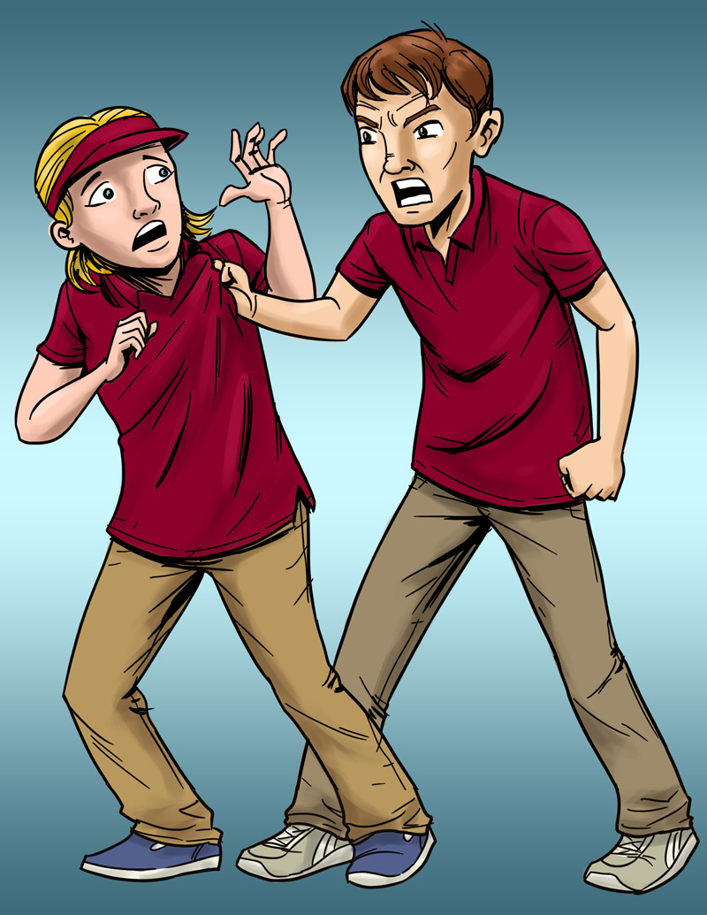
Teen Work Injuries
Lindsey’s Story
Job: Pizza shop cashier
Hazard: Violence (by a co-worker)
Injury: Bumps and bruises caused by abusive co-worker
The Impact of Work Injuries
What could Lindsey's employer have done to stop her abuser?
What would you do in this situation?
How might Lindsey’s life be affected by this incident?

Slide 12
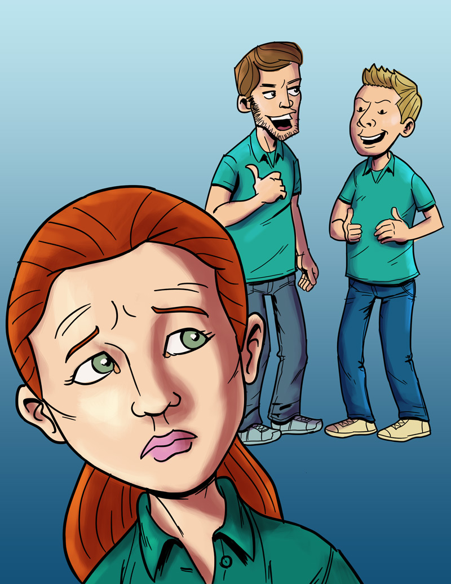
Teen Work Injuries
Anna’s Story
Job: Smoothie shop worker
Hazard: Sexual harassment
Injury: Emotional trauma
The Impact of Work Injuries
What could Anna's employer have done to stop her harasser?
What would you do in this situation?
How might Anna’s life be affected by this incident?

Slide 13
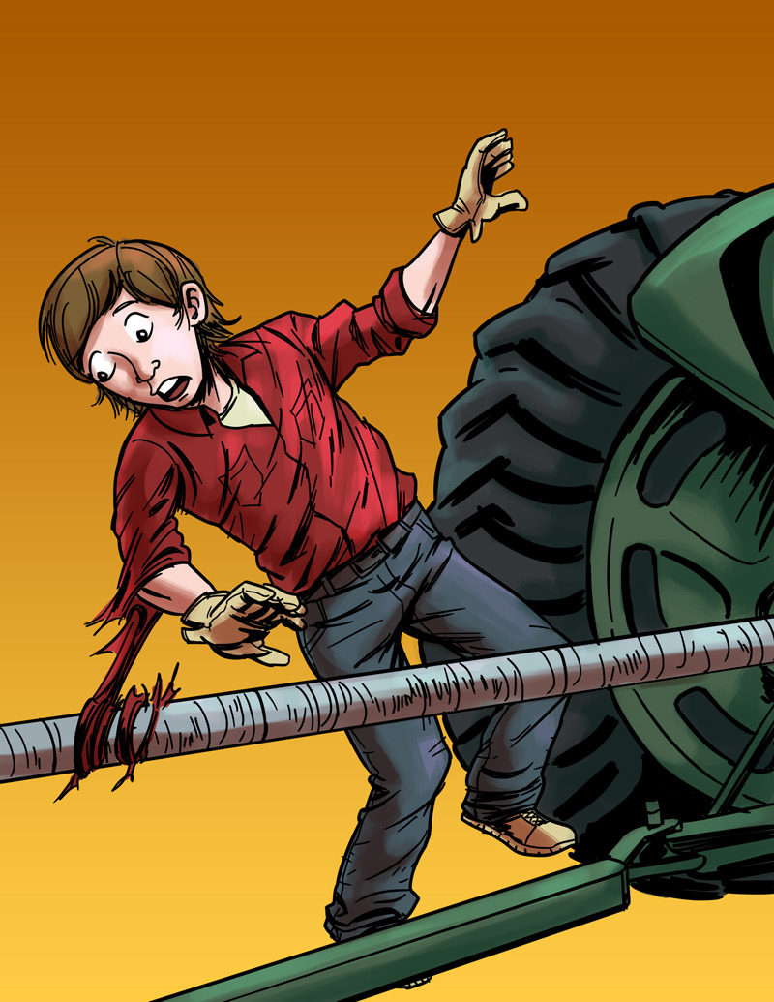
Teen Work Injuries
Logan’s Story
Job: Farm worker
Hazard: Unguarded, rotating bar on a tractor
Injury: Severed arm, broken neck
The Impact of Work Injuries
Why do you think this happened?
What could have prevented Logan from being injured?
How might this injury impact Logan’s daily life?

Slide 14
Teen Worker Injury Statistics
Approximately 1.6 million teens, ages 15–17, in the United States work. About 50% of 10th graders and 75% of 12th graders have jobs.
Many youths are injured on the job.
On average, each year
59,800 workers younger than 18 are sent to the ER for job-related injuries, but actual injury statistics are much higher.
37 workers younger than 18 die on the job.
Young workers are two times more likely to be injured than adult workers.
NIOSH 2010 www.cdc.gov/niosh/topics/youth/chartpackage.html
www.cdc.gov/mmwr/preview/mmwrhtml/mm5915a2.htm

Slide 15
Hurt of the Job
FTE Equivialant
 | 16-17 years old | 16-24 years old
2000 | 1,339,652 | 16,650,600
2001 | 1,205,290 | 16,128,316
2002 | 1,080,861 | 15,664,494
2003 | 1,013,417 | 15,281,131
2004 | 962,786 | 15,501,908
2005 | 1,020,529 | 15,688,383
2006 | 1,099,986 | 15,944,701
2007 | 1,024,802 | 15,812,503
2008 | 879,431 | 15,123,179
2009 | 708,523 | 13,265,510
2010 | 587,391 | 12,919,472
2011 | 568,546 | 13,181,252
2012 | 589,177 | 13,625,684
2013 | 644,170 | 13,989,220
2014 | 667,117 | 14,321,703
2015 | 708,234 | 14,595,800

Slide 16
Teen Worker Statistics
Where Teens Work:
% of total workers, ages 15–17, per industry
*Includes restaurants
Based on national data, and may vary by state. Working teens under age 14 not represented. Youth farm workers not represented.
Source: NIOSH / CDC 2009 (www.cdc.gov/niosh/topics/youth/chartpackage.html)

Slide 17
Teen Worker Injury Statistics
Where Teens are Injured on the Job:
% of total workers, ages 15–17, per industry
*Includes restaurants.
These data are for injuries that require at least one day away from work. They do not include youth who work on small farms, work for government agencies, or are self-employed.
Source: NIOSH / CDC 2009 (www.cdc.gov/niosh/topics/youth/chartpackage.html)

Slide 18
Key Points of the Curriculum
By the end of the course, you will be able to
Recognize and reduce hazards on the job
Identify the laws that protect teens from working too late or too long
Identify the laws that protect teens from doing dangerous work
Identify the laws that protect teens from discrimination (including harassment) at work
Assess ways to solve health and safety problems at work
Name some of the agencies that enforce health and safety laws and child labor laws
Determine what to do in an emergency

