Slide 1
Gabrielino Tribe
BY Jayme, Sasha, and Alyssa

Slide 2
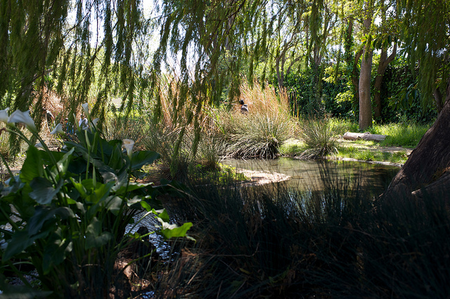
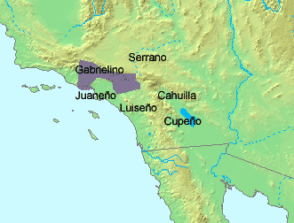
LOCATION
The location of the Gabrielino tribe was in the southern coast of California. The Gabrielino lived on the Channel Islands in the Pacific ocean. The weather is not too hot or too cold which means it is a mild climate.
This Photo by Unknown author is licensed under CC BY-SA-NC.
This Photo by Unknown author is licensed under CC BY-SA.

Slide 3
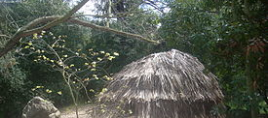
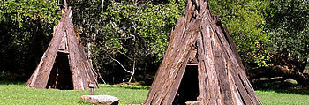
SHELTER
The homes of the Gabrielino tribe helped keep them safe. For homes they used bent tree saplings covered with tule mates. They had a round or a pointed roof. To keep them warm they had thick walls, so if it got cool outside it stayed warm inside. If it got hot outside they would be cool inside.
This Photo by Unknown author is licensed under CC BY-SA.
This Photo by Unknown author is licensed under CC BY-SA.
This Photo by Unknown author is licensed under CC BY-SA.

Slide 4
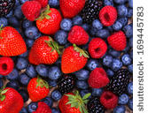
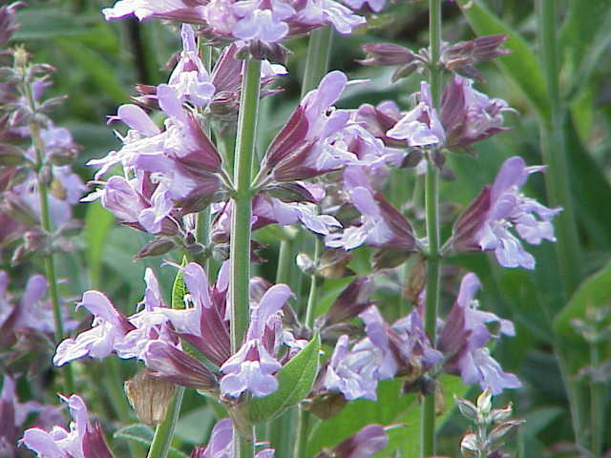
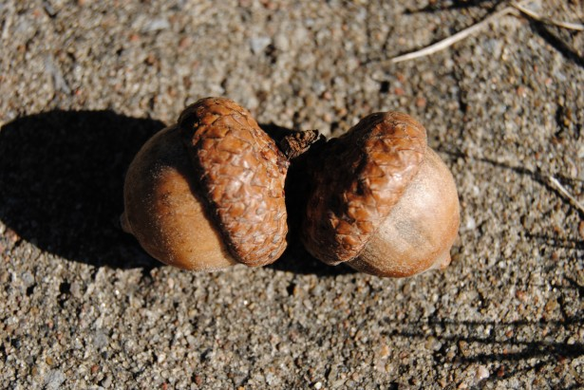
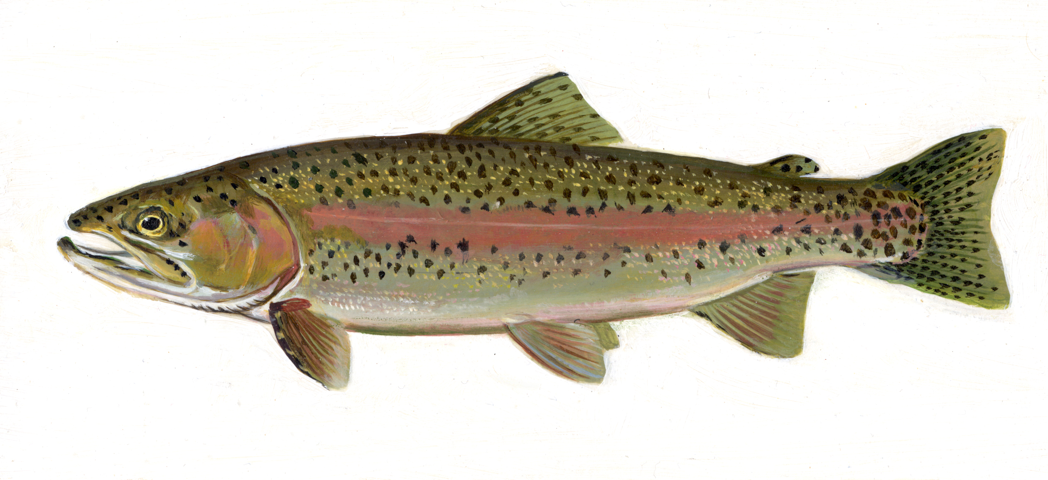
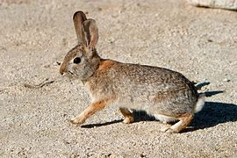
FOOD
The Gabrielino ate acorns, pinon nuts, berries, sage, and other plants. They from moved place to place to find more food. They were hunters and gatherers.
This Photo by Unknown author is licensed under CC BY-ND.
This Photo by Unknown author is licensed under CC BY-SA.
This Photo by Unknown author is licensed under CC BY-SA.

Slide 5
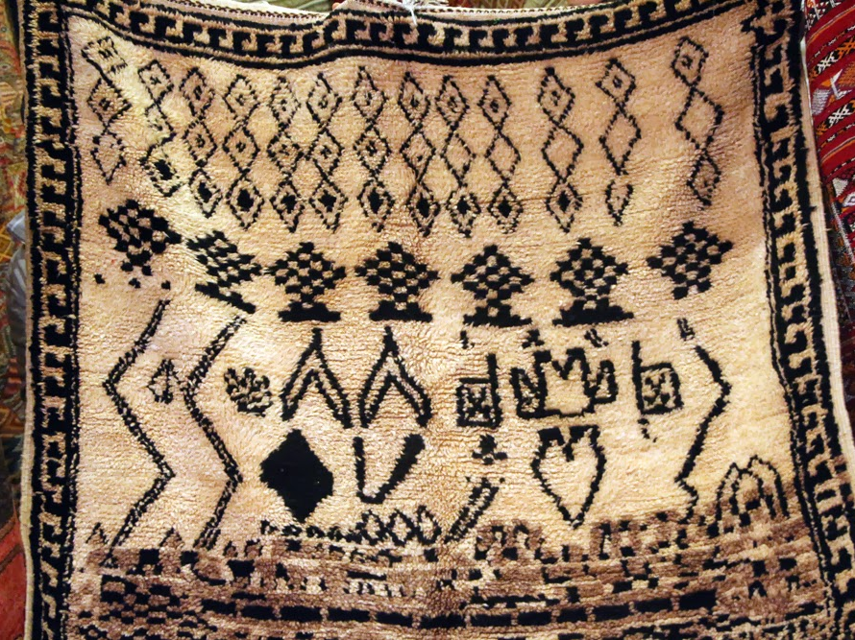
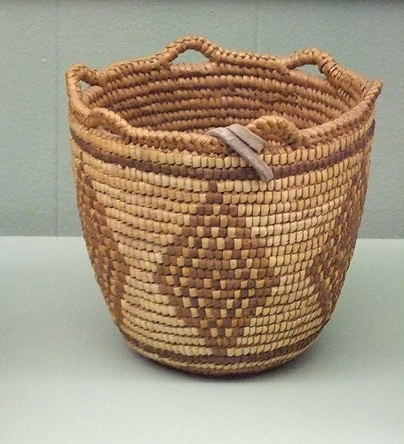
CULTURE
The cultures of the Gabrielino tribe were very exciting. They were probably the most richest and most powerful tribe in California. They wove baskets and boats from reeds and grasses. They had a fall ceremonies for the ones that died.
This Photo by Unknown author is licensed under CC BY-SA-NC.
This Photo by Unknown author is licensed under CC BY-SA.
This Photo by Unknown author is licensed under CC BY-SA.

Slide 6
