Slide 1
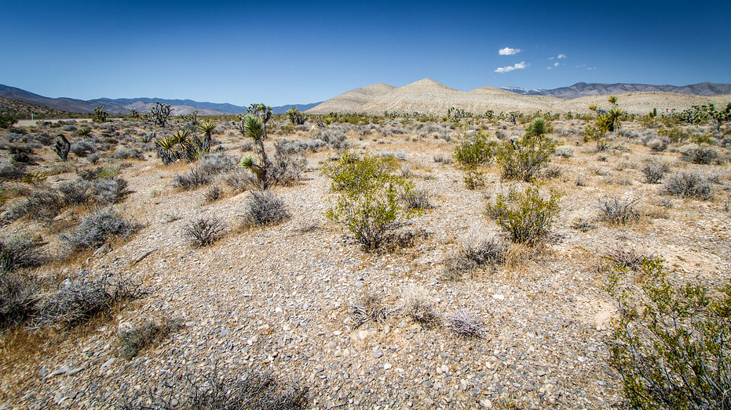
Mojave Tribe
By Haley Rose Cormack
This Photo by Unknown author is licensed under CC BY-SA-NC.

Slide 2
Food
This Photo by Unknown author is licensed under CC BY-SA.
Squash, corn, beans, berries
Used nets and baskets to catch fish
Irrigation system for farming
Both men and women worked the fields

Slide 3
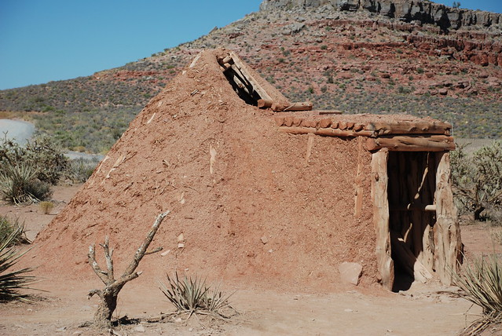
Shelter
This Photo by Unknown author is licensed under CC BY-SA-NC.
Winter homes were made of clay to keep heat in
In warmer months homes were made of wood and bushes raised on stills
Inside homes had a stone pit for cooking and heat
Summer homes had a ramada to provide shade

Slide 4
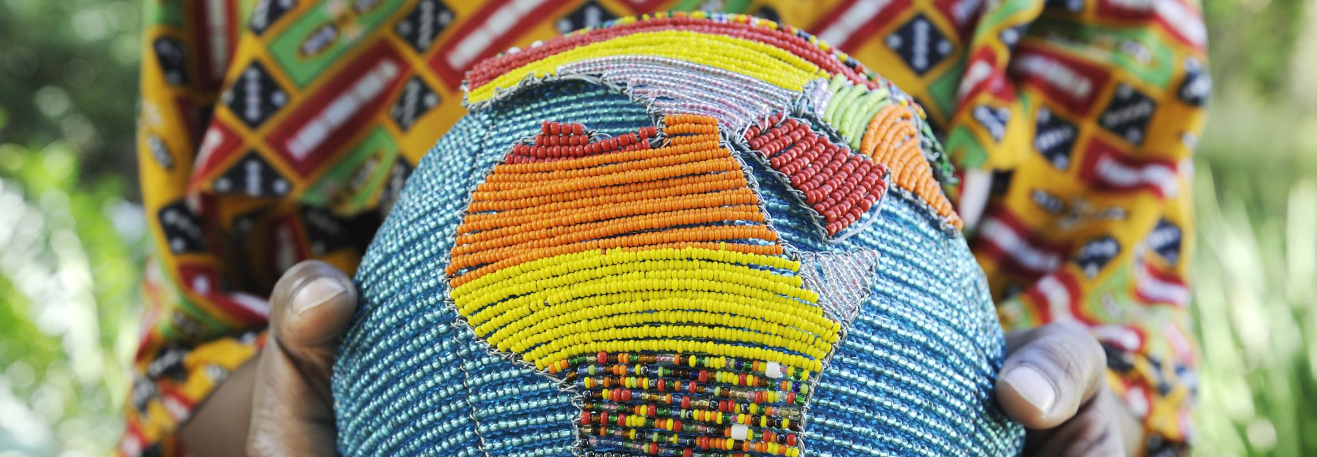
Culture
Mojave tribe believed in animism-this is the belief that souls and spirts exist in all living and non-living things.
They spoke Yuman language
They used blue cactus ink for tattooing their bodies
Men were always the tribal leaders

Slide 5
Location
This Photo by Unknown author is licensed under CC BY-SA.
During winter and early spring shelter was on high ground to avoid river floods
In late spring and summer people moved their shelter closer to the river
Mojave Tribe was located in parts of Arizona, Nevada, California, and Mexico
The Temperature was extremely hot in summers and mild in winter

Slide 6
Current Day Mohave Reservation

Slide 7
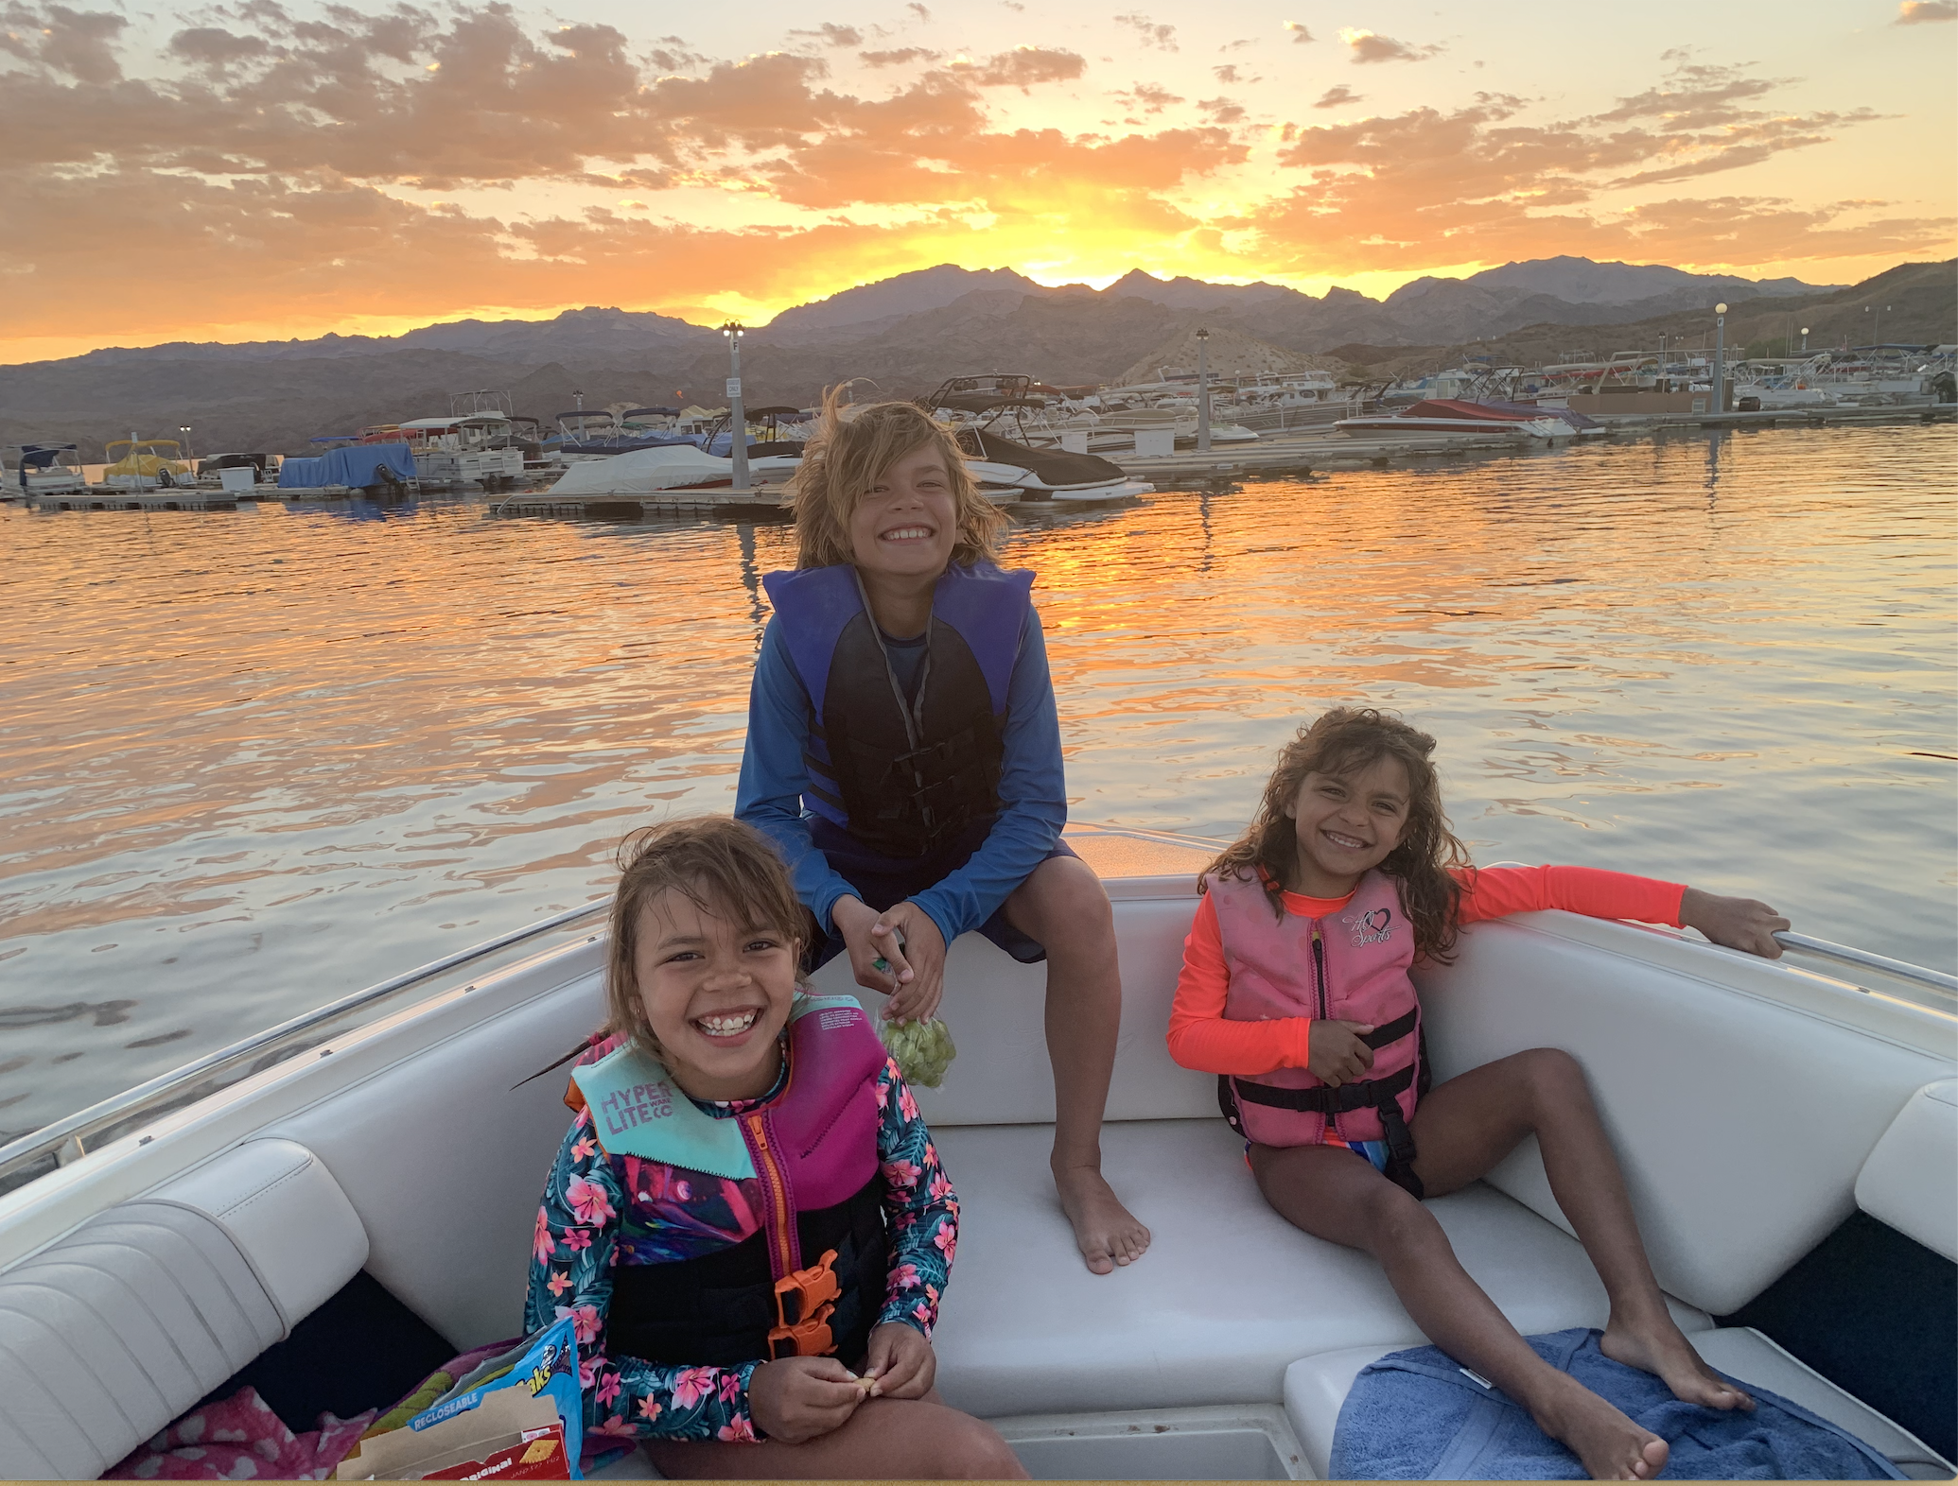
Now the Colorado River and tribe land is used by many for recreational activities.

