Slide 1
The Wonderful World Of Weather
By: Adrianna Geiss and
Daniella Stabio

Slide 2
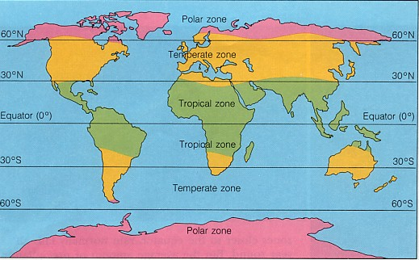
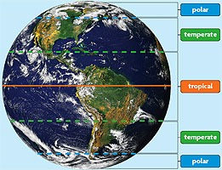
The Difference Between Climate and Weather
Climate is a kind of weather a place has over a period of years.
Weather is the rainfall, the humidity, the sunshine, and the winds that make up the climate.

Slide 3
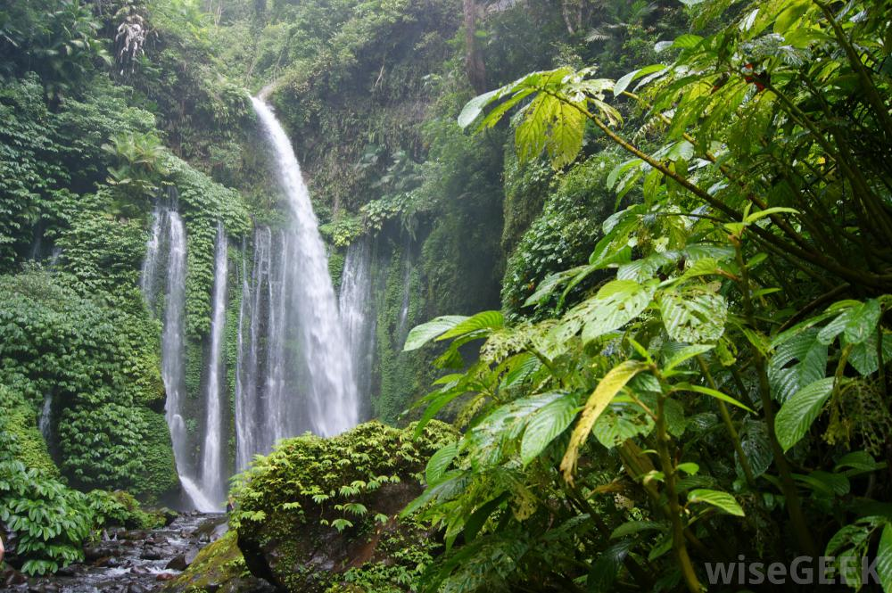
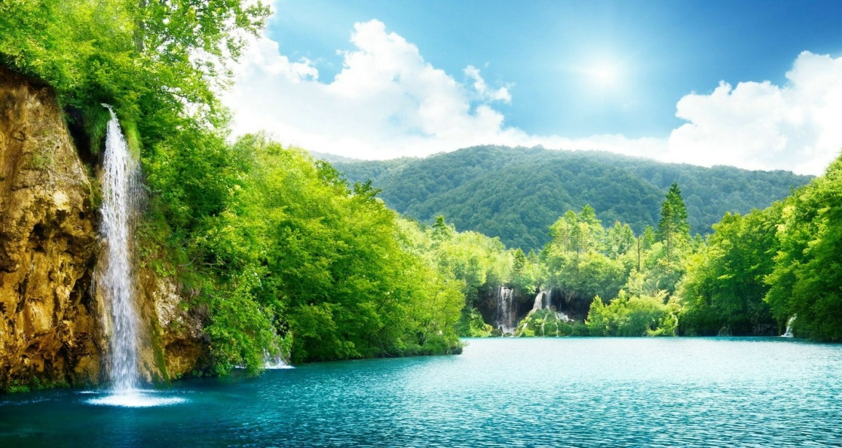
Tropical Climate Zone
Located along the equator
Sticky and humid
Warm and sunny
More living things here than any other place on Earth
Hot climate
Feels like no winter

Slide 4
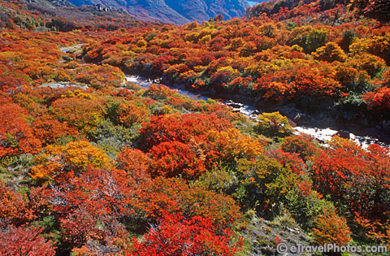
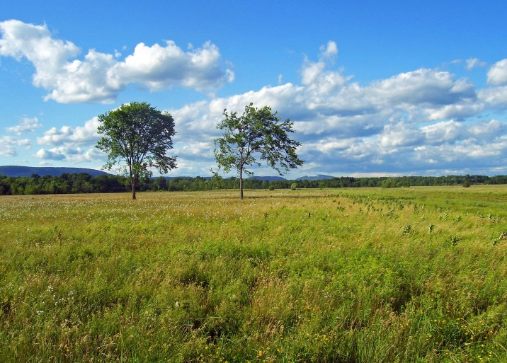
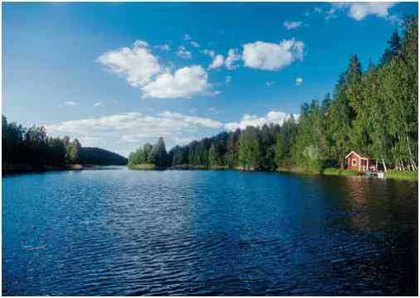
Temperate Climate Zone
Located above and below the equator
Four distinct seasons
Large forests with lots of trees

Slide 5
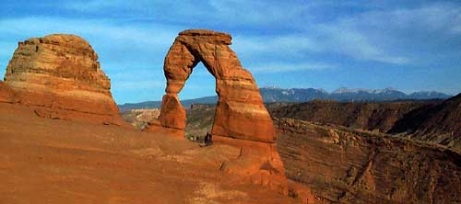
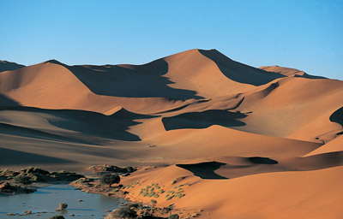
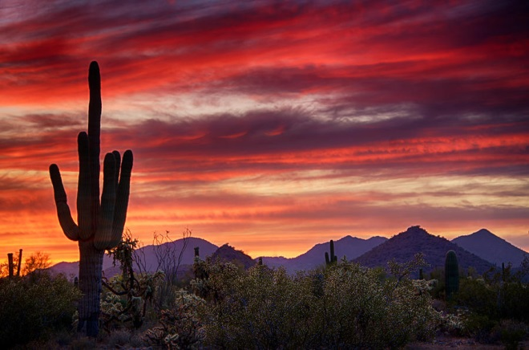
Desert Climate Zone
Located by The Tropical Zone
Very hot
Ground gets so hot it heats the air
Rocky and sandy

Slide 6
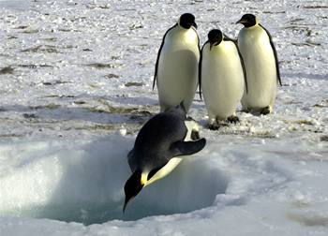
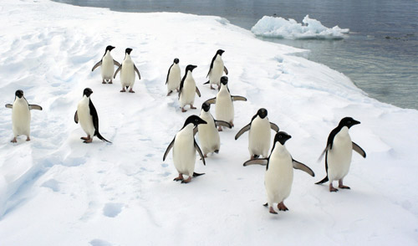
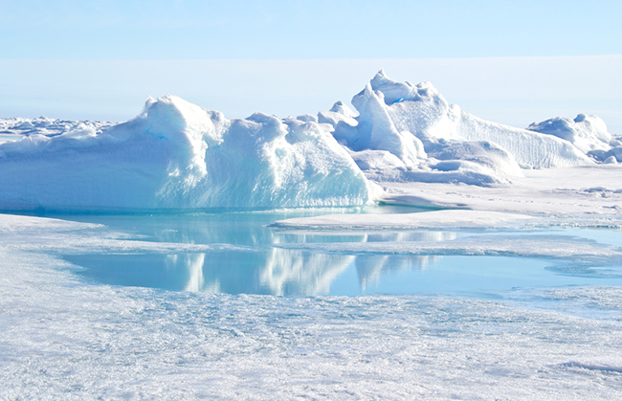
Polar Climate Zone
Located on the north and south poles
Very cold summers
Short summers
Not much daylight

Slide 7
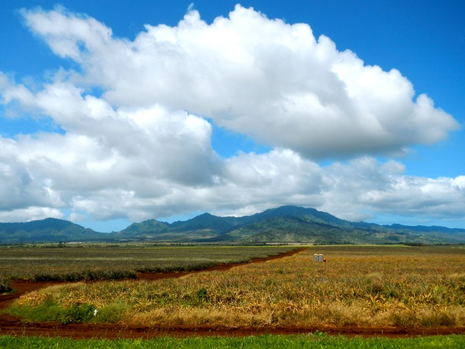
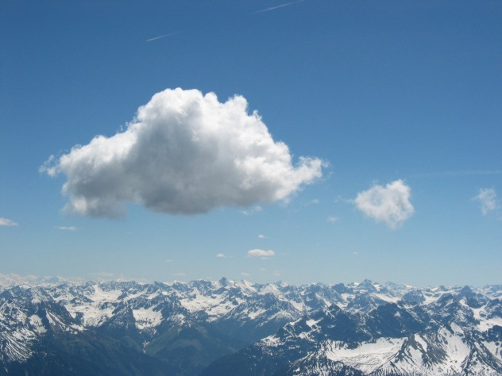
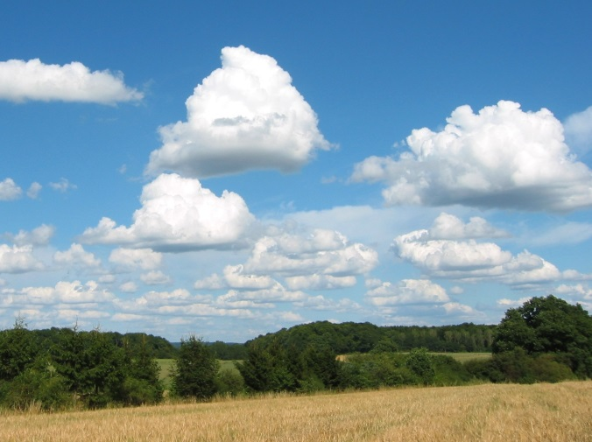
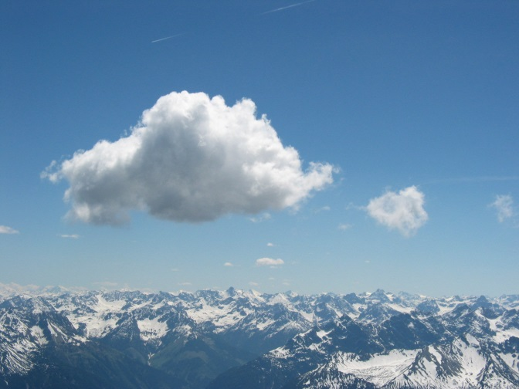
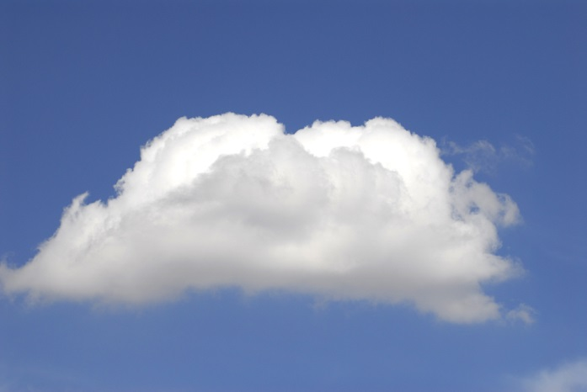
Cumulus Clouds
Fluffy
No storms
Nice weather
Large piles of white clouds
Up to 10,000 feet high

Slide 8
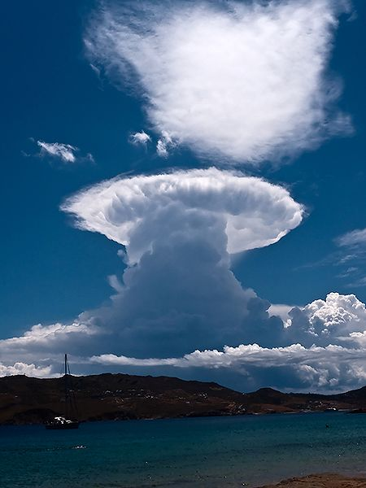
Cumulonimbus Clouds
Tall
20,000 feet high
Can be different shapes
Storms last less than an hour
Storms can involve snowball-sized hail

Slide 9
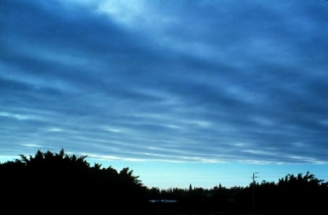
Stratus Clouds
Stratus clouds are spread out and look like a blanket across the sky. They are not dark and have no storms. They can reach up to 5,000 feet.

Slide 10
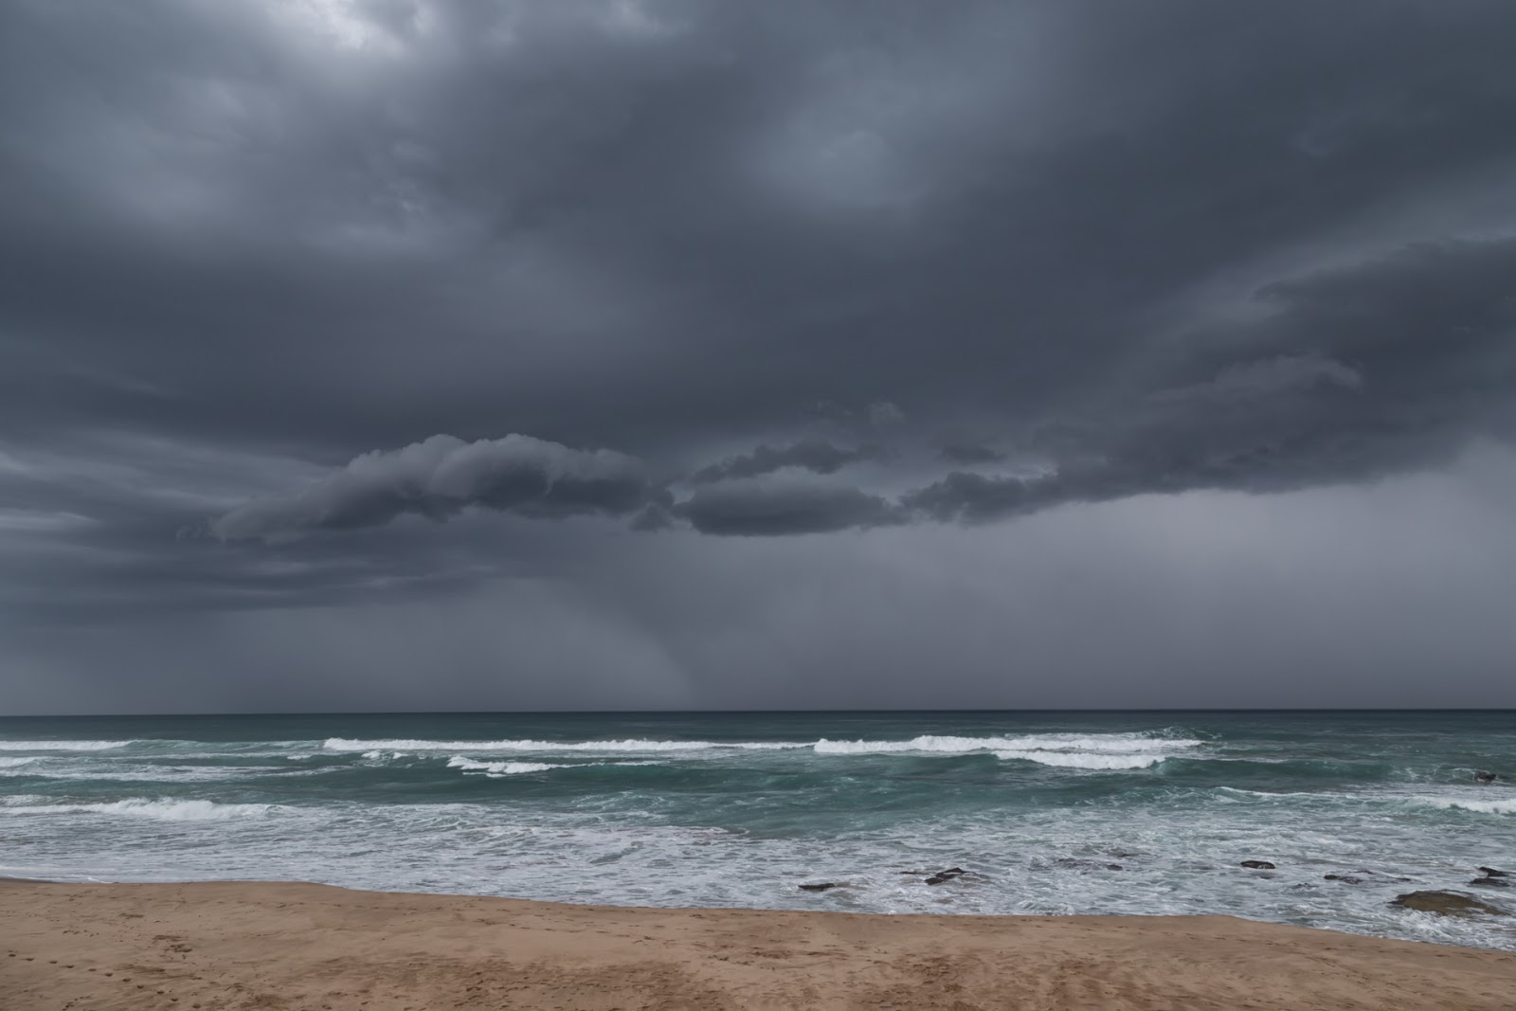
Stratonimbus Clouds
Stratonimbus clouds are spread out and are really dark. The storms can last all day and also look like a blanket in the sky. They can reach up to 5,000 feet.

Slide 11
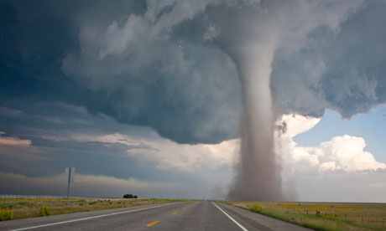
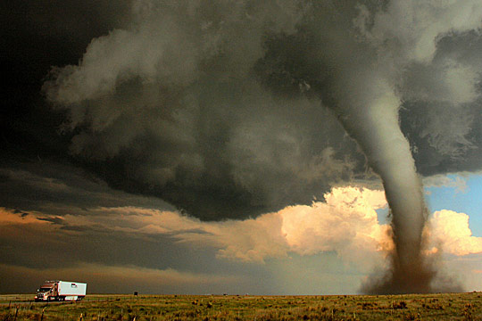
Tornadoes
Tornadoes look like a giant funnel in the sky. Tornadoes happen when hot and cold air are moving in opposite directions. South Dakota, Nebraska, Kansas, Oklahoma, Northern Texas, and Eastern Colorado make up “Tornado Alley.”

Slide 12
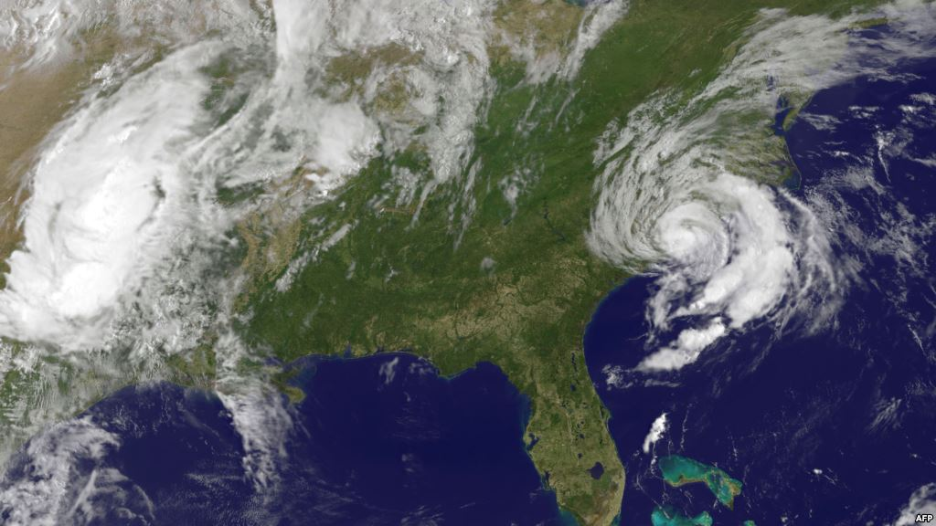
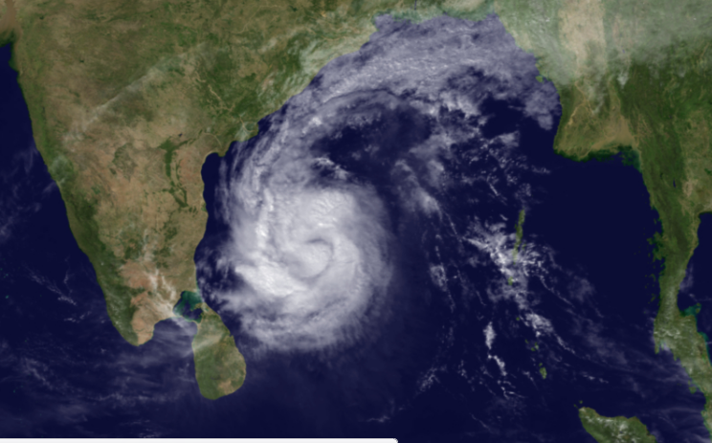
Hurricanes
A hurricane begins as a tropical storm, but when it reaches 74 mph, it changes. Hurricanes bring heavy rain and strong winds. When hurricanes are out at sea, they cause little damage. When hurricanes hit land, they are very destructive.

Slide 13
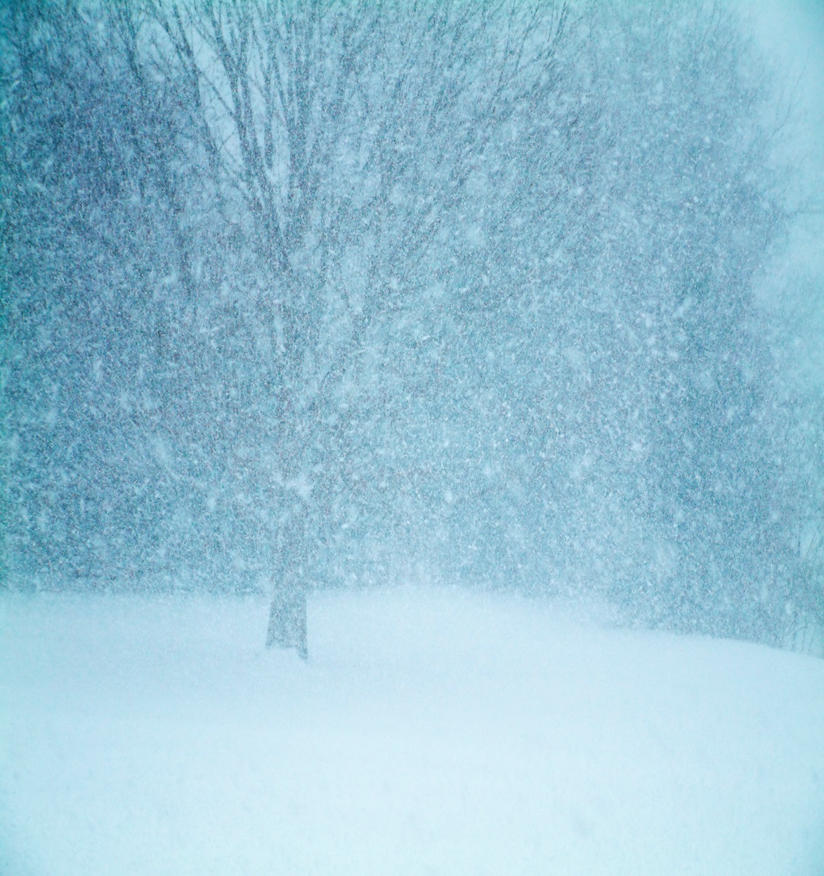
Blizzards
A blizzard is a big snowstorm that causes people to stay inside all day. Blizzards bring strong winds and lots of snow. People that get caught in a blizzard find that it is hard to see and very cold.

Slide 14
Extreme Weather Pictures

Slide 15
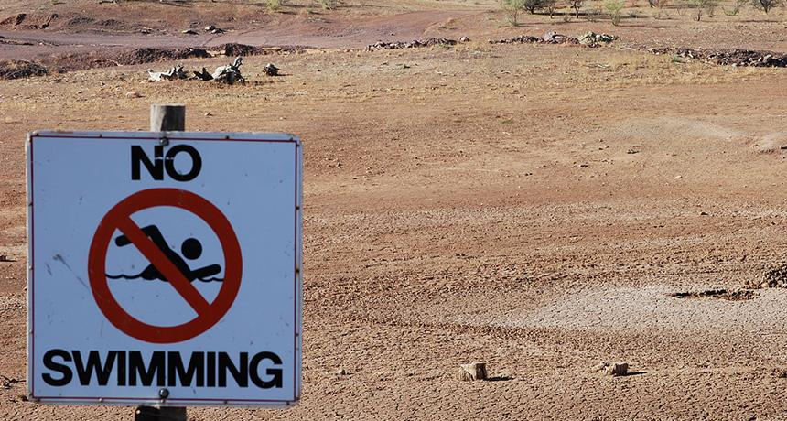
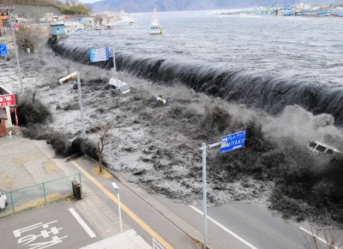
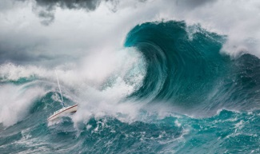
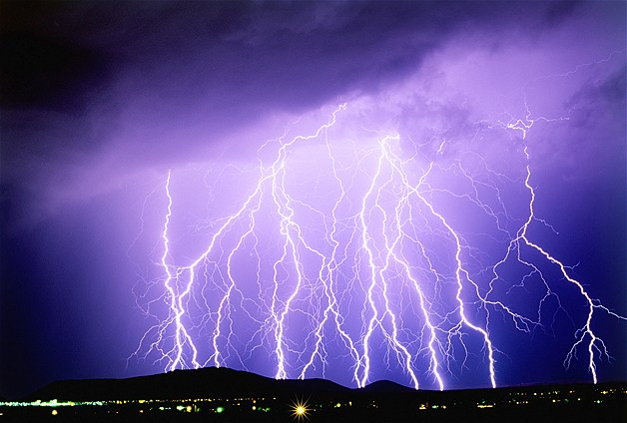

Slide 16
Hope You Learned Something New!!

