Slide 1
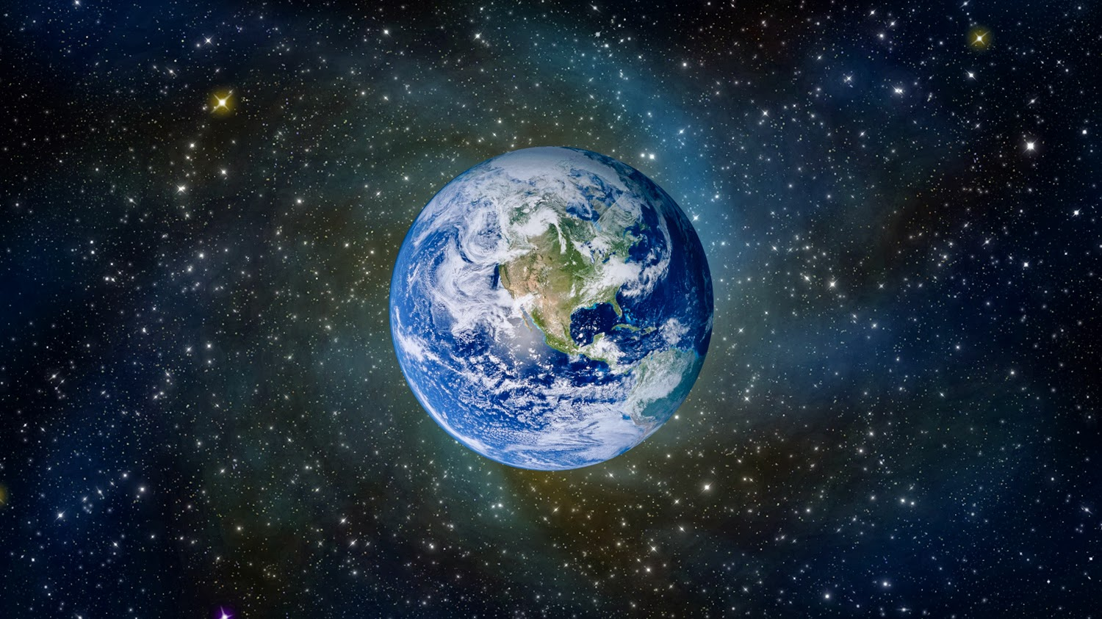
Weather and Climate
By: Jayme & Sofia

Slide 2
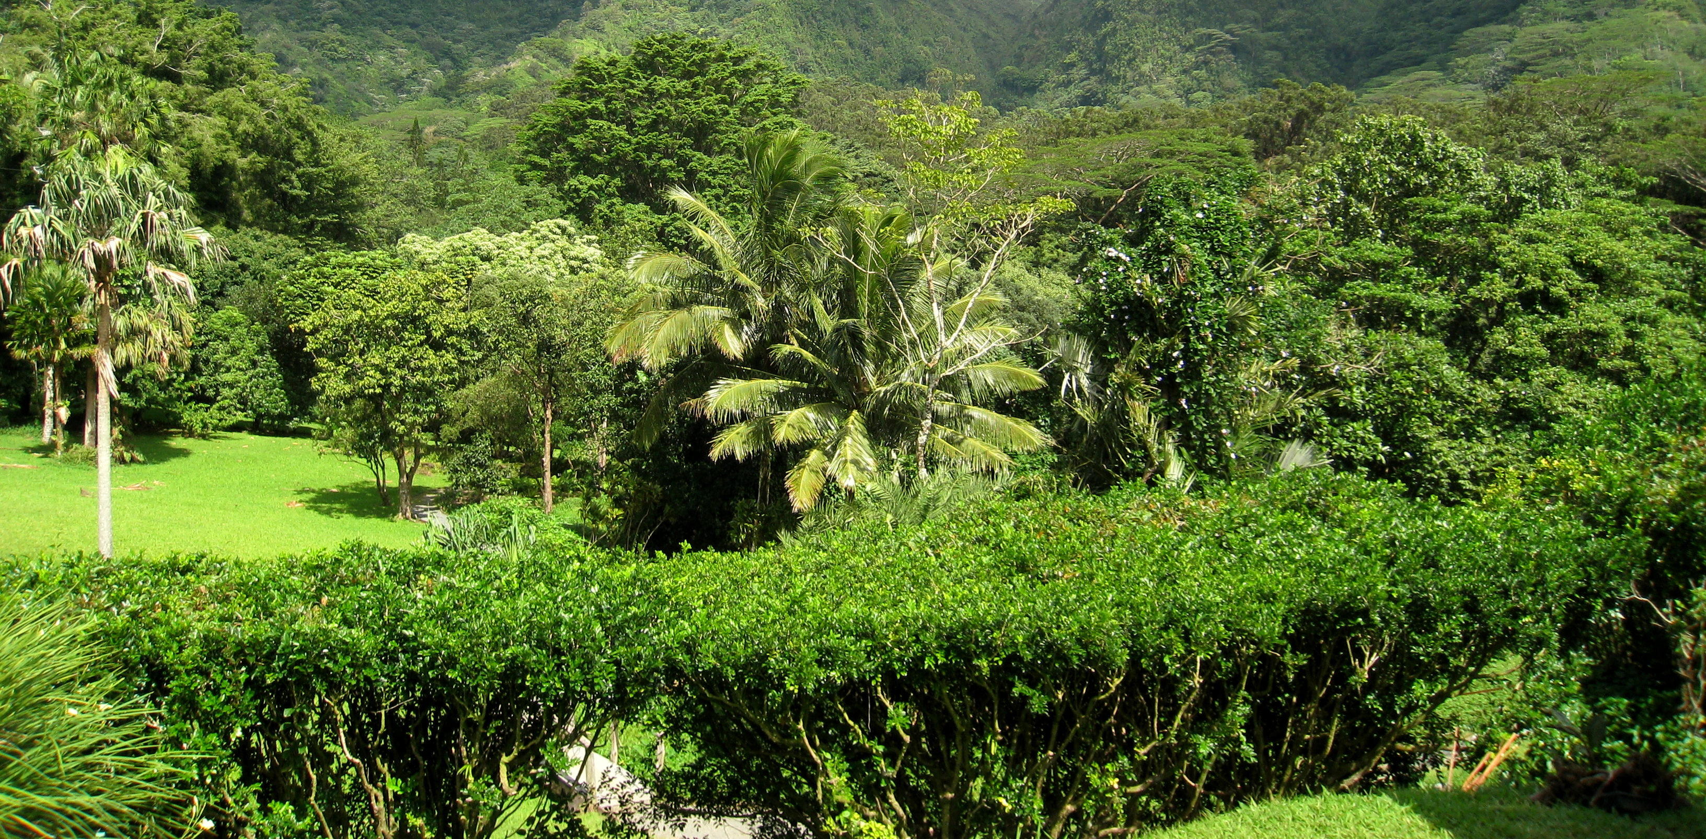
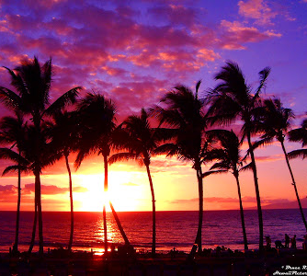
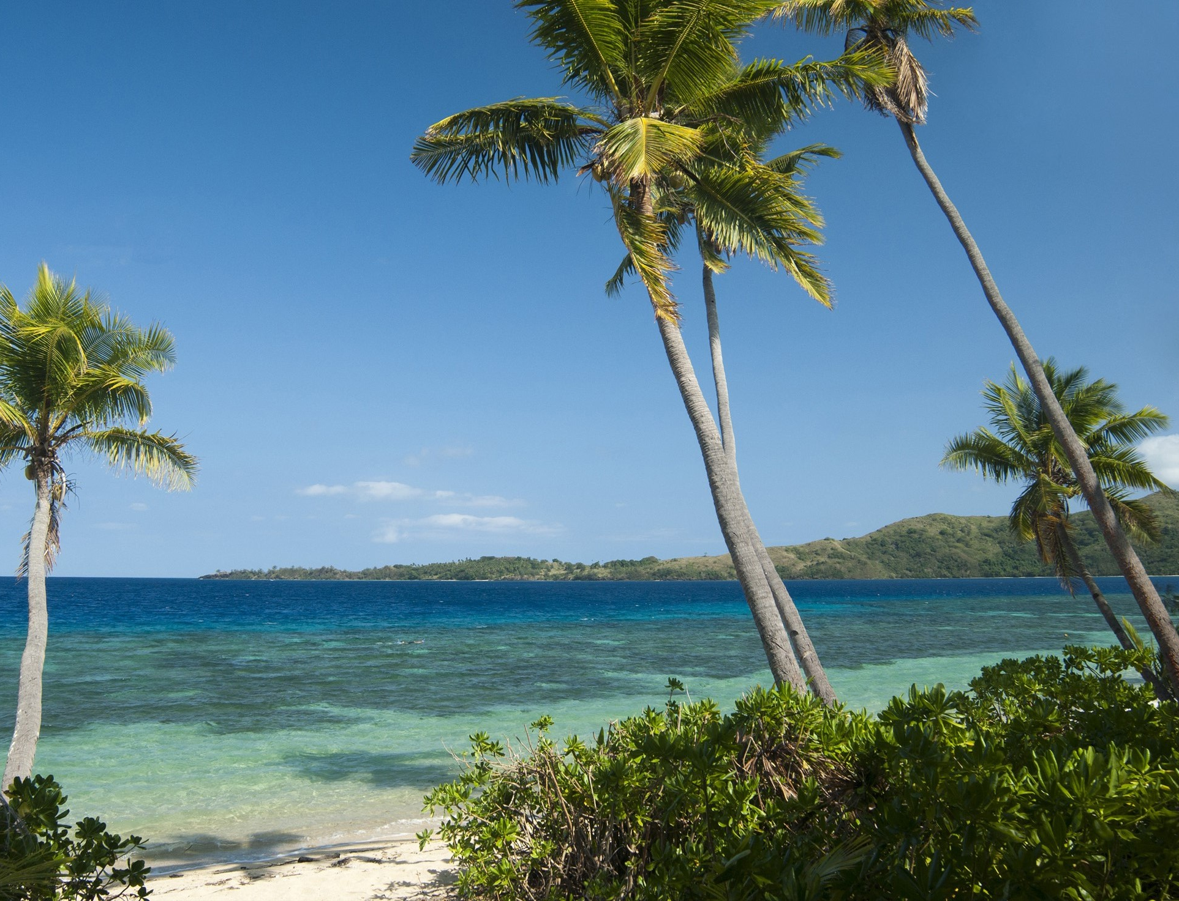
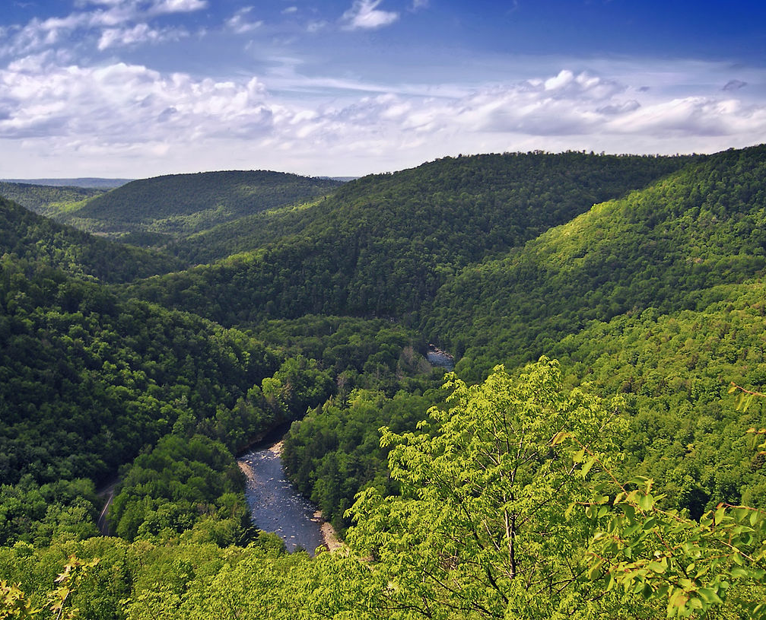
Tropical Climate Zone
The tropical climate zone is hot because it is the closest to the Equator.
Tropical climate zones are mostly always sunny.
Rain forests grow in the tropical climate zone.
In the rainforests it rains a lot.
This Photo by Unknown author is licensed under CC BY-SA.

Slide 3
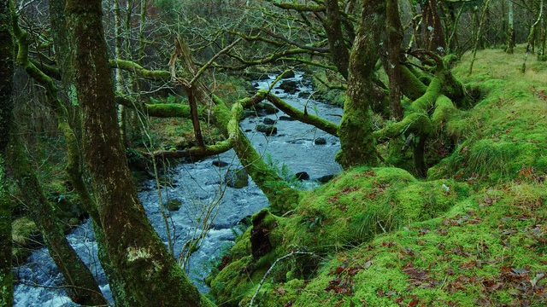
Temperate Climate Zone
The temperate climate zone has warm summers and cold winters.
The climate there is mostly a mild climate.
The temperate climate zone is popular for plants, animals and humans.

Slide 4
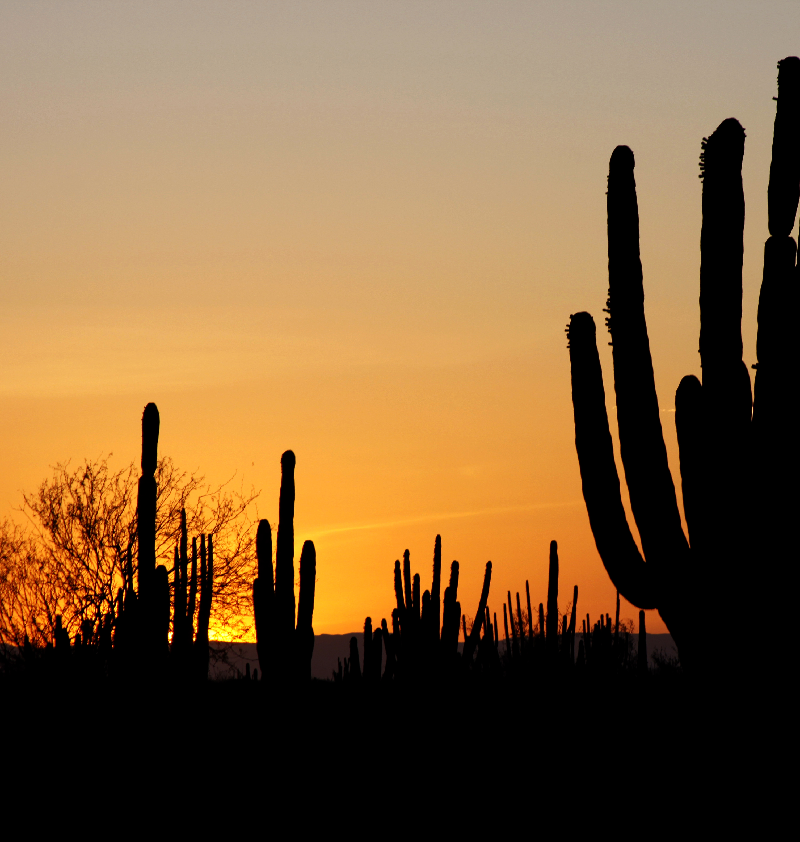
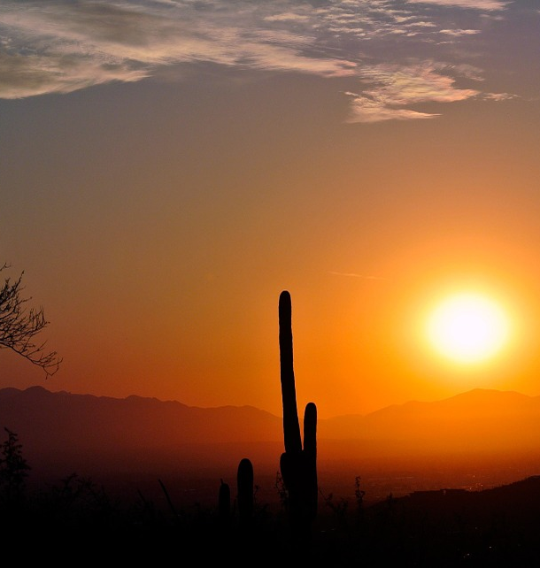
Desert Climate Zone
The desert climate is very hot and dry.
Animals that live in the hot and dry desert adapt to the desert.
Most desert climates get 1 to 8 inches of rainfall.

Slide 5
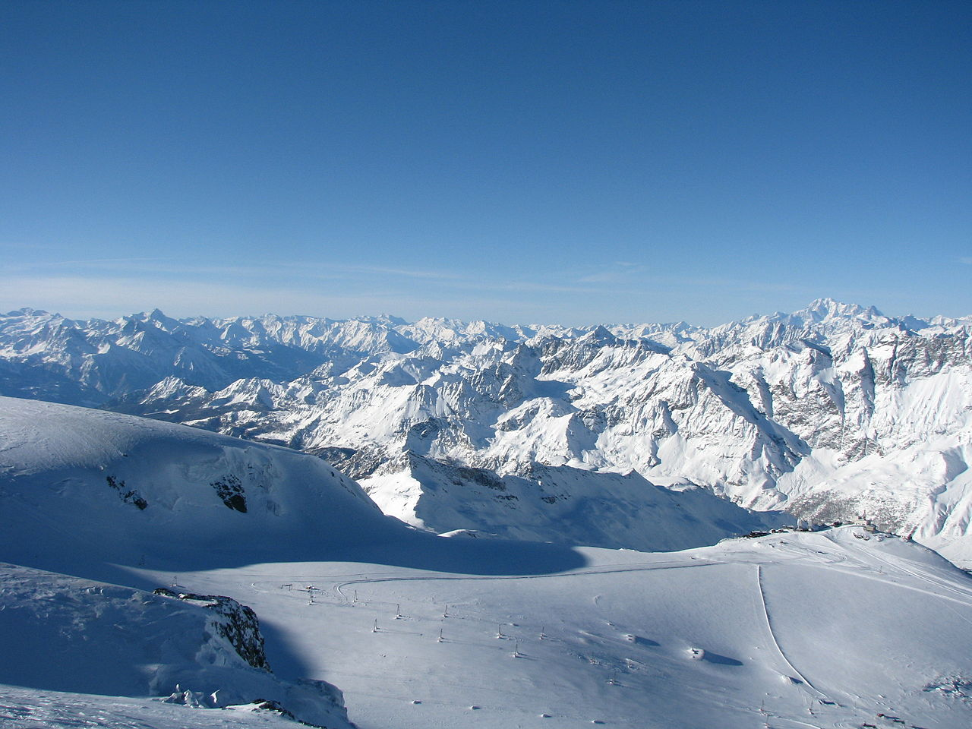
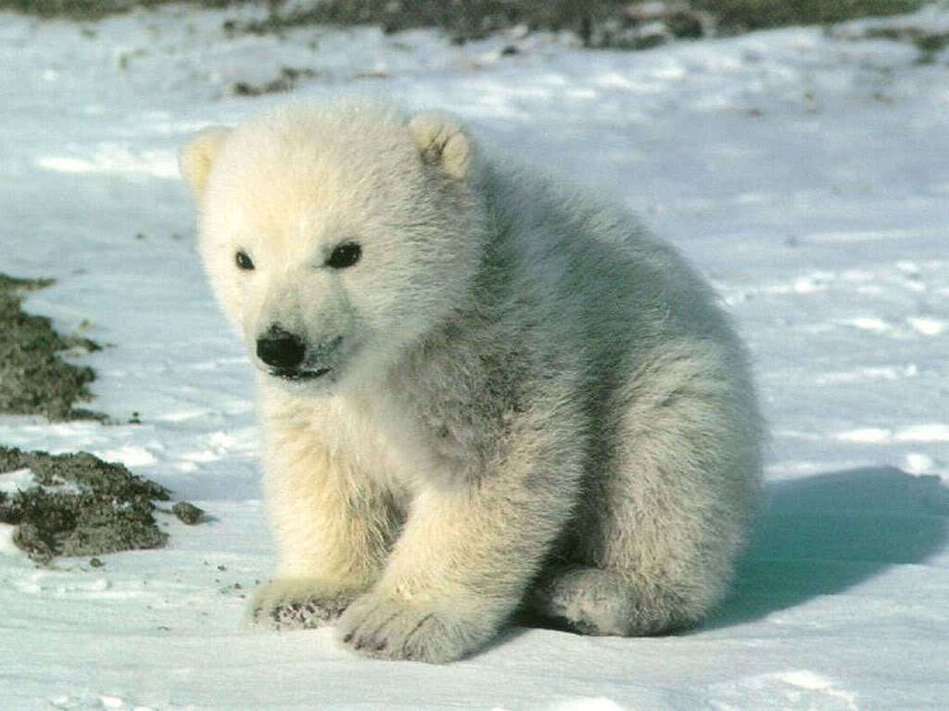
Polar Climate Zone
Sun shines for long hours in summer, but in winter it shines for only a few hours.
The South Pole is colder than the North Pole.
Plants and animals survive in the polar climate by their adaptations.

Slide 6
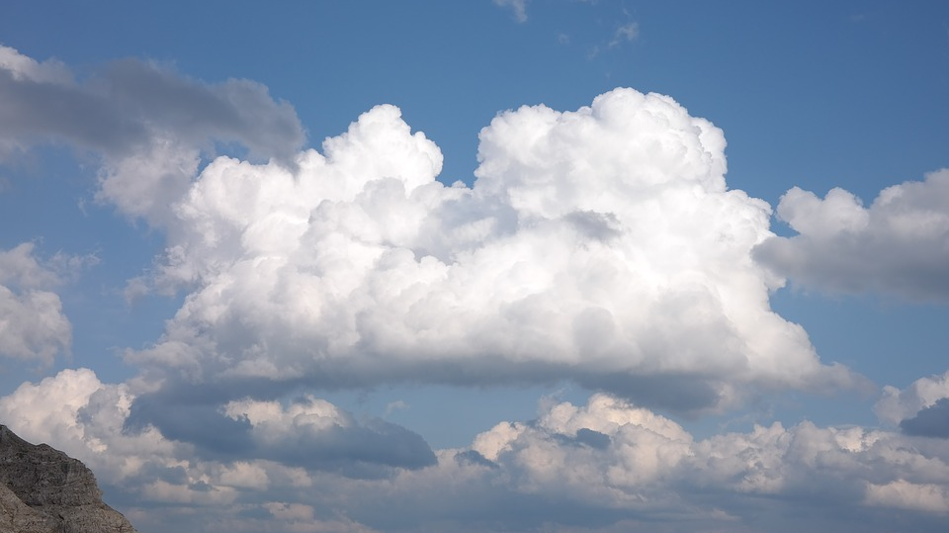
Cumulus Clouds
Large piles of white clouds that can billow high in the sky. They appear during fair weather.

Slide 7
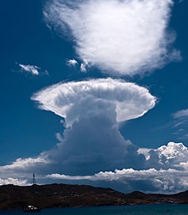
Cumulonimbus Clouds
Dark towering clouds that are known as thunderclouds because they bring thunderstorms.

Slide 8
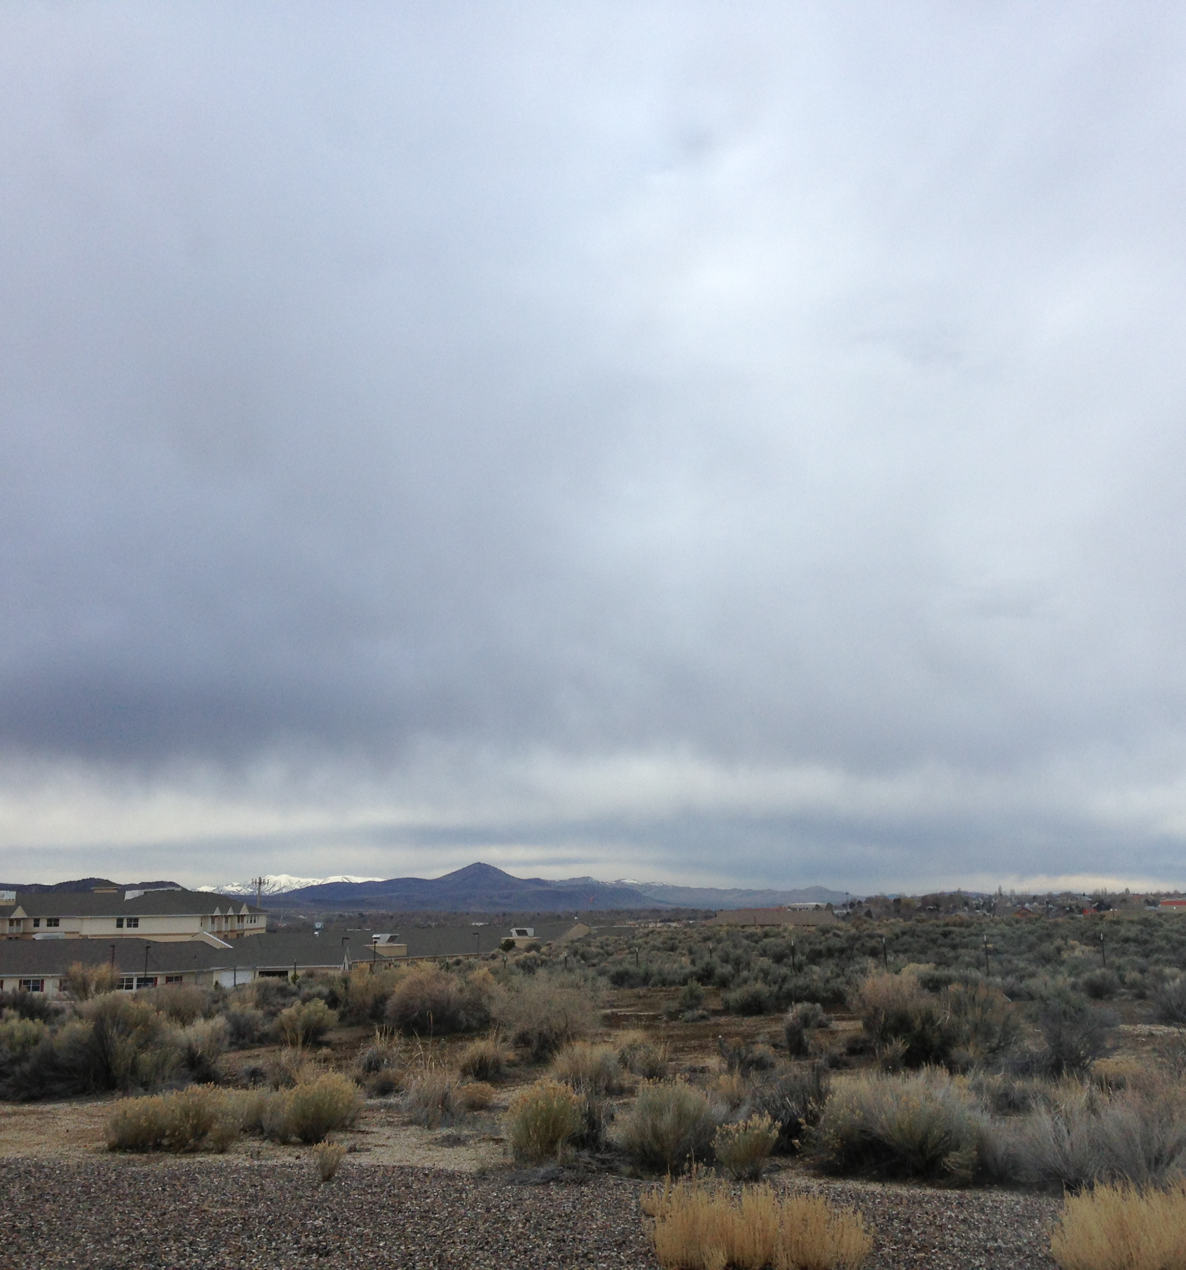
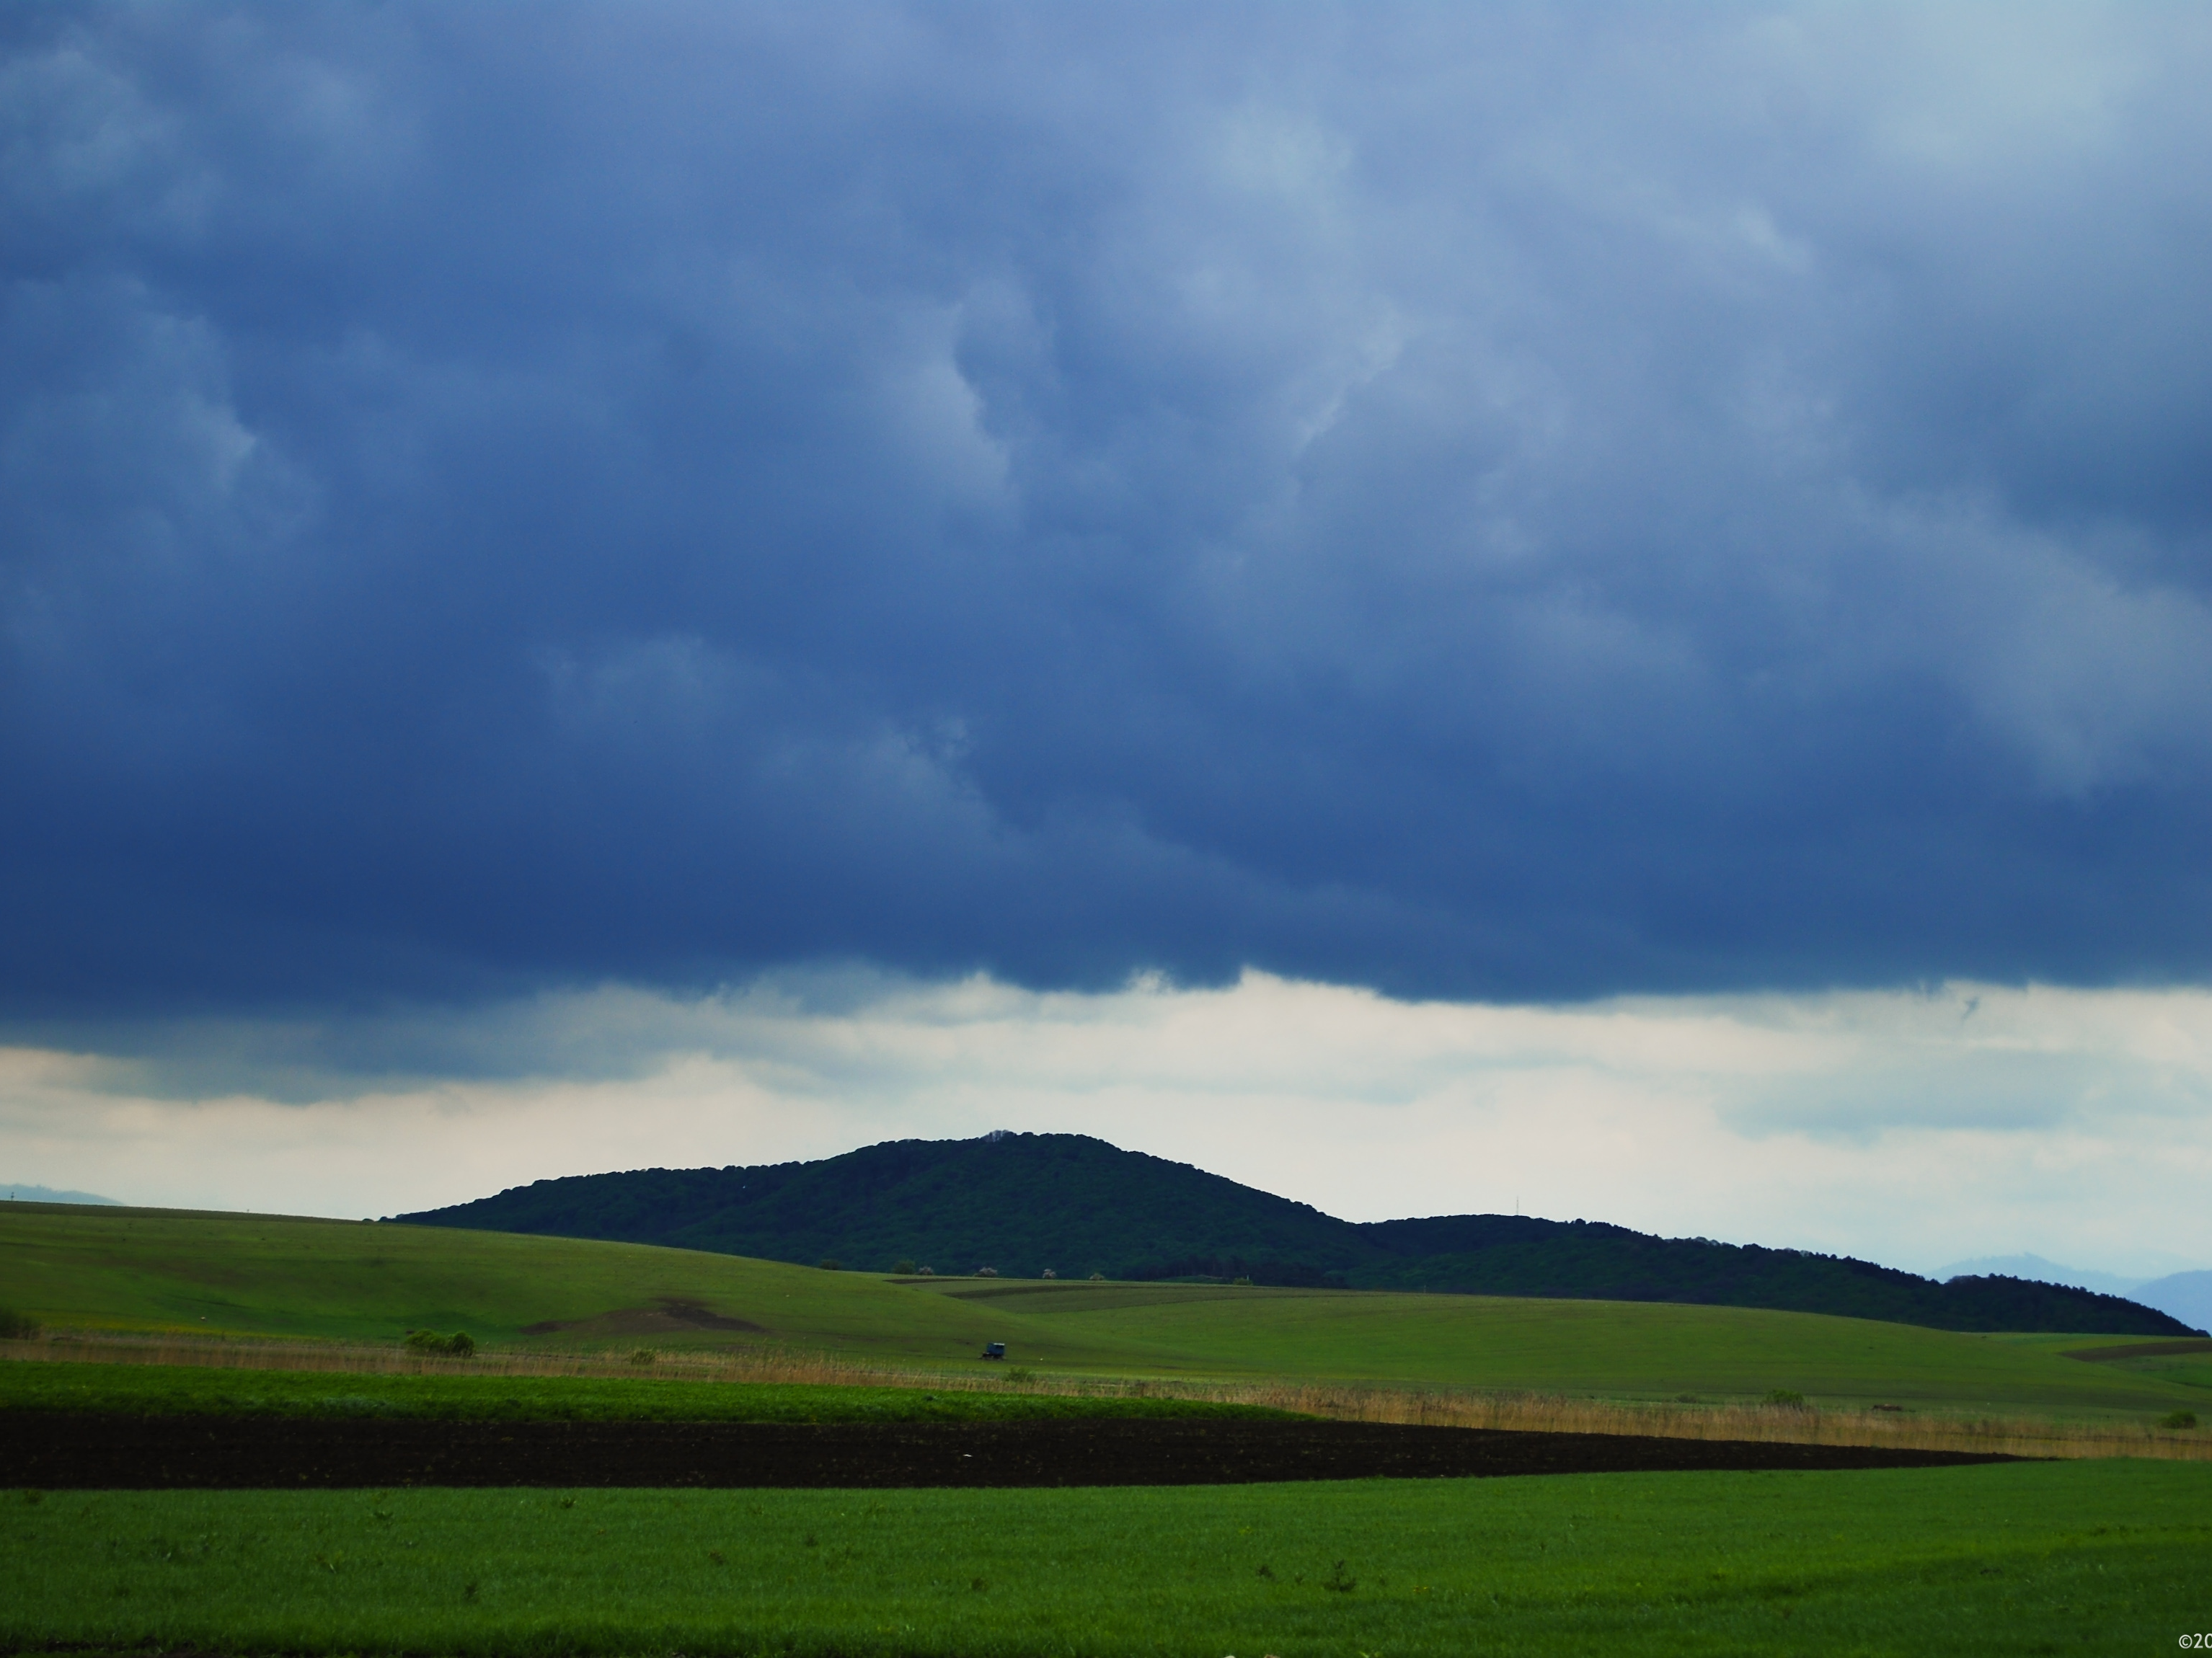
Stratus Clouds
Stratus clouds are light grey clouds spread across the sky
Stratus clouds also look like a light grey blanket spread across the sky.
Stratus clouds are not rain clouds.

Slide 9
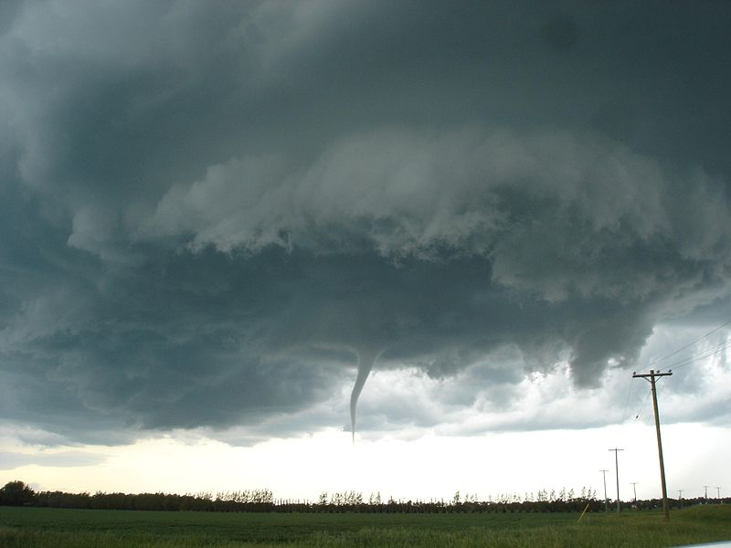
Stratonimbus Clouds
Stratonimbus clouds are rain clouds
Stratonimbus clouds are dark grey clouds spread across the sky.
These rain storms last about all day.
his Photo by Unknown author is licensed under CC BY-SA.

Slide 10
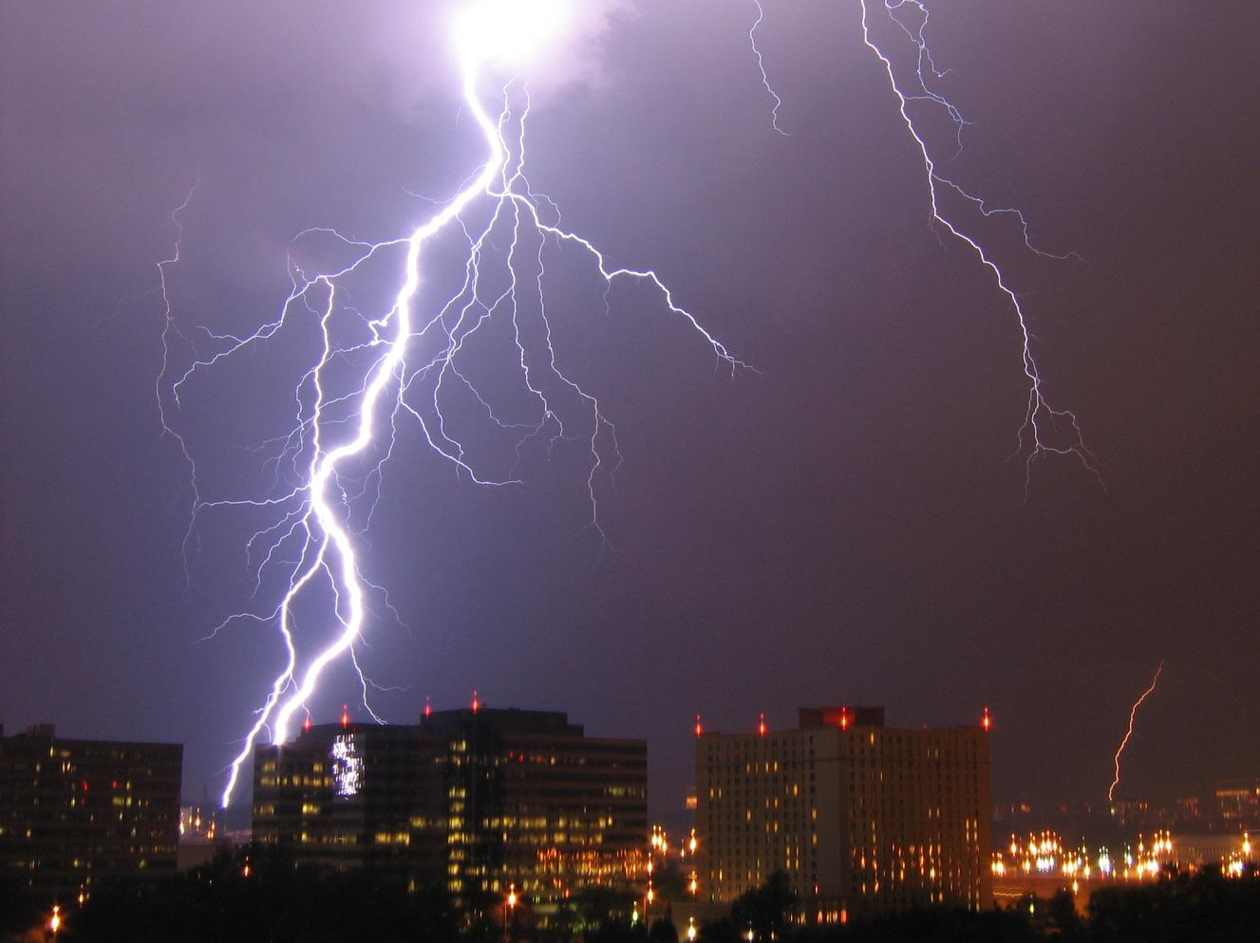
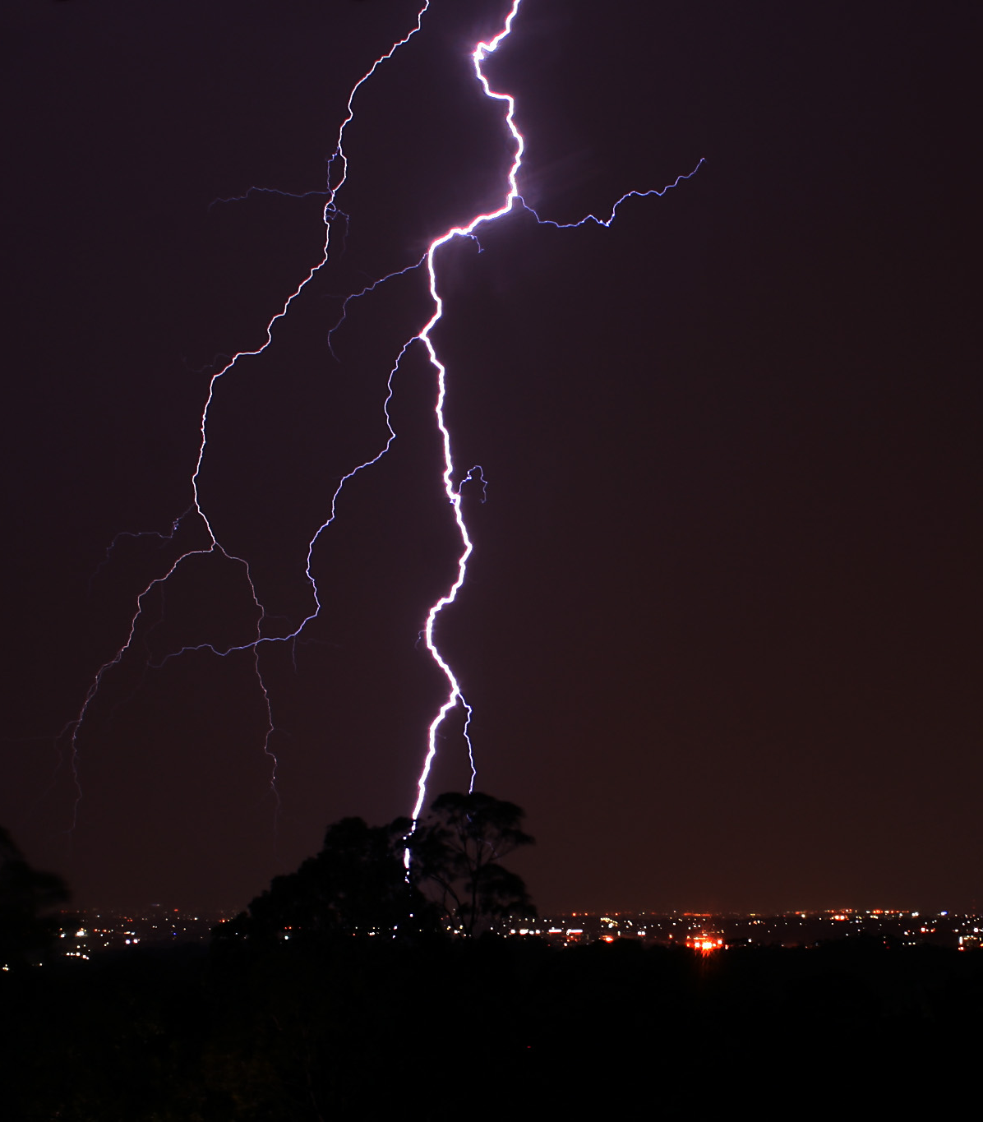
Extreme Weather-Lightning
Lightning causes many injuries and deaths in the United States.
Many people don't realize that they can be struck by lightning 10 miles away when there are blue skies overhead.
A lightning bolt can be in cloud a cloud to ground and a cloud to cloud.

Slide 11
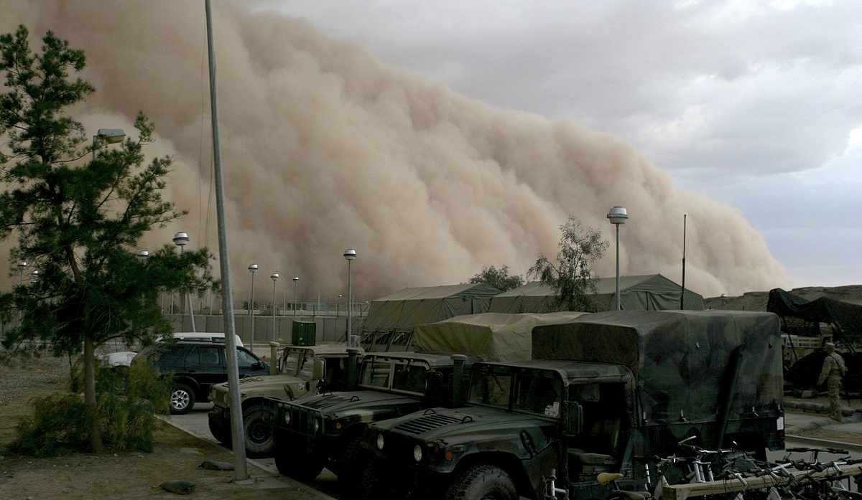
Extreme Weather-Dust storms
Dust storms can cause many bad injuries and horrible deaths.
Dust storms can reach up to a mile in height.
If you are in the middle, you cannot breathe.

Slide 12
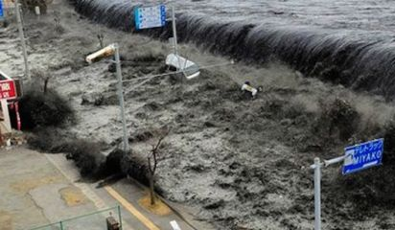
Extreme Weather-Tsunami
The energy of a tsunami is forced into a smaller place.
A tsunami is sometimes called a tidal wave.
A series of waves generated by a tsunami is called a wave train.

