Slide 1
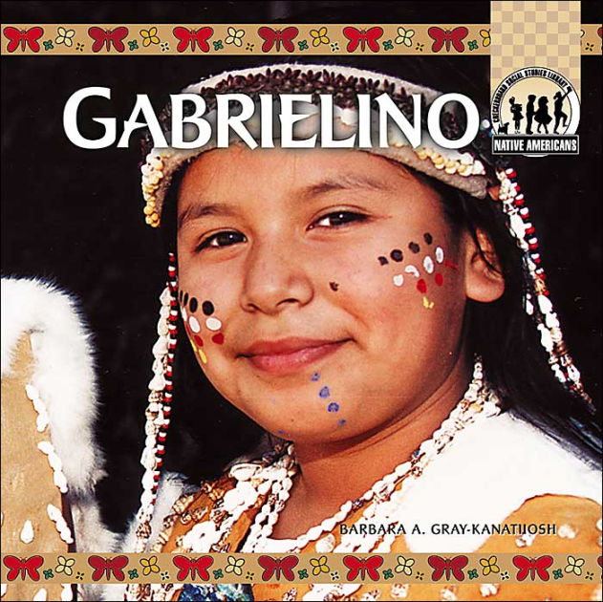
The Gabrielino Tribe
By Alaa Khalil

Slide 2
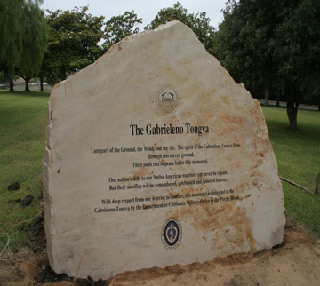
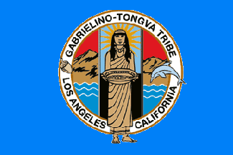
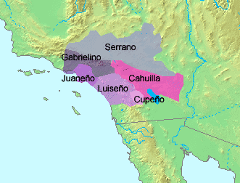
The Gabrielino's Location
These Indians once lived in San Gabriel Valley.
They lived in the valleys in Southern California where earthquakes are common
They told a story to explain the cause of earthquakes and how California was made.

Slide 3
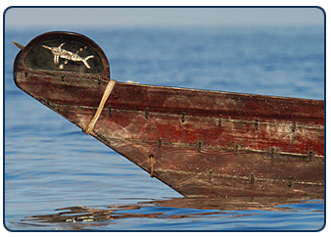
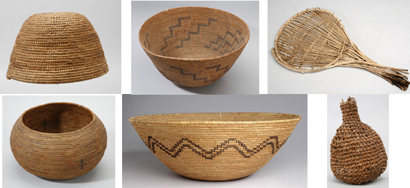
The Gabrilino culture
The Gabrielino were expert basket makers.
For ceremonies they marked off a fence of willow poles around it.
The fence was decorated with feathers, animal skin, and flowers.
This ceremonial enclosure was called the Yuvar.

Slide 4
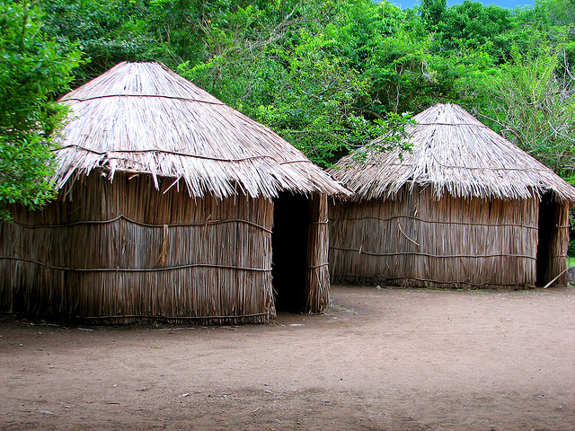
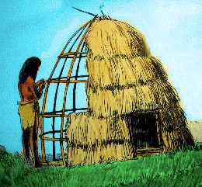
The Gabrielino's shelter
They made their homes by placing poles up right in a circle and bent them into meet in the middle they also covered their homes with grass and sticks.
Also some houses were able to hold 50 or 60 people
The Gabrielino village also had a sweathouse where the men met to talk and sweat.

Slide 5
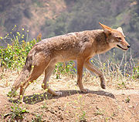
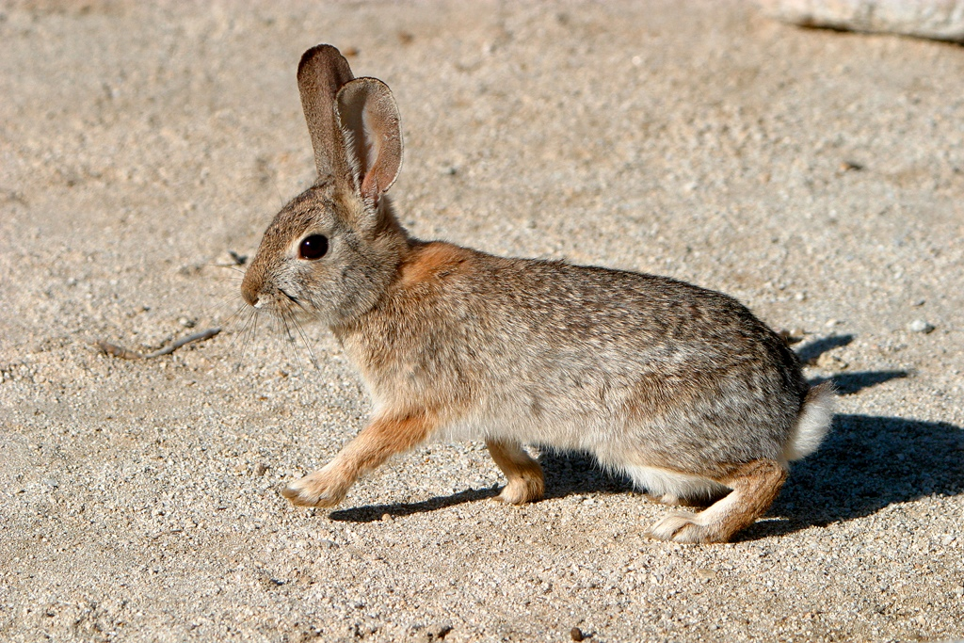
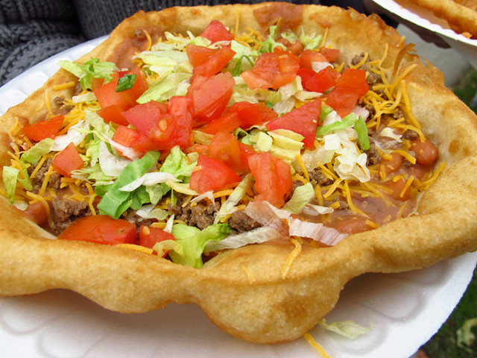
The Gabrilino food
The Gabrielino ate birds, fish, grapes, and berries.
They used a bow and arrow to hunt .
They hunted animals such as birds, deer, coyote, squirrels, badgers, rabbits, hawks, and rats
They gathered prickly pear, apples ,white sage, cherries, and black berries.

Slide 6
The Gabrielino tribe by Alaa
This is how the Gabrielino tribe lived hope you like it thx so much bye

