Slide 1
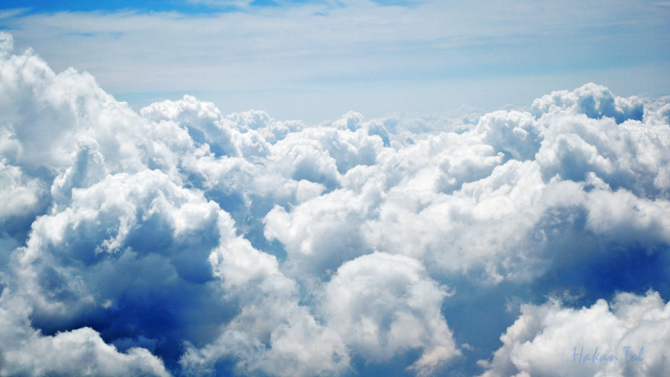
Weather and Climate
By Damian Perez and Armando Acevedo

Slide 2
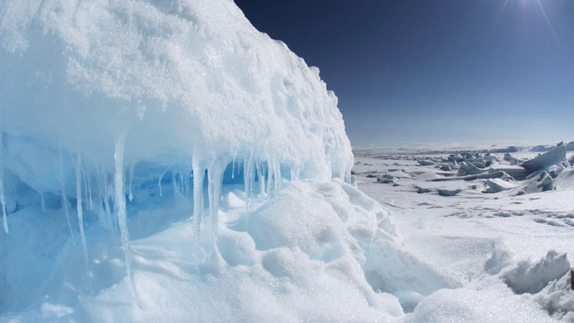
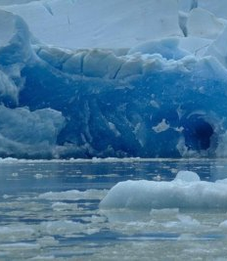
Polar Climate Zone
Very, very cold winters and summers
Animals that live there can change their fur color to white in winter
The summers are short but the winters are long.
Occur only above 60 degrees north latitude or below 60 degrees south latitude

Slide 3
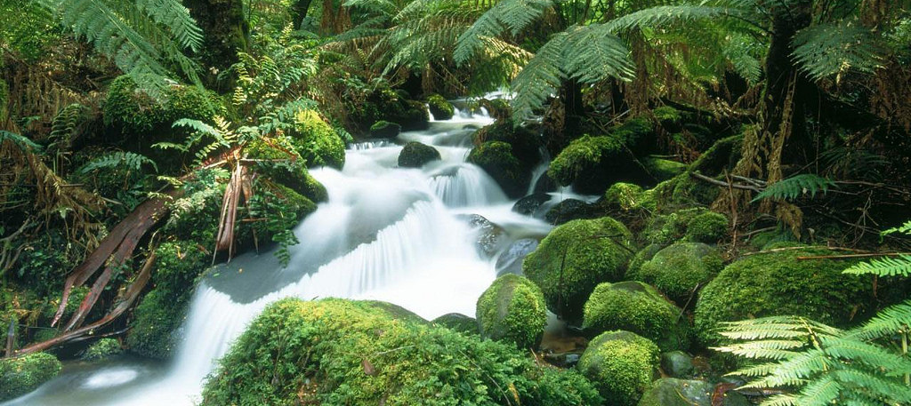
Tropical Climate Zone
Can extend as wide as 30 degrees north and 30 degrees south latitude.
This is mostly found between the Tropic of Cancer and the Tropic of Capricorn.
Supports large hardwood forests, palm trees, and many kinds of mosses and vines.
The climate is perfect for
rainforests, teeming with amazing amounts of life and growth.

Slide 4
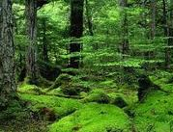
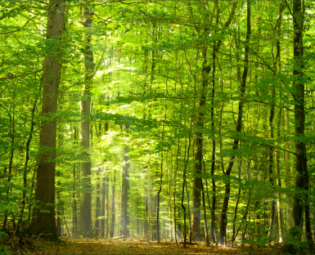
Temperate Climate Zone
The weather is never too extreme
The winters are cool and dry
Most of the United states falls into the Temperate zone
Summers are warm and wet
Neither season has very hot or cold temperature
Many plants and animal species live there

Slide 5
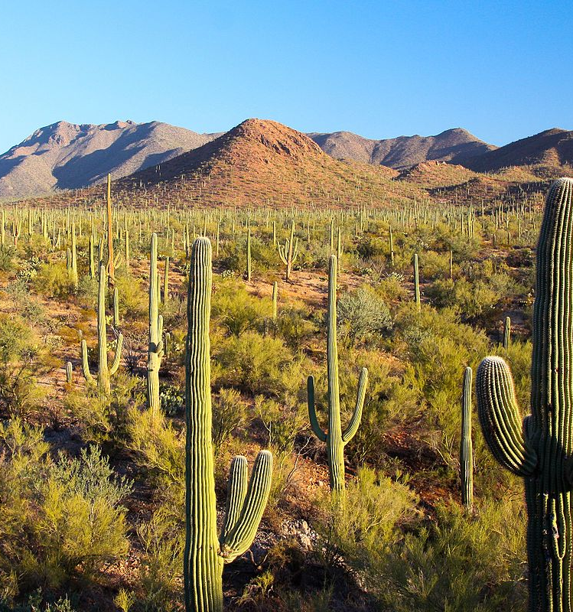
Desert Climate Zone
Dry winters and hot summers
Summers are very hot and dry
Heavy rain could cause flash floods
Little rain falls most of the year

Slide 6
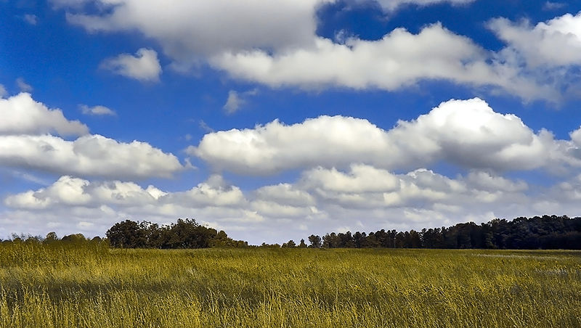
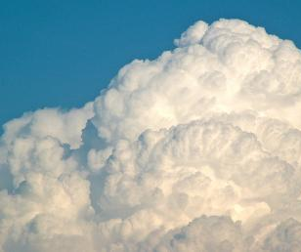
Cumulus clouds
Clouds are thin and wispy
Also called weather clouds
Known as a vertical cloud
Below 6,500 ft. [2,000 meters high]
Formed by water droplets
Look like floating cotton

Slide 7
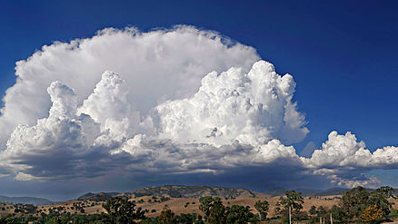
Cumulonimbus clouds
Clouds can take up several miles across the sky
Can reach elevations of 39,000 feet or
higher
Made of water droplets
Can bring lightning, thunder, violent
tornadoes
They consist of ice crystals

Slide 8
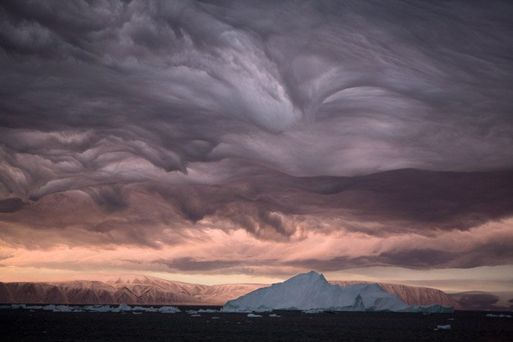
Stratus clouds
Are among the low-lying clouds
Gray clouds that cover entire sky
Can be the result of very thick fog lifting in the morning

Slide 9
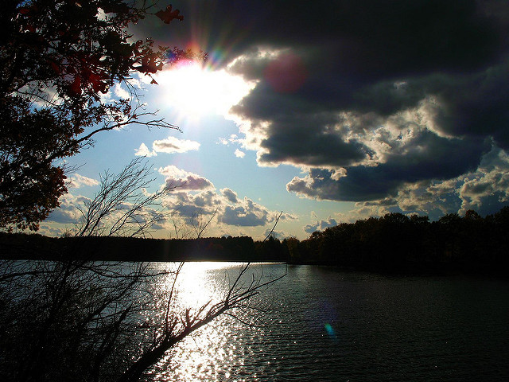
Nimbostratus clouds
Dark, grey, and long clouds
Produce hail, rain, and snow
The lowest cloud

Slide 10
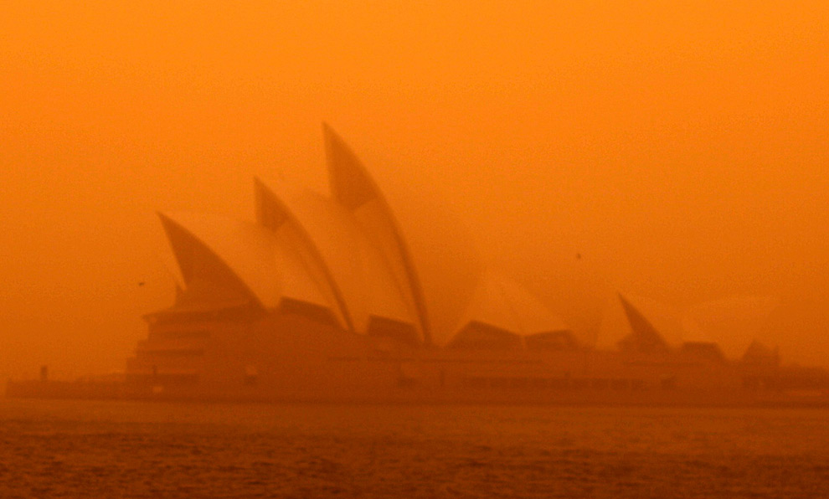
Dust storms
Often happen in deserts
Are able to turn into mud when it's done
When strong winds and dry conditions mix, it forms a dust storm
The small ones are called dust devils
Can rise more than 10 kilometers [6 miles] high
Able to cover entire cities

Slide 11
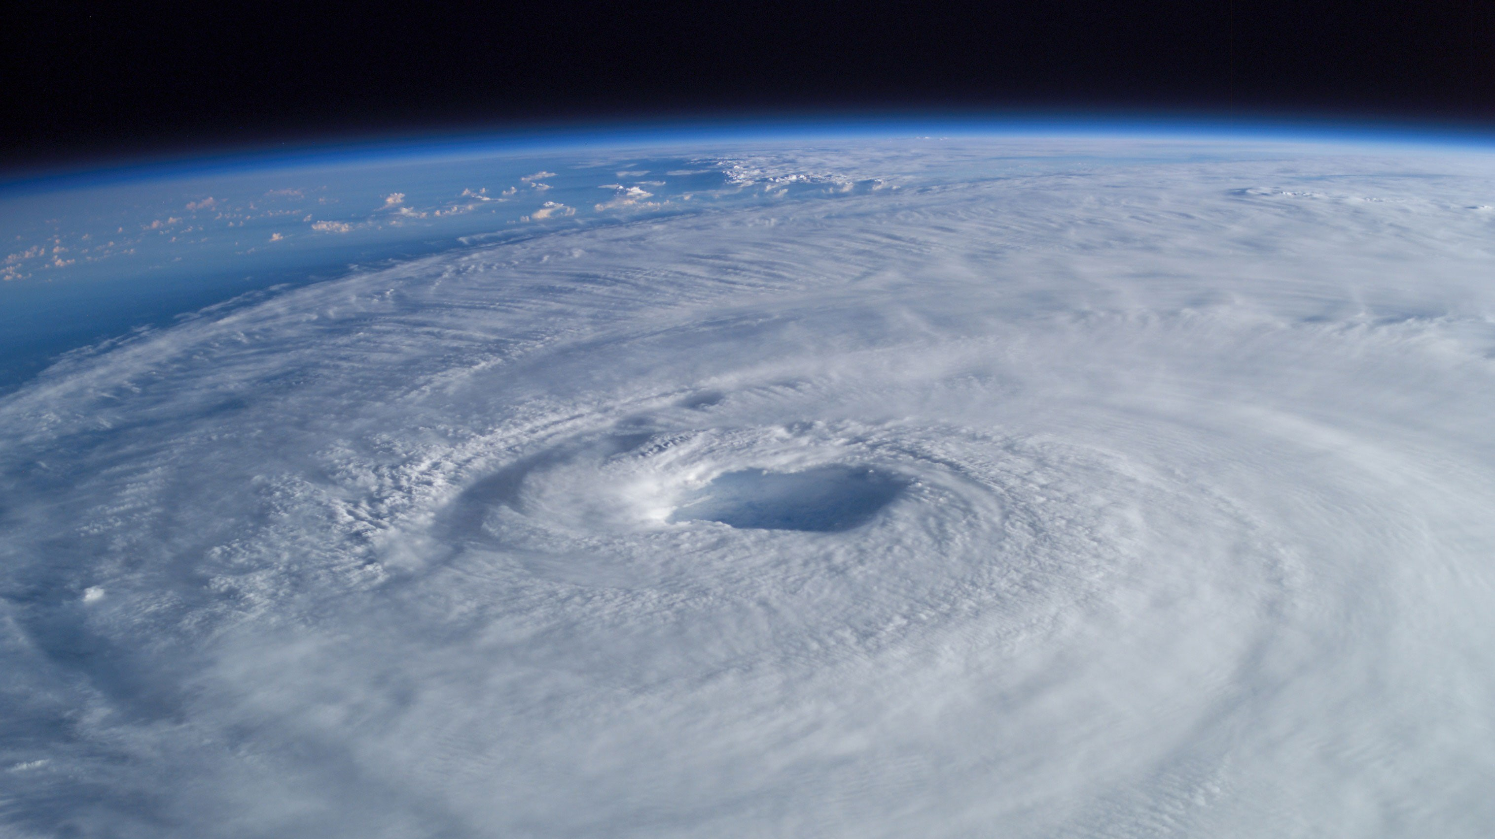
Hurricanes
Happen in the Gulf of Mexico, Flordia , Hawaii and more
Bring heavy rain and strong winds
Begins as a tropical storm
Causes huge floods when it's over
Able to break houses, cars, or buildings
Can effect more than one state at a time

Slide 12
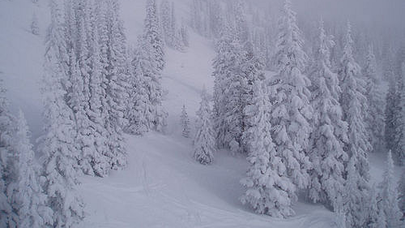
Blizzards
Fierce winter storms with strong winds and cold temperatures
Bring a lot of snow very, very fast
Can cause people to get frostbite
Jet streams and warm air can cause blizzards

Slide 13
