Slide 1
Colonies to Country
Ch 2 sec 2

Slide 2
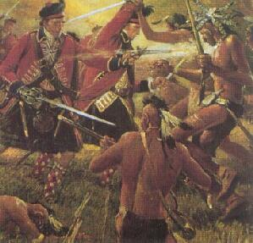
I. The Colonies on Their Own
The colonists were subjects of the British monarchy and they owed their allegiance to the crown.
Although Britain regarded the American colonies largely as a source of economic benefits, it allowed them limited self-government.
The colonial legislatures were more capable of running the colonies on a day to day basis than the British government 3000 miles away.

Slide 3
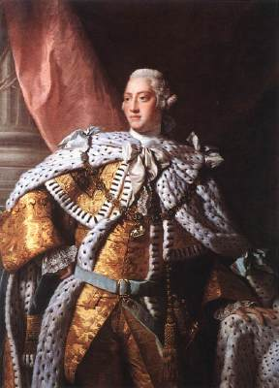
I. The Colonies on Their Own
The French and Indian war caused Britain to increase control of the colonies with all the new land they acquired.
King George III and his ministers wanted the colonies to help pay for the war by levying new taxes on the colonists.
The colonists resented the attempt to change the relationship between Britain and the colonies.

Slide 4
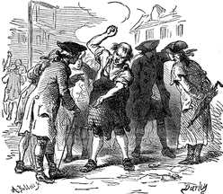
I. The Colonies on Their Own
The colonies responded to the taxes by boycotting British goods, which made the government repeal many of the taxes.
The Tea Act spurred Boston to have a tea party in Boston Harbor. This caused the British government to pass the Intolerable Acts to punish Boston.
The Intolerable Acts made the other colonies afraid of what the government would do if they upset the king.
Notes:
http://www.historycentral.com/Revolt/photos/Boycott.GIF

Slide 5
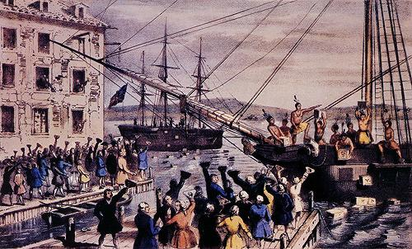
II. Colonial Unity
Harsh British policies and taxes helped unite the colonies.
The colonists shared a hostility towards British attempts to control them.
To protest British policies, the colonist sent petitions to the king and also organized committees of correspondence.

Slide 6
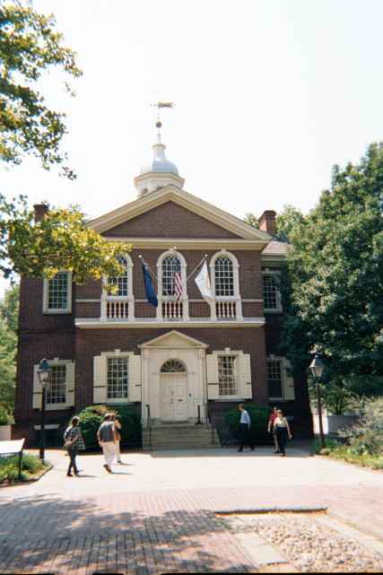
Colonial Unity
The First Continental Congress held in Philadelphia in 1774 debated what the colonies should do about their relationship with Britain.
They sent a Declaration of Rights to the king, who refused to read it.
Then, the governor of Massachusetts wanted to arrest patriot leaders and capture a store of weapons near Boston.

Slide 7
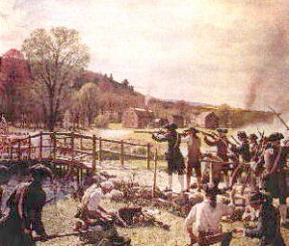
II. Colonial Unity
A force of minutemen met the British soldiers outside of Concord, Massachusetts, and they began firing at each other.
When the Second Continental Congress met in 1775, fighting had begun and Congress acted as a central government.
At first, the goal was reconciliation and not independence. But several things came together to drive the colonists to declare independence.
Notes:
http://www.wpi.edu/Images/CMS/Military/milsci-battles-open.jpg

Slide 8
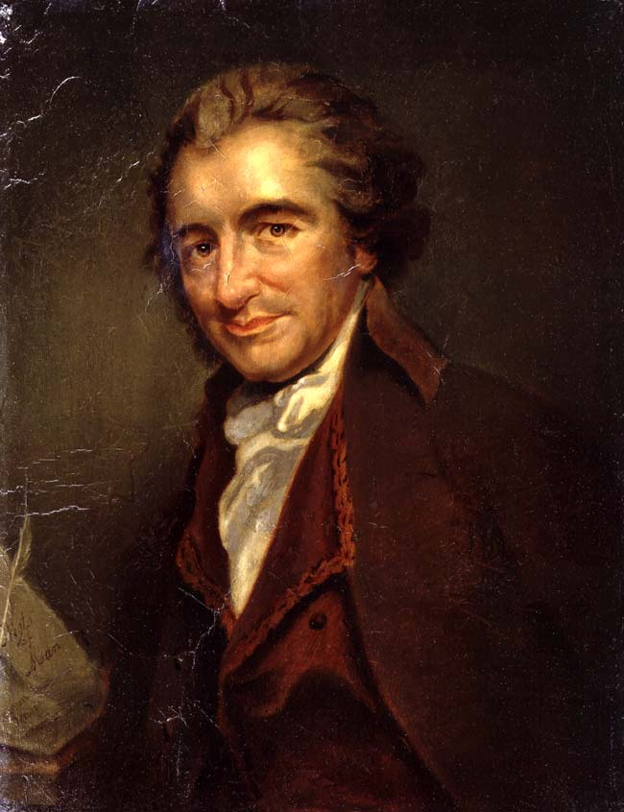
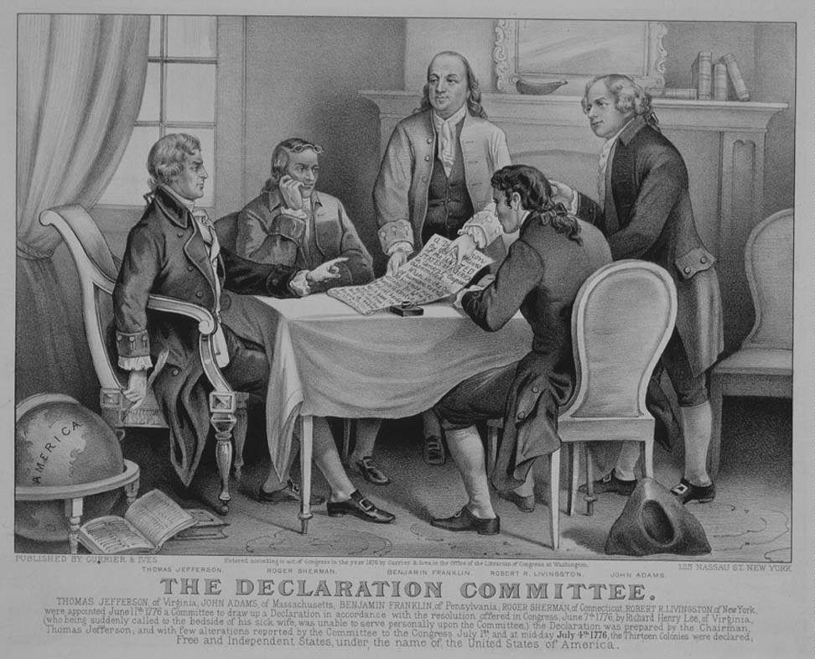
III. Independence
Thomas Paine’s Common Sense strengthened the independence movement.
A committee of delegates to the Philadelphia Congress, headed by Thomas Jefferson, drafted the Declaration of Independence in 1776.

Slide 9
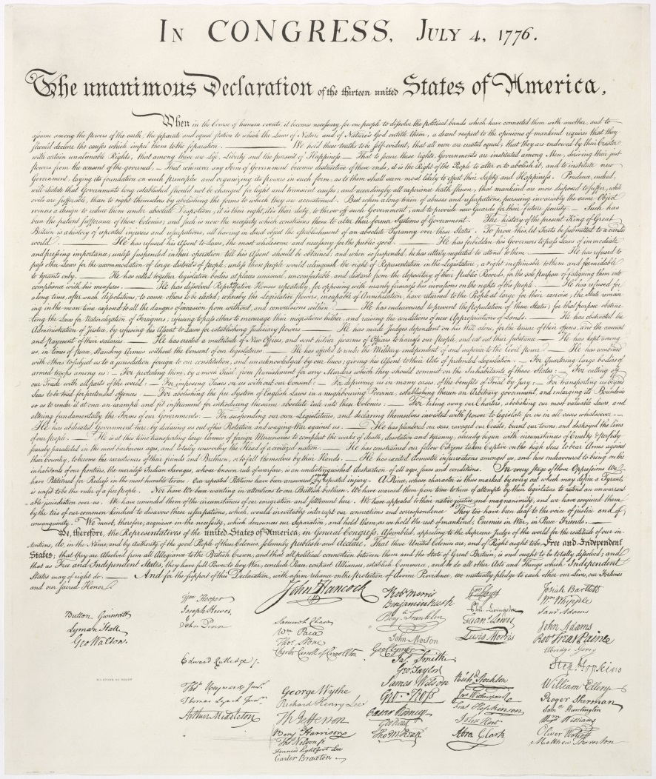
III. Independence
The Declaration set forth the principles for the new nation.
The Declaration had three parts: a statement of purpose, including a description of basic human rights, a list of specific complaints against King George III; and a statement of the colonists’ determination to separate from Great Britain.

Slide 10
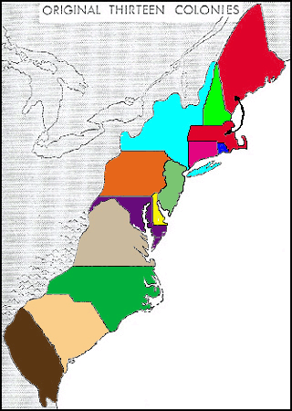
III. Independence
By 1776 eight states had adopted written constitutions, which were based on the consent of the governed, limited government, and the protection of individual rights.

Slide 11
In your notebooks
321+1
Write 3 things you learned from the lecture today
Write 2 things you want to learn more about
Write 1 thing you did not understand
Write 1 thing that someone else learned that you did not write down.

