Slide 1
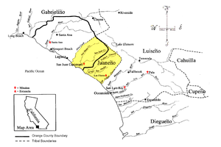
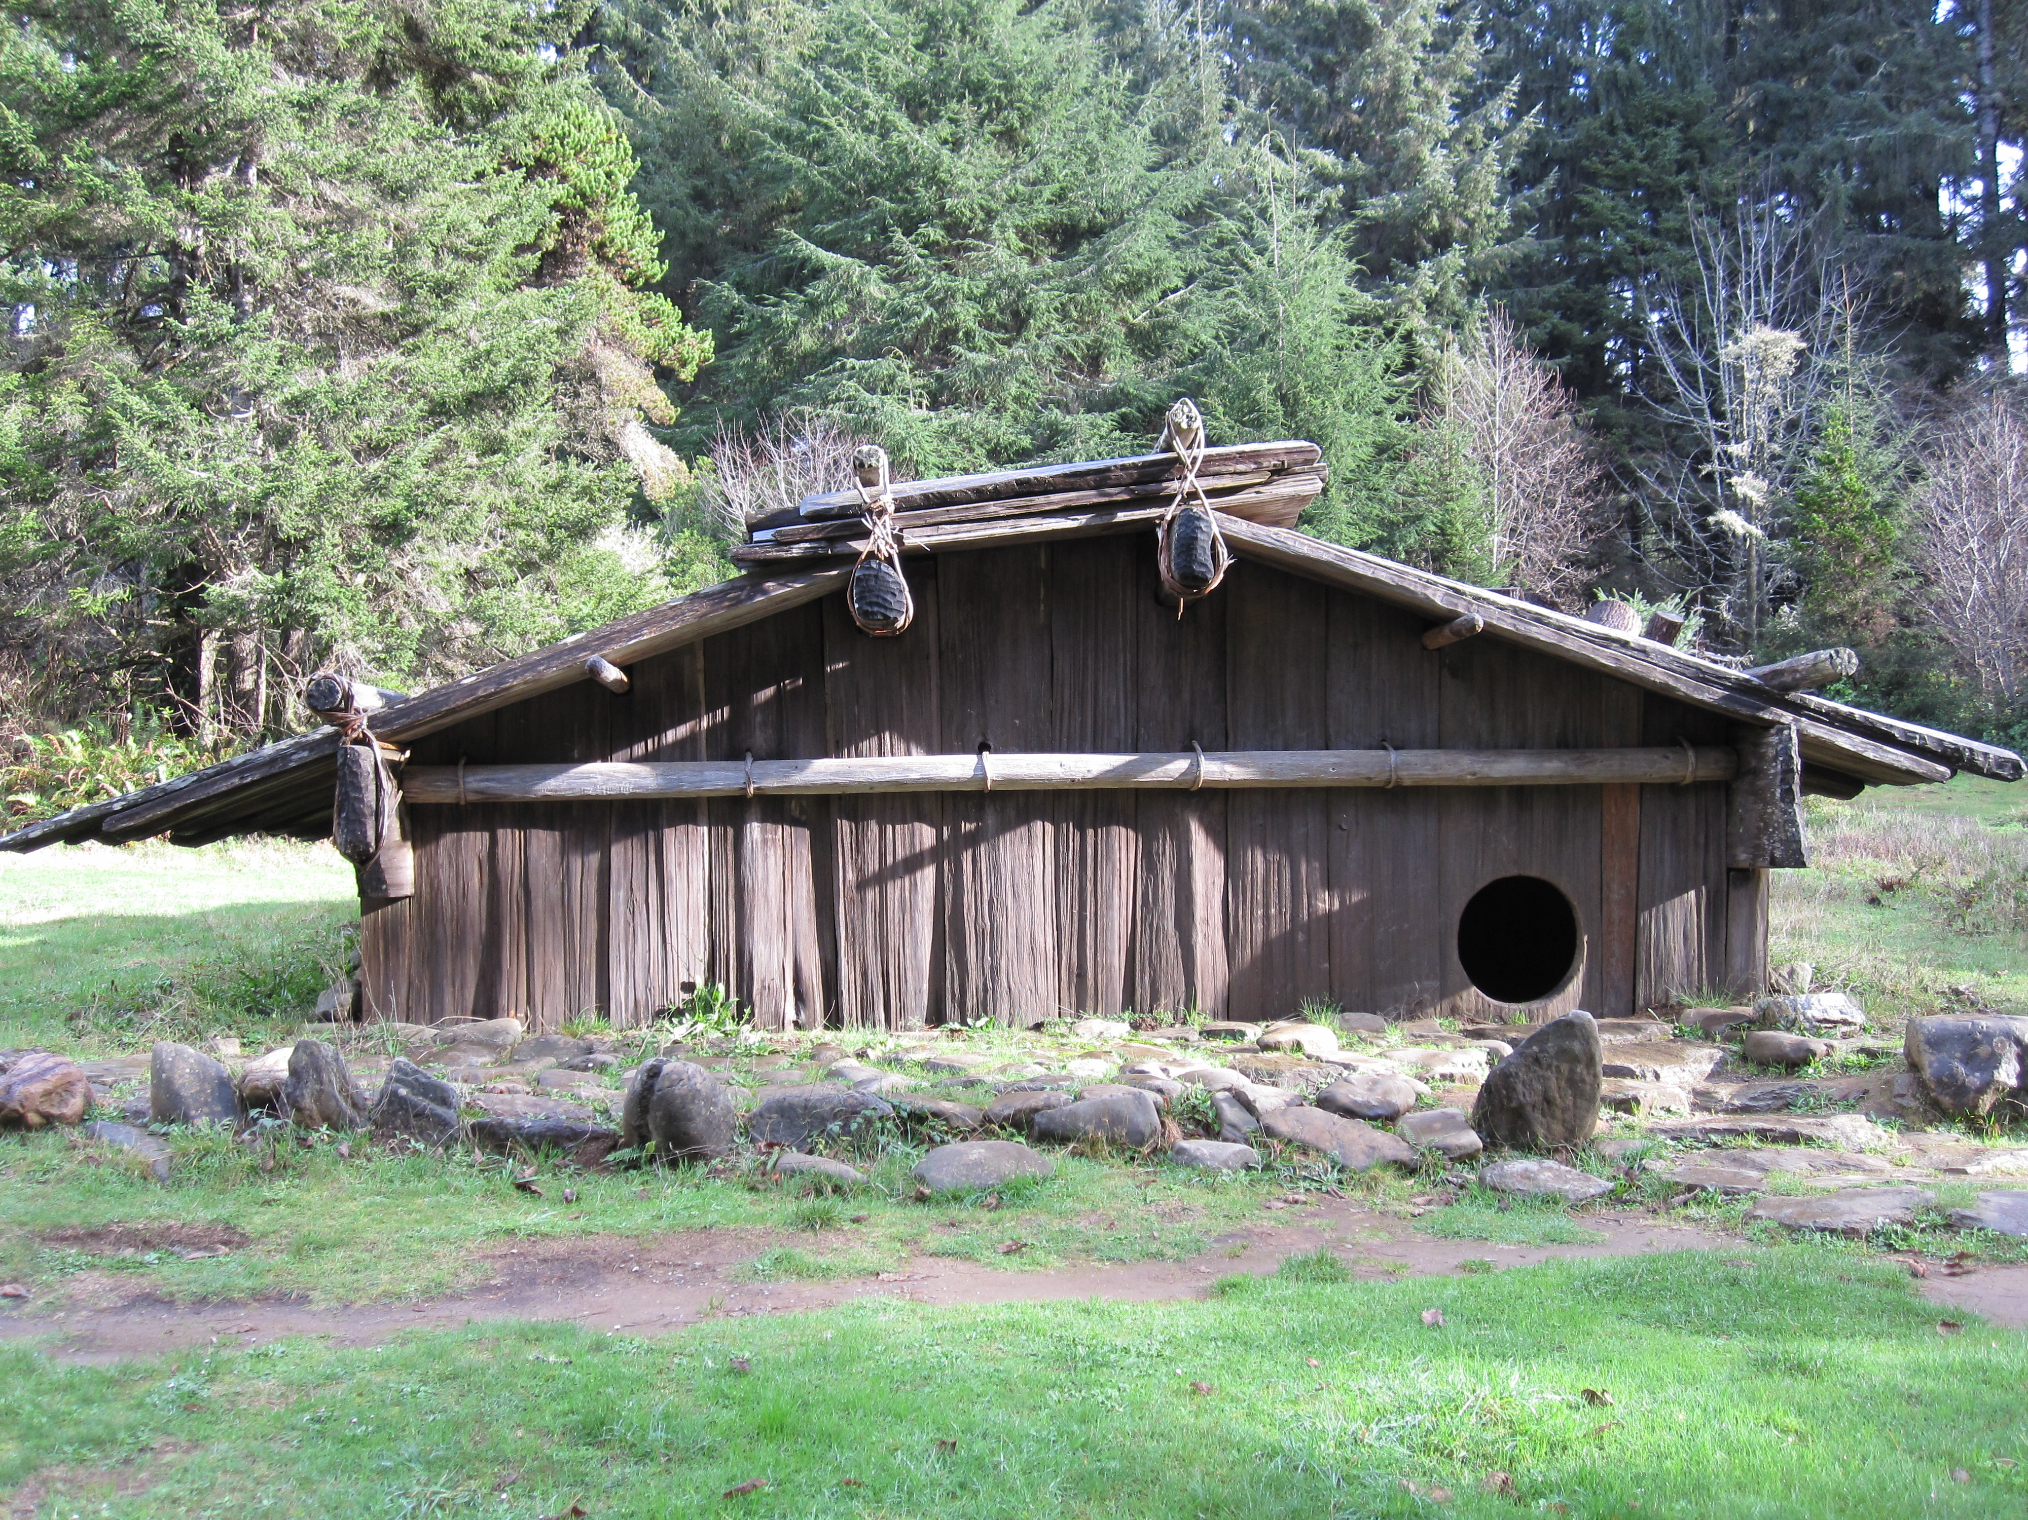
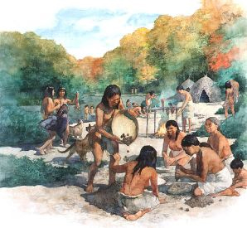
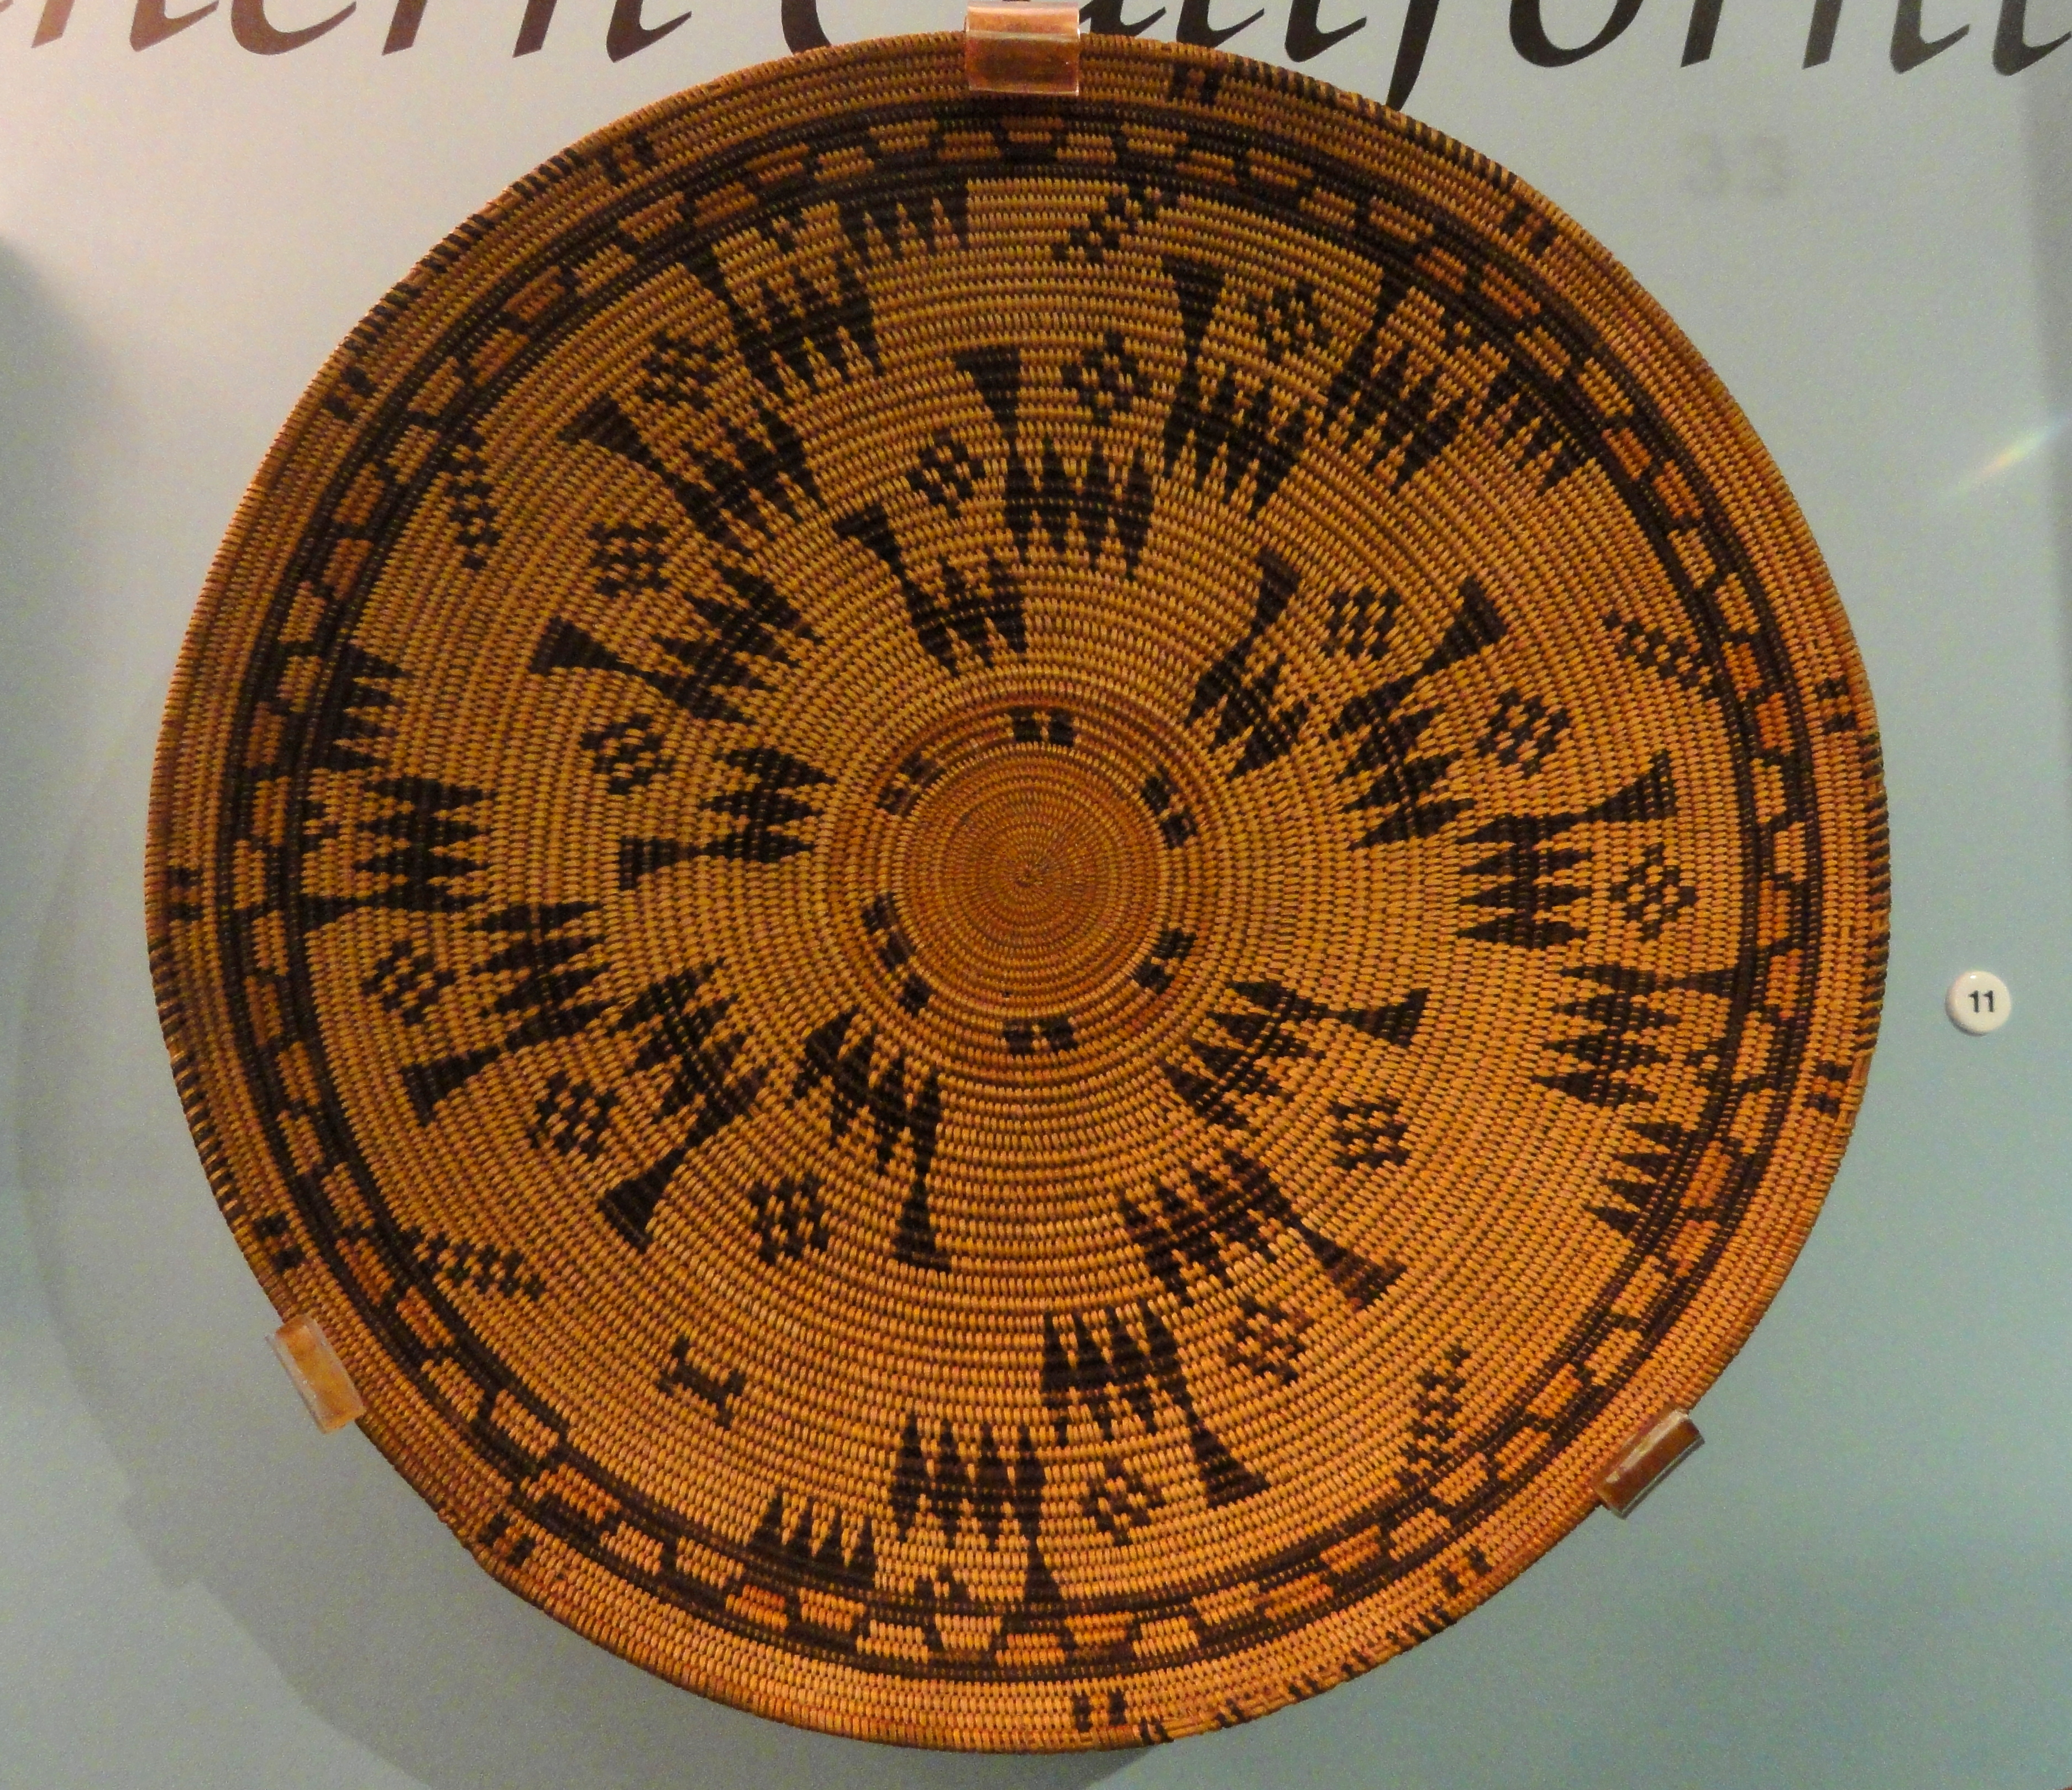
Gabrielino
By :Abigail Lauren Sholtis

Slide 2
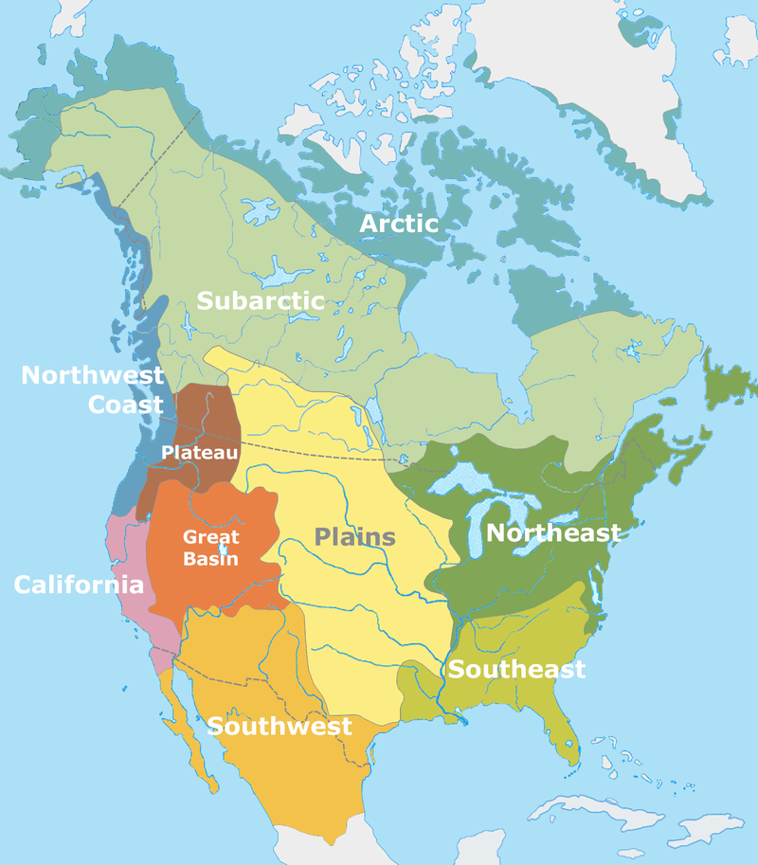
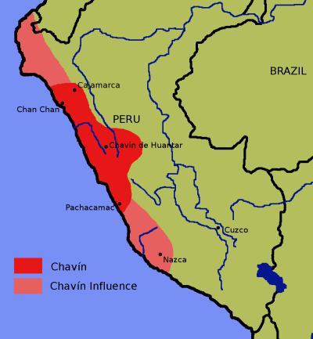
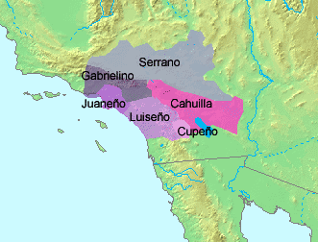
Location
The Gabrielino tribe lived in the southwest part of California.
They lived on the Southern California coast.
They lived off shore from Los Angeles, Orange Counties, parts of western Riverside and San Bernardino.
Summer was really hot and winter was cool.
Their landforms were also the islands of Santa Catalina, San Nicholas, and San Clemente.

Slide 3
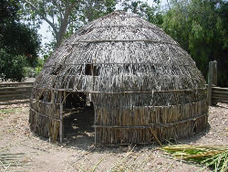
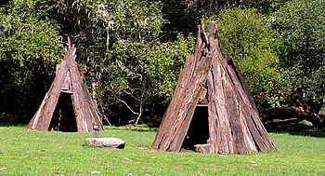
Shelter
The homes of the Gabrielino tribe protected them from the environment.
Their homes were bowl shaped or cone shaped.
They were made by placing poles and bending them to meet in the middle.
Most Gabrielino people lived in earth houses which are made from an underground room covered by clay and brush.
Farthen houses were dwellings with a domed mound built over the top.
Today Gabrielino families live in apartment buildings just like us
They marked off a place and put willow poles around it.
Notes:
Gibe r

Slide 4
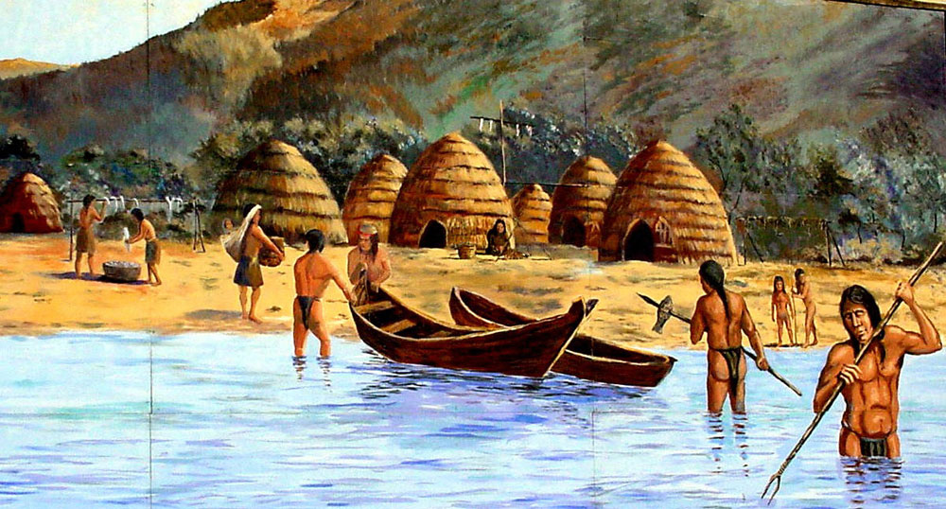
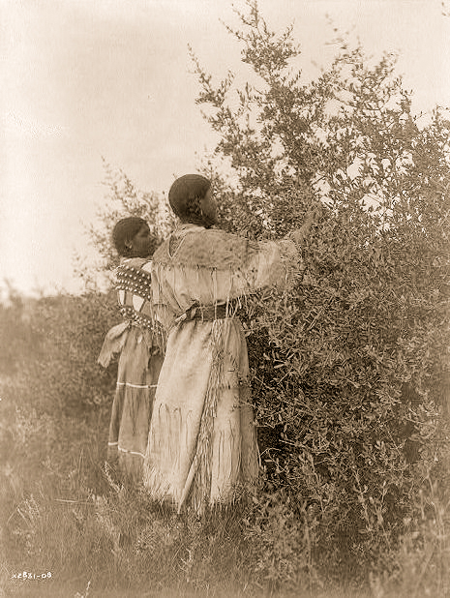
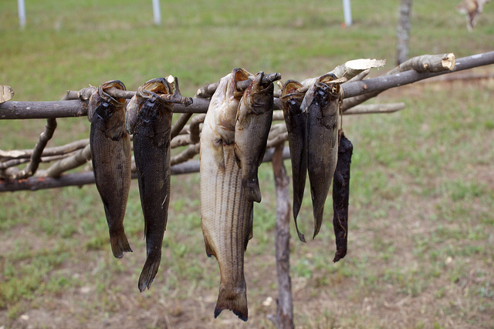
Food
The men hunted, the women cooked, and the children gathered water.
The Gabrielino tribe used their natural resources to hunt food.
They ate Tuna, Swordfish, sharks, shellfish, sea mammals, and seabirds.
They dried their food for 7 days.
They gathered a wide variety of nuts and berries from the local surroundings.
They gathered tule roots, pine nuts, blackberries, wild oat, jicamas, sage seeds, isly, lemonade berries, soap roots, and caterpillars.

Slide 5
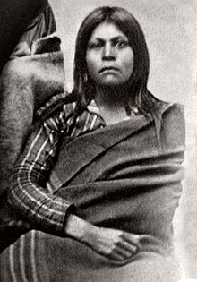
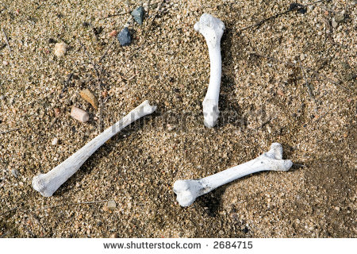
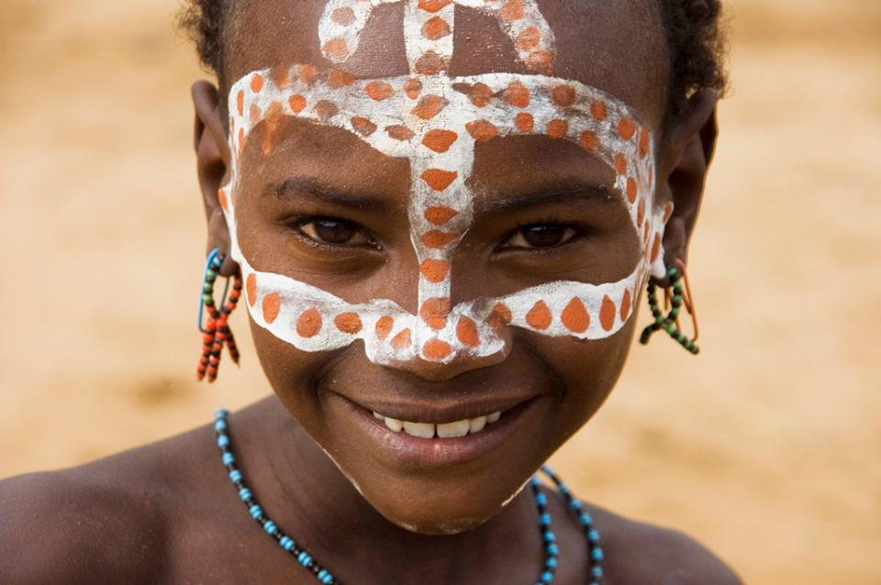
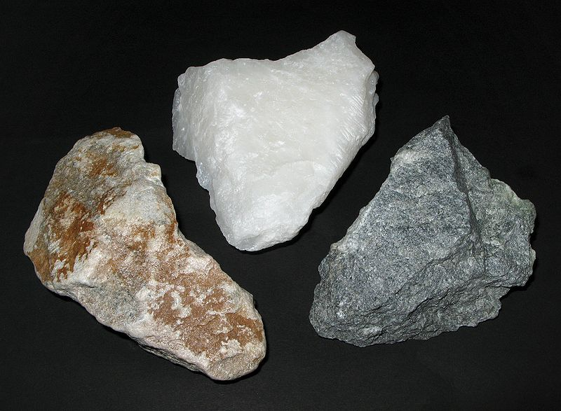
Culture
The culture of the Gabrelino is interesting.
Gabrielino woman wore aprons made of deer skin.
They tattooed themselves.
They used soapstone to carve things like cooking utensils and tools.

Slide 6
Gabrielino

