Slide 1
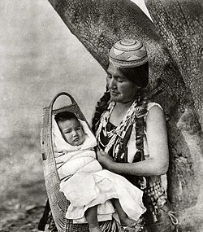
The Pomo
By Marissa and Micaiah
This Photo by Unknown author is licensed under CC BY-SA.

Slide 2
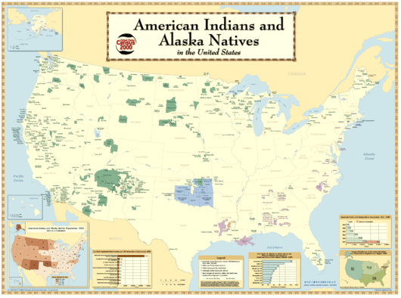
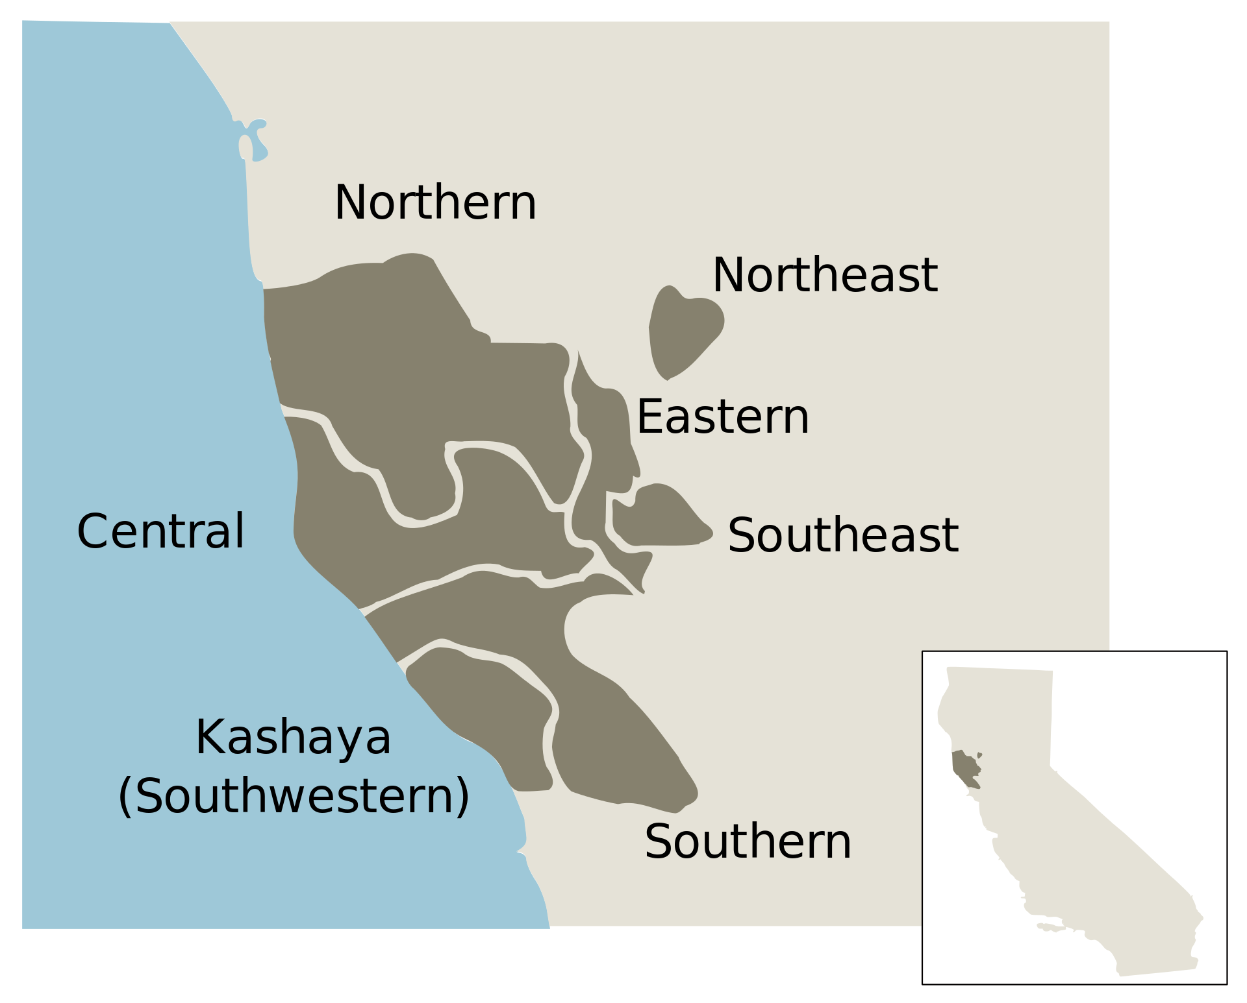
Location
Pomo have always lived on land from the San Francisco Bay area north to Redding, California. They lived near the rivers and the pacific ocean. There are more than 70 villages along the north central coast.

Slide 3
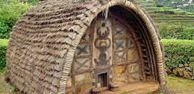
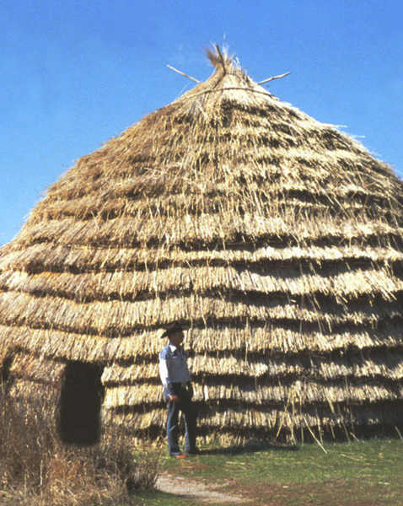
Shelter
This Photo by Unknown author is licensed under CC BY-SA.
They used Tule reeds tied to poles That formed a circular or oval shaped building. Some covered with grass. The groups closer to the sea, built cone shaped houses.
This Photo by Unknown author is licensed under CC BY-SA.

Slide 4
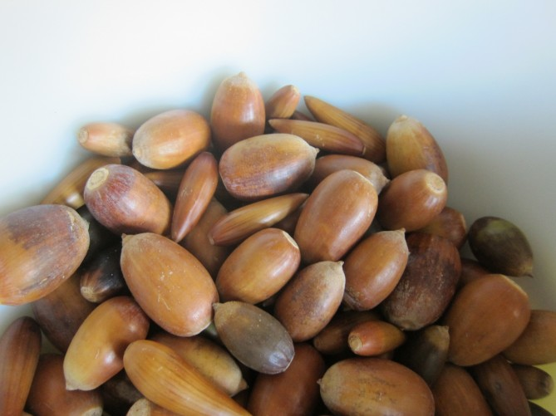
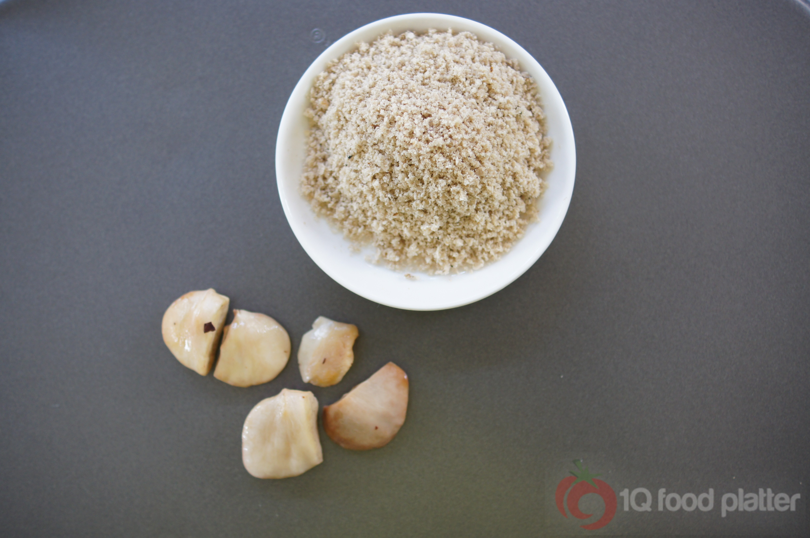
Food
This Photo by Unknown author is licensed under CC BY.
This Photo by Unknown author is licensed under CC BY-NC.
They ate fish, dried seaweed, deer, elk, antelope, rabbits, and squirrels. They hunted forest animals with bow and arrows. They gather nuts and berries.

Slide 5
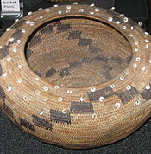
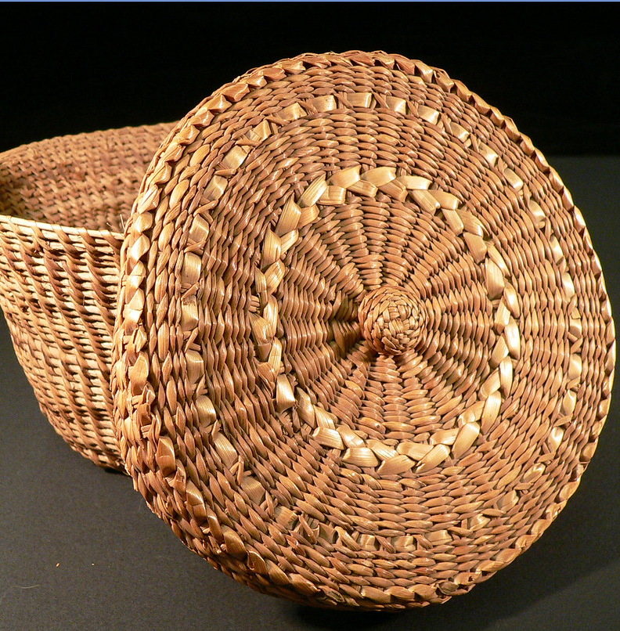
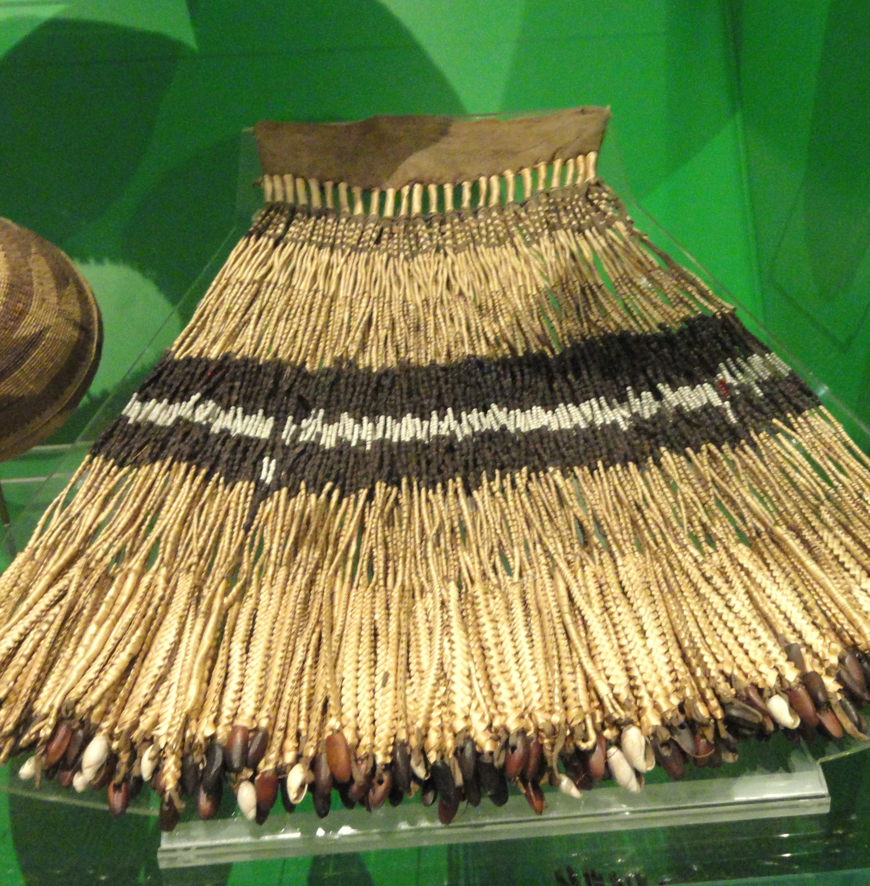
Culture
This Photo by Unknown author is licensed under CC BY-SA.
This Photo by Unknown author is licensed under CC BY-NC-ND.
This Photo by Unknown author is licensed under CC BY-SA.
The Pomo tribe was very musical. A ceremony which combined several days of dancing was called Haikil. They are expert basket makers.

Slide 6
By Micaiah and Marissa
This Photo by Unknown author is licensed under CC BY-SA.

