Slide 1
Finding Hazards
Lesson 2 (and 2B)

Slide 2
Job Hazards
A job hazard is anything at work that can hurt you either physically or mentally.
Some are obvious (easily seen), but others are not. Some hazards can hurt you now, while others may cause health problems in the future.
Safety hazards can cause immediate injuries
Knives, hot grease
Chemical hazards are gases, vapors, liquids, or dusts that can harm your body
Cleaning products, pesticides

Slide 3
Job Hazards (continued)
Biological hazards are living things that can cause sickness or disease, such as HIV/AIDS, hepatitis, tuberculosis.
Bacteria, viruses
Other health hazards are other harmful things that can injure you or make you sick.
Noise, radiation, repetitive movements, heat, cold, stress, harassment

Slide 4
Hazard’s in the Workplace

Slide 5
Find out more about the chemicals?
You can …..
Read the Label
Ask your Supervisor
Get Training
Call a Resource Agency or Check its website.
Look for the Safety Data Sheet (SDS) for the Product.

Slide 6
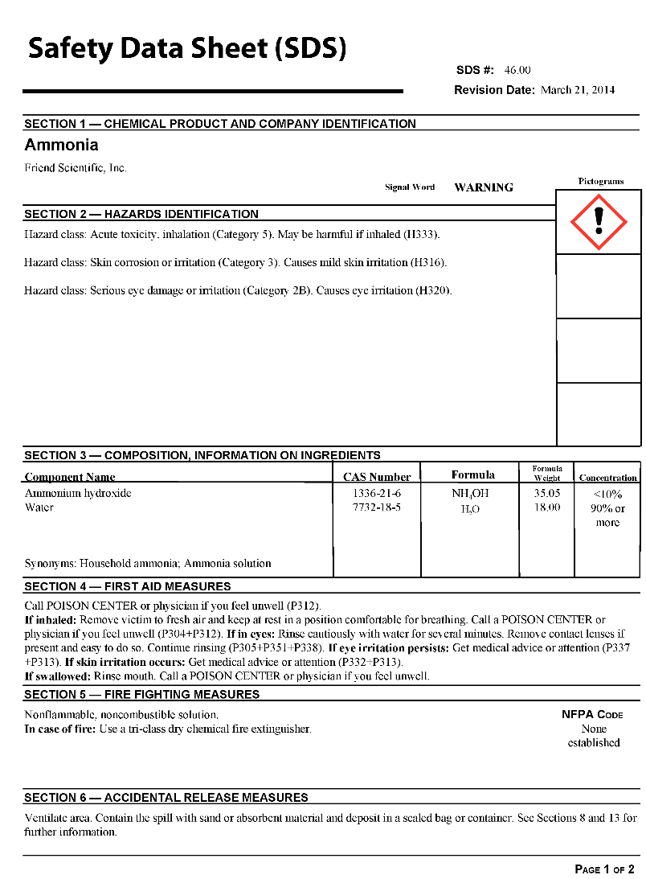
What is an SDS?
Safety Data Sheet (SDS)
Information sheets that manufacturers must send to companies along with their chemical products
An SDS tells you:
What is in the product
How it can harm you
How to protect yourself
http://go.usa.gov/jjpd

Slide 7
Who are the SDS for?
Employees
Employers
Emergency Responders

Slide 8
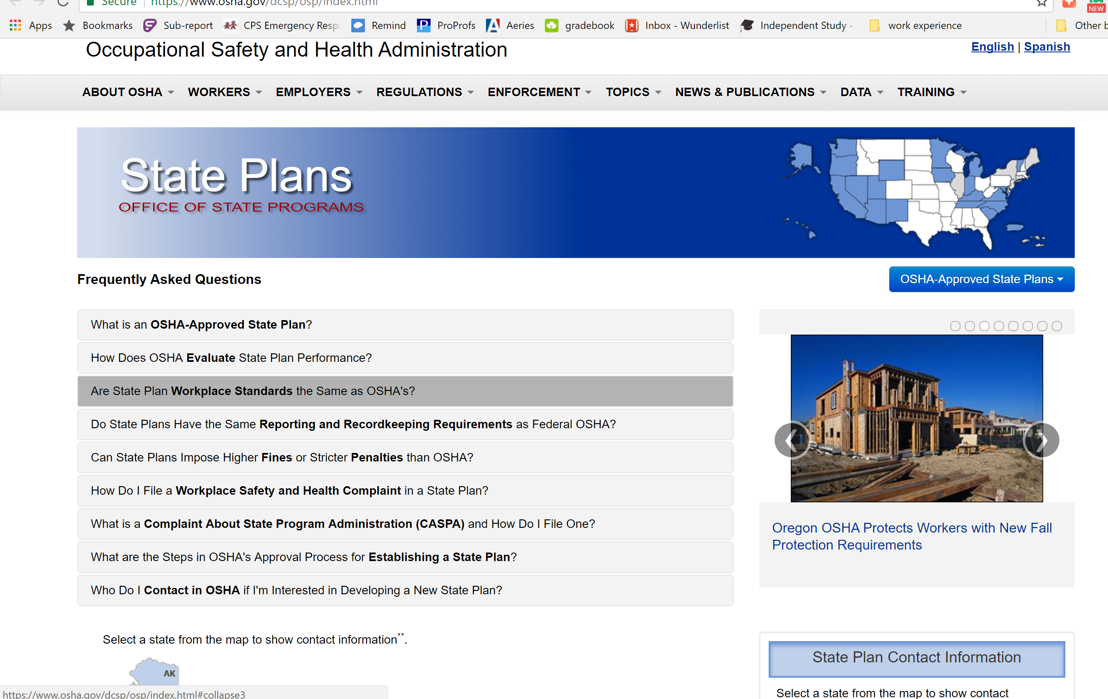
Find out more about the chemicals?
OSHA (Occupational Safety and Health Administration)

Slide 9
Find out more about the chemicals?
OSHA (Occupational Safety and Health Administration)
http://www.osha.gov/dcsp/osp/index.html

Slide 10
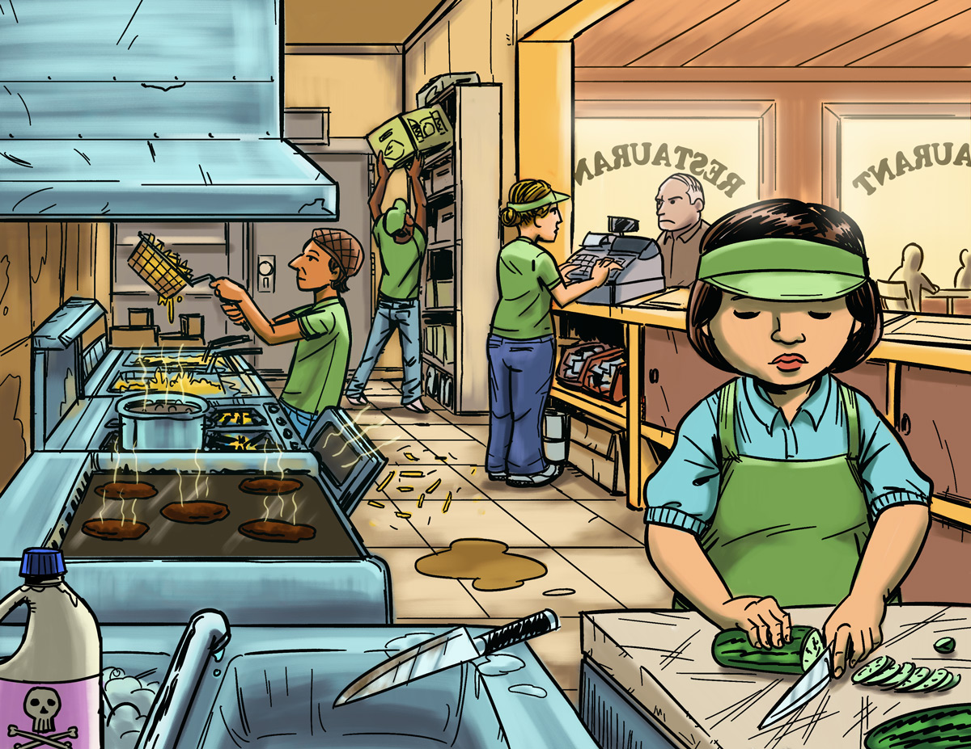
Find The Hazards: Fast Food Restaurant
a
Illustrated Workplaces

Slide 11
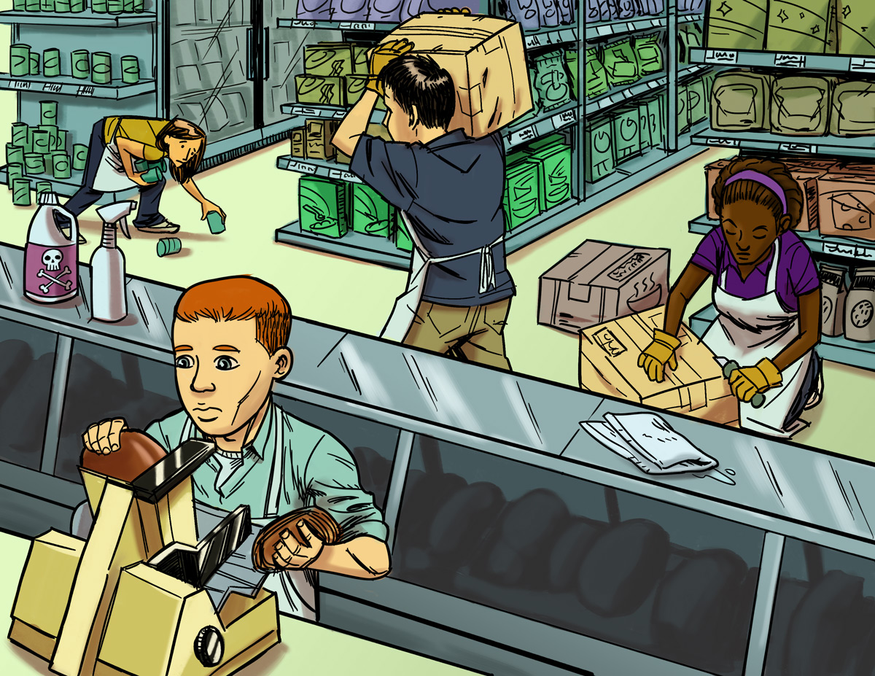
Find The Hazards: Grocery Store
a
Illustrated Workplaces

Slide 12
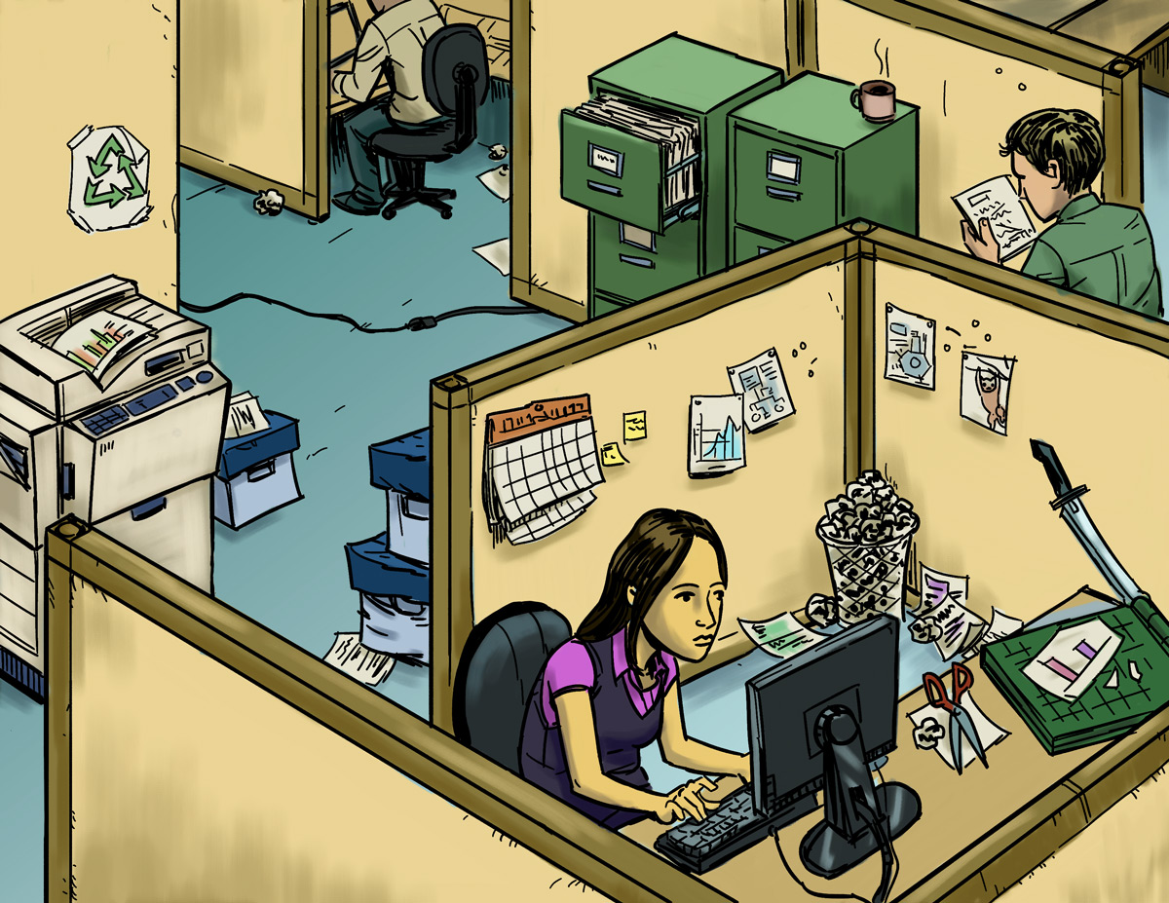
Find The Hazards: Office
a
Illustrated Workplaces

Slide 13
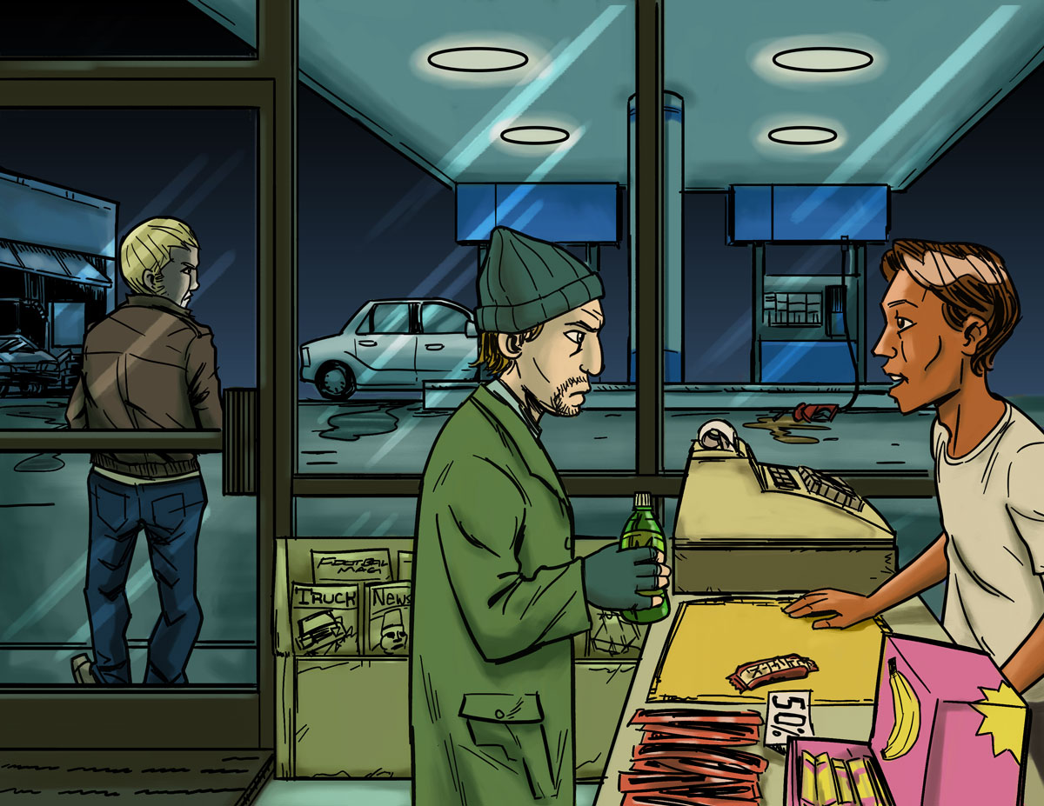
Find The Hazards: Gas Station
a
Illustrated Workplaces

Slide 14
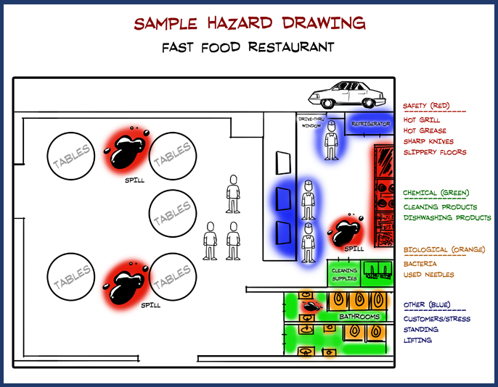
Hazard Mapping Activity

Slide 15
Finding Hazards: Main Points
All workplaces have hazards. A job hazard is anything at work that can hurt you, physically or mentally.
Some job hazards are obvious (easily seen), but others are not. Some hazards can hurt you now, while others may cause health problems in the future.
To be safe on the job, you must identify different types of hazards.
People have a right to know about chemicals and other hazardous substances in their workplaces! When using a new chemical, read labels and check the SDS (Safety Data Sheet).
An SDS tells you what is in a chemical product, how it can harm you, and how to protect yourself.

Slide 16
Making the Job Safer
Lesson 3 (and 3B)

Slide 17
Controlling Hazards
a
Remove
the Hazard
$2000
(for example, use safer
chemicals, use a machine guard)
Improve Work
Policies & Procedures
$1000
(for example, conduct training,
assign enough people to do the job)
Wear Personal Protective Equipment (PPE)
$500
(for example, wear gloves, use a respirator)

Slide 18
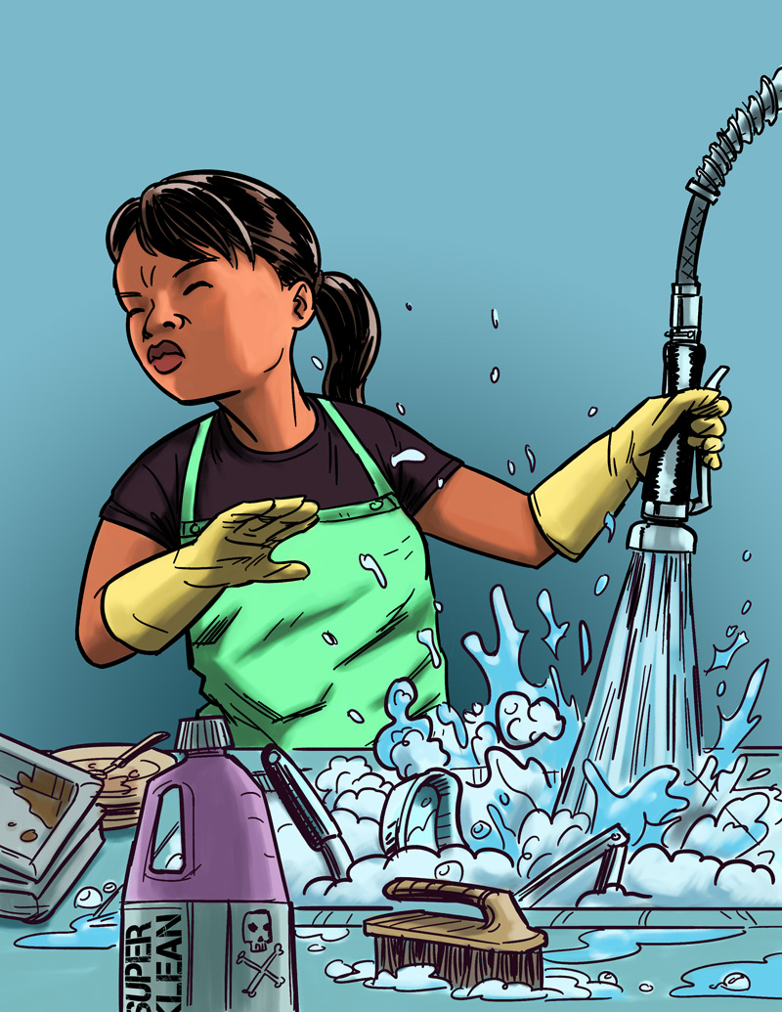
Eliminating or Reducing Hazards
Jasmin’s Story
Job: Hospital dishwasher
Hazard: Chemical dishwashing solution
Injury: Chemical burn to the eye
$25,000 Safety Pyramid Game

Slide 19
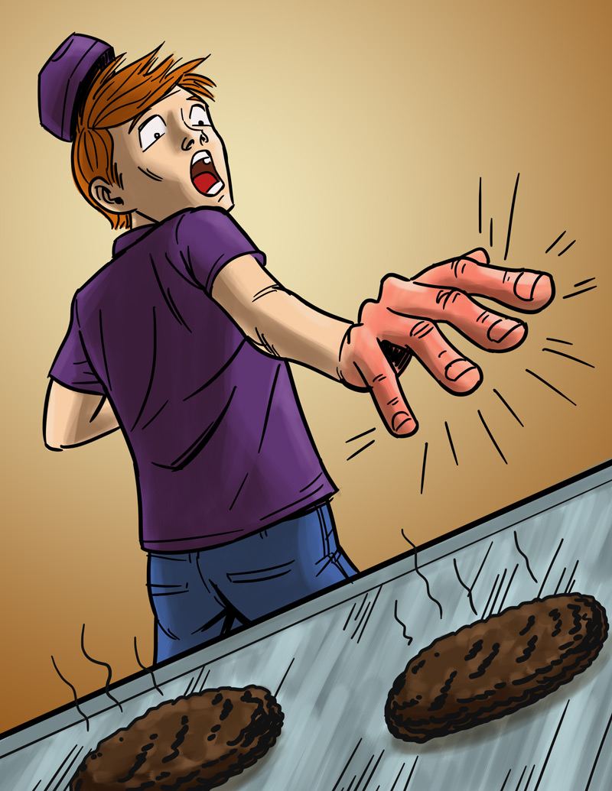
Eliminating or Reducing Hazards
Will’s Story
Job: Fast food worker
Hazard: Hot grill
Injury: Burned hand
$25,000 Safety Pyramid Game

Slide 20
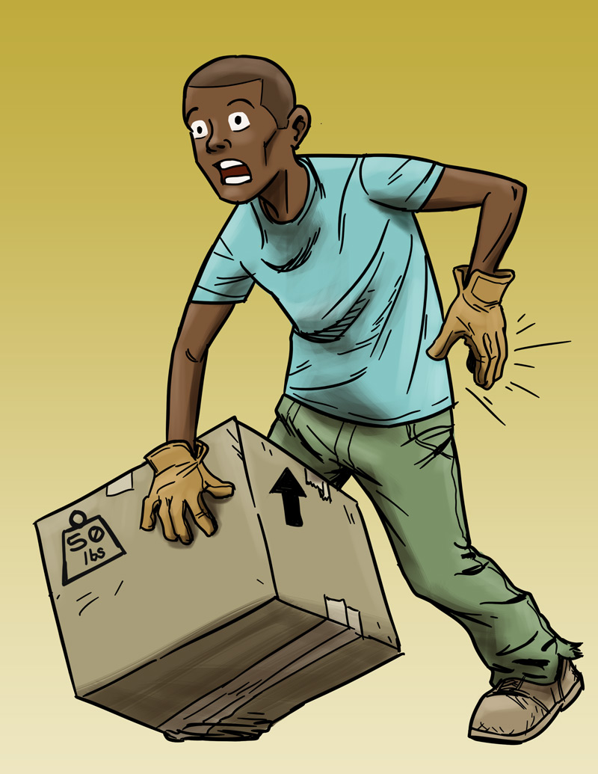
Eliminating or Reducing Hazards
Andre’s Story
Job: Grocery store clerk
Hazard: Lifting heavy boxes
Injury: Back strain
$25,000 Safety Pyramid Game

Slide 21
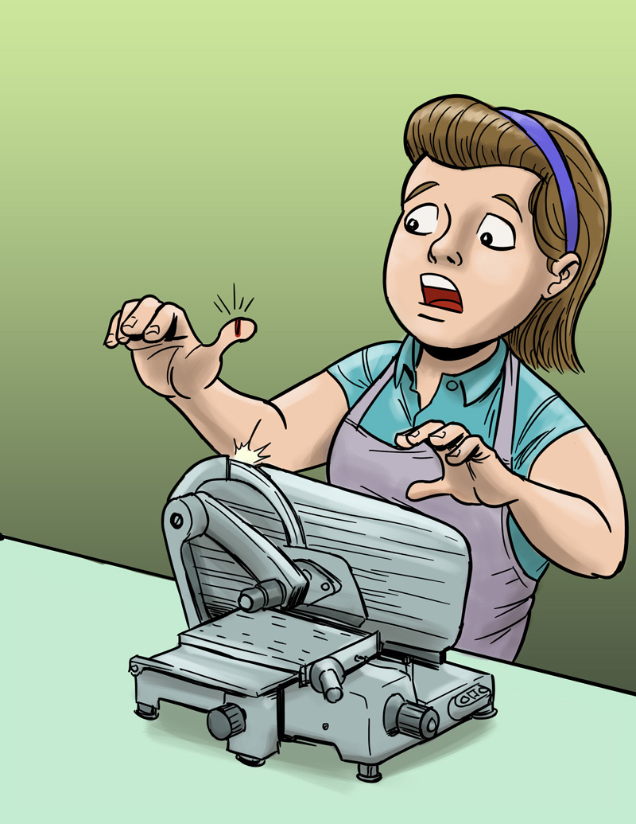
Eliminating or Reducing Hazards
Molly’s Story
Job: Grocery store deli clerk
Hazard: Meat slicer
Injury: Cut finger
$25,000 Safety Pyramid Game

Slide 22
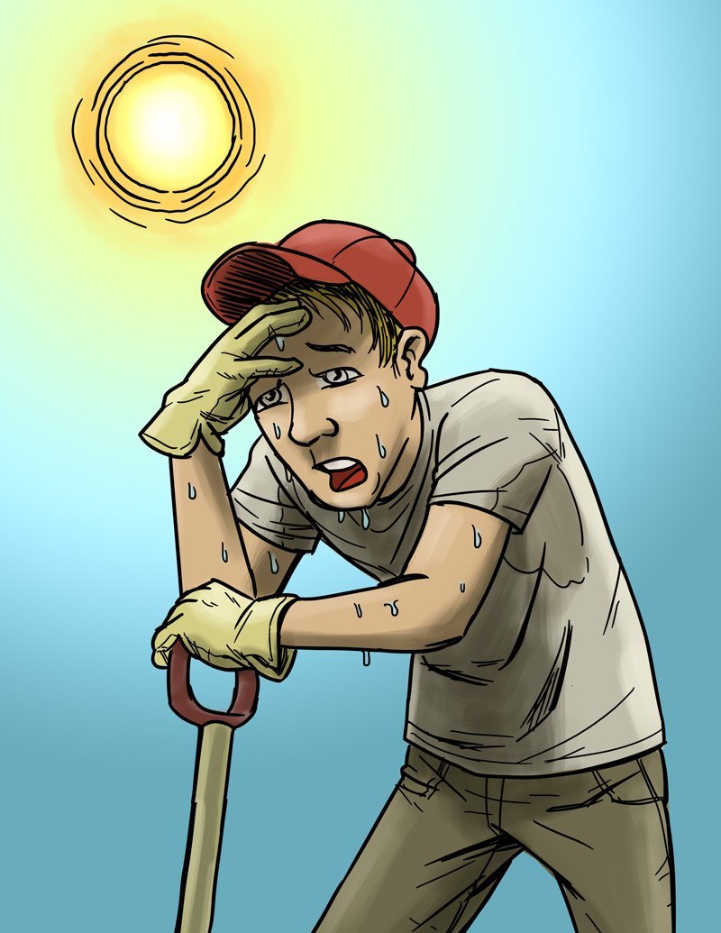
Eliminating or Reducing Hazards
Chris’s Story
Job: City public works employee
Hazard: Excessive heat
Injury: Heat stroke
$25,000 Safety Pyramid Game

Slide 23
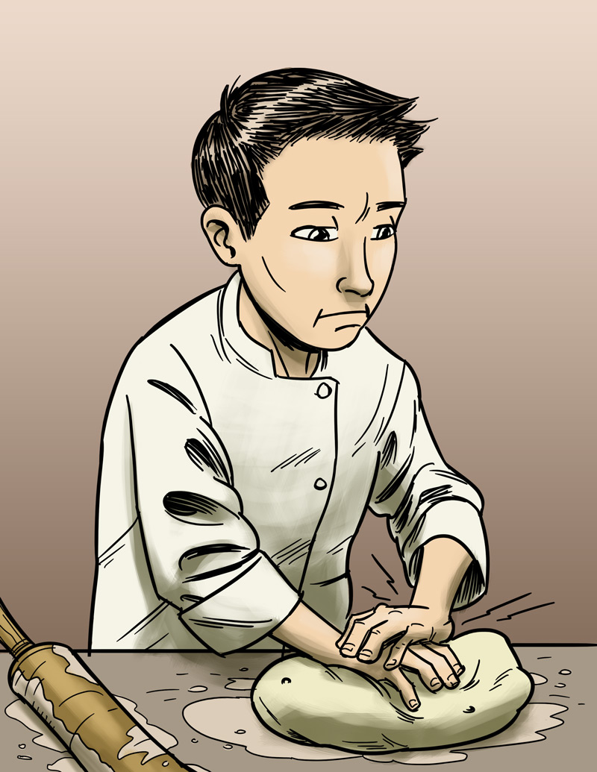
Eliminating or Reducing Hazards
James’s Story
Job: Pizza shop employee
Hazard: Repetitive motion
Injury: Hand, back injury
$25,000 Safety Pyramid Game

Slide 24
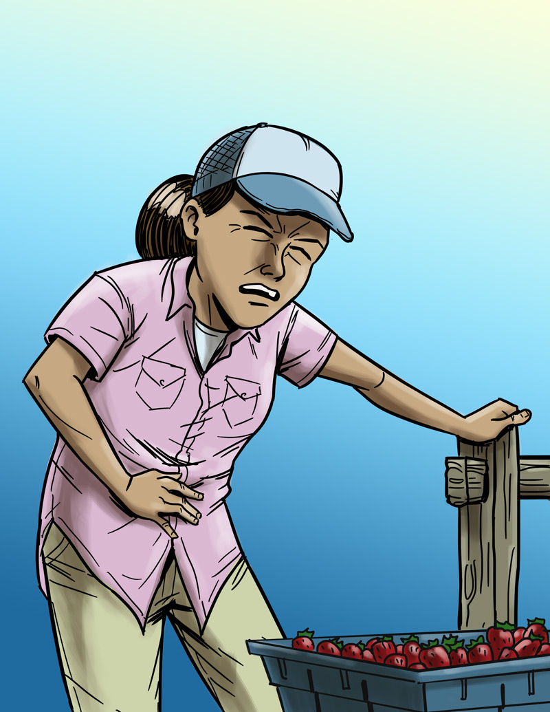
Eliminating or Reducing Hazards
Maria’s Story
Job: Farm worker
Hazard: Pesticide/chemical exposure
Injury: Illness due to poisoning
$25,000 Safety Pyramid Game

Slide 25
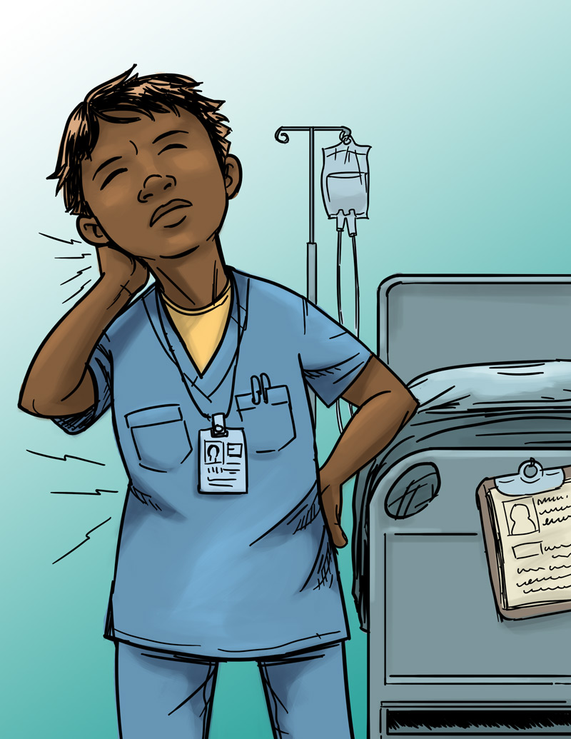
Eliminating or Reducing Hazards
Jada’s Story
Job: Nursing aide
Hazard: Heavy lifting
Injury: Back, neck, and shoulder pain
$25,000 Safety Pyramid Game

Slide 26
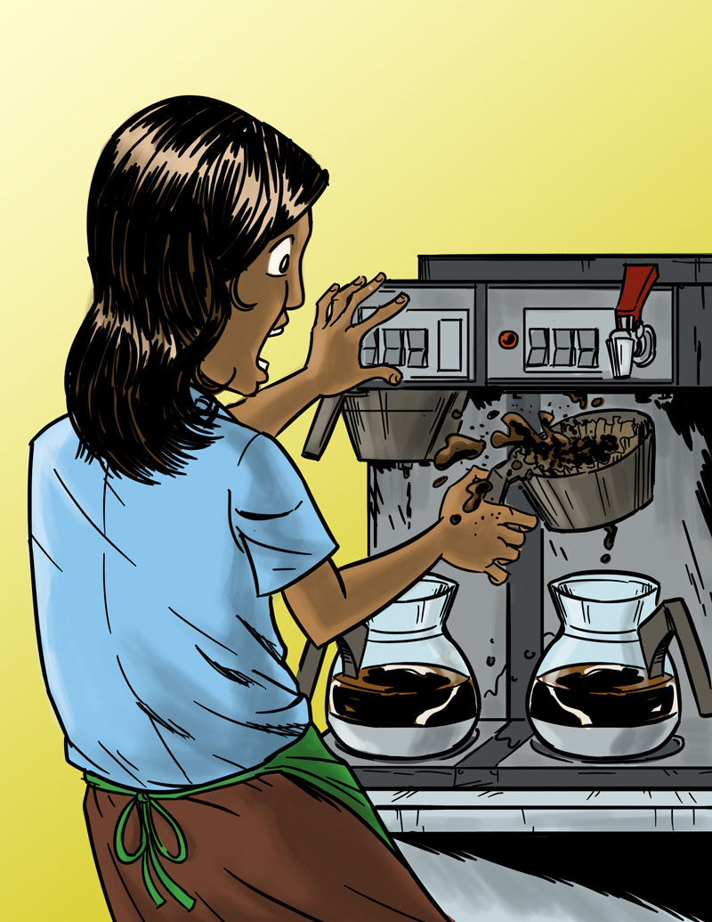
Eliminating or Reducing Hazards
Anita’s Story
Job: Barista
Hazard: Hot liquids
Injury: Burn
$25,000 Safety Pyramid Game

Slide 27
Making the Job Safer: Main Points
The best way to prevent a workplace injury or illness is to remove the hazard. If this can’t be done, then hazards can be controlled through work policies and procedures or the use of PPE (personal protective equipment), such as a respirator or hearing or eye protection.
Personal protective equipment is not usually the best way to protect workers because the hazard is still there, and because the equipment has to fit right and be used every time.
Most workplace injuries and illnesses are caused by unsafe environments—not human error.
A good way to think about addressing hazards in the workplace is, “Fix the workplace, not the worker.”

Slide 28
Emergencies at Work
Lesson 4 (and 4B)

Slide 29
Emergencies at Work
What is an emergency at work?
An unplanned event that harms or threatens employees, customers, or the public; that shuts down business operations; or that causes physical or environmental damage

Slide 30
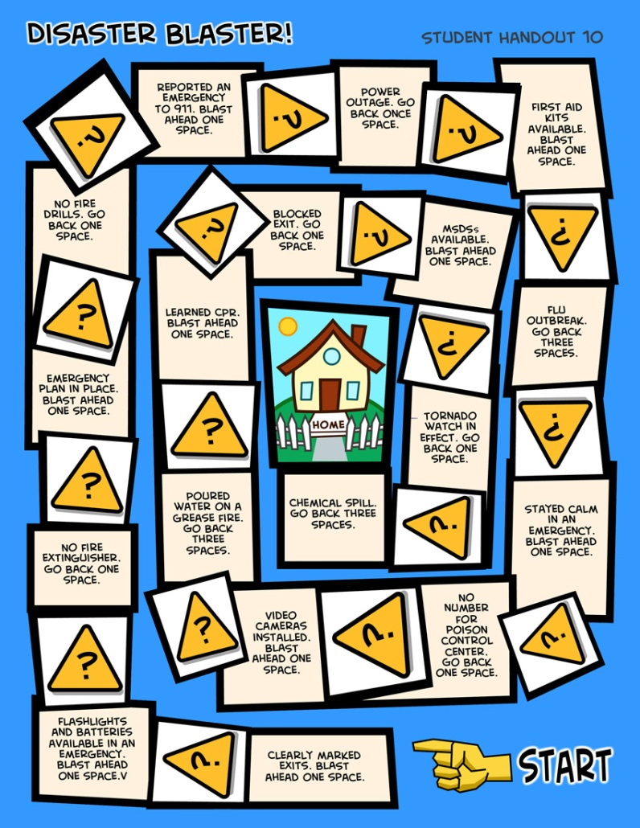
Emergencies at Work
Disaster Blaster! Game

Slide 31
Emergency Action Plans
Many workplaces need an emergency action plan. Workers should receive training on the plan.
The plan should include information about
Different emergencies and how to respond
Locations of meeting places
Evacuation routes
Emergency equipment and alert systems
Key personnel (who’s in charge)
Procedures to follow when someone is injured
Individual worker responsibilities
Practice drills

