Slide 1
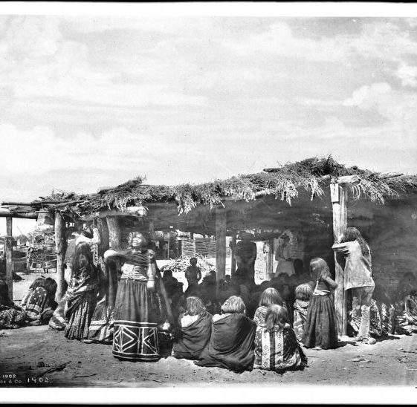
Mojave
By Colton
This Photo by Unknown author is licensed under CC BY-SA-NC.

Slide 2
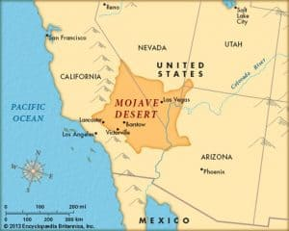
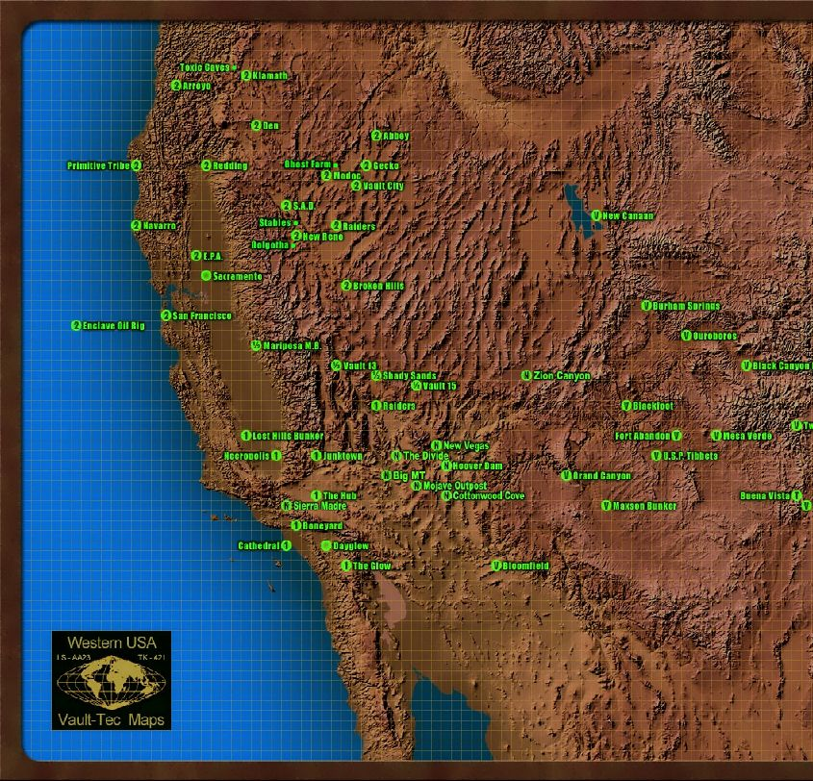
Location
The Mojave tribe lived in the desert part of California. The Mojave lived in southeastern California, along the Colorado river and they`re located on high ground. The climate in this area is hot, so they need little protection from the sun.
This Photo by Unknown author is licensed under CC BY-SA.
This Photo by Unknown author is licensed under CC BY-NC-ND.

Slide 3
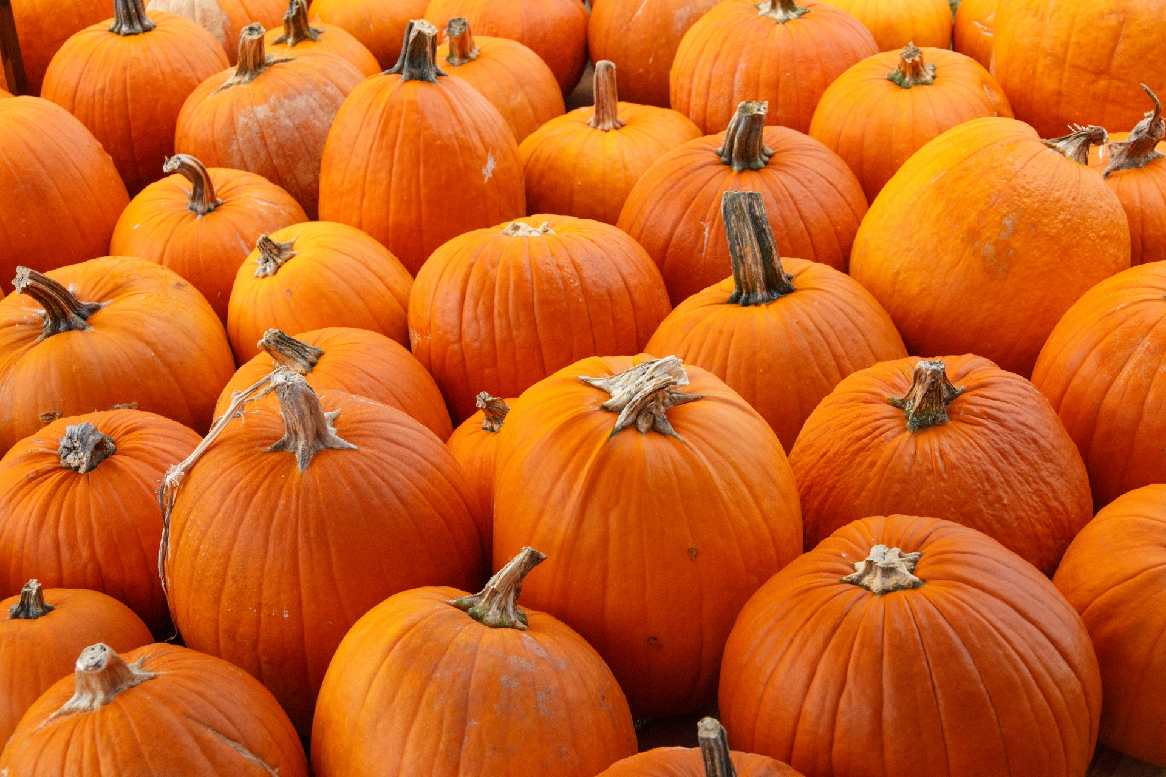
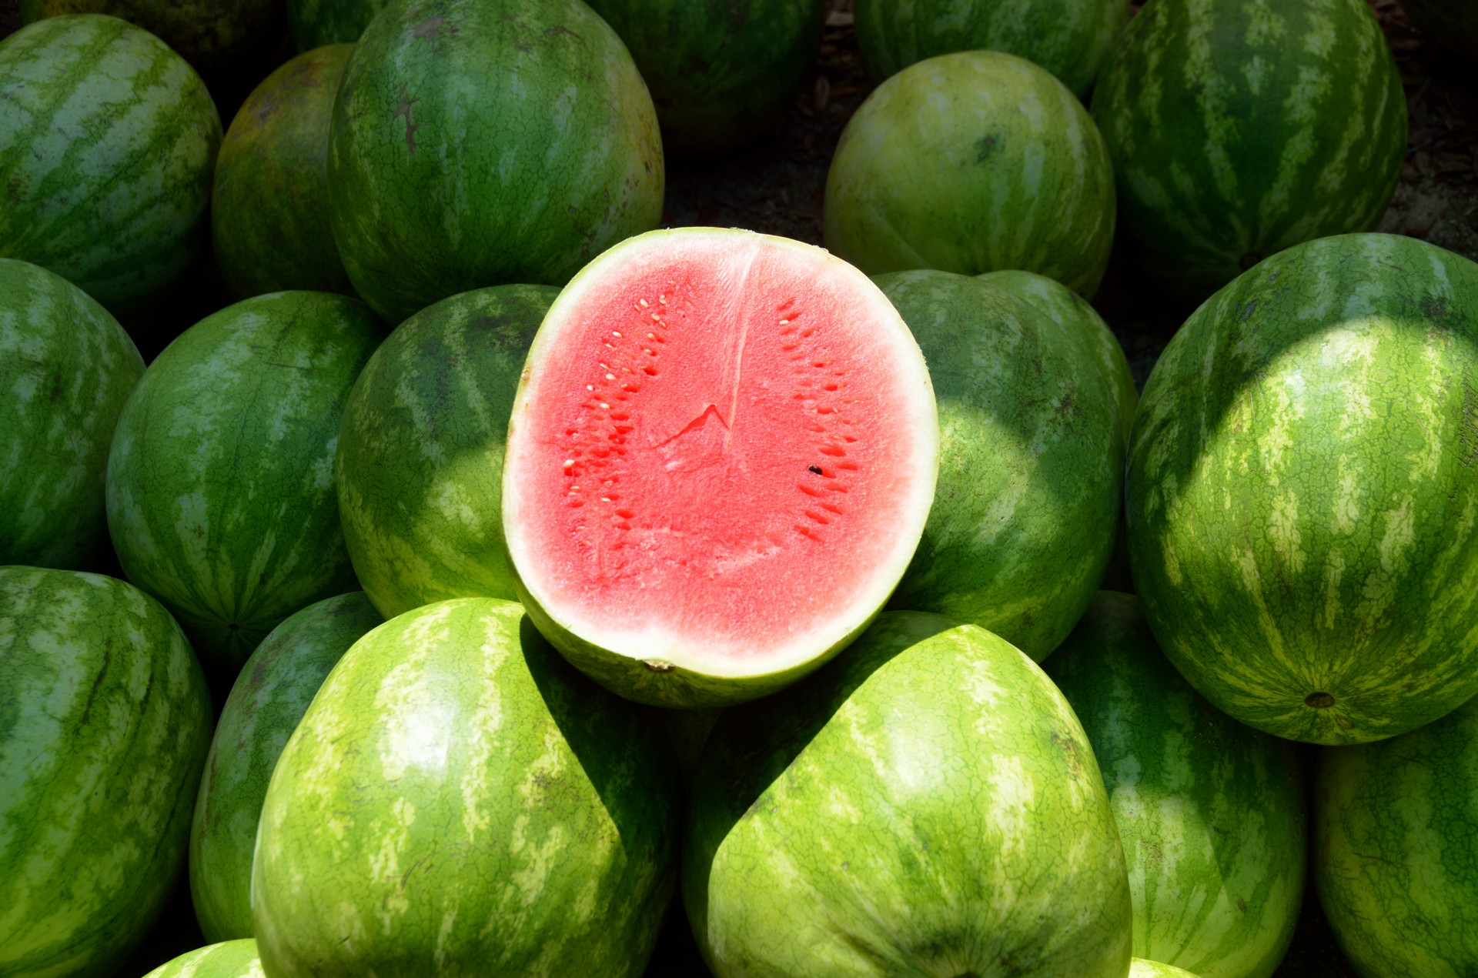
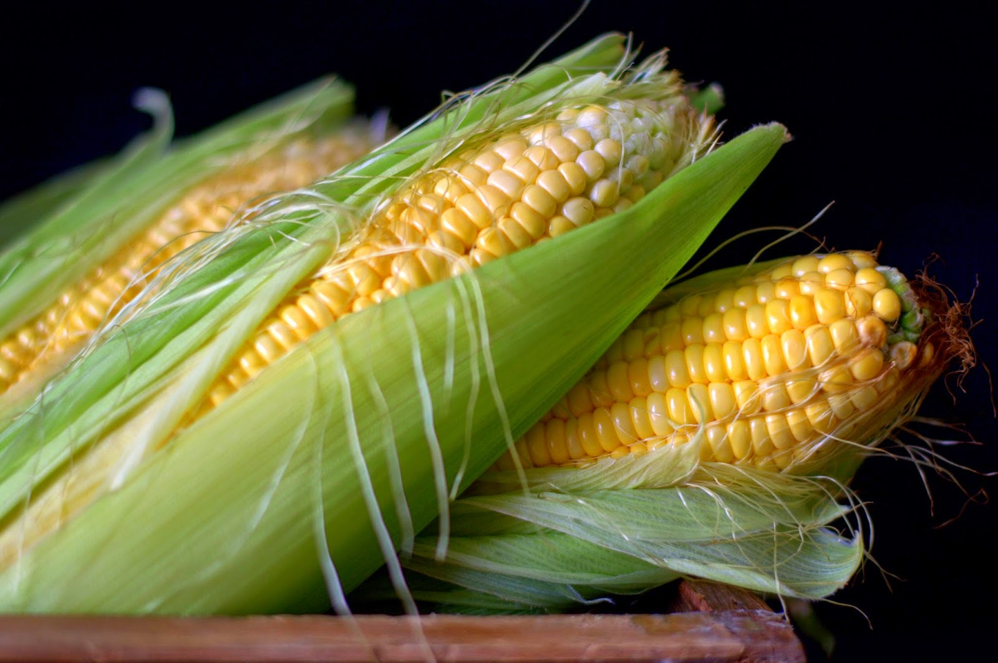
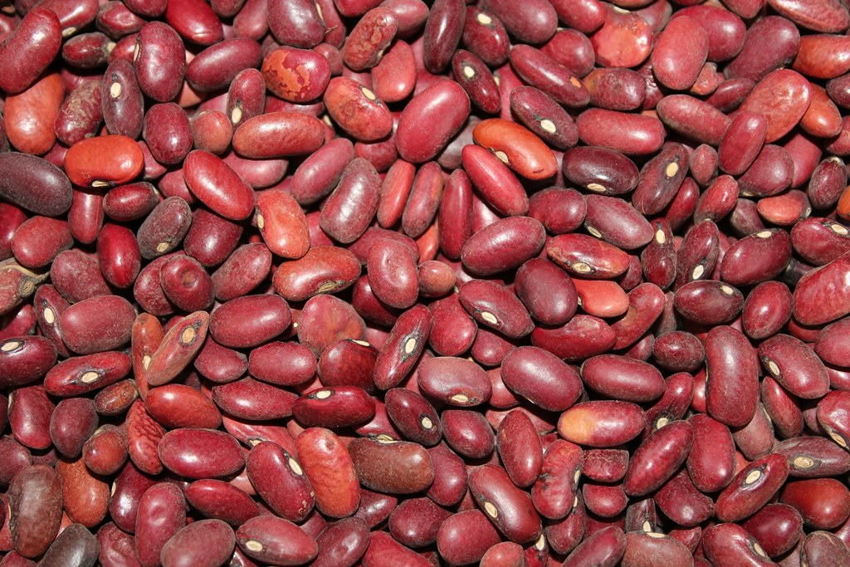
Food
The Mojave tribe used the land to find food in order to survive. The Mojave tribe were farmers and they grew corn, melons, beans and pumpkins. They also grew seeds of wild grasses.
This Photo by Unknown author is licensed under CC BY.
This Photo by Unknown author is licensed under CC BY-NC-ND.

Slide 4
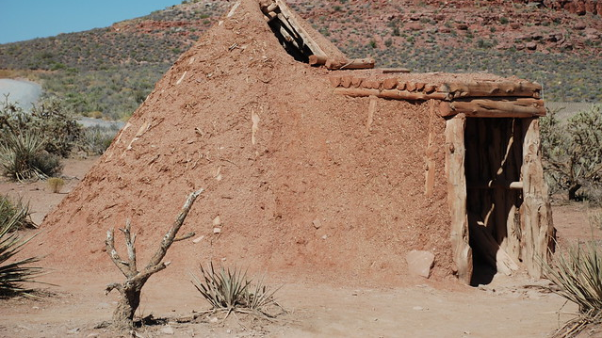
Shelter
The homes of the Mojave tribe protected them from the environment. The Mojave tribe built their homes with four poles supporting a flat roof and side walls made of wooden poles. They were called Ramadas.
This Photo by Unknown author is licensed under CC BY-SA-NC.

Slide 5
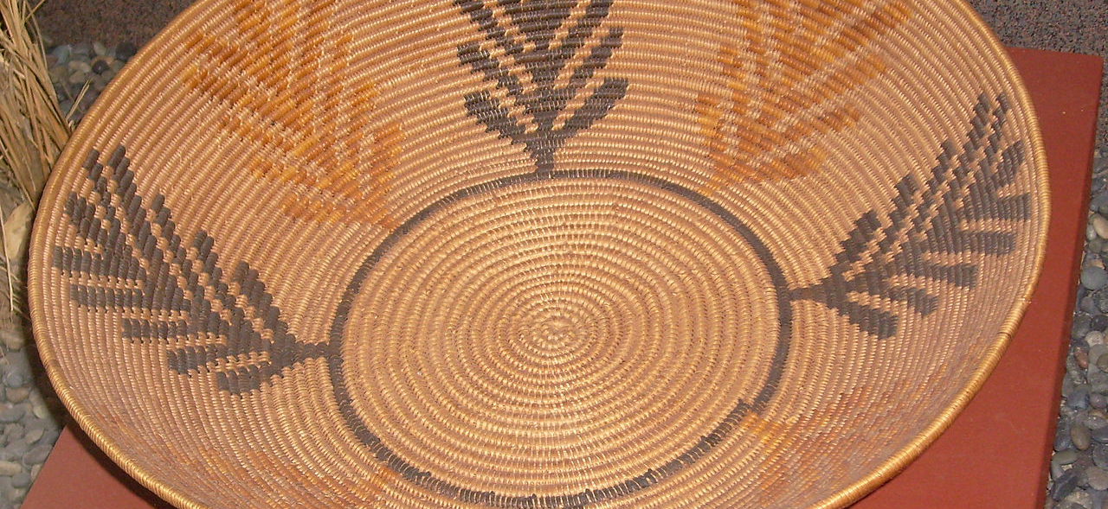
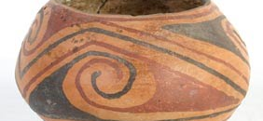
Culture
The culture of the Mojave tribe was unique and interesting. The Mojave women wove baskets for storing berries. The Mojave made clay pots for storing food and water. Each family brought food for the feasting on ceremonies.
This Photo by Unknown author is licensed under CC BY-ND.
This Photo by Unknown author is licensed under CC BY-SA-NC.

Slide 6
This Photo by Unknown author is licensed under CC BY-SA-NC.

