Slide 1
Presidential Roles
Ch 9 sec 2

Slide 2
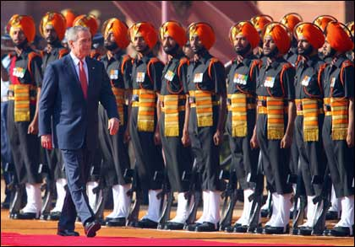
I. As Head of State
The president represents the nation at ceremonial functions. He is both the head of state and chief executive.
The president is considered more than a politician, but rather a symbol of the entire United States.

Slide 3
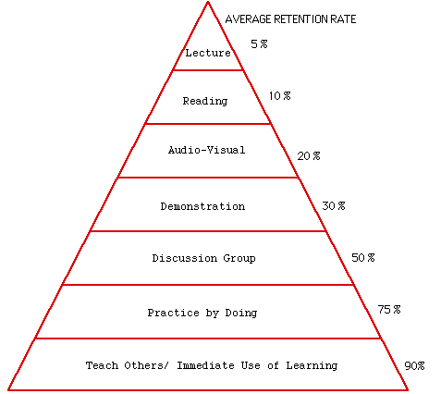
II. As Chief Executive
The president heads the 2 million person executive branch;
Influences how laws are executed through executive orders; presidential appointments, removal of appointed officials, and impoundment;
Grants pardons, reprieves, or amnesty.
Notes:
http://im.rediff.com/news/2006/mar/02nlook.jpg

Slide 4
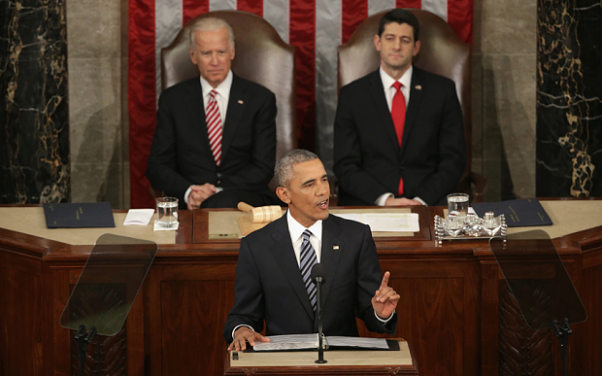
III. As Chief Legislator
The president proposes legislation to Congress, usually in the State of the Union Address;
Must work harder for congressional support when Congress is controlled by the opposition party;
Notes:
http://i.telegraph.co.uk/multimedia/archive/03547/barack-obama-state_3547919b.jpg

Slide 5
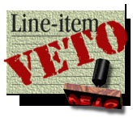
III. As Chief Legislator
May use political favors to gain congressional support;
Has the threat of the veto to influence Congress.
Notes:
http://www.cnn.com/ALLPOLITICS/1998/06/25/scotus.lineitem/line.item.veto.jpg

Slide 6
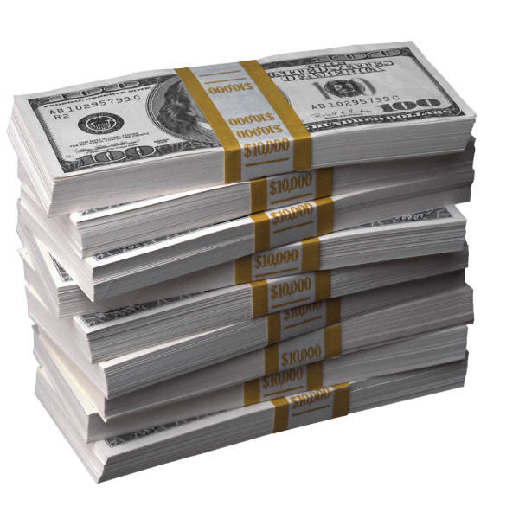
IV. As Economic Planner
The president has gained important economic powers since the New Deal;
Promotes high employment, production, and purchasing power;
Is required to prepare the federal budget every year.
Notes:
http://blogs.venturacountystar.com/vcs/dennert/archives/money.jpg

Slide 7
V. As Party Leader
The president helps raise party funds and plan campaign strategies;
Uses political patronage to appoint party members to government jobs.
Notes:
http://www.theage.com.au/ffximage/2006/11/17/party_narrowweb__300x328,0.jpg

Slide 8
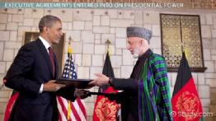
VI. As Chief Diplomat
The president directs foreign policy and oversees foreign affairs information agencies;
Has sole power to make treaties, with Senate approval;
May make, without congressional approval, executive agreements having the force of treaties with foreign nations;
Has the sole power to recognize foreign governments.
Notes:
http://study.com/cimages/videopreview/videopreview-small/executive-agreement-definition-examples_124478.jpg

Slide 9
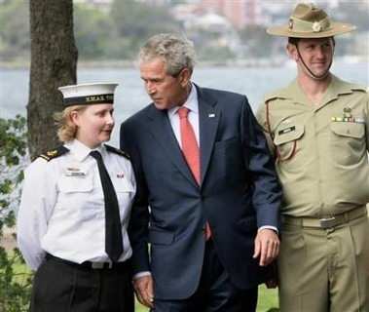
VII. As Commander In Chief
The president shares with Congress power to wage war.
Makes key military policy decisions.
Supports war efforts on the home front during wars.
May use the armed forces to end disorders or give aid in natural disasters.
Notes:
http://www.thewe.cc/thewei/_/images_3/us_terror_state/bush_military.jpe

Slide 10
Assignment
3 2 1 +1
Write three things you learned today
two things you want to learn more about
one thing you did not understand
one thing someone else learned that you did not write down

