Slide 1
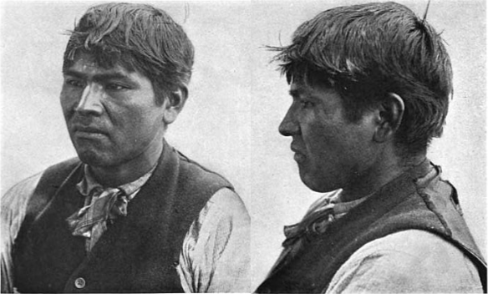
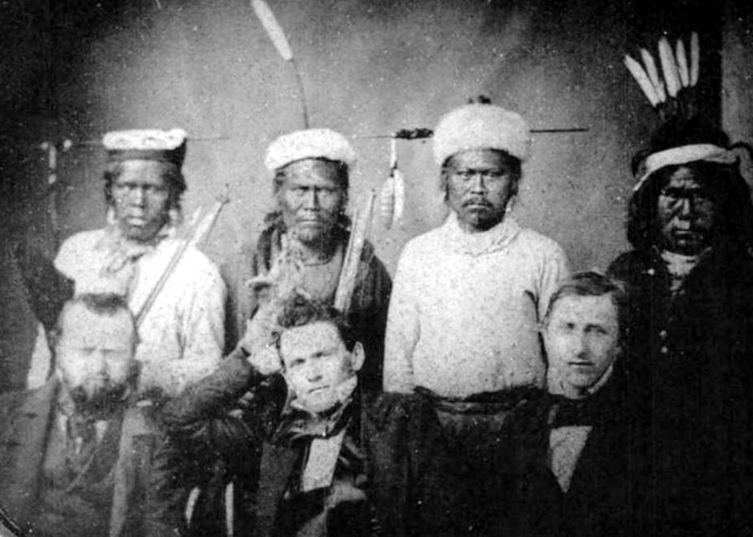
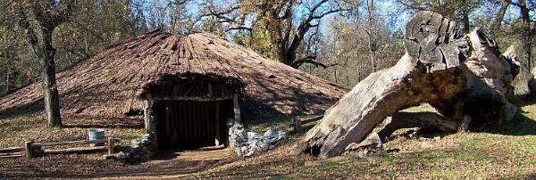
Maidu
By: Spencer Dives and Jeanine Rodriguez

Slide 2
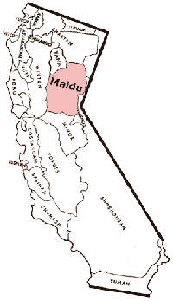
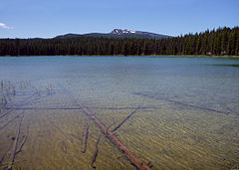
Location
The Maidus lived in the Central Valley part of California. The area occupied by the Maidu was a series of Mountain Valleys. The villages in each Valley were known to the people by the name of the Valley. Communities were made up of three to five villages.

Slide 3
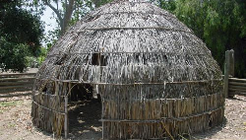
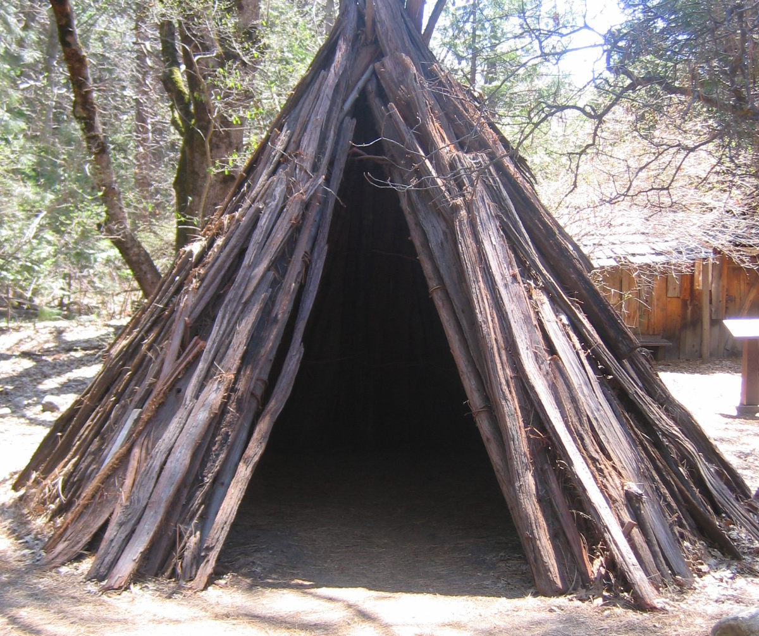
Shelter
The homes of the Maidu Tribe protected them from the environment. They lived in houses that were underground during winter. Homes were made from poles that formed the frame. The frame for the house was covered with bark, and then with packed earth. People made temporary shelter near where they hunted or gathering food.

Slide 4
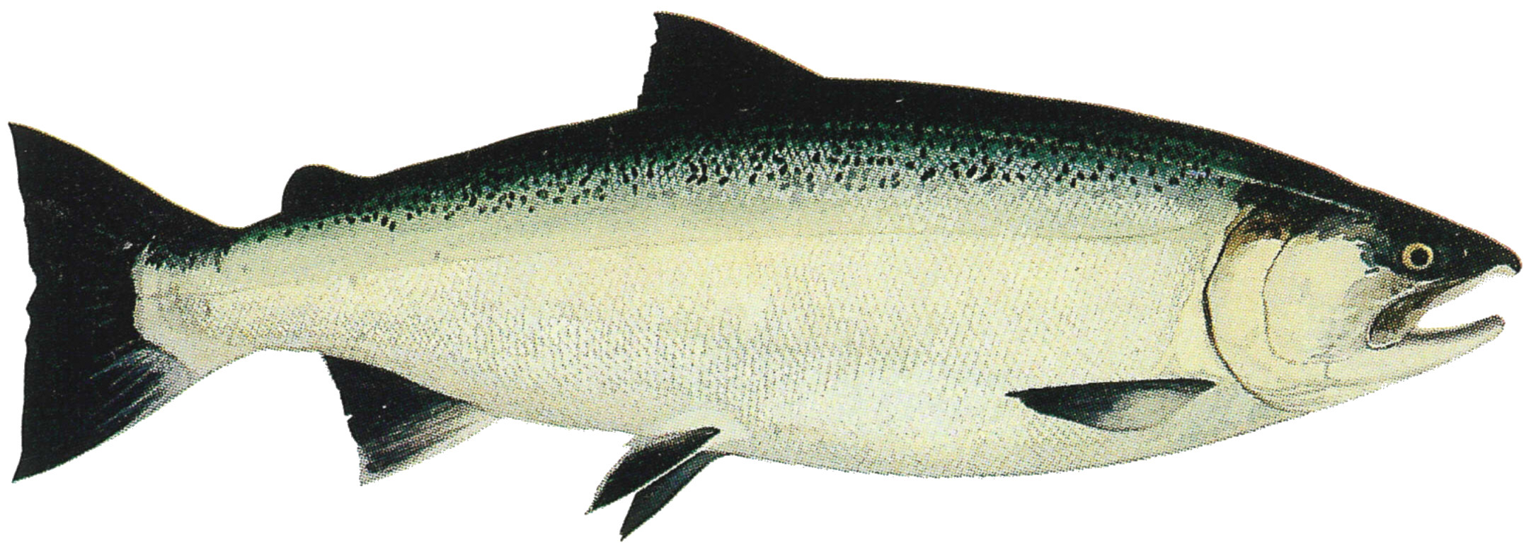
Food
The Maidu tribe used their land to find food in order to survive. They hunted deer ,elk, rabbets, birds, salmon, trout, and eels. Deer and elk were followed for days until the animals were tired and could be killed more easily. Squirrel and rabbits were shot with arrows or caught in nets.

Slide 5
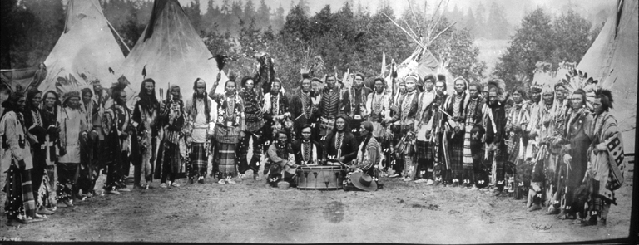
Culture
The Culture of the Maidu tribe was unique and interesting. They make blankets out of deerskin. They did not wear much clothing. The Moccasins were made of deerskin, with a seam sewn up the front. The Maidu wore their hair loose. Some men wore a net cap and women wore a basket cap made of Tules.

Slide 6
