Slide 1
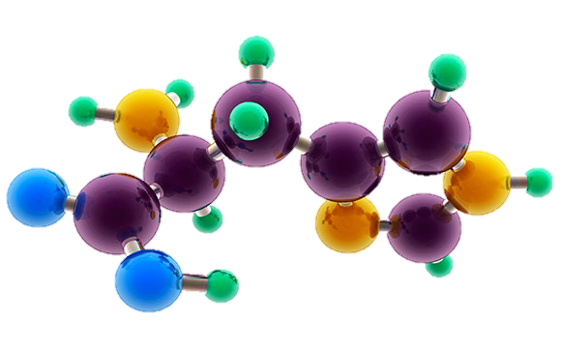
AP Chemistry Exam Review

Slide 2
Big Idea #3
Chemical Reactions

Slide 3
Changes in matter involve the rearrangement and/or reorganizations of atoms and/or the transfer of electrons.

Slide 4
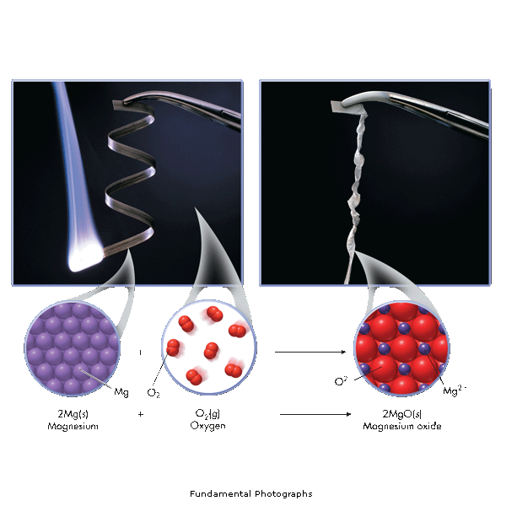
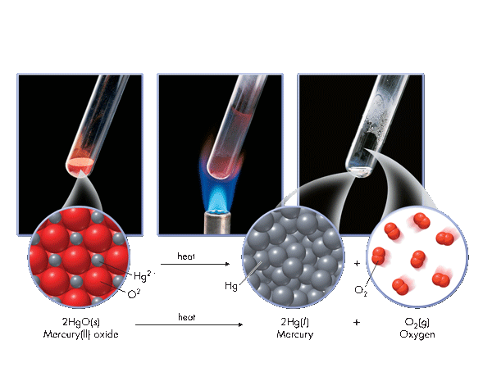
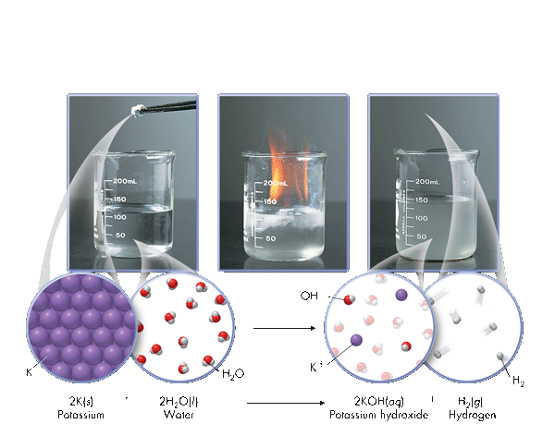
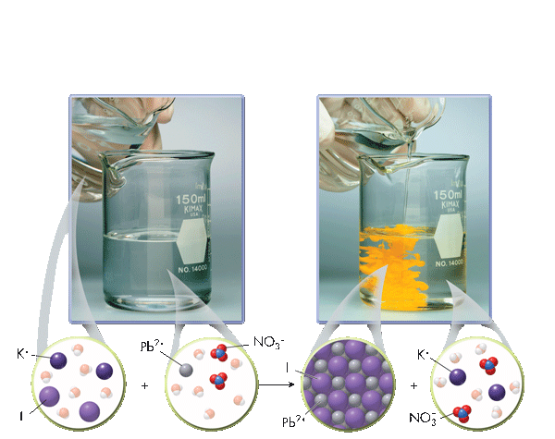
Types of Chemical Reactions
Source
Synthesis
A + B → AB
Decomposition
AB → A + B
Video
Single Displacement
A + BC → AC + B
Double Displacement
AB + CD→ AD + CB
Images from: Wilbraham, Antony C. Pearson Chemistry. Boston, MA: Pearson, 2012. Print.
LO 3.1: Students can translate among macroscopic observations of change, chemical equations, and particle views.

Slide 5
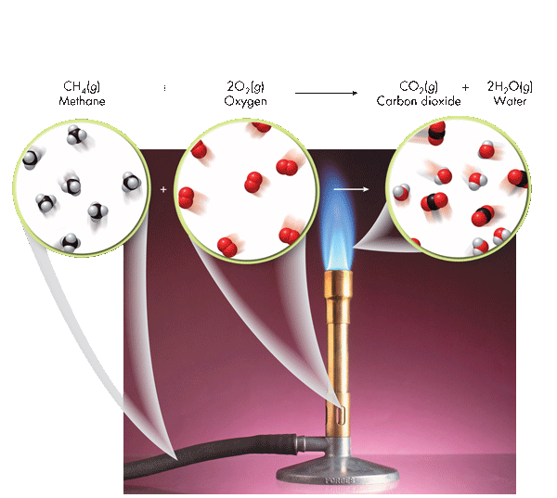
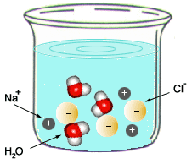
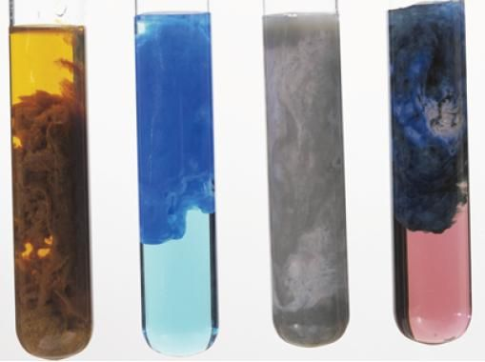
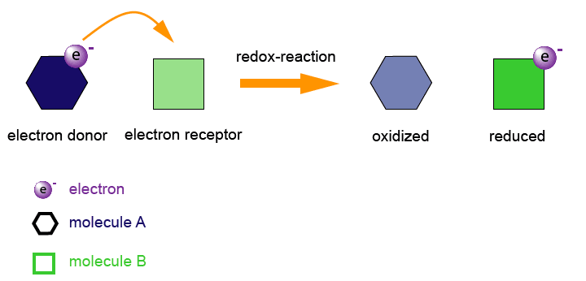
Types of Chemical Reactions
Source
Combustion
C_{x}H_{x} + O₂ → CO₂ + H₂O
Acid-Base (Neutralization)
HA + BOH → H₂O + BA
Video
C. Pearson Chemistry. Boston, MA: Pearson, 2012. Print.
Oxidation-Reduction
A ⁺ + e⁻ → A
B → B + e⁻
Precipitation
AB (aq) + CD (aq)→ AD (aq) + CB (s)
LO 3.1: Students can translate among macroscopic observations of change, chemical equations, and particle views.

Slide 6
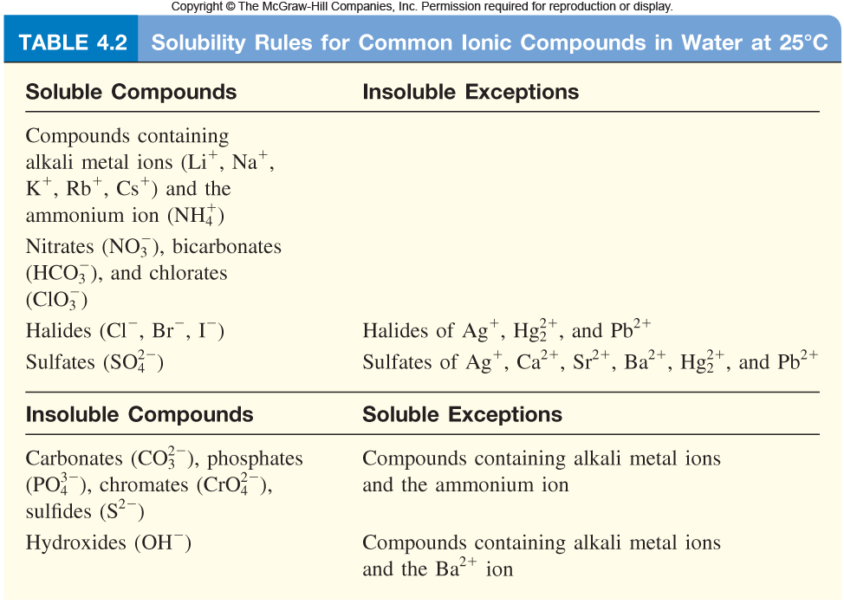
Balanced Equations
Source
Complete Molecular: | AgNO₃ (aq) + KCl (aq) ⎯→ AgCl (s) + KNO₃ (aq)
Complete Ionic : | Ag⁺(aq) + NO₃⁻(aq) + K⁺(aq) + Cl⁻(aq) ⎯→ AgCl (s) + K⁺(aq) + NO₃⁻(aq)
Net Ionic : | Ag⁺(aq) + Cl⁻(aq) ⎯→ AgCl (s)
Video
Quizlet
Spectator ions should not be included in your balanced equations.
Remember, the point of a Net Ionic Reaction is to show only those ions that are involved in the reaction. Chemists are able to substitute reactants containing the same species to create the intended product.
You only need to memorize that compounds with nitrate, ammonium, halides and alkali metals are soluble.
LO 3.2: The student can translate an observed chemical change into a balanced chemical equation and justify the choice of equation type (molecular, ionic, or net ionic) in terms of utility for the given circumstances.

Slide 7
Making Predictions
Source
Solid copper carbonate is heated strongly:
CuCO₃ (s) → CuO (s) + CO₂ (g)
What evidence of a chemical change would be observed with this reaction?
One would observe a color change and evolution of a gas
What is the percent yield of CO₂ if you had originally heated 10.0g CuCO₃ and captured 3.2g CO₂ ?
Step 1: Find the Theoretical Yeild
10.0g CuCO₃ x(1mol/123.555g) x (1mol CO₂ /1 molCuCO₃ ) X 44.01gCO₂/mol = 3.562 gCO₂
Step 2: Find Percent Yield
(3.2 g / 3.562 g) * 100 = 89.8 % → 90% with correct sig figs
How could you improve your percent yield?
-reheat the solid, to see if there is any further mass loss
-make sure you have pure CuCO₃
Click reveals answer and explanation.
Video
Click reveals answer and explanation.
Click reveals answer and explanation.
Click reveals answer and explanation.
LO 3.3: The student is able to use stoichiometric calculations to predict the results of performing a reaction in the laboratory and/or to analyze deviations from the expected results.

Slide 8
Limiting Reactants – D.A.
Source
Al₂S₃ + 6 H₂O ---> 2Al(OH)₃ + 3 H₂S
15.00 g aluminum sulfide and 10.00 g water react
Identify the Limiting Reactant
Video
Sim
pHet
Click reveals answer and explanation.
15.00g Al₂S₃ x (1mol/ 150.158 g) x (6mol H₂O/1mol Al₂S₃) x (18g/mol H₂0 ) = 10.782 g H₂0 needed
10g H₂0 x (1mol/ 18.015 g) x (1 mol Al₂S₃ / 6mol H₂O) x (150.158 g/mol) = 13.892g Al₂S₃ needed
H₂0 is limiting, because we need more than we were given
b) What is the maximum mass of H₂S which can be formed from these reagents?
Theoretical Yield
10.00 g H₂0 x (1mol/ 18.015 g) x (3/6) x (34.0809 g/mol ) = 9.459 g H₂S produced
Click reveals answer and explanation.
c) How much excess reactant is left in the container?
Click reveals answer and explanation.
15.00 g – 13.892 g = 1.11g Al₂S₃
**Dimensional Analysis is not the only way to solve these problems. You can also use BCA tables (modified ICE charts), which may save time on the exam →
LO 3.4: The student is able to relate quantities (measured mass of substances, volumes of solutions, or volumes and pressures of gases) to identify stoichiometric relationships for a reaction, including situations involving limiting reactants and situations in which the reaction has not gone to completion.

Slide 9
Limiting Reactants – BCA Table
Source
15.00 g aluminum sulfide and 10.00 g water react according to the following equation:
Al₂S₃ + 6 H₂O ---> 2Al(OH)₃ + 3 H₂S
Identify the Limiting Reactant
Video
Click reveals answer and explanation.
15.00g Al₂S₃ x (1mol/ 150.158 g) = .100mol
10g H₂0 x (1mol/ 18.015 g) = .555
Water is the limiting reactant.
 | Al₂S₃ | 6 H₂O | 2Al(OH)₃ | 3 H₂S
Before | .0999 | .5551 | 0 | 0
Change | -.0925 | -.5551 | + .1850 | + .2775
After | .0074 | 0 | .1850 | .2775
Complete the table using the molar relationships
b) What is the maximum mass of H₂S which can be formed from these reagents?
0.2775 mol H₂S x (34.0809 g/mol ) = 9.459 g H₂S produced
Click reveals answer and explanation.
c) How much excess reactant is left in the container?
Click reveals answer and explanation.
.0074mol Al₂S₃ x 150.158 g/mol = 1.11g Al₂S₃
LO 3.4: The student is able to relate quantities (measured mass of substances, volumes of solutions, or volumes and pressures of gases) to identify stoichiometric relationships for a reaction, including situations involving limiting reactants and situations in which the reaction has not gone to completion.

Slide 10
Experimental Design
Source
Synthesis
A sample of pure Cu is heated in excess pure oxygen. Design an experiment to determine quantitatively whether the product is CuO or Cu₂O.
Find the mass of the copper. Heat in oxygen to a constant new mass. Subtract to find the mass of oxygen that combined with the copper. Compare the moles of oxygen atoms to the moles of original copper atoms to determine the formula.
Video
Click reveals basic steps
Decomposition CaCO₃(s) → CaO(s) + CO₂(g)
Design a plan to prove experimentally that this reaction illustrates conservation of mass.
Find the mass of calcium carbonate and seal it in a rigid container. Evacuate the container of remaining gas. Heat the container and take pressure readings (this will be the pressure exerted by the CO₂). Using PV=nRT, calculate the moles of carbon dioxide gas present in the container and compare it to the molar relationships afforded by the balanced chemical equation.
Click reveals basic steps
LO3.5: The student is able to design a plan in order to collect data on the synthesis or decomposition of a compound to confirm the conservation of matter and the law of definite proportions.

Slide 11
Data Analysis
Source
When tin is treated with concentrated nitric acid, and the resulting mixture is strongly heated, the only
remaining product is an oxide of tin. A student wishes to find out whether it is SnO or SnO2. Mass of pure tin 5.200 grams.
Mass of dry crucible 18.650 g
Mass of crucible + oxide after first heating 25.500 g
Mass after second heating 25. 253 g
Mass after third heating 25. 252 g
How can you use this data, and the law of conservation of mass, to determine the formula of the product?
Video
1) Determine the number of moles of tin. 5.200/118.7 = 0.0438 moles. Sn
2) Subtract the mass of the crucible from the mass after the third heating. 25.252-18.650 = 6.602 g SnO_{x}
3) Subtract the mass of tin from the mass of oxide to get the mass of oxygen. 6.602-5.200 = 1.402 grams of oxygen.
4) Calculate the moles of oxygen atoms, and divide by the moles of tin atoms to get the formula ratio.
1.402 g/16.00 g/mol of atoms = 0.0876 moles. 0.0876/0.0438 = 2.00
The formula must be SnO₂.
Click reveals answer and explanation.
LO 3.6: The student is able to use data from synthesis or decomposition of a compound to confirm the conservation of matter and the law of definite proportions.

Slide 12
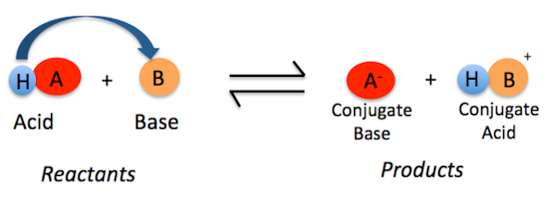
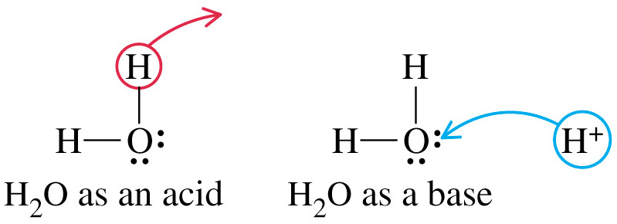
Bronsted-Lowery Acids & Bases
Source
According to Bronsted-Lowery (B.L.) an acid is a "proton donor" and a base is a "proton acceptor.“ The proton here is shown as a hydrogen.
The acid’s conjugate base is the anion.
The base’s conjugate acid now has the proton (hydrogen ion).
Video
Quizlet
Amphoteric nature of water
Water acts as both an acid & a base.
H₂O ←→ H⁺ + OH⁻
2H₂O ←→ H₃O⁺ + OH⁻
LO 3.7: The student is able to identify compounds as Bronsted-Lowry acids, bases and/or conjugate acid-base pairs, using proton-transfer reactions to justify the identification.

Slide 13
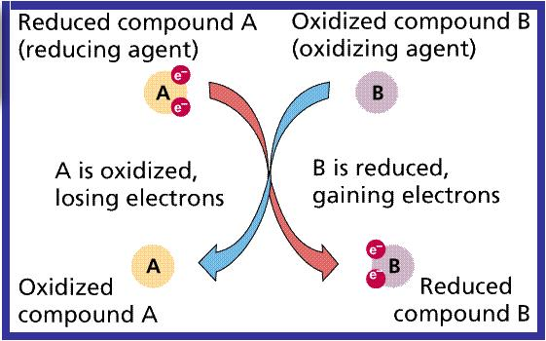
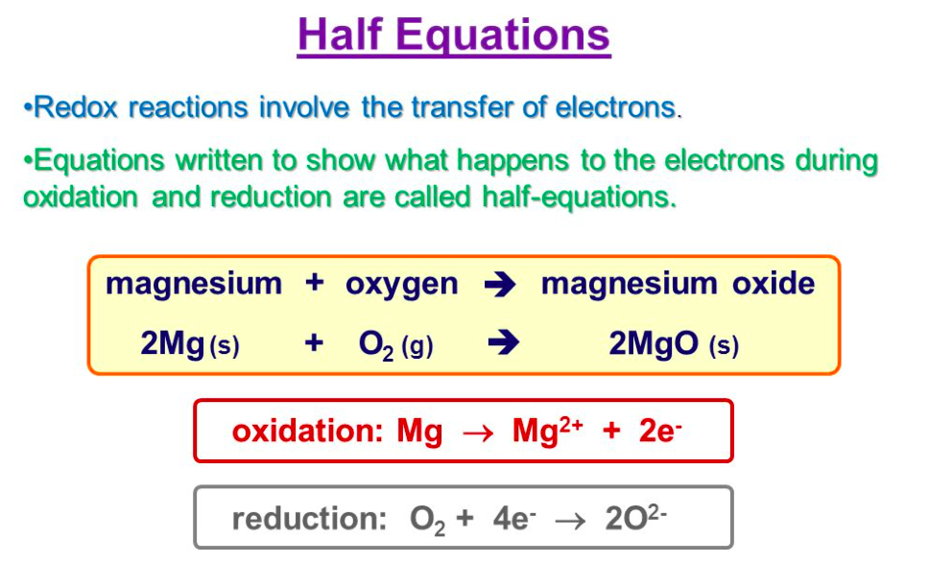
Redox Reactions
Source
When an electron is transferred, it is called a redox reaction. When something is reduced, the RED part of redox, it gains electrons. You may have a difficult time with this definition because when something is reduced, it usually means that it is losing something. In this case, it is a reduction in charge. Remember, electrons are negatively charged so if something is being reduced, it's getting more negatively charged by receiving more electrons. The other reaction that is coupled with this is called oxidation--the "OX" part of redox. Whenever something is reduced, the electron it gains has to come from somewhere. The oxidation is the loss of an electron, so if an atom is oxidized it loses its electron to another atom. And these are always coupled reactions. If one molecule is oxidized, another molecule must be reduced and vice versa: the electron must go somewhere.
Video
OILRIG
LO 3.8: The student is able to identify redox reactions and justify the identification in terms of electron transfer

Slide 14
Redox Titrations
Source
A redox titration (also called an
oxidation-reduction titration) can accurately determine the concentration of an unknown analyte by measuring it against a standardized titrant. A common example is the redox titration of a standardized solution of potassium permanganate (KMnO₄) against an analyte containing an unknown concentration of iron (II) ions (Fe²⁺). The balanced reaction in acidic solution is as follows:
MnO₄⁻ + 5Fe²⁺ + 8H⁺ → 5Fe³⁺ + Mn²⁺ + 4H₂O
In this case, the use of KMnO₄ as a titrant is particularly useful, because it can act as its own indicator; this is due to the fact that the KMnO₄ solution is bright purple, while the Fe²⁺ solution is colorless. It is therefore possible to see when the titration has reached its endpoint, because the solution will remain slightly purple from the unreacted KMnO₄
Video
LO 3.9: The student is able to design and/or interpret the results of an experiment involving a redox titration

Slide 15
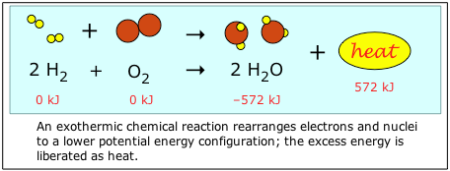
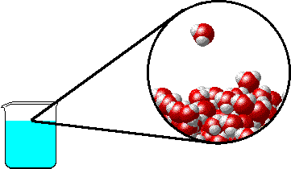
Evidence of Chemical Change
Source
Note: it is a common misconception that boiling water makes O₂ and H₂ gas. Notice that the water molecule stays intact as the water boils. Covalent bonds are not broken with this physical change- only intermolecular attractions (hydrogen bonds) between water molecules.
Video
Video
Video
Chemical Changes:
Production of a gas:
2KClO₃ _{(s)} + heat → 2KCl _{(s)} + 3O_{2 (g)}
Formation of a precipitate:
AgNO₃) _{(aq)} + KCl _{(aq)} → AgCl _{(s)}+ 2KNO_{3 (aq)}
Change in color:
Two white solids react to produce a mixture of a yellow and a white solid when shaken forcefully!
Pb(NO₃)_{2 (s)} + 2KI _{(s)} → PbI₂ _{(s)}+ 2KNO_{3 (s)}
Production of heat*:
2 Mg _{(s)} + O_{2 (s)} → 2MgO _{(s)} + heat
*can also include the absorption of heat
Physical Changes:
may produce similar visible evidence (i.e. boiling water creates “bubbles,” but bonds are not broken and reformed. No new substances are made.
LO 3.10: Evaluate the classification of a process as a physical, chemical, or ambiguous change based on both macroscopic observations and the distinction between rearrangement of covalent interactions and noncovalent interactions.

Slide 16
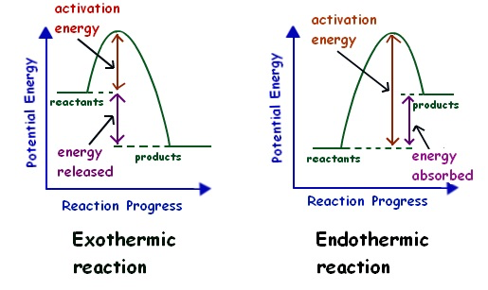
Energy Changes
Source
Chemical reactions involve the formation of new products
Bonds between atoms or ions in the reactants must be BROKEN (the enthalpy of the system is increasing … ENDOTHERMIC process)
Bonds are then FORMED between atoms or ions to make the producsts of the reaction. (the enthalpy of hte system is decreasing...EXOTHERMIC process)
Video
Video
LO 3.11: The student is able to interpret observations regarding macroscopic energy changes associated with a reaction or process to generate a relevant symbolic and/or graphical representation of the energy changes.

Slide 17
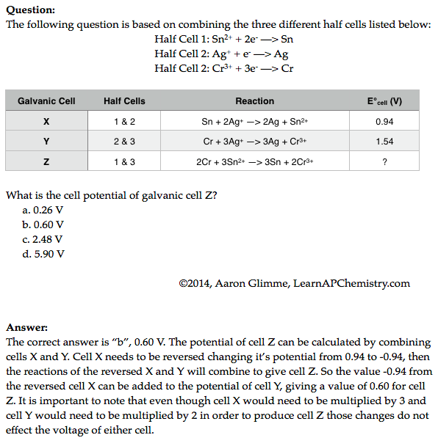
Galvanic Cell Potential
Source
Video
Video
Click reveals answer and explanation.
LO 3.12: Make qualitative or quantitative predictions about galvanic or electrolytic reactions based on half-cell reactions and potentials and/or Faraday’s laws.

Slide 18
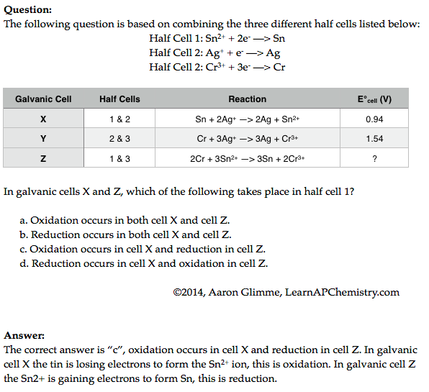
Redox Reactions and Half Cells
Source
Video
Video
LO 3.13: The student can analyze data regarding galvanic or electrolytic cells to identify properties of the underlying redox reactions

Slide 19
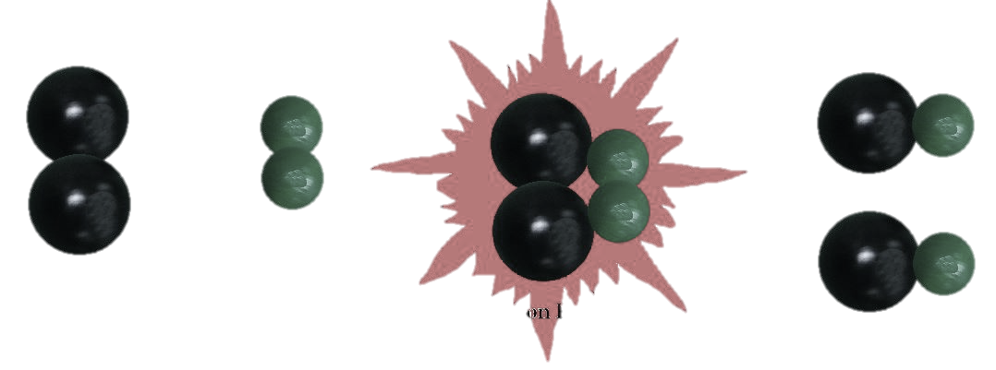
Big Idea #4
Kinetics

Slide 20
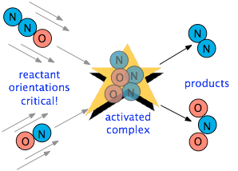
Factors Affecting Reaction Rate
Source
Factors that Affect Reaction Rate
State of reactants
Rate increases as state changes from solid → gas as increased molecular movement allows for more opportunity for collision
Greater surface area of solids will increase rate as more reactant is exposed and able participate in collisions
Temperature - more kinetic energy leads to more successful collisions between molecules
Concentration – more reactants → more collisions
Use of a catalyst – affect the mechanism of reaction leading to faster rate
Video
Collision theory states that reactants must collide in the correct orientation and with enough energy for the molecules to react; changing the number of collisions will affect the reaction rate
Rate is the change in concentration over time
Δ[A] / t
LO 4.1: The student is able to design and/or interpret the results of an experiment regarding the factors (i.e., temperature, concentration, surface area) that may influence the rate of a reaction.

Slide 21
Determining Rate Order
Source
Rate law for a reaction has the form: rate = k [A]^{m}[B]^{n}… (only reactants are part of the rate law)
Exponents (m, n, etc. ) are determined from examining data, not coefficients:
for A + B → C
The overall rate expression for the reaction is rate = k [B]
k is the rate constant and is determined experimentally by plugging in data into the rate expression
When [A] is doubled, the rate do not change, so the reaction is zero order with respect to A
When [B] is doubled, the rate doubles, so the reaction is first order with respect to B
Trial | Initial [A] (mol/L) | Initial [B] (mol/L) | Initial Rate (mol/(L•s)
1 | 0.100 | 0.100 | 0.002
2 | 0.200 | 0.100 | 0.002
3 | 0.200 | 0.200 | 0.004
Video
Plot to create a straight line graph:
Zeroth Order First Order Second Order
[A] / Time ln[A] / Time 1/[A] / time
The first and second order integrated rate laws can be found on the Kinetics section of the AP Equations Sheet
LO 4.2: The student is able to analyze concentration vs. time data to determine the rate law for a zeroth-, first-, or second-order reaction.

Slide 22
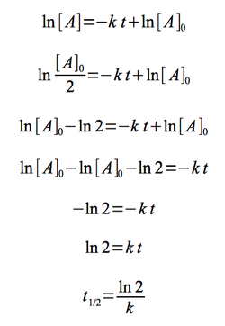
Half-life (First Order)
Source
Time needed for the concentration of reactant to reach half its initial value
Time to reach half concentration is dependent on k, not initial concentration
Half life remains constant in a first order reaction
Example: when t_{1/2}= 30 sec, the concentration is halved each 30 seconds
Video
The first order half life equation is derived from the first order integrated rate law
Initial Conditions After 30 seconds After 60 seconds
(12 molecules) (6 molecules) (3 molecules)
LO 4.3: The student is able to connect the half-life of a reaction to the rate constant of a first-order reaction and justify the use of this relation in terms of the reaction being a first-order reaction.

Slide 23
Reaction Mechanisms
Source
X₂ + Y₂ → X₂Y₂ rate = k[X₂]
A reaction and its experimentally determined rate law are represented above. A chemist proposes two different possible mechanisms for the reaction, which are given below.
Mechanism 1 Mechanism 2
X₂ → 2X (slow) X₂ → 2X (slow)
X + Y₂ → XY₂ (fast) X + Y₂ → XY + Y (fast)
X + XY₂ → X₂Y₂ (fast) X + XY → X₂Y (fast)
X₂Y + Y → X₂Y₂ (fast)
Based on the information above, which of the mechanisms is/are consistent with the rate law? List the intermediates in each mechanism:
Video
Answer: Both are consistent. In both mechanisms, the molecularity of the slow, rate determining step is consistent with the rate law. Furthermore, the sum of the elementary steps for both mechanisms gives the overall balanced equation for the reaction.
Intermediates in mechanism 1: X, XY2. Intermediates in mechanism 2: X, XY, Y, X2Y
LO 4.7: Evaluate alternative explanations, as expressed by reaction mechanisms, to determine which are consistent with data regarding the overall rate of a reaction, and data that can be used to infer the presence of a reaction intermediate.

Slide 24
Reaction Mechanisms
Source
The rate law for a reaction is found to be Rate = k[A]²[B]. What is the intermediate? Which of the following mechanisms gives this rate law?
I. A + B ⇄ E (fast)
E + B → C + D (slow)
II. A + B ⇄ E (fast)
E + A → C + D (slow)
III. A + A → E (slow)
E + B → C + D (fast)
A. I
B. II
C. III
D. Two of these
Video
Answer: E is the intermediate. Only Mechanism II is consistent with the rate law. Whenever a fast equilibrium step producing an intermediate precedes the slow rate determining step and we want to remove the intermediate from the rate law, we can solve for the concentration of the intermediate by assuming that an equilibrium is established in the fast step. The concentration of the intermediate in the rate determining slow step can be replaced with an expression derived from the equilibrium constant [E] =K_{eq}[A][B]. This substitution gives us the desired rate law: rate = k’[A]²[B]
LO 4.7 The student is able to evaluate alternative explanations, as expressed by reaction mechanisms, to determine which are consistent with data regarding the overall rate of a reaction, and data that can be used to infer the presence of a reaction intermediate.

Slide 25
Draw and label axes for the energy profiles below. Match the curves with the appropriate description.
Reaction Mechanisms and Energy Profiles – Practice Problem
exothermic reaction with a 2 step mechanism where the first step is slow. | endothermic reaction with a 2 step mechanism where the first step is slow.
endothermic reaction with a 2 step mechanism where the second step is slow. | exothermic reaction with a 1 step mechanism.
exothermic reaction with a 2 step mechanism where the second step is slow. | endothermic reaction with a 1 step mechanism.
D
C
F
Potential Energy
Potential Energy
Potential Energy
Reaction pathway
Reaction pathway
Reaction pathway
E
B
A
Potential Energy
Potential Energy
Potential Energy
Reaction pathway
Reaction pathway
Reaction pathway
LO 4.7 Cont. Dena K. Leggett, PhD Advanced Chemistry Teacher Allen High School Copyright 2015

Slide 26
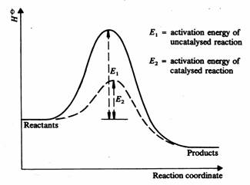
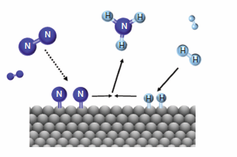
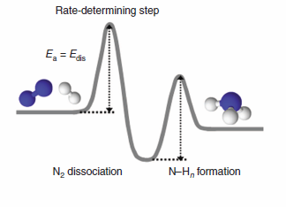
Catalysts
Source
A catalyst can stabilize a transition state, lowering
the activation energy.
A catalyst can participate in the formation of a new reaction intermediate,
providing a new reaction pathway.
Video
The rate of the Haber process for the synthesis of ammonia is increased
by the use of a heterogeneous catalyst which provides a lower energy pathway.
N₂(g) + 2H₂ (g) → iron-based catalyst + 2NH₃ (g)
Iron based catalyst
LO 4.8 The student can translate among reaction energy profile representations, particulate representations, and symbolic representations (chemical equations) of a chemical reaction occurring in the presence and absence of a catalyst.

Slide 27
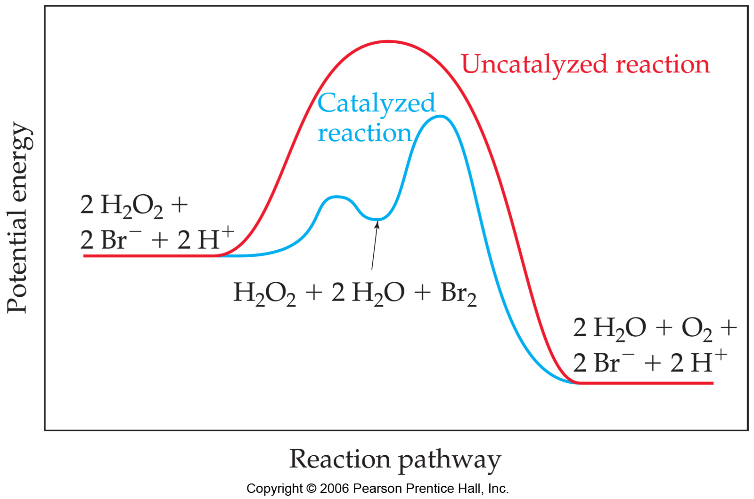
Catalysts
Source
catalysts provide alternative mechanisms with lower activation energy
In acid-base catalysis, a reactant either gains or loses a proton,
changing the rate of the reaction.
b. In surface catalysis, either a new reaction intermediate is formed or the probability of successful collisions is increased.
Video
c. In Enzyme catalysis enzymes bind to reactants in a way that lowers the activation energy. Other enzymes react to form new reaction intermediates.
Homogeneous catalysis
of the decomposition of H2O2
LO 4.9 The student is able to explain changes in reaction rates arising from the use of acid-base catalysts, surface catalysts, or enzyme catalysts, including selecting appropriate mechanisms with or without the catalyst present.

Slide 28
Big Idea #5
Thermochemistry

Slide 29
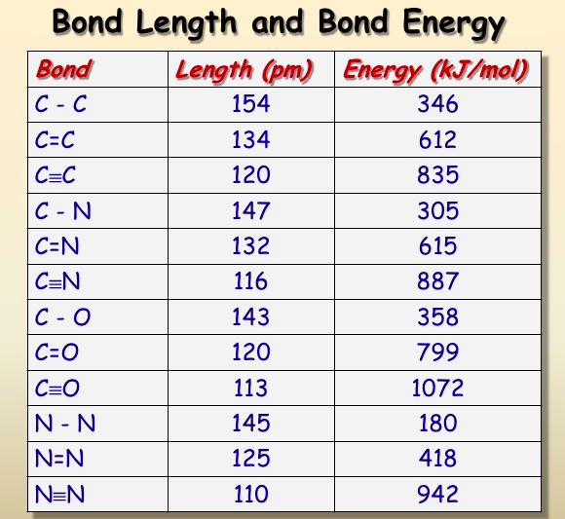
Bond Energy, Length & Strength
Source
Bond strength is determined by the distance between the atoms in a molecule and bond order. Multiple bonds shorten the distance & increase the force of attraction between atoms in a molecule.
Bond Energy is ENDOTHERMIC –the energy needed to break the bond.
Video
3 Factors
1) Size: H-Cl is smaller than
H-Br
2) Polarity: HCl is more polar than H-C
3) Bond order (length) C=C involves more e- is shorter than C-C.
Lowest PE =Bond Energy
LO: 5.1 The student is able to create or use graphical representations in order to connect the dependence of potential energy to the distance between atoms and factors, such as bond order and polarity, which influence the interaction strength.

Slide 30
Maxwell –Boltzmann Distributions
Source
Temperature is a measure of the average Kinetic Energy of a sample of substance.
Particles with larger mass will have a lower velocity but the same Average KE at the same Temperature.
Kinetic Energy is directly proportional to the temperature of particles in a substance. (if you double the Kelvin Temp you double the KE)
The M-B Distribution shows that the distribution of KE becomes greater at higher temperature.
The areas under the curve are equal and therefore the number of molecules is constant
Increasing Temperature (KE) increases the number of particles with the Activation Energy necessary to react.
Activation Energy is not changed with temperature but may be changed with a catalyst.
Video
LO 5.2: The student is able to relate Temp to motions of particles in particulate representations including velocity , and/ or via KE and distributions of KE of the particles.

Slide 31
Thermodynamic vocabulary
Source
Universe: The sum of the system and surroundings
System: The species we want to study
Surroundings: the environment outside the system
Endothermic: Heat flows to the system from the surroundings (surroundings temperature drops-i.e. beaker feels cold)
Exothermic: Heat flows from the system to the surroundings. (surroundings temperature rises-i.e. beaker feels hot)
Video
LO 5.3: The student can generate explanations or make predictions about the transfer of thermal energy between systems based on this transfer being due to a kinetic energy transfer between systems arising from molecular collisions.

Slide 32
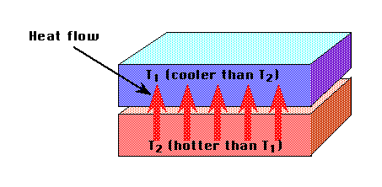
Heat Transfer
Source
Kinetic energy transferred between particles of varying temperature is heat energy.
Heat flows from particles of higher energy (hot) to those of lower energy (cold) when particles collide.
When the temperature of both particles are equal the substances are in thermal equilibrium.
Not all particles will absorb or release the same amount of heat per gram.
Specific Heat Capacity is a measure of the amount of heat energy in Joules that is absorbed to raise the temperature of 1 gram of a substance by 1 degree Kelvin.
Heat transfer can be measured q=mc_{p}∆T
Video
LO 5.3: The student can generate explanations or make predictions about the transfer of thermal energy between systems based on this transfer being due to a kinetic energy transfer between systems arising from molecular collisions.

Slide 33
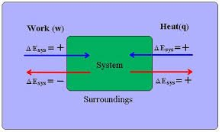
Conservation of Energy
Source
1st Law of Thermodynamics: Energy is conserved
Temperature is a measure of the average Kinetic energy of particles in a substance
Energy can be transferred as Work or Heat
∆E = q+w
Work = -P∆V (this is the work a gas does on the surroundings i:e the volume expanding a piston) a gas does no work in a vacuum.
Video
LO 5.4: The student is able to use conservation of energy to relate the magnitude of the energy changes occurring in two or more interacting systems, including identification of the systems, the type (heat vs. work), or the direction of the energy flow.

Slide 34
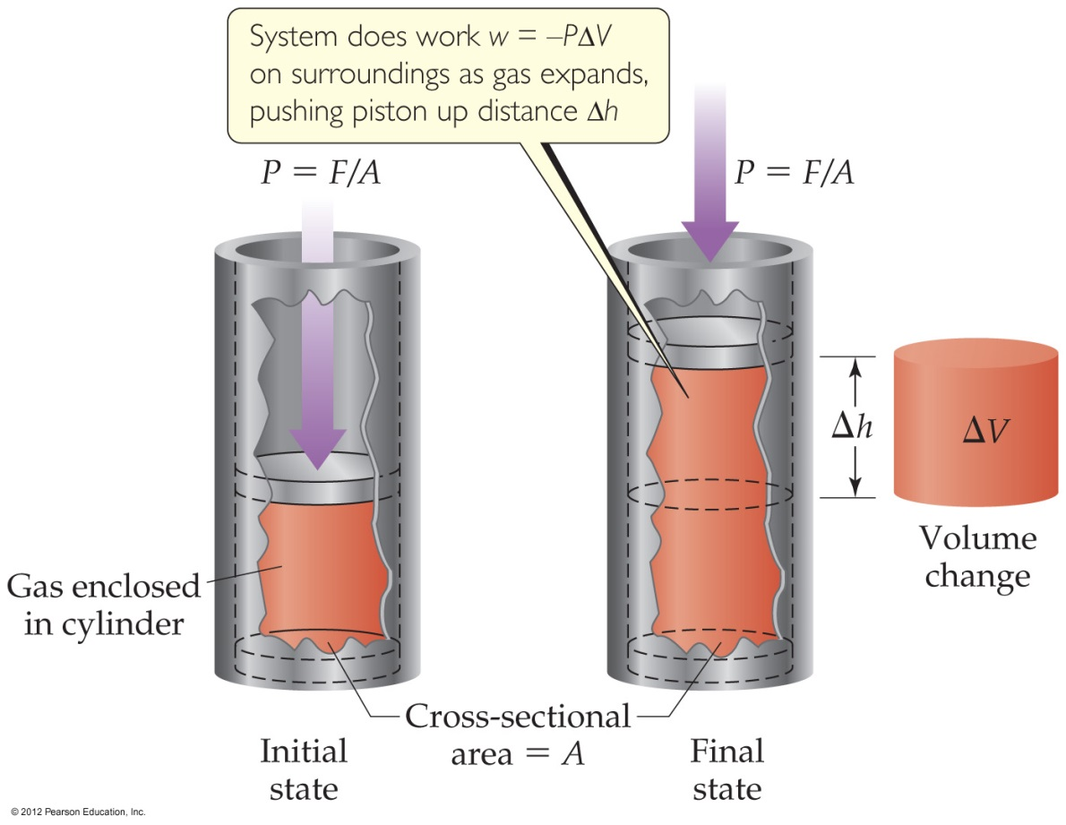
Conservation of Energy
Source
Video
Expansion/Compression of a gas
Volume increases, work is done by the gas
Volume decreases, work is done on the gas
LO 5.4: The student is able to use conservation of energy to relate the magnitude of the energy changes occurring in two or more interacting systems, including identification of the systems, the type (heat vs. work), or the direction of the energy flow.

Slide 35
Conservation of Energy when Mixing
Source
Energy is transferred between systems in contact with one another
Energy lost by one system is gained by the other so that total energy is always conserved.
-Q lost by system = +Q gained by surroundings
For example :
When room temperature water T1 (system) is mixed with cold water T2 (surroundings), the final temperature T3 will be in-between.
Q1 + Q 2 = 0 and energy is conserved
Video
LO 5.5: The student is able to use conservation of energy to relate the magnitudes of the energy changes when two non reacting substances are mixed or brought into contact with one another.

Slide 36
Calorimetry: an experimental technique used to determine the heat transferred in a chemical system. System can be a chemical reaction or physical process.
Source
Can use Calorimetry to solve for Heat Capacity of a calorimeter (C),, specific heat of a substance, (c), and ΔHvap, Δfus, ΔHrxn.
The data handling and math:
Law of Conservation of Energy: Q system + Qsurroundings = 0
Qsystem = - Qsurroundings where System = reaction, Surroundings = calorimeter
SO: Q rxn = - Q calorimeter
Heat Transfer due to Temperature Change in the Calorimeter:
Q= CΔT, or Q= mc ΔT where Q in J, C in J/K, m in g, c in J/g-K, ΔT in K
Q rxn = - Q calorimeter = - CΔT if the calorimeter Heat Capacity is Known, or can be determined.
Q rxn = - Q calorimeter = - mcΔT for reactions in solution.
When calculating ΔH, must take into account the mass of reactant that caused Q rxn.
Video
Example problem in video
LO 5.5: The student is able to use conservation of energy to relate the magnitudes of the energy changes when two non-reacting substances are brought into contact with one another.

Slide 37
Chemical Systems undergo 3 main processes that change their energy: heating/cooling, phase transitions, and chemical reactions.
Source
1. Heat Transfer due to Temperature Change: (kJ)
Q= mcΔT
m= mass (g), c= specific heat capacity (J/g-°C), ΔT= Temp. change in °C
Q is + for Heating, - for cooling
2. Heat Transfer due to Phase Change: (kJ/mol )
Q= ΔH phase change
Q phase change = + for ΔH fusion, ΔH vaporizing, ΔH subliming, - for ΔH freezing, ΔH condensing, ΔH deposition
3. Q for a chemical reaction at constant pressure = ΔH rxn
When calculating ΔH rxn from Q, remember ΔH rxn must agree with the stoichiometric coefficients in the reaction. Units of ΔH rxn are kJ/mol rxn.
4. When a gas expands or contracts in a chemical reaction, energy is transferred in the form of Pressure- Volume work. W= -PΔV (l-atm)
Gas Expands – Does work on surroundings (system loses energy)
Gas Contracts – Work done on the gas (system gains energy) No change in volume, no work done.
Video
LO 5.6: The student is able to use calculations or estimations to relate energy changes associated with heating/cooling a substance to the heat capacity, relate the energy changes associated with a phase transition to the enthalpy of fusion/vaporization, relate energy changes associated with a chemical reaction to the enthalpy of the reaction, and relate the energy changes to PΔV work.

Slide 38
Calorimetry: an experimental technique used to determine the heat transferred in a chemical system. System can be a chemical reaction or physical process.
Source
Video
LO 5.7 The student is able to design and/or interpret the results of an experiment in which calorimetry is used to determine the change in enthalpy of a chemical process. (heating/cooling, phase transition, or chemical reaction) at constant pressure.

Slide 39
The net energy change during a reaction is the sum of the energy required to break the reactant bonds and the energy released in forming the product bonds. The net energy change may be positive for endothermic reactions where energy is required, or negative for exothermic reactions where energy is released.
Source
Any bond that can be formed can be broken. These processes are in opposition. (their enthalpy changes are equal in magnitude, opposite sign)
ΔH bonds breaking → ENDOTHERMIC (+)
ΔH bonds forming → EXOTHERMIC (-)
To find ΔHrxn, apply Hess’s Law:
ΔHrxn = ΣΔH bonds breaking (+) + Σ ΔH bonds forming (-)
To calculate or estimate ΔHrxn from Bond Energy:
Draw the Lewis Structure. Don’t forget about double and triple bonds!
Add up ΔH bonds breaking. It’s + (kJ)
Add up ΔH bonds forming. It’s - (kJ).
Add the two terms. Units are kJ/mol rxn.
To calculate ΔH°_{rxn} from a table of standard enthalpies of formation:
ΔH°_{rxn} = ΣΔH°_{f} products - ΣΔH°_{f} reactants
.
Video
If a reaction is EXOTHERMIC, there is a net release in energy, since weaker bonds break and stronger bonds form. Product has higher kinetic energy and lower potential energy than reactant.
If a reaction is ENDOTHERMIC, there is a net absorption of energy, since stronger bonds break, and weaker bonds form. Product has lower kinetic energy, and higher potential energy than reactant.
LO 5.8: The student is able to draw qualitative and quantitative connections between the reaction enthalpy and the energies involved in the breaking and formation of chemical bonds.

Slide 40
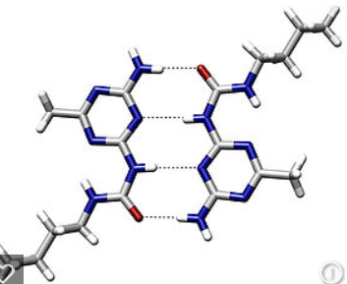
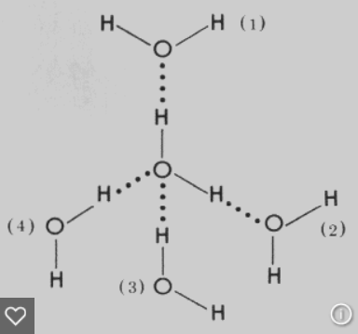
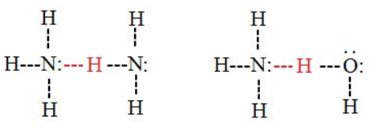
Electrostatic forces exist between molecules as well as between atoms or ions, and breaking these intermolecular interactions requires energy.
Source
The Stronger the IMF the more energy required to break it, the Higher the Boiling Point, the Lower the Vapor Pressure.
Intermolecular Forces Listed from weakest to strongest. Thus the boiling points and vapor pressure of molecular substances can be ordered based on IMF strength:
Dispersion (Induced Dipole- Induced Dipole): Caused by distortion of electron cloud. The larger the electron cloud, and the more surface area, the more polarizable the cloud, the stronger the dispersion force. Thus the boiling point trend in halogens is I₂ >Br₂>Cl₂> F₂ and n-butane (30.2° C) has a higher boiling point than isobutane (-11 °C). All substances have dispersion forces, as all electron clouds distort. Nonpolar molecules and atoms have only dispersion forces, as they have no permanent dipoles.
Dipole- Induced Dipole: Occurs between a polar molecule (HCl) and a nonpolar molecule. (Cl₂) The nonpolar molecule’s cloud distorts when affected by a dipole.
Dipole-Dipole: Occurs between 2 polar molecules. (HCl-HCl)
Hydrogen Bond: An extreme case of Dipole – Dipole. Occurs between molecules containing a H covalently bonded to F,O, or N. The “bond” occurs between the lone pair of F, O, or N, and the H which is attached to one of those elements.
Video
Weaker IMF, Lower Boiling, Higher Vapor Pressure
Stronger IMF, Higher Boiling, Lower Vapor Pressure
LO 5.9: Make claims and/or predictions regarding relative magnitudes of the forces acting within collections of interacting molecules based on the distribution of electrons within the molecules and the types of intermolecular forces through which the molecules interact.

Slide 41
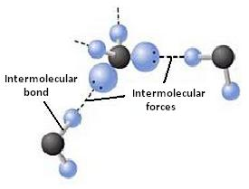
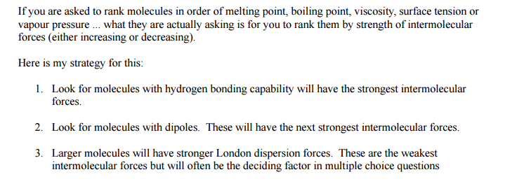
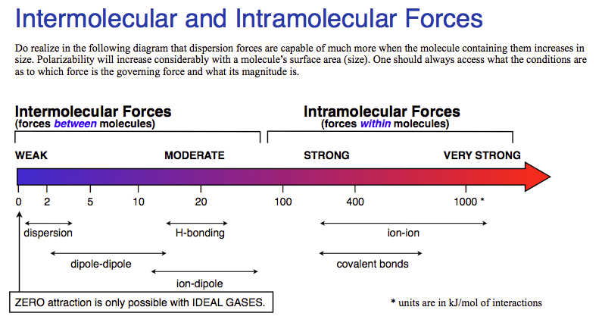
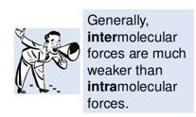
Inter vs Intra Chemical vs. Physical
Source
Source
Source
Source
Interstates- Between States
IMF- Between Molecules
Video
Chemical vs. Physical Changes
A physical change doesn’t produce a new substance. Phase changes are the most common. It involves IMF changes.
A chemical change produces new substances. Bonds are broken and new bonds are formed! The Intra-molecular forces are changed.
Strong IMF= High BP, High MP, High viscosity, high surface tension, low vapor pressure!
LO 5.10: The student can support the claim about whether a process is a chemical or physical change (or may be classified as both) based on whether the process involves changes in intramolecular versus intermolecular interactions.

Slide 42
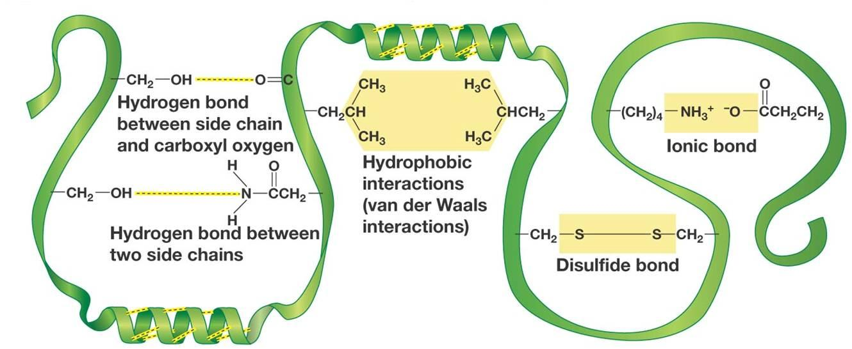
IMF and Biological/Large Molecules
Source
Source
Source
Video
LO 5.11: The student is able to identify the noncovalent interactions within and between large molecules, and/or connect the shape and function of the large molecule to the presence and magnitude of these interactions.

Slide 43
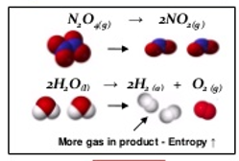
Entropy- Embrace the Chaos!
Source
Source
Entropy Changes that result in a + S:
Increasing moles
Increasing temperature
Increasing volume
Solid to liquid to gas
Forming more complicated molecules. (More moles of electrons)
Video
LO 5.12: The student is able to use representations and models to predict the sign and relative magnitude of the entropy change associated with chemical or physical processes.

Slide 44
Predicting How Reactions Will Go
Video #1
Video #2
Source
Entropy is typically given in J/K so you MUST convert to kJ!
LO 5.13: The student is able to predict whether or not a physical or chemical process is thermodynamically favored by determination of (either quantitatively or qualitatively) the signs of both delta Hº and delta Sº, and calculation or estimation of delta Gº when needed.

Slide 45
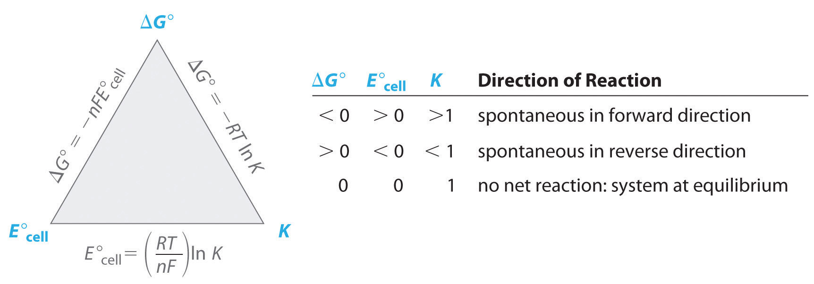
How can I calculate ΔG?
Source
Source
Video
Video
Video
ΔG$°=−nFE°$
LO 5.14: Determine whether a chemical or physical process is thermodynamically favorable by calculating the change in standard Gibbs free energy

Slide 46
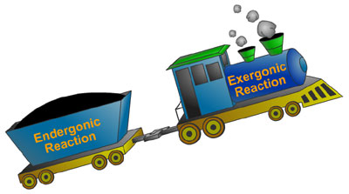
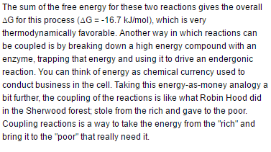
Coupling Reactions
Source
Video #1
ChooChoo
Exothermic Reaction
Endothermic Reaction
LO: 5.15 The student is able to explain the application the coupling of favorable with unfavorable reactions to cause processes that are not favorable to become favorable.

Slide 47
Source
Coupled Reactions and LeChatelier
Video
LO: 5.16 The student can use LeChatelier's principle to make qualitative predictions for systems in which coupled reactions that share a common intermediate drive formation of a product.

Slide 48
COUPLING OF REACTIONS
Reactions with known values can be COUPLED to produce a new reaction.
When we couple reactions (or half-reactions), we may multiple by a factor or reverse the reaction before we couple or add them together.
Video
Coupled Reactions and K
Source
Source
Source
Manipulation | Equilibrium constants (K) | Free energy, enthalpy or entropy | Standard Reduction potential (Eº)
Multiply by factor | Raise K to power of factor | Multiply by factor | NOTHING!
Flip/reverse rxn | Inverse of K | Change sign | Change sign
Add Reactions | Multiply values | Add Values | Add values
LO 5.17: The student can make quantitative predictions for systems involving coupled reactions that share a common intermediate, based on the equilibrium constant for the combined reaction.

Slide 49
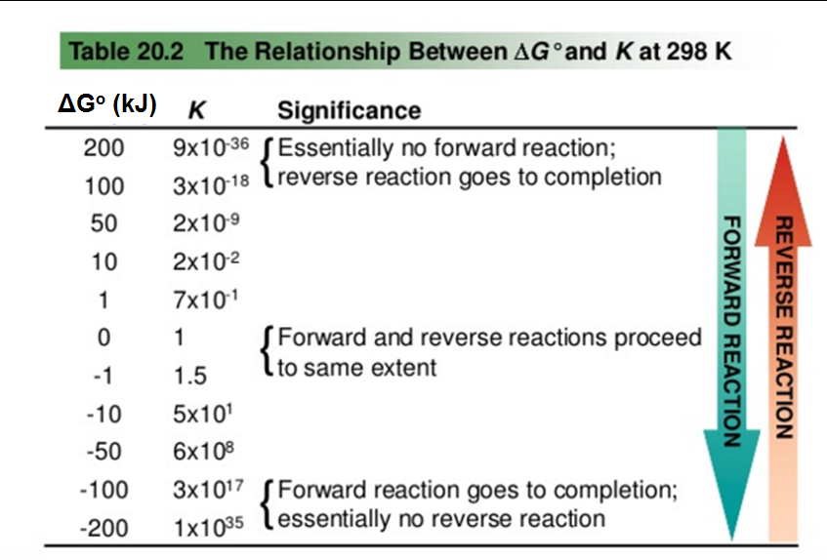
Is it thermo, kinetics, or K?
The free energy at non-standard, non-equilibrium states is given by:
At Equilibrium, ΔG = 0 and Q becomes “K”
Thermodynamically favorable (aka spontaneous) means a reaction is PRODUCT favored at a given temperature.
THERMODYNAMICALLY FAVORABLE
Kinetics tells us how FAST a reaction will proceed.
Equilibrium tells us how FAR a reaction proceeds.
Thermodynamics tells us whether or not the reaction is FAVORABLE at a given temperature.
A reaction that is thermodynamically favorable will form more products at equilibrium BUT the reaction may be so SLOW that few products form in a reasonable amount of time.
ΔGº and the Equilibrium Constant
Equilibrium constant | Description | Standard Gibbs Free Energy
K = 1 | Neither reactant nor product favored | ΔGº = 0
K > 1 | Product favored | ΔGº < 0 (thermodynamically favorable)
K < 1 | Reactant favored | ΔGº > 0 (thermodynamically unfavorable)
Video
ΔG ⁼ ΔGº + RTln(Q)
Source
Source
ΔGº = -RTln(K)
K > 1, ln(K) is positive, ΔGº is negative
ΔH
“Thermodynamically UNFAVORABLE” (aka non-spontaneous) reactions will run in reverse when set up with standard conditions (1M/1atm of ALL reactants and products) BUT can be made to proceed forward under different conditions. "
As K decreases, ΔGº becomes more positive
L 5.18: Explain why a thermodynamically favored chemical reaction may not produce large amounts of product (based on consideration of both initial conditions and kinetic effects), or why a thermodynamically unfavored chemical reaction can produce large amounts of product for certain sets of initial conditions.

