Slide 1
A Safety & Health Curriculum for Young Workers
California Edition
DEPARTMENT OF HEALTH AND HUMAN SERVICES
Centers for Disease Control and Prevention
National Institute for Occupational Safety and Health

Slide 2
Emergencies at Work
Lesson 4 (and 4B)

Slide 3
Emergencies at Work
What is an emergency at work?
An unplanned event that harms or threatens employees, customers, or the public; that shuts down business operations; or that causes physical or environmental damage

Slide 4
Emergencies at Work

Slide 5
Emergencies at Work

Slide 6
Emergencies at Work

Slide 7
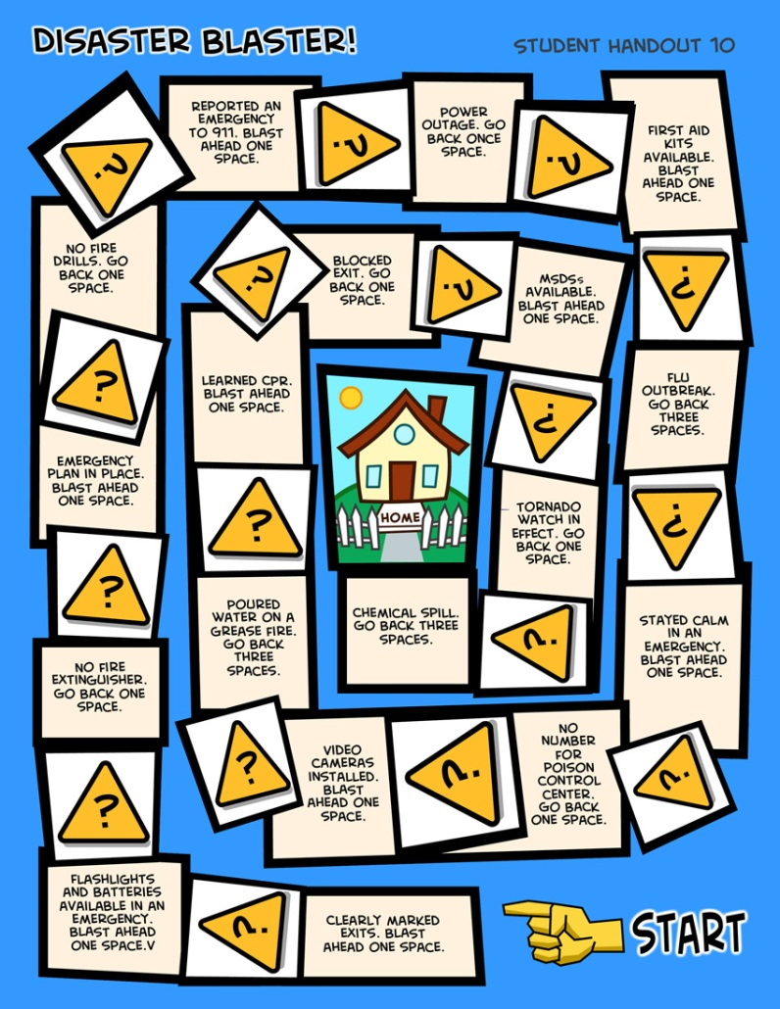
Emergencies at Work
Disaster Blaster! Game

Slide 8
Emergency Action Plans
Many workplaces need an emergency action plan. Workers should receive training on the plan.
The plan should include information about
Different emergencies and how to respond
Locations of meeting places
Evacuation routes
Emergency equipment and alert systems
Key personnel (who’s in charge)
Procedures to follow when someone is injured
Individual worker responsibilities
Practice drills

Slide 9
Know Your Rights and Responsibilities
Lesson 5 (and 5B)

Slide 10
Know Your Rights: Quiz Game
Questions
Rights on the Job | Dangerous Work and Work Permits | Child Labor Laws and Work Hours | Getting hurt, Getting help, Staying safe
$100
$100
$100
$100
$200
$200
$200
Some states require teens under 18 and still in school to get this before starting a job.
Click to close
It’s illegal for teens under 18 to operate these machines
(name 2).
Click to close
$200
These federal agencies handle complaints about workplace health and safety.
Click to close
Workers have rights on the job, including these (name 2).
Click to close
This type of insurance pays wages and medical benefits for workers hurt on the job. In exchange, the worker gives up the right to sue the employer.
Click to close
You can stay safe at work by doing these things (name 2).
Click to close
CA law says that 14- and 15-year-olds can work until this time on a school night.
Click to close
It’s illegal for teens under 18 to do these types of construction work (name 2).
Click to close
You have to be this old to operate a forklift.
Click to close
When you turn
this age, you aren’t protected anymore by child labor laws.
Click to close
Your employer must give you these health and safety protections on the job
(name 2).
Click to close
CA law says that this is the latest time teens 16 and 17 can work on school nights.
Click to close
CA law says that this is the maximum number of hours 14- and 15 year-olds can work in a school week.
Click to close
These laws protect teens from
working too long, too late,
or too early.
Click to close
These are two rights you have if you’re hurt on the job.
Click to close
This federal agency handles complaints about wages and work hours.
Click to close
It’s illegal for your employer to punish you for doing this
(name 1).
Click to close
It’s illegal for 14-and 15-year olds to do some jobs, including these (name 2).
Click to close
The law says that
your employer must pay you this amount per hour, your state’s minimum wage.
Click to close
If you are hurt at work, you should take these steps
(name 2).
Click to close
$300
$300
$300
$300
$400
$400
$400
$400
$500
$500
$500
$500

Slide 11
Know Your Rights: Main Points
OSHA laws protect workers from job hazards. Employers must provide a safe and healthy workplace, training, and safety equipment.
Tell your supervisor right away if you’re injured at work! You can’t be fired for reporting work hazards.
Departments of Labor enforce child labor laws. The Equal Employment Opportunity Commission (EEOC) protects workers from discrimination and harassment at work.
Child labor laws protect teens from working too long, too late, too early, or in certain dangerous jobs.
Young people have rights and responsibilities at work.

Slide 12
Taking Action
Lesson 6 (and 6B)

Slide 13
How to Approach a Workplace Problem
Steps in Problem Solving
Define the problem.
Get advice.
Choose your goals.
Know your rights.
Decide the best way to talk to the supervisor.
Contact a state or federal Wage & Hour Division or OSHA for help, if necessary.
Talk to a teacher, parent, co-worker, or other trusted adult.

Slide 14
Taking Action: Main Points
Steps for approaching a workplace problem include: defining the problem; getting advice; choosing goals; knowing your rights; talking to your supervisor.
If you don’t feel comfortable talking with your boss, speak with a trusted adult, OSHA, or another agency.
Trust your instincts! Don’t be afraid to speak up if you have a problem at work!

