Slide 1
AMERICAN REVOLUTION
CAUSES OF THE REVOLUTION
PROTESTS ESCALATED
FIRST CONTINENTAL CONGRESS
THE WAR BEGAN
Slide 3

Slide 2
MERCANTILISM
RESTRICTIVE
LAWS
PASSED
BY BRITISH
ENLIGHTENMENT
IDEAS
CAUSES OF
AMERICAN
INDEPENDENCE
MOVEMENT
GREAT
AWAKENING
FRENCH AND
INDIAN WAR
POPULATION
EXPLOSION AND EXPERIENCES
OF COLONIAL SELF-RULE

Slide 3
MERCANTILISM
DEFINED AS AN ECONOMIC SYSTEM PRACTICED DURING THE 18TH CENTURY BY EUROPEAN NATIONS.
BASED ON THE BELIEF THAT THERE WAS A LIMITED AMOUNT OF WEALTH IN THE WORLD AND THE WAY TO GET THE MOST GOLD AND SILVER WAS TO HEAVILY REGULATE MANUFACTURING, TRADE, AND PRODUCTION WITHIN A COUNTRY AND ITS COLONIES.
GREAT BRITAIN, FOR EXAMPLE, WOULD PURCHASE RAW MATERIALS FROM THE NORTH AMERICAN COLONIES AT A LOW PRICE DETERMINED BY THE BRITISH GOVERNMENT. THEN THE COLONIES WERE REQUIRED TO PURCHASE THE FINISHED GOODS MANUFACTURED IN BRITAIN AT HIGH PRICES ALSO SET BY THE BRITISH GOVERNMENT. THE NORTH AMERICAN COLONIES WERE ONLY ALLOWED TO TRADE WITHIN THE BRITISH EMPIRE.
THIS SYSTEM LED TO BITTERNESS ON THE PART OF THE COLONISTS WHO HAD VERY LITTLE INPUT IN THEIR ECONOMIC POLICIES.

Slide 4
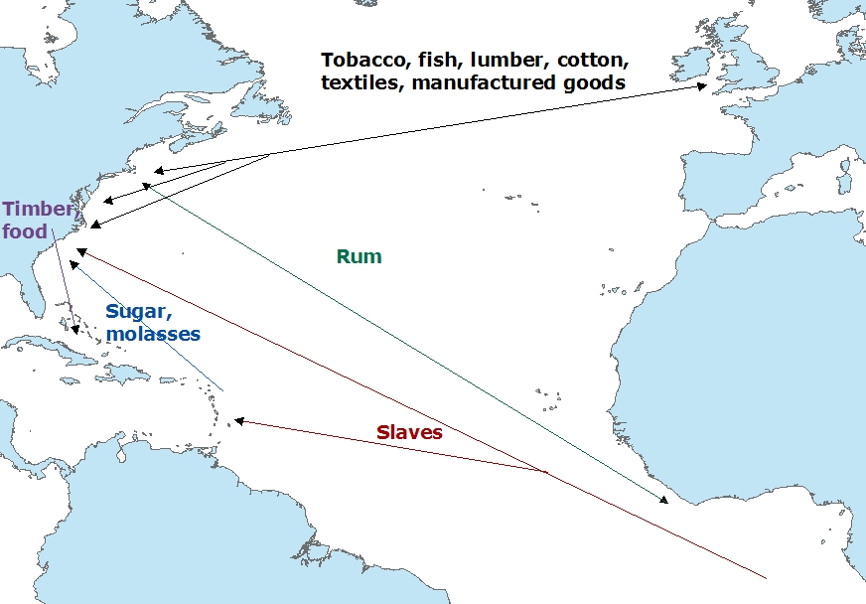
COLONIAL TRADE ROUTES

Slide 5
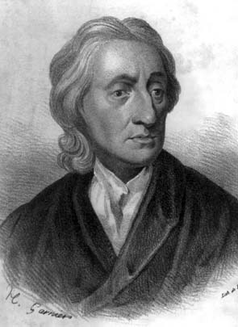
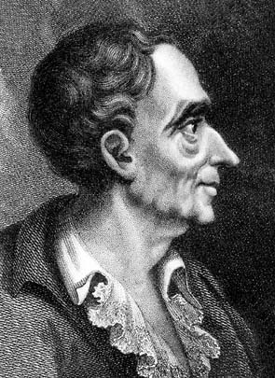
THE ENLIGHTENMENT INFLUENCED THE COLONISTS
PHILOSOPHICAL MOVEMENT THROUGHOUT EUROPE IN THE 17TH AND 18TH CENTURIES
EMPHASIS ON REASON AS THE MOST IMPORTANT HUMAN ABILITY
THOMAS HOBBES ARGUED THAT THE PURPOSE OF THE KING IS TO KEEP THE STATE STRONG AND SAFE
JOHN LOCKE ARGUED THAT PEOPLE POSSESSED NATURAL RIGHTS SUCH AS LIFE, LIBERTY, AND PROPERTY. HE BELIEVED THE PURPOSE OF GOVERNMENT WAS TO PROTECT THOSE RIGHTS.
BARON DE MONTESQUIEU ARGUED AGAINST ABSOLUTE MONARCHY, SPLIT THE POWER OF THE KING TO KEEP IT FROM ABUSE.
COLONIAL LEADERS BELIEVED THE BRITISH GOVERNMENT VIOLATED THESE IDEALS AND DISCUSSED STRATEGIES TO OVERCOME THE OPPRESSION OF KING GEORGE III
LOCKE
MONTESQUIEU

Slide 6
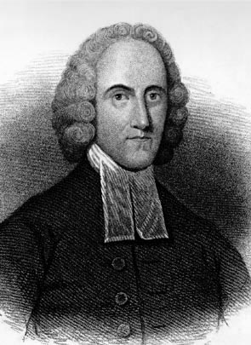
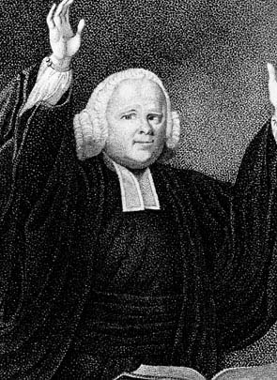
THE GREAT AWAKENING
RELIGIOUS MOVEMENT THROUGHOUT THE COLONIES IN THE EARLY 1700s. IT WAS BASED ON REVIVALISM WHICH STRESSED INDIVIDUAL RELIGIOUS EXPERIENCE RATHER THAN NEEDING CHURCH LEADERS TO CONNECT WITH GOD
PEOPLE BEGAN TO CHANGE CHURCHES TO MEET THEIR RELIGIOUS NEEDS (NEW LIGHTS VS. OLD LIGHTS)
CONTRIBUTED TO A SENSE OF EQUALITY SINCE ALL PEOPLE WERE QUALIFIED TO TAKE AN ACTIVE ROLE IN THE CHURCH
IT IS WIDELY BELIEVED THAT THIS WAS A MAJOR FACTOR WHICH LED TO THE SENSE OF FREEDOM AND INDEPENDENCE UNDERLYING THE AMERICAN REVOLUTION
INFLUENTIAL MINISTERS
JONATHON EDWARDS
GEORGE WHITEFIELD

Slide 7
POPULATION EXPLOSION AND COLONIAL SELF-RULE
THE COLONIAL POPULATION INCREASED AT AN EXTREMELY FAST PACE AFTER 1700
NEW ARRIVALS MADE UP OF: INDENTURED SERVANTS FROM EUROPE, SLAVES FROM AFRICA, AND BIRTHS FROM COLONISTS
CLEAN DRINKING WATER, PLENTY OF FOOD, AND GOOD CLIMATE WERE MAJOR CONTRIBUTING FACTORS TO THE SPIKE IN BIRTHS BETWEEN 1680-1776
MOST COLONIES HAD SOME FORM OF AN ELECTED LEGISLATURE WHICH FOSTERED A DESIRE TO SELF-RULE
SOME FORM OF SELF-RULE WAS NECESSARY DUE TO THE DISTANCE TO ENGLAND (6-WEEKS)

Slide 8
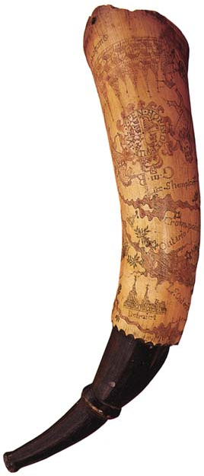
FRENCH AND INDIAN WAR 1754-1763
FOR OVER 100 YEARS THE FRENCH AND BRITISH HAD STRUGGLED FOR CONTROL OF NORTH AMERICA WHICH HAD RESULTED IN THREE EARLIER WARS
BOTH FRANCE AND ENGLAND WANTED TO EXPAND THEIR TERRITORY WEST OF THE APPALACHIAN MOUNTAINS INTO THE OHIO VALLEY
THE TWO SIDES FACED HARDSHIPS SUCH AS DISEASE, WEATHER, AND LOGISTICS OF TRANSPORTING SUPPLIES TO THE BATTLEGROUNDS
NATIVE AMERICANS IN THE AREA PLAYED THE COLONIAL POWERS OFF OF EACH OTHER AND TOOK SIDES WHEN THEY FELT IT WOULD BENEFIT THEIR GOAL OF HALTING FURTHER ENCROACHMENT ON THEIR LAND
FRANCE TOOK THE EARLY LEAD, HOWEVER THE BRITISH EVENTUALLY DEFEATED THE FRENCH IN A WAR THAT WAS FOUGHT IN THE OHIO VALLEY, MONTREAL, INDIA, THE PHILIPPINES, AND THE WEST INDIES
FRENCH POWDER HORN WITH RIVERS ENGRAVED ON IT

Slide 9
THE FRENCH AND INDIAN WAR FUELED THE DESIRE FOR INDEPENDENCE
COLONISTS UNIFIED FOR THE FIRST TIME BEHIND THE BRITISH TO DEFEAT THE FRENCH. THIS LED TO A SENSE OF PRIDE AND UNITY NOT EXPERIENCED PRIOR TO THE CONFLICT.
THE COLONISTS DID NOT FEEL THE SAME NEED TO REMAIN TIED TO THE BRITISH AFTER THE WAR AS THE “FRENCH THREAT” WAS REMOVED.
THE BRITISH IMPOSED MANY TAXES ON THE COLONISTS TO PAY FOR THE WAR EFFORT WITHOUT ANY COLONIAL INPUT OR REPRESENTATION IN PARLIAMENT.
THE BRITISH RESTRICTED FURTHER WESTERN SETTLEMENT WITH THE PROCLAMATION LINE OF 1763. THE COLONISTS FELT ENTITLED TO THE LANDS GAINED DURING THE WAR THEY HAD HELPED WIN.

Slide 10
GREAT BRITAIN PASSED MANY RESTRICTIVE LAWS THAT SPARKED PROTEST ON THE PART OF THE COLONISTS
SUGAR ACT OF 1764 WHICH ACTUALLY LOWERED THE TAX ON SUGAR BUT TIGHTENED ENFORCEMENT OF THE LAW AND CRACKED DOWN ON SMUGGLING
STAMP ACT OF 1765 WHICH TAXED ALL PRINTED MATERIALS FROM NEWSPAPERS TO COLLEGE DIPLOMAS
DECLARATORY ACT 1766 AUTHORIZED PARLIAMENT TO MAKE LAWS WITHOUT THE CONSENT OF THE COLONISTS’
TOWNSEND ACTS OF 1767 TAXED EXPORTED GOODS AND CREATED A CUSTOMS BOARD TO DESTROY SMUGGLING
TEA ACT 1773 TAX TO PROTECT THE MONOPOLISTIC EAST INDIA TEA COMPANY
INTOLERABLE/COERCIVE ACTS 1774 WERE DESIGNED TO PUNISH COLONISTS FOR BOSTON TEA PARTY AND MAKE THEM SUBMIT TO THE WILL OF THE BRITISH KING

Slide 11
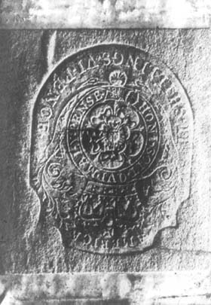
THE BRITISH HAD WAR DEBTS
IN 1764 PARLIAMENT PASSED THE SUGAR ACT WHICH COLLECTED DUTIES ON IMPORTS TO NORTH AMERICA FROM PLACES OUTSIDE THE BRITISH EMPIRE. THIS CAUSED A MAJOR UPSWING IN PRICES AS WELL AS ENFORCEMENT OF SMUGGLING LAWS. THE COLONISTS HAD NO REPRESENTATIVES IN PARLIAMENT AND SENT PETITIONS PROTESTING THE TAX.
THE STAMP ACT IN 1765 AFFECTED ALMOST EVERY COLONIST AS IT TAXED ANY PRINTED MATERIALS. THIS WAS THE FIRST TAX ON GOODS WITHIN THE COLONIES AND IT UNITED THE DIVERSE POPULATION AGAINST THE BRITISH GOVERNMENT AS THEY STILL HAD NO REPRESENTATIVES IN PARLIAMENT.
TAX STAMP USED ON ALL PRINTED MATERIALS

Slide 12
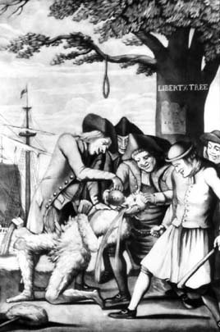
PROTESTS OVER THE NEW TAXES LED TO THE CREATION OF GROUPS SUCH AS THE SONS OF LIBERTY WHO WERE WILLING TO USE VIOLENCE IF NECESSARY TO CONVINCE THE BRITISH GOVERNMENT TO REPEAL THE LAWS MADE WITHOUT REPRESENTATION
THE TAX COLLECTOR TARRED, FEATHERED, AND FORCED TO DRINK STEAMING HOT TEA

Slide 13
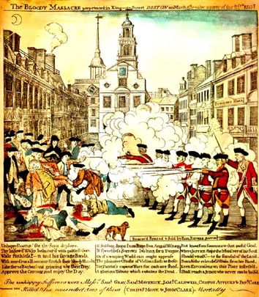
BOSTON MASSACRE
1770
THE BRITISH SENT TROOPS TO BOSTON IN AN ATTEMPT TO RESTORE ORDER, HOWEVER A CLASH BETWEEN SOLDIERS AND TOWNSPEOPLE RESULTED IN 5 COLONISTS’ DEATHS. THE TROOPS WERE BASICALLY ACQUITTED IN A TRIAL, WHICH FUELED THE ANGER OF THE COLONISTS.
ENGRAVING OF THE EVENT BY PAUL REVERE

Slide 14
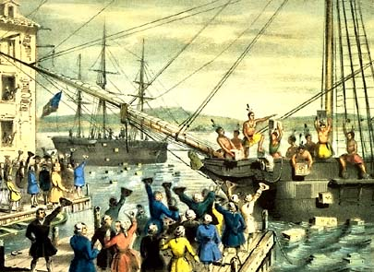
BOSTON TEA PARTY 1773
THE MOST FAMOUS OF MANY PROTESTS AGAINST THE TEA ACT OF 1773, A TAX DESIGNED TO PROTECT THE BRITISH TEA MONOPOLY. ABOUT 50 MEMBERS OF THE SONS OF LIBERTY ORGANIZATION DRESSED UP AS MOHAWK INDIANS AND DUMPED THOUSANDS OF POUNDS OF TEA FROM 3 SHIPS INTO THE BOSTON HARBOR.

Slide 15
COMMITTEES OF CORRESPONDENCE CREATED UNITY WITHIN THE DIVERSE COLONIES
THE DAILY LIVES OF THE COLONISTS WERE SO VARIED THAT THERE WAS NOT A UNIFIED RESPONSE TO THE NEW TAXES. MANY WERE VERY LOYAL TO THE BRITISH CROWN AND HAD NO INCLINATION TO PURSUE SEPARATION.
COMMITTEES OF CORRESPONDENCE, FIRST IN BOSTON AND THEN THROUGHOUT THE COLONIES, BEGAN DISTRIBUTING PAMPHLETS WHICH STATED THE RIGHTS OF COLONISTS. EVERYONE WAS ANGERED BY THE CLOSING OF HARBORS AS MOST OF THE COLONIES DEPENDED ON TRADING FOR REVENUE.
THESE COMMITTEES WERE USED TO CALL THE FIRST MEETING MADE UP OF DELEGATES FROM EACH OF THE COLONIES.

Slide 16
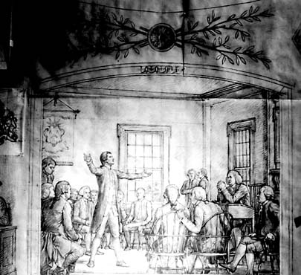
FIRST CONTINENTAL CONGRESS PHILADELPHIA, PENNSYLVANIA 1774
FIFTY SIX MEN FROM TWELVE COLONIES (GEORGIA DECLINED BECAUSE THEY RELIED ON THE BRITISH TO PROTECT THEM AGAINST NATIVE AMERICANS) MET TO DISCUSS THE INTOLERABLE ACTS PASSED BY PARLIAMENT TO PUNISH THE COLONISTS FOR THE BOSTON TEA PARTY. THEY DRAFTED THE DECLARATION OF RIGHTS AND GRIEVANCES TO BE SENT TO KING GEORGE.
THE GROUP WAS DIVIDED BETWEEN THOSE WHO WANTED TO RECONCILE WITH GREAT BRITAIN AND THOSE WHO WANTED TO SEPARATE.

Slide 17
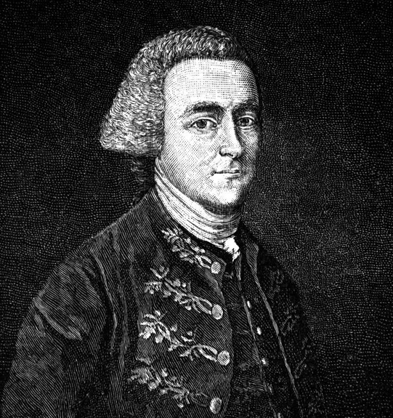
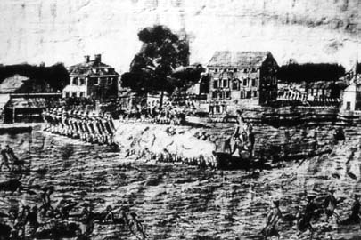
BRITISH TROOPS WERE SENT TO ARREST SAMUEL ADAMS AND JOHN HANCOCK IN LEXINGTON. COLONISTS WERE WAITING WITH WEAPONS AND FIGHTING BROKE OUT, WHICH STARTED THE AMERICAN REVOLUTION IN LEXINGTON AND CONCORD IN APRIL OF 1775.
JOHN HANCOCK
IN LEXINGTON 8 COLONISTS WERE KILLED. IN CONCORD 73 BRITISH TROOPS WERE KILLED AND 93 COLONISTS WERE KILLED.
SAMUEL ADAMS

Slide 18
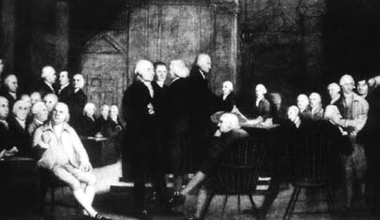
IN RESPONSE TO THE BLOODSHED THE SECOND CONTINENTAL CONGRESS WAS CALLED IN PHILADELPHIA IN MAY 1775. THEY SENT A PETITION TO THE KING THAT BLAMED PARLIAMENT FOR THE PROBLEMS IN THE COLONIES AND ASKED HIM FOR RESOLUTION. THE CONGRESS RAISED AN ARMY OF 20,000 MEN AND ELECTED GEORGE WASHINGTON AS THE COMMANDER IN CHIEF OF THE MILITARY. LATER THEY SENT DELEGATES TO NEGOTIATE WITH NATIVE AMERICANS, SET UP A POST OFFICE, SOUGHT FOREIGN AID, SIGNED THE DECLARATION OF INDEPENDENCE, SERVED AS THE GOVERNMENT DURING THE WAR AND ULTIMATELY WROTE THE ARTICLES OF CONFEDERATION.

Slide 19
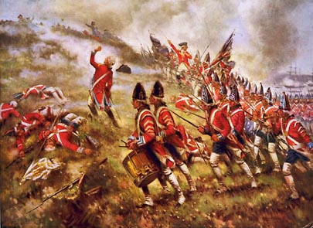
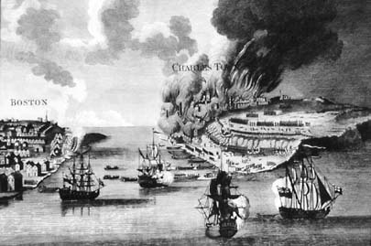
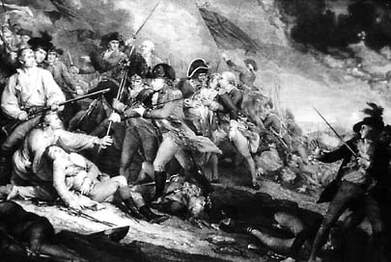
THE KING REJECTED THE PETITION AND SENT MORE TROOPS
BATTLE OF BUNKER HILL JUNE 1775

Slide 20
BOTH SIDES HAD STRENGTHS AND WEAKNESSES
COLONISTS | BRITISH
STRENGTHS | STRENGTHS
STRONG MILITARY LEADERS | LARGE NUMBER OF TROOPS
FOREIGN AID | PROFESSIONAL ARMY
MORAL ADVANTAGE | WEALTHY
AGRICULTURALLY SELF-SUFFICIENT | ABILITY TO HIRE MORE TROOPS
LARGE AREA
WEAKNESSES | WEAKNESSES
DISORGANIZED | 3,000 MILES AWAY: DIFFICULT TO GET SUPPLIES, ORDERS
LACK OF UNITY | WEAK GENERALS
ECONOMIC PROBLEMS | FRANCE WANTED REVENGE

Slide 21
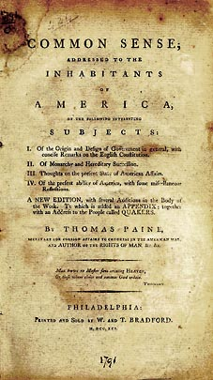
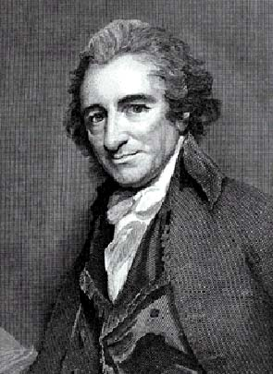
THOMAS PAINE AND COMMON SENSE
WIDELY READ PAMPHLET PUBLISHED IN JANUARY OF 1776 THAT OUTLINED THE REASONS TO SEPARATE FROM GREAT BRITAIN

Slide 22
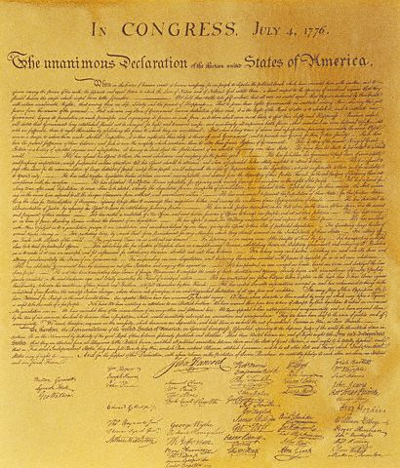
THE CONGRESS MET AGAIN IN JUNE 1776 AND COMMISSIONED THOMAS JEFFERSON TO DRAFT A DECLARATION OF INDEPENDENCE. THE DOCUMENT HAD THREE PARTS: THE PURPOSE OF A GOVERNMENT, 27 REASONS FOR SEPARATION, AND THE OFFICIAL DECLARATION OF INDEPENDENCE.

Slide 23
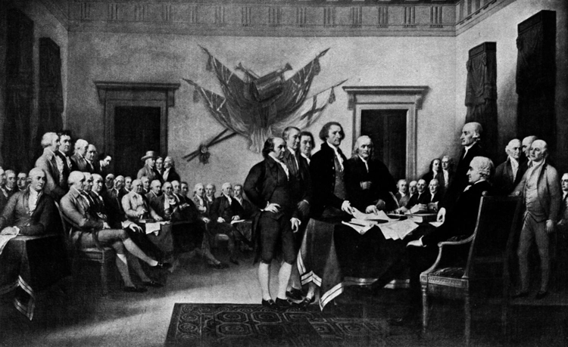
56 MEN SIGNED THE DECLARATION OF INDEPENDENCE OVER SEVERAL MONTHS, WITH THE ADOPTION ON
JULY 4, 1776

Slide 24
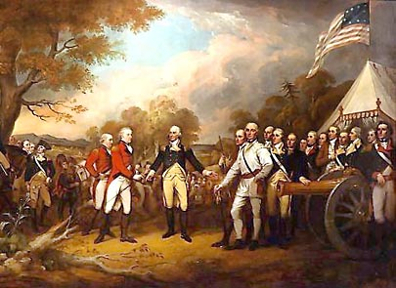
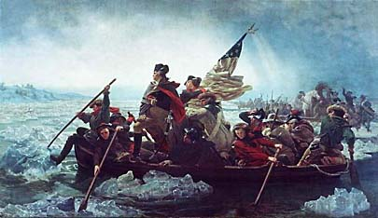
THE WAR FOR INDEPENDENCE LASTED UNTIL 1783 WITH MANY PIVOTAL MOMENTS FOR EACH SIDE
WASHINGTON CROSSED THE DELAWARE RIVER
BATTLE OF SARATOGA

Slide 25
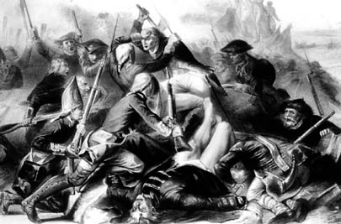
THE COLONISTS, WITH THE HELP OF THE FRENCH, FINALLY DEFEATED THE BRITISH AT THE BATTLE OF YORKTOWN 1781

Slide 26
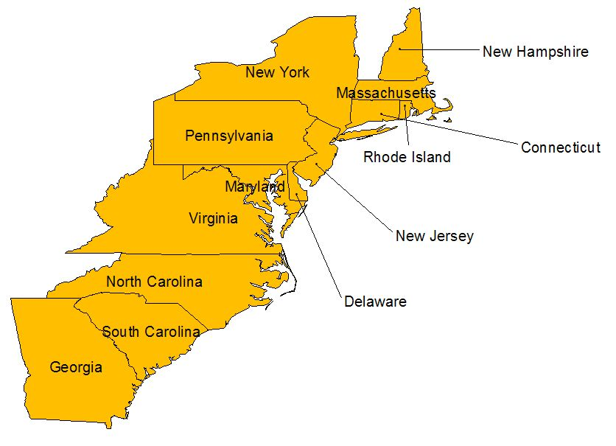
U.S. AFTER THE 1783 TREATY OF PARIS, WHICH ENDED THE AMERICAN REVOLUTION
Area given to the new U.S. by Great Britain in 1783

Slide 27
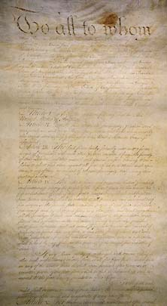
IN 1777 THE ARTICLES OF CONFEDERATION WERE WRITTEN BY THE SECOND CONTINENTAL CONGRESS AS THE FIRST INDEPENDENT GOVERNMENT IN THE UNITED STATES OF AMERICA. IT WAS OFFICIALLY ADOPTED IN 1781.

Slide 28
THE ARTICLES REFLECTED THE FEAR OF A STRONG EXECUTIVE BRANCH AND LACKED THE ABILITY TO FUNCTION IN SEVERAL IMPORTANT AREAS
NO POWER
TO TAX
NO DIRECT
POWER OVER
CITIZENS
COULD NOT
ENFORCE LAWS
WEAKNESSES OF
THE ARTICLES
OF CONFEDERATION
COULD NOT
BE CHANGED WITHOUT
CONSENT OF ALL
13 STATES
COULD NOT
REGULATE TRADE

Slide 29
SHAY’S REBELLION
DANIEL SHAY LEFT HIS FARM IN WESTERN MASSACHUSETTS TO SERVE AS A CAPTAIN IN THE REVOLUTIONARY ARMY. UPON HIS RETURN IN 1787 HE WAS FORCED TO IMMEDIATELY PAY BACK DEBTS. HE AND OTHERS PETITIONED THE GOVERNMENT FOR AN EXTENSION WHICH WAS DENIED. IN RESPONSE HUNDREDS OF FARMERS, WITH SHAY AS THEIR LEADER, MARCHED TO THE COURTHOUSE TO DISRUPT THE PROCESS OF SEIZING FARMS FROM PEOPLE UNABLE TO PAY BACK DEBTS. ABOUT 1200 MARCHED TO SPRINGFIELD WHERE THE STATE ARSENAL WAS LOCATED. MILITIA WAS PRIVATELY HIRED AS THE GOVERNMENT WAS UNABLE TO ACT DIRECTLY UPON CITIZENS. FIGHTING BROKE OUT BETWEEN SHAY’S FOLLOWERS AND THE MILITIA, RESULTING IN THE DEATHS OF FOUR FARMERS. SHAY WAS SENTENCED TO DEATH FOR HIS PARTICIPATION IN THE REBELLION.
THIS EVENT INDICATED THAT THE NEW GOVERNMENT WAS POWERLESS TO ACT IN A TIME OF CRISIS. IT LED TO THE CONSTITUTIONAL CONVENTION HELD THE NEXT YEAR.

