Slide 1
Chapter 3
Part 4

Slide 2
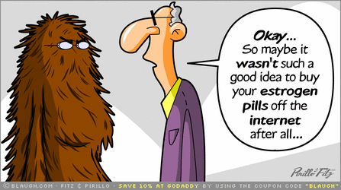
I. The Endocrine System
The communication from the neural system is very fast and effective, but it does not last very long. The neurotransmitters come and go quickly, so their effect is quick as well.
There are other chemicals that also transmit messages in the body, and they stay in the body longer. Those chemicals are hormones.
Notes:
https://dianeshealthandwellness.files.wordpress.com/2013/04/estrogen-cartoon.gif

Slide 3
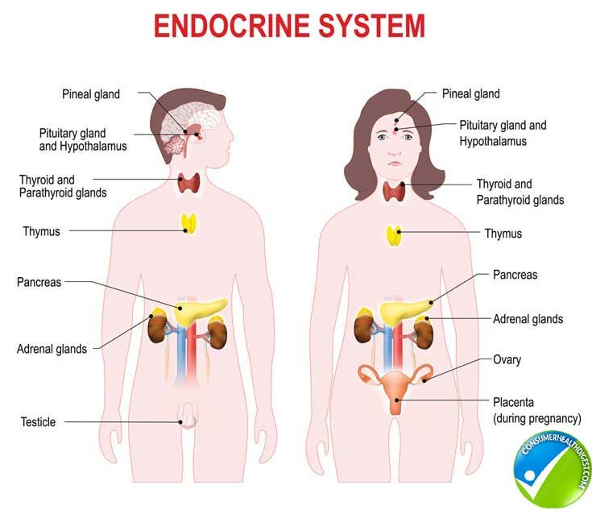
I. The Endocrine System
Hormones activate parts of the body in response to outside and internal stimuli. Glands within the body store and release hormones when the need arises or the brain commands it.
The system of glands throughout the body is called the endocrine system, and it includes the hormones that are released.
Notes:
https://www.consumerhealthdigest.com/wp-content/uploads/2017/07/endocrine-system-info.jpg

Slide 4
II. The Pituitary Gland
The pituitary gland is called the master gland of the body because it commands other glands to function. It even has control over what the brain and other organs do.
The pituitary sends out growth hormones that cause your body to grow and develop. It starts and stops producing it, but in the end most people will average out their height.
Notes:
https://media.giphy.com/media/ZIqbJ5Tbm6N0I/giphy.gif

Slide 5
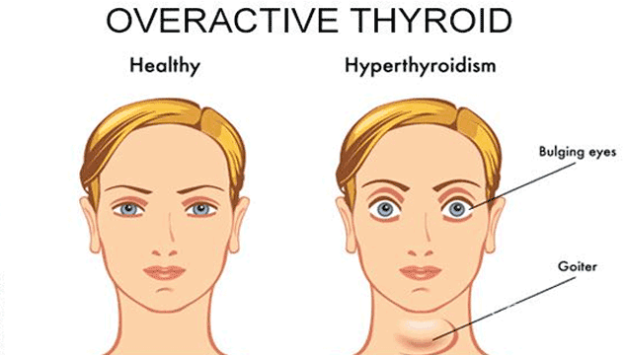
III. The Thyroid Gland
The thyroid gland is located in the throat area and is in charge of metabolism, or the speed of your bodily processes.
It can increase or decrease your energy, and even has an affect on your emotional state.
Notes:
https://www.conceiveeasy.com/wp-content/uploads/2015/09/can-i-get-pregnant-with-overactive-thyroid.png

Slide 6
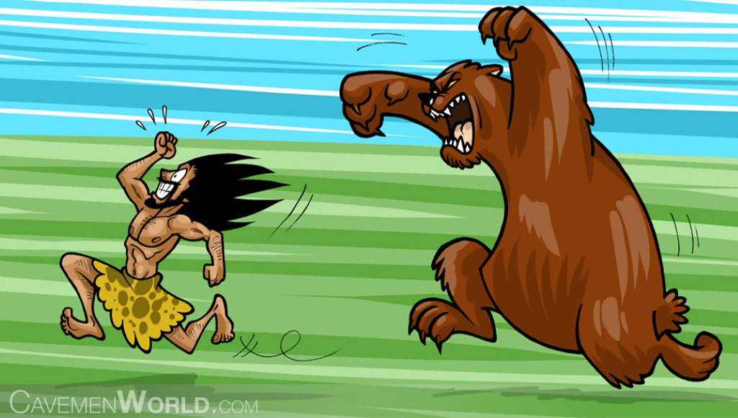
IV. The Adrenal Glands
The Adrenal glands are located just above the kidneys, and they produce adrenaline that provides energy in response to emergency situations.
It increases blood pressure and heart beats, and dumps sugar into the bloodstream for increased energy.
Notes:
http://www.cavemenworld.com/wp-content/uploads/2012/12/adrenaline-the-bodys-kick-starter-a-huge-bear-is-attacking-a-caveman.jpg

Slide 7
V. The Gonads
These are the sex glands that produce eggs or sperm for reproduction. The male sex hormone is called androgen, and the female sex hormone is estrogen. They are both in male and female bodies, but males have an abundance of androgen, females have estrogen.
Unlike animals, sex and sex drives are not strictly a result of the sex hormones. They do initiate the sex drive, but then the cerebral cortex takes over and the desire stays.
Notes:
https://tenor.com/view/manly-gif-5680327

Slide 8
In your notebooks
Answer review questions 1-20 on page 85. notebooks due tomorrow.

