Slide 1
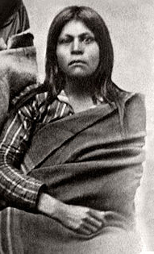
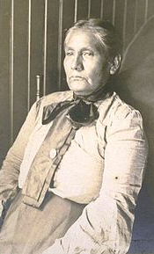
Gabrielino
By Noah Galvan and Javier Gonzalez
This Photo by Unknown author is licensed under CC BY-SA.
This Photo by Unknown author is licensed under CC BY-SA.

Slide 2
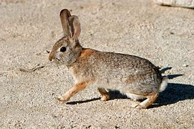
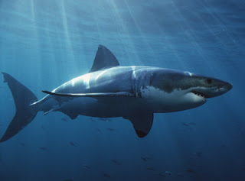
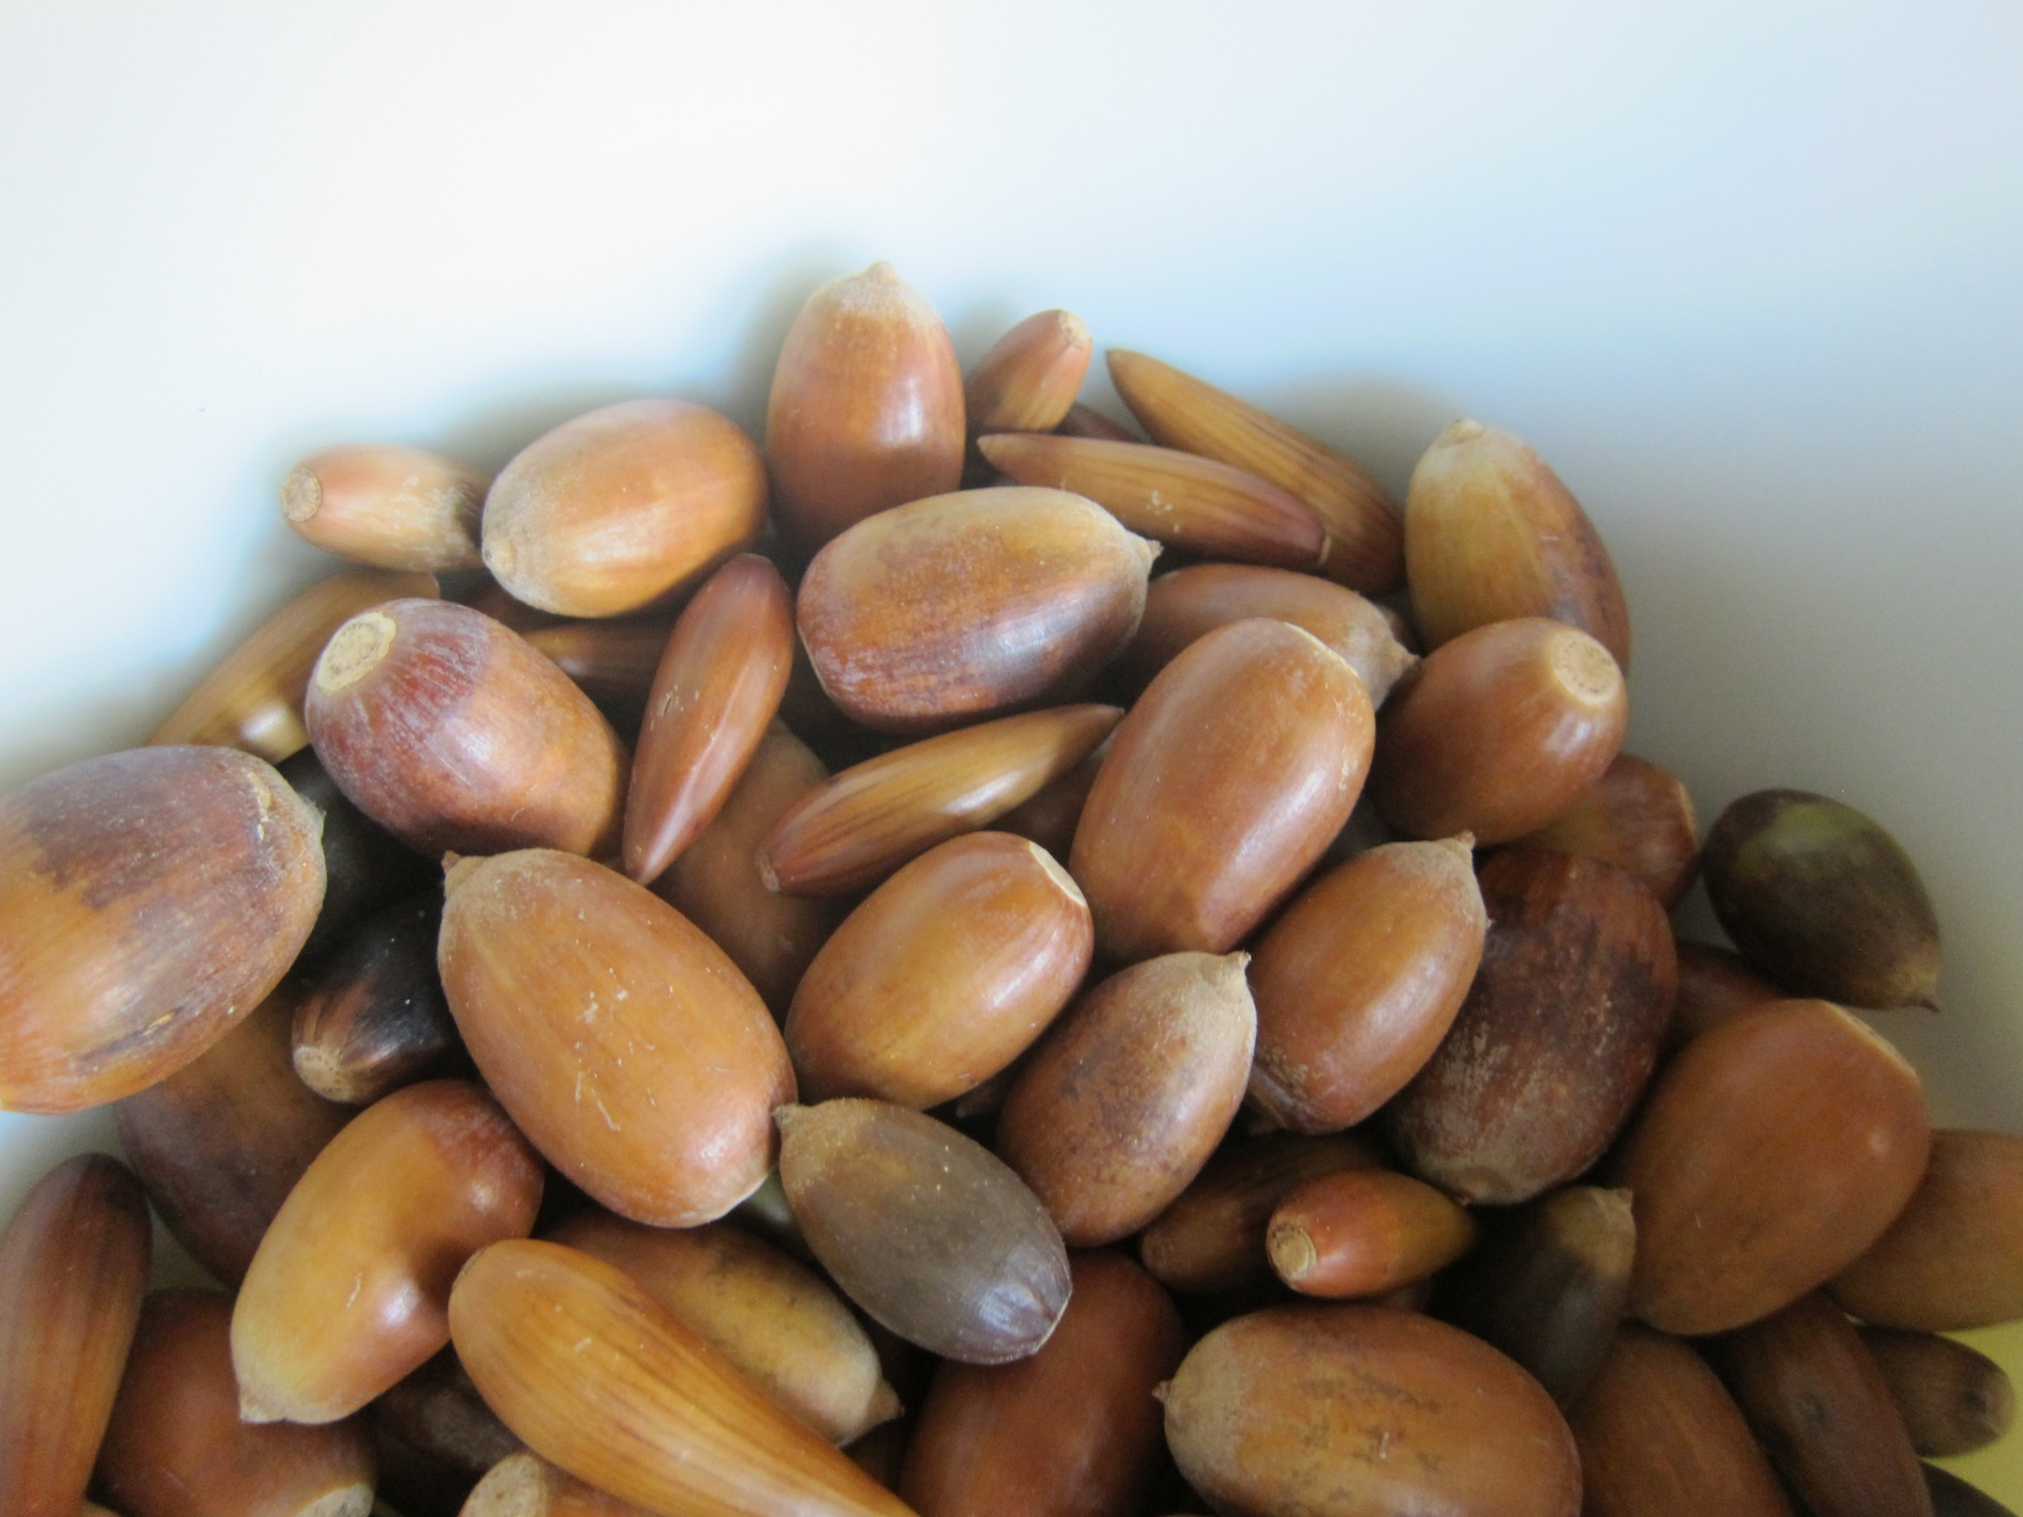
Food
The food of the Gabrielino tribe was found in nature. They ate nuts, seeds, fruits, and deer. They also ate swordfish and sharks. They also ate squirrels and rabbits.
This Photo by Unknown author is licensed under CC BY-SA.
This Photo by Unknown author is licensed under CC BY-SA.
This Photo by Unknown author is licensed under CC BY-SA.
This Photo by Unknown author is licensed under CC BY-SA.
This Photo by Unknown author is licensed under CC BY-SA.
This Photo by Unknown author is licensed under CC BY-NC.

Slide 3
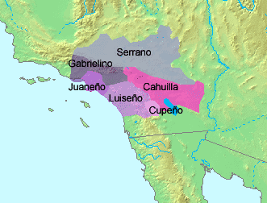
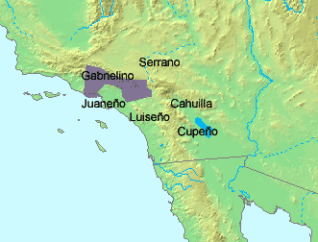
Location
The Gabrielino tribe lived in the southern coast of California.
Gabrielino was near the Pacific Ocean.
Gabrielino lived near the same place as we live.

Slide 4
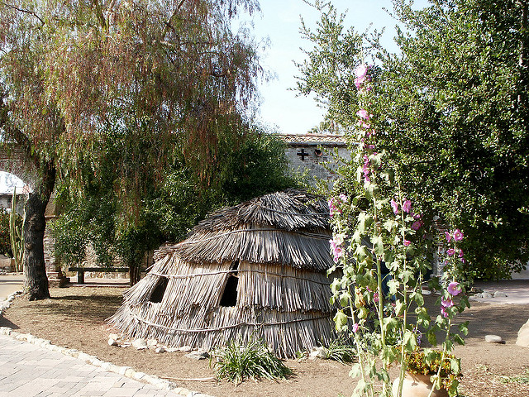
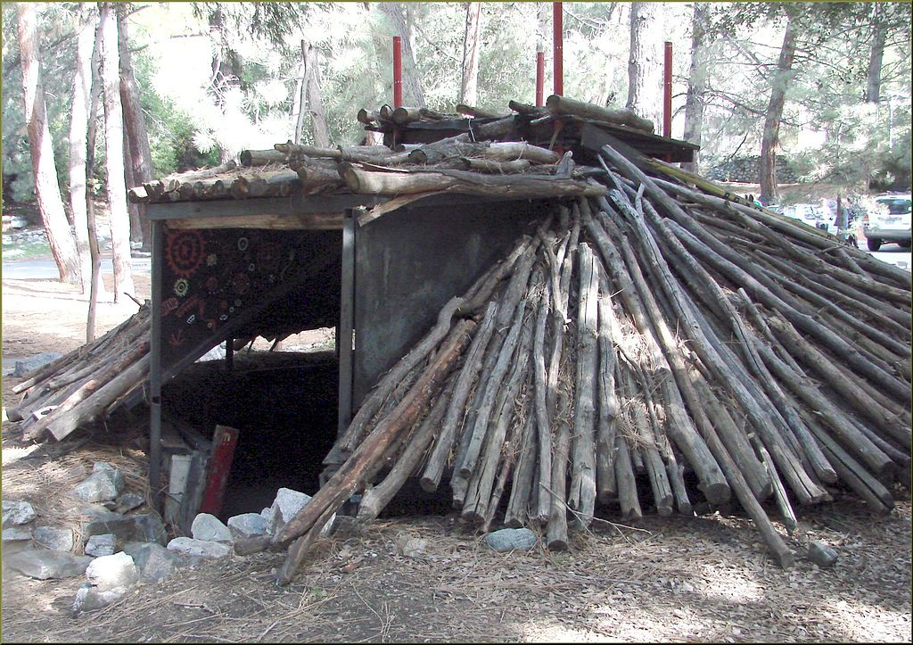
Shelter
The home of the Gabrielino tribe was built for protection. The shelter was made of tree saplings covered with tule mats. They also made huts made of hay and wood . They built villages by the coast, rivers and streams.

Slide 5
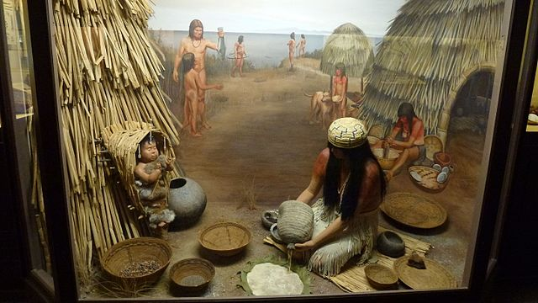
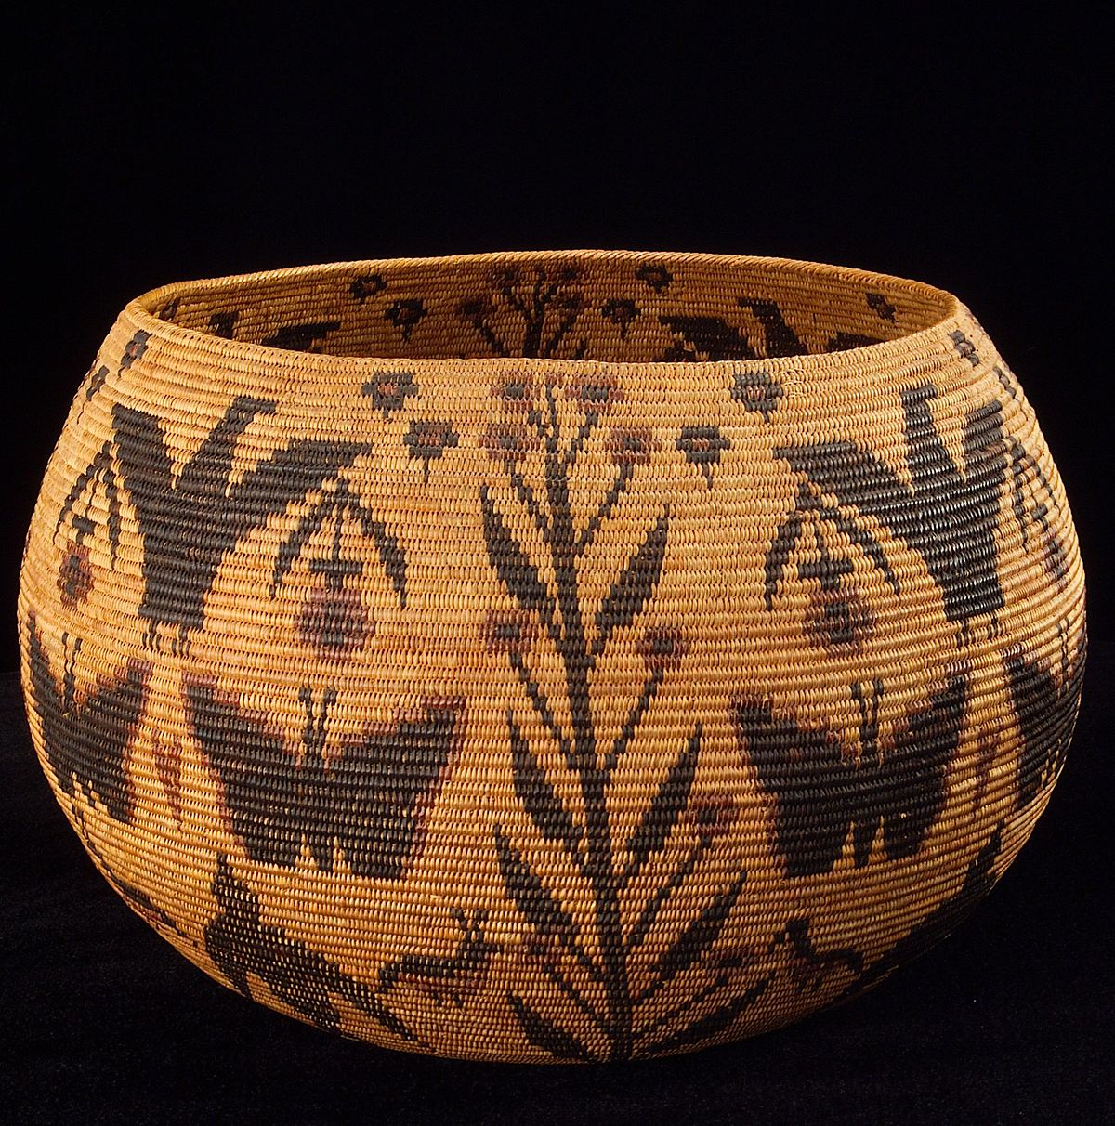
Culture
The culture of the Gabrielino tribe was interesting. Women were expert basket makers using reeds and grasses. They were probably the most richest and powerful group. They wore outfits made with hawk and eagle feathers. They had strong plank boats and carved whales from soapstone.
This Photo by Unknown author is licensed under CC BY-SA.
Thisnknown author is licensed under CC BY-SA.

Slide 6
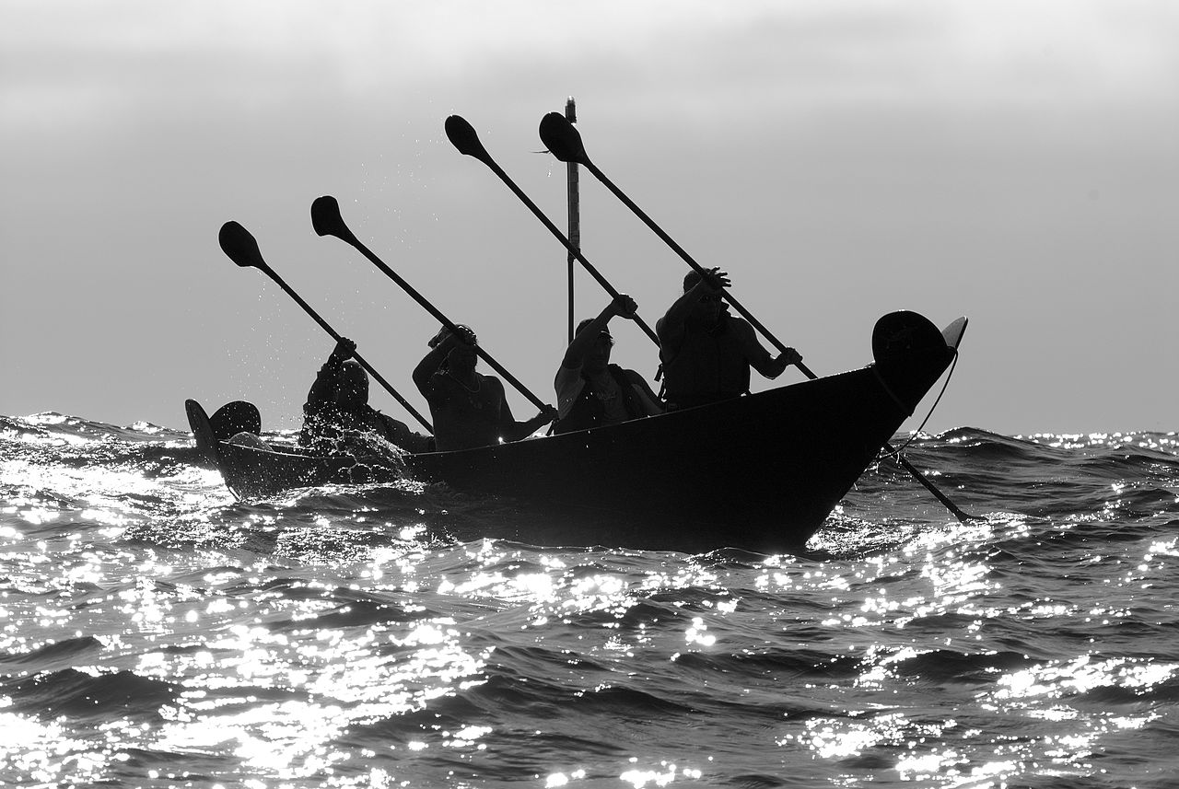
.
This Photo by Unknown author is licensed under CC BY-NC-ND.
This Photo by Unknown author is licensed under CC BY-NC-ND.
This Photo by Unknown author is licensed under CC BY-SA.
This Photo by Unknown author is licensed under CC BY-SA.

