Slide 1
Mojave tribe
by Jacob and Bradley
This Photo by Unknown author is licensed under CC BY-NC-ND.

Slide 2
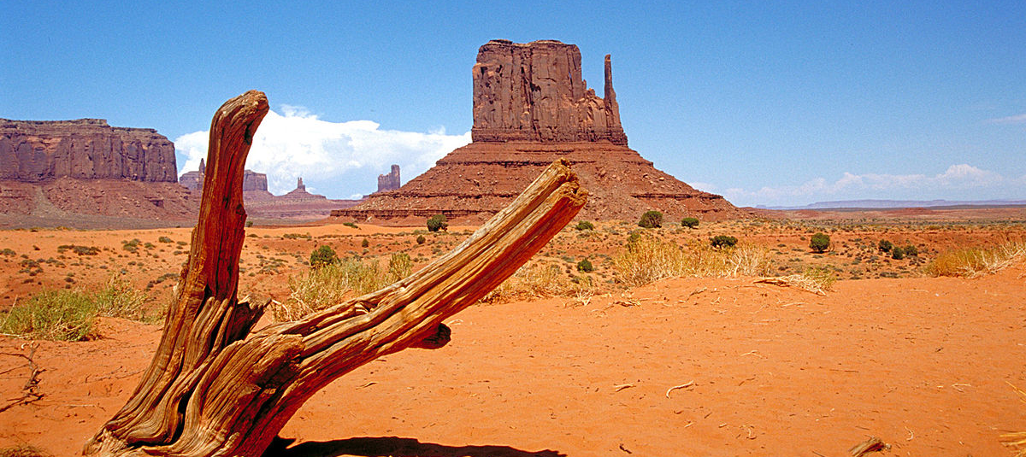
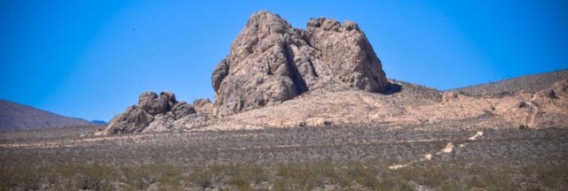
Location
The Mojave tribe lived in southeastern California.
They had rich soil from yearly floods.
There was hot weather during the summer.

Slide 3
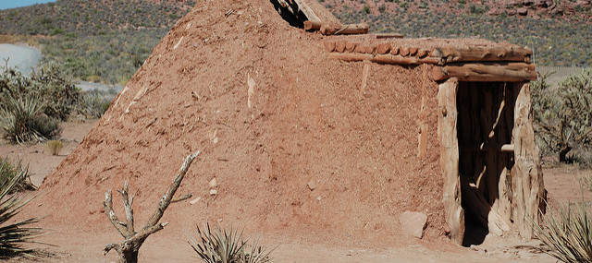
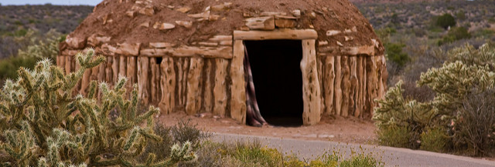
Shelter
Their shelters were perfect for them.
They lived around farming land.
They used poles for their walls and grass as their roof.
This Photo by Unknown author is licensed under CC BY-SA-NC.
This Photo by Unknown author is licensed under CC BY-SA-NC.

Slide 4
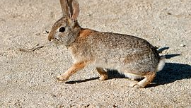
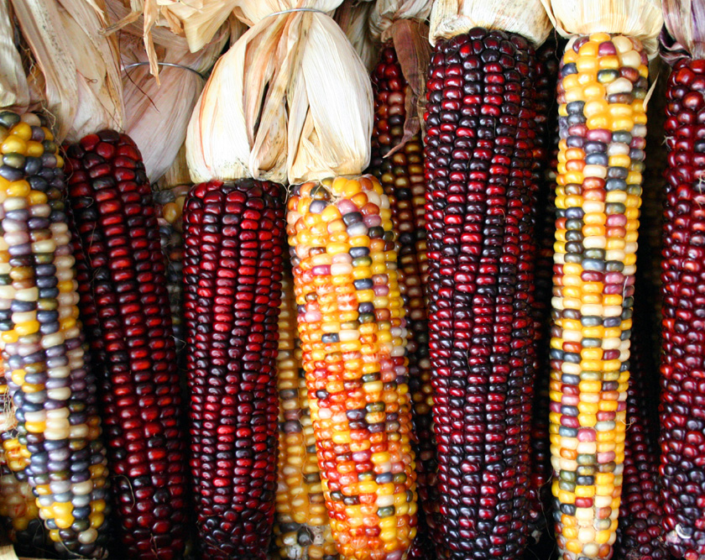
Food
The Mojave tribe's food was found in nature.
They ate beans, melons, pumpkins, and roasted caterpillars.
They used traps and nets to catch food.
This Photo by Unknown author is licensed under CC BY-SA.
This Photo by Unknown author is licensed under CC BY-SA.

Slide 5
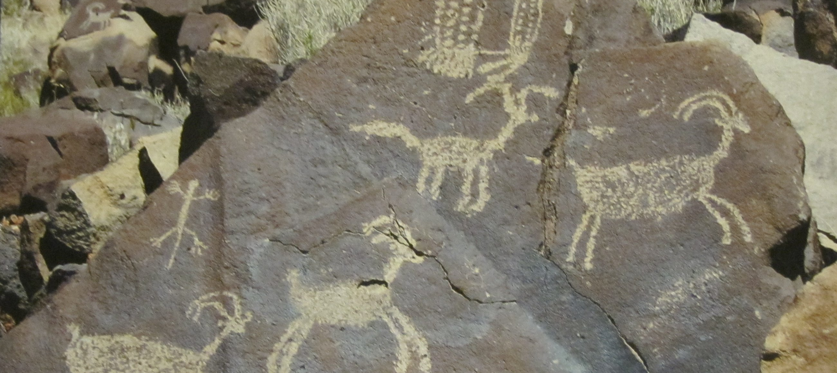
Culture
The Mojave tribe's culture is interesting.
They made cord from twisting plant fiber.
They made woven baskets to store food.
This Photo by Unknown author is licensed under CC BY-SA.
This Photo by Unknown author is licensed under CC BY-SA.

Slide 6
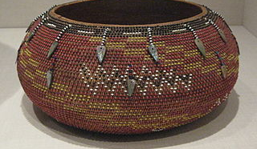
Trading
The Mojave tribe traded with people far away.
They traded pots for clothes.
They also traded wheat for tools.
Photo by is licensed under CC BY-SA.

Slide 7
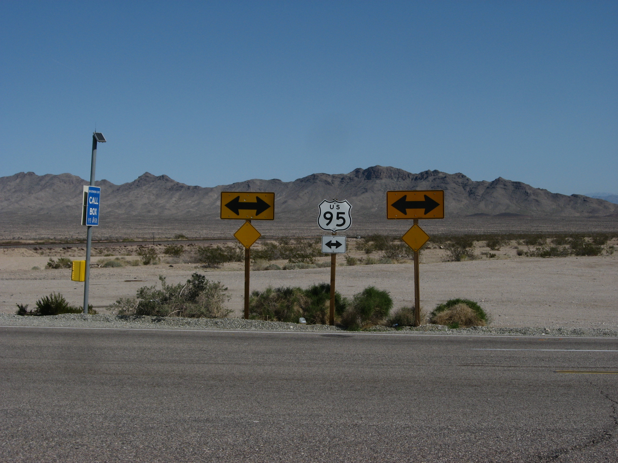
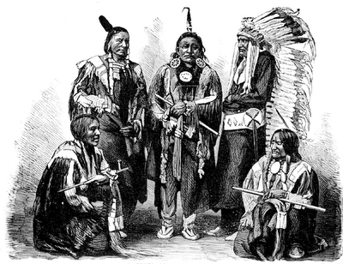
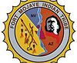
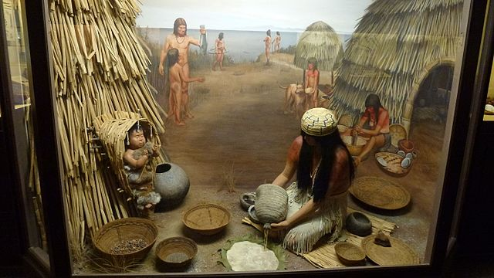
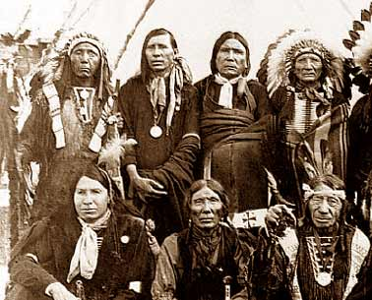
This Photo by Unknown author is licensed under CC BY-ND.
This Photo by Unknown author is licensed under CC BY-SA.
This Photo by Unknown author is licensed under CC BY-SA.

