Slide 1
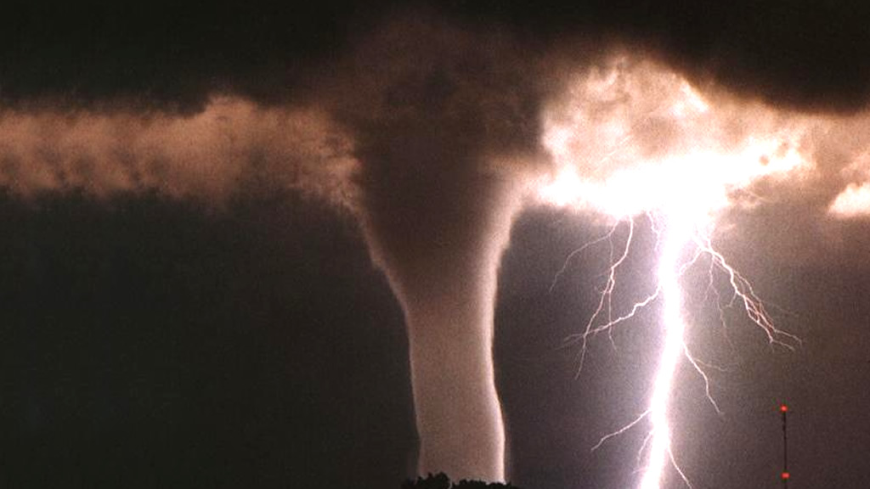
Weather & Climate
By Jayden and Sophie

Slide 2
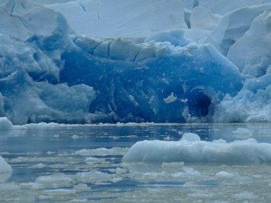
Polar Climate Zone
The polar climate zone is a cold zone that is frozen and many arctic animals live there. It is located in the South pole and the North pole. No plants can grow there because it is too frozen.

Slide 3
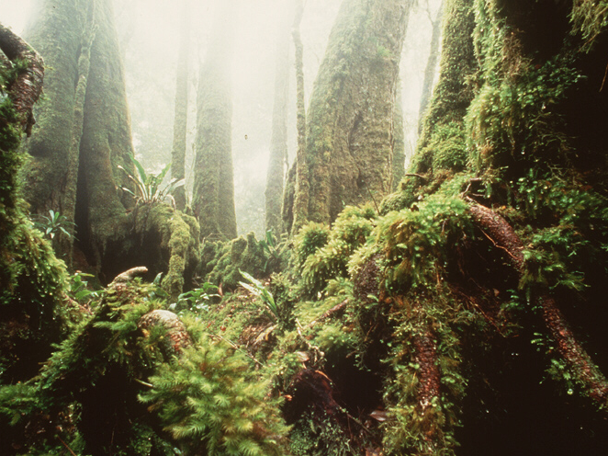
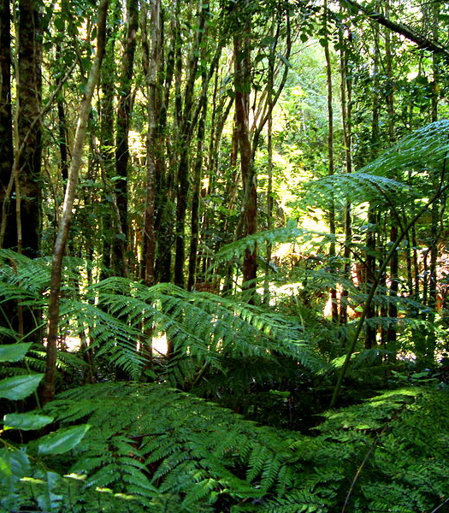
Temperate Climate Zone
The weather in the temperate climates is never too extreme. Summers are warm and wet. Winters are cool and dry. They are never too cold or never too hot.

Slide 4
Tropical Climate Zone
The tropical zone is a hot, wet place where sloths live. It rains a lot in that climate zone . This climate zone is located around the equator. The warm and wet climates are a perfect place to grow plants and trees..

Slide 5
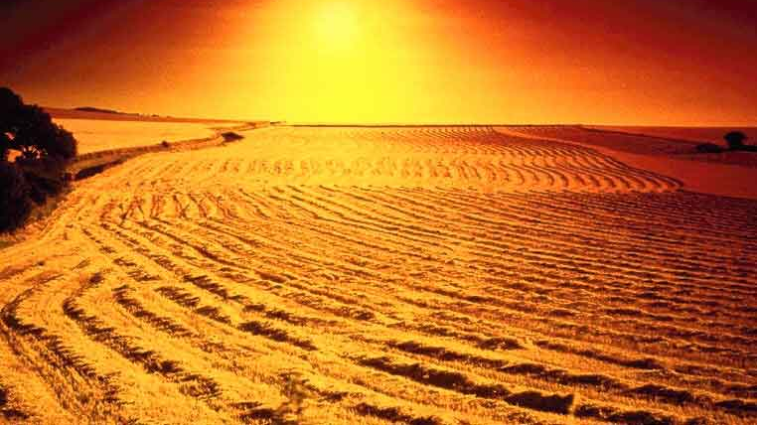
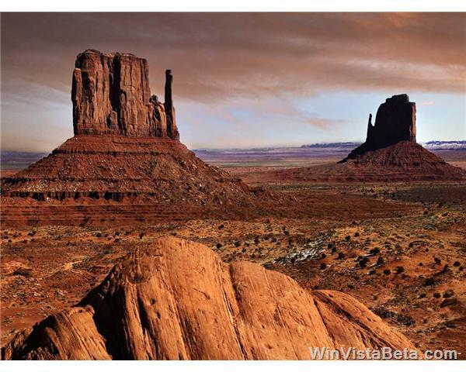
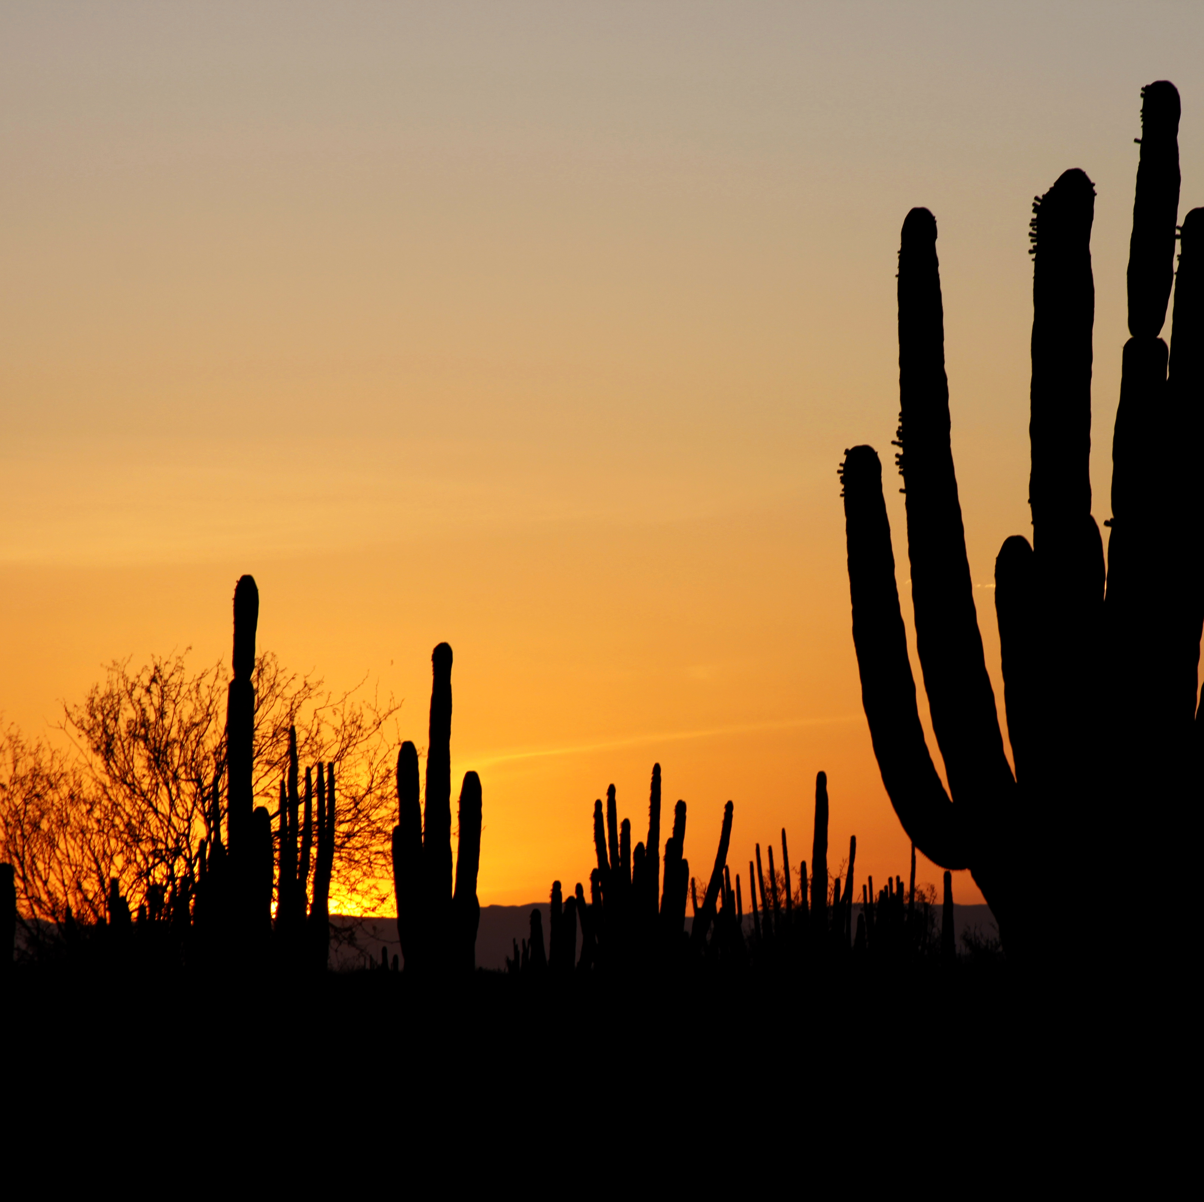
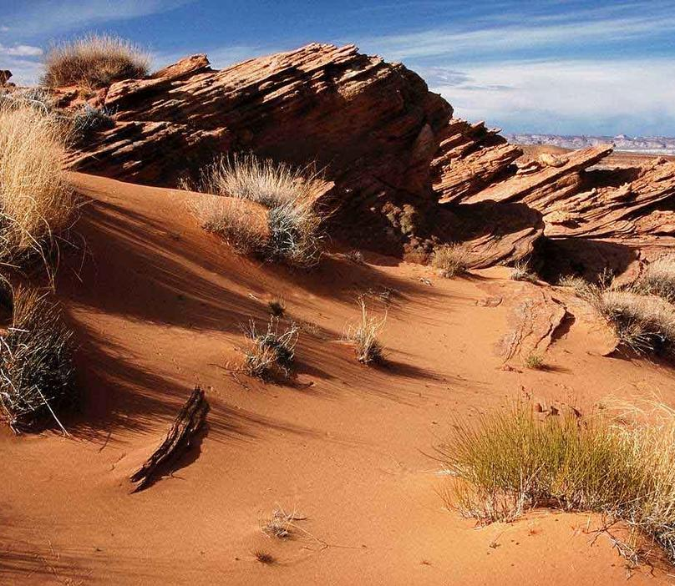
Desert Climate
The Desert climate is a hot climate with animals such jack Rabbits, kangaroo Rats and, rattle Snakes . Plants can grow but they die because there is not enough water there.

Slide 6
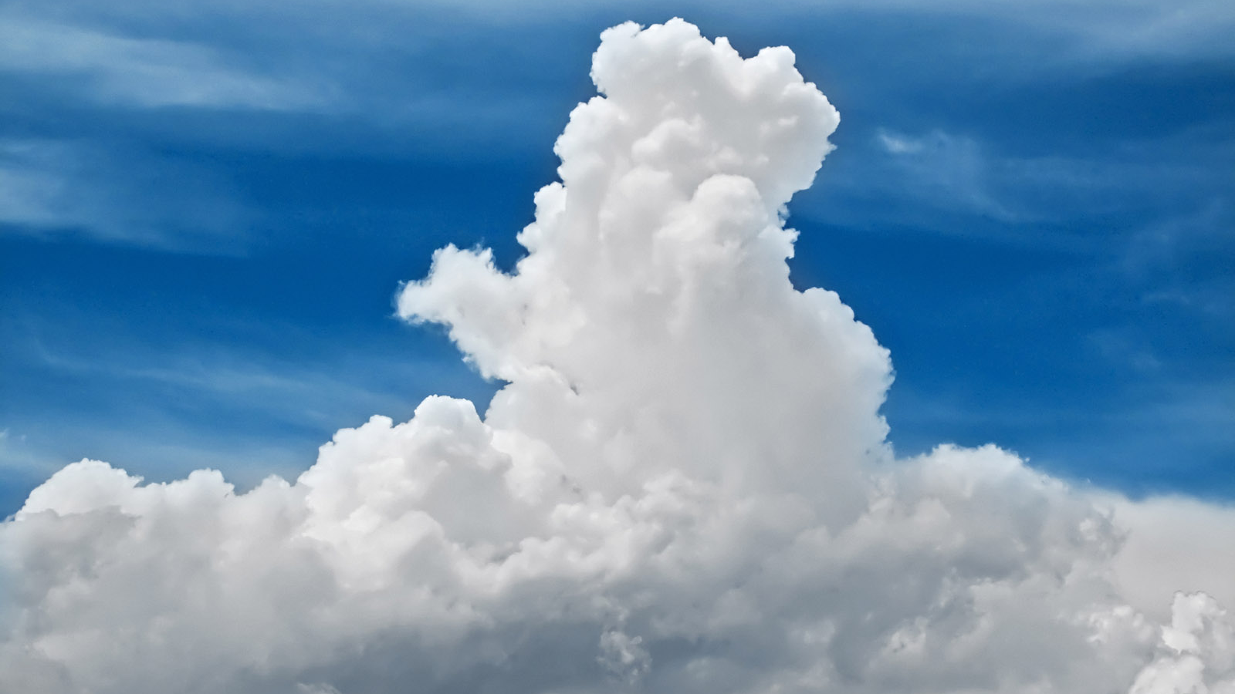
Cumulus Clouds
The Cumulus clouds are fair weather clouds that look like floating cotton candy. They are also white and fluffy with a flat bottom and they are not that tall.

Slide 7
Cumulonimbus Clouds
They can take up several miles across the sky and reach the elevation of 39,000 feet or higher because of very strong updrafts in the atmosphere.

Slide 8
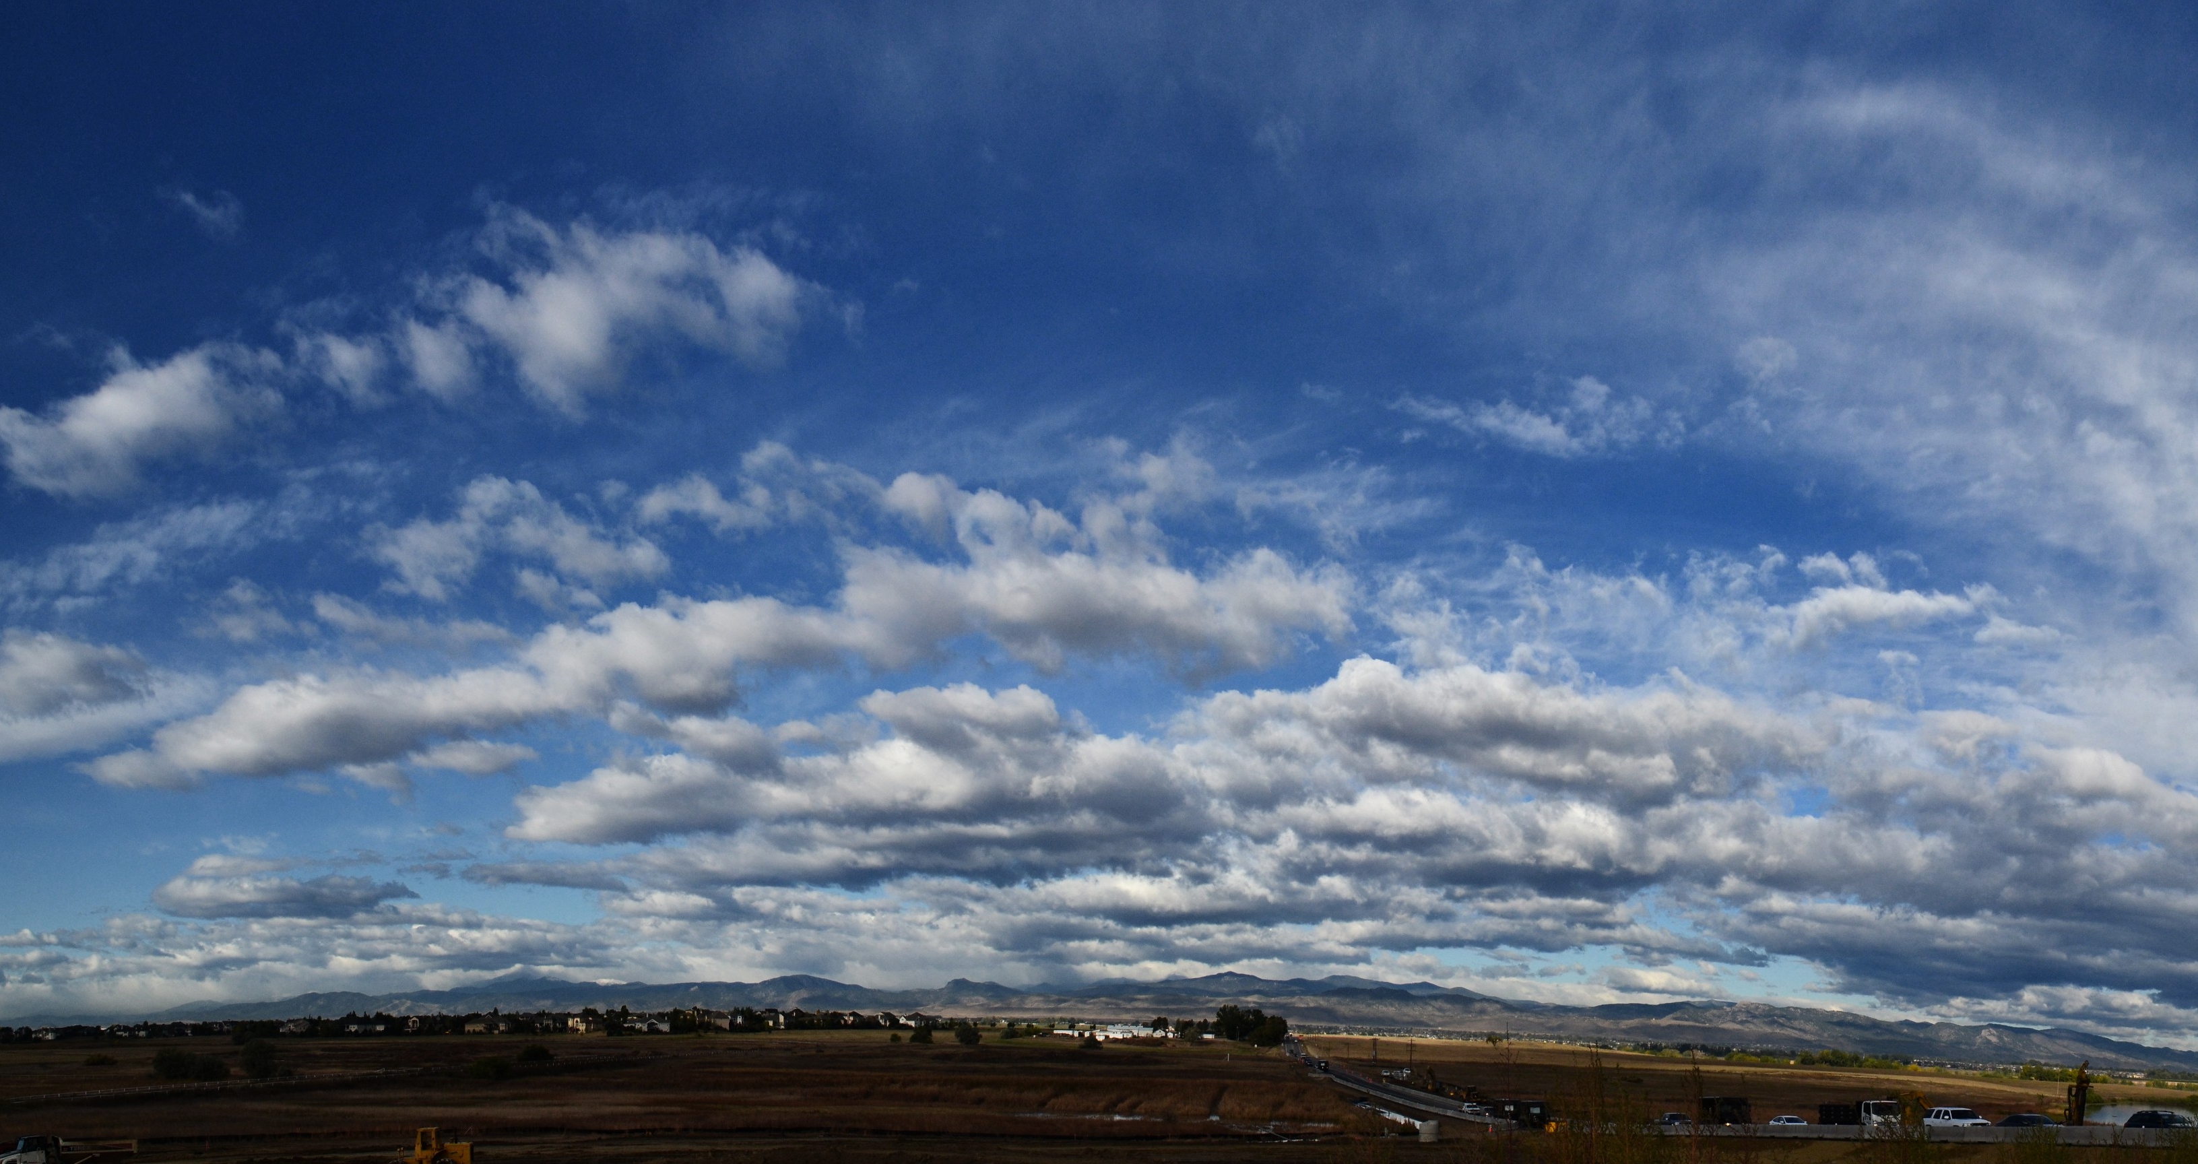
Stratus Clouds
Stratus clouds are among the low-lying clouds.
They also make the thick fog in the morning
They are spread out clouds with no storm.

Slide 9
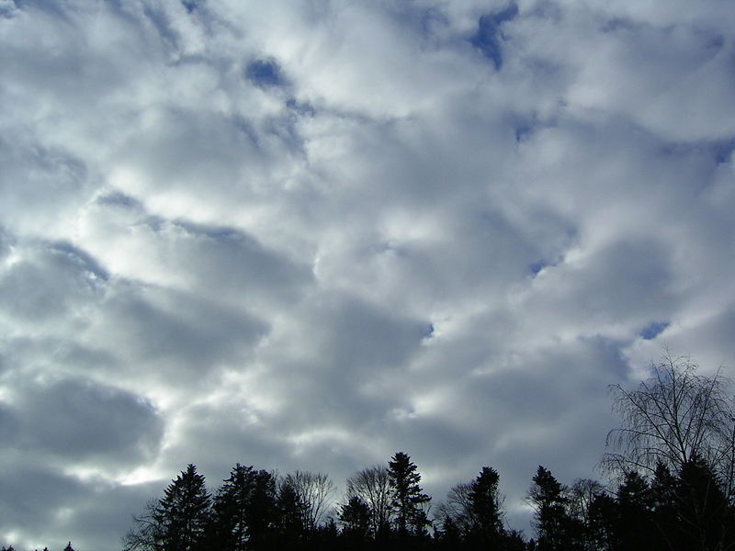
Stratonimbus Clouds
Stratonimbus Clouds blanket the sky with long storms that last all day long. They are also very dark and stormy clouds and brings rain.

Slide 10
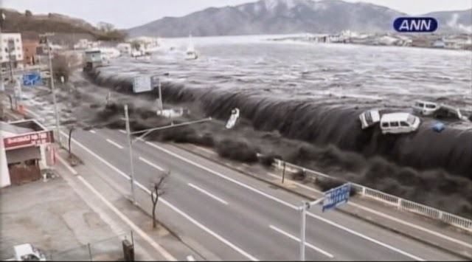
Extreme Weather-Tsunami!
A Tsunami is a huge wave that covers the whole beach and the surroundings that can flood buildings and take down houses.

Slide 11
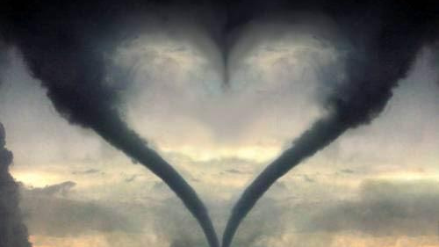
Extreme Weather –Tornado!
Tornadoes are made from hot air and cold air chasing each other around. It makes a funnel and becomes so powerful that it can take away houses forever.

Slide 12
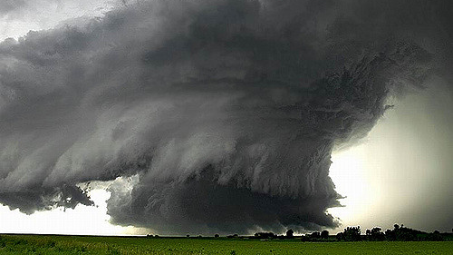
Extreme weather- Hurricane
Hurricanes are huge spinning storms that develop in warm areas around the equator. Hurricanes bring strong winds, heavy rains and sometimes even tornados.

