Slide 1
Pomo
By Adrianna Geiss

Slide 2
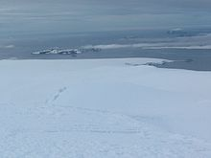
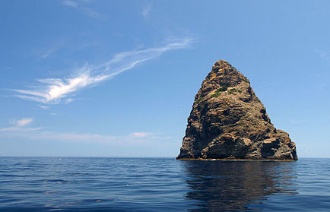
LOCATION
Pomo weather is cold, chilly, wet, and damp.
They live along the Russian River.
They lived along coastal ranges too.

Slide 3
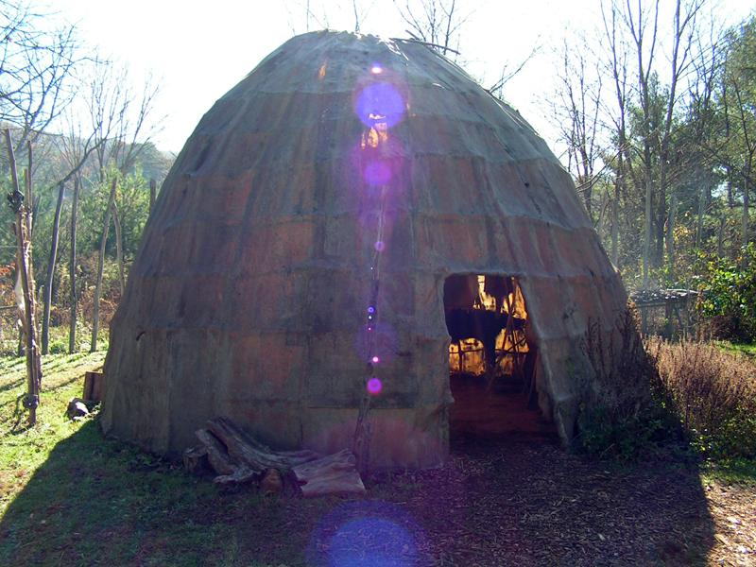
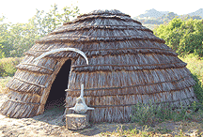
SHELTER
They had bent poles to make an upside down bowl shape.
They were built over holes dug in the ground.
They had holes in the top to let out smoke.
They lived in large communities.

Slide 4
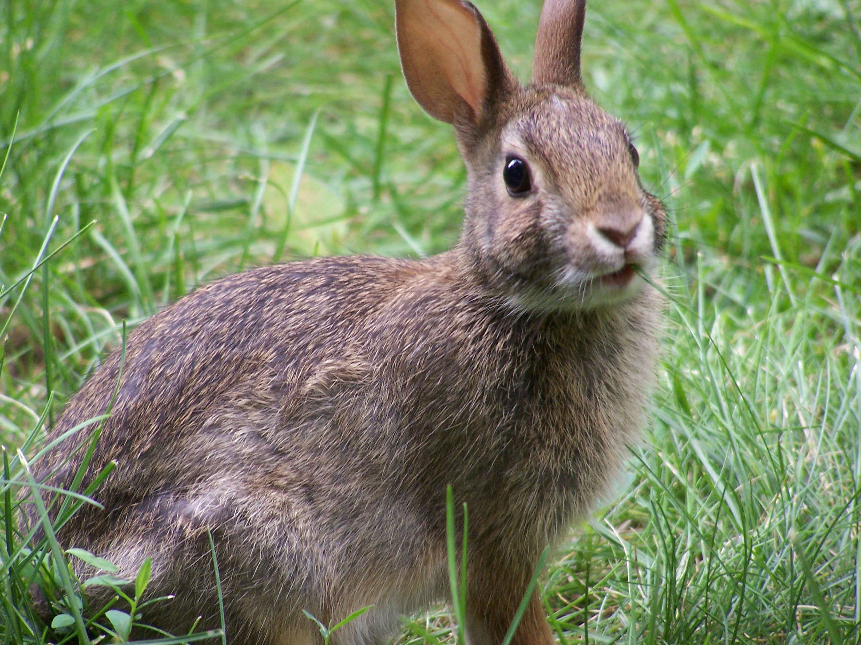
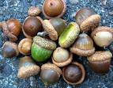
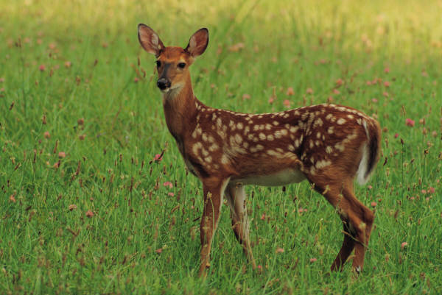
FOOD
Acorns were their most important food.
They gathered seeds, nuts, and berries to eat.
Rabbit and deer were a meat of their choice.
They also fished for fish.

Slide 5
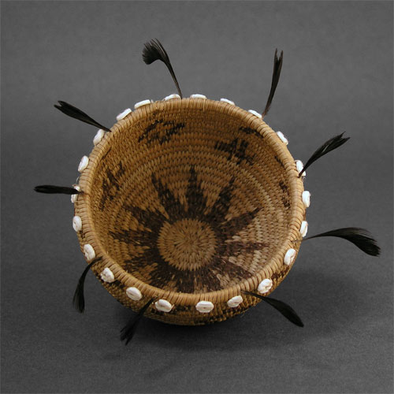
CULTURE
They were the most popular basket makers.
Some of the baskets were 3 feet tall!
Shells and feathers could be woven into them.
They believed that animals, trees, rocks, and rivers all had spirits.

Slide 6
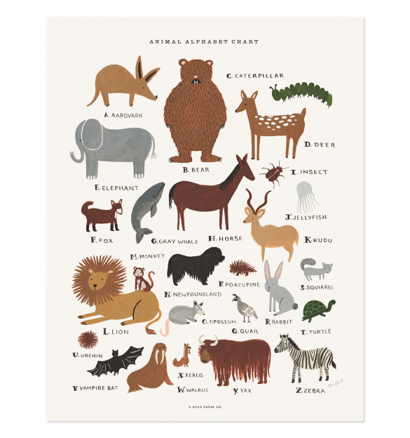
LANGUAGE
The Pomo spoke Hokan.
It is one of the most popular Native American languages.
The Pomo were the only tribe to have no word for famine or parish.

Slide 7
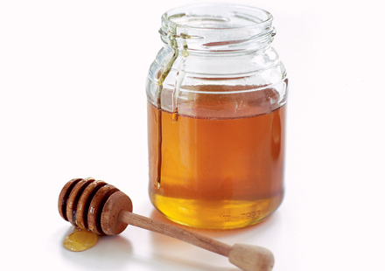
MEDICINE
Their doctors were called Shaman.
Shaman sang powerful songs.
Pomo people believed that Shaman sucked out disease or poison.
Pomo people also believed in a Kuksu or Guksu would heal illnesses at ceremonies.

