Slide 1
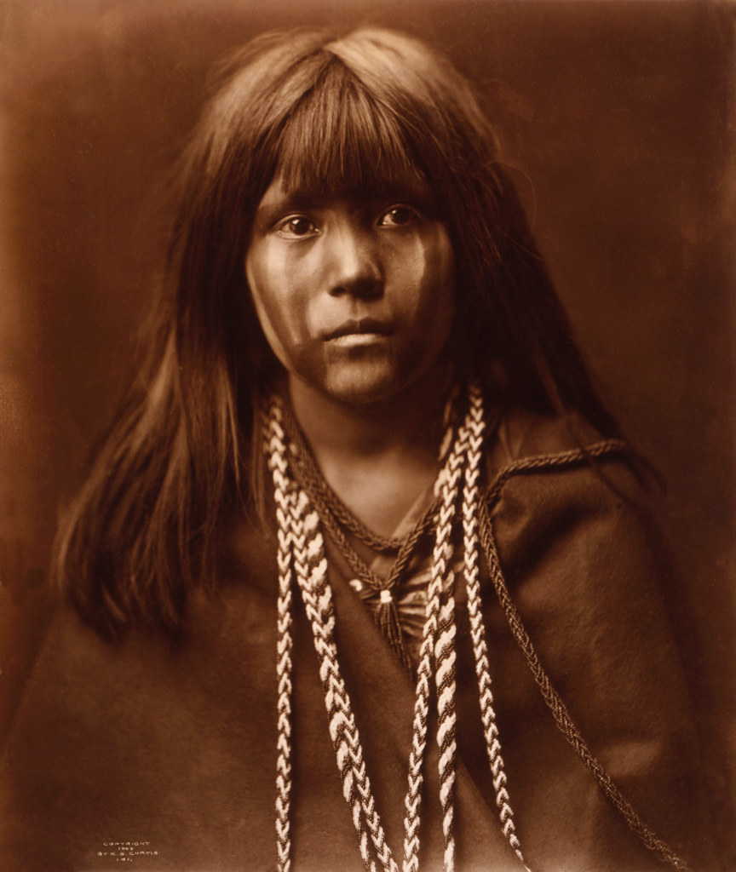
Mojave
By Arie

Slide 2
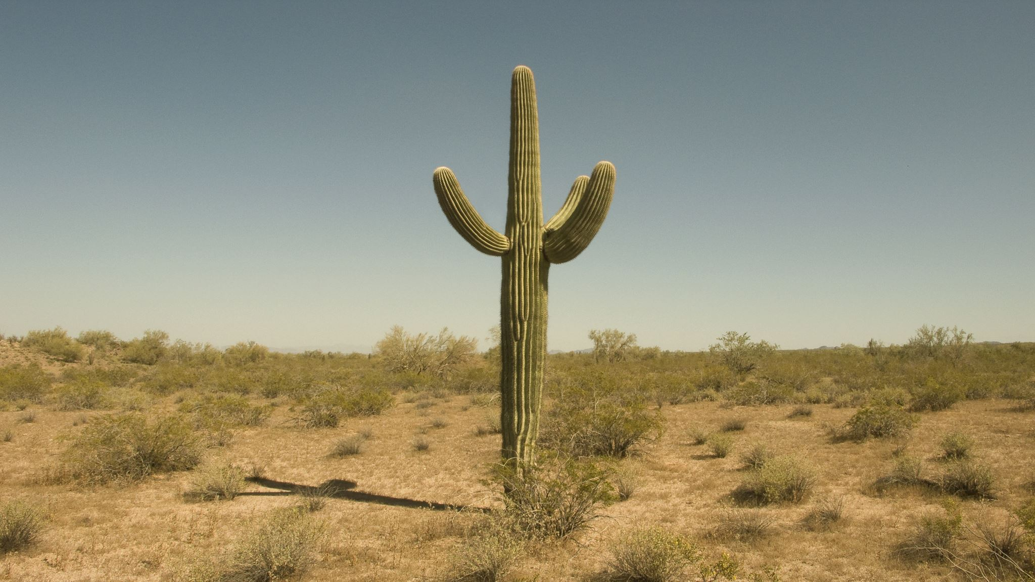
Location
The location is in the desert of California and Arizona.
The climate is super hot. The land had cacti ,sand, and mountains.
The land very divers and harsh weather.

Slide 3
This Photo by Unknown author is licensed under CC BY-NC-ND.

Slide 4
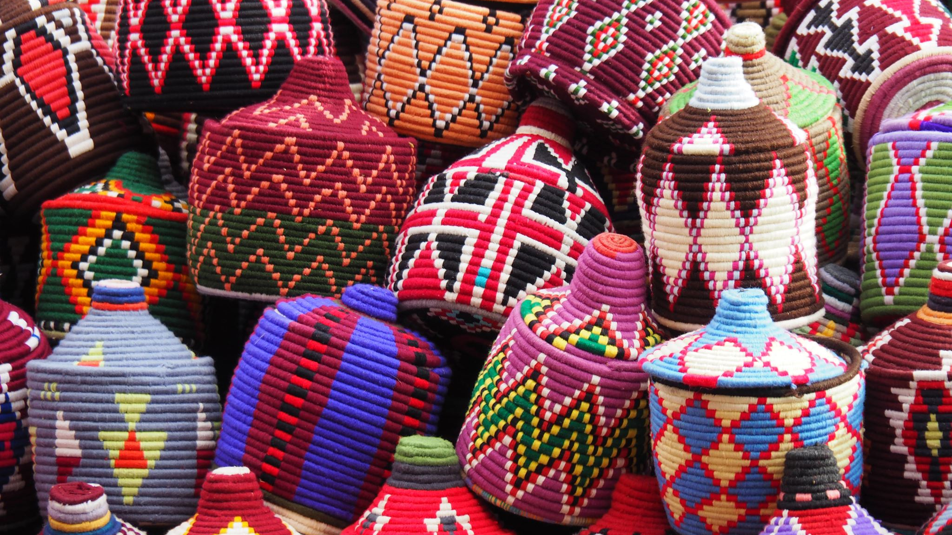
Culture
Their culture is unique.
They painted their faces.
They used baskets for seeds.

Slide 5
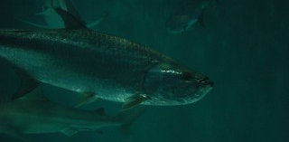
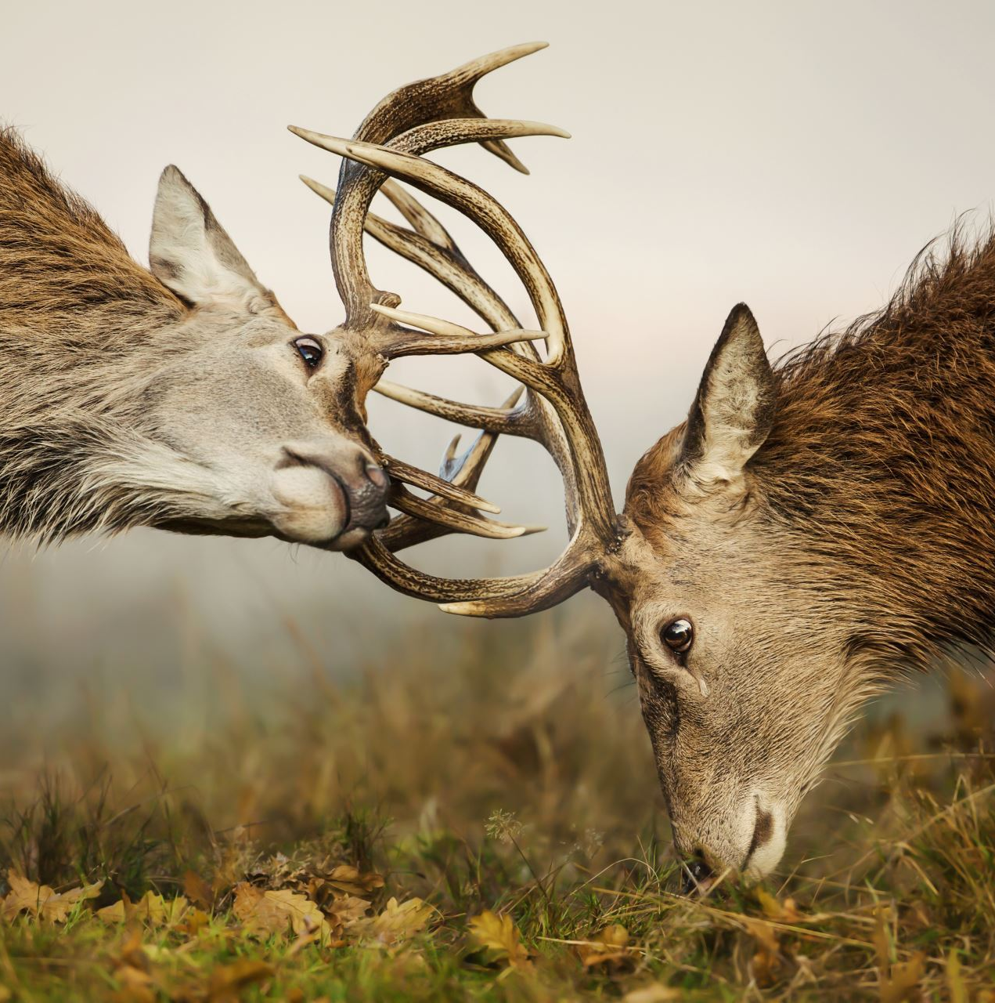
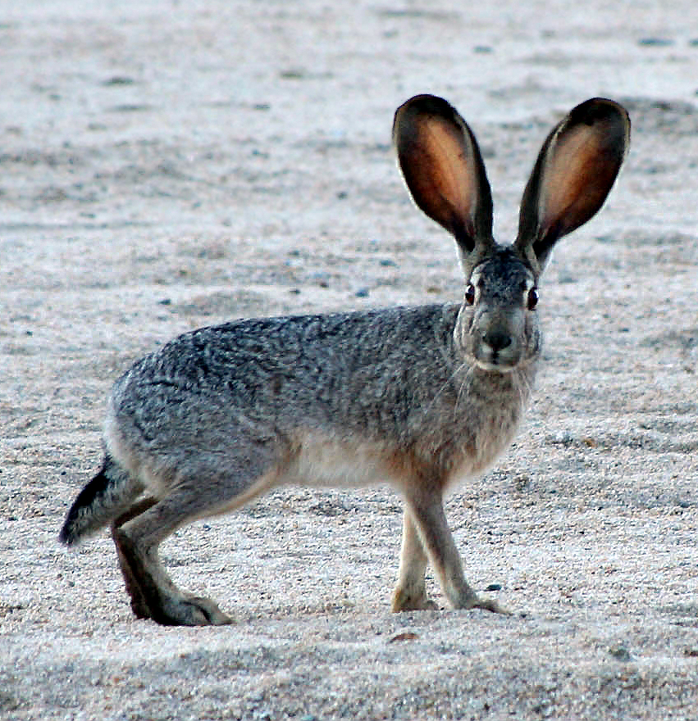
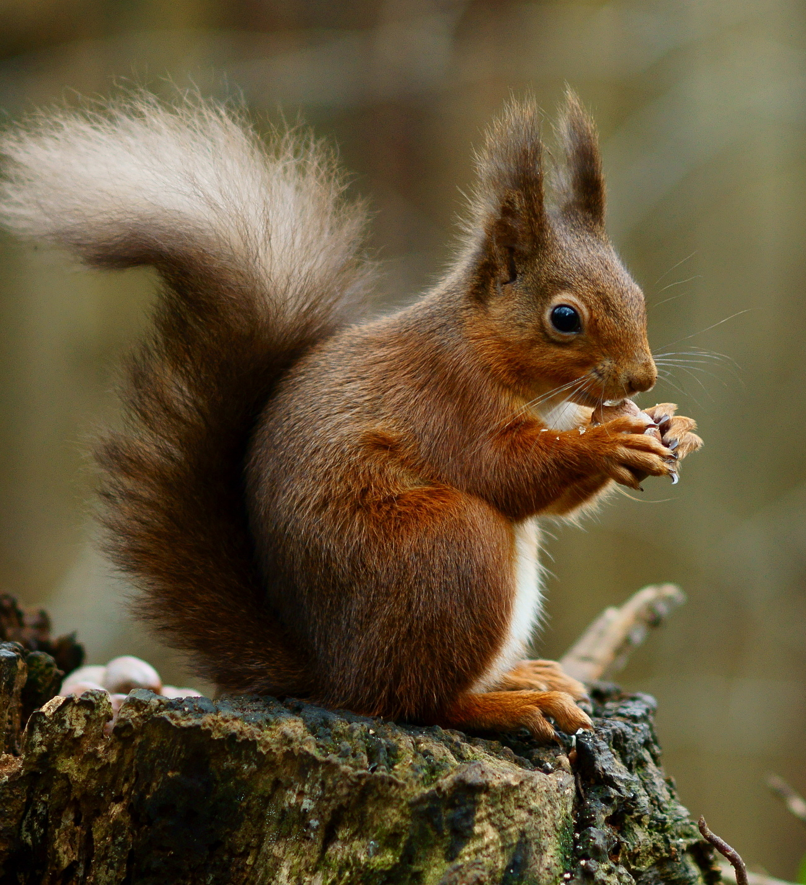
FOOD
They hunted bunnies, deer, and ground squirrels.
They farmed corn, melons, pumpkins, and beans.
They also fished for large fish.
This Photo by Unknown author is licensed under CC BY-SA.
This Photo by Unknown author is licensed under CC BY.
This Photo by Unknown author is licensed under CC BY-SA.

Slide 6
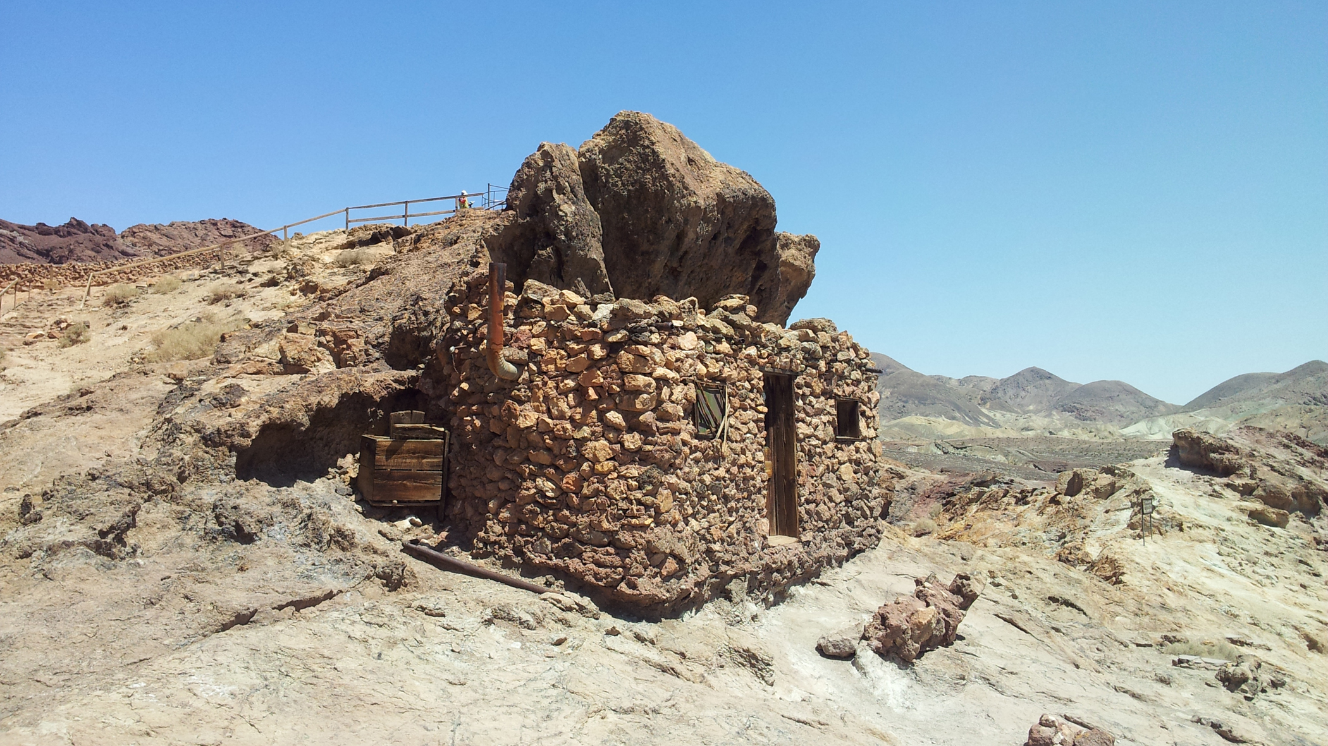
Shelter
They had two types of homes.
One of homes is called Ramadas. The homes protected them from nature.
In the summer the houses had no walls and in winter the houses had walls.
This Photo by Unknown author is licensed under CC BY.

Slide 7
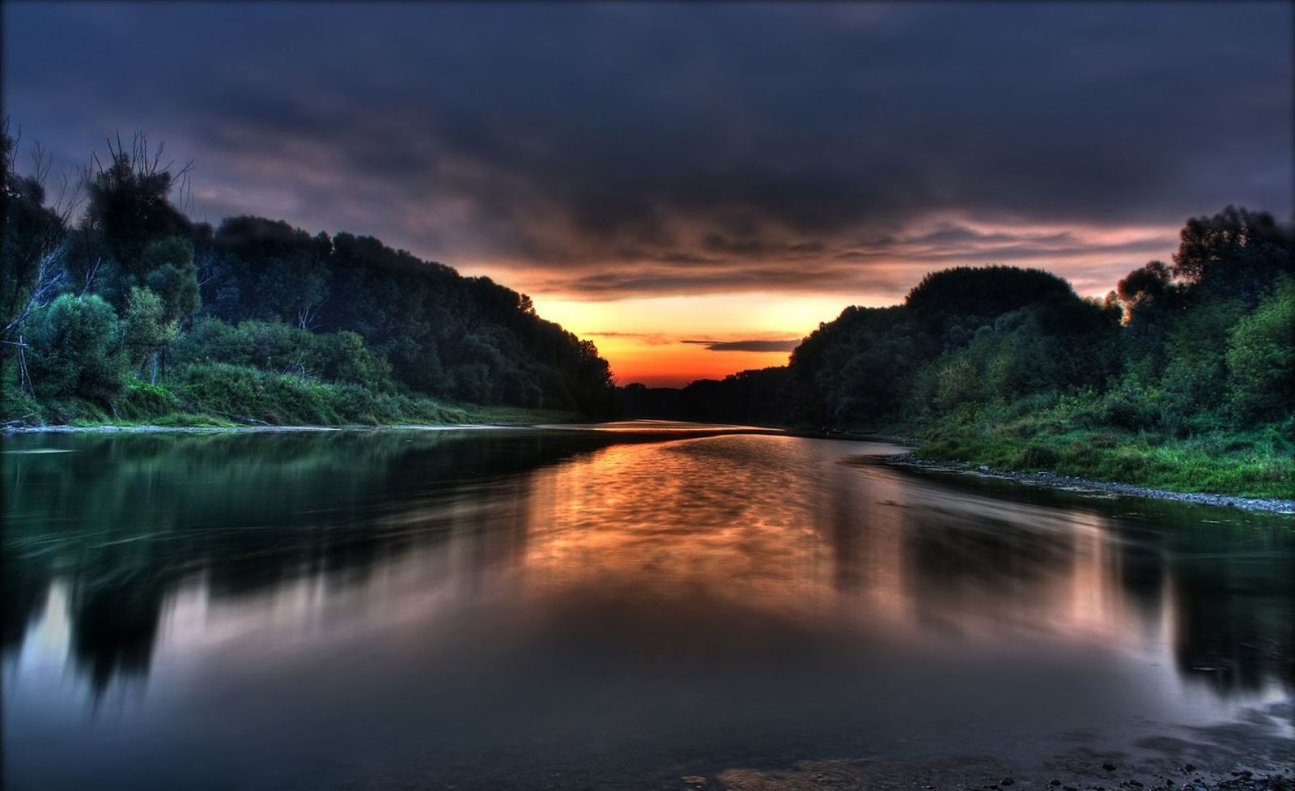
Thank yo
Thank you for watching.
This Photo by Unknown author is licensed under CC BY-NC-ND.

